Slide 1
Mitron Bank Credit Card Expansion

Slide 2
Dataset and Data Analysis
Dataset
Sample dataset of 4000 customers
Data is collected from 5 cities
Data Analysis
Data Collection
Data Cleaning
Data Preparation
EDA (Exploratory Data Analysis)
Customer Segmentation

Slide 3
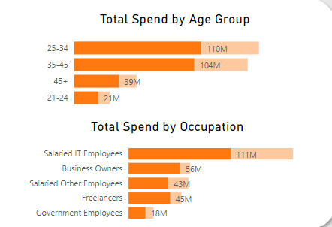
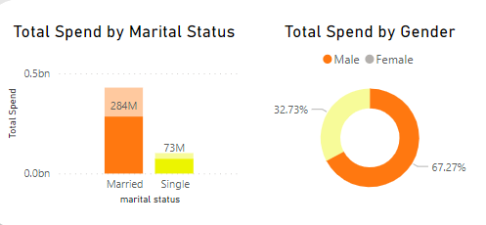
Demographic Insights
According to the data analysis conducted, it has been observed that married male customers, specifically within the age bracket of 25-34 years, exhibit a higher propensity for increased utilization of credit cards, particularly among those employed in the IT sector with a salaried income.

Slide 4
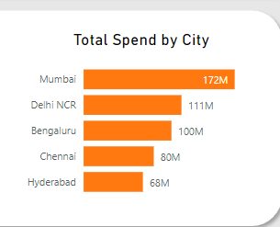
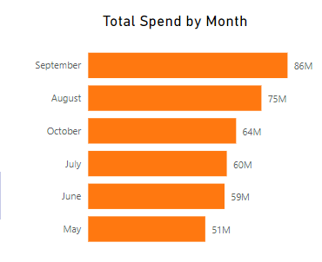
Spending Insights
Based on the analysis, it is evident that residents of Mumbai exhibit higher expenditure levels compared to other cities. Additionally, the features introduced in the credit card offering for September appear to effectively target and maximize customer segmentation.

Slide 5
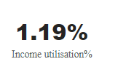
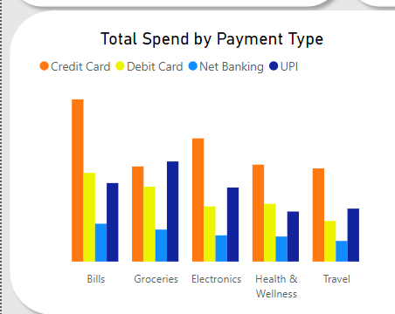
Financial Insights
Comprehending the relationship between income utilization, credit scores across various segments remains pivotal. A notable trend emerges: as the average income increases, there is a heightened probability of credit card usage.
Moreover, a prevalent pattern indicates that a majority of customers opt for credit card payments to settle their bills, while the least proportion of customers resort to net banking payment methods for bill settlements.

Slide 6
Credit Card Feature Recommendations
City-Focused Campaigns:
Concentrate marketing efforts on high-spending cities such as Mumbai and Delhi NCR through tailored city-specific campaigns, reflecting local market dynamics.
Demographic Targeting:
Craft targeted marketing messages for distinct demographics, catering to the specific needs of age groups and occupations.
Promotion of Credit Card Payments:
Introduce specialized incentives to promote credit card usage, particularly among segments favoring this payment method.
Collaboration with Top Categories:
Establish partnerships with key businesses in top-spending categories (e.g., Bills, Groceries, Electronics, etc), offering exclusive rewards or discounts for credit card users within these categories.

Slide 7
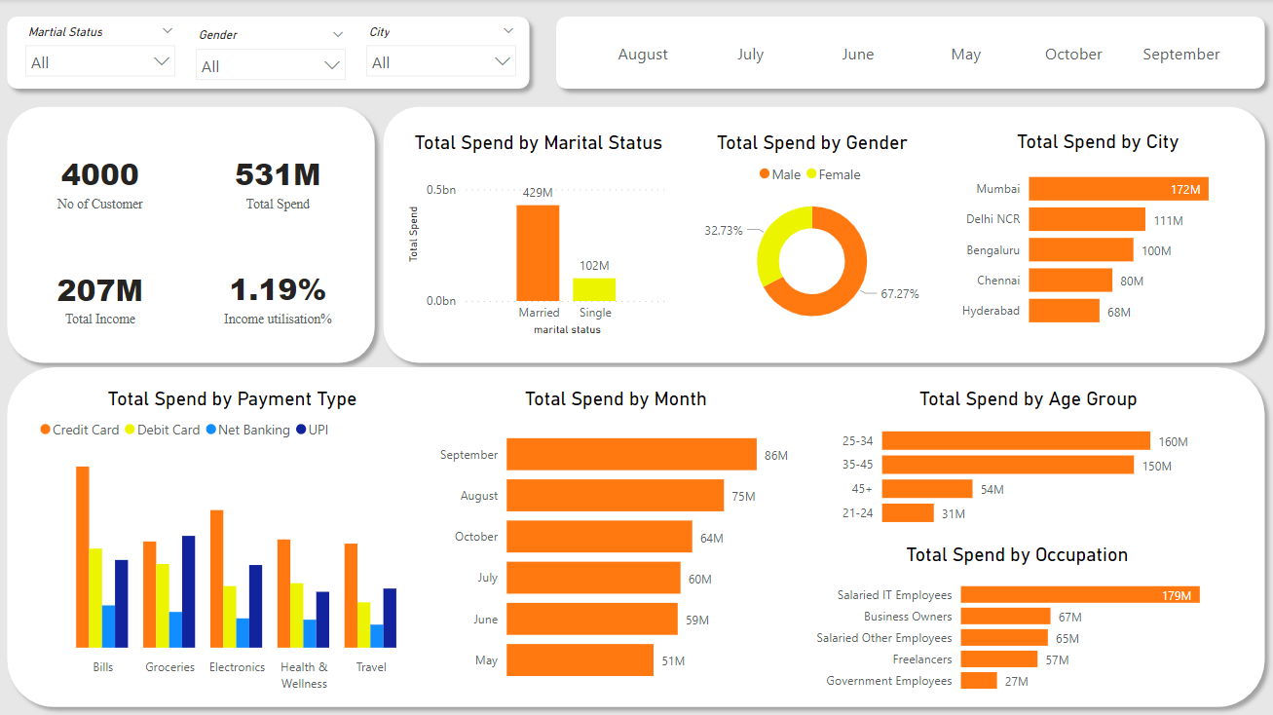
BI Dashboard

Slide 8
Thank You

