Slide 1
Is the NFL ProBowl Just a Popularity Contest? A Data Science Approach

Slide 2
Table of Contents:
Probowl Background & Motivation
Data
Exploratory Data Analysis (EDA)
MVP: Multivariate Linear Regression
ProBowl Logistic Regression
Conclusion

Slide 3
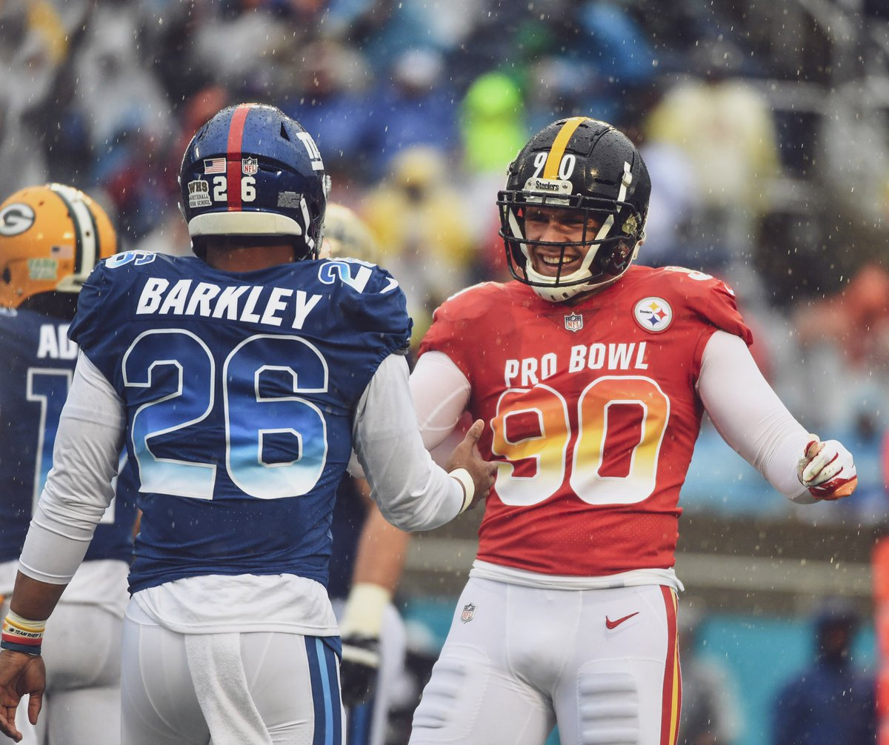
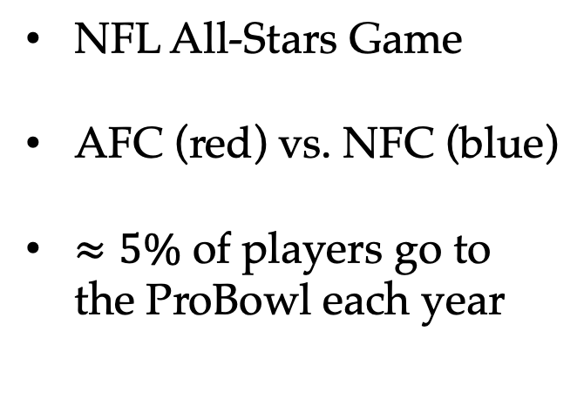
What is the ProBowl?
NFL All-Stars Game
AFC (red) vs. NFC (blue)
$≈5\%$ of players go to the ProBowl each year
Notes:
84 players go to the probowl
1696 players in the NFL

Slide 4

How are players selected to the ProBowl?
Votes are cast by:
Other Players
Coaches
Fans
Research Question:
Does a player’s stats backup the vote?

Slide 5
Data
Pro Football Reference
All 32 NFL teams
4 years of data
2300 rows of data
Each row represents a different player in the NFL
29 features:
7 of importance:
RRTD, Yards, Fumble, Age, Games, Touches, ProBowl Status

Slide 6
Data
Variable | Description
RRTD | Rushing and receiving touchdowns
Yards | Total yard from scrimmage
Fumble | Number of times fumbled
Age | Player’s age on Dec 31st of that year
Games | Games played
Touch | Touch: Rushing and receiving attempts
ProBowl | {1, 0} => 1 if the player went to the ProBowl

Slide 7
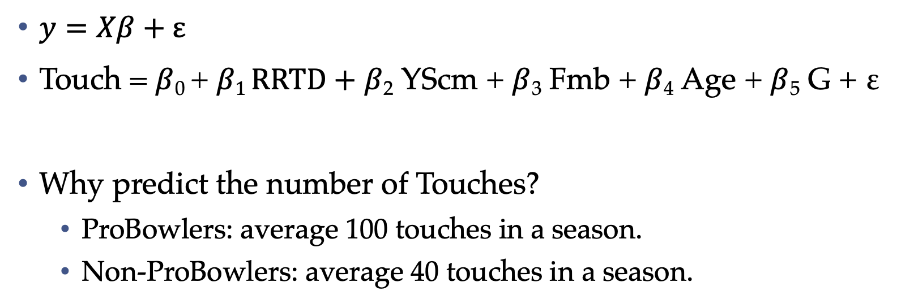
MVP: Multivariate Linear Regression (OLS)
$y=Xβ+ε$
Touch = $β$₀ + $β1 RRTD+$ $β$₂ YScm + $β$₃ Fmb + $β$₄ Age + $β$₅ G + ε
Why predict the number of Touches?
ProBowlers: average 100 touches in a season.
Non-ProBowlers: average 40 touches in a season.

Slide 8

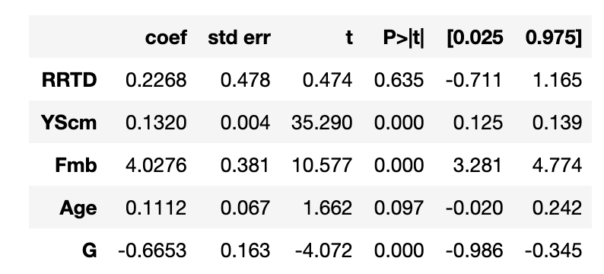

Slide 9
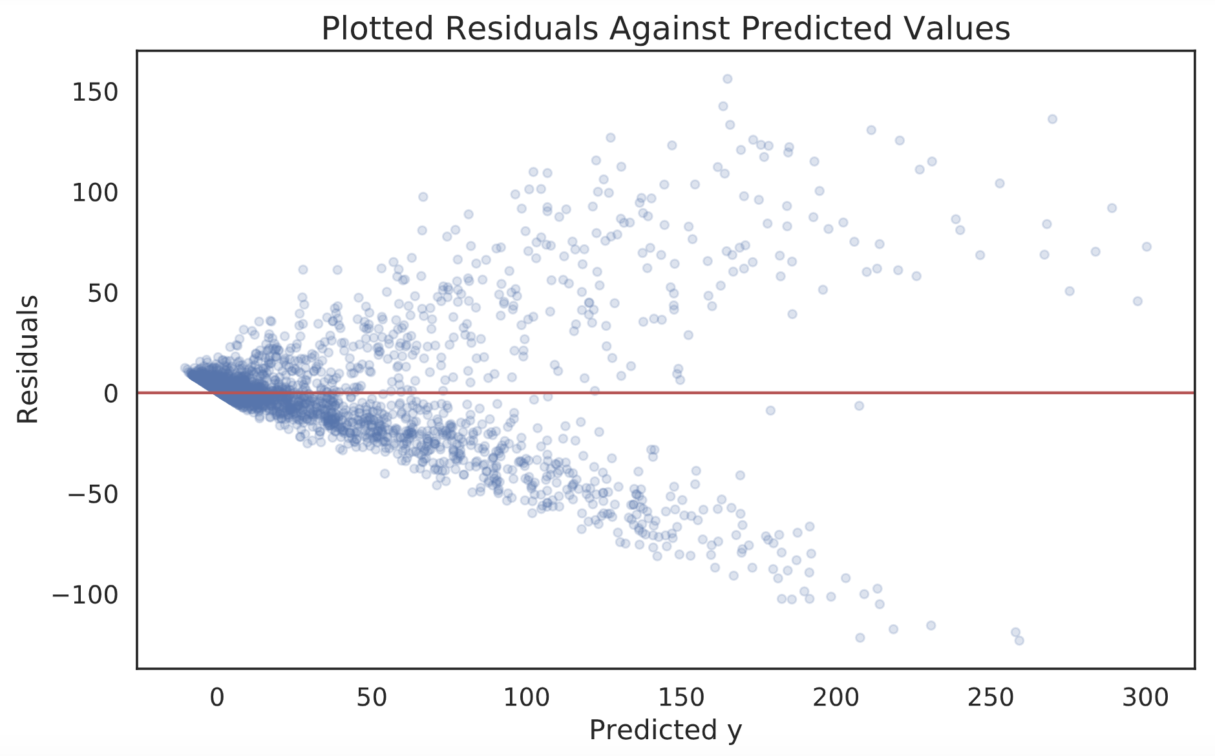

Slide 10
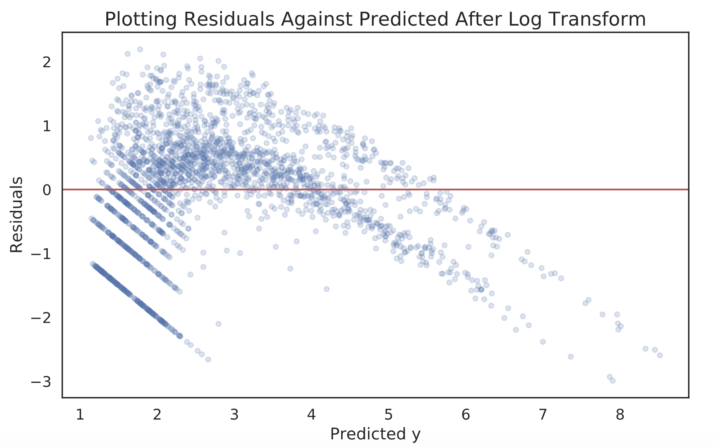
Notes:
Number of time a player gets the football is a counting variable
Heteroskedasticity has serious consequences for the OLS estimator. Although the OLS estimator remains unbiased, the estimated SE is wrong. Because of this, confidence intervals and hypotheses tests cannot be relied on.
Future research could include Poison regression

Slide 11

Logistic Regression Model
Equation:
ProBowl = $β1 RRTD+$ $β$₂ YScm + $β$₃ Fmb + $β$₄ Age + $β$₅ G + $β$₆ Touch
Note:
ProBowl $∈\{0, 1\}$

Slide 12
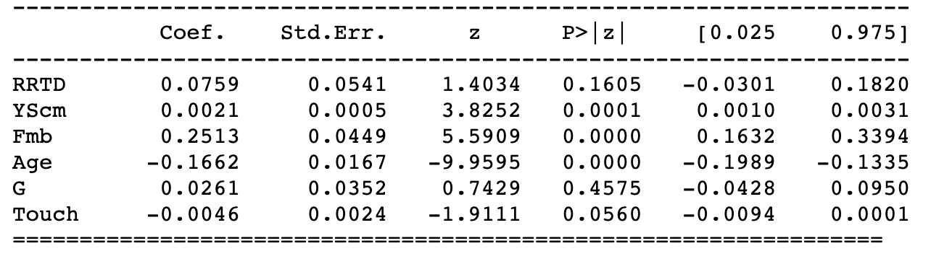
Notes:
In logistic regression observations y∈{0,1} are assumed to follow a Bernoulli distribution

Slide 13
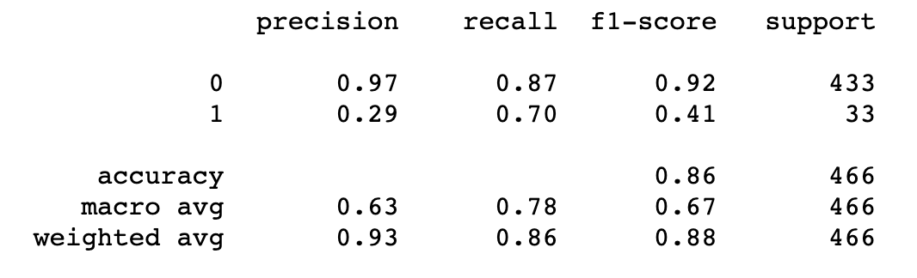
Notes:
Recall in this context is defined as the number of true positives divided by the total number of elements that actually belong to the positive class

Slide 14
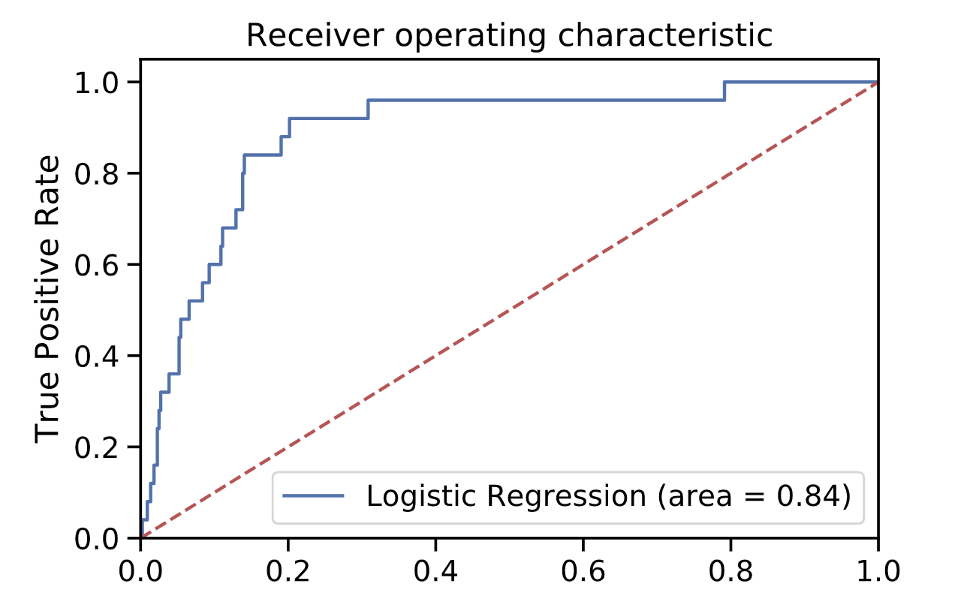
Notes:
The closer the curve follows the left-hand border and then the top border of the ROC space, the more accurate the test.
The closer the curve comes to the 45-degree diagonal of the ROC space, the less accurate the test.

Slide 15
Conclusion
Logit is a better model to estimate whether a player voted into the ProBowl deserves to be there or not
Still have issues with class imbalance
Future Research: Poisson Regression

Slide 16
Thank You
Alex Lou
d.alexlou17@gmail.com

