Slide 1
Is the NFL ProBowl Just a Popularity Contest? A Data Science Approach

Slide 2
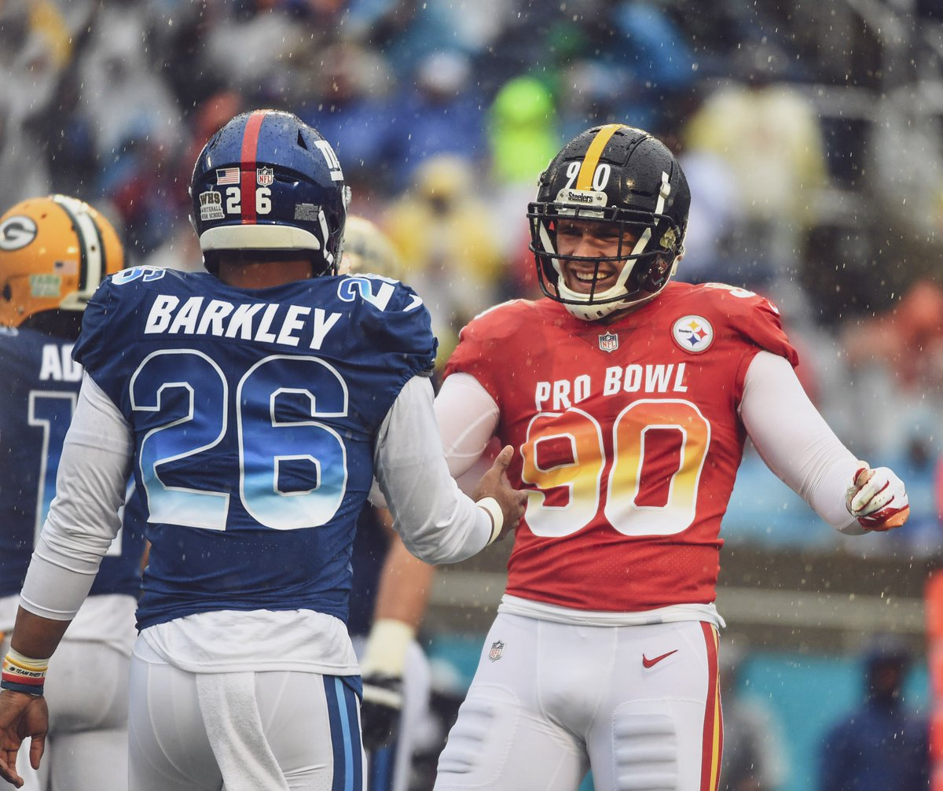
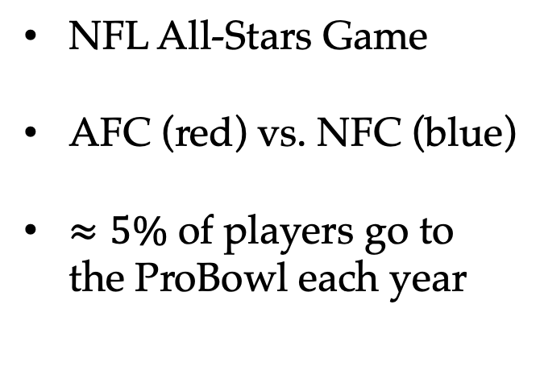
What is the ProBowl?
NFL All-Stars Game
AFC (red) vs. NFC (blue)
$≈5\%$ of players go to the ProBowl each year
Notes:
84 players go to the probowl
1696 players in the NFL

Slide 3
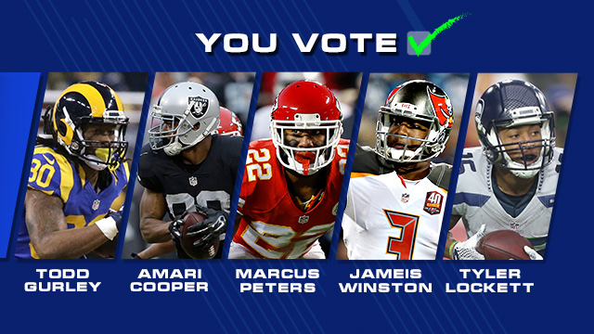
How are players selected?
Votes are cast by:
Other Players
Coaches
Fans

Slide 4
Research Question:
Does a player’s stats backup the vote?

Slide 5
Data
Pro Football Reference
All 32 NFL teams
4 years of data
2300 rows of data
29 features

Slide 6
Data
Variable | Description
RRTD | Rushing and receiving touchdowns
Yards | Total yard from scrimmage
Fumble | Number of times fumbled
Age | Player’s age on Dec 31st of that year
Games | Number of games played
Touches | Rushing and receiving attempts
ProBowl | {1, 0} => 1 if the player went to the ProBowl

Slide 7
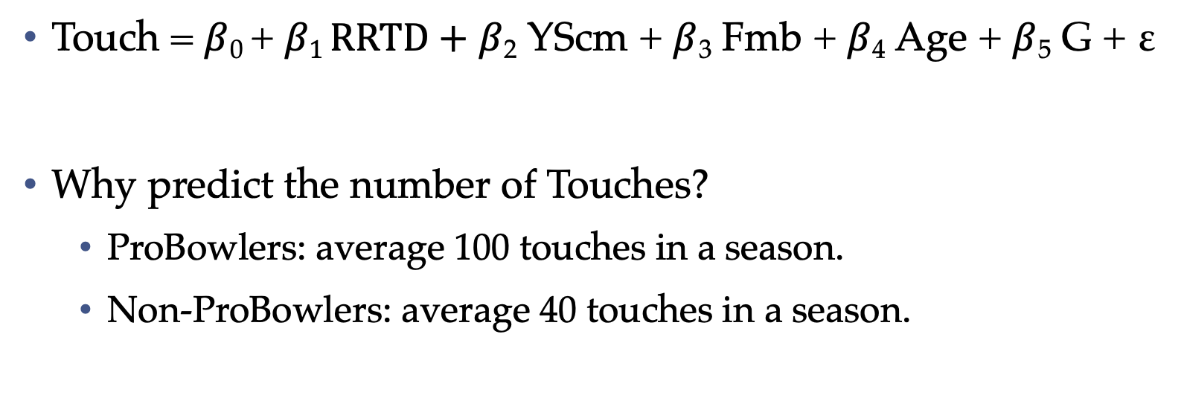
MVP: Multivariate Linear Regression (OLS)
Touch = $β$₀ + $β1 RRTD+$ $β$₂ YScm + $β$₃ Fmb + $β$₄ Age + $β$₅ G + ε
Why predict the number of Touches?
ProBowlers: average 100 touches in a season.
Non-ProBowlers: average 40 touches in a season.
Notes:
You want the ball in your best player’s hands, and the best player should be going to probowl!

Slide 8
OLS Result
R² = 0.921 (Also known as ”goodness of fit”)
Interpretation:
This model explains 92.1% of the variability when predicting the number of plays that a NFL player get.

Slide 9
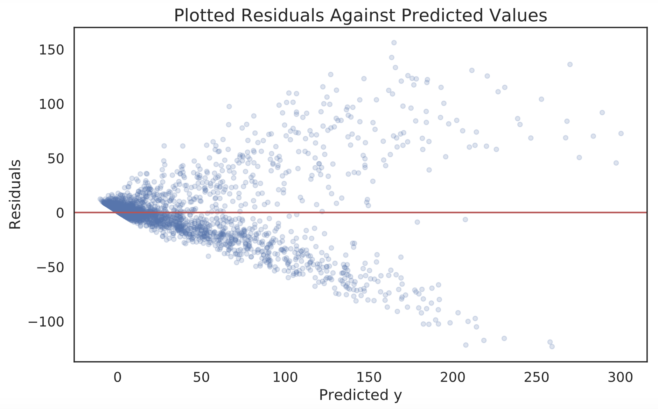

Slide 10
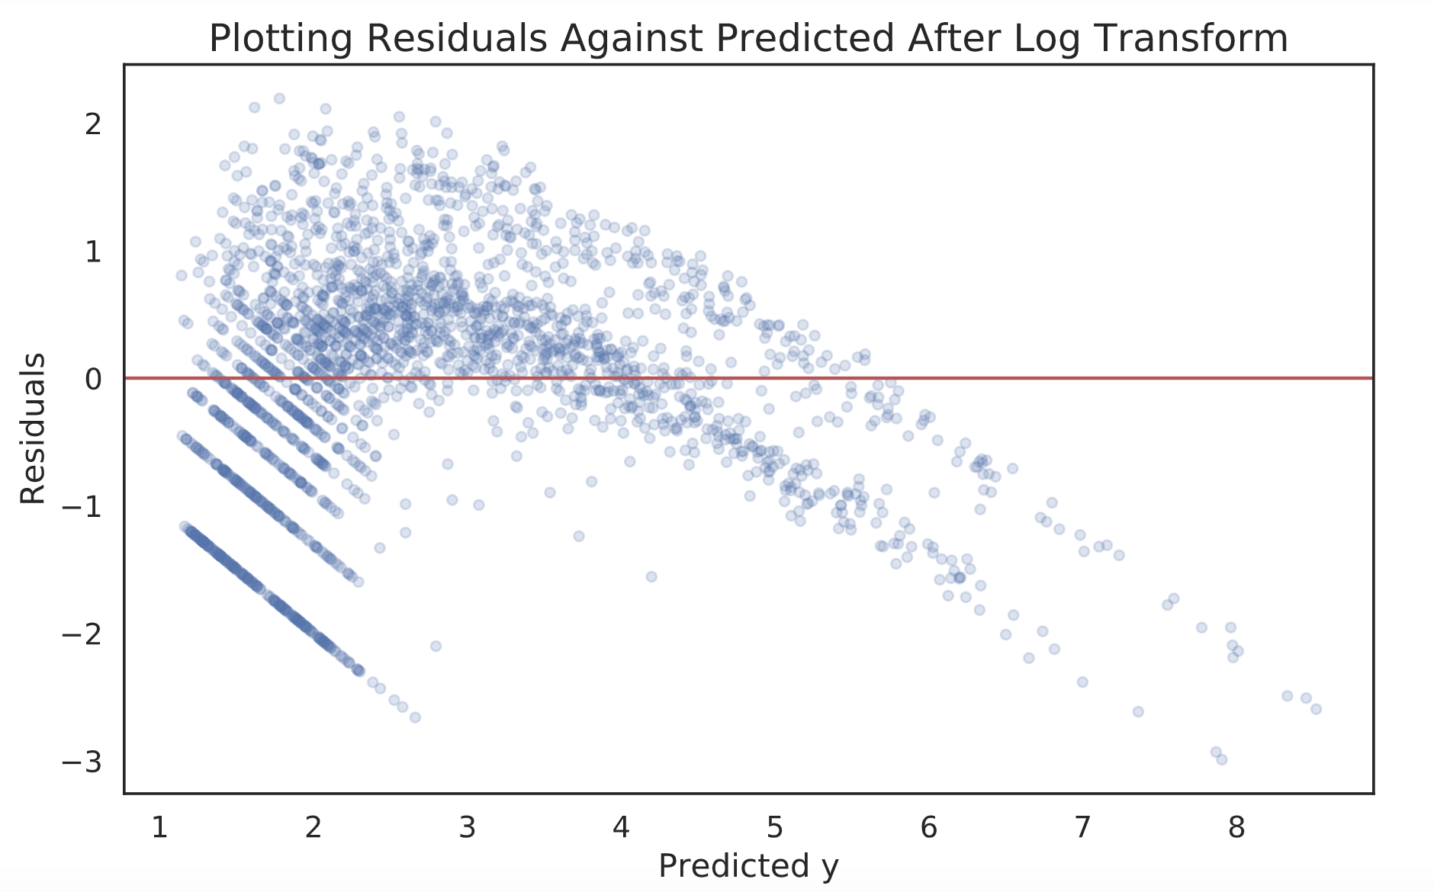
Notes:
Number of time a player gets the football is a counting variable
Heteroskedasticity has serious consequences for the OLS estimator. Although the OLS estimator remains unbiased, the estimated SE is wrong. Because of this, confidence intervals and hypotheses tests cannot be relied on.
Future research could include Poison regression

Slide 11

Logistic Regression Model
Equation:
ProBowl = $β1 RRTD+$ $β$₂ YScm + $β$₃ Fmb + $β$₄ Age + $β$₅ G + $β$₆ Touch
Note:
ProBowl $∈\{0, 1\}$

Slide 12
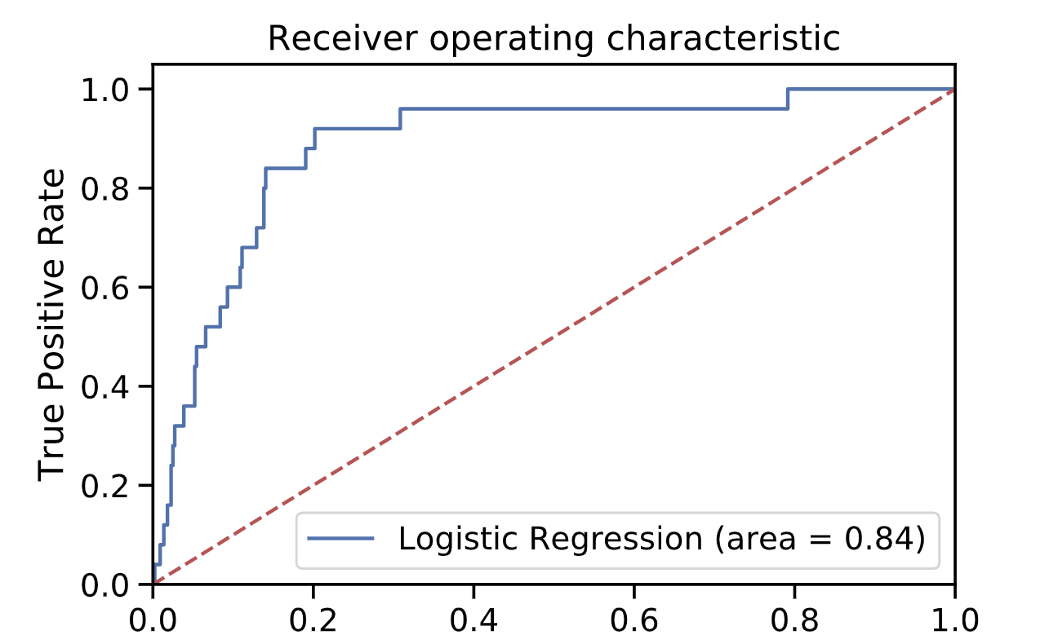
Notes:
The closer the curve follows the left-hand border and then the top border of the ROC space, the more accurate the test.
The closer the curve comes to the 45-degree diagonal of the ROC space, the less accurate the test.
The AUC thus gives the probability that the model correctly ranks such pairs of observations.

Slide 13
Conclusion
Research Answer: A player’s stats does in fact back the vote!
Logit is a better model to estimate whether a player voted into the ProBowl deserves to be there or not
Still have issues with class imbalance
Future Research: Poisson Regression

Slide 14
Thank You
Alex Lou
Alexlou.squarespace.com
d.alexlou17@gmail.com

Slide 15
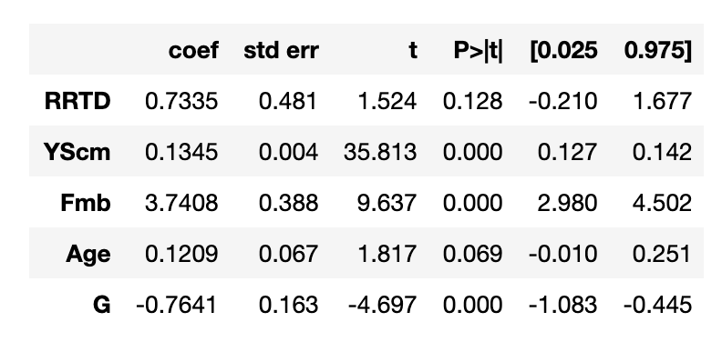
Appendix: OLS

Slide 16
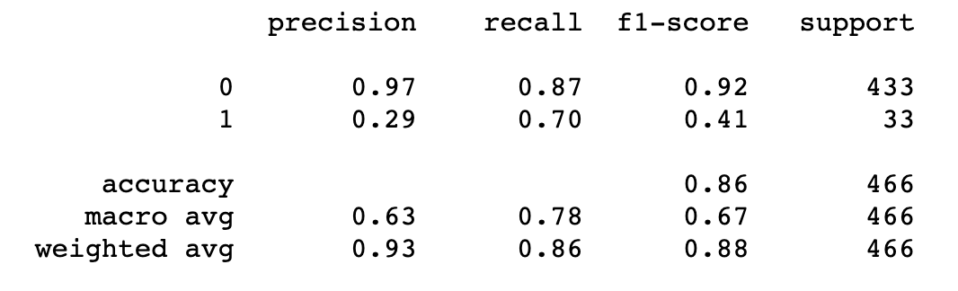
Appendix: Logit
Notes:
Recall: What proportion of actual positives was identified correctly?
Pecision: What proportion of positive identifications was actually correct?

Slide 17
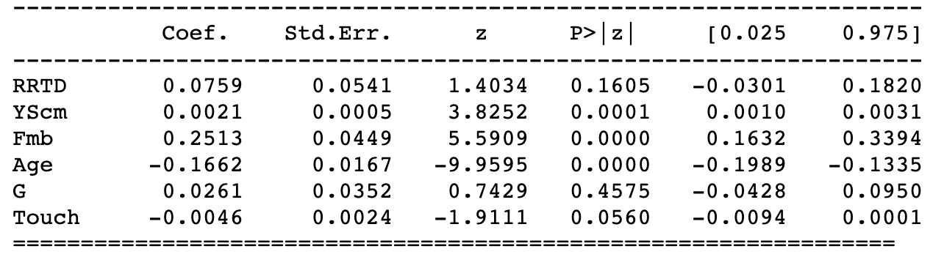
Appendix: Logit
Notes:
In logistic regression observations y∈{0,1} are assumed to follow a Bernoulli distribution

