Slide 1
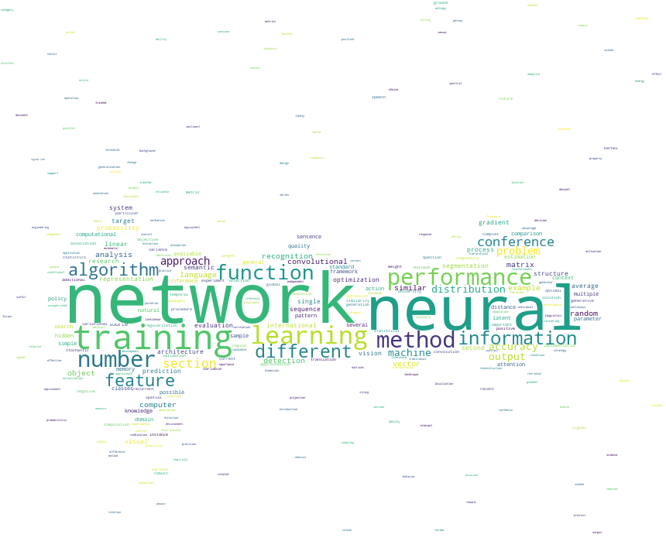
WordCloud and Query System for Papers with Code
蘇柏庄 郭毓萍

Slide 2
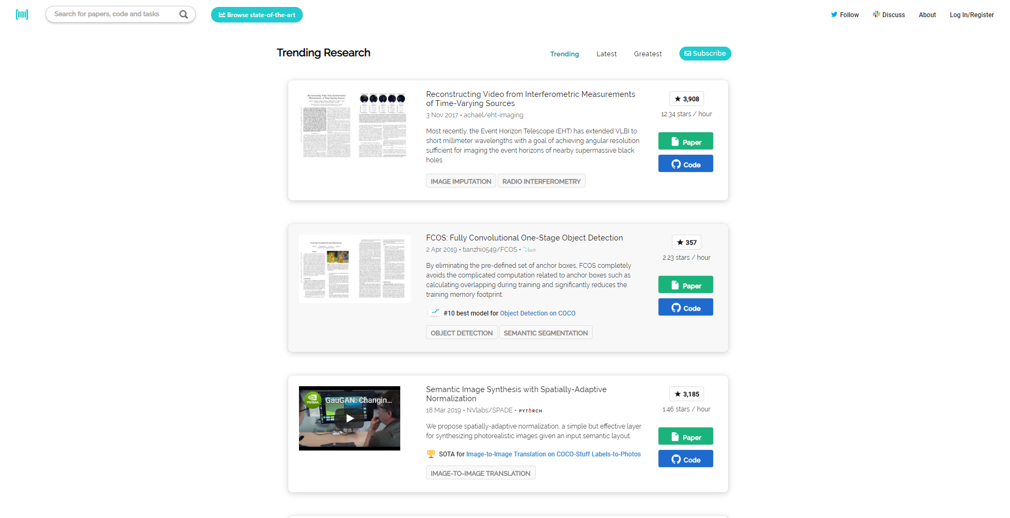

Slide 3
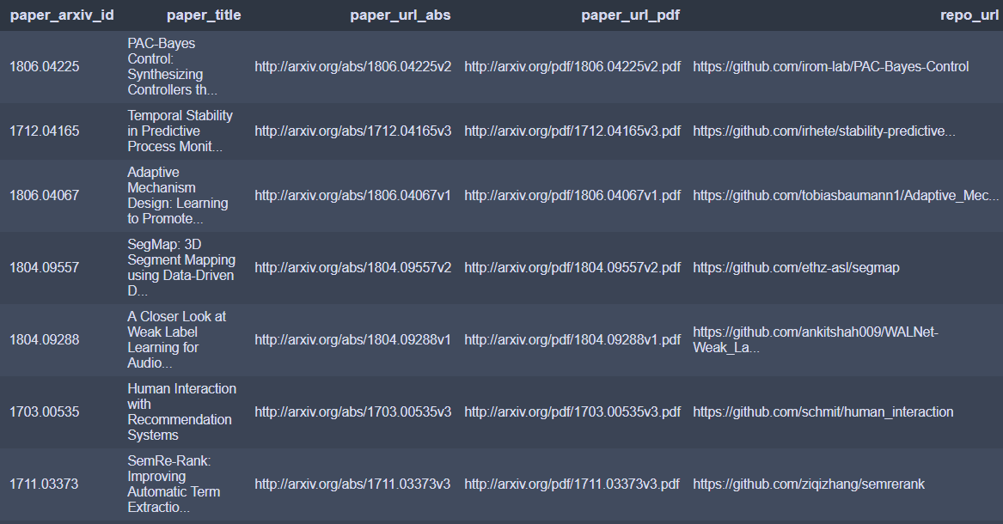
Data Collection
Data collected from
Papers with Code: the latest in Machine Learning https://paperswithcode.com/

Slide 4
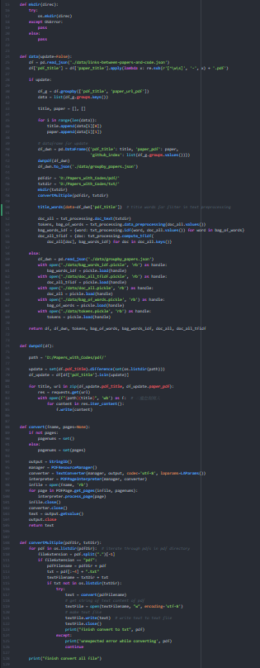
Data Preprocessing
Convert to text files (.txt)
Remove punctuations
Remove Non-English words
Combine title tokens and papers tokens
Part of Speech tagging – take nouns & adjective

Slide 5
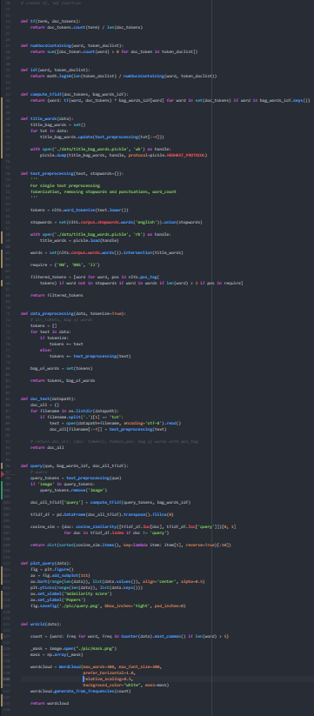
Textual Weighting
TF-IDF weighting –
high frequencies in single document
& rareness in all papers
cosine distance –
pick ten of the closest distance to query
with cosine similarity function
pickle files –
dump all the files to .pickle
to save time of calculation

Slide 6
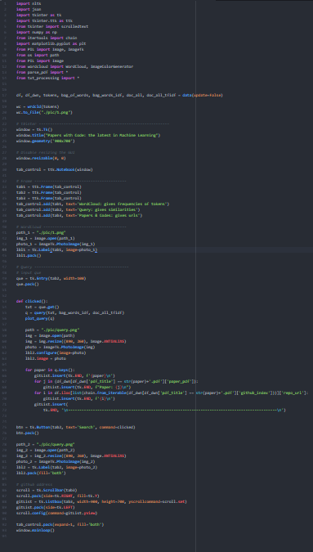
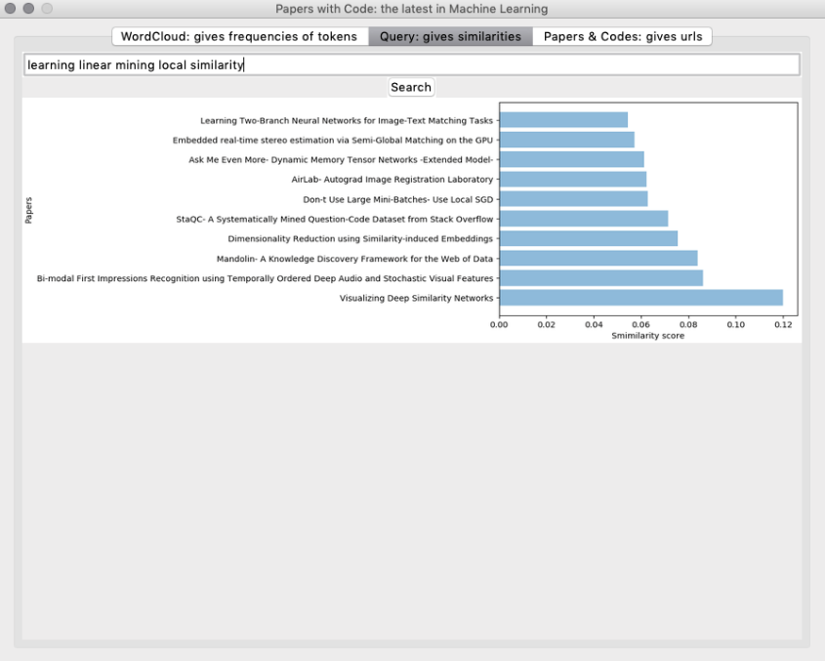
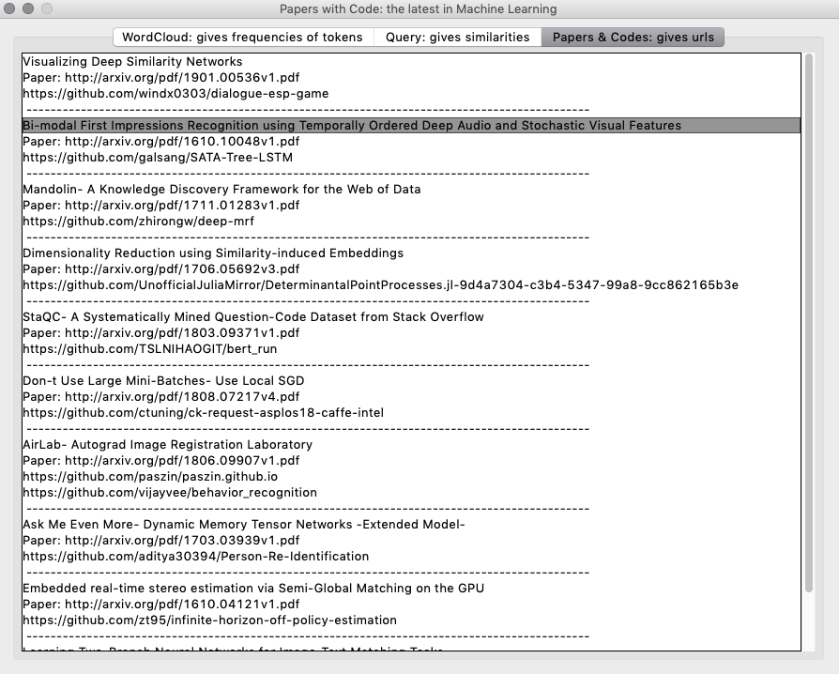
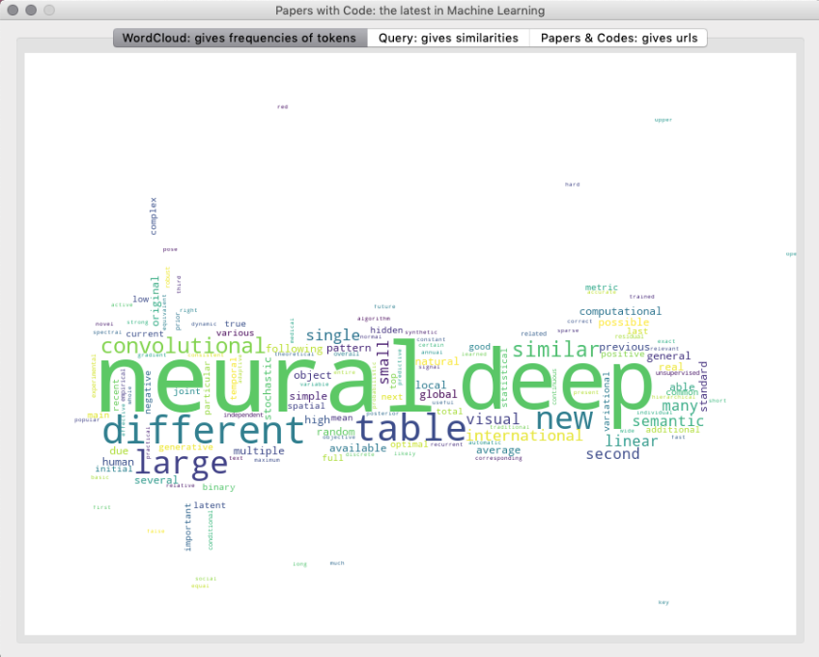
Query Recommendation (GUI)

Slide 7
technique
Future Improvements
More specific key words for machine learning
Improve the query system in terms of calculation
# Can’t improve the speed of downloading pdf files
interface
Add hyperlinks to the address of papers & github codes
Add Rocchio Feedback

Slide 8
Thank you for listening

