Slide 1

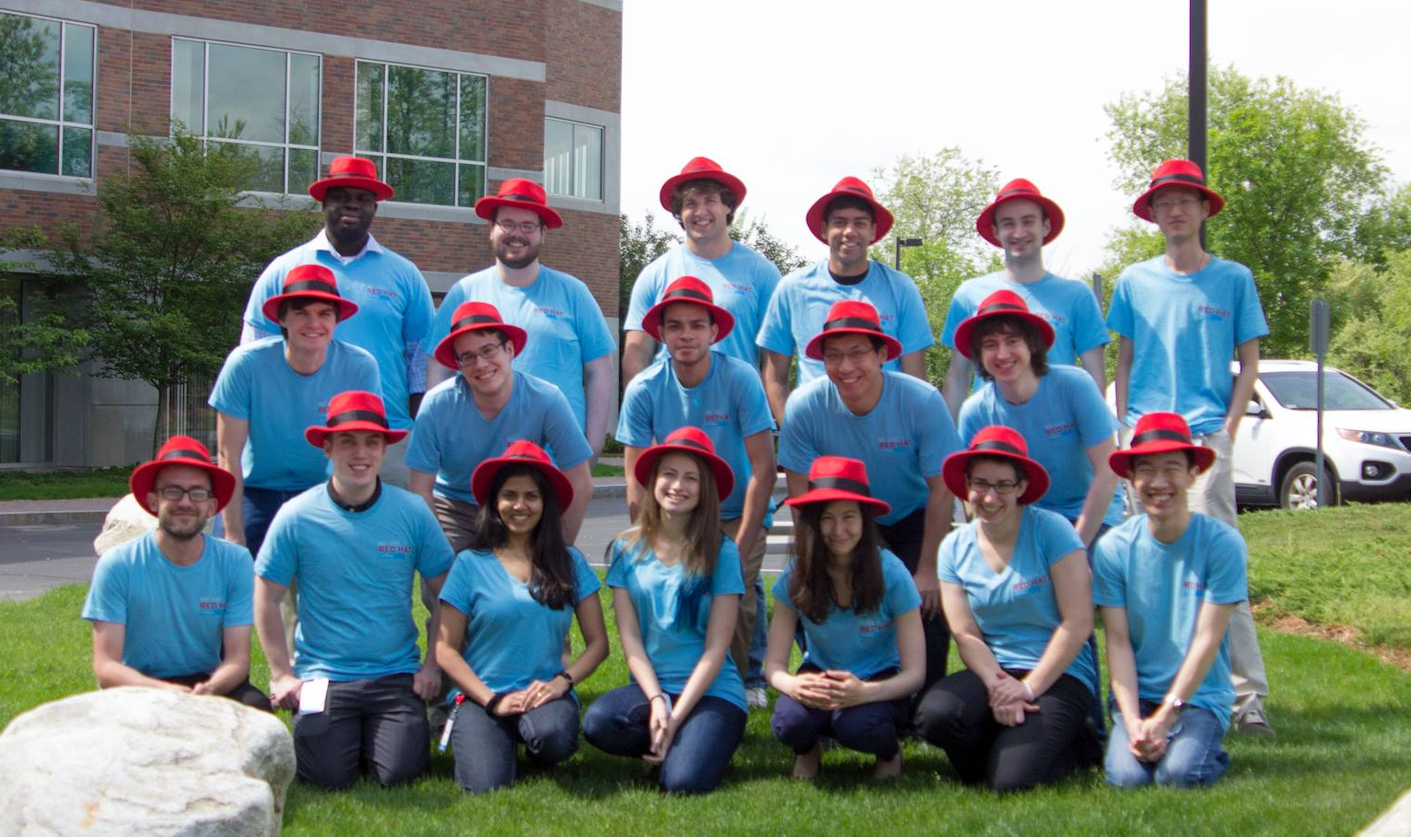
INTERN ICE CREAM EXPO
August 7, 2 – 4 pm, Westford Cafeteria
Stop by to support your interns while enjoying free ice cream
See what projects the interns have been working on!
Chance to win our raffle prize!

