Slide 1
Sales Data Analysis
Kathryn Hopkins
June 2024

Slide 2
Summary: Sales data Nov 2019 to Jun 2024
Sales fluctuated month by month and showed a downward trend from 2021 onwards
Average daily sales was around $345 but also fluctuated over the period
Peak sales was reached in 2021 at nearly $1.3m. By 2023, this had dropped to nearly half (around $700k)
The highest sales volumes were achieved on average on Saturdays, at $612, followed by Sundays, at $557

Slide 3
Time Series Analysis of Sales between November 2019 and June 2024

Slide 4
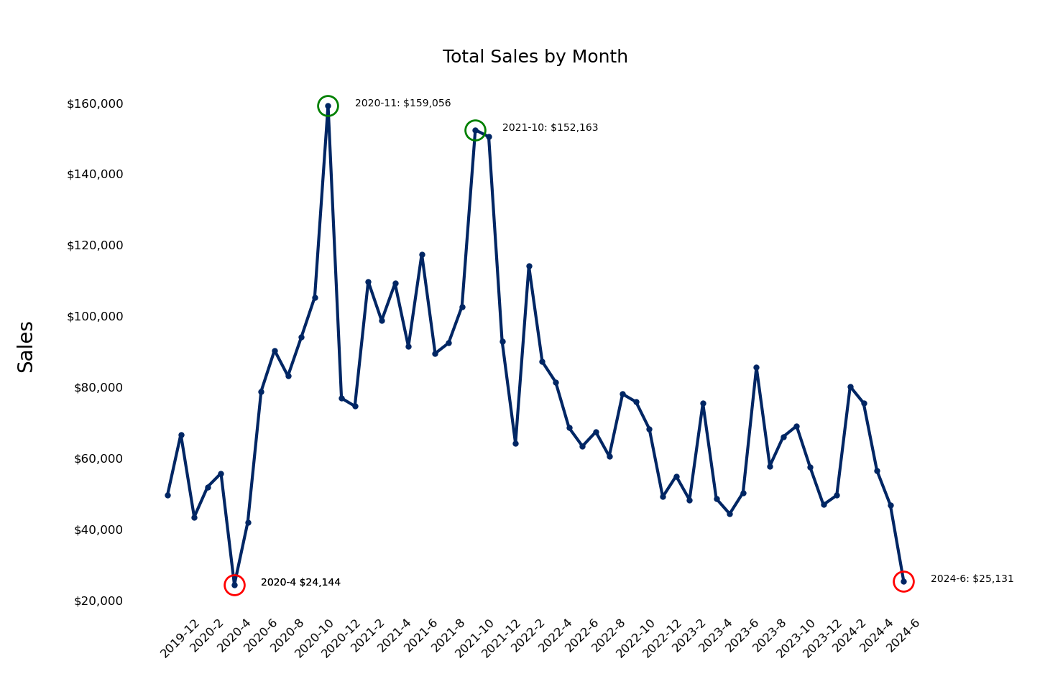
Total Sales by Month between November 2019 and June 2024
Total Sales Nov 19 – Jun 24
$4,206,780.15
Total Sales varied from $160K in November 2020 to $25K in June 2024
Fluctuation in sales volumes between months was large
Peak sales occurred before 2022, with a downward trend observed since November 2021
A seasonal pattern in sales was not detected at face value

Slide 5
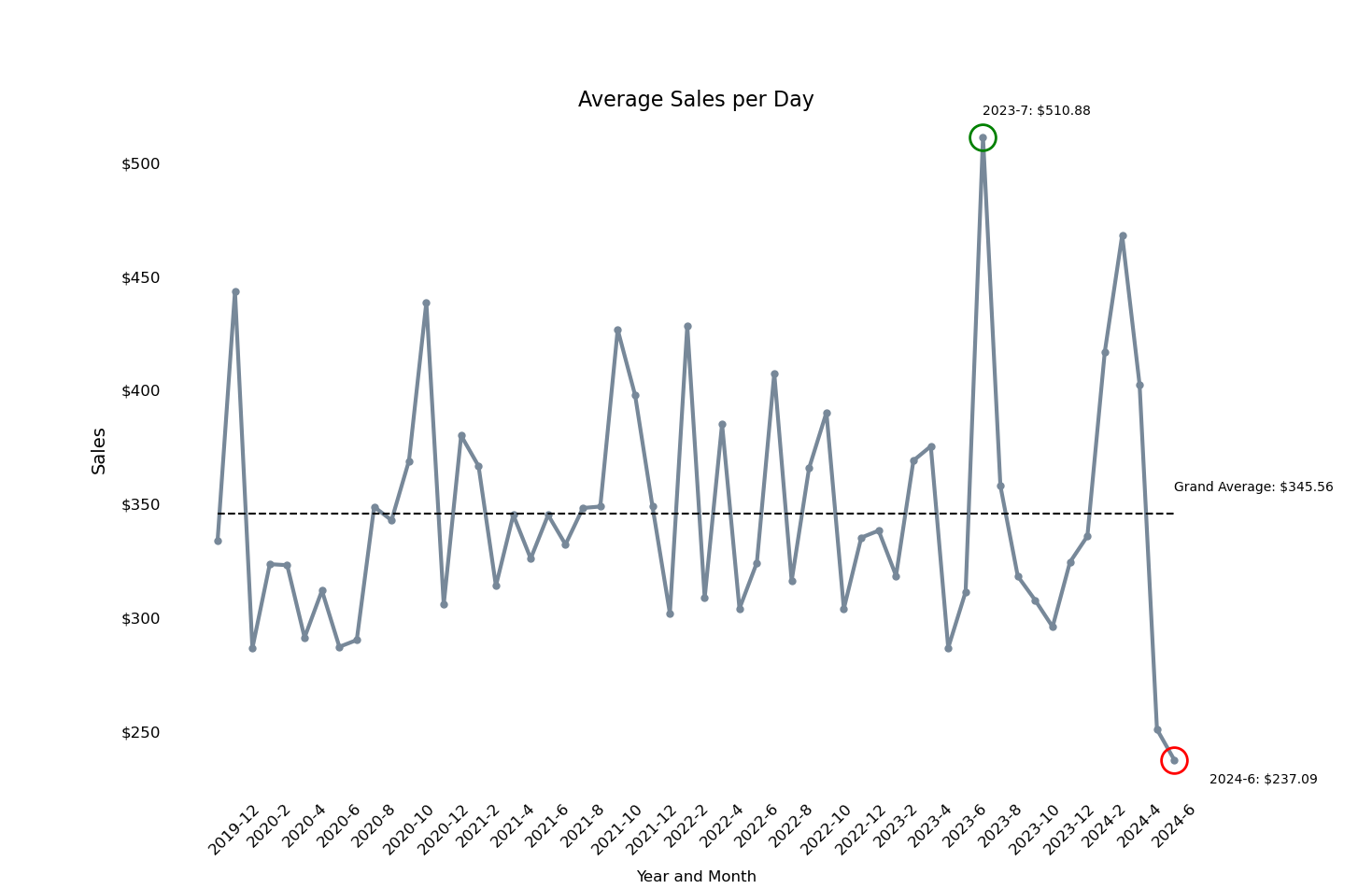
Average Sales per day between November 2019 and June 2024
Ave. Daily Sales Nov 19 – Jun 24
$345
The overall average sales volume per day was around $345
Average sales per day varied between months with a peak in July 2023 when an average of around $511 in sales was achieved each day
By June, 2024 the average sales per day had dropped to around $237 per day

Slide 6
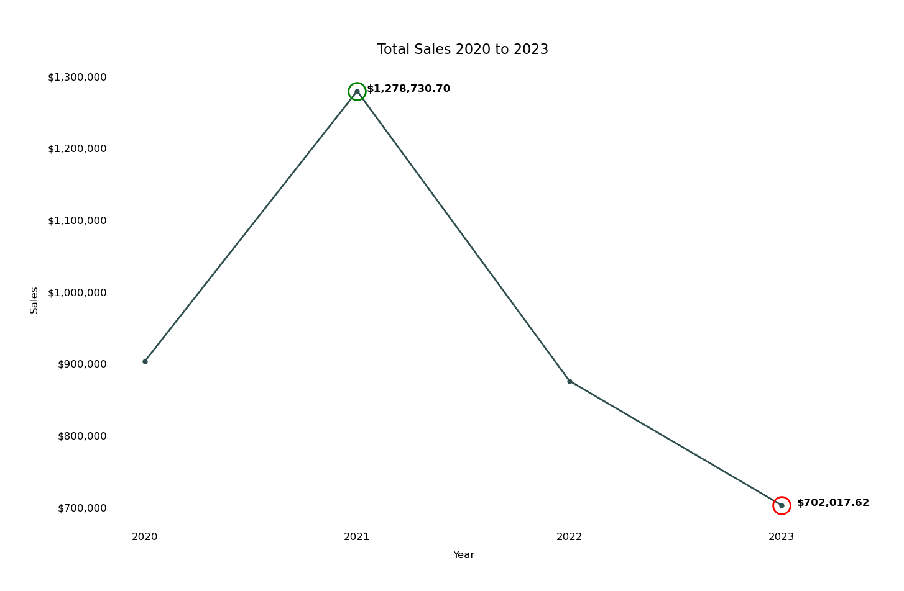
Total Sales each year 2020 to 2023 (full years only)
Peak Annual Sales
2021: $1.3M
Peak sales was reached in 2021 at nearly $1.3m
By 2023, this had dropped to nearly half (around $700k)

Slide 7
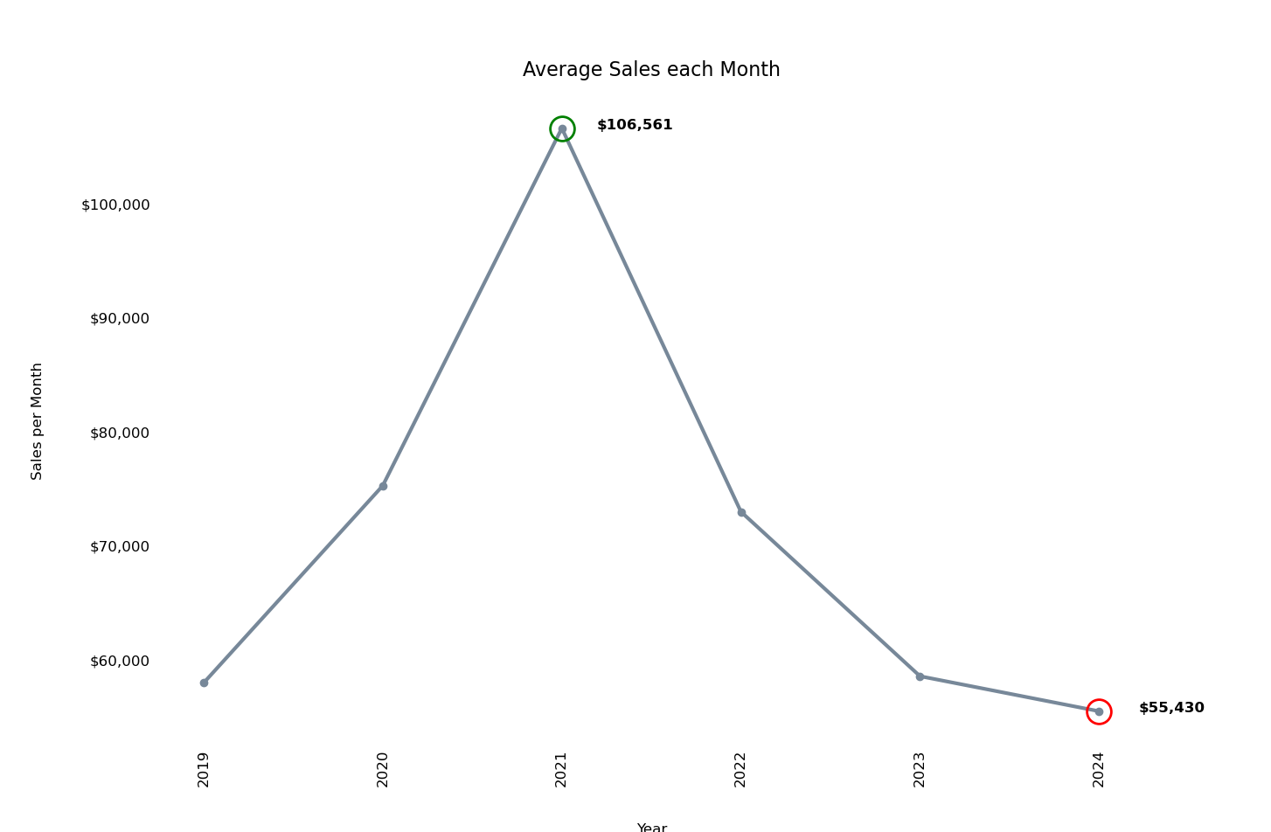
Average Sales each month 2019 to 2024
Peak Monthly Average Sales
2021: $106.5K
Peak monthly average sales was reached in 2021 at around $106.5K each month
By 2024, this had dropped to around $55K per month on average

Slide 8
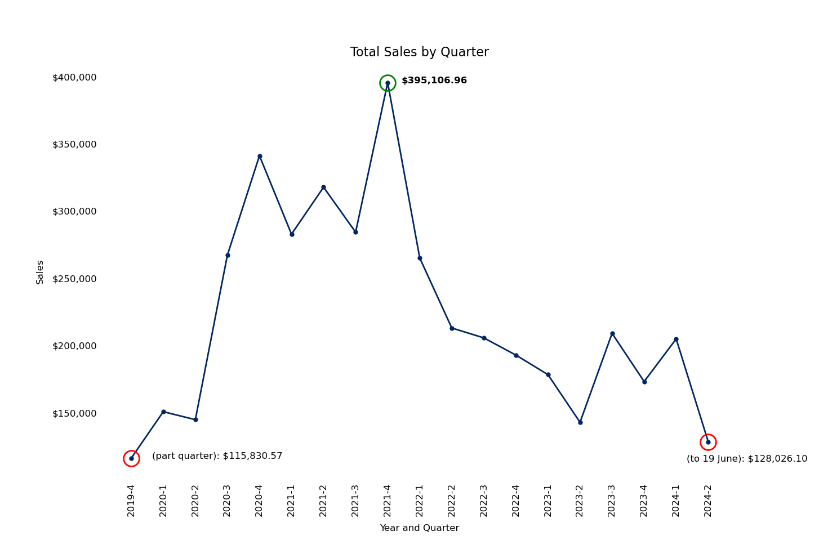
Total Sales each Quarter 2019 to 2024
Peak Quarterly Sales
2021 Q4: $400K
Peak quarterly sales was reached in Quarter 4, 2021 at nearly $400k
By Quarter 2, 2024, total sales had dropped to around $128k

Slide 9
Seasonal Patterns

Slide 10
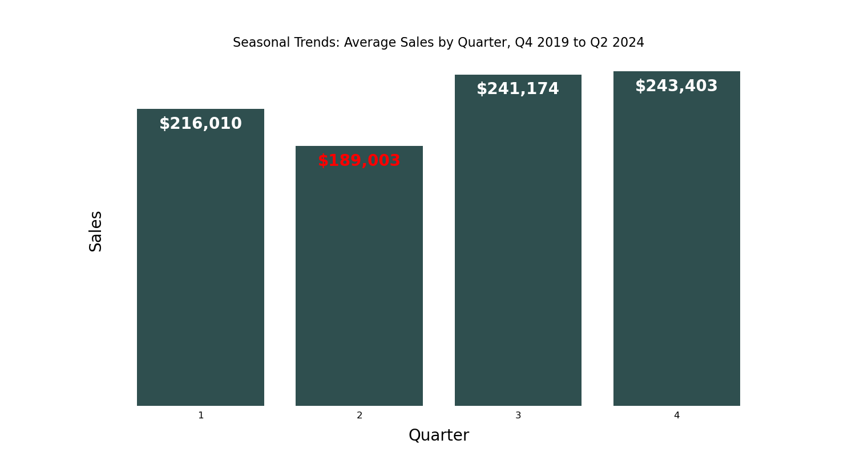
Average Sales by Quarter
Lowest Average Quarter Sales
Quarter 2: $189K
Quarter 2 resulted in the lowest sales volumes on average, at around $190K
The highest sales volumes were achieved on average in Quarter 4 at around $243K

Slide 11
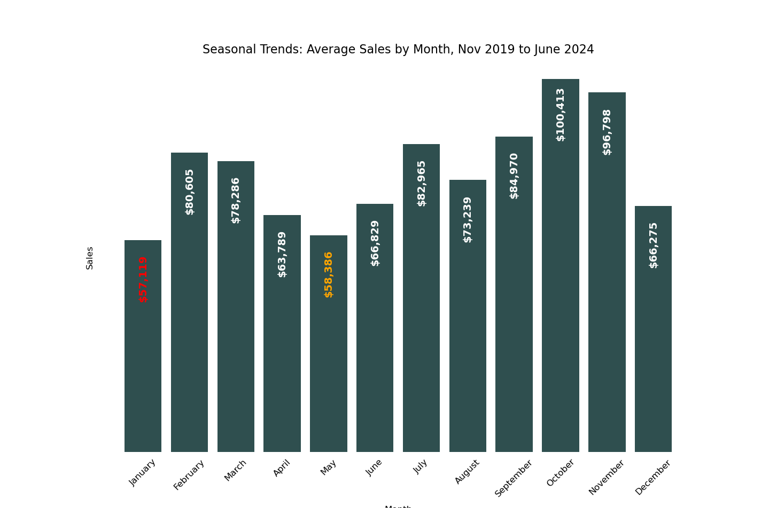
Average Sales by Month
Highest Average Month Sales
October: $100K
January resulted in the lowest sales volumes, at around $57K achieved in sales on average
The next lowest sales volumes occurred in May, at around $58K on average
The highest sales volumes were achieved on average in October at around $100K on average, nearly double the sales observed in January and May

Slide 12
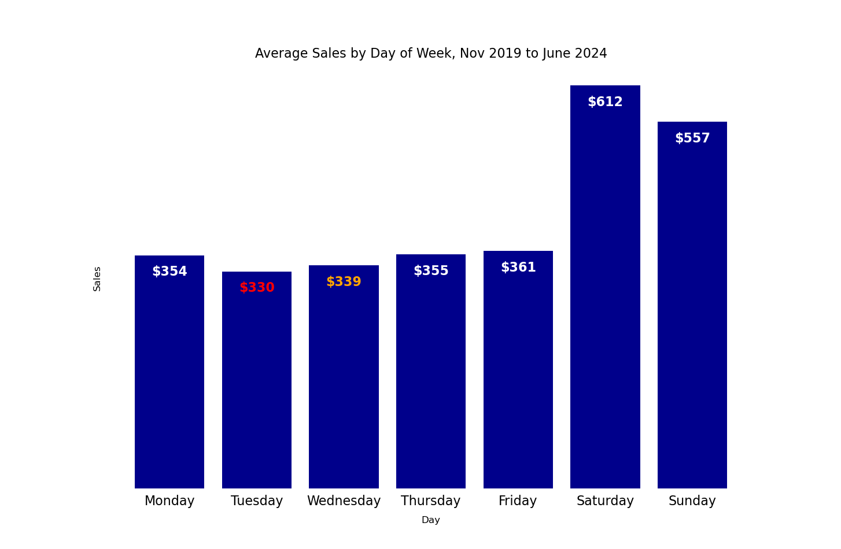
Average Sales by Day of Week
Highest Average Day Sales
Saturday: $612
Tuesdays are the least-selling days, on average at $330
The next lowest sales volumes occurred on Wednesdays, at $339
The highest sales volumes were achieved on average on Saturdays, at $612, followed by Sundays, at $557

Slide 13
Customer Analysis

Slide 14
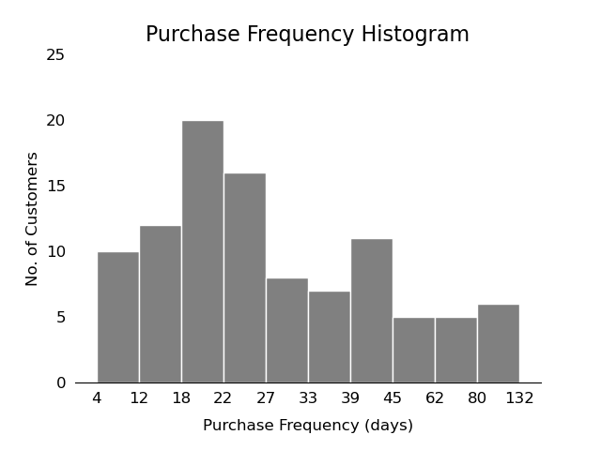
Customer Purchase Frequency
Most Frequent Purchasing Pattern
18-22 days between purchases
More customers purchased items between 18 and 22 days apart than any other purchase rate
Some customers purchased more frequently (making purchases every 4 – 12 days).
Some customers purchased items as infrequently as between 80 and 132 days apart

Slide 15
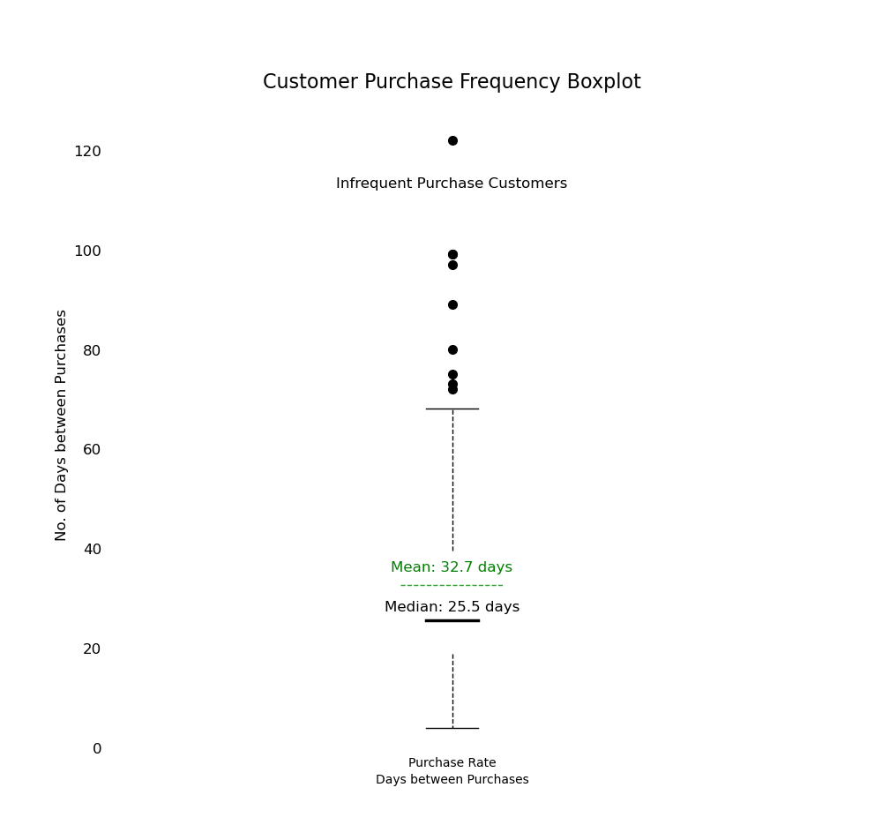
Purchase Frequency
Average Purchasing Pattern
One purchase per month
On average, customers made purchases every 33 days, or around once per month.
Generally, customers tended to purchase at least every two months or so (just over every 60 days)
However, some customers purchased less frequently, with some purchasing only every 120 days or so

Slide 16
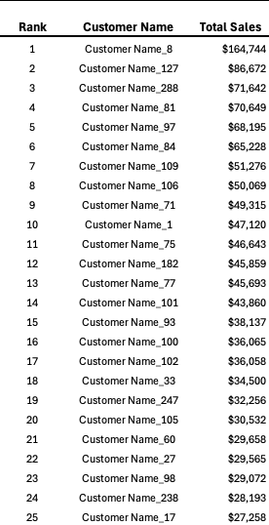
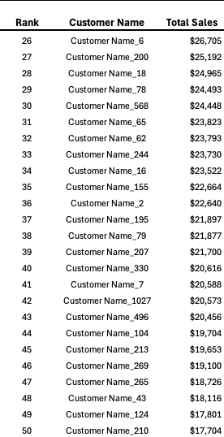
Top 100 Customers (Top 50 listed)
Top 100 Customers Total Sales Nov 19 – Jun 24
$2,459,088.16
The Top 100 customers in terms of Total Sales spent around $2.5M, or around 59% of all sales during the period
The Top 100 customers accounted for around 9% of all customers
The remaining 1,020 customers accounted for around 41% of sales

Slide 17
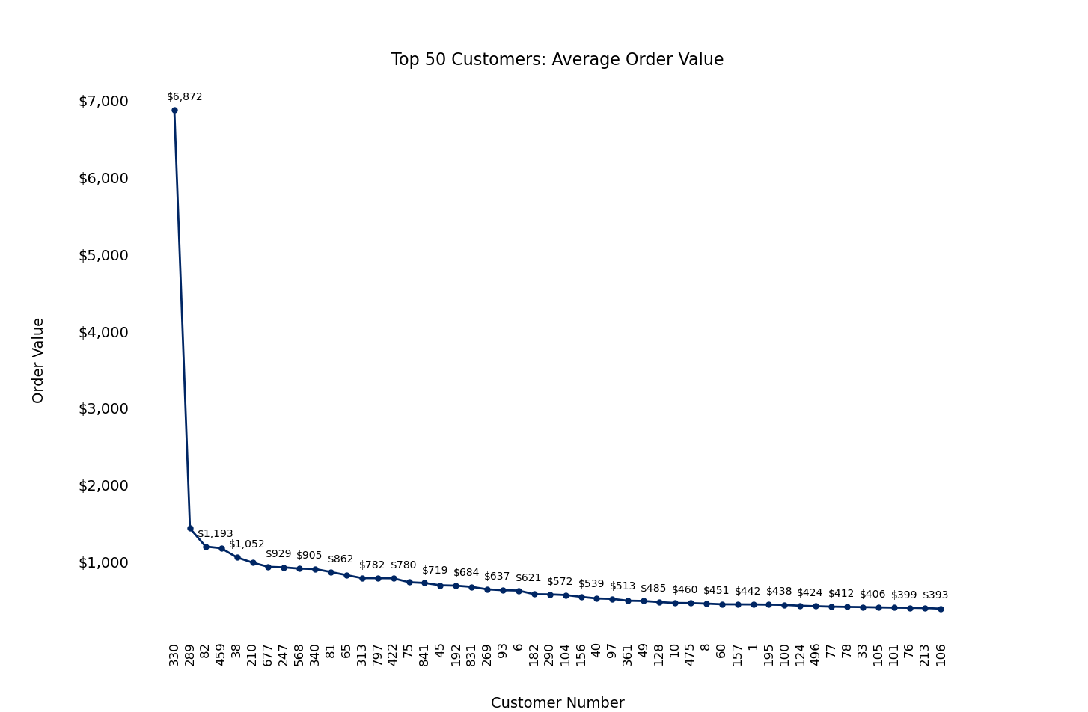
Average Order Value: Top 50 Customers
Average Order Value (Top 50 Customers)
$761.70
The average order value of the Top 50 Customers over the period was $761.70
One customer, number 330, was an outlier, with an average order value of $6,872
Customers ranked 2 to 50 ranged from $1,428.84 to $385.14 in terms of their average order value

Slide 18
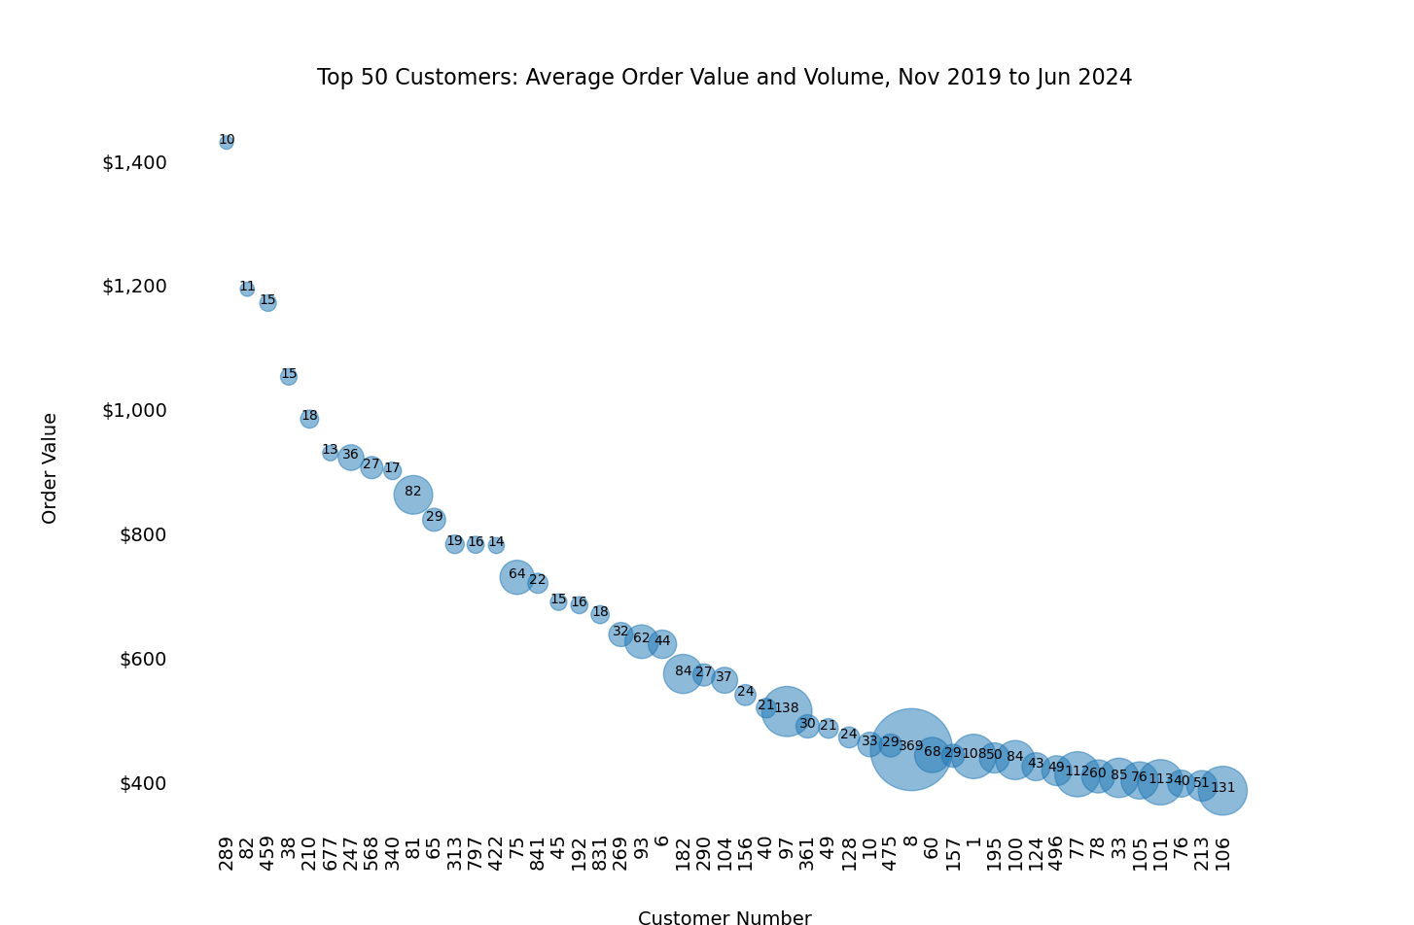
Average Order Value & Volumes of Products Purchased : Top 50 Customers (minus outlier)
Highest Product Volume:
369 items
The chart shows the Top 50 customers with the outlier removed (highest spend customer number 330). The bubble size is the volume of products purchased, and the volumes are labelled inside each bubble.
The customer with the highest volume of purchases was Customer 8 with a total purchase of 369 items over the period. There is no obvious correlation between average order value and number of products purchases

Slide 19
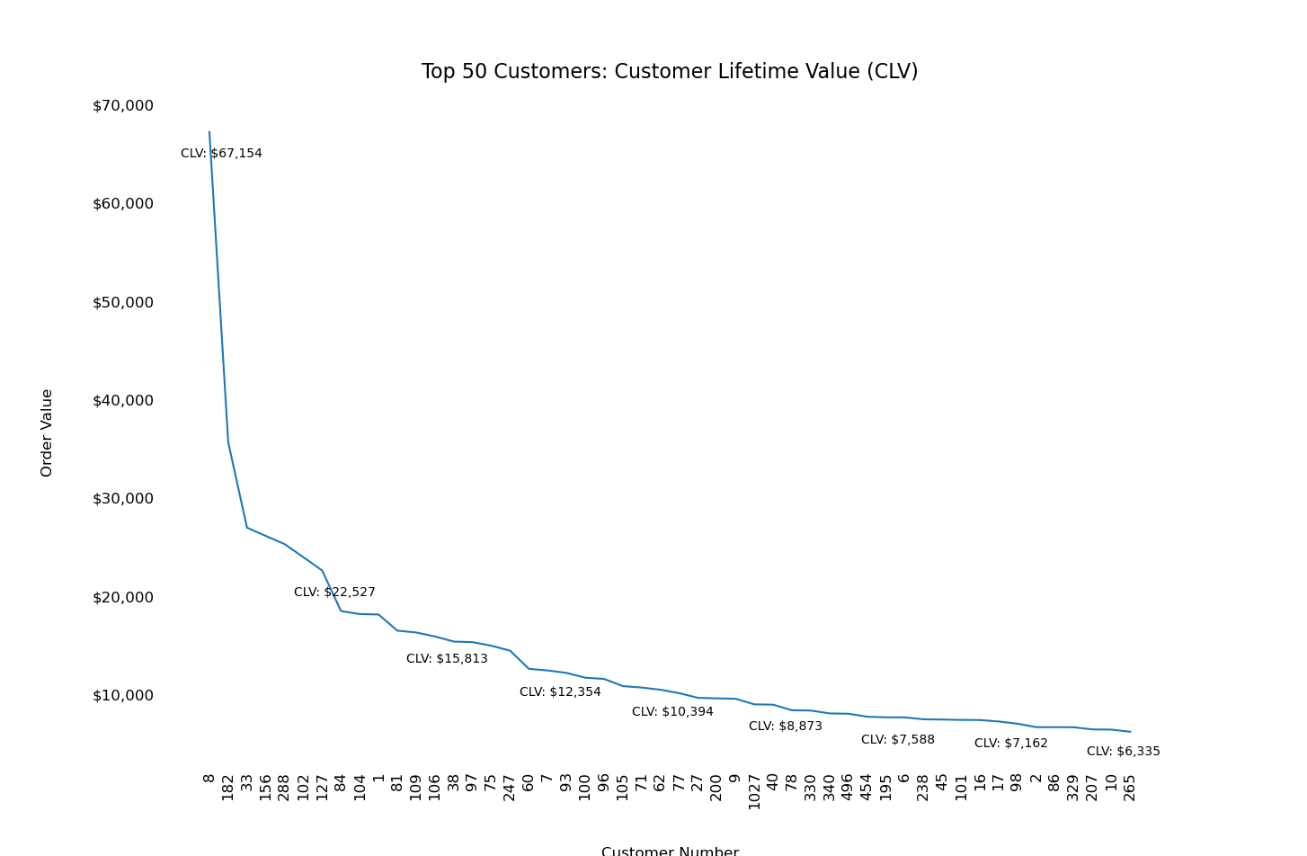
Customer Lifetime Value (CLV) : Top 50 Customers
Highest CLV:
$47,646
Customer 8, who had the highest purchase volume over the period, had the highest Customer Lifetime Value (CLV) of $47,646
CLV was calculated using the Total Gross Profit for each customer divided by their lifespan as at their most recent purchase date multiplied by the average lifespan of customers (1,335 days)

Slide 20
Product Analysis

Slide 21
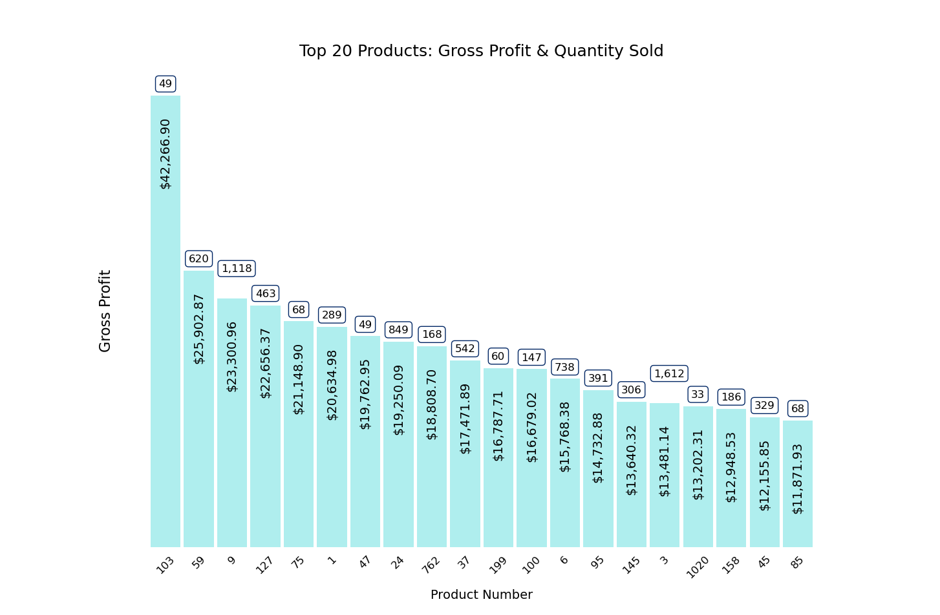
Top 20 Products: Gross Profit & Quantity Sold
Most Profitable Product:
Product Number 103
Product Number 103 had the highest Gross Profit over the period at around $42K. 49 of these products were sold over the period
The next-most profitable product was number 59, with a Total Gross Profit of around $26K over the period
The most-frequently purchased product was number 3, with 1,612 units sold

Slide 22
Customer Segmentation

Slide 23
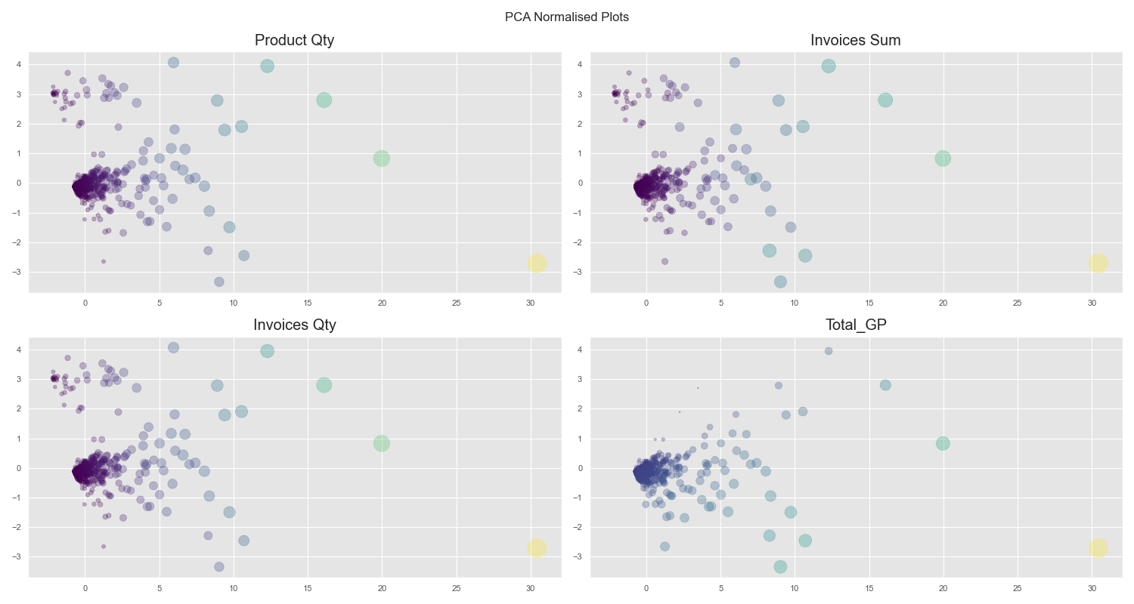
Principal Component Analysis (PCA)

Slide 24
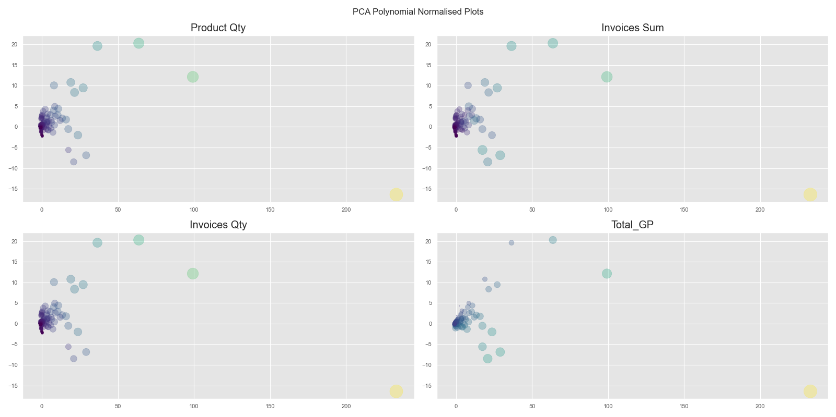
Polynomial Principal Component Analysis (PCA)

Slide 25
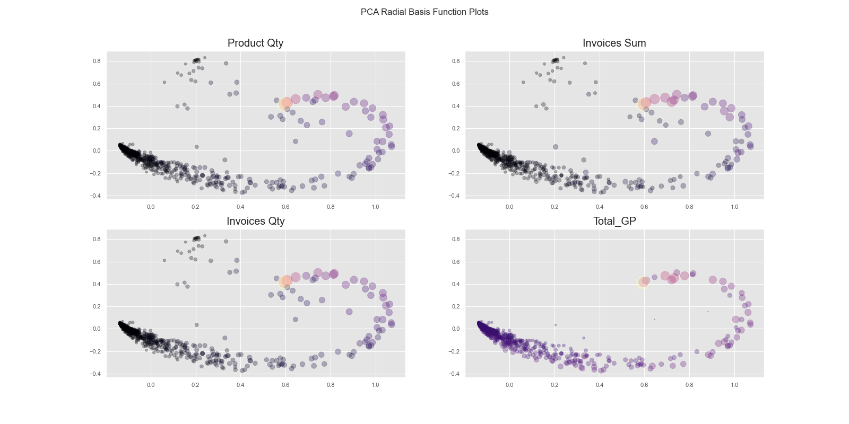
Radial Basis Principal Component Analysis (PCA)

Slide 26
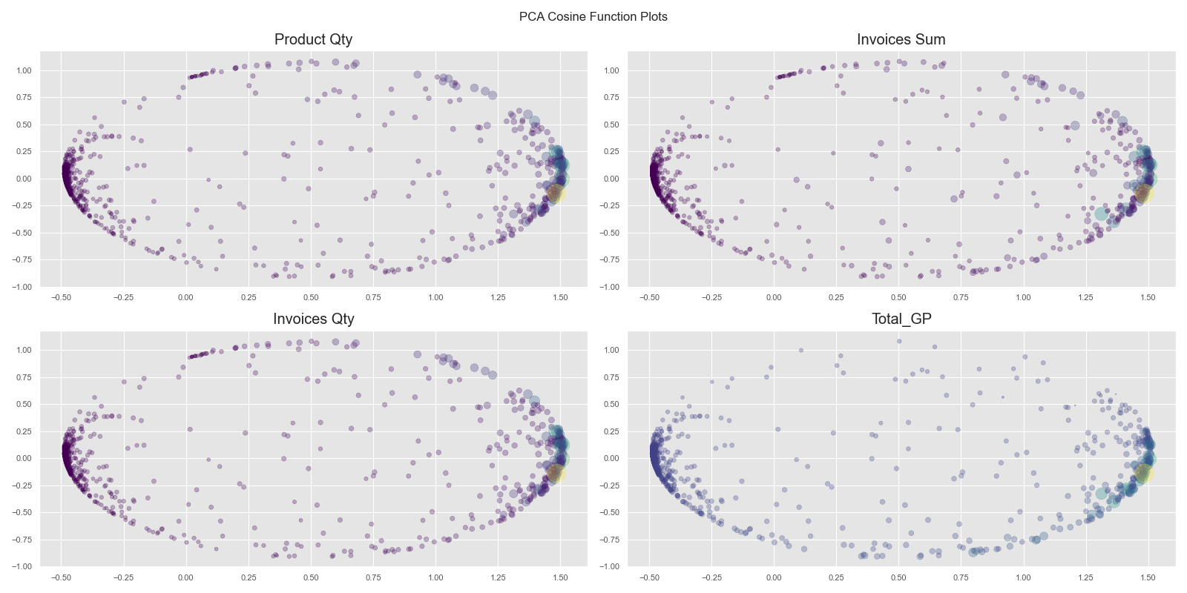
Cosine Principal Component Analysis (PCA)

Slide 27
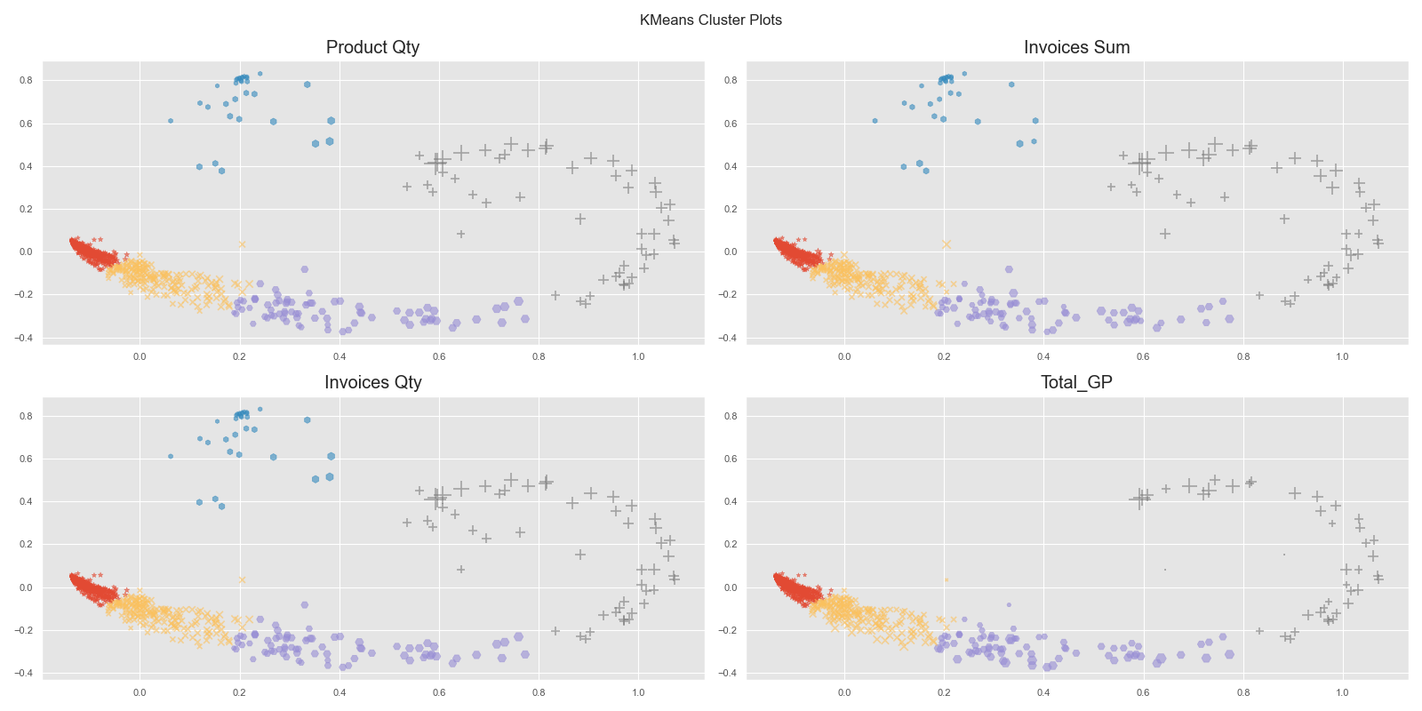
K Means Cluster Plots

