Slide 1


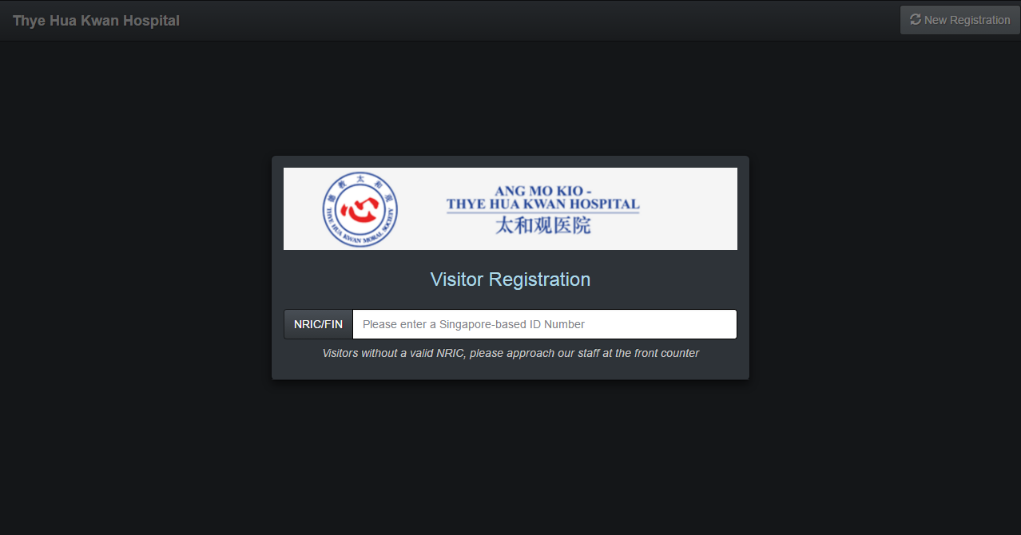


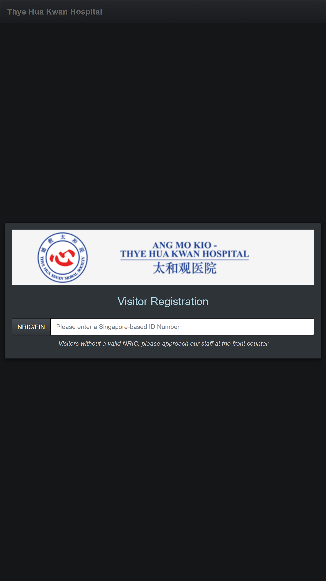






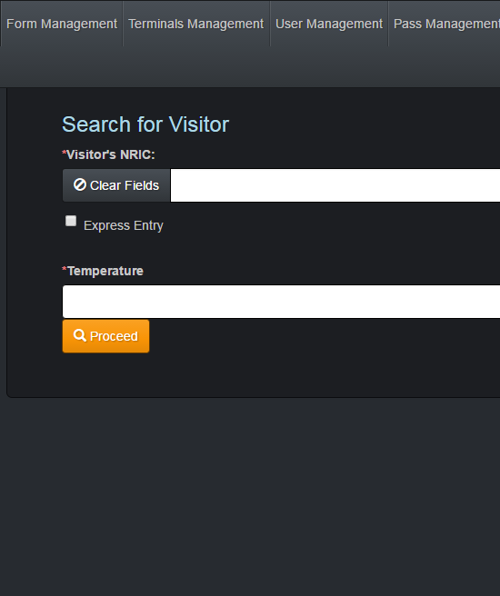
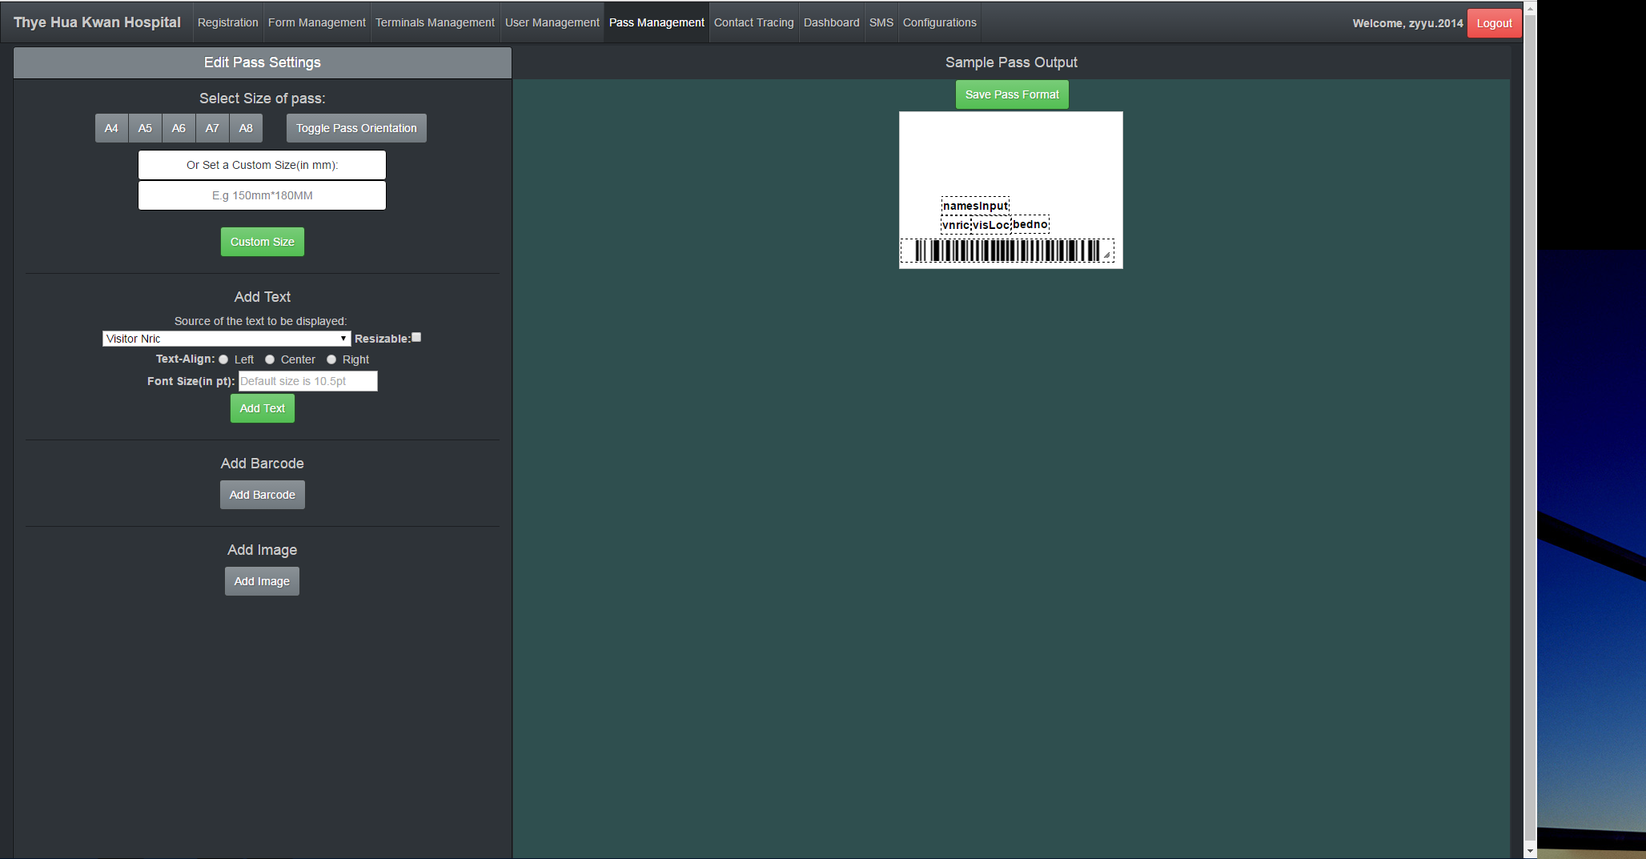
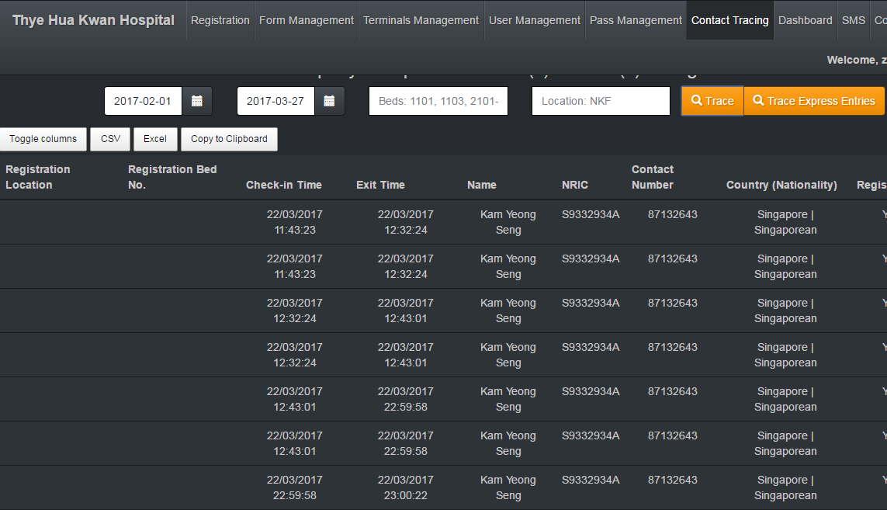
























Stepwise
Stepwise is a lightweight Visitor Management System, designed to empower hospital’s infection control teams keep track of contact between visitors and patients within the hospital. Built and tested for AMK-THK Hospital, it's the ideal, scalable solution for healthcare institutions to adopt at any stage of digitization, from simple visitor guestbooks, to advanced movement.
FEATURES
User Management
Easily add or remove user from the system based on their level of security.
Self
Assisted
Form Management
Flexibility to customise Health Screening Form.
Self / Assisted Registration
Conveniently allows visitors to pre-register their visit online and allows
staff to register visitors onsite.
Pass Management
Flexibility to customise visitor pass to suit any design and information requirements.
Contact Tracing
Quickly identify a group of people
that might been infected.
SMS
Instantly inform people based on contact tracing information.
X-FACTOR
TECHNOLGIES USED
20 nurses in biannual simulation of pandemic drill over 2 hours beginning Feb 2017. 1 visitor entry point for 8 locations and 360 beds
Fast setup time of 15 minutes. 1-click Contact Tracing report and visualisation of visitor data.
AMK Hospital confirmation to replace visitor management system for use in pandemic situations.
CanvasJS
THE TEAM
Christopher
Jason
Aloysius
Shahid
Zheng Yuan
Friedemann
OUR SUPERVISOR
OUR SPONSORS
Benjamin Gan
Damien Tong
Edy Chandra
Notes:
Stepwise is a lightweight Visitor —>Management <— System, designed to empower hospital's —>infection<— control teams —> (remove) to<— keep track of contact between visitors and patients within the hospital. Built and tested for AMK-THK Hospital, it's the ideal, scalable solution for healthcare institutions to adopt at any stage of digitization: <— from simple visitor guestbooks, to —>advanced movement<—

