Slide 1
Kick Off Meeting:
Enforcing Correct Hand Positioning during X-Rays

Slide 2
Administrative Considerations
Research scientist contract extension: approved
Anything else?

Slide 3
Timeline
Literature Review [1-2 weeks]
Software Development [8-10 weeks]
Prospective Validation Study [4-6 weeks]
Thesis Writing [4 weeks]

Slide 4
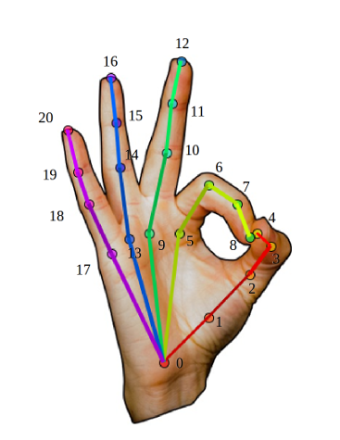
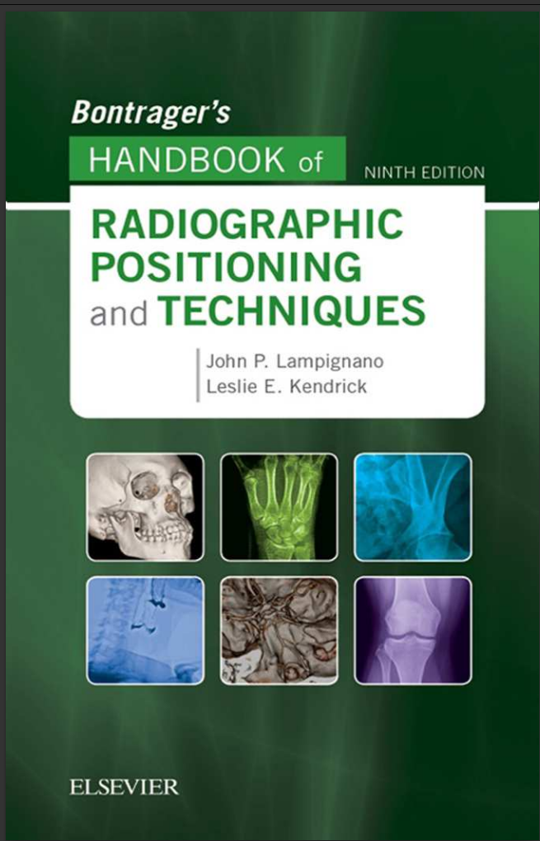
Literature Review
Hand Pose Estimation
Google MediaPipe (Commercial Use: OK)
CMU OpenPose (Commercial Use: Not OK)
100+ Papers: https://github.com/xinghaochen/awesome-hand-pose-estimation
Hand Radiographic Positioning
Other attempts?
Notes:
@inproceedings{simon2017hand,
author = {Tomas Simon and Hanbyul Joo and Iain Matthews and Yaser Sheikh},
booktitle = {CVPR},
title = {Hand Keypoint Detection in Single Images using Multiview Bootstrapping},
year = {2017}
}
@inproceedings{48292,
title = {MediaPipe: A Framework for Perceiving and Processing Reality},
author = {Camillo Lugaresi and Jiuqiang Tang and Hadon Nash and Chris McClanahan and Esha Uboweja and Michael Hays and Fan Zhang and Chuo-Ling Chang and Ming Yong and Juhyun Lee and Wan-Teh Chang and Wei Hua and Manfred Georg and Matthias Grundmann},
year = {2019},
URL = {https://mixedreality.cs.cornell.edu/s/NewTitle_May1_MediaPipe_CVPR_CV4ARVR_Workshop_2019.pdf},
booktitle = {Third Workshop on Computer Vision for AR/VR at IEEE Computer Vision and Pattern Recognition (CVPR) 2019}
}

Slide 5
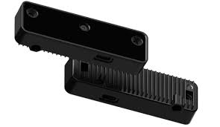
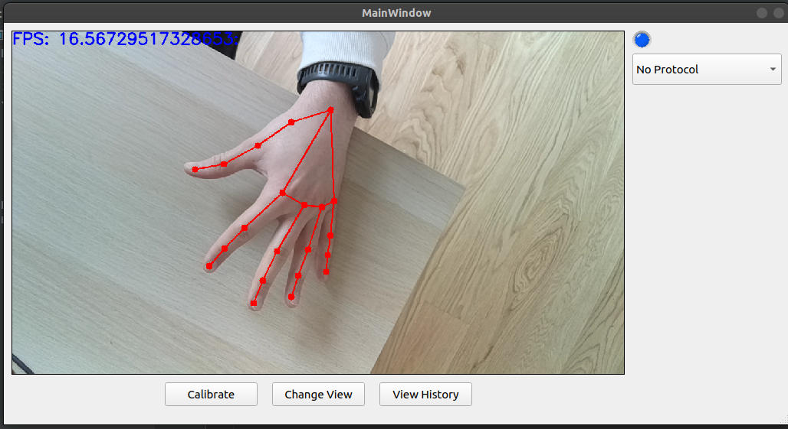
Software Development
Hand Pose Tracking
Radiographic Protocol Definition
Radiographic Protocol Enforcement
Viewing Information (2D view / 3D view)
Calibration (Translation With Respect to Emitter)

Slide 6
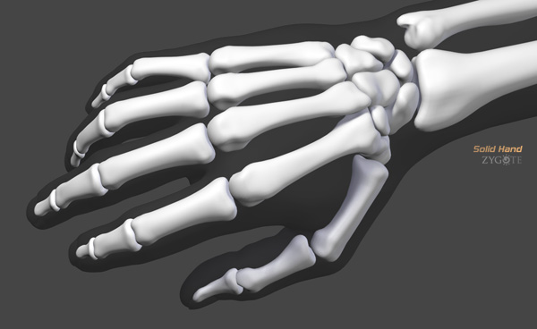
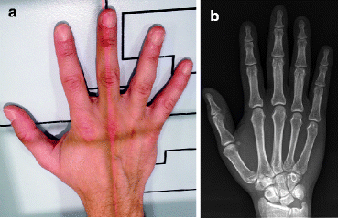
Optional Auxiliary Tasks
"Graphics" Solution:
URDF/Blender Hand Bone Model
Inverse Kinematics
Deep Learning Solution:
Generative Modeling: Requires paired RGB images and X-Ray captures (Hand Phantom)
Extra-Validation Steps

Slide 7
Prospective Validation Study
Hand Phantom X-Ray Room Captures with Positioning Accessory Equipped
Define Variables:
How many captures required ?
What metrics? Radiologist rating?
Need to think and read up about this more. Any suggestions or input much appreciated.

Slide 8
Additional Information
March 15: Concordia GCS Innovation Fund - 50k CAD

