Slide 1
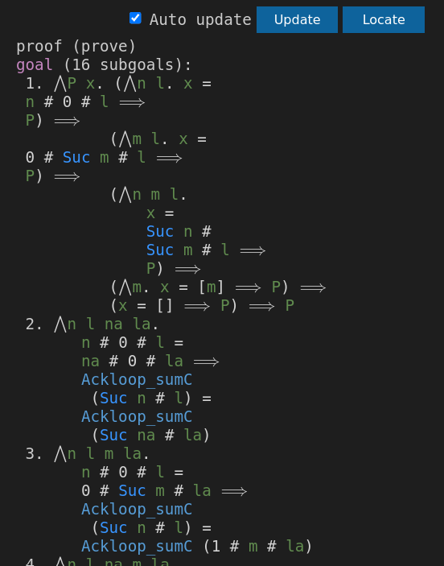
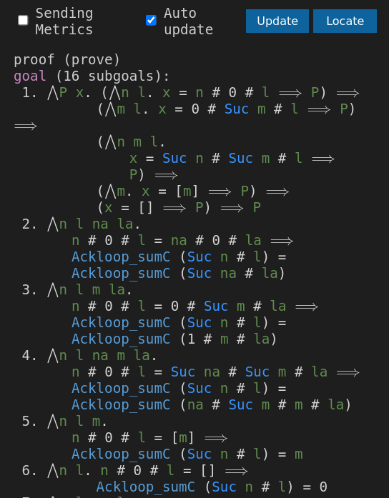
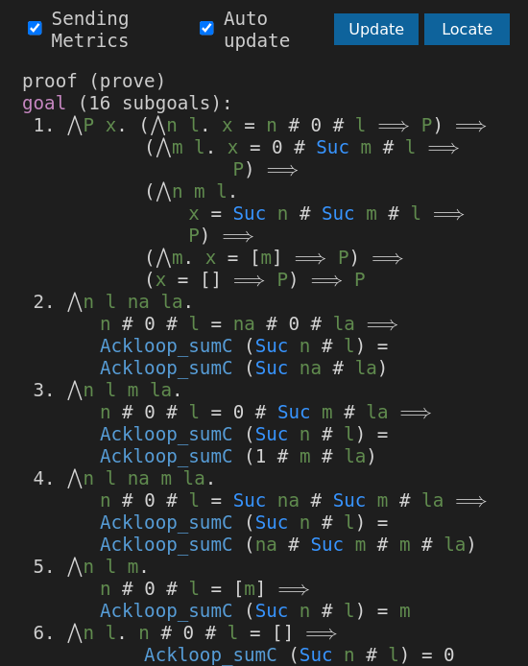
423.33px width
(a) Measurement in main.js
(b) Measurement in state panel
VSCode_Metric

Slide 2
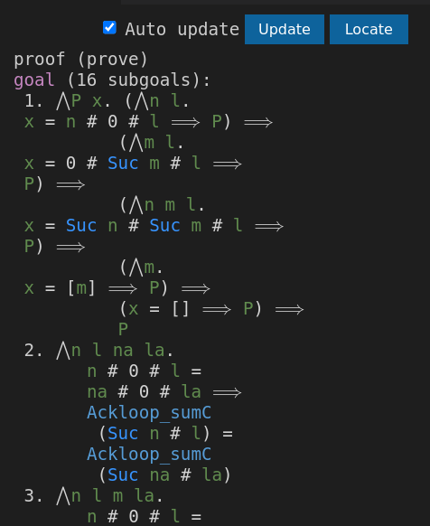
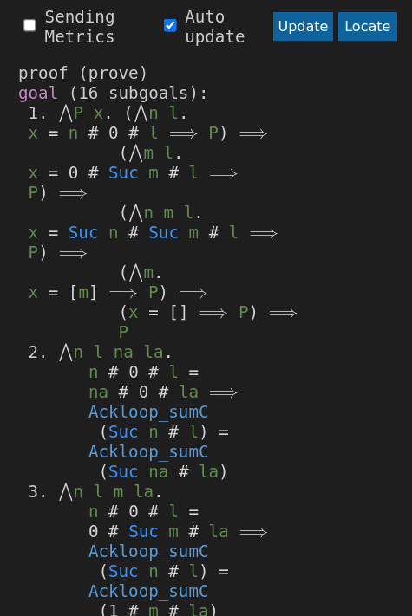
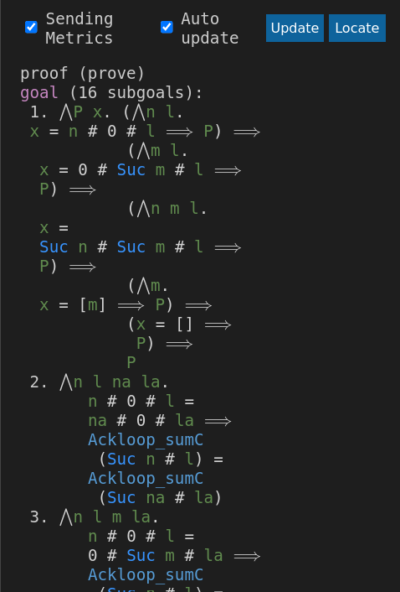
364.17px width
(Breitenmessung in main.js)
ursprünglich
Symbol.Metric
VSCode_Metric

Slide 3
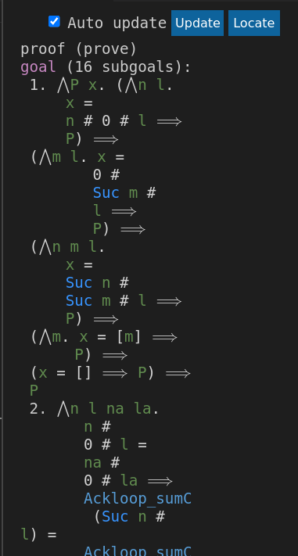
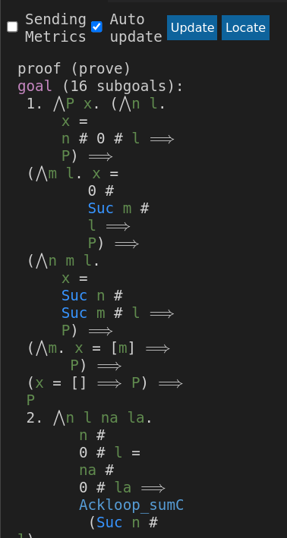
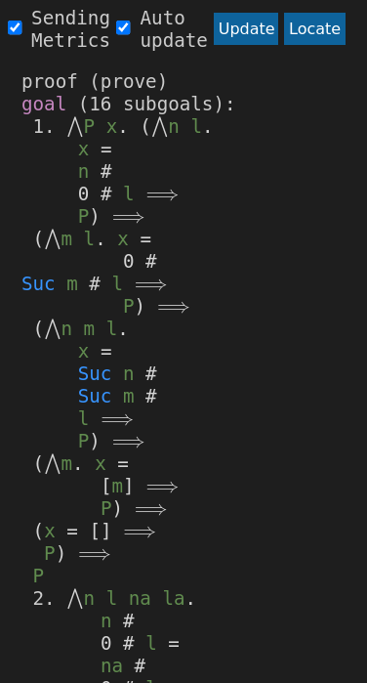
(Breitenmessung in main.js)
276.67px width
ursprünglich
Symbol.Metric
VSCode_Metric

Slide 4
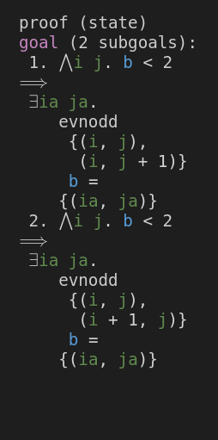
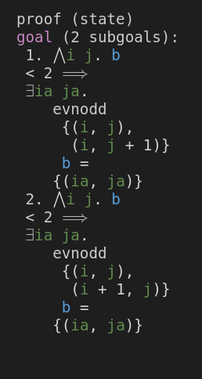
Symbol Metric
VSCode_Metric
XML: 16 Lines
Gerendert: 18 Lines
XML: 18 Lines
Gerendert: 18 Lines
(Mutilated_Checkerboard.thy – domino_singleton)

Slide 5
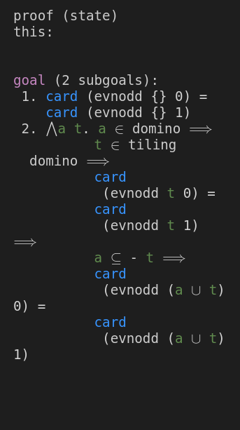
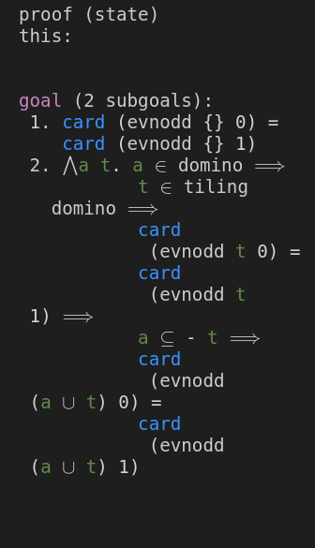
Symbol Metric
VSCode_Metric
XML: 18 Lines
Gerendert: 19 Lines
XML: 19 Lines
Gerendert: 19 Lines
(Mutilated_Checkerboard.thy – lemma tiling_domino_01:)

Slide 6
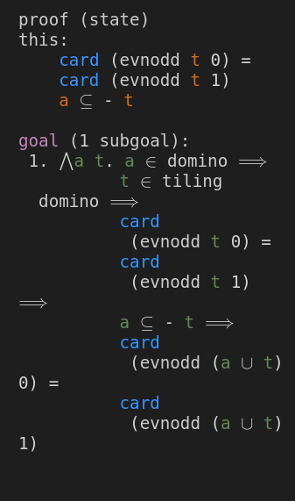
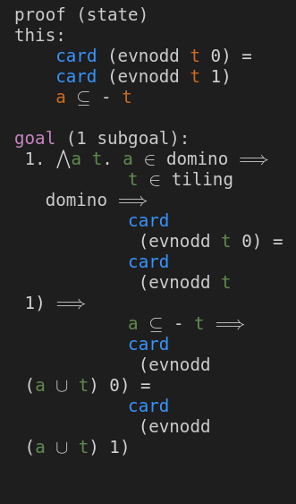
Symbol Metric
VSCode_Metric
XML: 21 Lines
Gerendert: 22 Lines
XML: 22 Lines
Gerendert: 22 Lines
(Mutilated_Checkerboard.thy – lemma tiling_domino_01:)

Slide 7
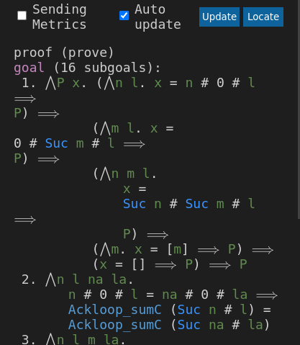
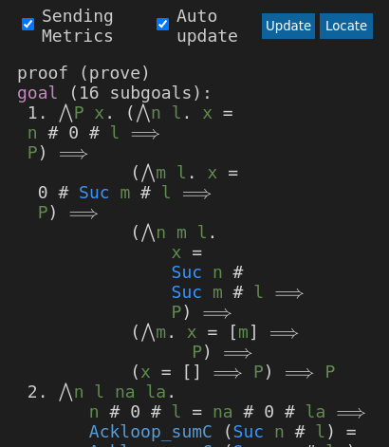
(a) Symbol Metric
(b) VSCode_Metric
1.
1.
2.
2.
3.
3.
Formatted output: 56 Lines
Rendered: 58 Lines
Formatted output: 59 Lines
Rendered: 59 Lines
(Ackermann.thy)

Slide 8
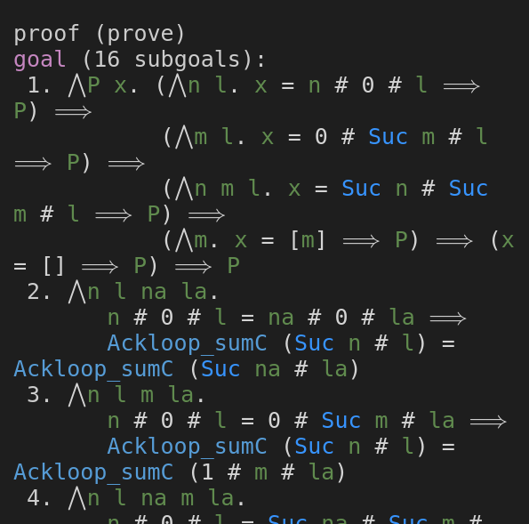
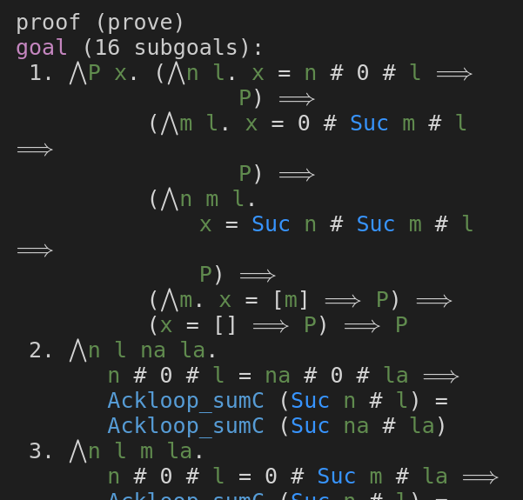
(a) Before resize
(b) After resize
(Breitenmessung in state_panel.ts)

Slide 9
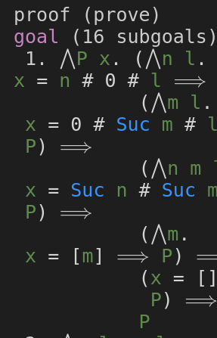
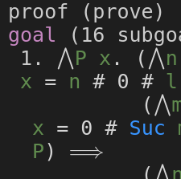
4.
3.
2.
1.

Slide 10
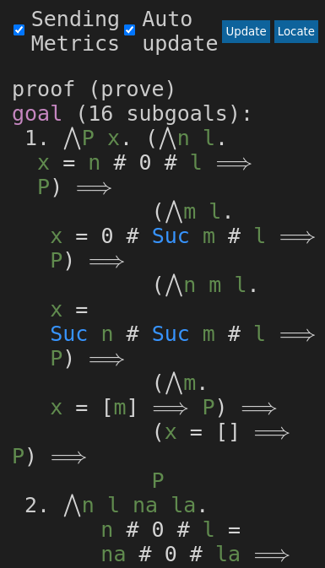
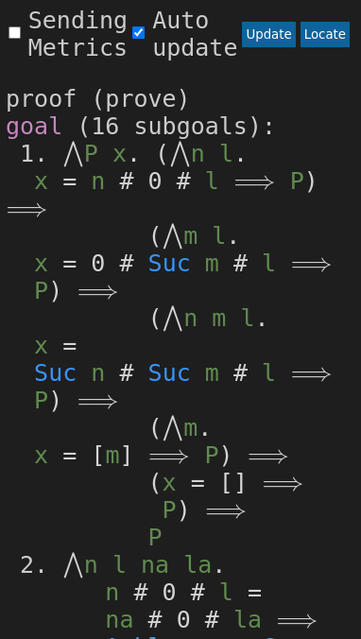
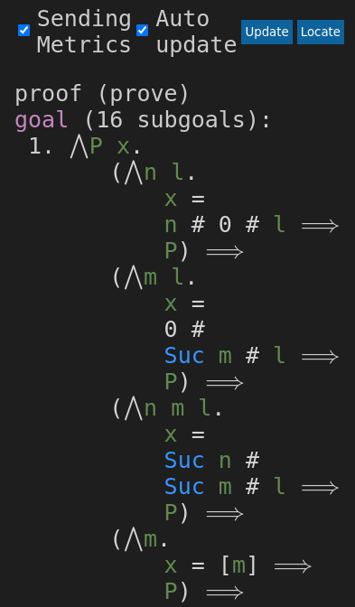
365px width
without dynamic breakgain
with dynamic breakgain

Slide 11
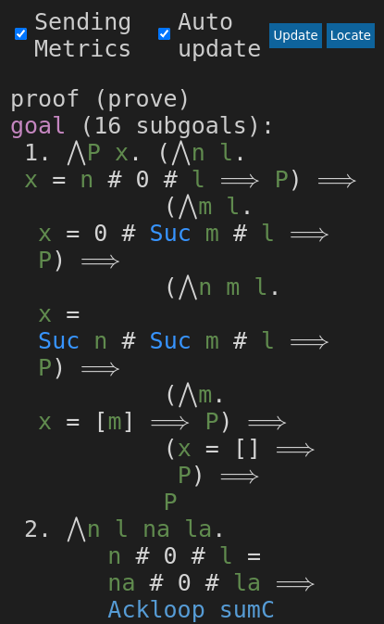
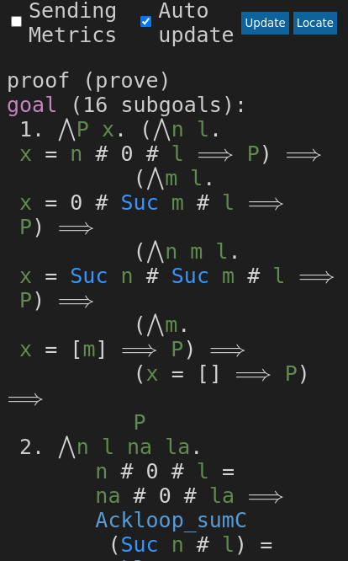
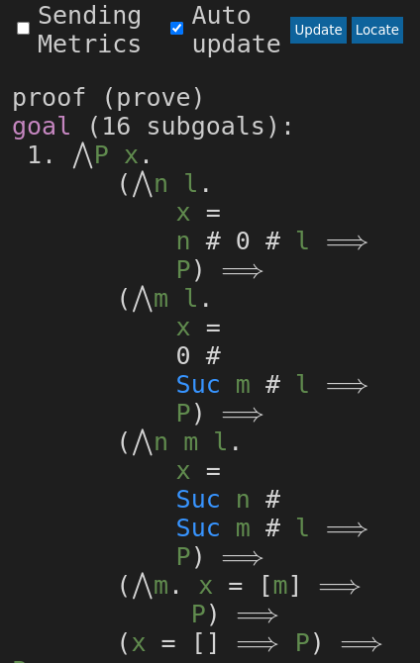
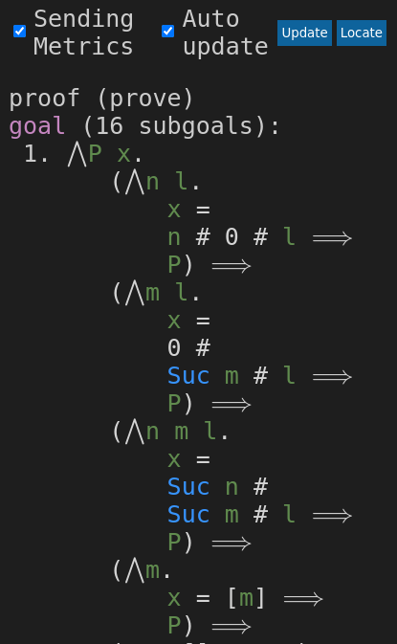
394px width
with dynamic breakgain
with default breakgain

Slide 12
394px width
(a) With default breakgain
(b) With actively set breakgain

Slide 13
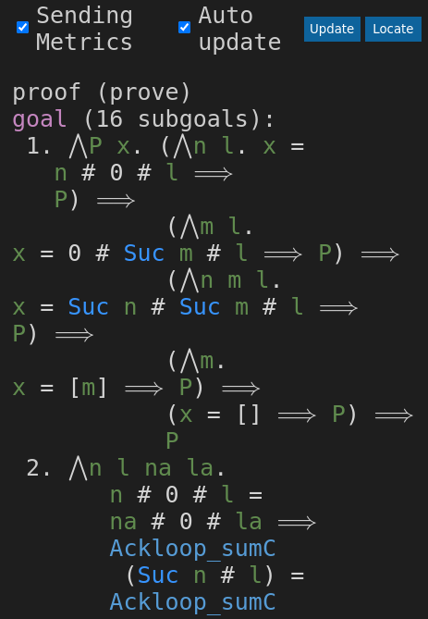
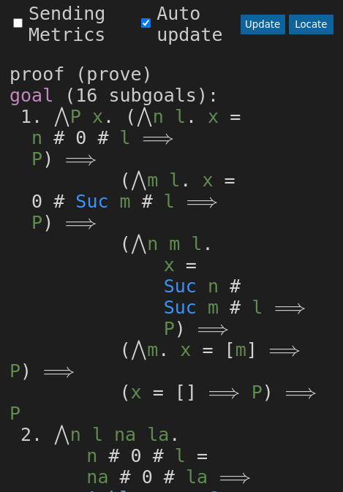
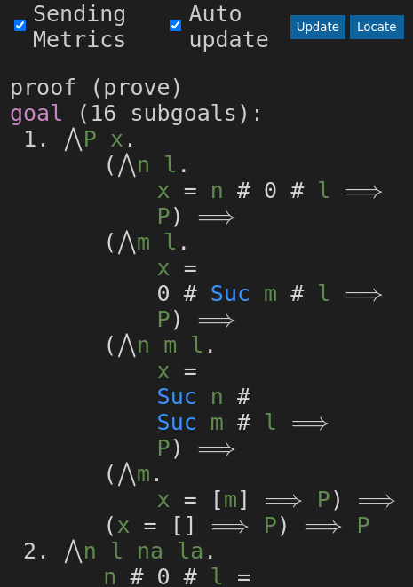
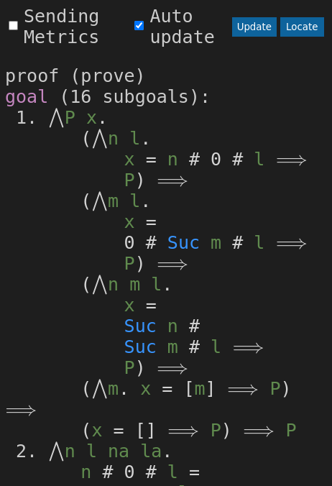
444px width
with dynamic breakgain
with default breakgain

Slide 14
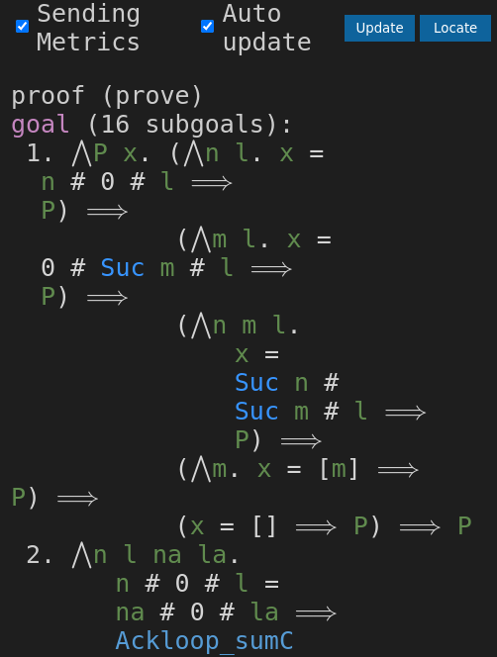
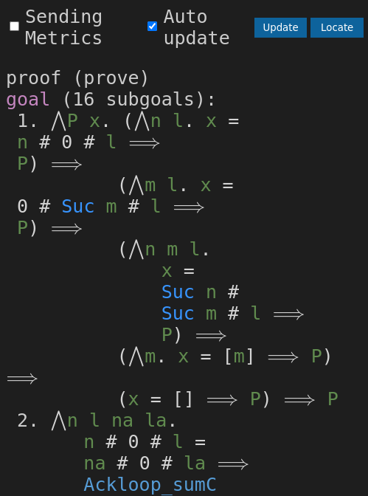
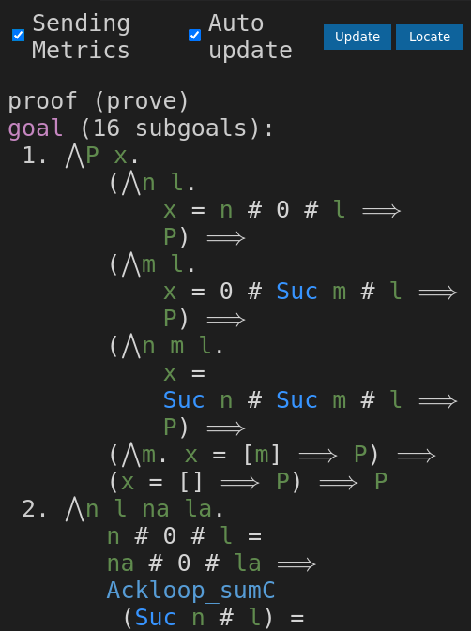
485px width
with dynamic breakgain
with default breakgain

Slide 15
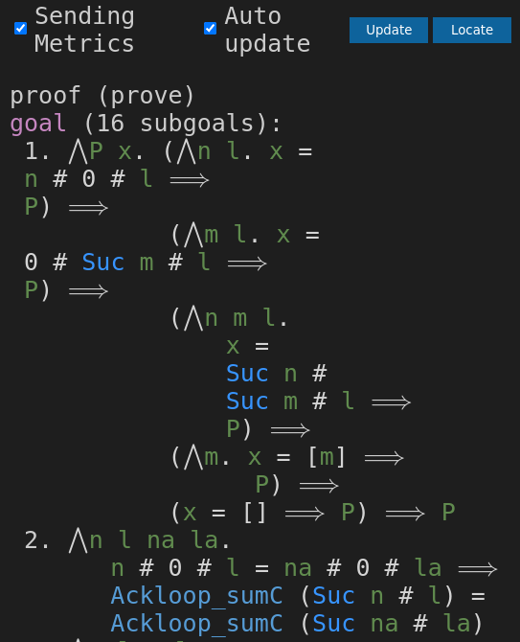
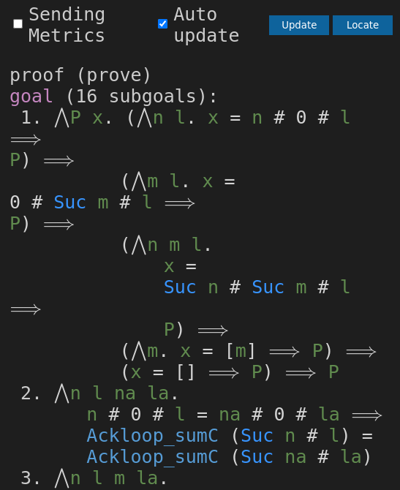
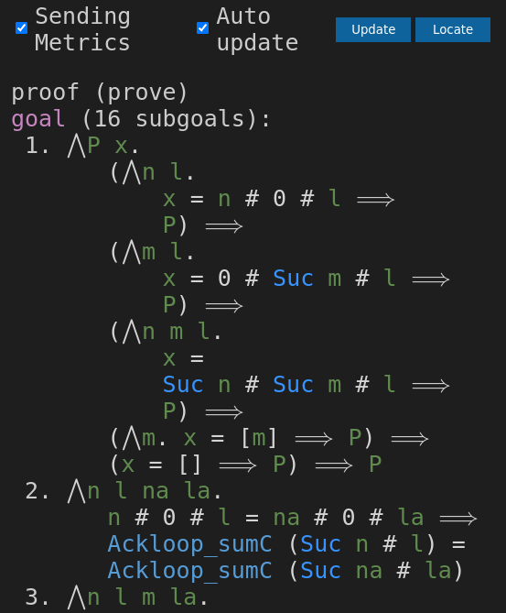
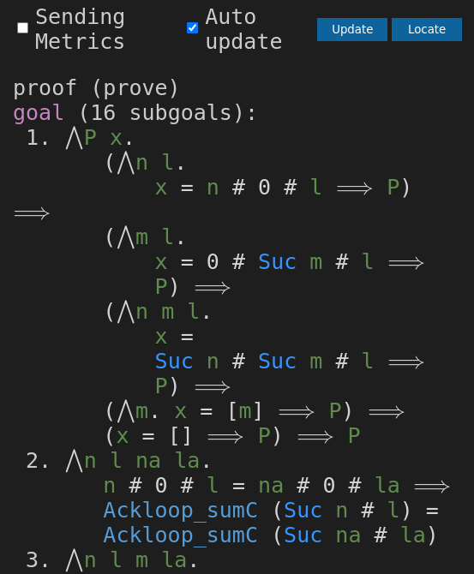
523px width
with default breakgain
with dynamic breakgain

Slide 16
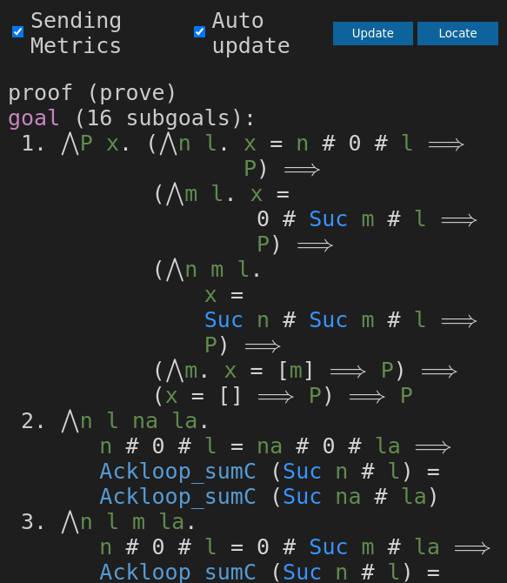
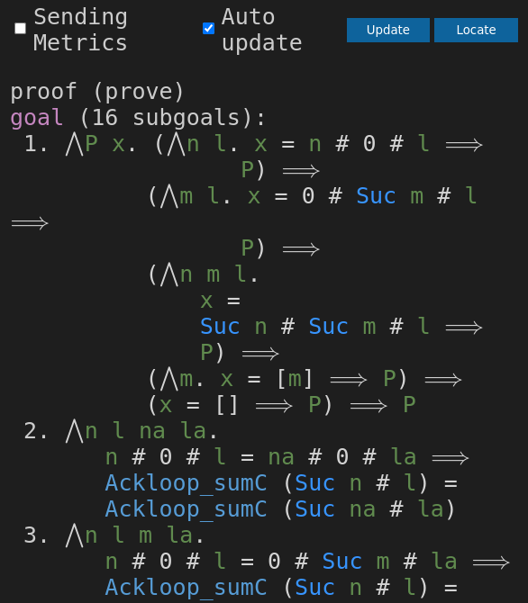
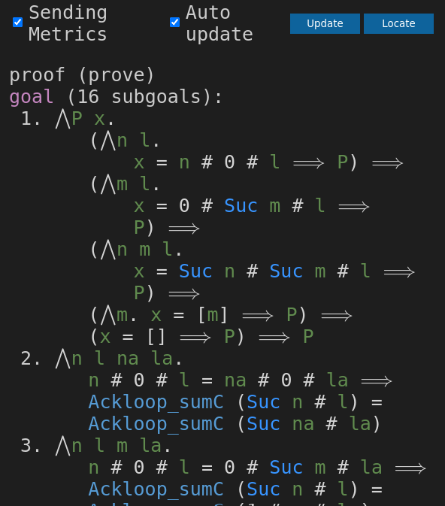
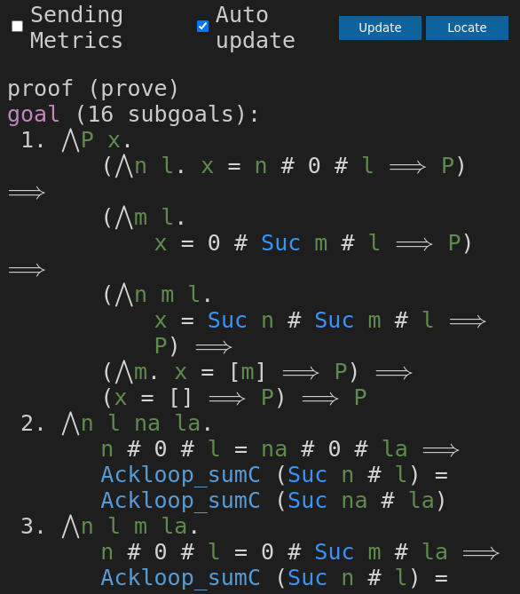
564px width
with dynamic breakgain
with default breakgain

