Slide 1
Introduction to Electrical and Computer Engineering
ECE-3 Fall 2022
LAB 9

Slide 2
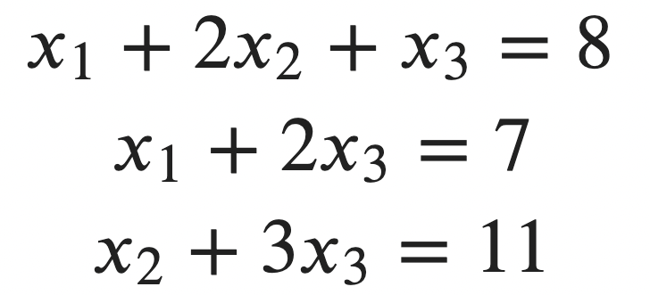
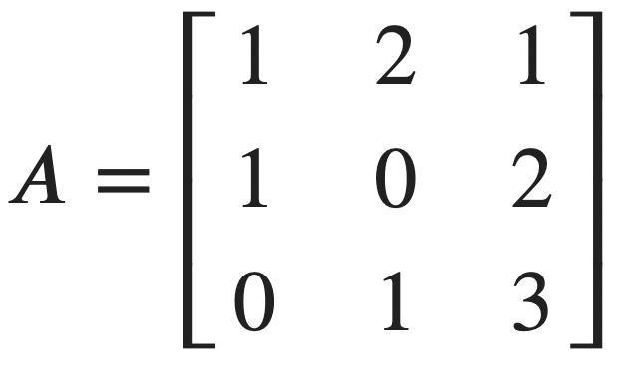
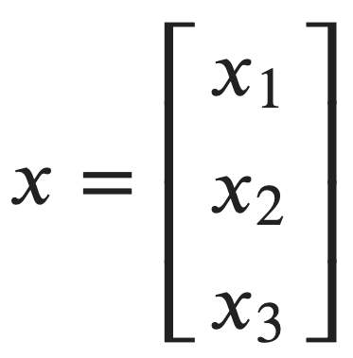
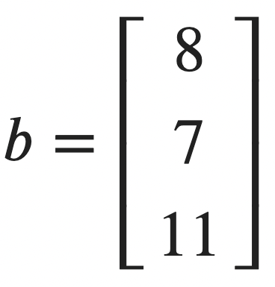
Using numpy.linalg.solve

Slide 3
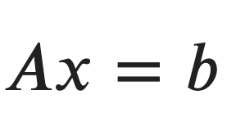
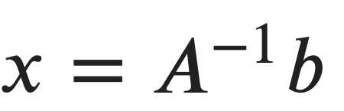
Using numpy.linalg.solve
x=np.linalg.solve(A,b)
x=np.linalg.inv(A) @ b

Slide 4
Least Squares Problem (LSP)
Let A, b be a mxn matrix and m-vector respectively
Objective: Find a vector x such that Ax ≈ b
Mathematically,
Obj(x) = ||Ax - b||² where || . || represents euclidean norm
x* = argmin [ Obj(x) ] = choice of x which makes Obj(x) minimum
If x is a solution to Ax=b then x* = x
If x* is a solution to LSP, then x* is not necessarily the solution to Ax=b

Slide 5
Least Squares Solution
Let A, b be a mxn matrix and m-vector respectively
Objective: Find a vector x such that Ax ≈ b
x* = (A^{T}A)⁻¹ A^{T} b = A† b
where A† = (A^{T}A)⁻¹ A^{T} = pseudo-inverse of A

Slide 6
LSP in Python
Using function np.linalg.lstsq(A, b)
Manually computing product of b and pseudo-inverse of A ie A† = (A^{T}A)⁻¹ A^{T}

Slide 7
LSP in practice
Data fitting - regression analysis
Median house prices over time
Depreciation of car value…
Classification
Spam email or not ?
Product categorization…

Slide 8
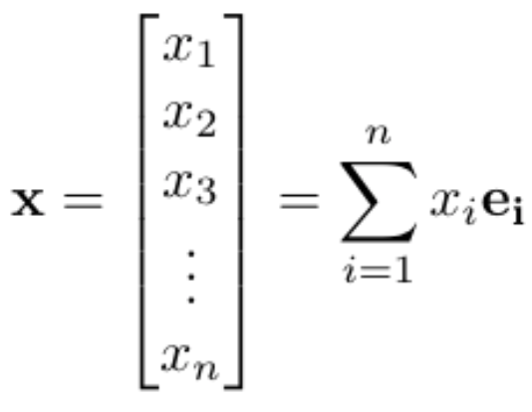
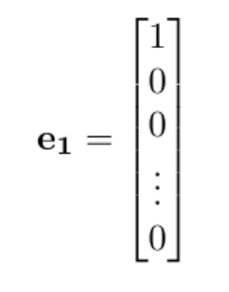
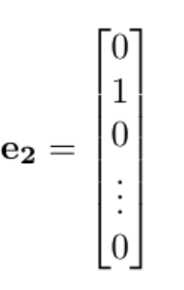
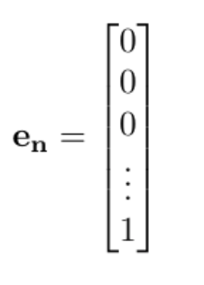
Review: Vectors
An n-vector x can be written as a column vector with n number of indices
The vector x can equivalently be written as a sum over all of the index coefficients x_{i} times corresponding unit vectors e_{i} which form the basis set for the n-dimensional vector space
with
,
, …,

Slide 9
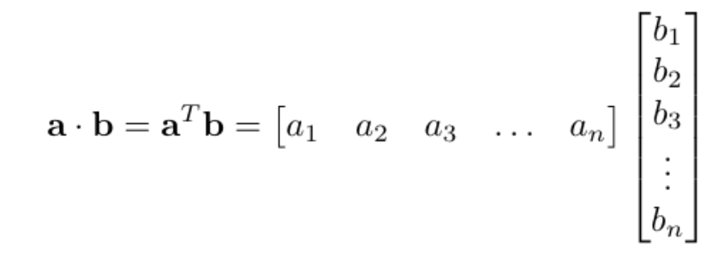
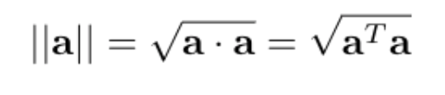
Review: Dot Product, Norm
The dot product of two n-vectors a and b is a·b
a·b can be expressed as the vector products of the transpose of a (a row vector) with the column vector b
The norm of a vector is the square root of the dot product of that vector with itself. This can be thought of the vector’s “magnitude” or the overall distance of the vector’s tip from the origin of the vector space. This is the Euclidean Norm of the vector.

Slide 10
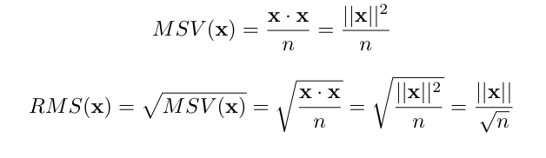
Review: Mean Square Value, RMS
The “Mean Square Value” of a vector is the norm of the vector squared (ie: the dot product of the vector with itself) divided by the number of index values there are (ie: divide by n in an n-dimensional space, or the total number of points being considered)
The “Root Mean Square Value,” or RMS value, is the square root of the mean square value

Slide 11
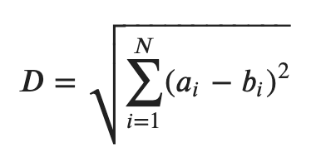
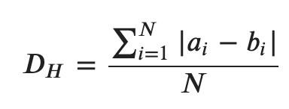
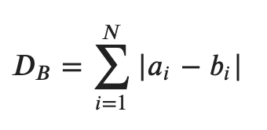
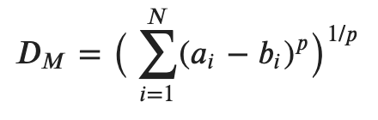
Review: Distance Metrics
Distances in a vector space can be defined in various ways. We will usually consider only the Euclidean distance metric, but others may be used depending on the application
Examples of various distance metrics in an n-dimensional space are shown below
Euclidean Distance
Hamming Distance
Block Distance
Minkowski Distance

Slide 12
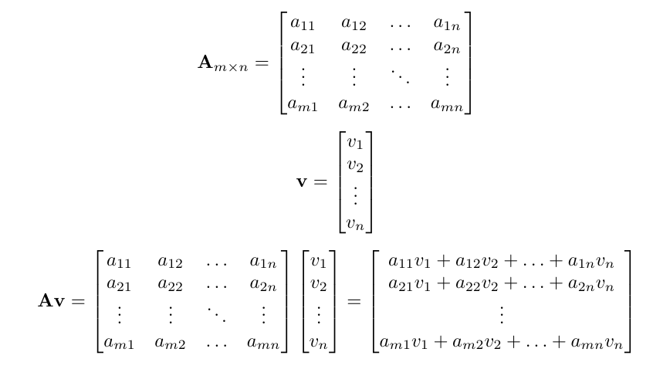
Review: Matrix-Vector Multiplication
A matrix A can be multiplied with a vector v as long as the number of columns in the matrix A match the number of rows in the column vector v
ex: An mxn matrix A (ie: m rows, n columns) can operate on an n-vector v (ie: column vector with n rows) from the left, producing an m-vector
m x n matrix
n x 1 column vector
m x 1 column vector

Slide 13
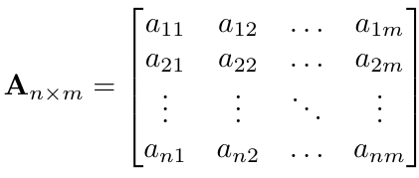
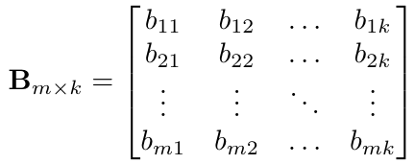
Review: Matrix Multiplication
A matrix A can be multiplied with another matrix B as long as the number of columns in the matrix A match the number of rows in the matrix B
ex: An nxm matrix A (ie: n rows, m columns) can operate on an mxk matrix B (ie: m rows, k columns), producing an nxk matrix (n rows, k columns)
A_{nxm} B_{mxk}= (AB)_{nxk} = C_{nxk}

Slide 14
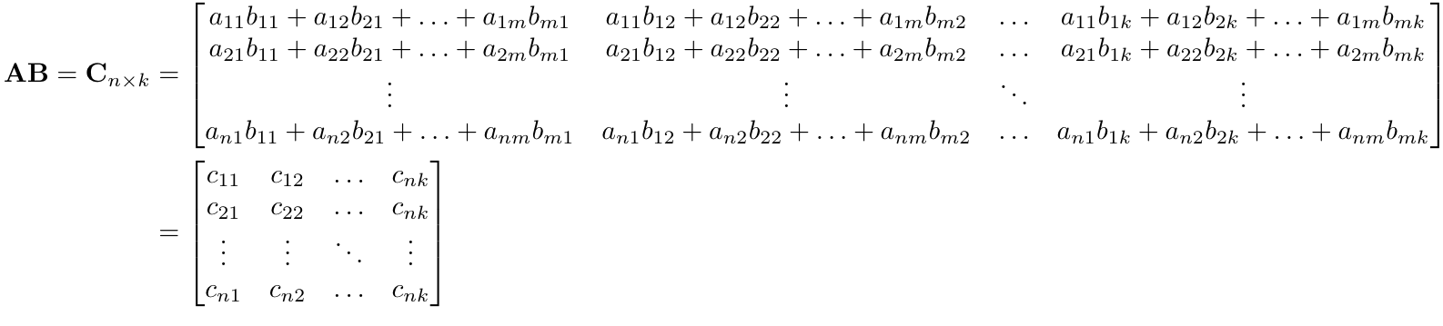
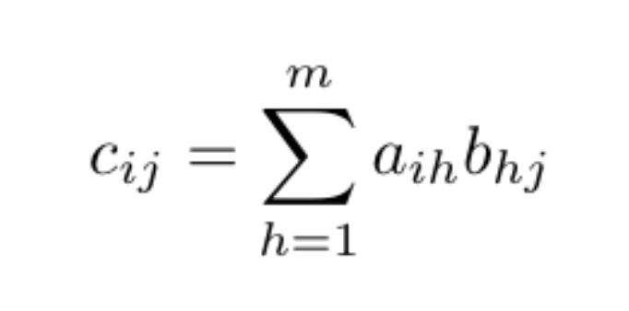
Review: Matrix Multiplication (cont.)
With each coefficient c_{ij} calculated as the sum of the products of row elements a_{ih} and column elements b_{hj}, from matrices A and B respectively.

Slide 15
Review: Matrix Operation Properties
The identity matrix I is a square diagonal matrix whose diagonal entries are entirely populated with 1’s, with the rest of the values being 0
Operating the identity matrix on a matrix from the left or the right will reproduce that matrix (assuming dimensions make it computable)
The following properties hold (assuming dimensions make them computable):
Associativity: ABC = (AB)C = A(BC)
Distributivity: A(B + C) = AB + AC
Transpose: (AB)^{T} = B^{T}A^{T}
Scalar Multiplication: (ɑAB) = (AɑB) = (ABɑ) = ɑ(AB)

Slide 16
Review: Matrix Inverse
A matrix has a left inverse if its columns are linearly independent
A matrix has a right inverse if its rows are linearly independent
A matrix is invertible if both the left and right inverses exist. In this case, the matrix inverse is unique and equal to both the left and the right inverses
If a matrix is invertible (ie: the inverse of the matrix exists), it must be a square matrix. This is not necessarily true for the left or right inverses
Left and Right Inverse: A⁻¹_{Left} A = I A A⁻¹_{Right} = I
Invertible Matrix: A⁻¹ A = A A⁻¹ = I, with A⁻¹ = A⁻¹_{Left} = A⁻¹_{Right}

Slide 17
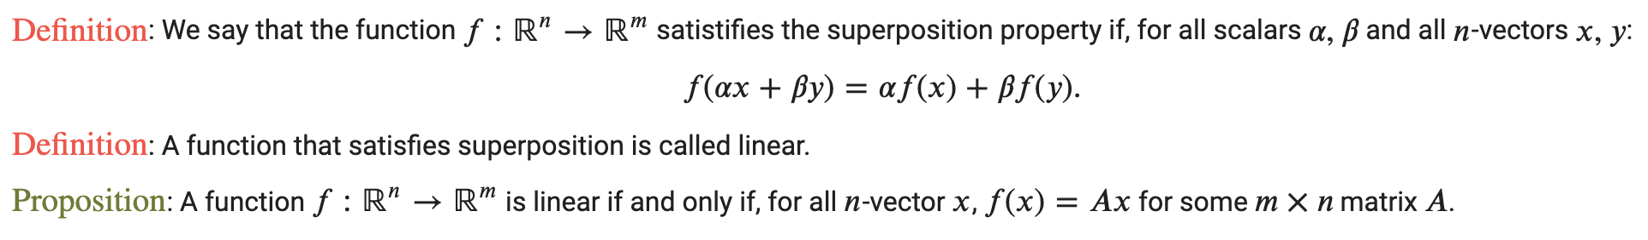
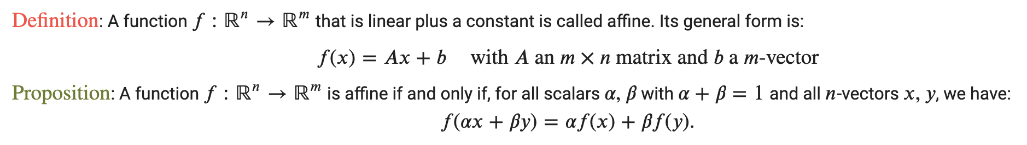
Review: Linear and Affine Functions

Slide 18
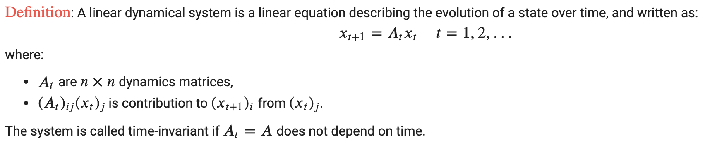
Review: Linear Dynamical Systems
Each state x_{t} depends on the previous state x_{t-1}
To successfully define the system, you need to define:
x₀, the initial state of the system
A_{t}, the dynamic matrix at each time t
If the system is time-invariant, this dynamic matrix will be constant
In this case, the n^{th} new state can be determined by repeatedly operating the A matrix on the initial state, ie: x_{n} = (A)^{n}x₀

