Slide 1
Introduction to Electrical and Computer Engineering
ECE-3 Fall 2022
LAB 1
Notes:
Check font size and visibility. Start off by asking familiarity with python

Slide 2
Outline
Installing Jupyter Notebook
Introduction to Python (using Jupyter)
Variables
Lists
Loops
Functions
NumPy**
Notes:
By the end of this lab, you will be able to...

Slide 3
Installation
….. 01110010101010
Can you print 3 for me?
What is Python?
A way to talk to computers. Just like I need English to talk to you all.
Writing text vs Running Code?
Code is a command. When the code is run, the (enslaved) computer listens to the command and does something.
print(“Hello”)
100010...
Magic Translator

Slide 4
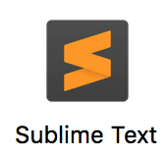


Installation
Jupyter Notebook is a useful tool to run your code.
Alternatives: Code editors
Everything that runs code has magic translator embedded.
Anaconda is a bundle of Jupyter Notebook, Python, etc.
Like how dish soap and sponges are sold together.

Slide 5
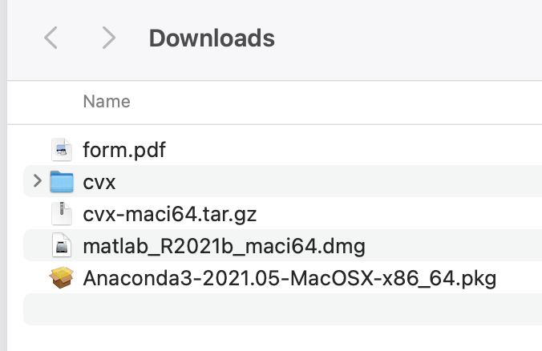

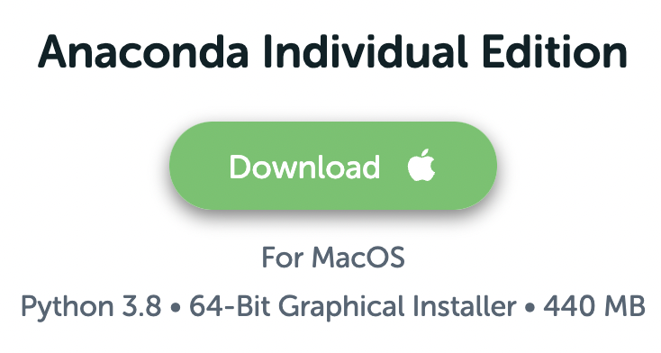
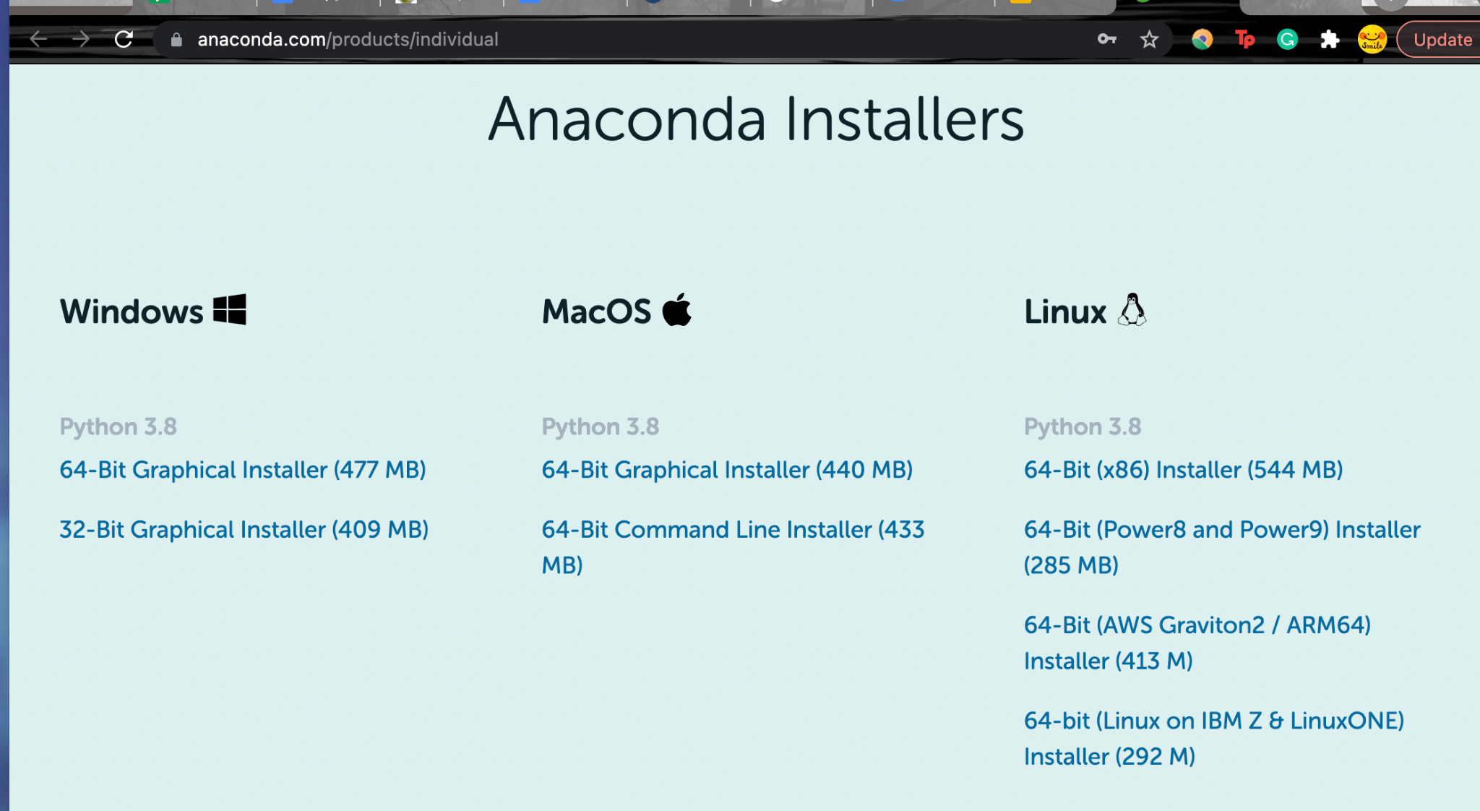
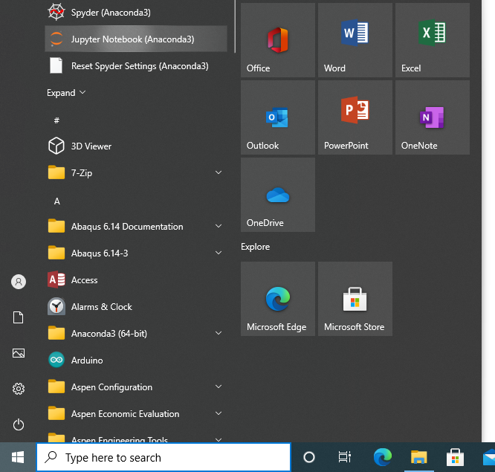
Installation
https://www.anaconda.com/download
Keep clicking“Next”
In LaunchPad
Please don’t change installation location or other advanced options, unless you are sure what you are doing!
Choose the graphic Installer and your corresponding OS.

Slide 6

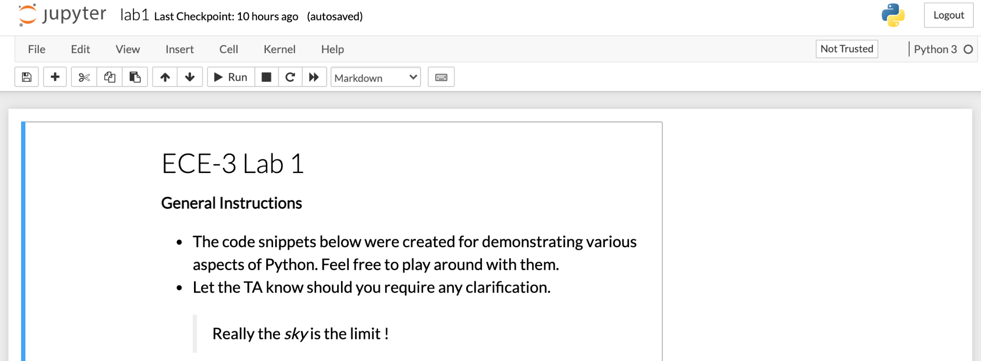
Open lab notebook
Navigate to bit.ly/lab1-ece3-nb
Notes:
Also add mathematical operators

Slide 7
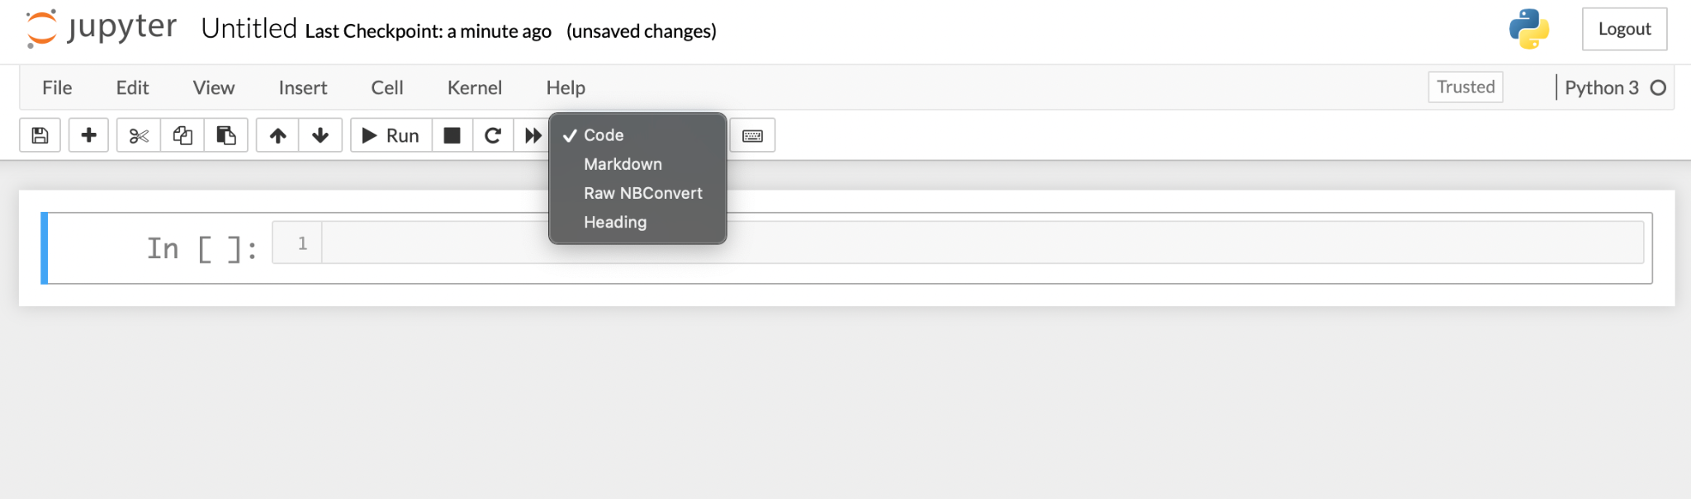
Notebook Basics
3
2
1
Notes:
Run and show basic markdown, latex and code syntax

Slide 8
Python Basics
Basic Calculations
Python can be used as a calculator, with the basic arithmetic operators +, -, *, and /
Other operators include “modulo” (%), floor-division (//), and exponentials/powers (**)
Examples:
>>> 1.2847 + 1.4828
>>> 15 / 3
>>> 12 * 1.5
>>> 7 - 100
2.7675
5.0
18.0
-93
Notes:
Also add mathematical operators

Slide 9
Python Basics
Variable Basics
Values can be stored by defining variables
Variables are helpful because they can be more descriptive of what the value represents in your calculation (ex: ‘distance’, ‘time’, ‘velocity’, ‘voltage’, etc.)
Variables are assigned using the = operator
Example:
>>> velocity = 19.0
time = 59
distance = velocity * time
distance
1121.0
Notes:
Also add mathematical operators

Slide 10
Python Basics
Variable Types
Variables come in different types
The basic data types are listed below
Type | Declaration | Example | Usage
Integer | int | x = 5 | Whole numbers
Float | float | y = 1.028 | Floating point (decimal) numbers
Boolean | bool | bool1 = True, bool2 = False | Conditional statements, boolean logic
String | str | my_word = ‘hello’ | Text, display, etc.
NoneType | None | my_var = None | Empty variables, standard function return
Notes:
Also add mathematical operators

Slide 11
Python Basics
Lists
Lists are another datatype. A list literal is created with square brackets ([])
Can be used to create ordered arrays or “lists” of values or variables
Nested lists can be used to represent matrices
Starts with index 0 (NOT 1!)
Examples:
1 2
2 7
>>> my_list = [1, 2, 3, 4]
print(my_list[1])
The matrix
Can be represented
with the statement
2
my_matrix = [[1, 2], [2, 7]]
Notes:
Also add mathematical operators

Slide 12
Python Basics
Tuples
A tuple is an immutable datatype - this means the tuple cannot be edited once it is created.
However, the variable where a tuple is stored can be reassigned to contain another, different tuple
Tuples are useful for storing data that you do not want to change, or for representing spatial coordinates (lists can do this as well)
Tuples are iterable like lists
Example:
>>> point1 = (1.2, 4.8)
print(‘The point’, point1, ‘has x =’, point1[0], ‘and y =’, point1[1])
The point (1.2, 4.8) has x = 1.2 and y = 4.8
Notes:
Also add mathematical operators

Slide 13
Python Basics
Comments
Further information about your code or calculations can be added using comments (description of code, units, etc.)
Comments are defined using the # symbol before the start of a comment - this will “comment out” the remainder of that line of code, while executing the preceding code on that line
Example:
>>> # Calculate the distance travelled by a flying cannonball
velocity = 19.0 # meters / seconds
time = 59 # seconds
distance = velocity * time # meters
distance
1121.0
Notes:
Also add mathematical operators

Slide 14
Python Basics
Print Statements
You can display values and variables generated by your code using print statements
Print statements are declared using the print function, print()
The values inserted into the parentheses are displayed on the terminal/screen of whichever python environment you are using
Examples:
>>> x = 500.0
print(x)
>>> print(5)
>>> print(“Hello World!”)
5
Hello World!
500.0
Notes:
Also add mathematical operators

Slide 15
Python Basics
If-elif-else construct
Equivalent to asking the question :
If something is equal to (==) something ?
If something is different (!=) from something ?
Similarly for <=, <, >=, >
Uses Boolean operators i.e True and False to store the results
>>> print(2*3 == 7)
>>> print(6 <= 2)
>>> print(True != False)
False
False
True

Slide 16
Python Basics
The Boolean results along with and, or, not operators are used to form the condition for an if-else statement
day = "Monday"
first_lab = True
if day=="Monday" and first_lab:
print("Today is " + day + " and the first lab!")
elif day=="Monday" and not first_lab:
print("Today is " + day + " but not first lab!")
else:
print("Today is not " + day)
Today is Monday and the first lab!

Slide 17
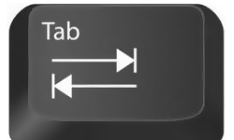
Python Basics
Indentation is important !
It is the only way Python interprets which statements are included in the if-elif-else block
1 if(4%2==0):
2 print("4 is even")
3 print("4 is divisible by 2")
4 print("This statement is always executed")
4 is even
4 is divisible by 2
This statement is always executed
Line 6 is not inside the if-block
Notes:
Tab space is mostly handled automatically

Slide 18
Python Basics
in operator can be used to check if a particular item is present in an iterable object (such as lists)
name = "Columbus"
missions = ["Starlink 2-1","Inspiration4","Dragon CRS‑23"]
if name in missions:
print(name + " belongs to SpaceX")
else:
print(name + " does not belongs to SpaceX")
name = "inspiration4"
missions = ["Starlink 2-1","Inspiration4","Dragon CRS‑23"]
if name in missions:
print(name + " belongs to SpaceX")
else:
print(name + " does not belongs to SpaceX")
name = "Inspiration4"
missions = ["Starlink 2-1","Inspiration4","Dragon CRS‑23"]
if name in missions:
print(name + " belongs to SpaceX")
else:
print(name + " does not belongs to SpaceX")
CASE SENSITIVE
Columbus does not belongs to SpaceX
inspiration4 does not belongs to SpaceX
Inspiration4 belongs to SpaceX

Slide 19
Python Basics
if-elif-else construct
Exercise - 1

Slide 20
Python Basics
For loop construct
Used to iterate over all the elements contained within a data structure.
for item in groceries:
(do something to item)
Indentation is important !

Slide 21
Python Basics
range(start, stop, step) function
Generates a sequence of numbers from start to stop (exclusive) in increments of step.
start, step are optional having defaults of 0 and 1 respectively.
stop is required to be given.
Example:
x = range(3,6)
for i in x:
print(i)
3
4
5
x = range(3,6,2)
for i in x:
print(i)
3
5
Notes:
Also add mathematical operators

Slide 22
Python Basics
groceries = ["eggs", "bread", "veggies"]
for item in groceries:
print(“I got some “ + item + “ on Sunday.”)
groceries = ["eggs", "bread", "veggies"]
print("I got some " + groceries[0] + " on Sunday.")
print("I got some " + groceries[1] + " on Sunday.")
print("I got some " + groceries[2] + " on Sunday.")
What if there are more items, say 100 ?
len(groceries) returns length of the list i.e 3
OR
for i in range(len(groceries)):
print("I got some " + groceries[i] + " on Sunday.")
I got some eggs on Sunday.
I got some bread on Sunday.
I got some veggies on Sunday.
Lesser lines of code.
Scalable
Notes:
Imagine 1000 of items (*ofc not groceries”)

Slide 23
Python Basics
Numerical for-loop:
for i in range(4):
print(str(i) + " squared is " + str(i ** 2))
0 squared is 0
1 squared is 1
2 squared is 4
3 squared is 9
range(n) returns 0,1,... upto and including n-1

Slide 24
Python Basics
while loop construct
Similar to for loops but does not runs for a predefined number of times.
Loop breaks when a certain condition is met.
n = 5
while n > 0:
print(str(n) + " is greater than 0")
n = n - 1
5 is greater than 0
4 is greater than 0
3 is greater than 0
2 is greater than 0
1 is greater than 0

Slide 25
Python Basics
break statement
Allows us to “break” out of the loop within which it is called.
n = 5
while True:
if n <= 2:
break
print(str(n) + " is less than 5 and greater than 2")
n = n - 1
5 is less than 5 and greater than 2
4 is less than 5 and greater than 2
3 is less than 5 and greater than 2
Notes:
https://open.ed.ac.uk/5861-2/

Slide 26
Python Basics
Loops
Exercise - 2
953
959

Slide 27
Python Basics
Functions
Pack a functionality in terms of certain inputs and an output.
Enhances code readability and reusability
👍🏻 Planning to reuse a block of code ?
A function is all you need !
Input
f
Output

Slide 28
Python Basics
General structure
def functionName(argument1, argument2, …. , argumentN):
‘’’This string describes the function, called docstring’’’
result = argument1 + argument2 + … + argumentN
return(result)
functionName - Name of the function (must start with a letter or “_”)
argument1, ….argumentN - Values fed into the function (any #)
return(result) - Exits the function and returns a value (optional)
help(functionName) - prints the docstring

Slide 29
Python Basics
Example #1 (with a return value)
def square(n):
‘’’This function returns the square of the input’’’
return(n**2)
print(square(4))
16

Slide 30
Python Basics
Example #2 (without a return value)
def print_var(nums):
"This function prints the contents of a list"
for item in nums:
print(item)
my_list = [13, 17, 9]
print_var(my_list)
13
17
9
Notes:
nums and my_list need not to be same. One used for defining the function, the other is used for actually invoking the function.

Slide 31
Python Basics
Functions
Exercise - 3

Slide 32
NumPy
What is NumPy?
It’s a Python package (library) for scientific computing
Why should I use it?
It has a lot of functions that enable various operations on arrays already implemented so you don’t have to write them yourself
It’s faster and more memory efficient than just using Python
A plethora of scientific Python-based packages require it
How do I get it?
You already did when you installed Anaconda

Slide 33
NumPy
Example - dot product
They are n-dimensional arrays
Different from Python lists in that:
Their size is fixed at creation
Their elements must all have the same data type
They facilitate fast advanced mathematical operations using pre-compiled C code
When used correctly they save us from using loops!

Slide 34
NumPy
Example - element-wise multiplication
Python:
c = []
for i in range(len(a)):
c.append(a[i]*b[i])
NumPy:
c = a*b
NumPy combines the convenience of Python with the speed of C, while also making our code more concise and easier to read!

Slide 35
NumPy
The basics
You need to import it on the top of your code:
import numpy as np
Define an array:
a = np.array([[1, 2, 3], [4, 5, 6]])
Check its properties:
a.ndim -> 2
a.size -> 6
a.shape -> (2, 3)

Slide 36
NumPy
Useful functions
a = np.array([3, 2, 1, 4]), b = np.array([5, 8, 7, 6])
np.reshape(a, (2, 2)) -> [[3, 2], [1, 4]]
np.sort(a) -> [1, 2, 3, 4]
np.hstack((a, b)) -> [3, 1, 2, 4, 5, 8, 7, 6]
np.vstack((a, b)) -> [[3, 1, 2, 4], [5, 8, 7, 6]]
np.sum(a) -> 10
np.min(a) -> 1

