Slide 1
Introduction to Electrical and Computer Engineering
ECE-3 Fall 2022
LAB 3

Slide 2
Outline
Classification using K-NN
Regression using K-NN

Slide 3
Lab-3 Notebook
bit.ly/lab3-ece3-nb

Slide 4
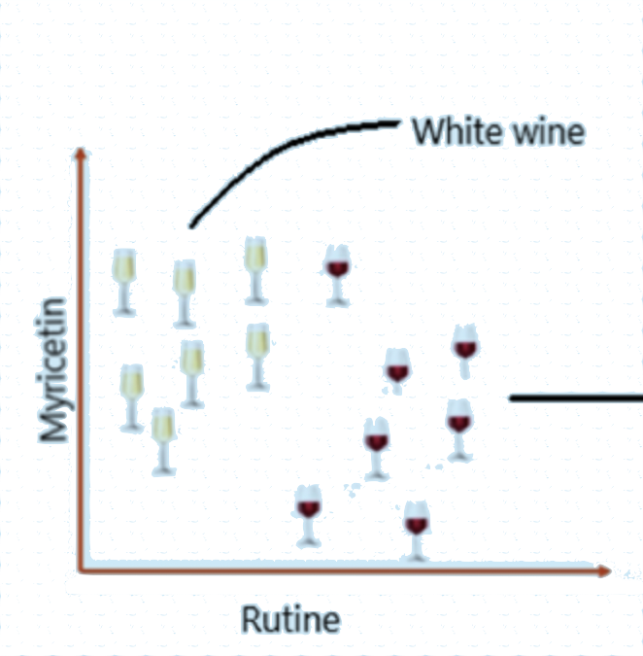
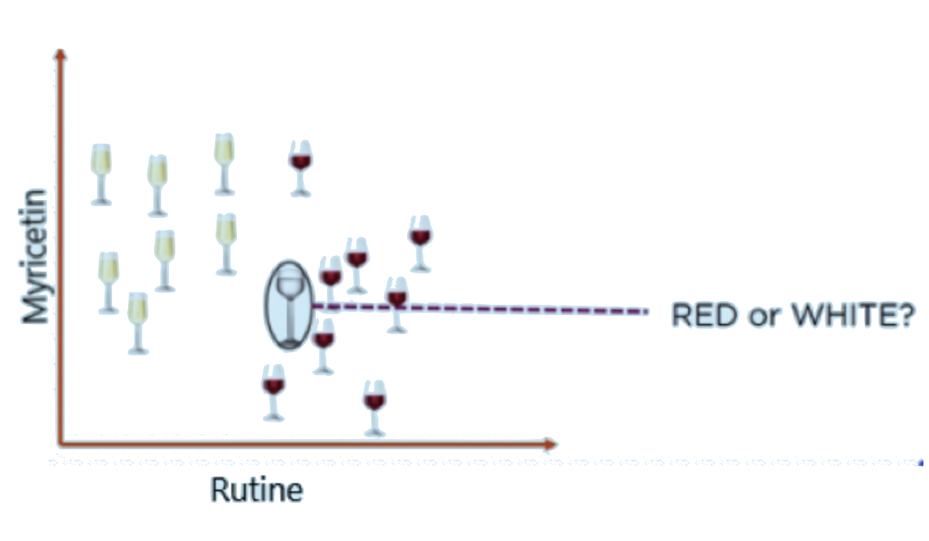
Classification using K-NN
To assign an item into a group based on similarity.
A forgetful worker later...
Red wine
Fig 1. A wine seller’s data about the amount of chemical Myricetin & Rutin in their two wine production.
Figure source: [1].
Fig 2. Wine seller tries to classify a glass of unknown liquid based on the amount of each chemicals it contains.
Figure source: [1].
Notes:
For the left graph, says “Imagine you are a wine seller. You tested some of your white wine and red wine for how much Myricetin and Rutin (2 chemicals) is in each of them and created this graph.” For the right graph, says sth like “One day you found an unknown glass of liquid on your table because of your underpaid worker forgot to label and would like to find out whether it is red or white wine.”

Slide 5
Classification using K-NN
The wine seller has just used the K-Nearest Neighbors algorithm to perform a classification task!
Fig 3. Let k=5. The 5 nearest neighbors of the unknown glass consist of 4 red and 1 white. Therefore, by majority rule, the seller classify the unknown glass as “red wine”. Figure source: [1].
Q for the class: How did the seller decide the distance between the glasses of wine?
Notes:
Answer to the red question: The seller used Euclidean Distance. Distance between a known glass A and the unknown glass B = sqrt((B’s Rutine - A’s Rutine)^2 + (B’s Myricetin - A’s Myricetin)^2).

Slide 6
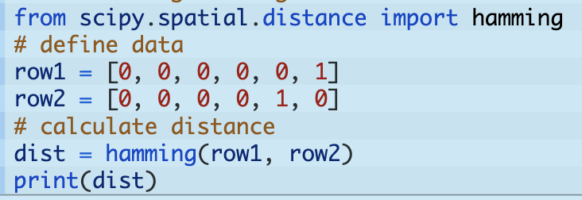
Beyond Euclidean Distance
Hamming Distance : (1/n) ∑_{i=1}^{n} |a_{i} - b_{i}|, for a_{i}, b_{i} ∈ R^{n}
Figure source: [1].
Answer: 1/3
Great for categorical data, because you can encode categories into binary vectors.
Notes:
Start the slide with “Euclidean distance is the most natural distance definition for us, but there are other useful distance measures.”
Examples to talk about since categorical data could be new for ppl -> you have data about cities your customer live in. Out of the 6 zeros in the example code screenshot, each position can represent a city.

Slide 7
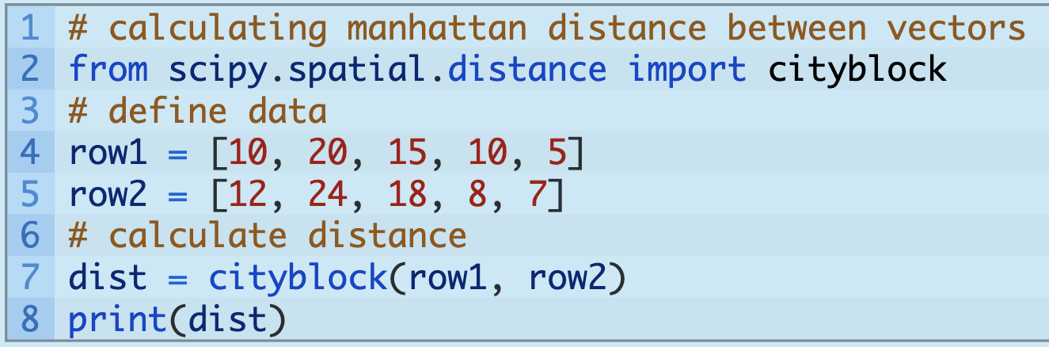
Beyond Euclidean Distance
Manhattan / City Block Distance : ∑_{i=1}^{n} |a_{i} - b_{i}|, for a_{i}, b_{i} ∈ R^{n}
Figure source: [1].
Answer:13
Notes:
Ask the students to give you the value for dist.

Slide 8
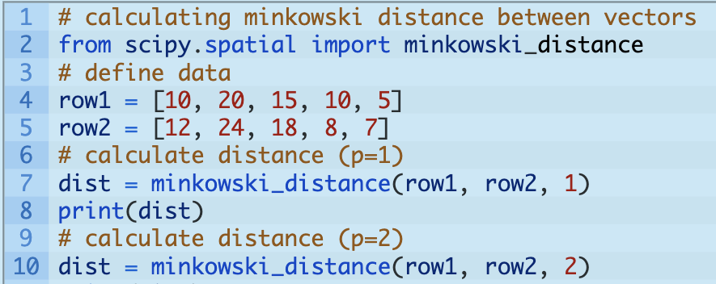
Beyond Euclidean Distance
Minkowski Distance : (∑_{i=1}^{n} |a_{i} - b_{i}| ^{p} ) ^{1/p}, for a_{i}, b_{i} ∈ R^{n}, p ≥ 1
p=1 <-> cityblock
p=2 <-> Euclidean
Figure source: [1].

Slide 9
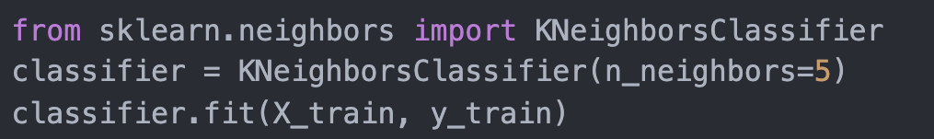
K-NN Algorithm for classification
Calculate distance between your new data point with all the preexisting data. O(n) - Not cheap!
Pick k data points with the smallest distance and use the majority of their group assignment to label your new data point.
source: [3].

Slide 10
Classification vs Regression
Output is group assignment - categorical data.
Output is a real number, the average value of k closest points.

Slide 11
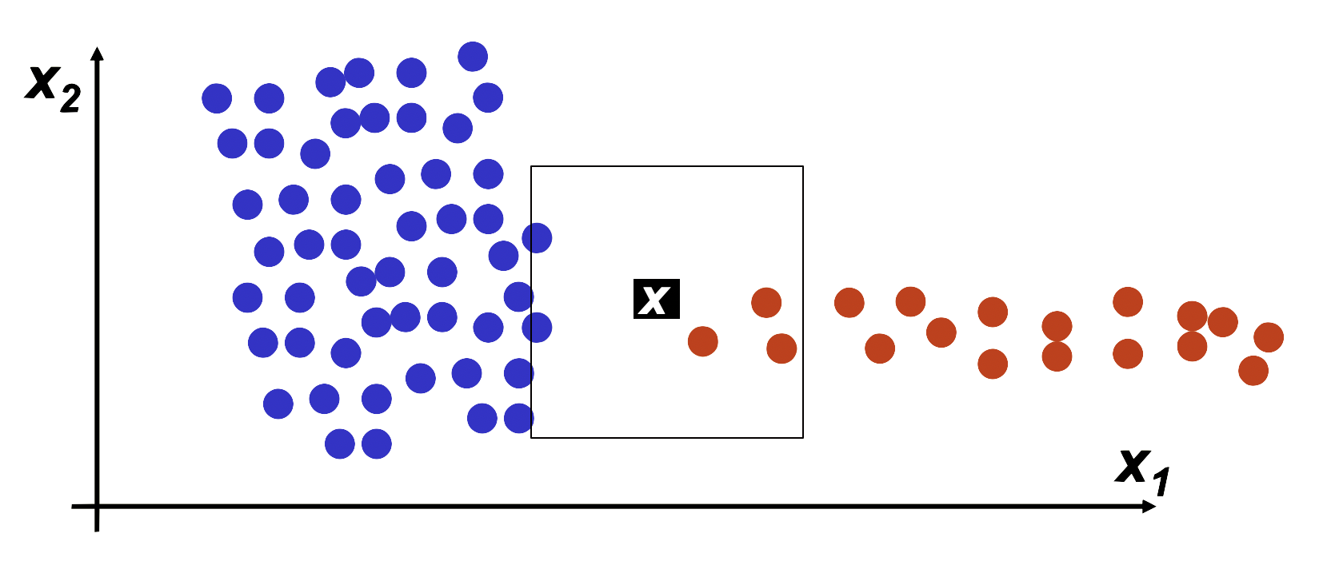
How to pick k?
Pick an odd number to avoid ties.
If k is too small -> noisy data can ruin your result
If k is too big -> be aware of density of far-away data points
k = 15, bad k >.<
k=5, good k :D
Fig 4. Downfall of a k too-big. Visually x belongs to red. However k=15 falsely classifies x to blue.
source: [2].

Slide 12
How to pick k?
In the real world, this value highly depends what you are using the algorithm for.
Cross Validation
Take a portion of your known data and pretend that you don’t know their group assignments. (Validation data)
Run the K-NN algorithm on the validation data with k=1,2,... n-1 and pick k that gives you results closest to the true group assignment.
If n is too large, starting from k=1 is absurd, so starting at k=n^(½) is a good heuristic to save time.
Validation data
Red wine
Fig 5. Create validation data with known data to pick the best parameter k.

Slide 13
Reference
https://towardsdatascience.com/a-simple-introduction-to-k-nearest-neighbors-algorithm-b3519ed98e
http://www.cs.haifa.ac.il/~rita/ml_course/lectures/KNN.pdf
https://stackabuse.com/k-nearest-neighbors-algorithm-in-python-and-scikit-learn/

