Slide 1

Data Quality Revolution : The Fabric-OpenAI Approach

Slide 2






Alpa Buddhabhatti
About Me
She/Her
Azure Data Engineer/Trainer
Microsoft MVP
Microsoft Certified Trainer(MCT)
Azure Developer(AZ-204)
Azure Data Engineer(DP-203)
Azure Data Scientist(DP-100)
Azure Administrator(AZ-104)
alpabuddhabhatti
@AlpaB7
alpaBuddhabhatti/AzureOpenAI
@meetalpa
@alpabuddhabhatti

Slide 3
Abstract
In this session, I'll walk you through practical techniques for handling various data issues, such as formatting problems, conversion, and more. Whether you're a seasoned data professional or just starting your data journey, this session will equip you with the skills and knowledge needed to turn chaotic datasets into valuable insights. Don't miss this opportunity to master the art of data cleaning with Fabric and Open AI. We'll see demo using following technologies: **Microsoft Fabric **Azure OpenAI **Azure SQL Attendees will gain insights on applying generative AI using Azure OpenAI to various data sources within their organization
11:30 to 12:15 Room - Under Pressure

Slide 4
Agenda
Quick overview of Microsoft Fabric
Quick overview of Azure OpenAI
Demo –
Azure OpenAI using AI studio
Using Postman
Microsoft Fabric & Azure OpenAI - Data quality and Cleansing

Slide 5

Quick overview of Microsoft Fabric
A Complete Analytic Solution
A unified software-as-a-service (SaaS) solution
Complete Analytic solution
Data Engineer, Data Science, Real time Data Analytics, Visualizing data, etc
Using a single environment, you can ingest, store, process, analyse, visualize, and share your data
All your data stored in a single open format in one place—OneLake
Try Fabric at https://app.fabric.microsoft.com

Slide 6

Quick overview of Azure OpenAI
Azure AI service help you to apply generative AI on your data or Public data
Make you Apps more smart
Azure PaaS AI Service
Natural Language Processing Algorithm
Co-developed by Microsoft +OpenAI
Enterprise level security
Easy to consume it using Rest Endpoint and key

Slide 7
Few Examples
Apps (Q&A Or Chatbot)
Summarize your data
Ask natural language queries to your structured data.
The automatic Code generation
Media analysis

Slide 8
How to Consume Azure OpenAI
REST Endpoint & Key
Azure Services (Azure Logic Apps, Azure Functions, Azure SQL Database, ADF, Microsoft Fabric, Power Apps, etc)
Power BI

Slide 9
How to Consume Azure OpenAI
Azure OpenAI SDKs (c#, Python etc)
REST API (Endpoint , Key, etc)
Example:
curl $AZURE_OPENAI_ENDPOINT/openai/deployments/gpt-35-turbo-instruct/completions?api-version=2024-04-01 \
-H "Content-Type: application/json" \
-H "api-key: $AZURE_OPENAI_KEY" \
-d "{\"prompt\": \"Once upon a time\"}"

Slide 10








High-Level Azure OpenAI Design
User
Private Data Sources
… etc
OR
Query
Response
Private Data
Knowledge
Public Data
OPEN DATA

Slide 11
DEMO
Calling Azure OpenAI
Fabric ADF
Postman
Data Quality
Microsoft Fabric Notebook

Slide 12
How to Consume Azure OpenAI
Azure OpenAI SDKs (c#, Python etc)
REST API (Endpoint , Key, etc)
Example:
curl $AZURE_OPENAI_ENDPOINT/openai/deployments/gpt-35-turbo-instruct/completions?api-version=2024-04-01 \
-H "Content-Type: application/json" \
-H "api-key: $AZURE_OPENAI_KEY" \
-d "{\"prompt\": \"Once upon a time\"}"

Slide 13


How to integrate Azure OpenAI with Microsoft Fabric – ADF
1. Azure OpenAI Rest URL+API API Version
2. Method : POST
3. Header : Content-Type +Key
4. Message : Prompt
Query: 2+2=?
Response : 2+2 = 4
Open
Data
Knowledge
Public Data
(Data over internet )

Slide 14
Description for Zip code on your own data
zip_codes:
["98052", "10001", "60601", "90210"]
Response
Zip code 90210 corresponds to the city of Beverly Hills…..
Knowledge
Private Data
Prompt /Query
Tell me about zip code {zip_code}

Slide 15
Missing Data on your own data
Customer ID,Name,Age,Gender,Occupation,Purchase Amount,Email,Address
9,James,,Male,Product Manager,,james@example.com,890 Pine St
10,Sarah,32,Female,Software Engineer,1900,sarah@example.com,
Response
Completeness Assessment:
Based on the provided dataset, the assessment of completeness is as follows:
Yes, there are missing values in the dataset.
2. The "Age", "Purchase Amount", and "Address" columns contain missing values.
Knowledge
Private Data
Query
Assess the completeness of the dataset:
1. Are there any missing values in the dataset?
2. Which columns contain missing values?

Slide 16
Prerequisites – Azure OpenAI
Azure account.
Azure subscription with access enabled for the Azure OpenAI service.
You can request access with this form- Request Access to Azure OpenAI Service (microsoft.com)
3. Azure account permissions(subscription-level permissions OR RG level):
Microsoft.Authorization/roleAssignments/write permissions (such as Role Based Access Control Administrator, User Access Administrator, or Owner.)
Microsoft.Resources/deployments/write permissions on the subscription level.
You need App Registration (Client Id)

Slide 17
Prerequisites – Microsoft Fabric
Free Trial: Go to https://app.fabric.microsoft.com
To enable Fabric for your organization. The permissions required to enable Fabric are either:
Fabric admin (Fabric Admin roles explained)
Power Platform admin
Microsoft 365 admin

Slide 18
Alpa Buddhabhatti
Thank you!!
She/Her
Azure Data Engineer/Trainer
Microsoft MVP
Microsoft Certified Trainer(MCT)
Azure Developer(AZ-204)
Azure Data Engineer(DP-203)
Azure Data Scientist(DP-100)
Azure Administrator(AZ-104)
alpabuddhabhatti
@AlpaB7
alpaBuddhabhatti/AzureOpenAI
@meetalpa
@alpabuddhabhatti

Slide 19
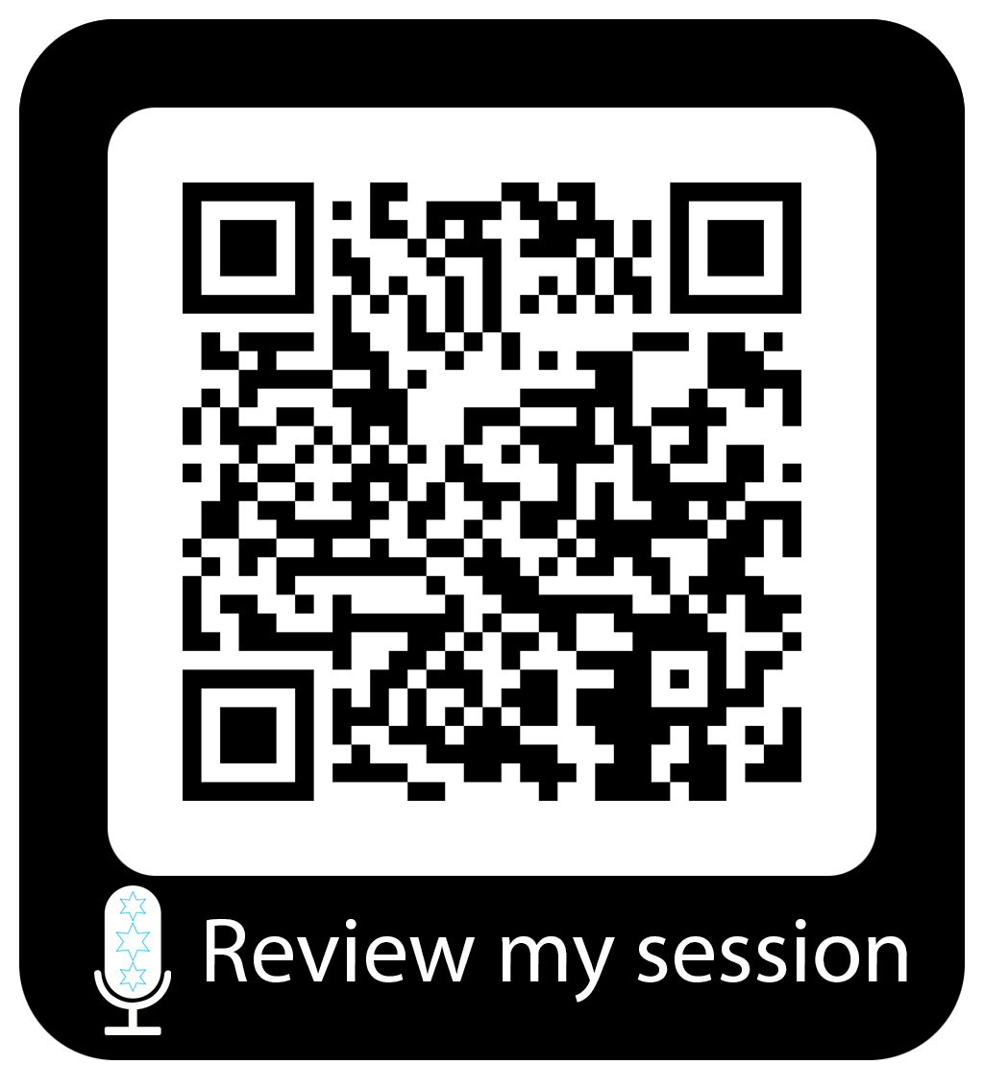
Session Feedback
Q&A

