Slide 1




Azure Data Factory, Azure Logic Apps and Power BI for everyone!!!
+
+
Regular 50 minute session Thu 10th March 17:10

Slide 2

Your Feedback
Every feedback form submitted will be entered into a draw for the attendees to win a great prize. 2. For every 10 feedback forms we receive we will donate a sapling to the National Trust https://www.nationaltrust.org.uk/features/plant-a-tree and we want to plant enough to fill an area the size of a football pitch 3. To Improve Session | QR Code URL https://sqlb.it/?6991

Slide 3



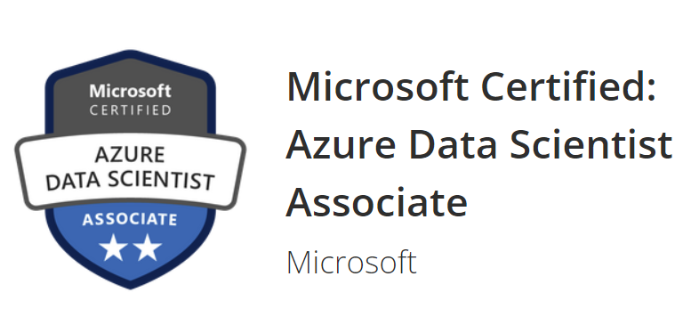

Alpa Buddhabhatti
Senion Azure Consultant @Cluster reply, UK
Speaker @ Events and Conferences
Linkedin:
https://www.linkedin.com/in/alpabuddhabhatti/
Slideshare:
Home · alpaBuddhabhatti/SQLBits2020 Wiki (github.com)
GitHub:
alpaBuddhabhatti/SQLBits2020 at ADF (github.com)

Slide 4
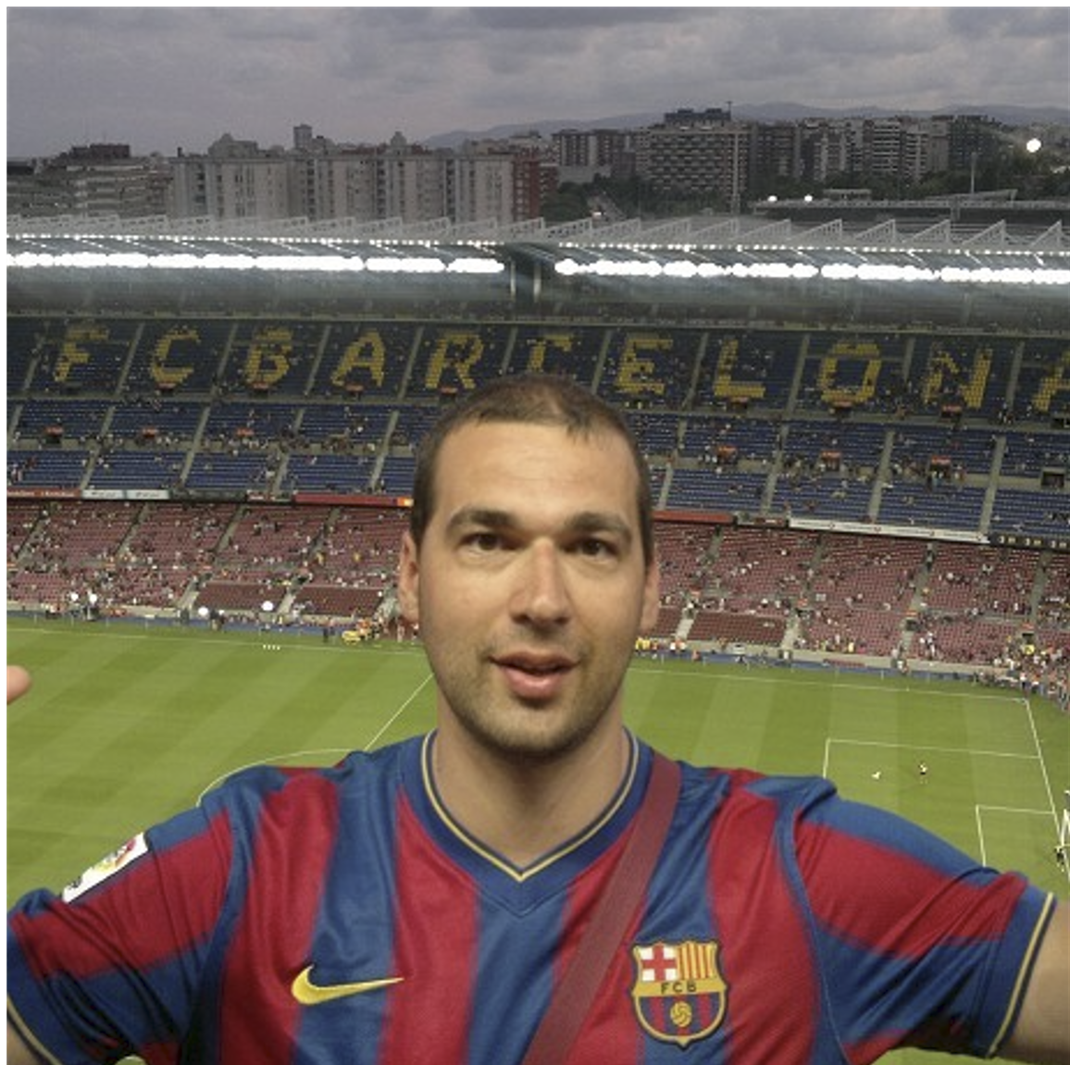




Nikola Ilic
I make music from the data!
Independent consultant and trainer
Barca fan
https://data-mozart.com
@DataMozart

Slide 5
Agenda
In this session, we will provide a basic introduction of Azure Data Factory, a scalable cloud-based data integration service and Azure Logic Apps Power BI. We will show a Demo to refresh Power BI datasets with few options such as
*ADF
*Azure Logic Apps
*Using above both options
This demo will also use the following technologies:
*Azure Key Vault
*Azure Data Factory
*Azure Logic Apps
*Azure SQL Server
*Power BI
The main goal of this session is to provide basic knowledge of ADF ,Azure Logic Apps and Power BI using Demo so attendee will leave with above technology and how to apply them in different scenarios.

Slide 6
Agenda
1. Azure Data Factory (ADF) Overview
Demo – ADF Quick Tour !!!
2. Azure Logic Apps Overview
Demo – Azure Logic Apps Tour!!!
3. Power BI Overview
Demo – Power BI!!!
4. DEMO –
Refresh Power BI Dataset using Azure Data Factory & Logic Apps

Slide 7

Azure Data Factory (ADF)

Slide 8



What is Azure Data Factory(ADF)?
A cloud-based data integration service that orchestrates and automates the movement and transformation of data

Slide 9
What is Azure Data Factory(ADF)?
Azure PaaS Service
It is Serverless
Only pay for what you have use
Low-code and no-code Solutions

Slide 10
What are Key Components of ADF?
1
Linked services
2
Datasets
3
Activities
4
Pipelines
5
Triggers

Slide 11












What can you do in ADF?
Data Movement
COPY DATA
>100
Copy activity - Azure Data Factory & Azure Synapse | Microsoft Docs

Slide 12

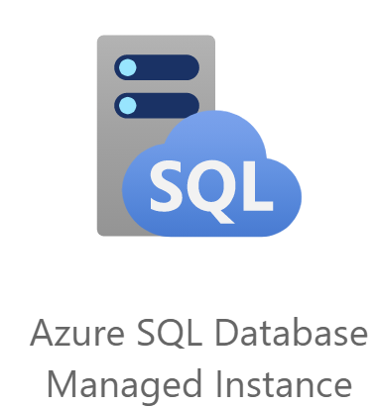
What can you do in ADF?
Data Transformation
TRANSFORMATION
~12
Source transformation in mapping data flow - Azure Data Factory & Azure Synapse | Microsoft Docs

Slide 13




What can you do in ADF?
Pipelines are JSON, ready for Source Control
Git Integration built in
Monitor
Manage

Slide 14



What can you do in ADF?
A Specific Time
File created or deleted from Blob Storage
Customer Activity such as
Trigger pipeline

Slide 15
DEMO
Lets have a Quick ADF Tour!!!
SQLBits2020/Azure Data Factory.docx at main · alpaBuddhabhatti/SQLBits2020 (github.com)

Slide 16
2. Azure Logic Apps Overview

Slide 17

What is Azure Logic Apps?
It is a cloud-based platform for creating and running automated workflows that integrate your apps, data, services, and systems
Few example:
Schedule and send email notifications
Move uploaded files from an SFTP or FTP server to Azure Storage

Slide 18
What is Azure Logic Apps?
It provides a cloud based serverless engine (hosting , Scaling , Managing , Monitoring, and Maintaining solution)
Pay for what it has used for
No code or Low code Solution
200+ connectors for expansion
Create your Custom connectors
https://docs.microsoft.com/en-us/azure/logic-apps/quickstart-create-first-logic-app-workflow

Slide 19
DEMO
Azure Logic Apps Quick Tour!!
SQLBits2020/Azure Logic Apps.docx at main · alpaBuddhabhatti/SQLBits2020 (github.com)

Slide 20
3. Power BI Overview

Slide 21
What is Power BI?
Collection of software services, apps, and connectors
Desktop vs Service
Data can be in
- Excel spreadsheets
- Cloud
- On-premises
Connect to data sources
Model the data
Enhance model with DAX
Visualize
Share and collaborate
What is Power BI? - Power BI | Microsoft Docs

Slide 22
Power BI Components
2
1
Dashboards and Apps
Sharing and collaboration
Dataflows
Power BI Desktop
Power BI Service
Windows Application
Report authoring tool
Create reports (connect to data, apply data transformations, generate new columns, create a data model)
3
Power BI mobile apps
Consume reports via mobile apps on iOS, Android, or Windows mobile devices

Slide 23

DEMO
Let’s have a Quick Power BI Tour!!!

Slide 24
4.DEMO
A Power BI imported dataset would be refreshed after populating data in Azure SQL Table
+
+

Slide 25
Problem Statements
Azure Data Factory Pipelines Or Logic Apps
Power BI Desktop Imported Dataset
Frequency of refreshing dataset more than 48 times per day
OR
Power BI Dataset should only updated when your Source data changed or Data warehouse populated
Refresh your dataset as part of Orchestration

Slide 26






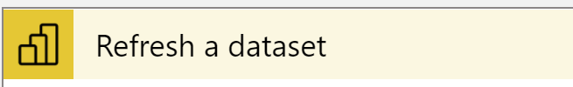
High Level Solution Design
1
2
3
4
Azure Data Factory Pipelines
Azure Logic Apps
Home · alpaBuddhabhatti/SQLBits2020 Wiki (github.com)

Slide 27
5. Tools

Slide 28
Tools
Azure Data Factory
Azure Subscription
Create your Azure free account today | Microsoft Azure
2. Power BI Desktop
powerbi.microsoft.com
Windows OS Power BI Service
3. Power BI Service
App.powerbi.com
Available with a free license
Pro license only required for some more advanced scenarios

Slide 29
Conclusion
Azure Data Factory
Cloud based Data Integration Service
Azure Platform as Services (PaaS)
Serverless
No code, Low code Solution
Operationalized, Parameterized and Orchestra pipelines and work flow
ETL or ELT
2. Azure Logic Apps
It is Azure Integration Services.( Apps, Data, Systems , service etc)
Azure Platform – as Service (PAAS)
Serverless Engine
No code, Low code Solution
Automated Workflow
3. Power BI Overview
Collection of software services, apps, and connectors
Build Model
Visualized
Share
4. Refresh Power BI dataset
Power BI Imported dataset has been refreshed just after populating Azure Sql Table during ADF pipelines.

Slide 30
Thank you !!!
Alpa Buddhabhatti
Azure Consultant, Cluster Reply https://www.linkedin.com/in/alpabuddhabhatti/
Nikola Ilic
Independent consultant and trainer
https://www.linkedin.com/in/alpabuddhabhatti/

Slide 31
Questions !!!
Alpa Buddhabhatti
Azure Consultant, Cluster Reply https://www.linkedin.com/in/alpabuddhabhatti/
Nikola Ilic
Independent consultant and trainer
https://www.linkedin.com/in/alpabuddhabhatti/

Slide 32
Your Feedback
Every feedback form submitted will be entered into a draw for the attendees to win a great prize. 2. For every 10 feedback forms we receive we will donate a sapling to the National Trust https://www.nationaltrust.org.uk/features/plant-a-tree and we want to plant enough to fill an area the size of a football pitch 3. To Improve Session | QR Code URL https://sqlb.it/?6991

Slide 33
Useful links
https://www.mssqltips.com/sqlservertip/5976/refresh-power-bi-dataset-from-azure-data-factory-part-1/
https://www.mssqltips.com/sqlservertip/5979/refresh-power-bi-dataset-using-azure-logic-apps-part-2/#:~:text=Debug%20the%20ADF%20pipeline%20to%20trigger%20the%20Logic,on%20the%20ellipsis%20to%20go%20to%20its%20settings.
https://www.moderndata.ai/2019/05/powerbi-dataset-refresh-using-adf/
https://www.moderndata.ai/2019/05/powerbi-dataset-refresh-using-adf/
https://datasavvy.me/2020/07/09/refreshing-a-power-bi-dataset-in-azure-data-factory/

