Slide 1


Azure Machine Learning for everyone
Regular 20 minute session Sat 12th March 15:30

Slide 2
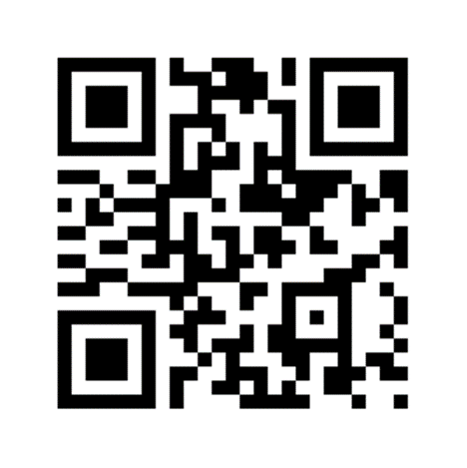
Your Feedback
Every feedback form submitted will be entered into a draw for the attendees to win a great prize. 2. For every 10 feedback forms we receive we will donate a sapling to the National Trust https://www.nationaltrust.org.uk/features/plant-a-tree and we want to plant enough to fill an area the size of a football pitch 3. To Improve Session
https://sqlb.it/?6984

Slide 3

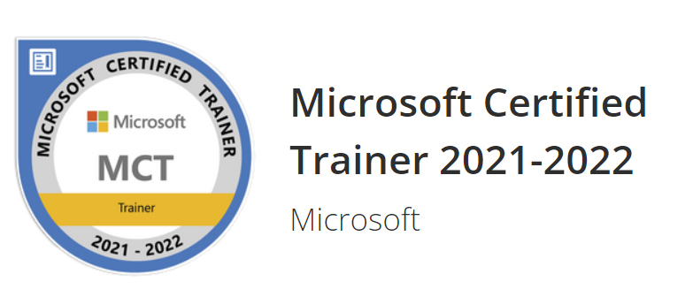

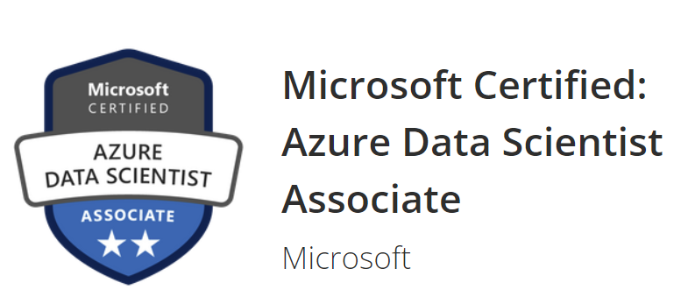

Alpa Buddhabhatti
Senior Azure Consultant @Cluster reply, UK
Speaker @ Events and Conferences
Linkedin:
https://www.linkedin.com/in/alpabuddhabhatti/
Slideshare:
Home · alpaBuddhabhatti/SQLBits2020 Wiki (github.com)
GitHub:
alpaBuddhabhatti/SQLBits2020 at ADF (github.com)

Slide 4
Abstract
This session shows step by step Demo for how to use Azure Machine learning studio with data and create a Machine Learning system without any prior knowledge of Machine Learning , Data Science, Maths and programming languages. Also, It explains, basic key terms related to Azure ML, Data science and Algorithms. I also show a demo to predicted a user get Loan or not. This demo will also use the following technologies: *Azure Blob Storage *Azure Machine Learning Studio The Key takeaway is that attendees will get ideas about the skills and knowledge required to recognize an opportunity for a machine learning application and seize it. Also attendee gets to know well about Azure Machine Leaning. Feedback link https://sqlb.it/?6984
Room 09

Slide 5
Agenda
Machine learning and Azure Machine Learning
What is Machine Learning (ML)?
What is Azure Machine Learning (ML)?
Why we need Azure Machine Learning (ML)
Steps to create Machine Learning Model
Azure Machine Learning Designer Tour!!!
2. DEMO
Azure ML Studio – Using a classification models to predict approval of loans
Test a Machine Learning Model using Postman
Consume a Machine Learning Model using Azure Data Factory

Slide 6
Machine Learning

Slide 7
What is Machine Learning?
A Computer Program/system that can learn from
“Experience”
It finds pattern from experience and able to make predictions about the future.
Without being explicitly programmed or told to do
Data or Examples

Slide 8
What is Azure Machine Learning ?
It is a cloud-based service for creating and managing Machine Learning solutions

Slide 9
Why Azure Machine Learning?
PAAS Service
No Code, Low code, Code First
In Built – Algorithms
Speed up Data science process
Deployment

Slide 10
Steps to create Machine Learning Model
Data Processing
Feature Selection
Split Data
Train Model
Score Model
Evaluate Model

Slide 11
2. DEMO

Slide 12
DEMO -
Approval for a loan using Machine Learning Designer

Slide 13
DEMO -
Consume a Machine Learning Model using Azure Data Factory

Slide 14
DEMO -
Test a Machine Learning Model Using Postman

Slide 15
Conclusion
Azure Machine Learning
Steps to create a Machine Learning model
Approval for a loan using AML studio
Test Machine Learning Endpoint using Postman
Consume Machine Learning Endpoint using Azure Data Factory

Slide 16
Thank you
Alpa Buddhabhatti
Azure Consultant, Cluster Reply https://www.linkedin.com/in/alpabuddhabhatti/
https://sqlb.it/?6984
Every feedback form submitted will be entered into a draw for the attendees to win a great prize.
2. For every 10 feedback forms we receive we will donate a sapling to the National Trust https://www.nationaltrust.org.uk/features/plant-a-tree and we want to plant enough to fill an area the size of a football pitch
3. To Improve Session

Slide 17

Questions !!!
Alpa Buddhabhatti
Azure Consultant, Cluster Reply https://www.linkedin.com/in/alpabuddhabhatti/
https://sqlb.it/?6984
Every feedback form submitted will be entered into a draw for the attendees to win a great prize.
2. For every 10 feedback forms we receive we will donate a sapling to the National Trust https://www.nationaltrust.org.uk/features/plant-a-tree and we want to plant enough to fill an area the size of a football pitch
3. To Improve Session

Slide 18
Useful links

