Slide 1

alpaka Parallel Programming Library
Plasma-PEPSC alpaka and OpenPMD Workshop
23 October 2024
Notes:
Hello everyone. Thank you for participating. In this presentation I will initially introduce alpaka generally. Then I will go over an alpaka program and explain it step by step. Lastly I will talk about performance and participants of alpaka.

Slide 2
Section - I
Introduction: What is alpaka, where it is used?
Hands on 1: Installing alpaka and running an example (LUMI)
Parallel programming concepts and portable parallelization by alpaka
  Grid Structure and WorkDivision
  Data Parallelism
  Indexing
Hands on 2: HelloIndex kernel which prints indexes
Section – II
Memory management for 1D and 2D data
Filling buffers in parallel
Hands on 3: Kernel to fill initial conditions of heat equation
Heat Equation
Preparing stencil kernel
Hands on 4: Heat Equation stencil kernel
Programming features and data-structures of alpaka
Usability and Optimization
  Using alpaka mdspan for easier indexing
    Hands on 5
  Domain Decomposition
    Hands on 6 (Day2)
  Using async queues for performance increase
    Hands on 7 (Day2)
  Using shared memory for performance increase
    Hands on 8 (Day2)
Notes:
If we just go over the list of top HPC systems, we can see that hardware ecosystem is quite heterogenous.
The first one in the list, Frontier in USA is using AMD GPUs, Aurora is using Intel GPUs, the third one Eagle is using Nvidia GPUs, Fugaku is using CPUs which are actually CPUs with ARM architecture and Lumi in Finland is using AMD GPUs.
And these different vendors propose different programming APIs. Even they are using different colors in their logos and publications.

Slide 3
alpaka – Abstraction Library for Parallel Kernel Acceleration
alpaka is…
A parallel programming library: Accelerate your code by exploiting your hardware‘s parallelism!
An abstraction library independent of hardware ecosystem: Create portable code that runs on CPUs and GPUs!
Open-source software & open-development
Notes:
Alpaka is a parallel programming library. You ca accelerate your code by exploiting your hardware’s paralelism. It is an abstraction library independent of hardware ecosystem.
With alpaka you can create create portable code which runs on different GPUs, and on CPUs.
Alpaka is free and open-source.
And lastly it is yet another library using an animal as logo.

Slide 4
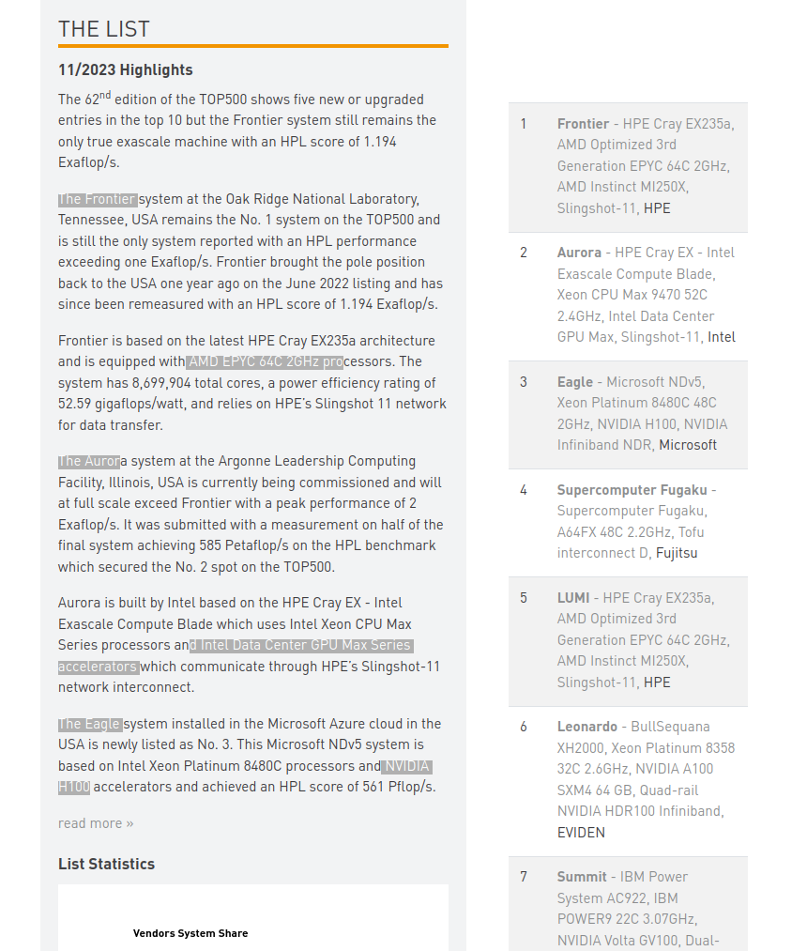
www.top500.org
Problem of HPC Systems?
Heterogenous Hardware Ecosystem!
TOP500
Frontier(USA) 1.194 Exaflop/s,
AMD EPYC CPU + AMD Instict GPU
Aurora(USA) 585 Petaflop/s,
Intel Xeon CPU + Intel GPU Max
Eagle(USA) 561 Petaflop/s,
Intel Xeon CPU + Nvidia GPU H100
Fugaku(Japan) 442 Petaflop/s,
Fujitsu A64FX CPU
Lumi(Finland) 380 Petaflop/s,
AMD EPYC CPU + AMD Instinct GPU
Notes:
If we just go over the list of top HPC systems, we can see that hardware ecosystem is quite heterogenous.
The first one in the list, Frontier in USA is using AMD GPUs, Aurora is using Intel GPUs, the third one Eagle is using Nvidia GPUs, Fugaku is using CPUs which are actually CPUs with ARM architecture and Lumi in Finland is using AMD GPUs.
And these different vendors propose different programming APIs. Even they are using different colors in their logos and publications.

Slide 5
Without alpaka
Hardware ecosystem is heterogenous, platforms are not inter-operable → parallel programs not easily portable
alpaka: single API to rule them all
Abstraction (not hiding!) of the underlying hardware, compiler and OS
  No default device, built-in functions, language extentions
Easy change of the backend in code
Direct usage of vendor APIs
  GPU Backends: Hip (AMD), Cuda (NVidia), SYCL (Intel GPUs)
  One can use vendor profilers and debuggers (Cuda,HIP…) for alpaka code!
  CPU Backends: OpenMp, Threads, TbbBlocks
Zero abstraction overhead for Kernel execution!
Heterogenous Programming: Using different backends in a synchronized manner.
User
alpaka
CPU
GPU

Slide 6
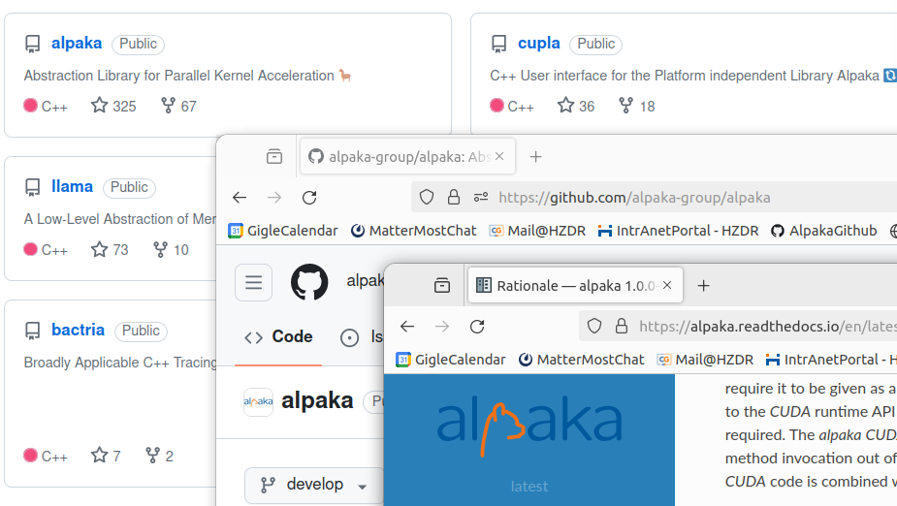

Find us on GitHub!
alpaka library: https://www.github.com/alpaka-group/alpaka
  Full source code and many examples, Issue tracker
The documents: https://alpaka.readthedocs.io/en/latest/
  Installation guide
  Cheatsheet
  Abstraction model and the rationale behind alpaka
Project group: https://www.github.com/alpaka-group
  Contains all alpaka-related projects such as vikunja, cupla ...
PLASMA-PEPSC Workshop Presentations and Hands-ons:
  https://github.com/alpaka-group/alpaka-workshop-slides/tree/oct2024_workshop
alpaka is a free software (MPL 2.0)
Notes:
// text cupla easy porting from cuda, vikunja is for high level algorithms
Find us on GitHub!
alpaka library: https://www.github.com/alpaka-group/alpaka
Full source code and many examples, Issue tracker
The documents: https://alpaka.readthedocs.io/en/latest/
Installation guide
Cheatsheet
Abstraction model and the rationale behind alpaka
Project group: https://www.github.com/alpaka-group
Contains all alpaka-related projects, documentation, samples, …
alpaka is a free software (MPL 2.0)

Slide 7

Programming with alpaka
C++ only!
alpaka is written entirely in C++17 and C++20.
Header-only library. No additional runtime dependency.
#include <alpaka/alpaka.hpp> is enough!
Supports a wide range of modern C++ compilers (g++, clang++, Apple LLVM, MSVC)
Portable across operating systems: Linux, macOS, Windows

Slide 8
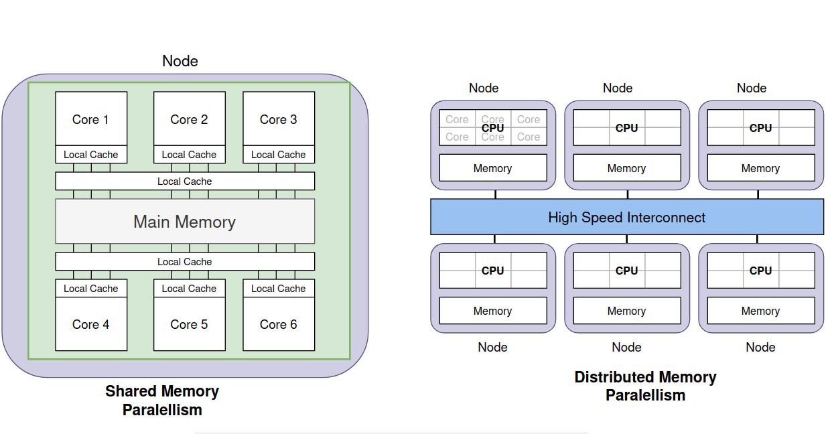
Alpaka uses Shared-Memory Paralelism (Node-level parallelism)

Slide 9
Alpaka uses Shared-Memory Paralelism (Node-level parallelism)
Distributed Memory Parallelism
MPI (Message Passing Interface)
Node-Level
Parallelism
HIP
Cuda
OpenMP
SYCL
Tbb
….

Slide 10
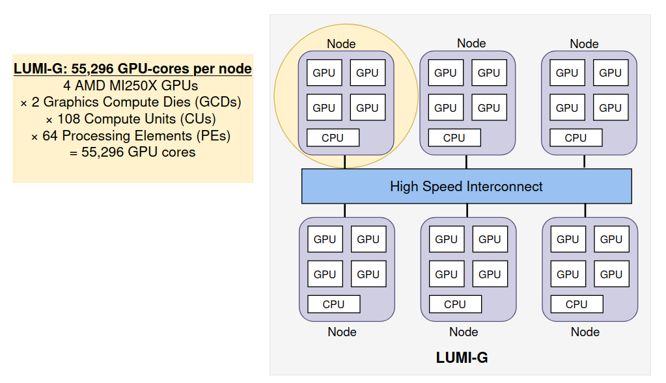
Node-Level Parallelism on LUMI Supercomputer

Slide 11
Node-Level Parallelism on LUMI Supercomputer
Node-Level Parallelism
Alpaka

Slide 12
Distributed Memory Parallelism
MPI (Message Passing Interface)
Full Parallelism on LUMI Supercomputer!
Node-Level Parallelism
Alpaka

Slide 13
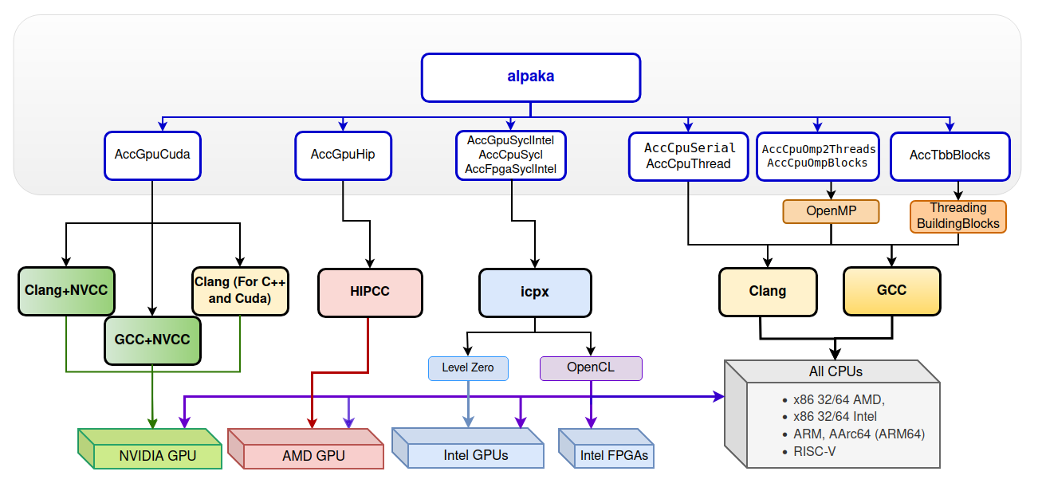
Alpaka abstraction tree
October, 2024
Notes:
// text cupla easy porting from cuda, vikunja is for high level algorithms
Find us on GitHub!
alpaka library: https://www.github.com/alpaka-group/alpaka
Full source code and many examples, Issue tracker
The documents: https://alpaka.readthedocs.io/en/latest/
Installation guide
Cheatsheet
Abstraction model and the rationale behind alpaka
Project group: https://www.github.com/alpaka-group
Contains all alpaka-related projects, documentation, samples, …
alpaka is a free software (MPL 2.0)

Slide 14






Profiling and Debugging Alpaka Code
Vendor tools can be used on Alpaka applications!
Because alpaka builds down to same machine-code as the vendor solutions.
- Perfomance Analzers: Timeline of events, system-wide analysis, bottleneck detection for softwares
- Pofilers: Analysis of memory usage, instruction statistics, kernel execution times threading, vectorization.
- Sanitizers: Detect the memory issues, data races, threading issues at runtime. Integer overflow, memory leak etc are typical errors found by sanitizers
- Debuggers: Interactive developer tools to debug.
HIP Tools: Rocprof, Omniperf, Omnitrace, AMD uProf, Rocgdb ...
SYCL Tools: Intel VTune Profiler, Intel Advisor, Inspector debugger ...
Cuda Tools: Nsight Systems, Nsight Compute, Cuda-gdb ...
Notes:
// text cupla easy porting from cuda, vikunja is for high level algorithms
Find us on GitHub!
alpaka library: https://www.github.com/alpaka-group/alpaka
Full source code and many examples, Issue tracker
The documents: https://alpaka.readthedocs.io/en/latest/
Installation guide
Cheatsheet
Abstraction model and the rationale behind alpaka
Project group: https://www.github.com/alpaka-group
Contains all alpaka-related projects, documentation, samples, …
alpaka is a free software (MPL 2.0)

Slide 15
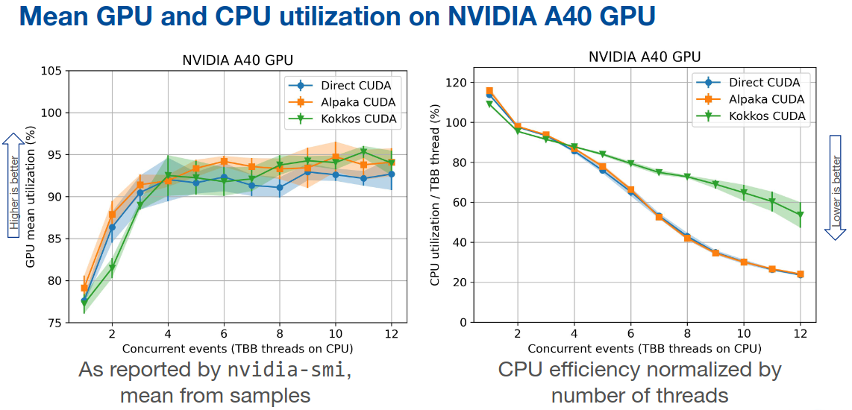
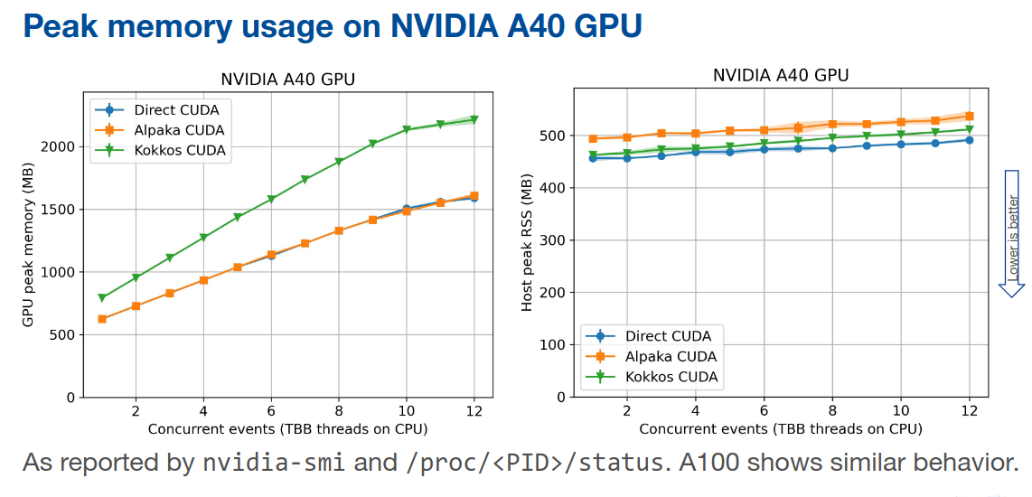




Performance of Alpaka
Source:
https://indico.jlab.org/event/459/contributions/11824/attachments/9281/14171/20230511-CHEaP23_CMSPortability.pdf

Slide 16
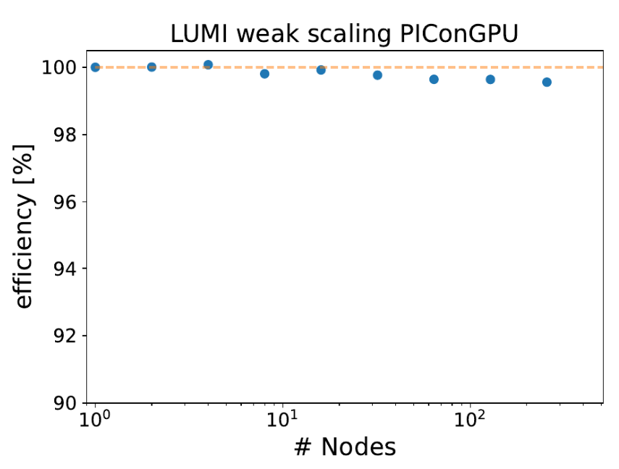
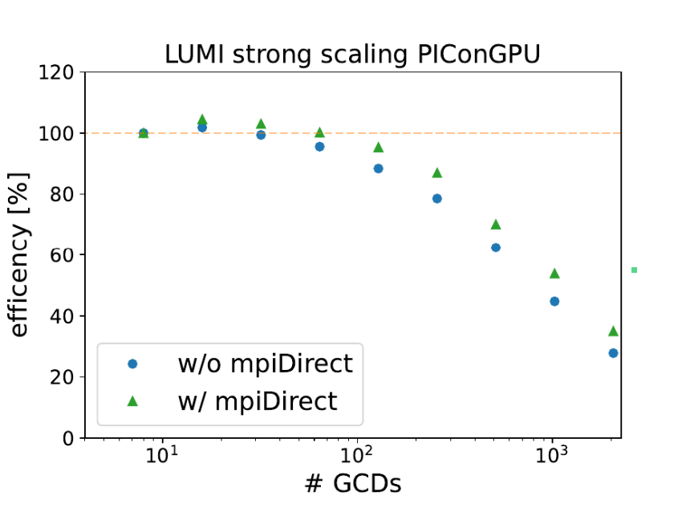

alpaka in the wild...
PIConGPU:
Fully relativistic, manycore, 3D3V particle-in-cell (PIC) code
Implements central algorithms in plasma physics
Scalable to more than 18,000 GPUs
Developed at Helmholtz-Zentrum Dresden-Rossendorf
https://github.com/ComputationalRadiationPhysics/picongpu

Slide 17




Community and Long Term Support
Partners using and contributing to alpaka
alpaka is a part of Strategic Helmholtz Program-Oriented Funding Roadmap 2027-2034

Slide 18
As a summary
Without alpaka
In HPC world, Multiple hardware types are available from different vendors (CPUs, GPUs, …)
Platforms are not inter-operable → parallel programs are not easily portable
alpaka: one API to rule them all
Abstraction (not hiding!) of the underlying hardware & software platforms
  AMD, Nvidia, Intel GPUs, Different CPU parallelisations like TbbBlocks, OpenMP, Threads
Easy change of the backend in Code
Builts down to the same machine code with the vendor solutions
Zero abstraction overhead for Kernel execution!
Heterogenous Programming: Using different backends in a synchronized manner
User
alpaka
CPU
GPU

Slide 19
If you use alpaka for your research, please cite one of the following publications:
Matthes A., Widera R., Zenker E., Worpitz B., Huebl A., Bussmann M. (2017): Tuning and Optimization for a Variety of Many-Core Architectures Without Changing a Single Line of Implementation Code Using the alpaka Library. In: Kunkel J., Yokota R., Taufer M., Shalf J. (eds) High Performance Computing. ISC High Performance 2017. Lecture Notes in Computer Science, vol 10524. Springer, Cham, DOI: 10.1007/978-3-319-67630-2_36.
E. Zenker et al., “alpaka – An Abstraction Library for Parallel Kernel Acceleration”, 2016 IEEE International Parallel and Distributed Processing Symposium Workshops (IPDPSW), Chicago, IL, 2016, pp. 631 – 640, DOI: 10.1109/IPDPSW.2016.50.
Worpitz, B. (2015, September 28). Investigating performance portability of a highly scalable particle-in-cell simulation code on various multi-core architectures. Zenodo. DOI: 10.5281/zenodo.49768.
Thank you!
You can contact us for any of your questions about alpaka!

Slide 20
Repositories of the Workshop
  Hands-on Exercises
  Presentations
alpaka Documentation:
  Main Page: https://alpaka.readthedocs.io/en/latest/index.html
  Installation Guide
  Cheat Sheet
  CMake Variables
  API Docs
Webinar May 2024
  Webinar Slides (pdf)
Links

Slide 21
Section - I
Introduction: What is alpaka, where it is used?
Hands on 1: Installing alpaka and running an example (LUMI)
Parallel programming concepts and portable parallelization by alpaka
  Grid Structure and WorkDivision
  Data Parallelism
  Indexing
Hands on 2: HelloIndex kernel which prints indexes
Section – II
Memory management for 1D and 2D data
Filling buffers in parallel
Hands on 3: Kernel to fill initial conditions of heat equation
Heat Equation
Preparing stencil kernel
Hands on 4: Heat Equation stencil kernel
Programming features and data-structures of alpaka
Usability and Optimization
  Using alpaka mdspan for easier indexing
    Hands on 5
  Domain Decomposition
    Hands on 6 (Day2)
  Using async queues for performance increase
    Hands on 7 (Day2)
  Using shared memory for performance increase
    Hands on 8 (Day2)
Notes:
If we just go over the list of top HPC systems, we can see that hardware ecosystem is quite heterogenous.
The first one in the list, Frontier in USA is using AMD GPUs, Aurora is using Intel GPUs, the third one Eagle is using Nvidia GPUs, Fugaku is using CPUs which are actually CPUs with ARM architecture and Lumi in Finland is using AMD GPUs.
And these different vendors propose different programming APIs. Even they are using different colors in their logos and publications.

Slide 22
Hands-on Session
Hands-On Session1: Install alpaka and run VectorAdd example

Slide 23
Parallel Programming Concepts and
Portable Parallelization by alpaka

Slide 24
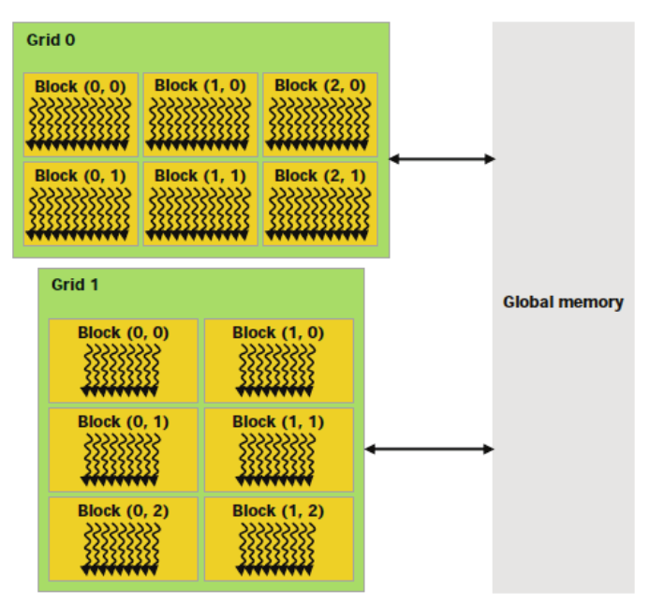
Thread Parallel Programming depends on Grid hierarchy
GPU
• In Parallel Programming, kernels are executed on a "grid" of multiple threads that run on a GPU
• 1D, 2D, and 3D grids are supported
• Each dimension of the grid is partitioned into equal sized "blocks" of threads
• Each block is made up of multiple "threads"
• The threads are the things that do the work.

Slide 25
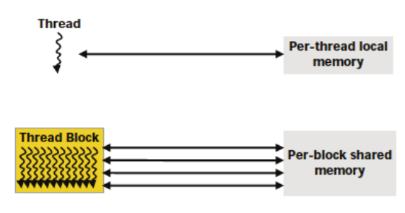
Thread Parallel Programming depends on Grid hierarchy
GPU
• In Parallel Programming, kernels are executed on a "grid" of multiple threads that run on a GPU
• 1D, 2D, and 3D grids are supported
• Each dimension of the grid is partitioned into equal sized "blocks" of threads
• Each block is made up of multiple "threads"
• The threads are the things that do the work.

Slide 26
GPU
The architecture of a GPU
Threads are distributed among CUs
(Compute Units or Streaming MultiProcessors)
Main determinants of mapping threads to the CUs:
  Number of cores per CU,
  Shared memory usage of each thread,
  Register and local memory (lm) usage of each thread,
  Limits on Threads per CU
  Memory latencies
  Memory sizes
Threads
T0
CU0
CU1
T1
C0
C0
C1
C0
C1
T2
C0
C2
C3
C0
C2
C2
C3
T3
Shared Mem(L1)
Shared Mem(L1)
T4
CU2
CU4
T5
C0
C1
C0
C1
...
CPU
Host
C2
C3
C2
C3
...
...
Shared Mem(L1)
Shared Mem(L1)
Tn
Global Memory (GDDR or HBM)
Constant Memory (Read Only)

Slide 27
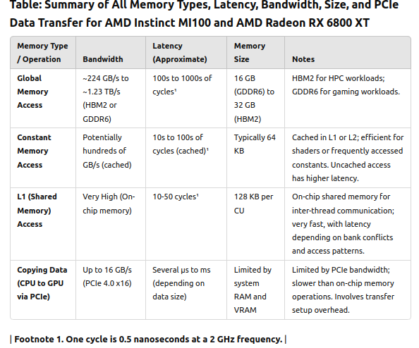
GPU
Threads
T0
CU0
CU1
T1
C0
C0
C1
C0
C1
T2
C0
C2
C3
C0
C2
C2
C3
T3
Shared Mem(L1)
Shared Mem(L1)
T4
CU2
CU4
T5
C0
C0
C1
C0
C1
...
CPU
Host
C2
C3
C2
C3
...
...
Shared Mem(L1)
Shared Mem(L1)
Tn
Global Memory (GDDR or HBM)
Constant Memory (Read Only)

Slide 28
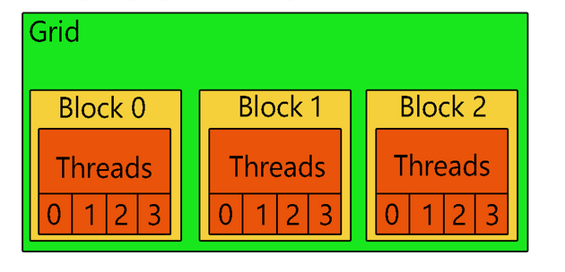
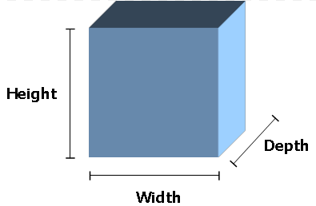
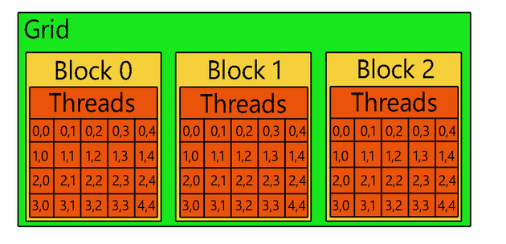
Thread-Parallel Programming Terminology
Indexing of threads. Each thread has an index accessible in kernel.
In other words kernel implicitly knows the index of thread which runs it.
Dimensions: Set of dimension names. {Z-dimension, Y-dimension, X-dimension}
Extent: A vector representing the sizes along dimensions.
In 3D {Depth,Height, Width}. The order is important.
Grid-Block Extent: {3}
Block-Thread Extent: {4}
Alpaka | HIP (AMD) | SYCL (Intel) | Cuda (NVIDIA)
Grid | Grid | NDRange/Range | Grid
Block | Workgroup | Workgroup | Block
Warp | Wavefront | Subgroup | Warp
Thread | Work-item | Work-item | Thread
Grid-Block Extent: {1,3}
Block-Thread Extent: {4,5}

Slide 29

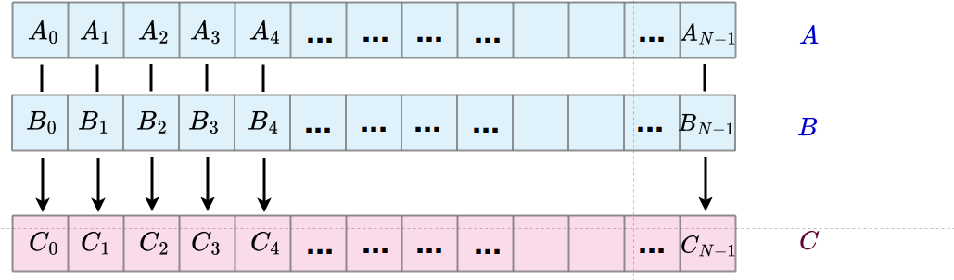
How to paralelize Vector addition problem

Slide 30
How to paralelize Vector addition problem

Slide 31
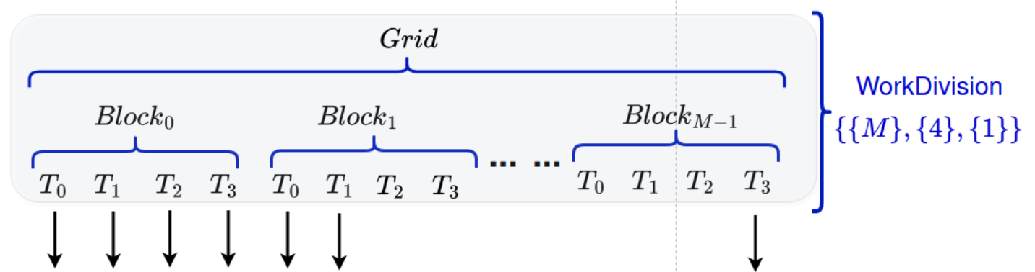
What is work division in alpaka?

Slide 32
1D Grid with 1D Blocks
WorkDivision in Alpaka has 3 vectors
1D WorkDivision
- Grid-Block Extent 1D vector = {M}
- Block-Thread Extent 1D vector {4u}
- Thread-Elem Extent 1D vector = {1u}
1D WorkDivision {{M}, {4u}, {1u}}
Block0
Block1
BlockM-1
T0
T0
T0
T1
T1
…..
T1
T2
T2
T2
T3
T3
T3
Block0,0
Block0,1
2D Grid with 2D Blocks
Block0,1
Block0,1
Block0,2
Block0,M-1
T0,0
T0,0
T0,1
2D WorkDivision
- Grid-Block Extent 2D vector = {M,M}
- Block-Thread Extent 2D vector = {2u,2u}
- Thread-Elem Extent 2D vector = {1u,1u}
2D WorkDivision {{M,M}, {2u,2u}, {1u,1u}}
T0,1
0,0
0,1
…..
0,0
0,1
0,0
0,1
0,0
0,1
T1,0
T1,0
T1,1
T1,1
1,0
1,1
…..
1,0
1,1
1,0
1,1
1,0
1,1
…..
…..
…..
…..
…..
…..
BlockM-1,1
BlockM-1,M-1
0,0
0,1
…..
0,0
0,1
……..
…..
1,0
1,1
1,0
1,1

Slide 33
Sequentiential and Parallel Vector Sums
// Sequential Code for CPU
std::vector<int> A = {...};
std::vector<int> B = {...};
std::vector<int> C; C.resize(N);
for (int i = 0; i < N; ++i) {
C[i] = A[i] + B[i];
}
// DEFINE THE KERNEL
auto addKernel = [ ] ALPAKA_FN_ACC (TAcc const& acc,
int * A, int* B, int* C, unsigned const& N) -> void
{
// Get the thread index
auto const threadIdx = alpaka::getIdx<alpaka::Grid, alpaka::Thread> (acc)[0];
C[threadIdx] = A[threadIdx] + B[threadIdx];
} ;
// CALL THE KERNEL
// first find workdiv
auto const workDiv = alpaka::getValidWorkDiv(kernelCfg, devAcc, addKernel, ptrA, ptrB, ptrC, N);
// define Acc
using Acc = alpaka::AccGpuHipRt<Dim, Idx>;
// call kernel
alpaka::exec<Acc>(queue, workDiv, addKernel, ptrA, ptrB, ptrC, N );
// Parallel Code for CPU: OpenMP
std::vector<int> A = {...};
std::vector<int> B = {….};
std::vector<int> C; C.resize(N);
#pragma omp parallel for
for (int i = 0; i < N; ++i) {
C[i] = A[i] + B[i];
}

Slide 34
function object as kernel
struct HelloWorldKernel {
template <typename Acc>
ALPAKA_FN_ACC void operator()(Acc const & acc) const {
uint32_t threadIdx = alpaka::getIdx<Grid, Threads>(acc)[0];
printf("Hello, World from alpaka thread %u!\n", threadIdx);
}
};
using Acc = acc::AccGpuHipRt<Dim, Idx>;
HelloWorldKernel helloWorlKernel;
alpaka::exec<Acc>(queue, workDiv, helloWorlKernel);
alpaka Kernel and thread indices
Kernel is run by each thread
Can be thought as “code inside a hypothetical parallel for loop where indices are magically provided”
Kernel can acces to the thread index currently running the kernel
Usually thread indexes are used to access to the specific part of the data
Arguments can be pointers and trivially copyable types
Returns void
Has an argument of type Accelerator
Function object as kernel
Select backend type
Execute kernel in Grid
lambda function as kernel
auto kernelLambda = [] ALPAKA_FN_ACC(Acc const& acc, size_t const nExclamationMarksAsArg) -> void
{
auto globalThreadIdx = alpaka::getIdx<alpaka::Grid, alpaka::Threads>(acc);
auto globalThreadExtent = alpaka::getWorkDiv<alpaka::Grid, alpaka::Threads>(acc);
auto linearizedGlobalThreadIdx = alpaka::mapIdx<1u>(globalThreadIdx, globalThreadExtent);
printf(
"[y:%u, x:%u][linear:%u] Hello world from a lambda",
static_cast<unsigned>(globalThreadIdx[0]),
static_cast<unsigned>(globalThreadIdx[1]),
static_cast<unsigned>(linearizedGlobalThreadIdx[0]));
for(size_t i = 0; i < nExclamationMarksAsArg; ++i)
{ printf("!"); }
};
using Acc = acc::AccGpuHipRt<Dim, Idx>;
alpaka::exec<Acc>(queue, workDiv, kernelLambda, nExclamationMarks);
Lambda as kernel
Select backend type
Execute kernel in Grid

Slide 35
Getting thread index in Kernel
1D Grid with 1D Blocks
Block0
Block1
BlockM-1
T0
T1
T2
T3
T0
T1
T2
T3
...
T0
T1
T2
T3
  Index of Thread on the Grid:
  auto gridThreadIndex = alpaka::getIdx<alpaka::Grid, alpaka::Threads>(acc);
  // gridThreadIndex is {7}, alpaka::Grid and alpaka::Threads are alpaka defined types
  Index of Thread on a Block:
  auto theradBlockIndex = alpaka::getIdx<alpaka::Block, alpaka::Threads>(acc);
  // threadBlockIndex is {3}, alpaka::Block is an alpaka type
  Index of Block on the Grid:
  auto blockGridIndex = alpaka::getIdx<alpaka::Grid, alpaka::Blocks>(acc);
  // the blockGridIndex is {1}
Obtaining
the indices of threads
// Hip or Cuda way 4 * 1 + 3
int threadIdx = blockIdx.x * blockDim.x + threadIdx.x;

Slide 36
Getting the extents
1D Grid with 1D Blocks
Block0
Block1
BlockM-1
T0
T1
T2
T3
T0
T1
T2
T3
...
T0
T1
T2
T3
  Extents of Grid in number of threads:
  auto gridThreadExtent = workdiv::getWorkDiv<alpaka::Grid, alpaka::Threads>(acc);
  // gridThreadExtent is {M*4}, alpaka::Grid and alpaka::Threads are alpaka defined types
  Extents of Block in number of threads:
  auto blockThreadExtent = alpaka::getWorkDiv<alpaka::Block, alpaka::Threads>(acc);
  // blockThreadExtent is {4}
  Extents of Grid in number of blocks:
  auto gridBlockExtent = alpaka::getWorkDiv<alpaka::Grid, alpaka::Blocks>(acc);
  // gridBlockExtent is {M}
Obtaining
the extents of grids and blocks

Slide 37
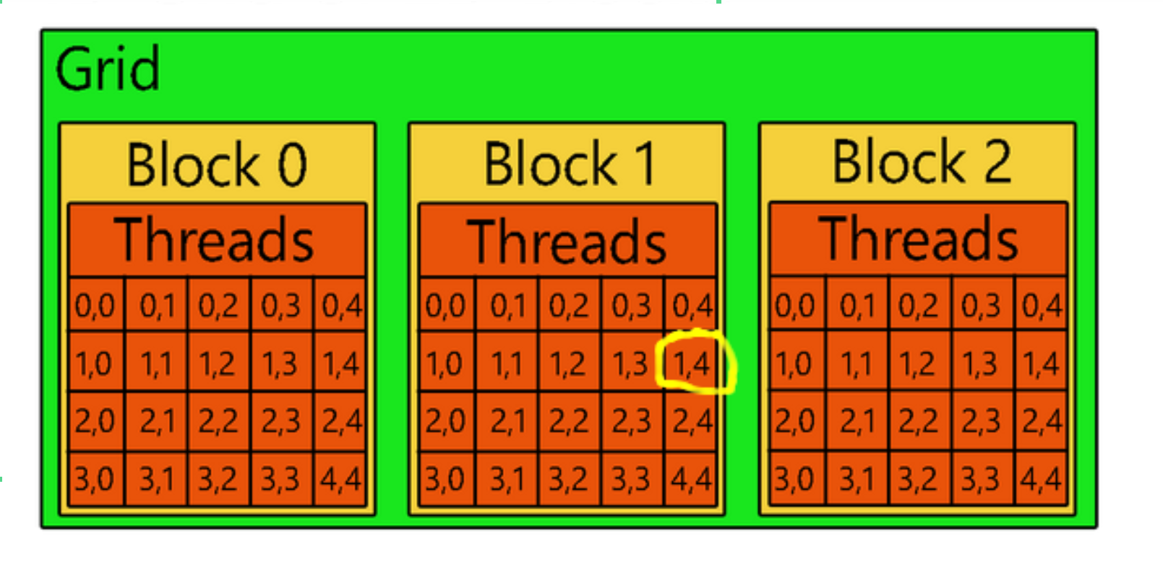
Getting Thread Index in Kernel
  Index of Thread on the Grid:
  auto gridThreadIndex = alpaka::getIdx<alpaka::Grid, alpaka::Threads>(acc);
  // gridThreadIndex is {1,9}
  Index of Thread on a Block:
  auto threadBlockIndex = alpaka::getIdx<alpaka::Block, alpaka::Threads>(acc);
  // threadBlockIndex is {1,4}
  Index of Block on the Grid:
  auto blockGridIndex = alpaka::getIdx<alpaka::Grid, alpaka::Blocks>(acc);
  // the blockGridIndex is {0,1}
Obtaining
the indices of threads

Slide 38
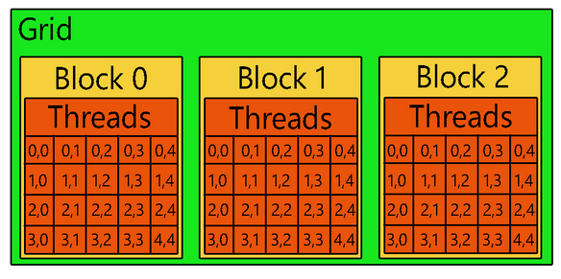
Obtaining
the extents of grids and blocks
  Extents of Grid in terms of threads:
  auto gridThreadExtent = workdiv::getWorkDiv<alpaka::Grid, alpaka::Threads>(acc);
  // gridThreadExtent is {4,15}, alpaka::Grid and alpaka::Threads are alpaka defined types
  Extents of Block in terms of threads:
  auto blockThreadExtent = alpaka::getWorkDiv<alpaka::Block, alpaka::Threads>(acc);
  // blockThreadExtent is {4,5}
  Extents of Grid in terms of blocks:
  auto gridBlockExtent = alpaka::getWorkDiv<alpaka::Grid, alpaka::Blocks>(acc);
  // gridBlockExtent is {1,3}

Slide 39
Alpaka Kernel
class VectorAddKernel
{ public:
template<typename TAcc>
ALPAKA_FN_ACC auto operator()( TAcc const& acc, // the accelerator
int * A, int* B, int* C, unsigned const& N) const -> void
{ // Get the thread index
auto const threadIdx = alpaka::getIdx<alpaka::Grid, alpaka::Thread>(acc)[0];
C[threadIdx] = A[threadIdx] + B[threadIdx];
} };
1D Blocks in 1D Grid (Multi Thread Acc)
Block0
Block1
BlockM-1
...
T0
T1
T2
T3
T0
T1
T2
T3
...
T0
T1
T2
T3
Thread Index in Grid ( GPU or CPU)
T0
T1
T2
T3
T4
T5
T6
T7
… ...
TN-1
Alpaka Kernel Call
auto const workDiv = alpaka::WorkDivMembers<Dim, Idx>({M}, {4}, {1});
// Launch the vector addition kernel
VectorAddKernel vectorAddKernel;
alpaka::exec<Acc>(queue, workDiv, vectorAddKernel, bufA, bufB, bufC);
A0
A1
A2
A3
A4
A5
A6
A7
… ...
AN-1
+
+
+
+
B0
B1
B2
B3
B4
B5
B6
B7
… ...
BN-1

Slide 40
Should I change work-division in code if I change the accelerator?
A Multi Thread Accelerator
A Single Thread Accelerator
Block0
Block1
BlockM-1
Block0
Block1
Block2
Block3
BlockN-1
...
T0
T1
T2
T3
T0
T1
T2
T3
...
T0
T1
T2
T3
T0
T0
T0
T0
...
...
T0
auto const workDiv = alpaka::WorkDivMembers<Dim, Idx>({M}, {4}, {1});
auto const workDiv = alpaka::WorkDivMembers<Dim, Idx>({N}, {1}, {1});
Thread Index in Grid ( GPU or CPU)
T0
T1
T2
T3
T4
T5
T6
T7
… ...
TN-1

Slide 41
Should I change work-division in code if I change the accelerator?
A Multi Thread Accelerator
A Single Thread Accelerator
Block0
Block1
BlockM-1
Block0
Block1
Block2
Block3
BlockN-1
...
T0
T1
T2
T3
T0
T1
T2
T3
...
T0
T1
T2
T3
T0
T0
T0
T0
...
...
T0
auto const workDiv = alpaka::WorkDivMembers<Dim, Idx>({M}, {4}, {1});
auto const workDiv = alpaka::WorkDivMembers<Dim, Idx>({N}, {1}, {1});
Alpaka Kernel
class VectorAddKernel
{ public:
template<typename TAcc>
ALPAKA_FN_ACC auto operator()( TAcc const& acc, // the accelerator
int * A, int* B, int* C, unsigned const& N) const -> void
{ // Get the thread index, only first element of the vector needed since we are in 1D
auto const threadIdx = alpaka::getIdx<alpaka::Grid, alpaka::Thread>(acc)[0];
C[threadIdx] = A[threadIdx] + B[threadIdx];
} };
Thread Index in Grid ( GPU or CPU)
T0
T1
T2
T3
T4
T5
T6
T7
… ...
TN-1
Alpaka Kernel Call
// since accelerator can be a CPU or GPU don’t use constant workDiv
auto workDiv = ?
// Launch the vector addition kernel
VectorAddKernel vectorAddKernel;
alpaka::exec<Acc>(queue, workDiv, vectorAddKernel, bufA, bufB, bufC);

Slide 42
Should I change work-division in code if I change the backend?
A Multi Thread Accelerator
A Single Thread Accelerator
Block0
Block1
BlockM-1
Block0
Block1
Block2
Block3
BlockN-1
...
T0
T1
T2
T3
T0
T1
T2
T3
...
T0
T1
T2
T3
T0
T0
T0
T0
...
...
T0
auto const workDiv = alpaka::WorkDivMembers<Dim, Idx>({M}, {4}, {1});
auto const workDiv = alpaka::WorkDivMembers<Dim, Idx>({N}, {1}, {1});
Alpaka Kernel
class VectorAddKernel
{ public:
template<typename TAcc>
ALPAKA_FN_ACC auto operator()( TAcc const& acc, // the accelerator
int * A, int* B, int* C, unsigned const& N) const -> void
{ // Get the thread index, only 0 indexed element of the vector since it is 1D
auto const threadIdx = alpaka::getIdx<alpaka::Grid, alpaka::Thread>(acc)[0];
C[threadIdx] = A[threadIdx] + B[threadIdx];
} };
Thread Index in Grid ( GPU or CPU)
T0
T1
T2
T3
T4
T5
T6
T7
… ...
TN-1
Alpaka Kernel Call
// since accelerator can be a CPU or GPU don’t use constant workDiv
auto workDiv = ?
// Launch the vector addition kernel
VectorAddKernel vectorAddKernel;
alpaka::exec<Acc>(queue, workDiv, vectorAddKernel, bufA, bufB, bufC);
??
OK

Slide 43
alpaka::getValidWorkDiv
A Multi Thread Accelerator
A Single Thread Accelerator
Block0
Block1
BlockM-1
Block0
Block1
Block2
Block3
BlockN-1
...
T0
T1
T2
T3
T0
T1
T2
T3
...
T0
T1
T2
T3
T0
T0
T0
T0
...
...
T0
auto const workDiv = alpaka::WorkDivMembers<Dim, Idx>({M}, {4}, {1});
auto const workDiv = alpaka::WorkDivMembers<Dim, Idx>({N}, {1}, {1});
Alpaka Kernel
class VectorAddKernel
{ public:
template<typename TAcc>
ALPAKA_FN_ACC auto operator()( TAcc const& acc, // the accelerator
int * A, int* B, int* C, unsigned const& N) const -> void
{ // Get the thread index, only first element of the vector needed since we are in 1D
auto const threadIdx = alpaka::getIdx<alpaka::Grid, alpaka::Thread>(acc)[0];
C[threadIdx] = A[threadIdx] + B[threadIdx];
} };
Thread Index in Grid ( GPU or CPU)
T0
T1
T2
T3
T4
T5
T6
T7
… ...
TN-1
Alpaka Kernel Call
// since accelerator can be a CPU or GPU don’t use constant workDiv
auto workDiv = alpaka::getValidWorkDiv(kernelCfg, devAcc,ptrA, ptrB, ptrC);
// Launch the vector addition kernel
VectorAddKernel vectorAddKernel;
alpaka::exec<Acc>(queue, workDiv, vectorAddKernel, bufA, bufB, bufC);

Slide 44
alpaka::getValidWorkDiv
A Multi Thread Accelerator
A Single Thread Accelerator
Block0
Block1
BlockM-1
Block0
Block1
Block2
Block3
BlockN-1
...
T0
T1
T2
T3
T0
T1
T2
T3
...
T0
T1
T2
T3
T0
T0
T0
T0
...
...
T0
auto const workDiv = alpaka::WorkDivMembers<Dim, Idx>({M}, {4}, {1});
auto const workDiv = alpaka::WorkDivMembers<Dim, Idx>({N}, {1}, {1});
Alpaka Kernel
class VectorAddKernel
{ public:
template<typename TAcc>
ALPAKA_FN_ACC auto operator()( TAcc const& acc, // the accelerator
int * A, int* B, int* C, unsigned const& N) const -> void
{ // Get the thread index, only first element of the vector needed since we are in 1D
auto const threadIdx = alpaka::getIdx<alpaka::Grid, alpaka::Thread>(acc)[0];
C[threadIdx] = A[threadIdx] + B[threadIdx];
} };
Thread Index in Grid ( GPU or CPU)
T0
T1
T2
T3
T4
T5
T6
T7
… ...
TN-1
Valid (but may not be “optimal”)
Alpaka Kernel Call
// since accelerator can be a CPU or GPU don’t use constant workDiv
auto workDiv = alpaka::getValidWorkDiv(kernelCfg, devAcc,ptrA, ptrB, ptrC);
// Launch the vector addition kernel
VectorAddKernel vectorAddKernel;
alpaka::exec<Acc>(queue, workDiv, vectorAddKernel, bufA, bufB, bufC);

Slide 45
Only-accelerator function
class VectorAddKernel
{ public:
template<typename TAcc>
ALPAKA_FN_ACC auto operator()( TAcc const& acc, // the accelerator
int * A, int* B, int* C, unsigned const& N) const -> void
{ // Get the thread index
auto const threadIdx = alpaka::getIdx<alpaka::Grid, alpaka::Thread>(acc)[0];
C[threadIdx] = A[threadIdx] + B[threadIdx];
} };
Alpaka Function Qualifiers
ALPAKA_FN_ACC
  For functions called directly from accelerator code
  For kernels
ALPAKA_FN_HOST_ACC
  For functions which can be called from accelerator code or host code
ALPAKA_FN_HOST
  shows the code will only run on the host side.
No Qualifier:
  Same as using ALPAKA_FN_HOST
Any function, callable from Host and Acc
template<typename TAcc, typename T>
ALPAKA_FN_HOST_ACC auto divides(TAcc&, T const& arg1, T const& arg2)
{
return arg1 / arg2;
}
Any function, only callable from Host
ALPAKA_FN_HOST static auto getAccDevProps(DevCpu const& dev)
{ …. }

Slide 46
Section - I
Introduction: What is alpaka, where it is used?
Hands on 1: Installing alpaka and running an example (LUMI)
Parallel programming concepts and portable parallelization by alpaka
  Grid Structure and WorkDivision
  Data Parallelism
  Indexing
Hands on 2: HelloIndex kernel which prints indexes
Section – II
Memory management for 1D and 2D data
Filling buffers in parallel
Hands on 3: Kernel to fill initial conditions of heat equation
Heat Equation
Preparing stencil kernel
Hands on 4: Heat Equation stencil kernel
Programming features and data-structures of alpaka
Usability and Optimization
  Using alpaka mdspan for easier indexing
    Hands on 5
  Domain Decomposition
    Hands on 6 (Day2)
  Using async queues for performance increase
    Hands on 7 (Day2)
  Using shared memory for performance increase
    Hands on 8 (Day2)
Notes:
If we just go over the list of top HPC systems, we can see that hardware ecosystem is quite heterogenous.
The first one in the list, Frontier in USA is using AMD GPUs, Aurora is using Intel GPUs, the third one Eagle is using Nvidia GPUs, Fugaku is using CPUs which are actually CPUs with ARM architecture and Lumi in Finland is using AMD GPUs.
And these different vendors propose different programming APIs. Even they are using different colors in their logos and publications.

Slide 47
Hands-on Session
Hands-On Session2:
Hello Index Example

Slide 48
Thank you for attending!

Slide 49
APPENDICES

Slide 50
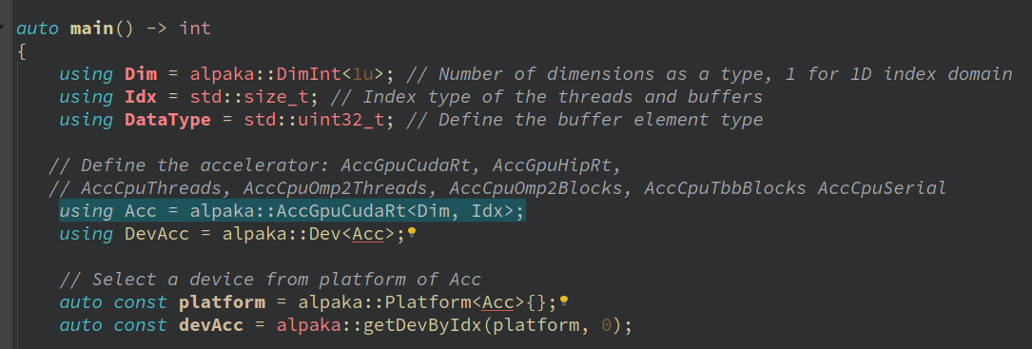
Appendix 1
Select the Accelerator, Platform and Device
alpaka provides a number of pre-defined Accelerators.
  AccGpuCudaRt for Nvidia GPUs
  AccGpuHipRt for AMD GPUs
  AccGpuSyclIntel for AMD, Intel and Nvidia GPUs
  AccCpuOmp2Blocks based on OpenMP 2.x
  AccCpuTbbBlocks based on TBB
  AccCpuThreads based on std::thread
  AccCpuSycl
  AccFpgaSyclIntel
Device instance represents a single physical device

Slide 51
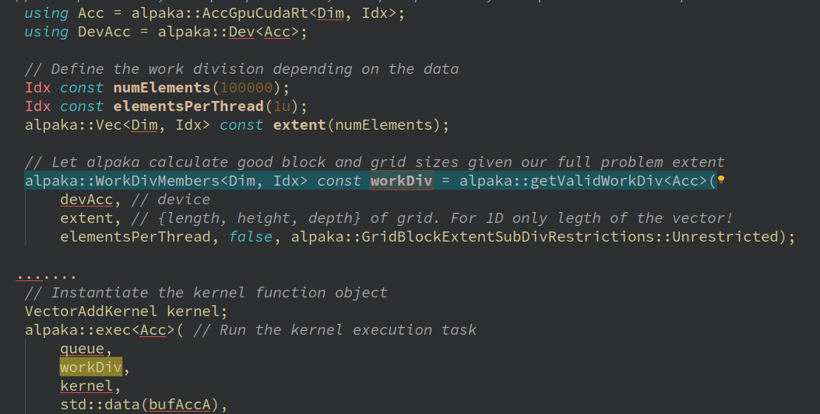
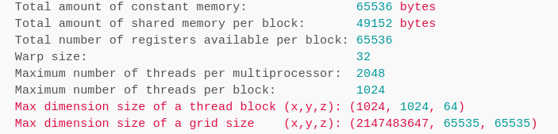
Appendix 2
3. How to parallelise?
I- Get a valid work division from alpaka
Use getValidWorkDiv function which devides the full grid-thread extent into blocks.
Inputs:
  Full grid-thread extent (total number of threads needed) and Elements per thread extent
The probable output:
{Vec{alpaka::core::divCeil(numElements,1024)}, Vec{1024}, Vec{1} }
II - Determine the workdivision manually
WorkDivision data structure consists 3 vectors:
  Grid block extent.
    Vec{alpaka::core::divCeil(numElements,1024)} or Vec{1,1,alpaka::core::divCeil(numElements,1024)} depending on the number of dimensions.
  Block thread extent: Vec{1024} or Vec{1,1,1024}
  Elements per thread is Vec{1} or Vec{1,1,1}
Nvidia Tesla K20 deviceQuery

Slide 52
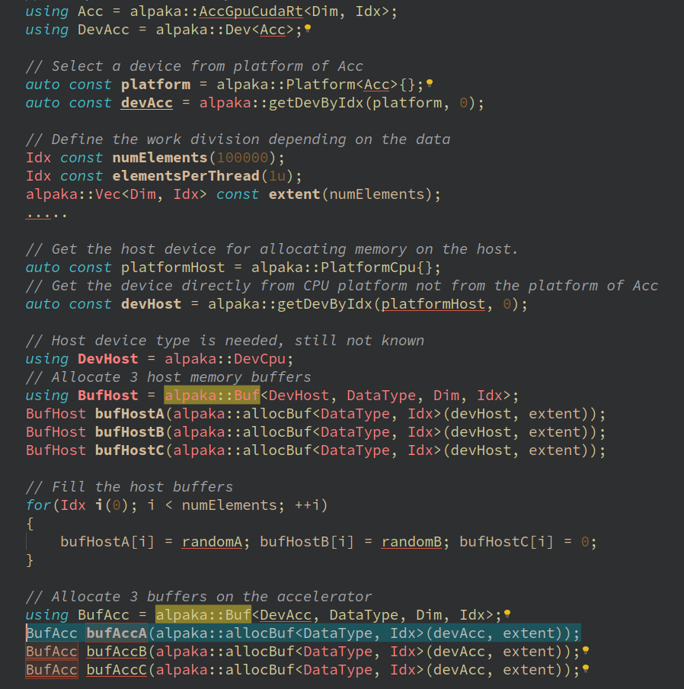
Appendix 3
4. Allocate data vectors on host and device.
alpaka::Buf is multi-dimensional dynamic (runtime sized) container.
It contains
  memory,
  size,
  the device, the memory is allocated in!
alpaka::allocBuf() allocates memory to the given device.

Slide 53
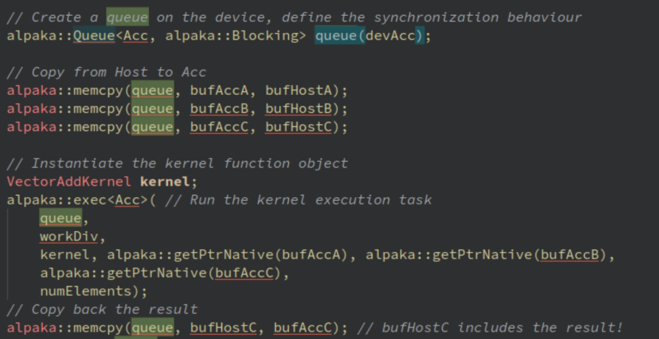
Appendix 4
5.1 Create the Queue for memcpy and kernel task
alpaka::Queue is “a queue of tasks”
Queue is always FIFO, everything is sequential inside the queue.
and more
  Different queues run in parallel for many devices
  Used for synchronization
  Accelerator back-ends can be mixed (used in interleaves) within a device queue.
  ...

Slide 54
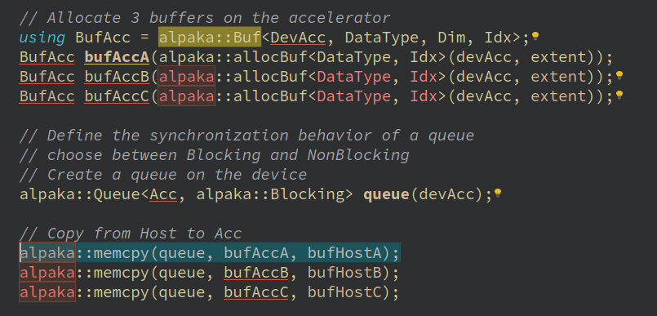
Appendix 5
5.2 Copy data vectors to the Device
alpaka::memcpy copies the data from one buffer/view to another buffer or view.
alpaka::Buf knows the device it belongs to.
Alternatively alpaka::View is used to adapt already allocated memory.
  if we already have a C++ std::vector at host; we don’t need to create an alpaka::Buf to copy it between different devices. Converting it to an alpaka::View is enough to copy it using alpaka::memcpy.

Slide 55
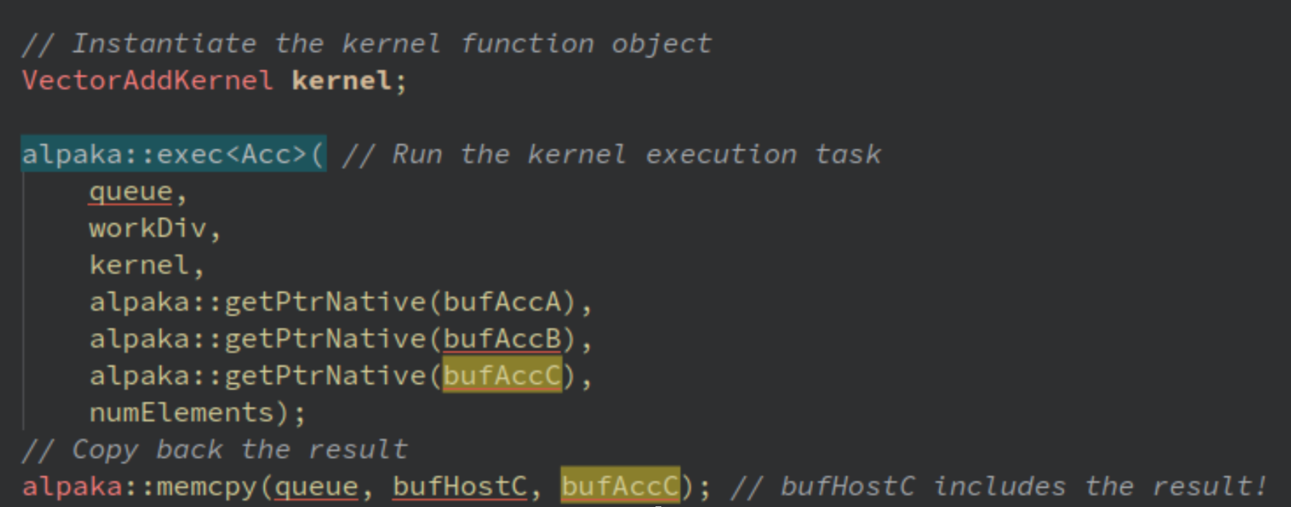
Appendix 6
Call alpaka::exec function
The result is stored in an alpaka::Buf
7. Copy result back
Copy the result in device to the host

Slide 56
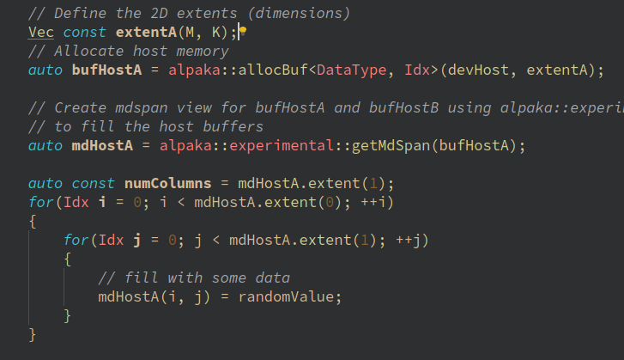
Appendix 7
Use mdspan which is a multi-dimensional and non-owning view.
alpaka::experimental::mdspan
std::mdspan standard
// std::mdspan
std::vector v{1,2,3,4,5,6,7,8,9,10,11,12};
// View data as 2D
auto ms2 = std::mdspan(v.data(), 2, 6);
// View the same data as 3D
auto ms3 = std::mdspan(v.data(), 2, 3, 2);
// Write data into v using 2D view
for(std::size_t i = 0; i!=ms2.extent(0); i++)
for(std::size_t j = 0; j!=ms2.extent(1); j++)
ms2[i, j] = i * 1000 + j;
// Read data using 3D view
Create an mdspan view
Easy set

Slide 57
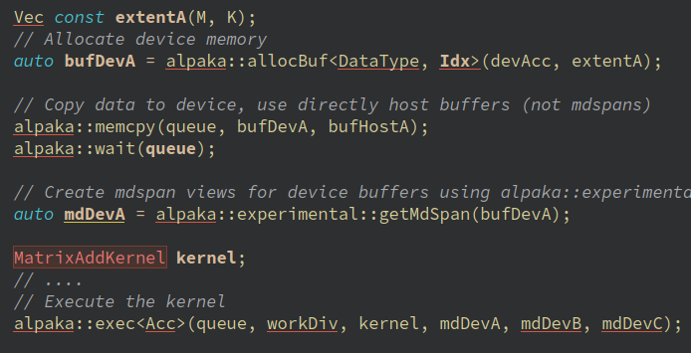
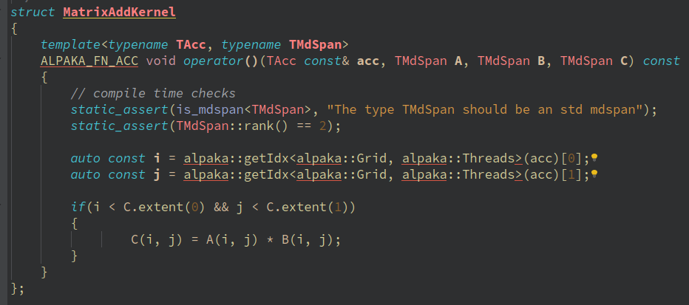
Appendix 8
Pass alpaka mdspan to the +heat+ kernel
Create an mdspan view
Use alpaka mdspan in the kernel
Pass to kernel
set/get values

Slide 58
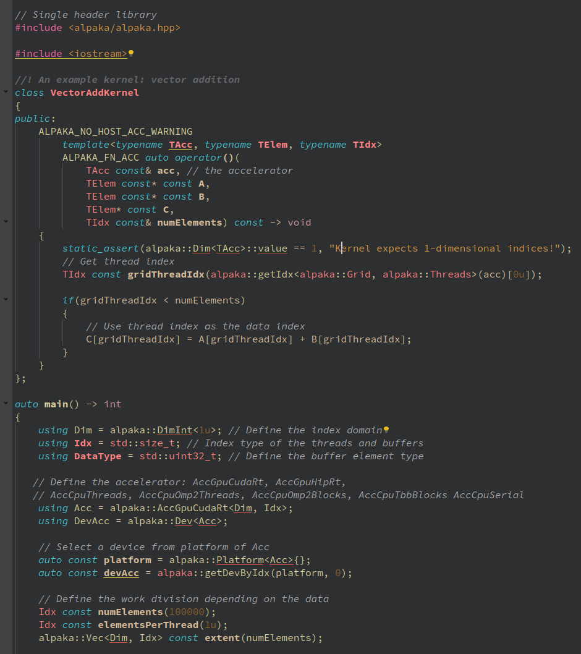
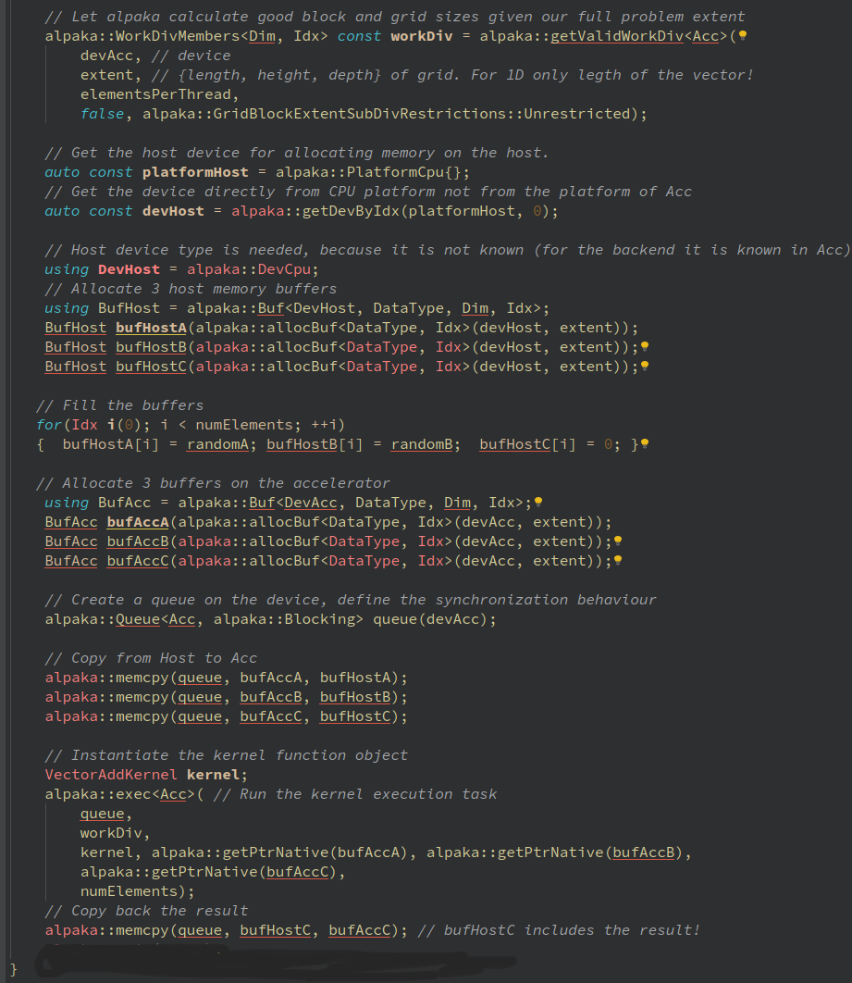
Parallel vector addition code
Appendix 9

Slide 59
Parallel vector addition code
Single header
Get Work division
kernel
Get host device (CPU)
allocate memory at host (CPU)
allocate memory at device (GPU)
Copy vectors to device (GPU)
Select accelerator
and the corresponding device (GPU)
Execute kernel
Copy result to host (CPU)

Slide 60
Appendix 10
Programing Tips
If you want to pass multi-dimensional data to kernel, use mdspan (enable it via cmake option)
(If you don’t use mdspan; you will need to take care of alignment/pitch values. Pass the pointer, extents and the pitch.)
To incease perfomance; using shared memory and constant memory of GPUs are among alpaka features.
A kernel can be run directly by exec function or can be enqueued as a task.
Vendor specific profiling and debugging tools (e.g. nsys, rocprof …) can be used on compiled alpaka code.
If you debug GPU code try to compile your code for CPU; and use CPU debugger tools
(Change accelerator type to CPU accelerators, then debug using gdb and similar tools.)
Inside alpaka Kernel, you can use printf; but you should not use std::cout for GPU backends.
For unused number of dimensions in workdiv; use 1, for that dimension.
auto blockThreadExtent = alpaka::Vec<TDim3D,Idx>{1u,1u,128u};

Slide 61
Appendix-11 Summary of alpaka Structures
Accelerator provides abstract view of all capable physical devices
Device represents a single physical device
Queue Enables synchronisation of tasks on different queues, enables communication between the host and a single Device, e
Platform is a union of Accelerator, Device and Kernel
Task is a device-side operation (e.g kernel, memory operation)
Others: Event, Buffer (runtime sized contiguous container), Vector (static array)

Slide 62
Appendix-12: Programming Heterogeneous Systems-I
// Define Accelerators
using AccCpu = alpaka::AccCpuOmp2Blocks<Dim, Idx>;
using AccGpu = alpaka::AccGpuCudaRt<Dim, Idx>;
// Acquire at least one Device per Accelerator
auto devCpu = alpaka::getDevByIdx<AccCpu>(0u);
auto devGpu = alpaka::getDevByIdx<AccGpu>(0u);
// Create one queue per device
using QueueProperty = alpaka::NonBlocking;
using QueueCpu = alpaka::Queue<AccCpu, QueueProperty>;
using QueueGpu = alpaka::Queue<AccGpu, QueueProperty>;
auto queueCpu = QueueCpu{devCpu};
auto queueGpu1 = QueueGpu{devGpu};
auto queueGpu2 = QueueGpu{devGpu};
// Run tasks in parallel
alpaka::enqueue(queueCpu, taskCpu);
alpaka::enqueue(QueueGpu1, taskGpu1);
alpaka::enqueue(QueueGpu2, taskGpu2);
// Make sure all non-blocking queue tasks finished
// before the main thread ends
alpaka::wait(queueCpu);
alpaka::wait(QueueGpu1);
alpaka::wait(QueueGpu2);
How to use multiple backends in parallel?
Acquire at least one Device per Accelerator
Create one Queue per Device

Slide 63
Appendix-13
Programming Heterogeneous Systems-II
// Allocate buffers
auto bufCpu = alpaka::allocBuf<float, Idx>(devCpu, extent);
auto bufGpu = alpaka::allocBuf<float, Idx>(devGpu, extent);
/* Initialization … */
// Copy buffer from CPU to GPU - destination comes first
alpaka::memcopy(gpuQueue, bufGpu, bufCpu, extent);
// Execute GPU kernel
alpaka::enqueue(gpuQueue, someKernelTask);
// Copy results back to CPU and wait for completion
alpaka::memcopy(gpuQueue, bufCpu, bufGpu, extent);
// Wait for GPU, then execute CPU kernel
alpaka::wait(cpuQueue, gpuQueue);
alpaka::enqueue(cpuQueue, anotherKernelTask);
Communication by Buffers
Buffers are defined and created per Device
Buffers can be copied between different Devices
Notice: CPU to GPU copies (and vice versa) require GPU queue

Slide 64
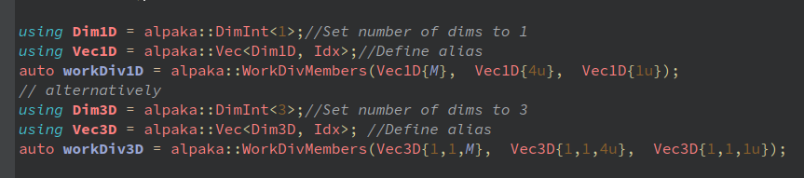
A + B = C
Appendix-14 Set the workdivision manually
WorkDivision data structure consists 3 vectors:
  Grid block extent.
    Vec{M} or Vec{1,1,M} depending on the number of dimensions.
  Block thread extent.
    Vec{4} or Vec{1,1,4}
  Elements per thread
Setting work-div manually
Thread0
A0
B0
C0
Thread1
A1
B1
C1
Block0
A2
B2
C2
Thread2
Thread3
A3
B3
C3
Thread4
A4
B4
C4
Grid
A5
B5
C5
Block1
Thread5
…….
...
...
...
...
...
...
…..
…….
…….
...
...
...
BlockM-1
An
Bn
Cn
ThreadN-1
Work Division

Slide 65
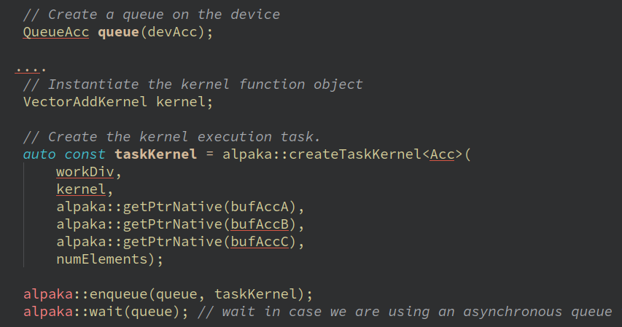
Appendix-15 Tasks and Events
Device-side related operations (kernels, memory operations) can be wrapped in tasks.
Tasks are executed by enqueue() function.
Tasks on the same queue are executed in order (FIFO principle)
  alpaka::enqueue(queueA, task1); alpaka::enqueue(queueA, task2); // task2 starts after task1 has finished, even queueA is non-blocking
Order of tasks in different queues is unspecified
  alpaka::enqueue(queueA, task1);
  alpaka::enqueue(queueB, task2); // task2 starts before, after or in parallel to task1
For easier synchronization, alpaka Events can be inserted before, after or between Tasks:
  auto myEvent = alpaka::Event<alpaka::Queue>(myDev);
  alpaka::enqueue(queueA, myEvent);
  alpaka::wait(queueB, myEvent); // queueB will only resume after queueA reached myEvent

Slide 66
Appendix-16 Accelerator Details
Accelerator chosen by the programmer and hides hardware specifics behind alpaka’s abstract API
  using Acc = acc::AccGpuCudaRt<Dim, Idx>;
Inside Kernel: contains thread state, provides access to alpaka’s device-side API
  The Accelerator provides the means to access to the indices
  // get thread index on the grid
  auto gridThreadIdx = alpaka::getIdx<Grid, Threads>(acc);
  // get block index on the grid
  auto gridBlockIdx = alpaka::getIdx<Grid, Blocks>(acc);
  The Accelerator gives access to alpaka’s shared memory (for threads inside the same block)
  // allocate a variable in block shared static memory
  auto & mySharedVar = block::shared::st::allocVar<int, __COUNTER__>(acc);
  // get pointer to the block shared dynamic memory
  float * mySharedBuffer = block::shared::dyn::getMem<float>(acc);
  It also enables synchronization on the block level
  // synchronize all threads within the block
  block::sync::syncBlockThreads(acc);
  Internally, the accelerator maps all device-side functions to their native counterparts
    Device-side functions require the accelerator as first argument:
      math::sqrt(acc, /* … */); time::clock(acc);
      atomic::atomicOp<atomic::op::Or>(acc, /* … */, hierarchy::Grids); (Atomics)
On Host: Meta-parameter for choosing correct physical device and dependent types

Slide 67
APPENDIX-17 Device information and device management
Each alpaka Device represents a single physical device;
Contains device information:
  auto const name = alpaka::getName(myDev); // Back-end-defined device name
  auto const bytes = alpaka::getMemBytes(myDev); // Size of device memory
  auto const free = alpaka::getFreeMemBytes(myDev); // Size of available device memory
Provides the means for device management:
  alpaka::reset(myDev); // Reset GPU device state
Encapsulates back-end device:
  auto nativeDevice = alpaka::getDev(myDev); // nativeDevice is not portable!

Slide 68
APPENDIX-18 Queue operations
Queues execute Tasks (see next slide):
  alpaka::enqueue(myQueue, taskRunKernel);
Check for completion:
  bool done = alpaka::empty(myQueue);
Wait for completion, Events (see next slide), or other Queues:
  alpaka::wait(myQueue); // blocks caller until all operations have completed
  alpaka::wait(myQueue, myEvent); // blocks myQueue until myEvent has been reached
  alpaka::wait(myQueue, otherQueue); // blocks myQueue until otherQueue’s ops have completed

Slide 69
Appendix-19 Changing the target platform by changing accelerator
using namespace alpaka;
using Dim = dim::DimInt<1u>;
using Idx = std::size_t;
/*** BEFORE ***/
using Acc = alpaka::AccCpuOmp2Blocks<Dim, Idx>;
/*** AFTER ***/
using Acc = alpaka::AccGpuHipRt<Dim, Idx>;
/* No change required - dependent types and variables are automatically changed */
auto myDev = alpaka::getDevByIdx<Acc>(0u);
using Queue = alpaka::Queue<Acc, queue::NonBlocking>;
auto myQueue = Queue{myDev};

