Slide 1

Plasma-PEPSC Workshop
23 October 2024
The Open Standard
for Particle-Mesh Data
Notes:
Hello everyone. Thank you for participating. In this presentation I will initially introduce alpaka generally. Then I will go over an alpaka program and explain it step by step. Lastly I will talk about performance and participants of alpaka.

Slide 2
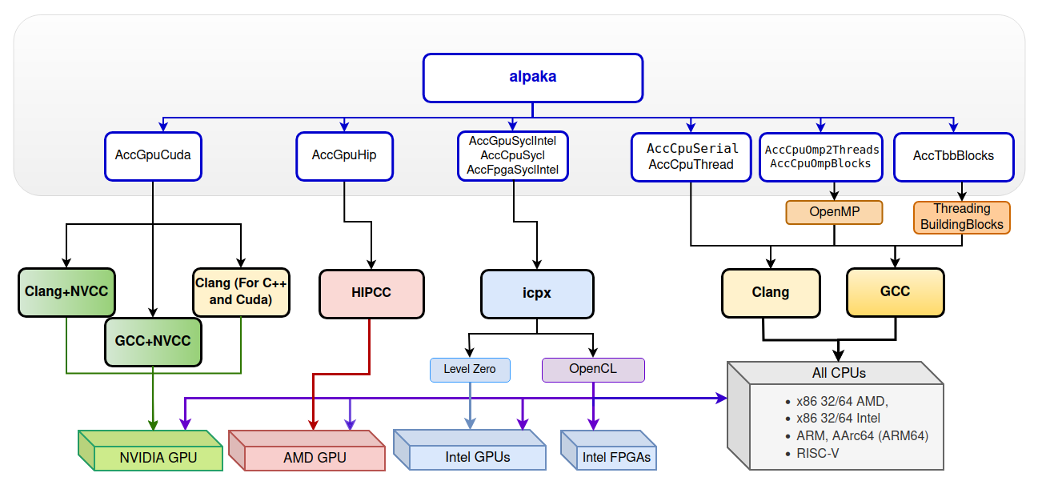
We saw this yesterday… what about I/O?
Alpaka abstraction tree
October, 2024
Notes:
// text cupla easy porting from cuda, vikunja is for high level algorithms
Find us on GitHub!
alpaka library: https://www.github.com/alpaka-group/alpaka
Full source code and many examples, Issue tracker
The documents: https://alpaka.readthedocs.io/en/latest/
Installation guide
Cheatsheet
Abstraction model and the rationale behind alpaka
Project group: https://www.github.com/alpaka-group
Contains all alpaka-related projects, documentation, samples, …
alpaka is a free software (MPL 2.0)

Slide 3


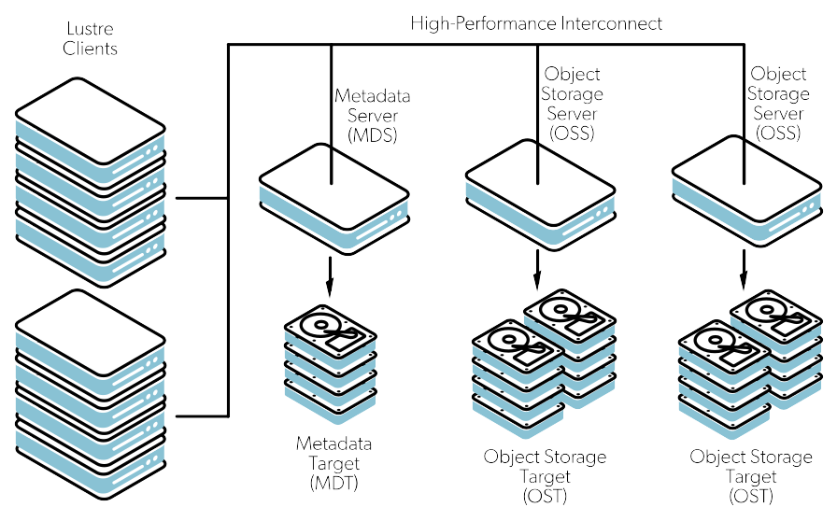




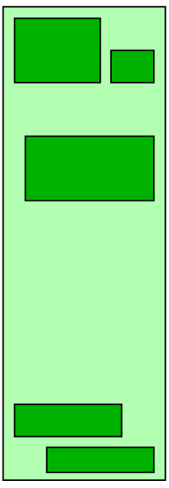


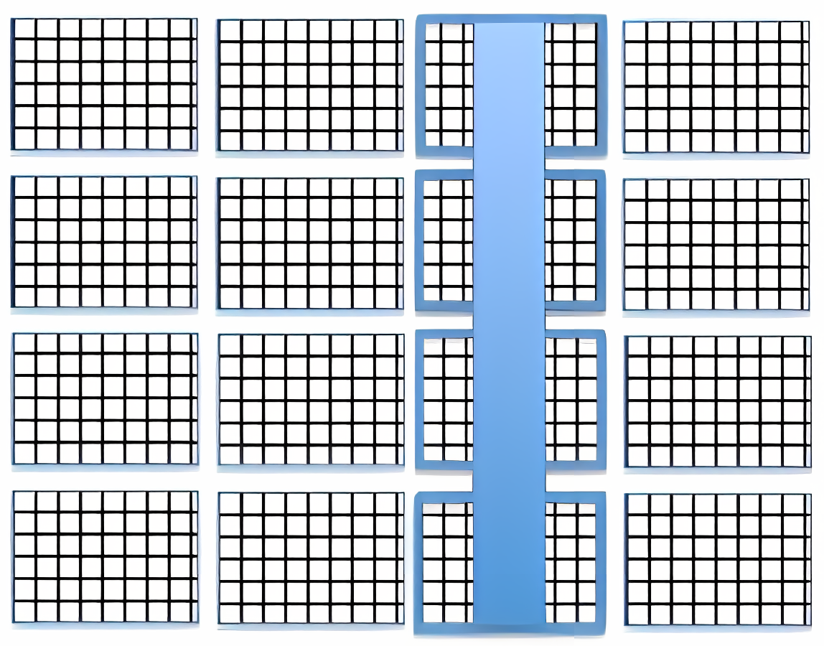
…let’s keep talking about performance portability
compute resources
serial filesystems
parallel: Lustre, GPFS, …
file striping? subfiling?
plenty of RAM? scarcely any?
backends / file formats
HDF5? ADIOS?
ASCII: JSON, TOML, XML, …
the new kid?
data storage / transport
even write to a file?
or stream to a consumer?
shared memory?
or do we need the network?
Infiniband, Slingshot, WAN, …?
data path
synchronous? asynchronous?
Burst Buffers?
staging buffer in RAM?
serial or parallel I/O?
parallel aggregation?
compression
compute on CPU/GPU?
lower file size,
but more compute effort?
c-blosc, zfp, sz, bzip, zlib, …
serialization
structured format?
log format?
read patterns?
None of these questions has a clear answer!

Slide 4
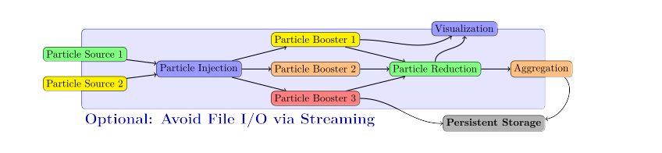
Heterogeneity through Standardized Data
Scientific workflows are complex:
need to span different time and length scales
scientific modeling requires multiple codes,
collaborating in a data processing pipeline
bridge heterogeneous models by standardization of data
Axel Huebl et al. “openPMD: A meta data standard for particle and mesh based data”. 2015. doi: 10.5281/zenodo.591699. url: https://openPMD.org
Franz Poeschel et al. “Transitioning from file-based HPC workflows to streaming data pipelines with openPMD and ADIOS2“. 2021. doi:10.1007/978-3-030-96498-6_6

Slide 5
Heterogeneity through Standardized Data
Scientific workflows are complex:
openPMD standard
→ for particle-mesh data
as communication layer
Axel Huebl et al. “openPMD: A meta data standard for particle and mesh based data”. 2015. doi: 10.5281/zenodo.591699. url: https://openPMD.org
Franz Poeschel et al. “Transitioning from file-based HPC workflows to streaming data pipelines with openPMD and ADIOS2“. 2021. doi:10.1007/978-3-030-96498-6_6

Slide 6
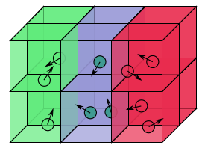
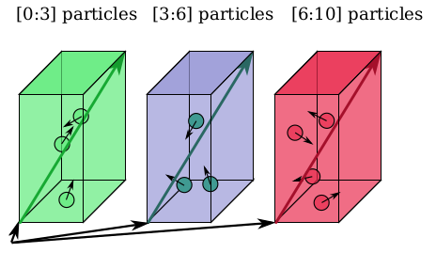
What is particle-mesh data?
Mesh
n-dimensional space,
divided into discrete cells
e.g. temperature:
store a scalar number per cell
e.g. electrical fields:
store a 3D vector per cell
Particles
A list of discrete objects,
located on the mesh
for each particle: list its position
optionally: list charge, weight, …

Slide 7
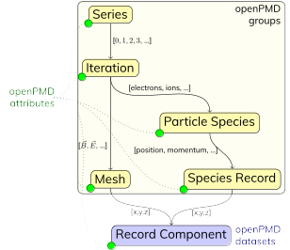
openPMD hierarchy
Structure for series & snapshots
encoded as either:
      files (one file per iteration)
      groups (reuse files)
      variables (reuse files & variables
      in ADIOS2)
Records for physical observables
constants, mixed precision, complex numbers
Attributes: unit conversion, description, relations, mesh geometry, authors, env. info, …

Slide 8
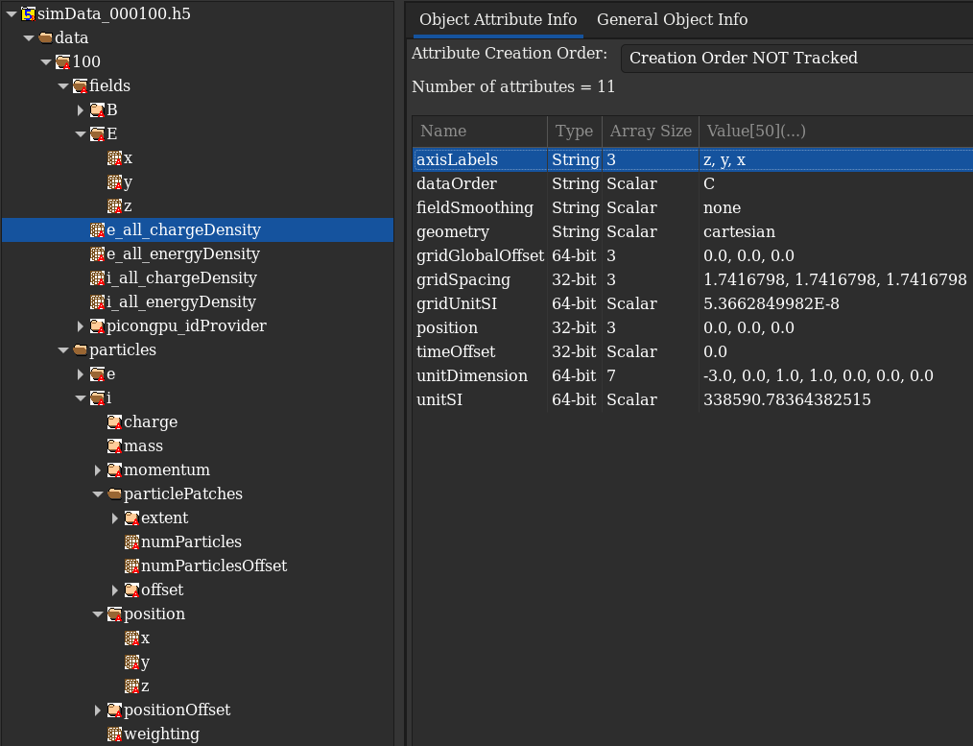
Example dataset: HDF5 backend
Sample data
created with PIConGPU

Slide 9
Example dataset: ADIOS2 backend
float /data/50/fields/E/x {128, 128, 128}
float /data/50/fields/E/y {128, 128, 128}
float /data/50/fields/E/z {128, 128, 128}
float /data/50/particles/e/position/x {50053105}
float /data/50/particles/e/position/y {50053105}
float /data/50/particles/e/position/z {50053105}
int32_t /data/50/particles/e/positionOffset/x {50053105}
int32_t /data/50/particles/e/positionOffset/y {50053105}
int32_t /data/50/particles/e/positionOffset/z {50053105}
string /data/50/fields/E/axisLabels attr = {"z", "y", "x"}
string /data/50/fields/E/dataOrder attr = "C"
string /data/50/fields/E/fieldSmoothing attr = "none"
string /data/50/fields/E/geometry attr = "cartesian"
double /data/50/fields/E/gridGlobalOffset attr = {0, 0, 0}
float /data/50/fields/E/gridSpacing attr = {1.74168, 1.74168, 1.74168}
double /data/50/fields/E/gridUnitSI attr = 5.36628e-08
float /data/50/fields/E/timeOffset attr = 0
double /data/50/fields/E/unitDimension attr = {1, 1, -3, -1, 0, 0, 0}
float /data/50/fields/E/x/position attr = {0.5, 0, 0}
double /data/50/fields/E/x/unitSI attr = 9.5224e+12
float /data/50/fields/E/y/position attr = {0, 0.5, 0}
double /data/50/fields/E/y/unitSI attr = 9.5224e+12
float /data/50/fields/E/z/position attr = {0, 0, 0.5}
double /data/50/fields/E/z/unitSI attr = 9.5224e+12
Hierarchical
data organization
n-dim. datasets
for heavyweight data
Attributes
for self-description

Slide 10
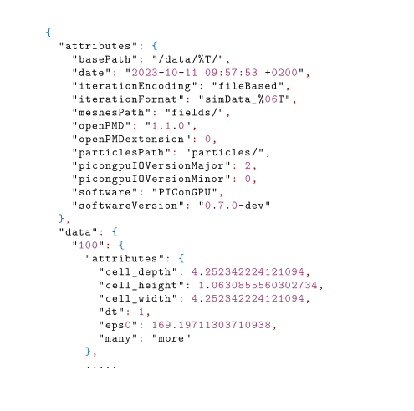
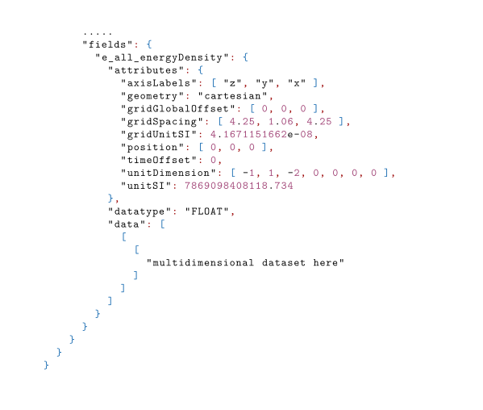
Example dataset: JSON/TOML backend
Part of the package: No need to install 3rd-party dependencies
Useful for debugging and prototyping
Limited parallel support
Courtesy to Nils Lohmann‘s JSON library for C++
With recent release:
Convert output to TOML
Idea: openPMD formatted configuration files

Slide 11
Schedule for the interactive sessions
Today:
Introduction to the API and backends
Modeling the HeatEquation’s output
as openPMD data
Specifying backend options with configurations files loaded at runtime
Visualizing the HeatEquation’s output
in a Jupyter Notebook
Streaming I/O: Watching the HeatEquation while it is running
Tomorrow:
Data Analysis, parallel I/O, advanced topics
Using the openPMD-viewer to visualize data created by a PIConGPU simulation
Using Paraview to do the same in 3D
More detailed modeling for openPMD data: particles, constant components
Parallel I/O with ADIOS2 and HDF5
Advanced session: Eliding memory copies by asking the I/O libraries to allocate buffers for us
(Optional) Preparing for tomorrow’s Paraview session: Download version 5.13 from https://www.paraview.org/download/
rsync -avuP lumi:/pfs/lustrep3/scratch/project_465001310/poeschel/2024-09-20/8_v1/simOutput/openPMD/simData_001800.bp5 ~/Downloads/

Slide 12
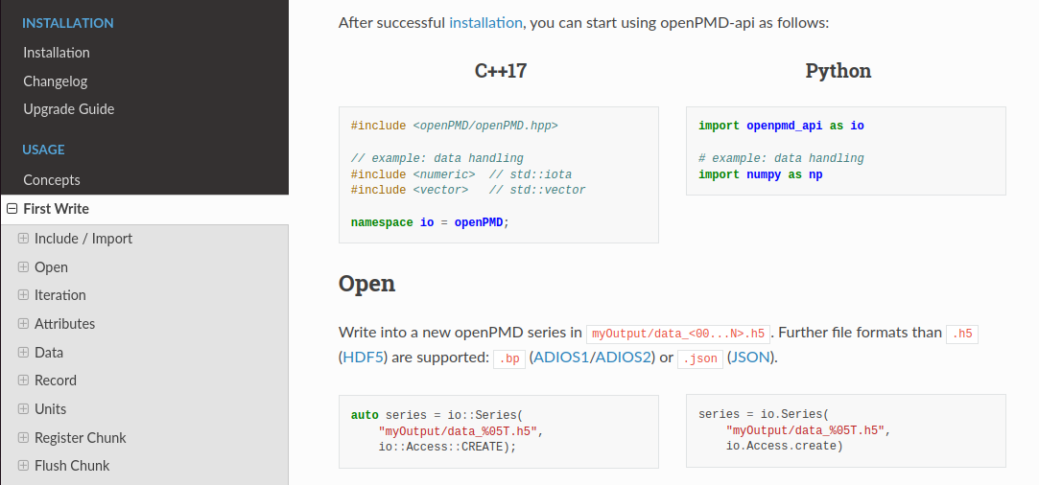
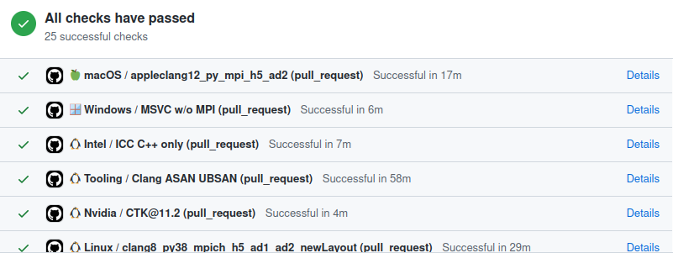





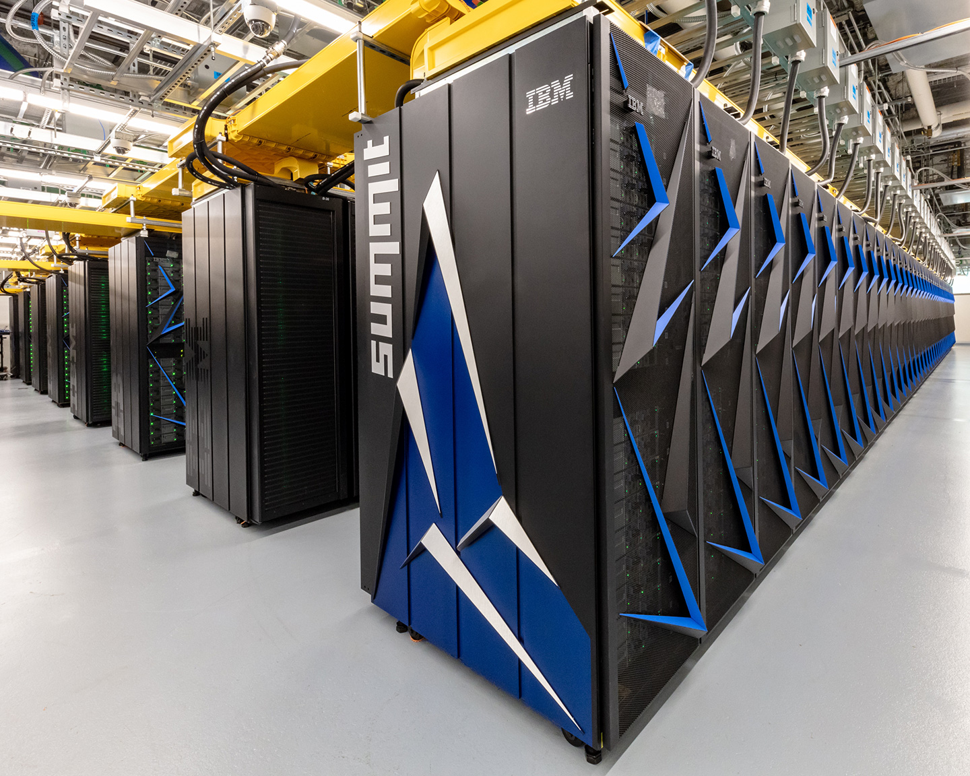

Reference Implementation in C++ & Bindings: Python and Julia
Online Documentation:
openpmd-api.readthedocs.io
Open-Source Development & Tests:
github.com/openPMD/openPMD-api
Rapid and easy installation on any platform:
python3 -m pip install
openpmd-api
brew tap openpmd/openpmd
brew install openpmd-api
cmake -S . -B build
cmake --build build
--target install
conda install
-c conda-forge
openpmd-api
spack install
openpmd-api
module load openpmd-api
A Huebl, F Poeschel, F Koller, J Gu, et al.
"openPMD-api: C++ & Python API for Scientific I/O with openPMD" (2018) DOI:10.14278/rodare.27

Slide 13
Hands-On: openPMD-api: basic object model
Module environment at /project/project_465001310/workshop_software/env.sh
Materials at https://github.com/alpaka-group/alpaka-workshop-slides/tree/oct2024_workshop
Read the TODO comments inside src/openPMDOutput.hpp:

Slide 14
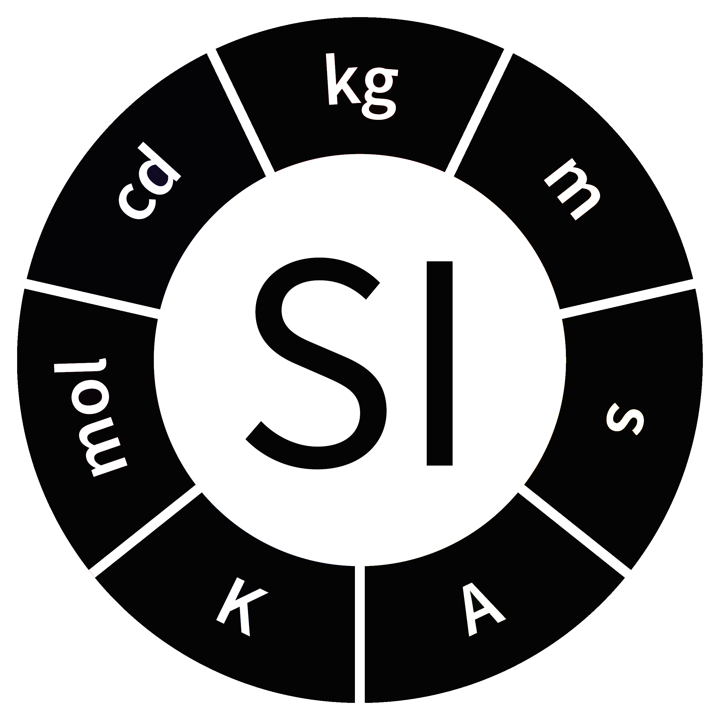
Unit System
unitDimension
automated description of physical dimension
only powers of base dimensions
length L, mass M, time T, electric current I,
thermodynamic temperature theta,
amount of substance N, luminous intensity J
Magnetic field: [B] = M / (I * T²)
→ (0, 1, -2, -1, 0, 0, 0)
unitSI (recommended)
relation to an absolute unit system
Wikimedia Commons

Slide 15
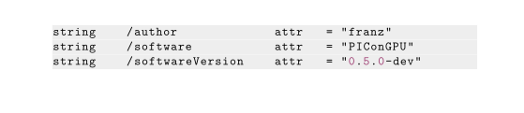

openPMD – a FAIR standard
Findable: Standardized metadata to identify the data producer
Accessible: Open standard, implementable in various formats
*currently implemented,
but not limited to
“The FAIR Guiding Principles for scientific data management and stewardship” (Mark D. Wilkinson et al.)

Slide 16
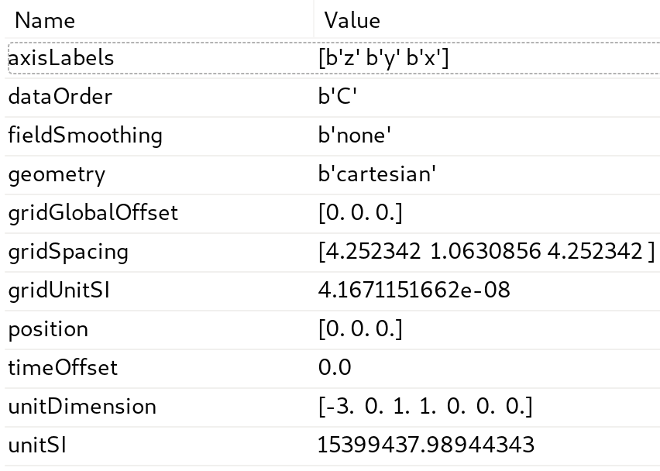
openPMD – a FAIR standard
Interoperable:
Data exchange spans
applications, platforms and teams
Reusable:
Rich and standardized description
for physical quantities
simulation
analysis
compression
visualization
“The FAIR Guiding Principles for scientific data management and stewardship” (Mark D. Wilkinson et al.)

Slide 17
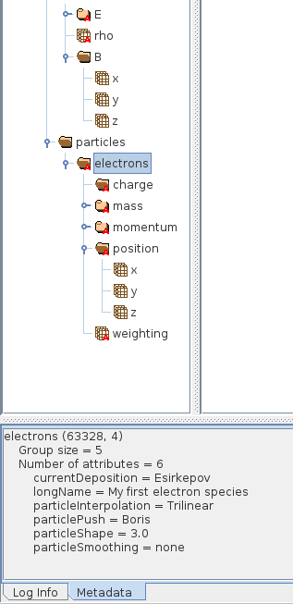
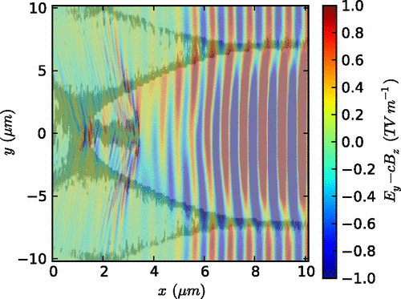
Extensions: e.g. ED-PIC
Field image → field solver, smoothing
similar:
Emittance → particle push, field solver, shape
Image CC-BY 3.0: R. Lehe et al., RRSTAB 16, 021301 (2013),
DOI:10.1103/PhysRevSTAB.16.021301

Slide 18
Modeling Mesh data
string /data/1000/fields/E/axisLabels attr = {"z", "y", "x"}
string /data/1000/fields/E/fieldSmoothing attr = "none"
string /data/1000/fields/E/geometry attr = "cartesian"
double /data/1000/fields/E/gridGlobalOffset attr = {0, 0, 0}
float /data/1000/fields/E/gridSpacing attr = {4.25234, 1.06309, 4.25234}
double /data/1000/fields/E/gridUnitSI attr = 4.16712e-08
float /data/1000/fields/E/timeOffset attr = 0
double /data/1000/fields/E/unitDimension attr = {1, 1, -3, -1, 0, 0, 0}
float /data/1000/fields/E/x {192, 1536, 192} = 0 / 0
float /data/1000/fields/E/x/position attr = {0.5, 0, 0}
double /data/1000/fields/E/x/unitSI attr = 1.22627e+13
float /data/1000/fields/E/y {192, 1536, 192} = 0 / 0
float /data/1000/fields/E/y/position attr = {0, 0.5, 0}
double /data/1000/fields/E/y/unitSI attr = 1.22627e+13
float /data/1000/fields/E/z {192, 1536, 192} = 0 / 0
float /data/1000/fields/E/z/position attr = {0, 0, 0.5}
double /data/1000/fields/E/z/unitSI attr = 1.22627e+13
float /data/1000/fields/e_all_energyDensity {192, 1536, 192} = 0 / 0
string /data/1000/fields/e_all_energyDensity/axisLabels attr = {"z", "y", "x"}
string /data/1000/fields/e_all_energyDensity/fieldSmoothing attr = "none"
string /data/1000/fields/e_all_energyDensity/geometry attr = "cartesian"
double /data/1000/fields/e_all_energyDensity/gridGlobalOffset attr = {0, 0, 0}
float /data/1000/fields/e_all_energyDensity/gridSpacing attr = {4.25234, 1.06309, 4.25234}
double /data/1000/fields/e_all_energyDensity/gridUnitSI attr = 4.16712e-08
float /data/1000/fields/e_all_energyDensity/position attr = {0, 0, 0}
float /data/1000/fields/e_all_energyDensity/timeOffset attr = 0
double /data/1000/fields/e_all_energyDensity/unitDimension attr = {-1, 1, -2, 0, 0, 0, 0}
double /data/1000/fields/e_all_energyDensity/unitSI attr = 7.8691e+12
Mesh attributes,
including fieldSmoothing defined by ED-PIC extension
x/y/z components for vector-type field (struct-of-array)
including component-specific metadata
Scalar-type field
x/y/z layer is skipped

Slide 19
Hands-On: openPMD-api: metadata
Module environment at /project/project_465001310/workshop_software/env.sh
Materials at https://github.com/alpaka-group/alpaka-workshop-slides/tree/oct2024_workshop
Read the TODO comments inside src/openPMDOutput.hpp:

Slide 20
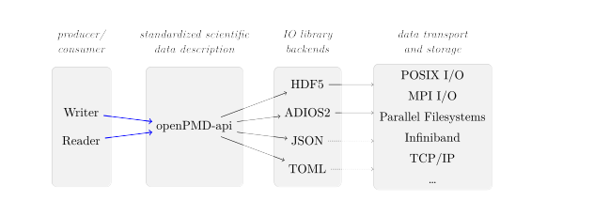
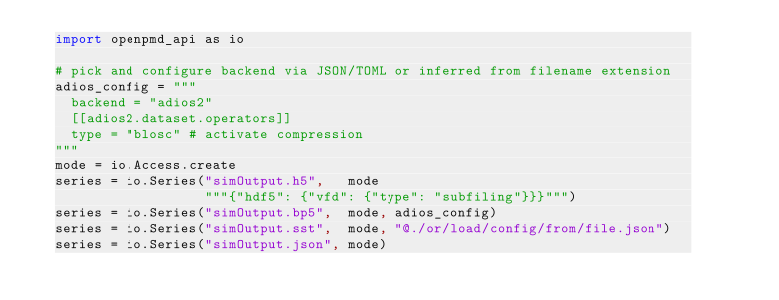
openPMD-api – open stack for scientific I/O
MPI support at all levels
Implemented in C++17
Bindings in C++17, Python and
(dev version only) Julia
Specify backend at runtime:
I/O library, transport, compression, streaming, aggregation, …
Notes:
Wasn mit NetCDF?

Slide 21
Hands-On: openPMD-api: visualization, backend configuration
Module environment at /project/project_465001310/workshop_software/env.sh
Materials at https://github.com/alpaka-group/alpaka-workshop-slides/tree/oct2024_workshop
Launch Notebook at https://www.lumi.csc.fi/
Read the instructions inside src/next_steps.md:
Notes:
TODO: mach ordentliche metadaten

Slide 22
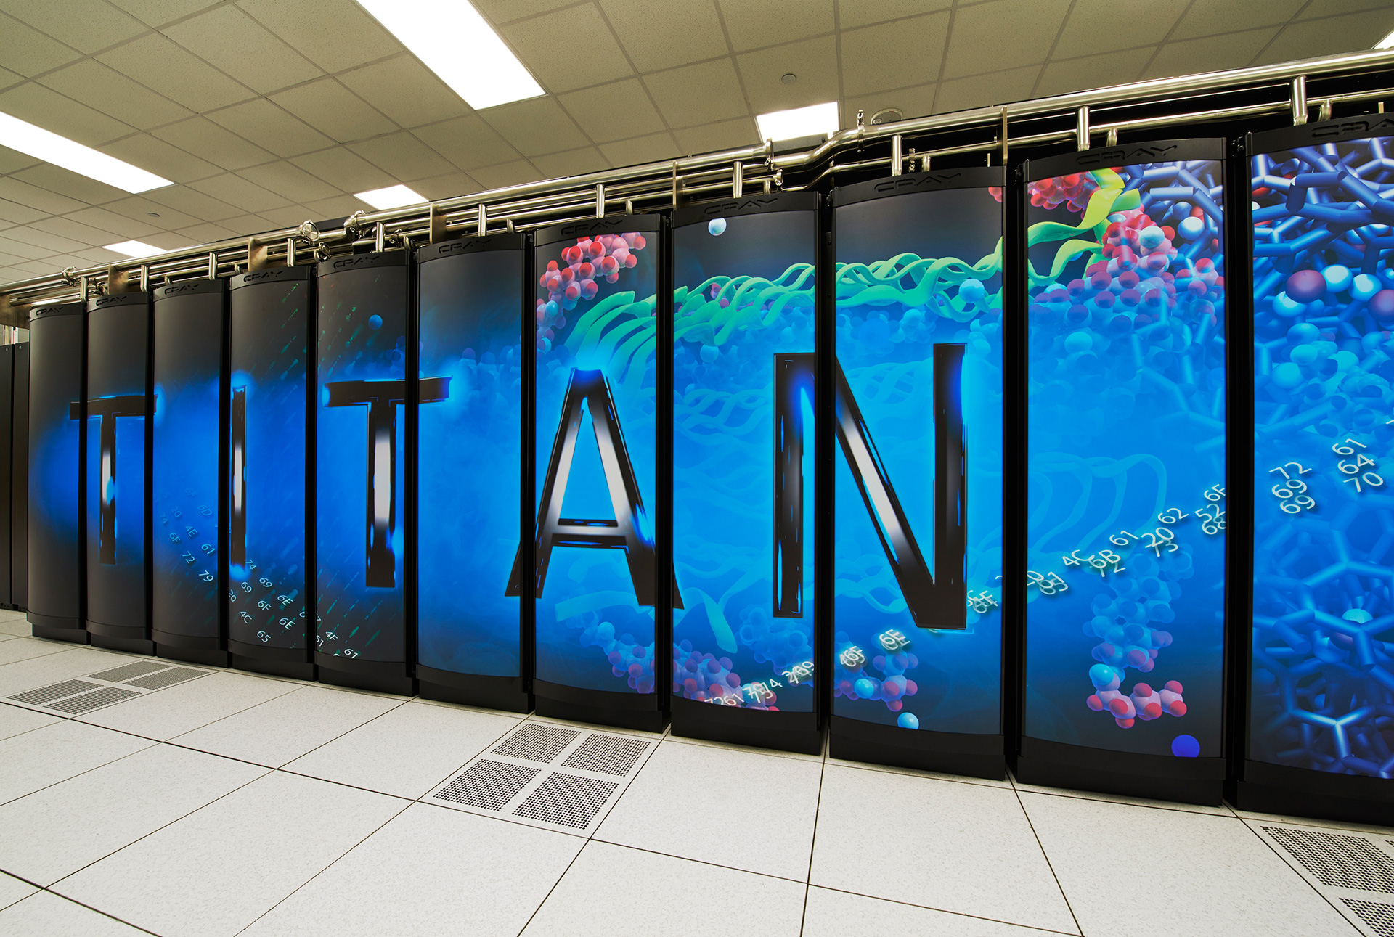

Compute Performance Outpaces Storage Performance
Peak Performance:
FS Throughput:
FS Capacity:
Titan
27 Pflop/s
1 TiByte/s
27 PiByte
Summit
200 Pflop/s
2.5 TiByte/s
250 PiByte
Frontier
1.6 Eflop/s
5~10 TiByte/s
500~1000 PiByte
Growth Factor
~60
5~10
18~37
→ parallel bandwidth insufficient for HPC at full scale
→ filesystem capacity insufficient for HPC at full scale
Same trend in experiments?
→ Increasing camera resolutions and data rates
Franz Poeschel et al. “Transitioning from file-based HPC workflows to streaming data pipelines with openPMD and ADIOS2”. 2022. doi: 10.1007/978-3-030-96498-6_6.

Slide 23
Compute Performance Outpaces Storage Performance
Peak Performance:
FS Throughput:
FS Capacity:
Titan
27 Pflop/s
1 TiByte/s
27 PiByte
Summit
200 Pflop/s
2.5 TiByte/s
250 PiByte
Frontier
1.6 Eflop/s
5~10 TiByte/s
500~1000 PiByte
Growth Factor
~60
5~10
18~37
Why does this concern us?
Heterogeneous data processing pipelines traditionally have large I/O usage
Scalable alternative: Streaming
Franz Poeschel et al. “Transitioning from file-based HPC workflows to streaming data pipelines with openPMD and ADIOS2”. 2022. doi: 10.1007/978-3-030-96498-6_6.

Slide 24
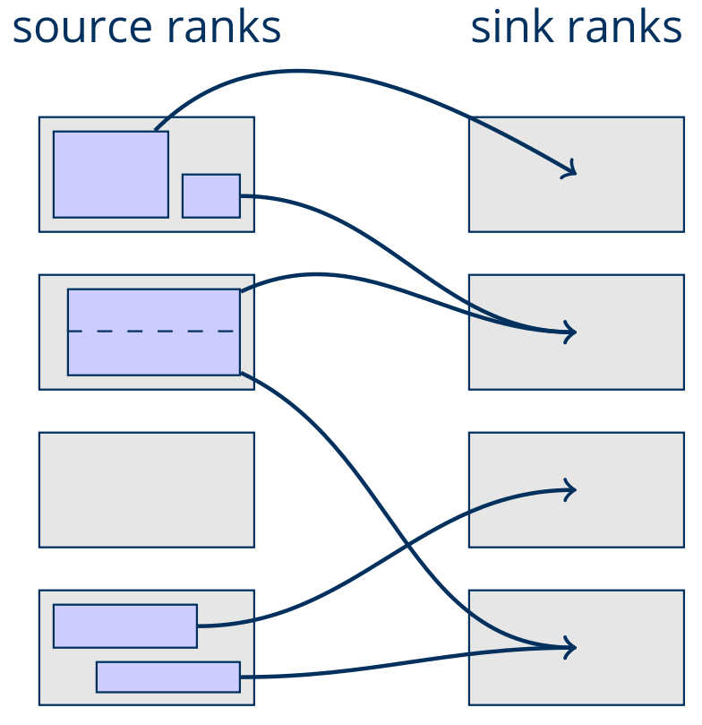
Streaming: Don’t touch the Filesystem at all
Data processing pipelines and increasingly experiments setups have large I/O usage
Scalable alternative: Streaming
e.g. via Infiniband (on HPC systems)
or wide area networks (in lab settings)
Challenge:
Compute a balanced, aligned, local mapping between two applications that remains useful in the problem domain
Franz Poeschel et al. “Transitioning from file-based HPC workflows to streaming data pipelines with openPMD and ADIOS2”. 2022. doi: 10.1007/978-3-030-96498-6_6.

Slide 25
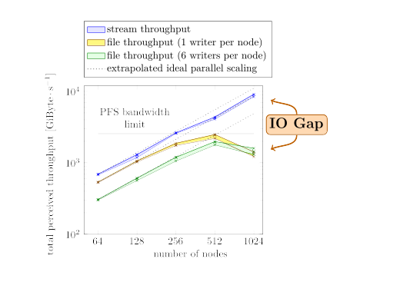


Break through Filesystem Bandwidth with Streaming
Memory-bound simulations
reach the I/O system limits
at a fraction of full scale
Summit FS bandwidth (2.5TiByte/s) reached at 512 nodes
(~11% of system size)
Streaming workflows unaffected
by filesystem bandwidth,
use Infiniband hardware to scale beyond it
(benchmarks at 1024 nodes done after Summit system upgrade)
Notes:
Jüngsten Ergebnisse auch dazutun

Slide 26
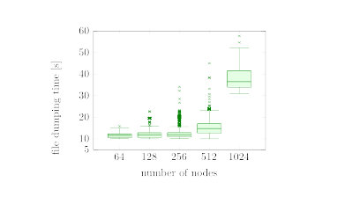
Summit: Performance fluctuations on single ranks
Same results, different display:
Plot every single measurement
Visualize reproducibility
Box: 50% of measurement points
Whiskers: “normal” measurements
Others: outliers
Evaluation for file-only setup:
Median time slightly raised at 512 nodes
Scaling stops due to PFS limit after that
Outliers increasing with scale
Outliers fatal in parallel contexts

Slide 27
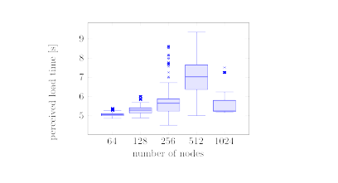
Summit: Well-reproducible performance of Infiniband Streaming
Same results, different display:
Plot every single measurement
Visualize reproducibility
Box: 50% of measurement points
Whiskers: “normal” measurements
Others: outliers
stream+file setup (stream part):
Overall times are lower
Median between 5 and 7 seconds
Outliers less dominating by far

Slide 28
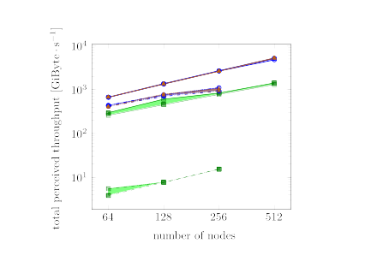
For good throughput:
Local streaming patterns, Infiniband/RDMA
Local streaming:
Distribute data chunks only within a node
Non-local streaming:
Distribute data chunks globally, optimize for balance and alignment
Straight lines:
Infiniband/RDMA
Dashed lines:
TCP/sockets
Local streaming
Non-local streaming
Setup: Couple PIConGPU with a scattering code (GAPD)
exchange particle data only
J. C. E, L. Wang, S. Chen, Y. Y. Zhang and S. N. Luo. “GAPD: a GPU- accelerated atom-based polychromatic diffraction simulation code”. In: Journal of Synchrotron Radiation 25.2 (Mar. 2018), pp. 604–611.

Slide 29
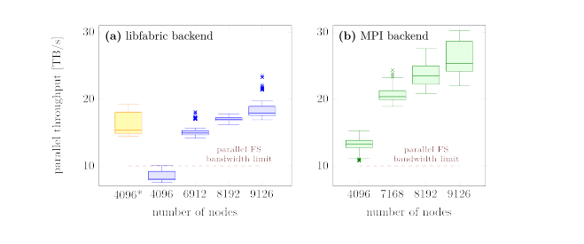
Break through Filesystem Bandwidth with Streaming
Full scale of Frontier:
Leaving behind us
the theoretical bandwidth
of the parallel filesystem
Notes:
Jüngsten Ergebnisse auch dazutun

Slide 30

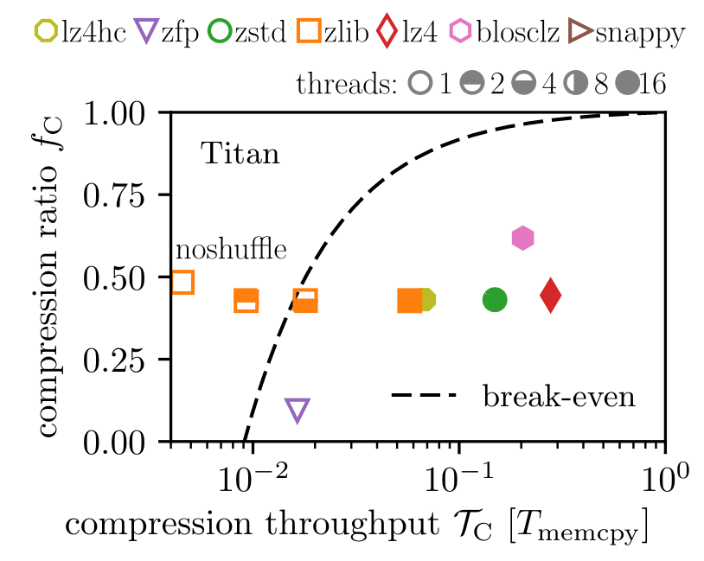
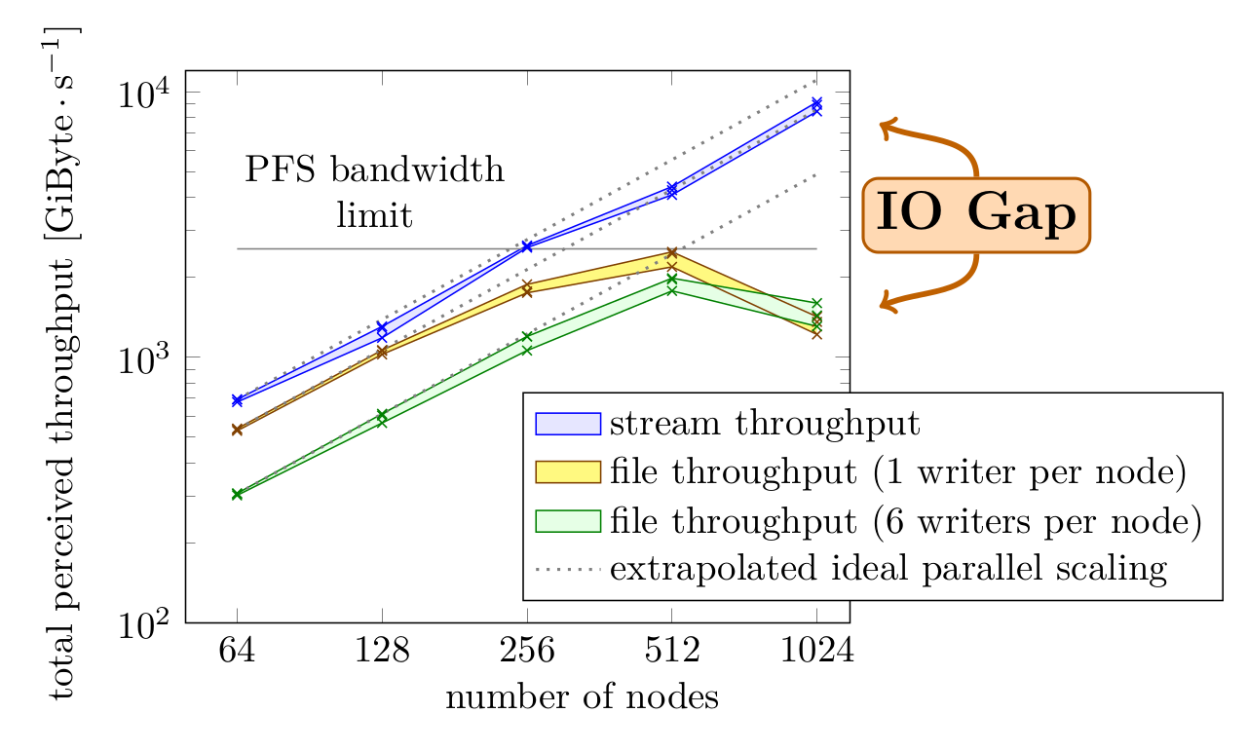
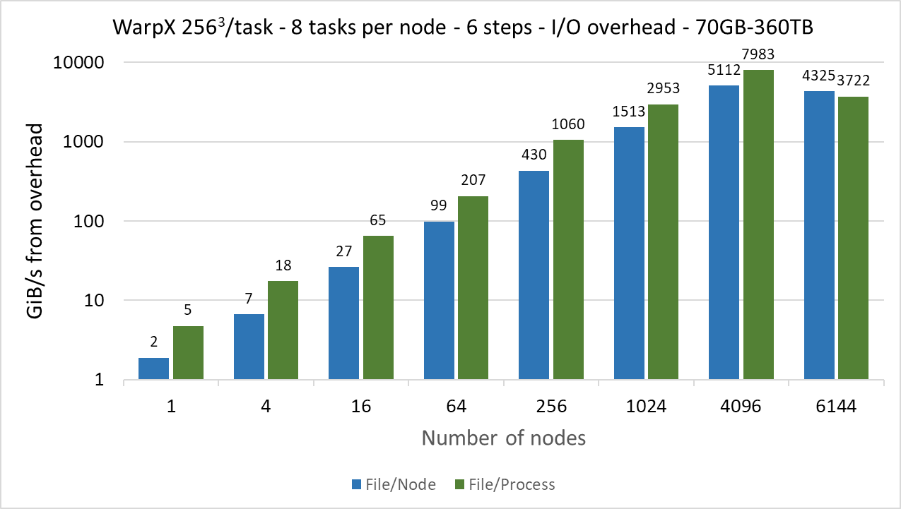

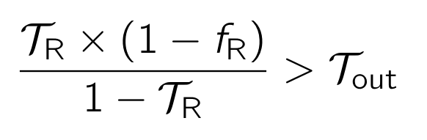

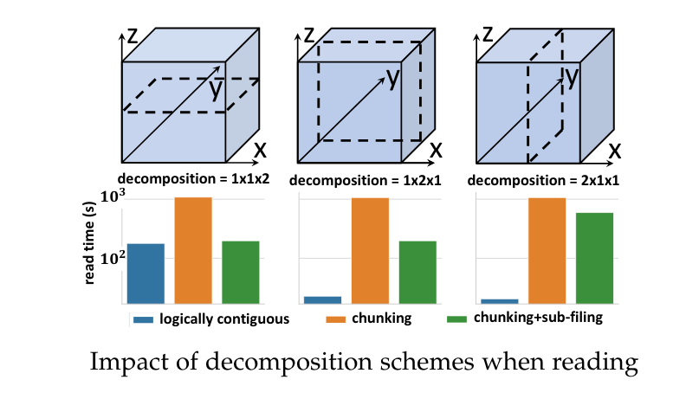
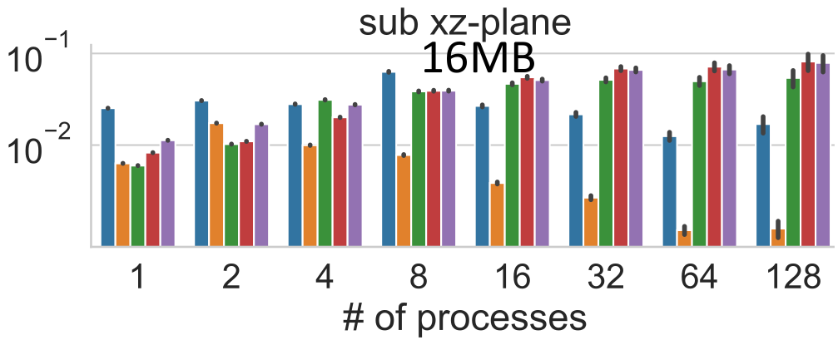
Performance: Data Layouts and no-file I/O
openPMD-api w/ WarpX
Fast Compressors Needed:
DOI:10.1007/978-3-319-67630-2_2
by A Huebl et al., ISC DRBSD-1 (2017)
>5.5TB/s FS BW: two-tier lustre w/ high-performance storage & progressive files
Streaming Data Pipelines: DOI:10.1007/978-3-030-96498-6_6
by F Poeschel, A Huebl et al., SMC21 (2022)
read GB/s
Online Data Layout Reorganization: DOI:10.1109/TPDS.2021.3100784
by L Wan, A Huebl et al., TPDS (2021)

Slide 31
Hands-On: openPMD-api: streaming I/O
Module environment at /project/project_465001310/workshop_software/env.sh
Materials at https://github.com/alpaka-group/alpaka-workshop-slides/tree/oct2024_workshop
Launch Notebook at https://www.lumi.csc.fi/
Read the instructions inside src/visualize.py (open as a Jupyter Notebook):

Slide 32
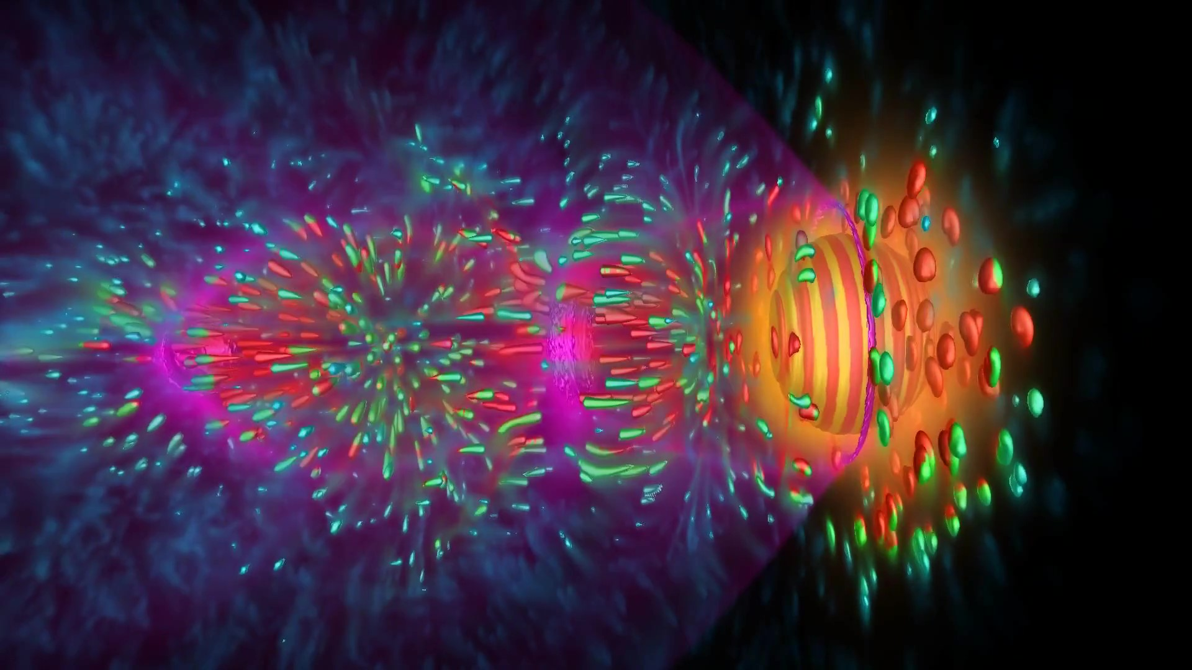
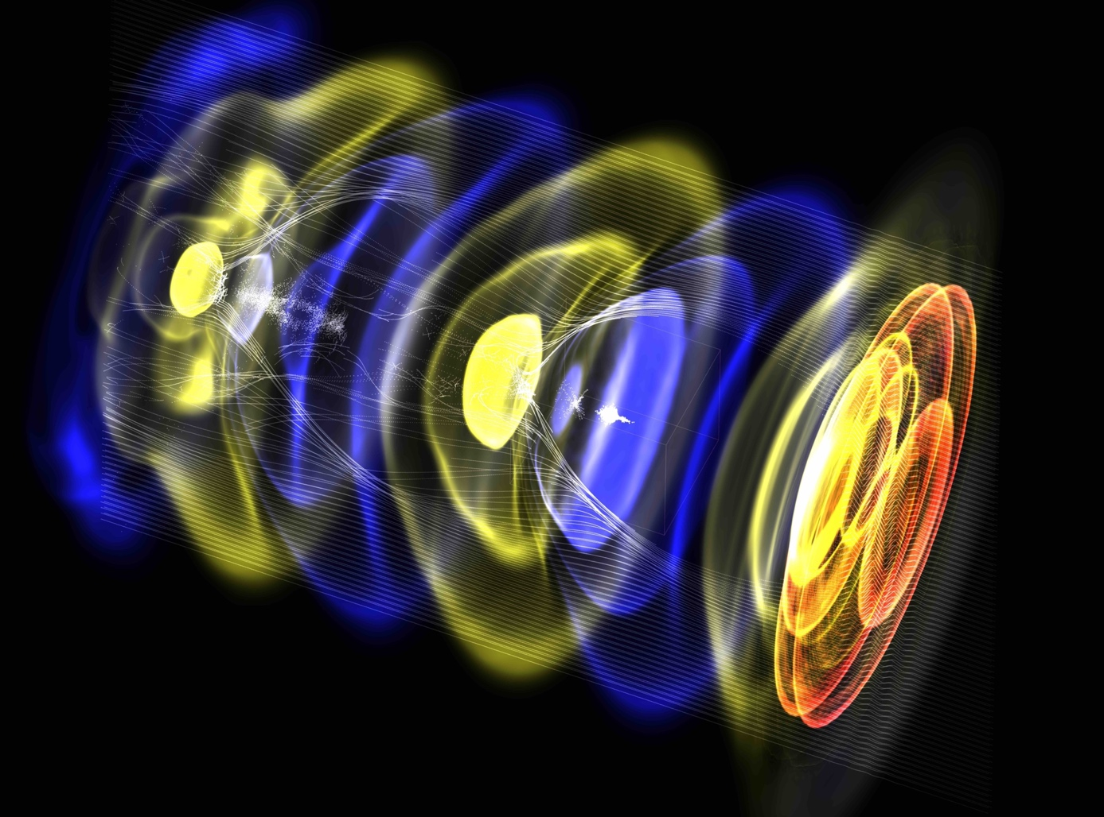
openPMD powered Projects and Users
Documents:
openPMD standard (1.0.0, 1.0.1, 1.1.0)
the underlying file markup and definition
A Huebl et al., doi: 10.5281/zenodo.33624
Scientific Simulations:
PIConGPU (HZDR)
electro-dynamic particle-in-cell code
maintainers: R Widera, S Bastrakov, A Debus et al.
WarpX (LBNL, LLNL)
electro-dynamic/static particle-in-cell code
maintainers: JL Vay, D Grote, R Lehe, A Huebl et al.
FBPIC (LBNL, DESY)
spectral, fourier-bessel particle-in-cell code
maintainers: R Lehe, M Kirchen et al.
SimEx Platform (EUCALL, European XFEL)
simulation of advanced photon experiments
maintainer: C Fortmann-Grote
Language Binding:
openPMD-api (HZDR, CASUS, LBNL)
reference API for openPMD data handling
maintainers: A Huebl, J Gu, F Poeschel et al.
PIConGPU+ISAAC on Summit
2nd prize Helmholtz Imaging
Best Scientific Image Contest 2022
Image credit: Felix Meyer/HZDR
WarpX
PI: Jean-Luc Vay/LBNL
see also: https://github.com/openPMD/openPMD-projects

Slide 33
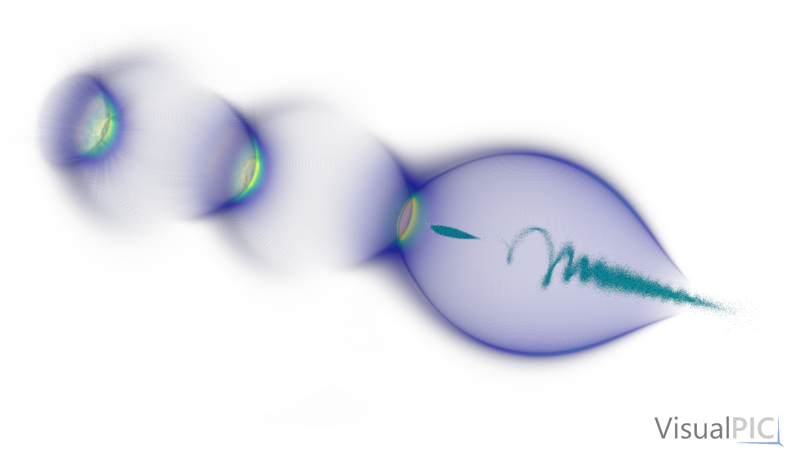
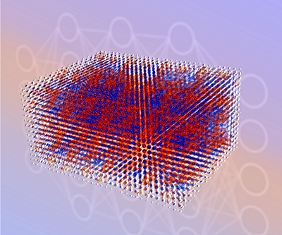
openPMD powered Projects and Users
Documents:
openPMD standard (1.0.0, 1.0.1, 1.1.0)
the underlying file markup and definition
A Huebl et al., doi: 10.5281/zenodo.33624
Language Binding:
openPMD-api (HZDR, CASUS, LBNL)
reference API for openPMD data handling
maintainers: A Huebl, J Gu, F Poeschel et al.
Wake-T (DESY)
fast particle-tracking code for plasma-based accelerators
maintainer: A Ferran Pousa
HiPACE++ (DESY, LBNL)
3D GPU-capable quasi-static PIC code for plasma accel.
maintainers: M Thevenet, S Diederichs, A Huebl
Bmad (Cornell)
library for charged-particle dynamics simulations
maintainers: D Sagan et al.
MALA (CASUS, SNL)
ML models that replace DFT calculations in materials science
maintainers: Attila Cangi & Sivasankaran Rajamanickam
and more…
HiPACE++ → VisualPIC
Credit: M.Thévenet
& A. Ferran Pousa (DESY)
Credit: M. Thévenet, A. Ferran Pousa
MALA → ParaView
Credit: A. Cangi (CASUS)
see also: https://github.com/openPMD/openPMD-projects

Slide 34


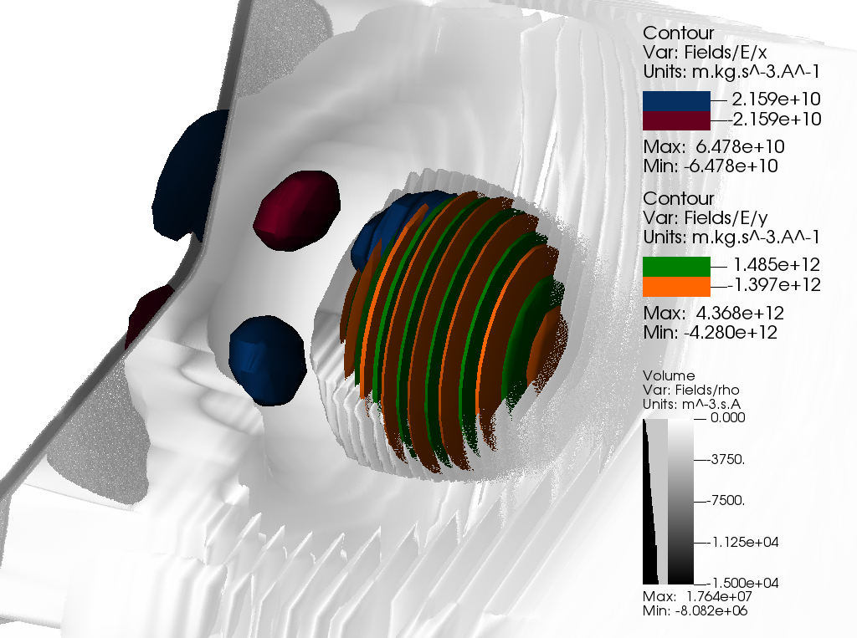





Analysis and Visualization
openPMD/openPMD-viewer
Standardization of data
→ integration into modern scientific compute workflows

Slide 35
Hands-On: openPMD-viewer: visualizing data written by a PIConGPU LaserWakefield simulation
Module environment at /project/project_465001310/workshop_software/env.sh
Materials at https://github.com/alpaka-group/alpaka-workshop-slides/tree/oct2024_workshop
Launch Notebook at https://www.lumi.csc.fi/
Read the instructions inside next_steps.md:

Slide 36
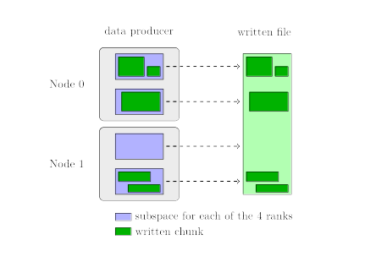
Comparing HDF5 and ADIOS2 files
HDF5’s output is structured
Simplest case: An n-dimensional dataset is represented as contiguous buffer
For most advanced features:
Divide the dataset into regular chunks
ADIOS2’s output is log-formatted
(log as in logbook, not logarithm)
→ Just write blocks as they
drop out of the data writer
Very efficient for writing,
read performance application-dependent
(e.g.: PIConGPU output is very clean)
Can handle sparse datasets
and overlapping regions
image from
https://www.hdfgroup.org/2017/05/24/hdf5-data-compression-demystified-2-performance-tuning/
openPMD includes heuristics
for setting the size automatically

Slide 37
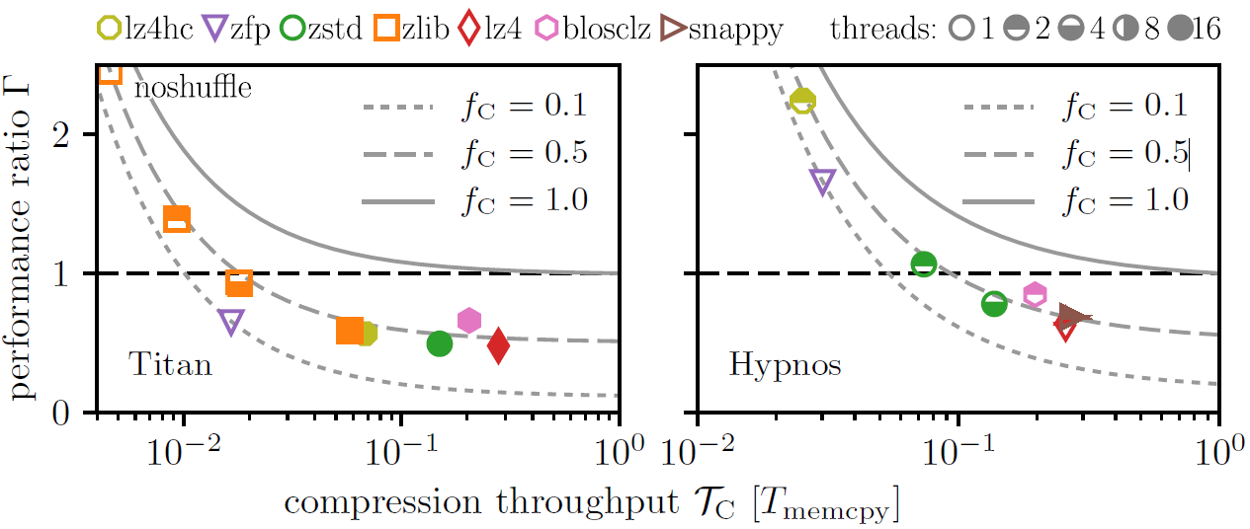
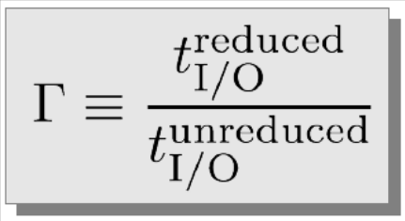
Data-driven Science
Just compress the data and everything will be fine …?
A. Huebl et al., "On the Scalability of Data Reduction Techniques in Current and Upcoming HPC Systems from an Application Perspective", In: Lect. Notes Comput. Sci. 10524.4, pp.15-20 (2017)

Slide 38
Hands-On: compression
Module environment at /project/project_465001310/workshop_software/env.sh
Materials at https://github.com/alpaka-group/alpaka-workshop-slides/tree/oct2024_workshop
Launch Notebook at https://www.lumi.csc.fi/
Continue with the instructions in the openPMD-viewer Notebook

Slide 39
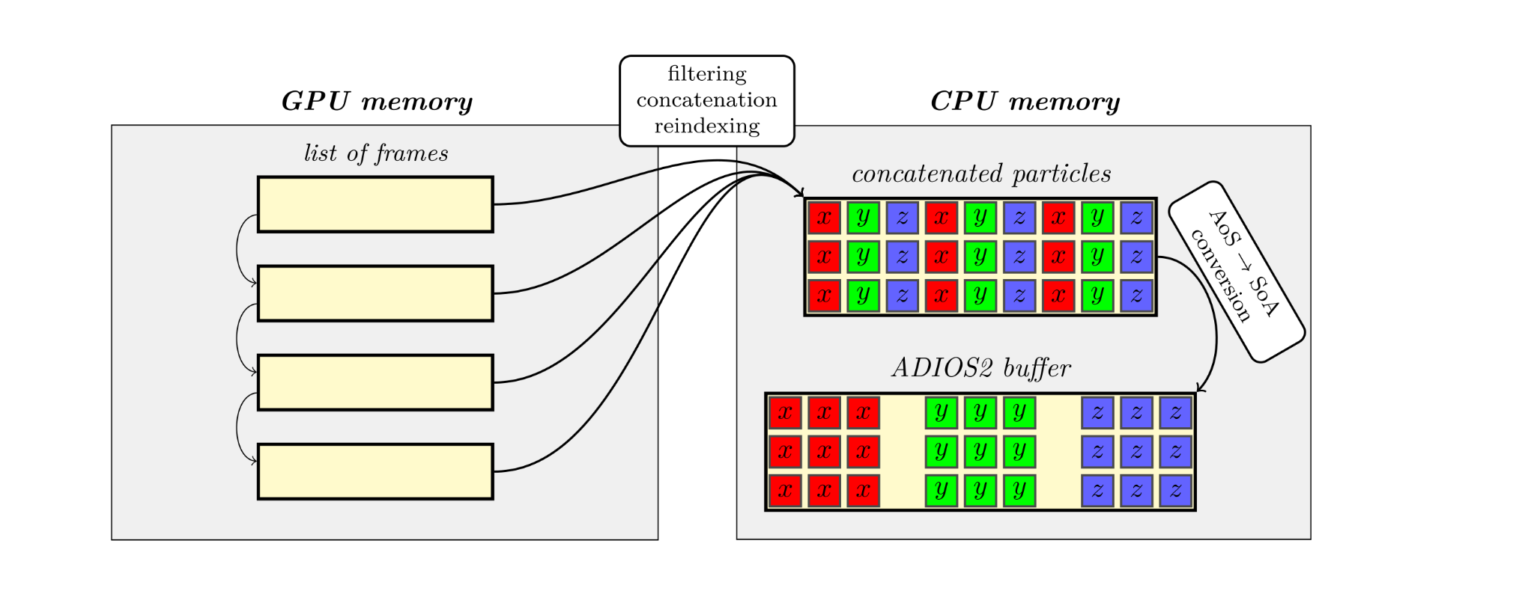
Data path in a realistic application
In real-world applications, data is often kept in a custom, algorithm-driven format
Reorganization needed before output
However: ADIOS2 (optionally) buffers data before output for I/O performance
Few big operations better than many small operations
Elide one data copy by writing directly into those internal buffers
Example:
Transforming PIConGPU particle data for output
Notes:
TODO: klaue die Folie vom ADIOS2-dev-Meeting

Slide 40
Advanced Hands-On: openPMD-api:
Span API
Module environment at /project/project_465001310/workshop_software/env.sh
Materials at https://github.com/alpaka-group/alpaka-workshop-slides/tree/oct2024_workshop
Launch Notebook at https://www.lumi.csc.fi/
Read the instructions inside src/openPMDOutput.hpp

Slide 41
Modeling particle data
uint32_t /data/particles/e/position/macroWeighted attr = 0
float /data/particles/e/position/timeOffset attr = 0
double /data/particles/e/position/unitDimension attr = {1, 0, 0, 0, 0, 0, 0}
double /data/particles/e/position/weightingPower attr = 0
float /data/particles/e/position/x {109134176} = 0 / 0
double /data/particles/e/position/x/unitSI attr = 1.772e-07
float /data/particles/e/position/y {109134176} = 0 / 0
double /data/particles/e/position/y/unitSI attr = 4.43e-08
float /data/particles/e/position/z {109134176} = 0 / 0
double /data/particles/e/position/z/unitSI attr = 1.772e-07
uint32_t /data/particles/e/positionOffset/macroWeighted attr = 0
float /data/particles/e/positionOffset/timeOffset attr = 0
double /data/particles/e/positionOffset/unitDimension attr = {1, 0, 0, 0, 0, 0, 0}
double /data/particles/e/positionOffset/weightingPower attr = 0
int32_t /data/particles/e/positionOffset/x {109134176} = 0 / 0
double /data/particles/e/positionOffset/x/unitSI attr = 1.772e-07
int32_t /data/particles/e/positionOffset/y {109134176} = 0 / 0
double /data/particles/e/positionOffset/y/unitSI attr = 4.43e-08
int32_t /data/particles/e/positionOffset/z {109134176} = 0 / 0
double /data/particles/e/positionOffset/z/unitSI attr = 1.772e-07
float /data/particles/e/weighting {109134176} = 0 / 0
uint32_t /data/particles/e/weighting/macroWeighted attr = 1
float /data/particles/e/weighting/timeOffset attr = 0
double /data/particles/e/weighting/unitDimension attr = {0, 0, 0, 0, 0, 0, 0}
double /data/particles/e/weighting/unitSI attr = 1
double /data/particles/e/weighting/weightingPower attr = 1
Let’s have a detailed look
at the electron species
written by PIConGPU…

Slide 42
Modeling particle data: mandatory records, vector vs. scalar
uint32_t /data/particles/e/position/macroWeighted attr = 0
float /data/particles/e/position/timeOffset attr = 0
double /data/particles/e/position/unitDimension attr = {1, 0, 0, 0, 0, 0, 0}
double /data/particles/e/position/weightingPower attr = 0
float /data/particles/e/position/x {109134176} = 0 / 0
double /data/particles/e/position/x/unitSI attr = 1.772e-07
float /data/particles/e/position/y {109134176} = 0 / 0
double /data/particles/e/position/y/unitSI attr = 4.43e-08
float /data/particles/e/position/z {109134176} = 0 / 0
double /data/particles/e/position/z/unitSI attr = 1.772e-07
uint32_t /data/particles/e/positionOffset/macroWeighted attr = 0
float /data/particles/e/positionOffset/timeOffset attr = 0
double /data/particles/e/positionOffset/unitDimension attr = {1, 0, 0, 0, 0, 0, 0}
double /data/particles/e/positionOffset/weightingPower attr = 0
int32_t /data/particles/e/positionOffset/x {109134176} = 0 / 0
double /data/particles/e/positionOffset/x/unitSI attr = 1.772e-07
int32_t /data/particles/e/positionOffset/y {109134176} = 0 / 0
double /data/particles/e/positionOffset/y/unitSI attr = 4.43e-08
int32_t /data/particles/e/positionOffset/z {109134176} = 0 / 0
double /data/particles/e/positionOffset/z/unitSI attr = 1.772e-07
float /data/particles/e/weighting {109134176} = 0 / 0
uint32_t /data/particles/e/weighting/macroWeighted attr = 1
float /data/particles/e/weighting/timeOffset attr = 0
double /data/particles/e/weighting/unitDimension attr = {0, 0, 0, 0, 0, 0, 0}
double /data/particles/e/weighting/unitSI attr = 1
double /data/particles/e/weighting/weightingPower attr = 1
position: mandatory record for particles
position is a vector quantity, i.e. has x/y/z
struct-of-array-like layout:
3 vectors of same length
positionOffset: also mandatory
specifies the base for the position
used for numerical reasons
weighting: custom record in PIConGPU
to model macro particles
scalar quantity, x/y/z is skipped

Slide 43
Modeling particle data: constant components
string /data/particles/e/currentDeposition attr = "Esirkepov"
string /data/particles/e/particleInterpolation attr = "uniform"
string /data/particles/e/particlePush attr = "Boris"
double /data/particles/e/particleShape attr = 2
string /data/particles/e/particleSmoothing attr = "none"
int32_t /data/particles/e/charge/macroWeighted attr = 0
uint64_t /data/particles/e/charge/shape attr = {109134176}
double /data/particles/e/charge/timeOffset attr = 0
double /data/particles/e/charge/unitDimension attr = {0, 0, 1, 1, 0, 0, 0}
double /data/particles/e/charge/unitSI attr = 1.11432e-15
double /data/particles/e/charge/value attr = -0.00014378
double /data/particles/e/charge/weightingPower attr = 1
int32_t /data/particles/e/mass/macroWeighted attr = 0
uint64_t /data/particles/e/mass/shape attr = {109134176}
double /data/particles/e/mass/timeOffset attr = 0
double /data/particles/e/mass/unitDimension attr = {0, 1, 0, 0, 0, 0, 0}
double /data/particles/e/mass/unitSI attr = 6.33564e-27
double /data/particles/e/mass/value attr = 0.00014378
double /data/particles/e/mass/weightingPower attr = 1
uint32_t /data/particles/e/momentum/macroWeighted attr = 1
float /data/particles/e/momentum/timeOffset attr = 0
double /data/particles/e/momentum/unitDimension attr = {1, 1, -1, 0, 0, 0, 0}
double /data/particles/e/momentum/weightingPower attr = 1
float /data/particles/e/momentum/x {109134176} = 0 / 0
double /data/particles/e/momentum/x/unitSI attr = 1.89938e-18
float /data/particles/e/momentum/y {109134176} = 0 / 0
double /data/particles/e/momentum/y/unitSI attr = 1.89938e-18
float /data/particles/e/momentum/z {109134176} = 0 / 0
double /data/particles/e/momentum/z/unitSI attr = 1.89938e-18
particle attributes defined
by the ED-PIC extension
charge and mass:
are fixed for one particle species,
i.e. record has one constant value
→ define via attributes shape and value
instead of writing the whole array
scalar quantities as well
momentum:
again a non-constant
vector quantity

Slide 44
Modeling particle data: particle patches
Common case: Each GPU computes one sub-areal of the global simulation space
→ Particles are written in patches,
each GPU’s patch is spatially bounded
offset/extent define the box
wherein the particles are located
numParticlesOffset/numParticles define the patch’s position in the list
uint64_t /data/1000/particles/e/particlePatches/offset/x {8}
(0) 0 0 0 0 96 96 96 96
uint64_t /data/1000/particles/e/particlePatches/offset/y {8}
(0) 0 512 1024 1536 0 512 1024 1536
uint64_t /data/1000/particles/e/particlePatches/offset/z {8}
(0) 0 0 0 0 0 0 0 0
uint64_t /data/1000/particles/e/particlePatches/extent/x {8}
(0) 96 96 96 96 96 96 96 96
uint64_t /data/1000/particles/e/particlePatches/extent/y {8}
(0) 512 512 512 0 512 512 512 0
uint64_t /data/1000/particles/e/particlePatches/extent/z {8}
(0) 192 192 192 192 192 192 192 192
uint64_t /data/1000/particles/e/particlePatches/numParticlesOffset {8}
(0) 0 16916087 35692896 54567264 54567264 71482787 90259808 109134176
uint64_t /data/1000/particles/e/particlePatches/numParticles {8}
(0) 16916087 18776809 18874368 0 16915523 18777021 18874368 0
e.g.: GPU 0 computes the box
(0, 0, 0)–(96, 512, 192)
(in simulation units),
its electron data is found
from index 0 to 16916087
Note: extent is always
relative to the offset
green: GPU 0

Slide 45
Advanced Hands-On: openPMD-api:
Python API: constant components
Module environment at /project/project_465001310/workshop_software/env.sh
Materials at https://github.com/alpaka-group/alpaka-workshop-slides/tree/oct2024_workshop
Launch Notebook at https://www.lumi.csc.fi/
Read the TODO comments inside write_parallel.py

Slide 46
Using parallel filesystems
Lumi uses Lustre,
a popular parallel filesystem
Parallel filesystems are built from distributed hardware
One ore more metadata servers manage one or more metadata targets
Many object storage servers manage each one or more object storage targets
Key to I/O performance:
Use the parallel resources
(but mind that they are shared with other users)
Image from
https://docs.lumi-supercomputer.eu/storage/parallel-filesystems/lustre/

Slide 47
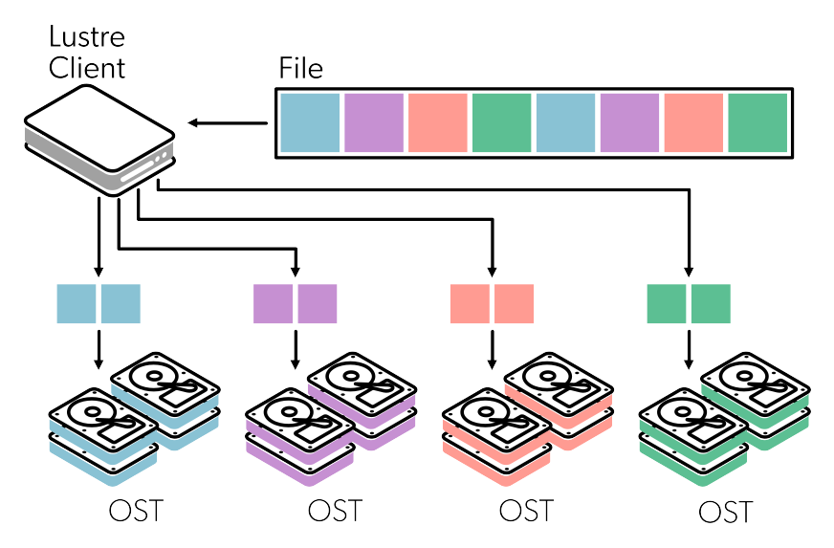
File striping – an approach at parallel I/O performance
Write file in parallel by striping it across multiple OSTs
stripe_size sets the homogeneous length of each stripe
stripe_count sets the number of used OSTs
Main use:
Improving speed of serial I/O
Improving speed of parallel I/O
to a single file
At low scale: Improving speed of parallel I/O to multiple files
Better: Write multiple files
from the start already → Subfiling
Image from
https://docs.lumi-supercomputer.eu/storage/parallel-filesystems/lustre/

Slide 48
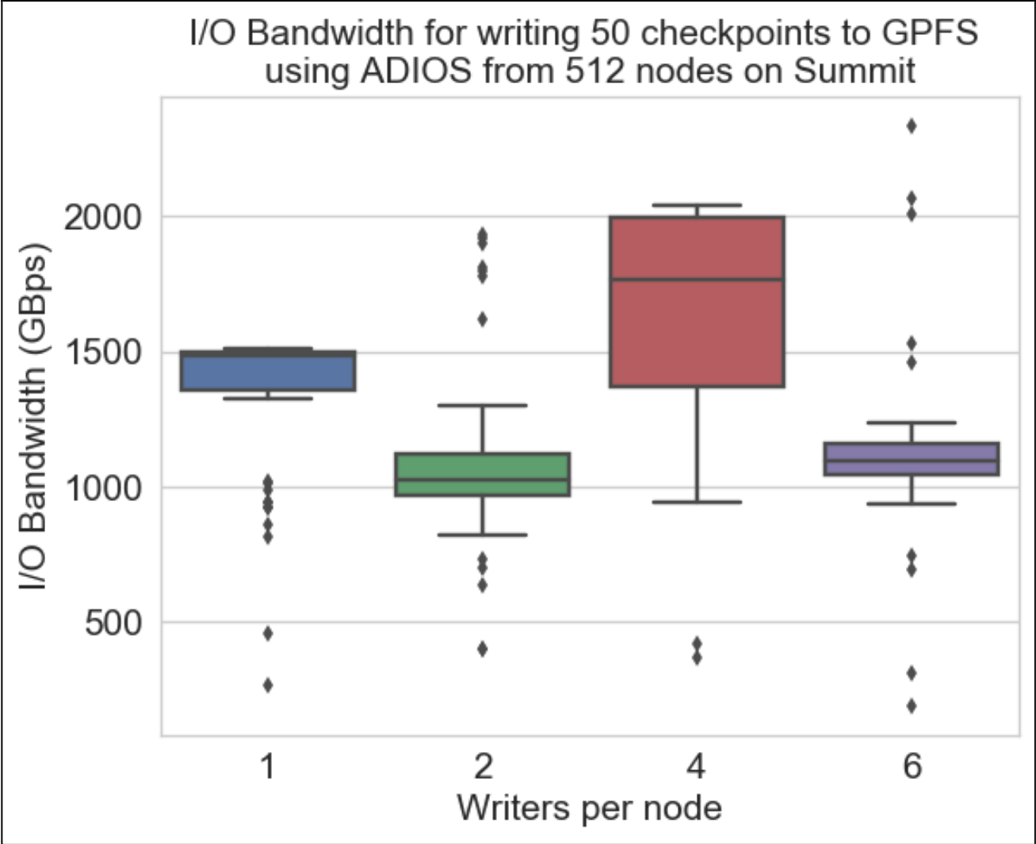
Subfiling – key for performance at full scale
openPMD-api w/ WarpX
Subfiling is NOT independent I/O
Mapping processes to files N:1 scales badly
Mapping processes to files N:N scales up to a mediocre size, then overloads the filesystem
Subfiling: N:M mapping where M≤N
Many different aggregation schemes in ADIOS2 and HDF5, one size does not fit all
ADIOS2: Aggregate to one writer per node by default
HDF5: Complex N→N aggregation scheme due to structured output to disk
>5.5TB/s FS BW: two-tier lustre w/ high-performance storage & progressive files
L. Wan et al.: Data Management Challenges of Exascale Scientific Simulations:
A Case Study with the Gyrokinetic Toroidal Code and ADIOS

Slide 49
Advanced Hands-On: openPMD-api:
Python API: Parallel Writing
Module environment at /project/project_465001310/workshop_software/env.sh
Materials at https://github.com/alpaka-group/alpaka-workshop-slides/tree/oct2024_workshop
Launch Notebook at https://www.lumi.csc.fi/
Read the TODO comments inside write_parallel.py

Slide 50
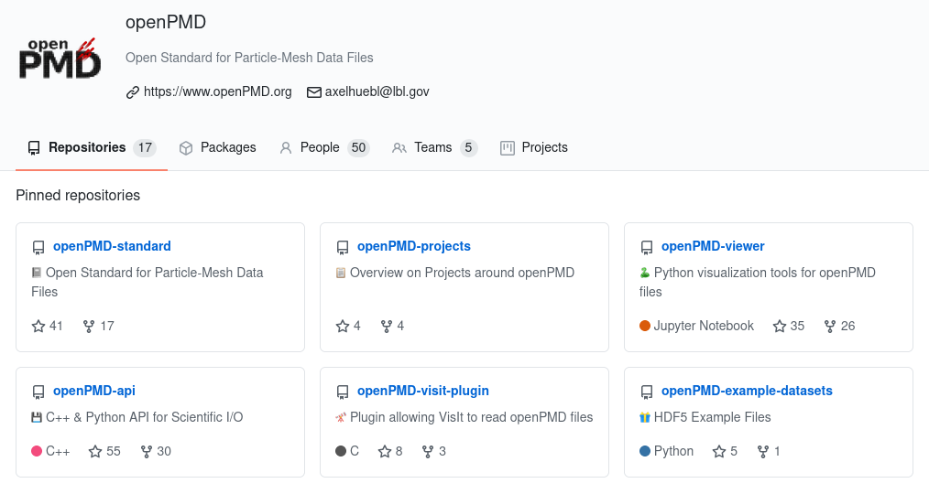

Where to find us
→ head to https://github.com/openPMD/
…and of course https://openpmd-api.readthedocs.io/
openpmd.slack.com
Notes:
TODO: Slack-Link
openpmd.slack.com

Slide 51
Community www.openPMD.org
The openPMD standard is co-authored by Axel Huebl, Rémi Lehe, Jean-Luc Vay, David P. Grote, Ivo F. Sbalzarini, Stephan Kuschel, David Sagan, Frédéric Pérez, Fabian Koller, Franz Poeschel, Carsten Fortmann-Grote, Ángel Ferran Pousa, Juncheng E, Maxence Thévenet, and Michael Bussmann.
The authors are thankful for the community contributions to libraries, software ecosystem, user support, review and integrations. Particularly, thank you to Yaser Afshar, Lígia Diana Amorim, James Amundson, Weiming An, Igor Andriyash, Ksenia Bastrakova, Jean Luca Bez, Richard Briggs, Heiko Burau, Jong Choi, Ray Donnelly, Dmitry Ganyushin, Marco Garten, Lixin Ge, Berk Geveci, Daniel Grassinger, Alexander Grund, Junmin Gu, Marc W. Guetg, Ulrik Günther, Sören Jalas, Manuel Kirchen, John Kirkham, Scott Klasky, Noah Klemm, Fabian Koller, Mathieu Lobet, Christopher Mayes, Ritiek Malhotra, Paweł Ordyna, Richard Pausch, Norbert Podhorszki, David Pugmire, Felix Schmitt, Erik Schnetter, Dominik Stańczak, Klaus Steiniger, Michael Sippel, Frank Tsung, Lipeng Wan, René Widera, and Erik Zenker!

Slide 52

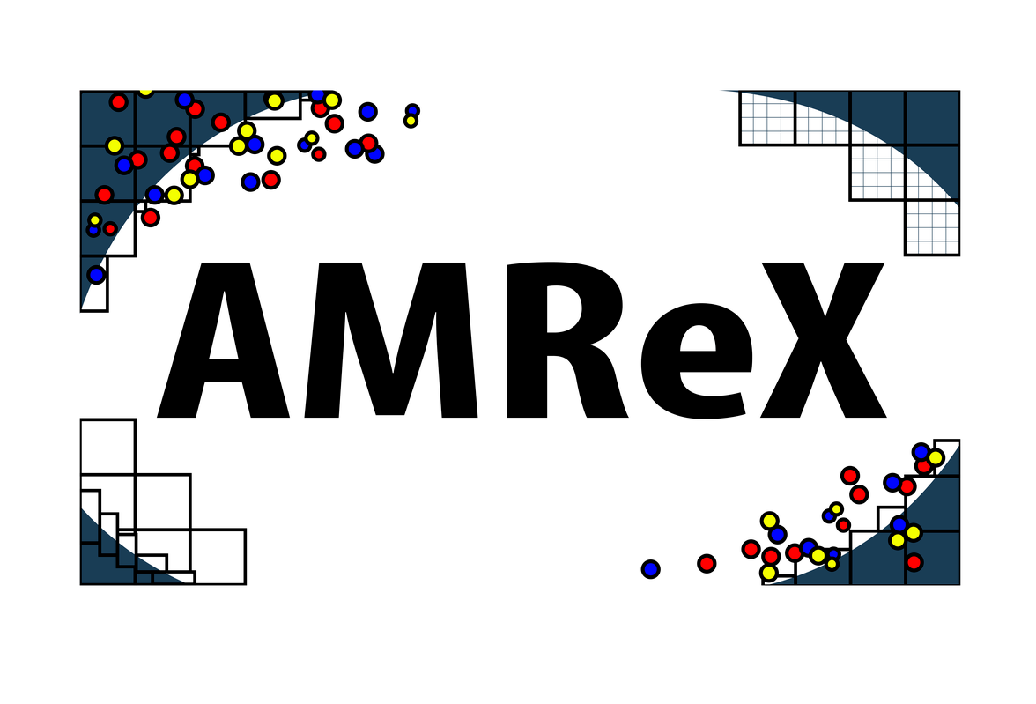
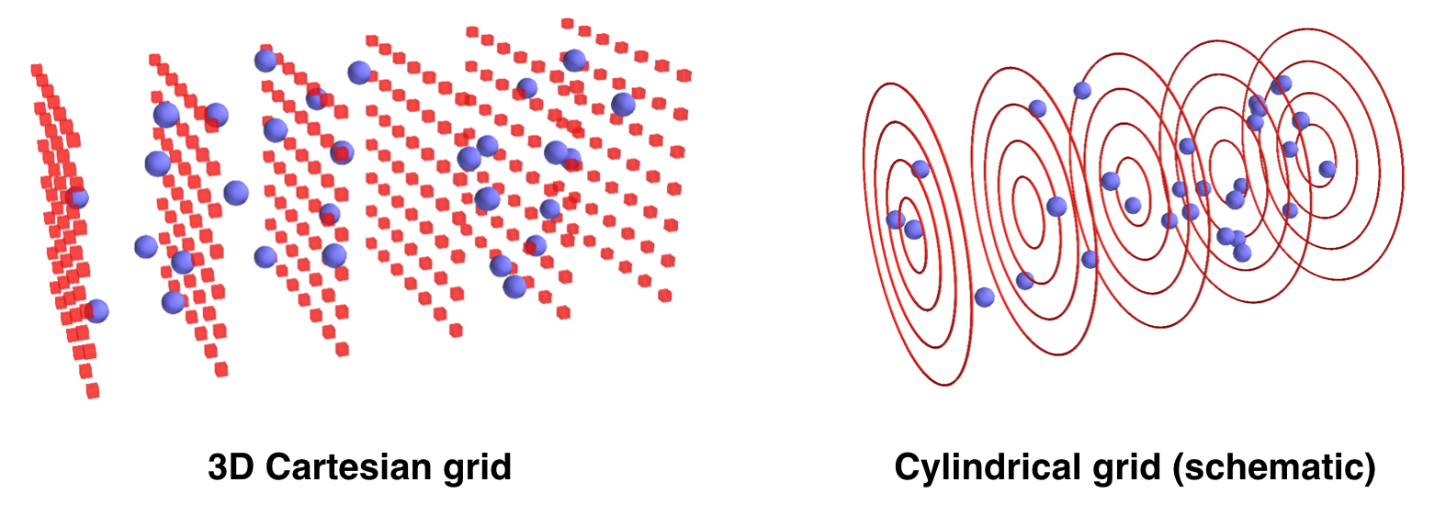

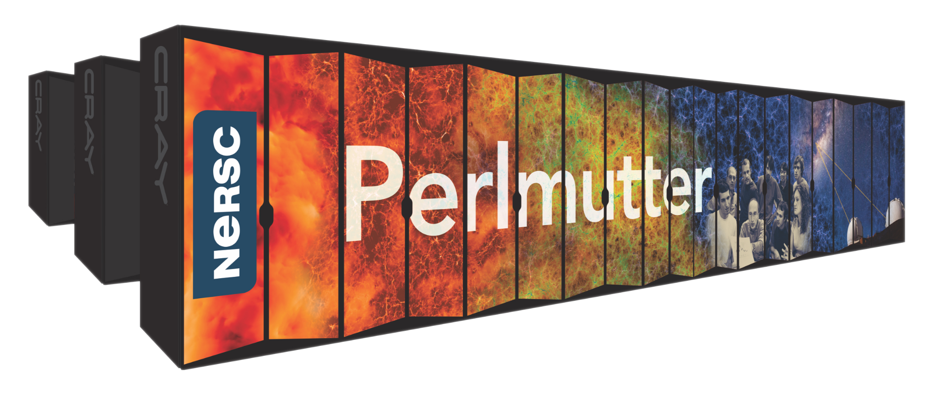







openPMD: Block-Structured Mesh-Refinement (WarpX)
Slide by Axel Huebl (LBNL)
WarpX Particle-in-Cell Code
implemented on AMReX
structured fields + many particles
Geometries
1D3V, 2D3V,
3D3V and
RZ (quasi-
cylindrical)
WarpX was first PIC code to win prestigious ACM Gordon Bell award, the “Oscars” of Supercomputing.
Block-Structured Mesh-Refinement in openPMD
ADIOS2:
  variable: 1 per level
  fill with partial blocks
HDF5:
  one variable per patch,
  N per level
  overhead…? see: Elena's sparsity proposal
alternative: AMReX HDF5
1 variable per level, but loses HDF5 self-description (concatenated patches)
level=0
open source
ecp-warpx.github.io
2
Multi-Node parallelization
MPI: 3D domain decomposition
dynamic load balancing
On-Node Parallelization
GPU: CUDA, HIP and SYCL
CPU: OpenMP
>100TB per output
Multi-PB per sim
1
Ref.: github.com/openPMD/openPMD-standard/pull/252

