Slide 1



PIConGPU: Designing An Application
On the shoulders of alpaka, openPMD and beyond...
CASUS · HZDR · Julian Lenz · j.lenz@hzdr.de · www.casus.science

Slide 2
Highlights of PIConGPU’s adaption of alpaka, openPMD
and more...
Execution and lockstep programming
Memory Management
Tailored kernel execution interface
Abstraction for iterations
Static: HostDeviceBuffer
Dynamic: MallocMC
I/O and In-Situ Processing
Other Learnings
OpenPMD as a backend
Plugin system
Floating point precision and normalisation
Performance tuning
Professional software development
…

Slide 3
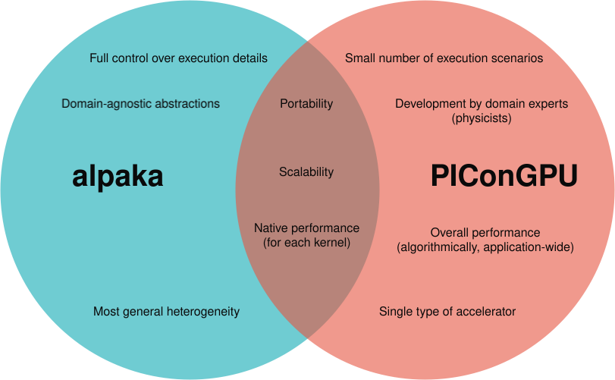
alpaka is not (yet!) tailored to your needs
Design goals, requirements and constraints

Slide 4
Execution & Lockstep
Tailored kernel definition and execution

Slide 5
The Idea: An Interface Fitting Your Task
Lockstep Programming
The Physicist’s Task
The Software Engineer’s Tasks
Conceptually most of our code is this:
Physicist: Write the process(cell) function.
Keeping track of parallelisation parameters
Handling indices
Bounds checks
Distributing work amongst threads
Handling special cases
...
void processAllCells() {
for (auto& cell : cells)
{
process(cell);
}
}
Provide a suitable interface!
The details of your application of alpaka are not generic to all applications.
But within your application you should provide tailored abstractions and interfaces!

Slide 6
The ForEach API: Abstracting iteration
Lockstep Programming
PIConGPU’s ForEach User Code
auto processAllCells = [] ALPAKA_FN_ACC (auto const& worker) {
auto forEachCell = makeForEach<numberOfCells>(worker);
forEachCell(
[](uint32_t const idx) {
process(cells[idx]);
}
);
};
What does ForEach do? (see include/pmacc/lockstep/ForEach.hpp)
Keep track of parallelisation parameters (152-154)
Iteration with bounds checks, grid striding, etc. (192-232)
Handle special cases like single-threading (235-243)

Slide 7
Tailored Execution: Exposing What You Need
Kernel execution
The PMACC_LOCKSTEP_KERNEL Macro
constexpr uint32_t blockSize = 32U;
uint32_t const numBlocks = 16U;
PMACC_LOCKSTEP_KERNEL(processAllCells)
.config<blockSize>(numBlocks)
(/*... we could pass arguments here... */);
The Call Stack (see include/pmacc/lockstep/Kernel.hpp and include/pmacc/exec/KernelLauncher.hpp)
PMACC_LOCKSTEP_KERNEL (Kernel.hpp#295 → 281) → KernelPreparationWrapper (70)
  debugging information, user kernel, launcher factory
.config<...>(...) (100) → KernelLauncher (KernelLauncher.hpp#49)
  execution details (in PIConGPU data structures), application context (event system, etc.)
.operator() (87)
  translate details to alpaka data structures, call alpaka::enqueue(…), inform event system

Slide 8
The Worker: Accelerator++
Execution & Lockstep
template<typename T_Acc, typename T_BlockCfg>
class Worker {
T_Acc const& m_acc;
uint32_t const m_workerIdx;
static constexpr uint32_t numWorkers(){
return T_BlockCfg::numWorkers();
}
static constexpr uint32_t blockDomSize() {/*...*/}
static constexpr auto blockDomSizeND() {/*...*/}
// ...
void sync() const {
alpaka::syncBlockThreads(m_acc);
}
// ...
};
See /include/pmacc/lockstep/Worker.hpp

Slide 9
A (Trivial) Real-World Example: Generating an ID
Execution & Lockstep
class IdProvider { // include/pmacc/IdProvider.hpp
// ...
uint64_t getNewIdHost() {
HostDeviceBuffer<uint64_t, 1> newIdBuf(DataSpace<1>(1));
auto kernel = [] ALPAKA_FN_ACC
(auto const& acc, auto idGenerator, uint64_t* nextId)
-> void {
*nextId = idGenerator.fetchInc(acc);
};
PMACC_LOCKSTEP_KERNEL(kernel)
.config<1>(1)
(getDeviceGenerator(), newIdBuf.getDeviceBuffer().data());
newIdBuf.deviceToHost();
return *newIdBuf.getHostBuffer().data();
}
// ...
};

Slide 10
A (Non-Trivial) Real-World Example: Transition Rates
Lockstep Programming
What does it do? (see /include/picongpu/particles/atomicPhysics/kernel/FillLocalRateCache_BoundFree.kernel#L193)
Request and initialise shared memory (214-228)
  Only one single thread in use
  PMACC_SMEM forwards to alpaka::declareSharedVar
  makeMaster forwards to makeForEach<1, 1>
Min/Max reduction over cells (230-258)
  One thread handles one cell
  Use atomics on shared memory
Reduction of ~N² transition rates to one sum per state (260-303)
  One thread handles transitions from one state
  Thread-local reduction doesn’t need atomics

Slide 11
Summary: Trade-Offs
Lockstep Programming
Advantages
Restrictions of generality
Clean interface & reduction of boilerplate
Versatile iteration schemes
Compile-time known memory access
Library agnostic
Block sizes must be compile-time const
Execution details are inaccessible to user
(device, queue, accelerator)

Slide 12
Outlook: That’s just a tiny glimpse
Lockstep Programming
Features we didn’t cover
Another layer of abstraction to iterate through our most common data structures
ContextVariables allow carrying state between ForEachs
Self-aware functors can express constraints on their execution parameters
Might be coming to alpaka!
Lessons learnt
Adoption of alpaka is best performed via…
  an application-specific interface layer...
  concretising (and hiding) application-specific choices.

Slide 13
Memory Management
Domain-specific memory handling

Slide 14
Integration into application context: Static == Fields
Memory Management
alpaka::Buf
PMacc’s requirements
Basics: malloc/free
Metadata: type, extent and pitch (host only)
Explicit interface and fully flexible:
  Device
  Queues
Convenient interface (STL-like, ...)
Metadata: on device!
Concrete environment:
  Fixed device
  Integration into event system
Association of host and device buffers
Communication awareness (MPI)
alpaka::Buf
(storage)
pmacc::HostBuffer
pmacc::DeviceBuffer
(interface implementation)
pmacc::HostDeviceBuffer
(association)
pmacc::GridBuffer
(communication awareness)
pmacc::Buffer
(interface & metadata)
See /include/pmacc/memory/buffers/<class name>.hpp

Slide 15
Single Buffers
Memory Management (static)
pmacc::Buffer
Interface & default implementations
Stores own size in alpaka::Buf
Models memory owning
alpaka::Buf
(storage)
pmacc::HostBuffer
pmacc::DeviceBuffer
(interface implementation)
pmacc::HostDeviceBuffer
(association)
pmacc::GridBuffer
(communication awareness)
pmacc::Buffer
(interface & metadata)
See /include/pmacc/memory/buffers/<class name>.hpp

Slide 16
Single Buffers
Memory Management (static)
pmacc::HostBuffer & pmacc::DeviceBuffer
Keep memory in alpaka::Buf
Stores size on device
Operations interact with event system
Provides copy operations
alpaka::Buf
(storage)
pmacc::HostBuffer
pmacc::DeviceBuffer
(interface implementation)
pmacc::HostDeviceBuffer
(association)
pmacc::GridBuffer
(communication awareness)
pmacc::Buffer
(interface & metadata)
See /include/pmacc/memory/buffers/<class name>.hpp

Slide 17
Double Buffers
Memory Management (static)
pmacc::HostDeviceBuffer
Associates one host and one device buffer
Adds sync operations for convenience
alpaka::Buf
(storage)
pmacc::HostBuffer
pmacc::DeviceBuffer
(interface implementation)
pmacc::HostDeviceBuffer
(association)
pmacc::GridBuffer
(communication awareness)
pmacc::Buffer
(interface & metadata)
See /include/pmacc/memory/buffers/<class name>.hpp

Slide 18
Double Buffers
Memory Management (static)
pmacc::GridBuffer
MPI communication interface
  send
  receive
  sync
Awareness of memory distribution
alpaka::Buf
(storage)
pmacc::HostBuffer
pmacc::DeviceBuffer
(interface implementation)
pmacc::HostDeviceBuffer
(association)
pmacc::GridBuffer
(communication awareness)
pmacc::Buffer
(interface & metadata)
See /include/pmacc/memory/buffers/<class name>.hpp

Slide 19
Integration into application context: Static == Fields
Memory Management
alpaka::Buf
PMacc’s requirements
Basics: malloc/free
Metadata: type, extent and pitch (host only)
Explicit interface and fully flexible:
  Device
  Queues
Convenient interface (STL-like, ...)
Metadata: on device!
Concrete environment:
  Fixed device
  Integration into event system
Association of host and device buffers
Communication awareness (MPI)
alpaka::Buf
(storage)
pmacc::HostBuffer
pmacc::DeviceBuffer
(interface implementation)
pmacc::HostDeviceBuffer
(association)
pmacc::GridBuffer
(communication awareness)
pmacc::Buffer
(interface & metadata)
See /include/pmacc/memory/buffers/<class name>.hpp

Slide 20
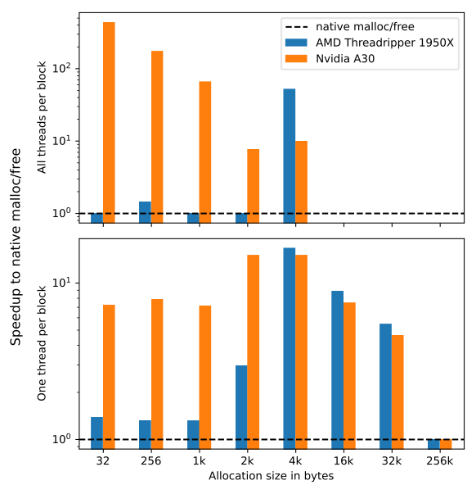
mallocMC: Dynamic == Particles
Memory Management
Particles move around,…
... so we need dynamic, in-kernel allocations!
Memory usage pattern:
    Allocate static memory on host and device.
    Reserve remaining device memory.
    Dynamically allocate particles...
    … on host (standard malloc/free) and
    … on device within reservation (mallocMC).
    Quantise allocations in „particle frames“.

Slide 21
I/O And Processing
Build only what you’re an expert in

Slide 22
I/O should be a thin layer in your application
I/O And Processing
You are...
… most likely not an expert in (all) distributed file systems and file formats.
… probably not paid for becoming one.
… hopefully an expert in how your numbers in memory shall related to numbers on disk.
Conclusion
You should employ a capable backend and
only code the domain specifics on top.
``

Slide 23



Success Stories
I/O And Processing
Migrating to Frontier
Enabling streaming
World’s largest supercomputer
Problem: I/O ran out of CPU memory
Solution: New ADIOS2 engine
Diff: +0 -0
Avoid filesystem limitations
Solution: openPMD streaming API
Diff: +72 -19
Writing Metadata
Open Source: Advance the community
Metadata is backend independent.
Problem: Different APIs for file formats
Solution: openPMD’s tailored API
Diff: +162 -395
Allow aspects to mature in implementations.
Contribute back:
  ED-PIC extension
  Dataset-specific compression

Slide 24
Further Learnings
Everything else we could possibly think off...

Slide 25
Precision and Normalisation
Know your limits and go beyond them!
Floating-point precision matters!
Example: Laser-Plasma Physics
Smaller type = larger memory throughput
Specialisation of hardware (not always!)
Rounding errors accumulate
Domain’s values might span large ranges
Speed ~ speed of light ~ 10⁸ m/s
Time ~ plasma freq ~ PIC time step ~ 10⁻¹⁶ s
Mass ~ macro-particle electron ~ 10²⁵⁻³¹ kg
Length ~ Time * Speed ~ 10⁻⁸ m
Normalisation and the unit system (see /include/picongpu/unitless/simulation.unitless)
In appropriate units all occuring numbers will be close to one. → Low precision required.
Configurable precision allows easier adaption to new hardware.
Implementing a unit system allows convenient interfacing with domain experts.
Not all operations allow reduced precision! (Example: sqrt)

Slide 26
Performance Tuning and Optimisation
Some Tips and Tricks
Understand your code!
Everything happens for a reason!
Compilers and tools are always right (except for when they are wrong)!
Benchmark, trace and profile (potentially roofline models for bottlenecks)
Feedback from production (ask users, check logs, check cluster statistics, ...)
alpaka: Tips and Tricks
alpaka compiles to native code. → Use vendor tools!
  Typically optimisations boost all vendors (but not all hardware types).
Single-header alpaka for compiler explorer
Check register counts, spills and occupancies: -Dalpaka_CUDA_SHOW_REGISTERS
Use -Dalpaka_DEBUG=2 to check workDivs

Slide 27
Professional Software Development
The Basics
Automated testing and continuous integration
→ Vary architectures, compilers and libraries, too!
Manage contributions
→ Pull requests, issues, code reviews, …
Communicate about your code
→ Ask questions, pair programming, code reviews, …
Less is more!
→ If your team is small, keep your code small! (If your team is large, still keep your code small!)

Slide 28
Thanks for the attention!

