Slide 1

INFO 5100 : FINAL PROJECT
Submitted By : Alpana Pothukuchi - 001217567
Anusha Jain - 001224049
Radhika Maheshwari - 001226514

Slide 2
Outline
1) Problem Statement 2) Proposed Solution 3) Object Model 4) Key Roles 5) Key Features 6) Extra Features

Slide 3
Problem Statement
False insurance claims are hazard to all the insurance companies, which are being claimed in numbers and bringing billions of dollars of loss to the insurance economy. Every insurance provider is a victim of these bogus claims and would want to implement measures against this malpractice.

Slide 4
Proposed Solution
The aim of project is to build a system which will help to establish a good and trusted communication between the customer , insurance company , hospital and pharmacy.

Slide 5
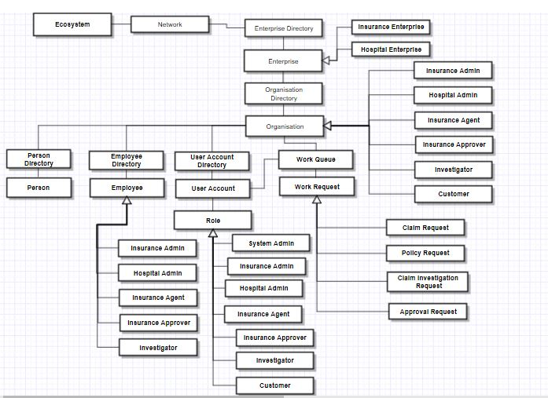
Object Model

Slide 6
Key Roles
Insurance Enterprise
Customer
Insurance Admin
Insurance Agent
Insurance Approver
Insurance Investigator
Hospital Enterprise
Hospital Admin
Pharmcist

Slide 7
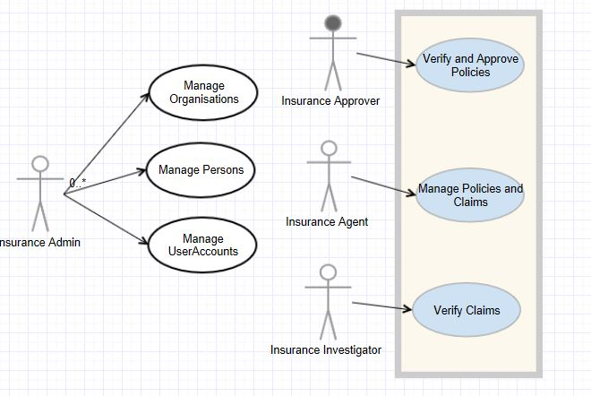
Use Case Scenarios

Slide 8
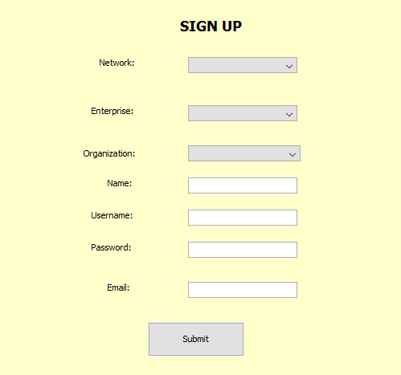
Use Case 1: The customer can request for a policy which will be approved based on the vital signs of patient sent from hospital.
1) Customer will sign up using the ‘New Customer’ button on the Main Jframe.

Slide 9
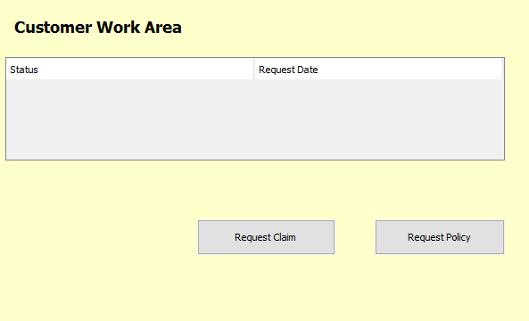
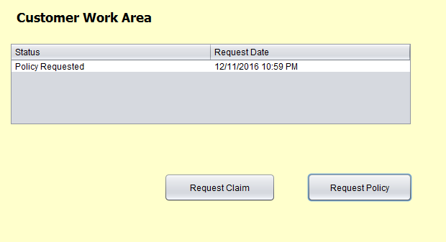
2) After Customer is logged in, they will land on the customer work area panel from where the customer can request for a claim or a policy. 3) Depending on what the customer chooses, a new policy will get generated.

Slide 10
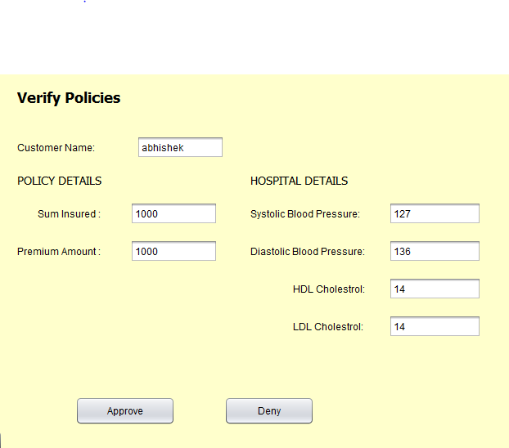
4) After the policy has reached the agent, it sends the same to the approver for verification of vital signs. Based on the details, the approver will approve or deny the request.

Slide 11
Use Case 2: The customer can request for a claim which will be detected as genuine or fraud based on the treatment details of patient sent from hospital.

Slide 12
Key Features:
Java Mail - Every time a request gets initiated, an email gets sent to the respective person.
IOT Implementation – The Vital Signs of the patient are taken into the system through a sensor based chip which a person can wear on his body like a tattoo.

Slide 13
Extra Features
Java Mail
DB40 implementation

Slide 14
Thank You ☺

