Slide 1
Genetic Sudoku
INFO6205 – Final Project
Problem Statement : Solving a N*N sudoku puzzle using genetic algorithm
Pranay Goyal
Alpana Pothukuchi

Slide 2
Contents
Introduction
  Sudoku
  Genetic Algorithm
Implementation
Code Snippets
Running the code
Running the unit tests
Results

Slide 3
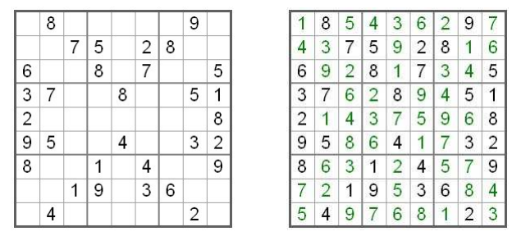
Introduction
Sudoku : It is a logic-based, combinatorial number-placement puzzle. Arrangement of numbers 1-9 in a 9*9 grid without repetition of digits in any row/ column / 3*3 sub-grid. Partially filled grid is the input.

Slide 4
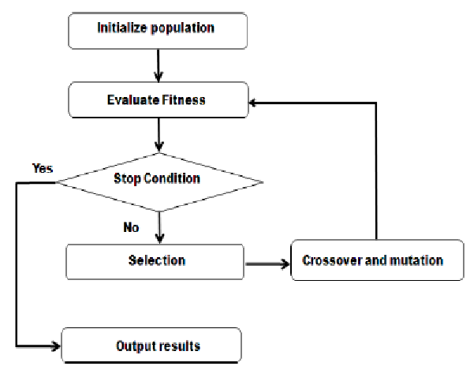
Introduction
Genetic Algorithm : It is a way of solving problems by mimicking the same processes nature uses. They use the same combination of selection, recombination and mutation to evolve a solution to the problem.

Slide 5
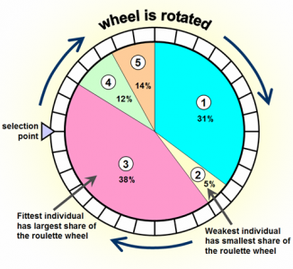
Implementation
Genes: Genotype is a 1-D array (or lists) of numbers.
Initial Gene: A partially filled grid given as input and the empty spaces are filled with 0.
Fitness Function: Genes are evaluated by counting the number of duplicate numbers in rows or columns or sub-grids. Fewer duplicates presumably means a better solution gene.
Fitness function = Row fitness + Column fitness + Sub-square fitness
Selection: Selection is done in two ways:
  Best Selection : The best gene is selected based on the fitness score.
  Roulette wheel Selection : Gene is selected based on roulette wheel method.
  This image explains the method clearly.

Slide 6
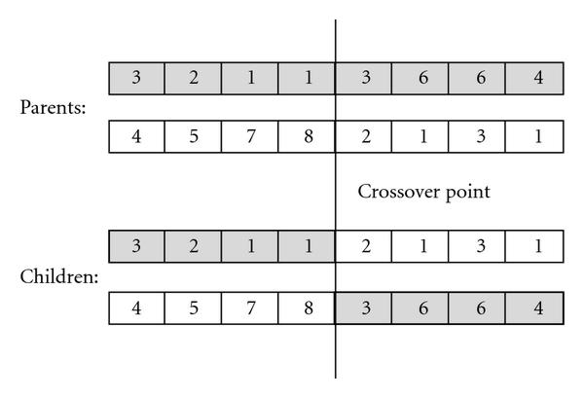
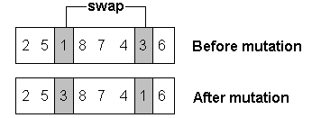
Implementation
Population: Indicates the number of genes in each generation.
Genetic Operators: Crossover or Mutation are chosen randomly for genes to produce a offspring.
  Crossover: Performs crossover of two selected genes and produces a new gene.
  Mutation: Performs mutation by swapping the digits in the gene array.

Slide 7
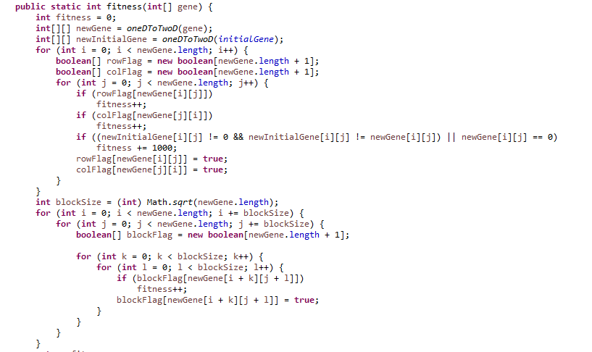
Code Snippets (Implementation)
Fitness function:

Slide 8
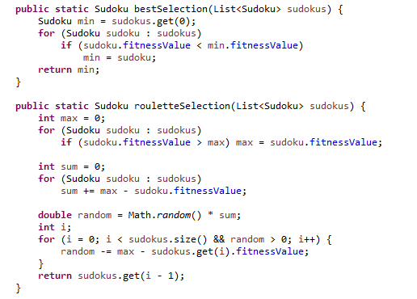
Code Snippets (Implementation)
Selection:

Slide 9
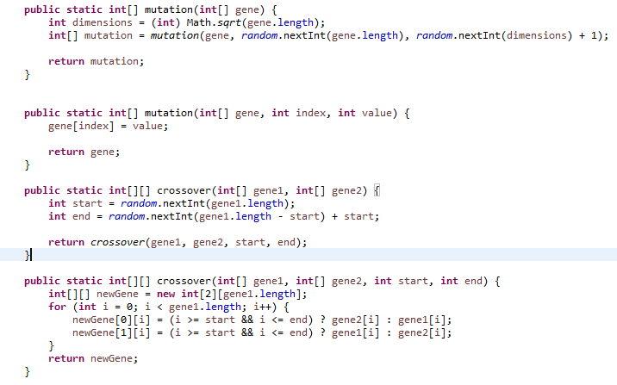
Code Snippets (Implementation)
Genetic Operators:

Slide 10
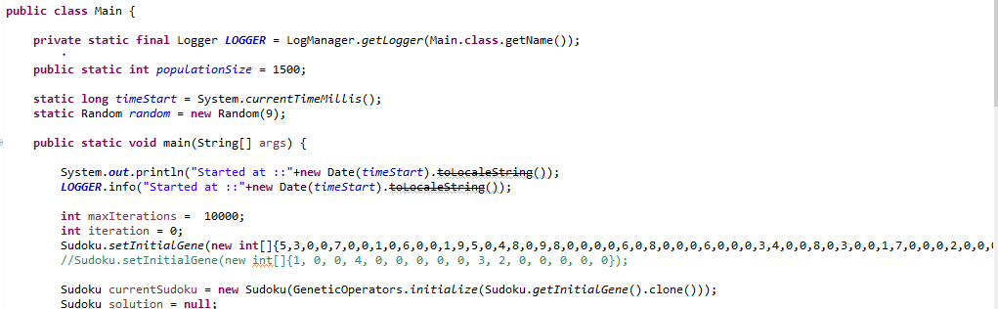
Running the code
To run the program, we can directly run the Main method.
The following parameters can be modified in main method, which will affect the program working:
Population size : number of genes to consider in a population.
Initial Gene : the partially filled puzzle passed as an integer array.
Iterations : Generations of chromosomes.

Slide 11
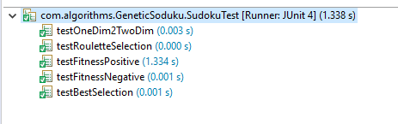
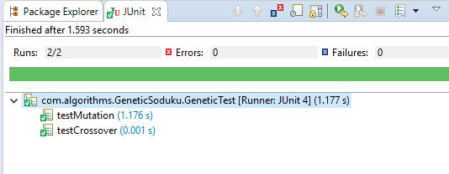
Running the JUnit Tests
Unit Tests have been developed for checking the following test cases:
For Sudoku :
  Testing the fitness function.
  Testing the function that converts one dimensional array to two dimensional array.
  Testing the tournament selection (best selection) function.
  Testing the roulette wheel selection function.
For Genetic :
  Testing the mutation function.
  Testing the crossover function.

Slide 12
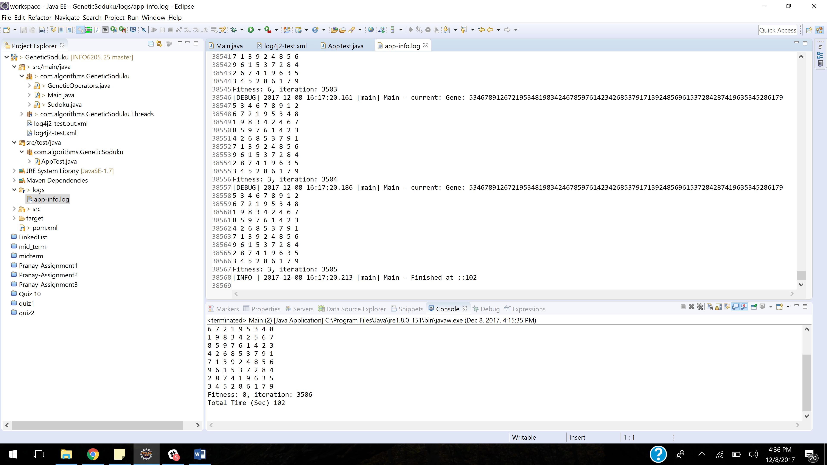
Results
The algorithm runs for any N*N sudoku grid, where N is a perfect square.
If the solution is not achieved in certain number of iterations (generations), then the GA will restart.
Ideal solution of fitness score 0 is obtained in 100-200 seconds.

