Slide 1
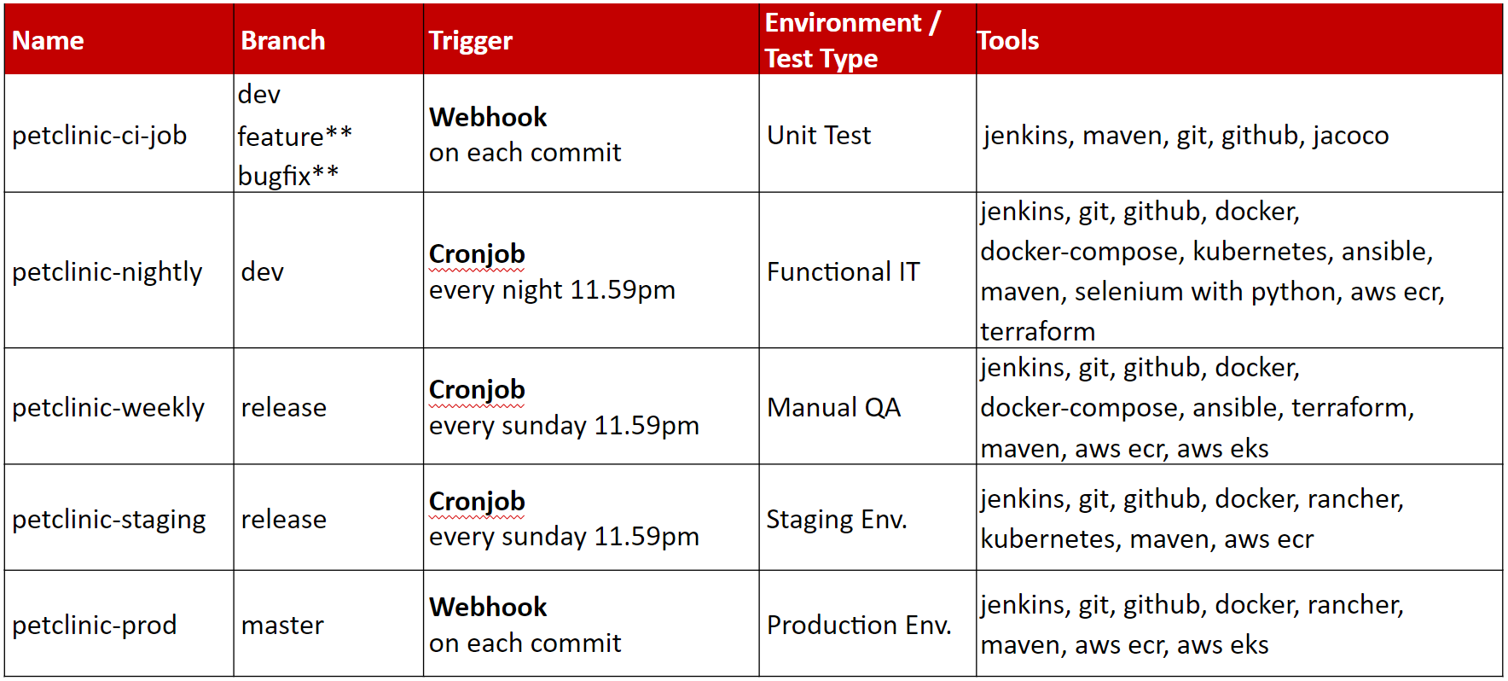
Development Server
GitHub
-dev
-feature/*
-bugfix/*
webhook
petclinic-microservice-app
git push/pull
- install docker
- install docker compose
- install java-11
- install git
- release
- main
Nexus Server
Rancher Server
Jenkins Server
- build
- unit test
master
- CI-jobb
master
staging env.
production env.
- functional test
- nightly
worker
cron-job (nightly)
worker
- manual test
- weeklyb
worker
workr
cron-job (weekly)
kubernetes
aws eks
- stagingg
cron-job (weekly)
- prodd
kubernetes
aws eks

