Slide 1


Kubernetes Security
©

Slide 2

Table of Contents
▶ SYMMETRIC ENCRYPTION
▶ ASYMMETRIC ENCRYPTION
▶ TLS/SSL CERTIFICATE
©
2

Slide 3
SYMMETRIC ENCRYPTION
1
©

Slide 4


SYMMETRIC ENCRYPTION
User: James Password: Pp123
http://clarus-commerce.com
©

Slide 5

SYMMETRIC ENCRYPTION
User: James Password: Pp123
http://clarus-commerce.com
http://clarus-commerce.com
©

Slide 6
SYMMETRIC ENCRYPTION
User: James Password: Pp123
User: James Password: Pp123
User: James Password: Pp123
http://clarus-commerce.com
http://clarus-commerce.com
©

Slide 7
SYMMETRIC ENCRYPTION
User: James Password: Pp123
User: James Password: Pp123
User: James Password: Pp123
http://clarus-commerce.com
http://clarus-commerce.com
©

Slide 8

SYMMETRIC ENCRYPTION
User: James Password: Pp123
DKFMGHLM98DSF89 3YH840FASLO142TU
http://clarus-commerce.com
©

Slide 9
SYMMETRIC ENCRYPTION
User: amFtZXMK Password: UHAxMjMK
http://clarus-commerce.com
http://clarus-commerce.com
©

Slide 10

SYMMETRIC ENCRYPTION
User: amFtZXMK Password: UHAxMjMK
User: amFtZXMK Password: UHAxMjMK
User: amFtZXMK Password: UHAxMjMK
http://clarus-commerce.com
http://clarus-commerce.com
©

Slide 11
User: amFtZXMK Password: UHAxMjMK
User: amFtZXMK Password: UHAxMjMK
User: amFtZXMK Password: UHAxMjMK
http://clarus-commerce.com
http://clarus-commerce.com
©

Slide 12
SYMMETRIC ENCRYPTION
Symmetric encryption is a type of encryption where only one key (a secret key) is used to both encrypt and decrypt electronic information. The entities communicating via symmetric encryption must exchange the key so that it can be used in the decryption process.
©

Slide 13
ASYMMETRIC ENCRYPTION
2
©

Slide 14
ASYMMETRIC ENCRYPTION
ASYMMETRIC ENCRYPTION
private Key
Public Key
Asymmetric Encryption, also known as Public-Key Cryptography, is an example of encryption method. Unlike symmetric encryption, Asymmetric Encryption encrypts and decrypts the data using two separate yet mathematically connected cryptographic keys. These keys are known as a Public Key and a Private Key. Together, they’re called a Public and Private Key Pair.
©

Slide 15

ASYMMETRIC ENCRYPTION
ASYMMETRIC ENCRYPTION
private Key
Public Key
To understand well, we symbolize public key as a lock box.
Public Key
©

Slide 16

ASYMMETRIC ENCRYPTION
Private Key
©

Slide 17
ASYMMETRIC ENCRYPTION
http://clarus-commerce.com
©

Slide 18
ASYMMETRIC ENCRYPTION
https://clarus-commerce.com
http turn to https
©

Slide 19
ASYMMETRIC ENCRYPTION
https://clarus-commerce.com
©

Slide 20

ASYMMETRIC ENCRYPTION
https://clarus-commerce.com
We make our private key secure with server public key
©
19

Slide 21
ASYMMETRIC ENCRYPTION
https://clarus-commerce.com
©

Slide 22

ASYMMETRIC ENCRYPTION
https://clarus-commerce.com
©

Slide 23
ASYMMETRIC ENCRYPTION
https://clarus-commerce.com
Server decrypt our private key with server private
key. Hacker doesn’t have private key of server. So
©
the hacker couldn’t get our private key.

Slide 24
ASYMMETRIC ENCRYPTION
https://clarus-commerce.com
Server decrypt our private key with server private
key. Hacker doesn’t have private key of server. So
©
the hacker couldn’t get our private key.

Slide 25
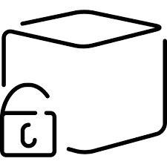

ASYMMETRIC ENCRYPTION
Hacker can allure and trick us. Hacker can get our
private key.
https://clarus-commerce.com
©

Slide 26
ASYMMETRIC ENCRYPTION
Hacker can allure and trick us. Hacker can get our
private key.
https://clarus-commerce.com
©

Slide 27
TLS/SSL CERTIFICATE
3
©

Slide 28
TLS/SSL CERTIFICATE
Transport Layer Security is a protocol that establishes an encrypted session
between two computers on the Internet. It verifies the identity of the server and prevents hackers from intercepting any data.
©

Slide 29
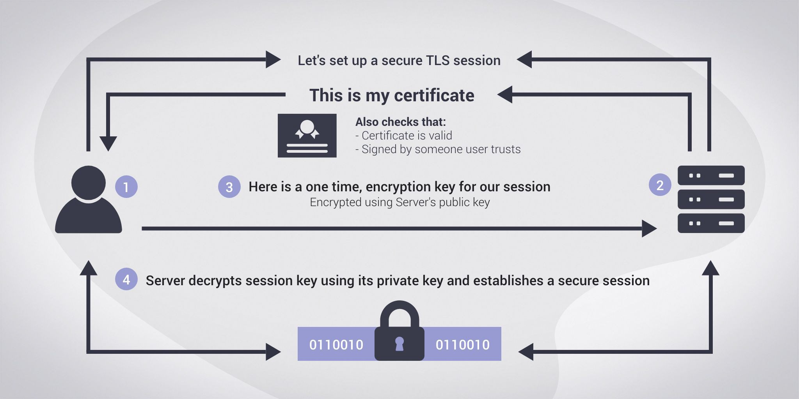
TLS/SSL CERTIFICATE
©

Slide 30
TLS/SSL CERTIFICATE
What is a TLS certificate?
Digital certificates, also known as identity certificates or public key certificates, are digital files that are used to certify the ownership of a public key. TLS certificates are a type of digital certificate, issued by a Certificate Authority (CA). The CA signs the certificate, certifying that they have verified that it belongs to the owners of the domain name which is the subject of the certificate.
©

Slide 31
TLS/SSL CERTIFICATE
TLS certificates usually contain the following information:
The subject domain name
The subject organization
The name of the issuing CA
Additional or alternative subject domain names, including subdomains, if any
Issue date
Expiry date
The public key (The private key, however, is a secret.)
The digital signature by the CA
©

Slide 32
TLS/SSL CERTIFICATE
How does a TLS certificate work?
When a user tries to connect to a server, the server sends them its TLS certificate. The user then verifies the server’s certificate using CA certificates that are present on the user’s device to establish a secure connection. This verification process uses public key cryptography, such as RSA or ECC, to prove the CA signed the certificate. As long as you trust the CA, this demonstrates you are communicating with the server certificate’s subject
©

Slide 33
TLS/SSL CERTIFICATE
http://clarus-commerce.com
©

Slide 34

TLS/SSL CERTIFICATE
http://clarus-commerce.com
©

Slide 35

TLS/SSL CERTIFICATE
http://clarus-commerce.com
©

Slide 36
TLS/SSL CERTIFICATE
http://clarus-commerce.com
©

Slide 37
TLS/SSL CERTIFICATE
https://clarus-commerce.com
©

Slide 38
How does a TLS certiﬁcate work?
We request a CSR(Certificate Signing Request) from any CA (Certificate Authority).
CA validate our request.
CA send signed certificate to us.
©

Slide 39
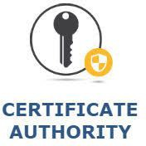
How does a browser know TLS certiﬁcate is valid?
CA public Key
CA public Key
Browsers has built-in CA’s public keys.
http://clarus-commerce.com
©
38

Slide 40
A public key infrastructure (PKI)
A public key infrastructure (PKI) is a set of roles, policies, hardware, software and procedures needed to create, manage, distribute, use, store and revoke digital certificates and manage public-key encryption.
The purpose of a PKI is to facilitate the secure electronic transfer of information for a range of network activities such as e-commerce, internet banking and confidential email. It is required for activities where simple passwords are an inadequate authentication method and more rigorous proof is required to confirm the identity of the parties involved in the communication and to validate the information being transferred.
©

Slide 41
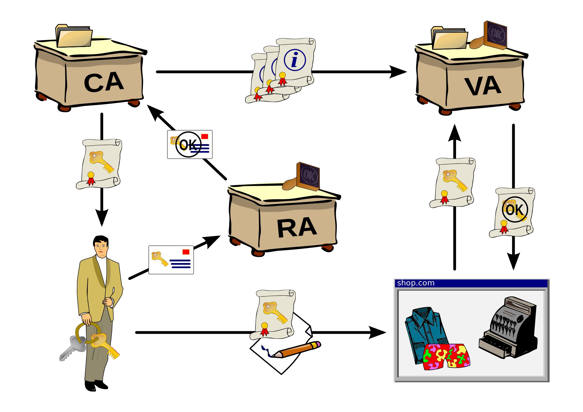
A public key infrastructure (PKI)
validation authority (VA)
©
registration authority (RA)

Slide 42



THANKS!
Any questions?
You can ﬁnd me at:
▸ james@clarusway.com
©
41

