Slide 1
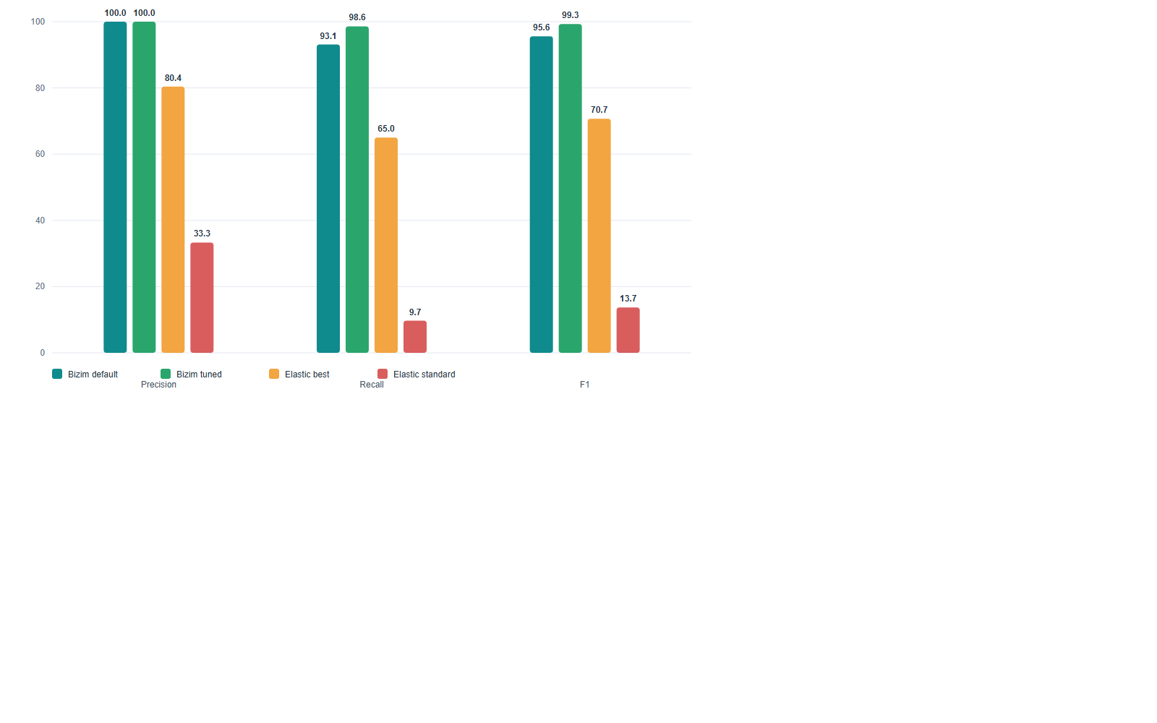
FUNCTIONAL QUALITY
Benchmark ozet tablosu
Overall quality chart ve senaryo bazli F1 matrisi ayni slaytta toplandi.
Kalite karari
Default mean F1 95.6% | Tuned mean F1 99.3% | Elastic best mean F1 70.7%
Elastic threshold notu
Standard threshold=25 icin recall 9.7% seviyesinde kaldi; best threshold 1.0 oldu.
Kodu iyilestiren ana basliklar
Seasonal fallback, window-context score ve panelde point/window/driver detaylarinin acilmasi.
Scenario
Default F1
Tuned F1
Elastic best
Latency spike
100.0%
100.0%
57.1%
Error burst
100.0%
100.0%
66.7%
Traffic drop
100.0%
100.0%
76.9%
Seasonal spike
100.0%
100.0%
100.0%
Resource step-up
100.0%
100.0%
36.4%
Subtle shift
73.7%
95.7%
87.0%

