Slide 1

SUPERMARKET SALES PERFORMANCE DASHBOARD
Excel Data Analytics Project
ALPATI SAI SIDDARTHA
2026 • SALES • PROFIT • CUSTOMERS • BRANCHES

Slide 2
1. Business Problem
Turning transaction data into actionable supermarket decisions
Supermarket transactions contain valuable information about sales, profitability, products, customers and branches.
Without structured analysis, it is difficult to identify high-performing categories, profitable branches and sales trends.
The project builds an interactive Excel dashboard to support faster, data-driven decision-making.

Slide 3
2. Project Objectives
Sales Performance
Track revenue across time, branches and product lines.
Profitability
Evaluate COGS, gross income and margin.
Customer Insights
Compare member vs normal customers and ratings.
Operational View
Analyze payment methods, quantity and branch performance.

Slide 4
3. Dataset Overview
Raw Records
501
500 transactions + 1 intentional duplicate
Columns
17
Transaction, product, customer & finance fields
Branches
5
Multiple store locations
Product Lines
8
Major supermarket categories
Core fields: Invoice_ID, Date, Time, Branch, City, Customer_Type, Gender, Product_Line.
Financial fields: Unit_Price, Quantity, Tax, Total_Sales, COGS, Gross_Income, Gross_Margin_%.
Other fields: Payment and Rating.
The raw file includes intentional quality issues for demonstrating cleaning and validation.

Slide 5
4. Data Cleaning & Transformation
Preserve the raw dataset and create a separate Clean_Data layer.
Convert the data into an Excel Table for structured filtering, formulas and PivotTables.
Identify duplicates and missing values; investigate critical missing Unit_Price and Quantity values.
Standardize text such as Member/member and UPI/upi; remove unnecessary spaces.
Validate Date and Time formats and numeric fields.
Create analytical fields such as Month, Month Number, Profit and Profit Margin.

Slide 6
5. Data Validation / Quality Checks
Duplicate Check
Invoice_ID uniqueness
Missing Values
Blanks in critical fields
Sales Check
Unit Price × Quantity + Tax
Profit Check
Total Sales − COGS
Margin Check
Gross Income ÷ Total Sales
Range Check
Quantity, price & rating

Slide 7
6. Data Analysis Questions
Which month generates the highest sales?
Which branch contributes the most revenue and profit?
Which product line performs best?
Which customer type contributes more sales?
Which payment method is most frequently used?
Where are the strongest and weakest business opportunities?

Slide 8
7. PivotTables & KPI Framework
PivotTables
Sales by Month
Branch • Product • Customer • Payment
Primary KPI
Total Sales
Revenue performance
Profit KPI
Gross Income
Profitability
Efficiency KPI
Margin %
Profit / Sales
Recommended KPIs: Total Sales, Total Profit/Gross Income, Transactions, Quantity Sold, Average Transaction Value and Gross Margin %.
Use PivotTables as the analytical engine behind dashboard charts.

Slide 9
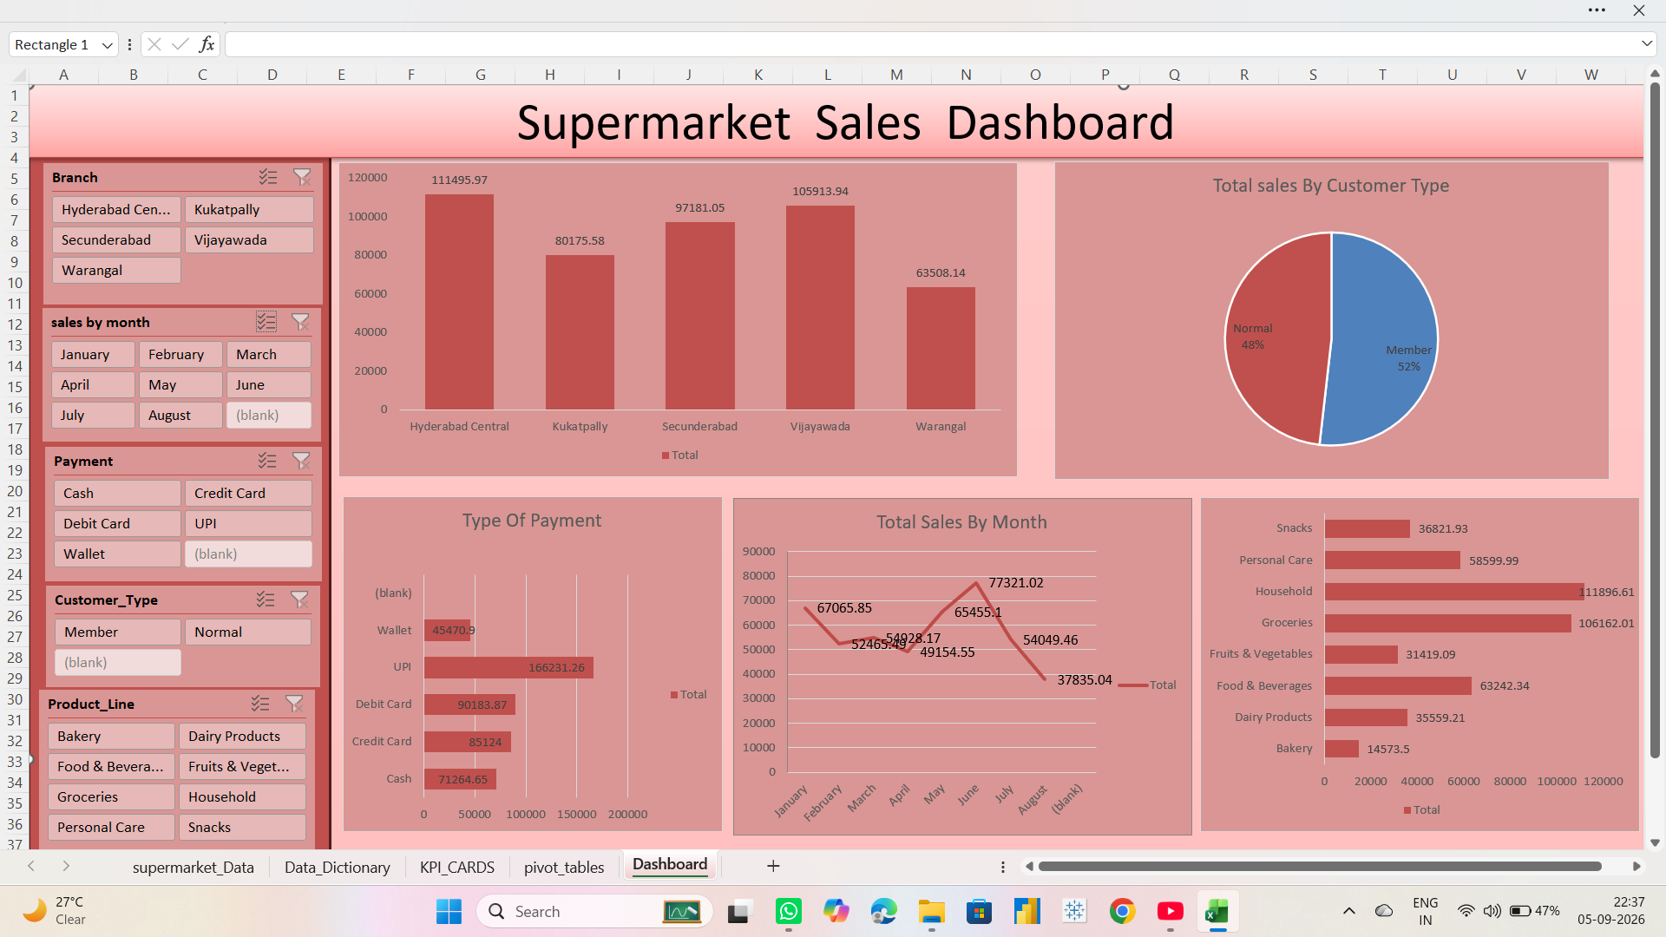
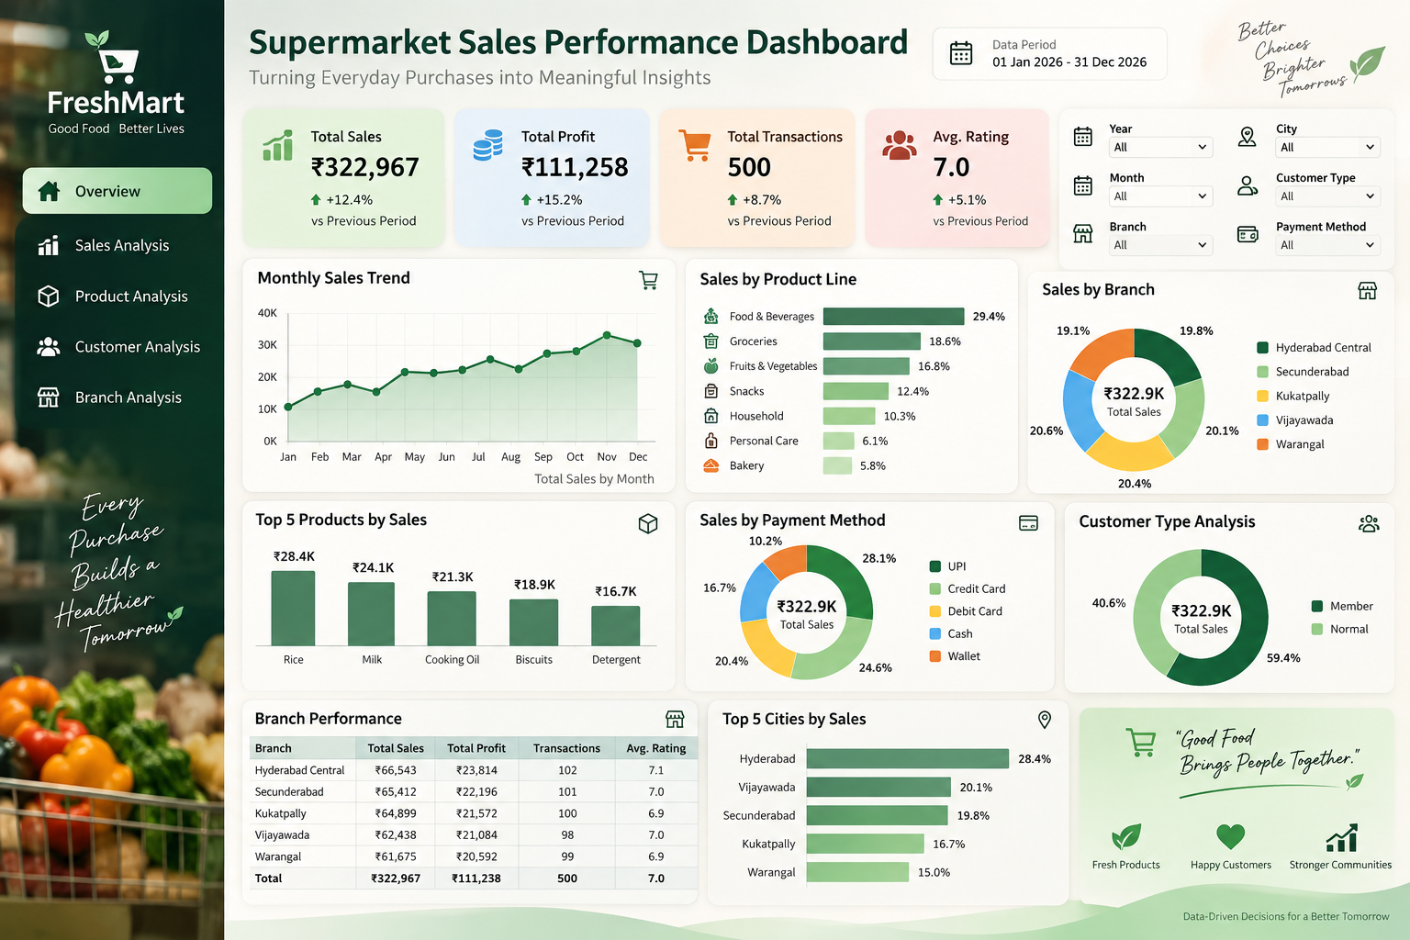
8. SUPERMARKET SALES PERFORMANCE DASHBOARD
Interactive Excel Dashboard • Sales • Customers • Payments • Product Performance

Slide 10
9. Key Insights Framework
Use the dashboard to identify the strongest sales month and compare it with weaker periods.
Compare branch sales and profit together so high revenue does not hide weak margins.
Rank product lines by sales and gross income to distinguish demand from profitability.
Compare Member vs Normal customers and payment methods to guide engagement strategy.
Translate every major observation into a measurable business action.

Slide 11
10. Business Recommendations
Prioritize inventory and promotions for high-demand, high-margin product lines.
Investigate lower-performing branches for assortment, pricing, availability and customer-demand differences.
Use monthly sales patterns for inventory and staffing planning.
Strengthen loyalty offers for valuable customer segments.
Monitor gross margin alongside sales to protect profitability.
Refresh the dashboard regularly as new transactions become available.

Slide 12
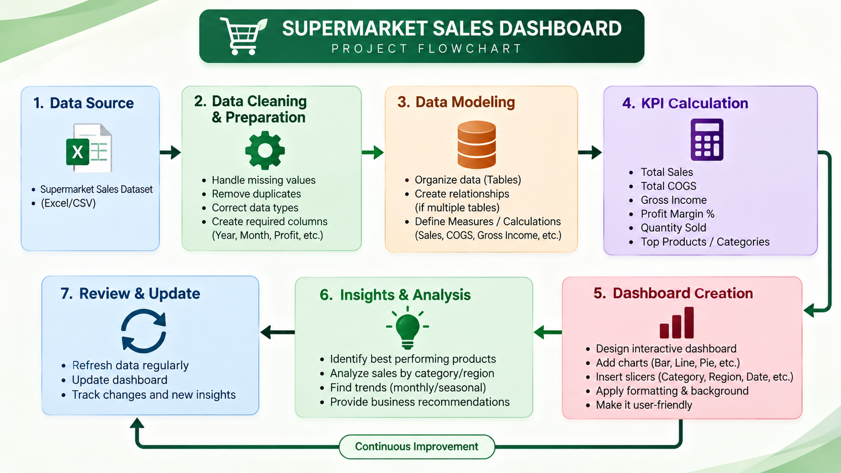
11. Project Flow

Slide 13
12. Conclusion
The project transforms raw supermarket transactions into a structured analytical solution.
Excel is used for cleaning, transformation, validation, PivotTables, KPI calculations and interactive visualization.
The final dashboard provides a single view of sales, profitability, customers, products and branches.
The end goal is not only reporting numbers—it is enabling better business decisions.
ALPATI SAI SIDDARTHA • SUPERMARKET SALES PERFORMANCE DASHBOARD

