Slide 1

Vaccination
Is it possible to get better results, using machine learning?
By Artur Cabral

Slide 2
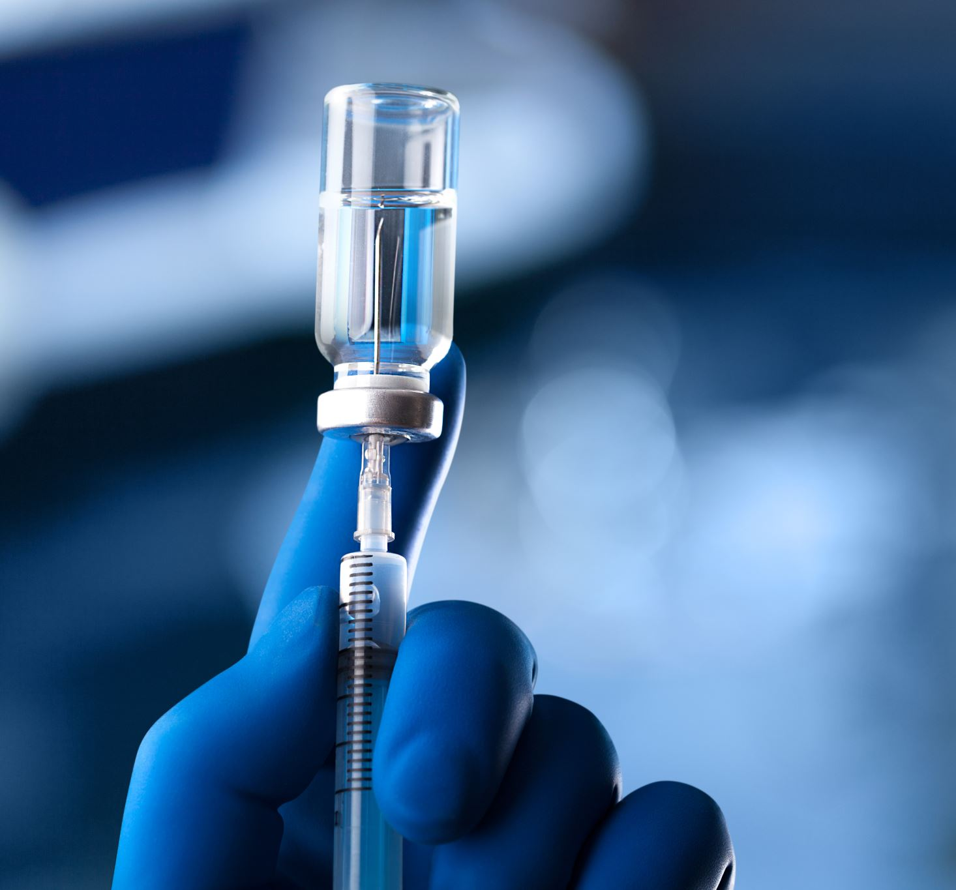
Exploring the Impact of Vaccination on Disease Cases
We are going to see the evolution of the vaccination numbers and case numbers;
Could an increase of vaccination prevent spikes of cases?
Could machine learning help in this type of analyses?

Slide 3
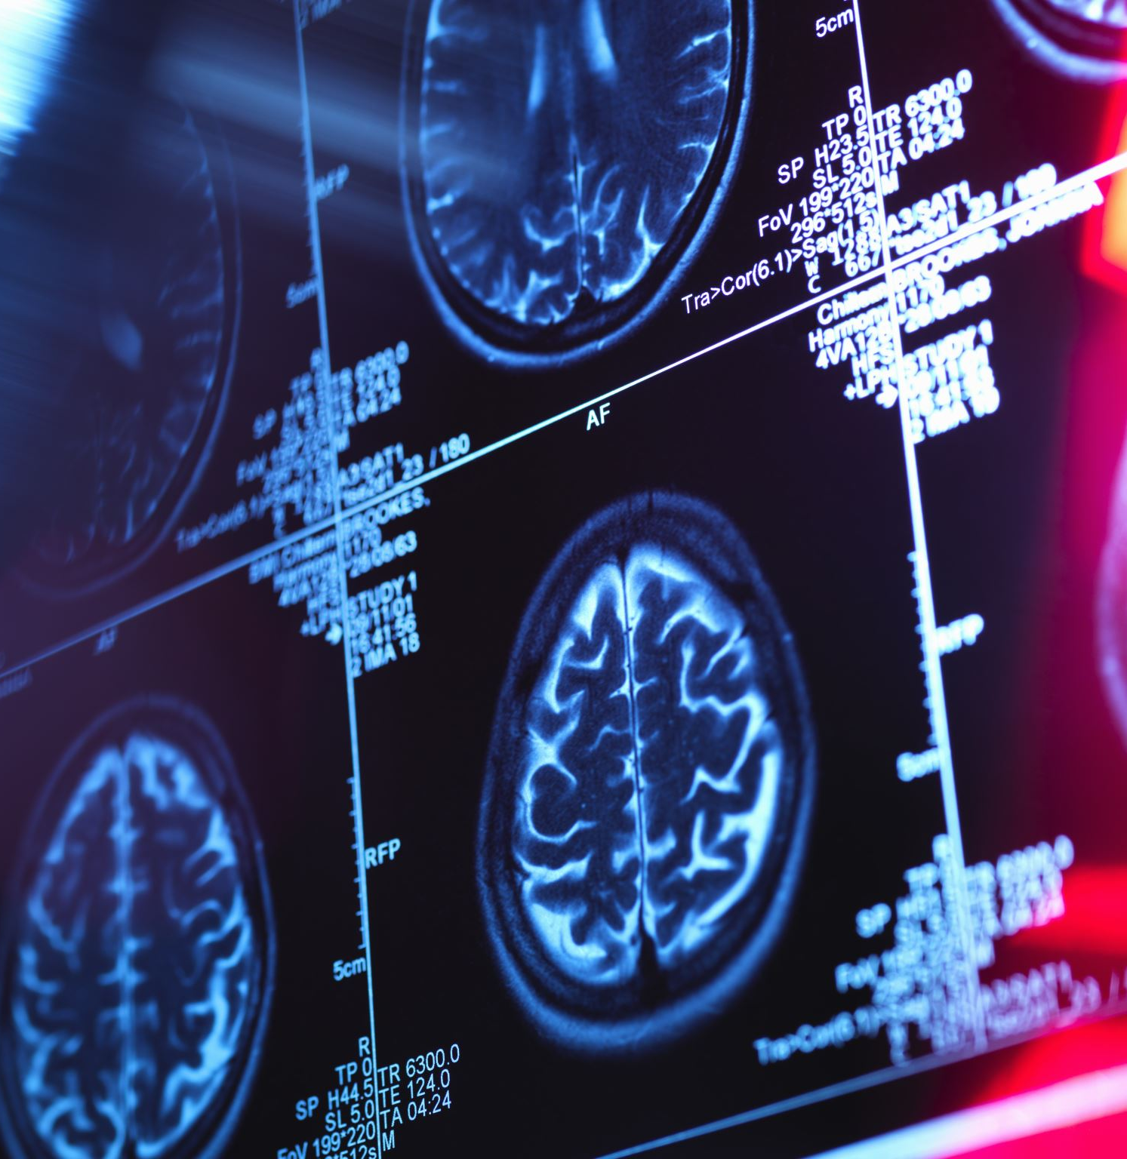
Where the data came from?
All the data was gathered from the World Health Organization (WHO) website;
After some cleaning it was decided that it’s only considered valid when there is vaccination and cases data for each disease;
The analysis was based on eleven diseases:
Congenital rubella syndrome
Diphtheria
Invasive meningococcal disease
Japanese encephalitis
Measles
Neonatal tetanus
Pertussis
Poliomyelitis
Rubella
Total Tetanus
Yellow fever

Slide 4
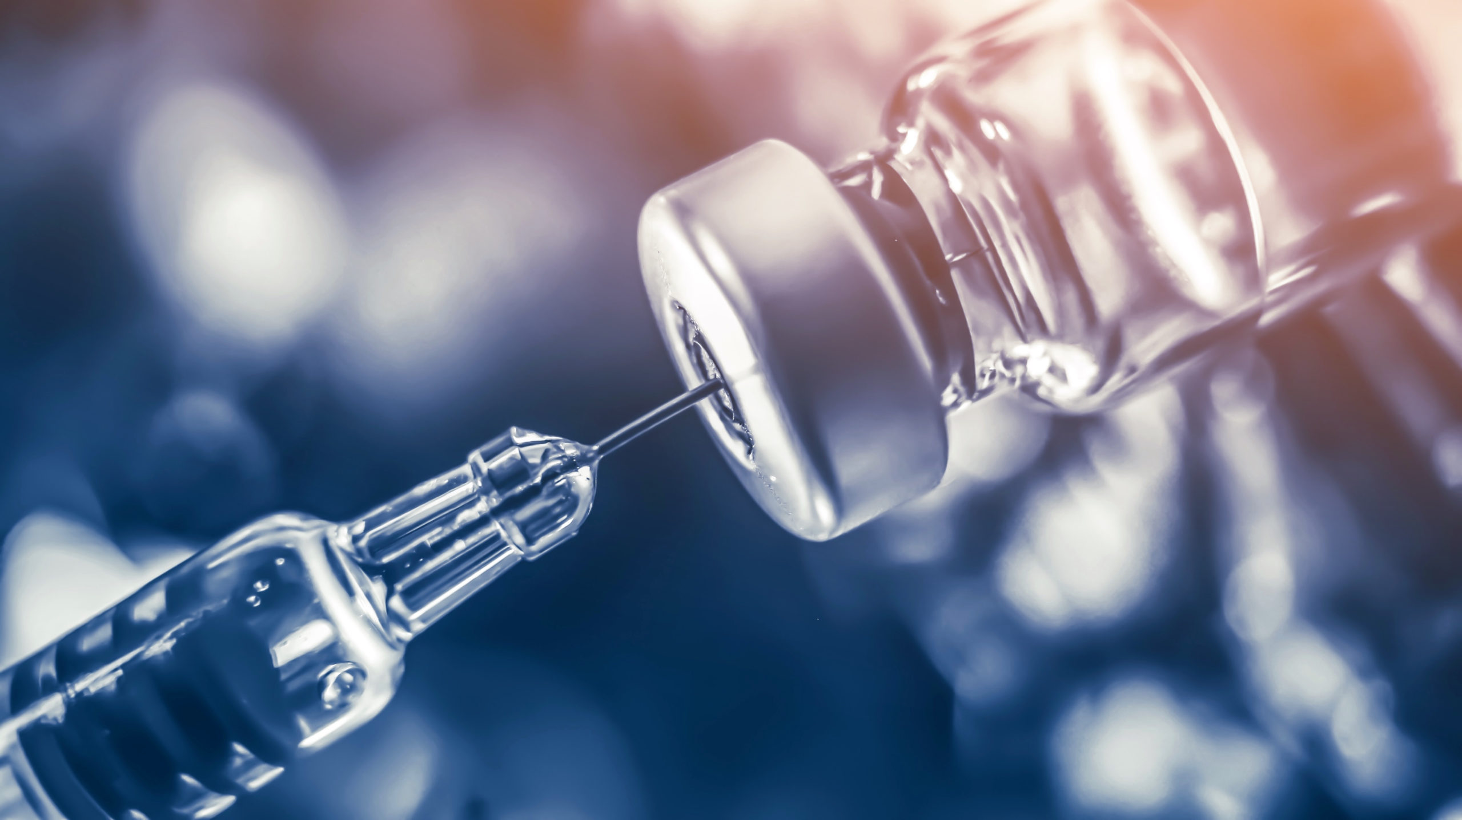
What was used for this analysis?
Python
MySQL
Tableau
PowerPoint
Tableau Presentation

