Slide 1
TRI
Version Control System
CSE 211 – Data Structures Term Project
Instructor: Batuhan Edgüer
TEAM MEMBERS
-Umut Ertuğrul Daşgın
-Alp Dikmen
-Deniz Kayra Aydın
-Ömer Kağan Zafer
-Eren Kocagökcen

Slide 2
Project Motivation
Modern software development requires tracking changes over time
  Version Control Systems (VCS) enable collaboration and history tracking
  Understanding Git internals strengthens data structure knowledge
  This project implements a simplified VCS from scratch

Slide 3
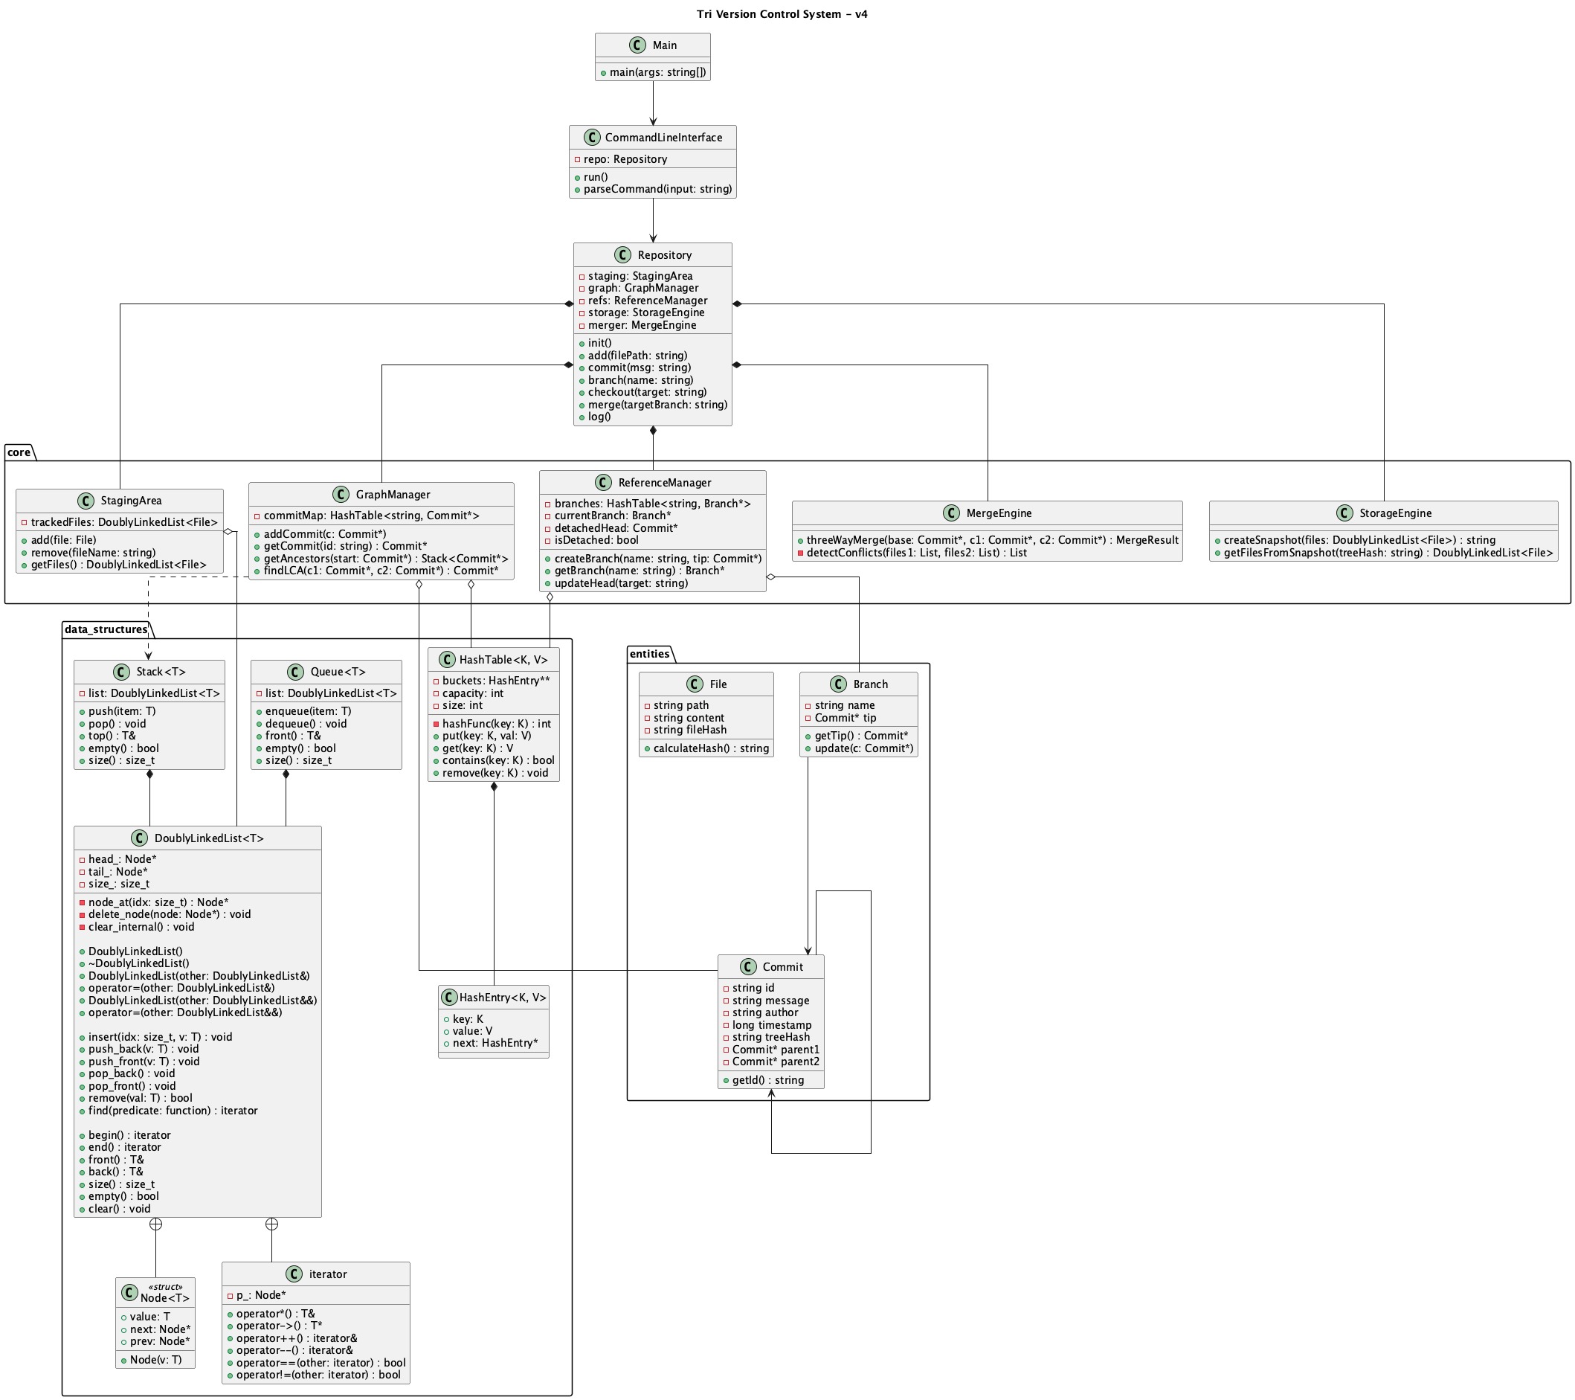
Problem Statement
Design a simplified Version Control System
  Support commits, branches, merging, and history visualization
  Represent commit history as a Directed Acyclic Graph (DAG)
  Each commit is an immutable snapshot with metadata

Slide 4
Core Data Structures Used
Directed Acyclic Graph (DAG) for commit history
  Hash maps for fast commit and branch lookup
  Lists/Sets for parent tracking and traversal
  Tree-like file snapshots for file versions

Slide 5
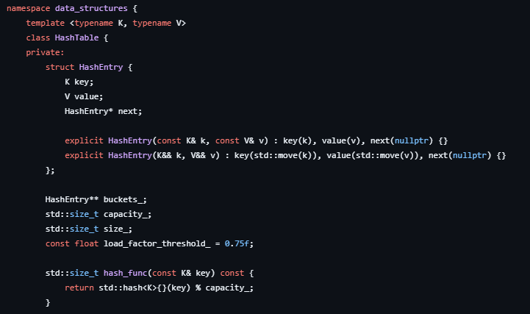
Commit Object
Unique commit ID (hash)
  Parent commit ID(s)
  Author and timestamp metadata
  Commit message
  Snapshot of all tracked files
  Immutable once created

Slide 6
Branch and HEAD
Branch: named pointer to a commit
  Branches move forward with new commits
  HEAD: indicates current working position
  Attached HEAD points to a branch
  Detached HEAD points directly to a commit

Slide 7

Directed Acyclic Graph (DAG)
Each node represents a commit
  Edges point from child commit to parent commit(s)
  No cycles: commits only reference earlier commits
  Merge commits have two parents
  Allows efficient history traversal

Slide 8
Core Operations – Commit
Save current working directory state
  Create a new commit object
  Link commit to its parent (HEAD)
  Move current branch pointer forward

Slide 9
Core Operations –
Branch & Checkout
Branch: create a new named pointer to current commit
  Checkout branch: move HEAD to that branch
  Working directory updates to branch snapshot
  Checkout commit: detached HEAD state

Slide 10
Core Operations – Log
Traverse commit history backwards
  Follow parent links in the DAG
  For merge commits, traverse both parents
  Avoid duplicate commit outputs

Slide 11
Core Operations – Diff
Compare file contents between two commits
  Detect added, deleted, and modified lines
  Line-by-line comparison
  Used during merge and inspection

Slide 12
Merge Operation
Combines two branches into one
  Creates a merge commit with two parents
  Requires finding a common ancestor (merge base)
  Uses three-way merge algorithm

Slide 13
Finding Common Ancestor
Traverse ancestors of first branch
  Traverse ancestors of second branch
  Find the most recent shared commit
  Critical for correct merge behavior

Slide 14
Three-Way Merge
Compare: base vs branch A
  Compare: base vs branch B
  If both branches modify same line differently → conflict
  Conflicts must be detected and reported

Slide 15
Sample Input Scenario
Initial commit with basic files
  Create and switch to feature branch
  Modify source code and commit
  Switch back to main branch
  Modify README and commit
  Merge feature into main

Slide 16
Why This Project Matters
Demonstrates real-world use of data structures
  Deepens understanding of graphs and traversal
  Shows practical application of hashing
  Builds foundation for advanced systems courses

Slide 17
Conclusion
Implemented a simplified but functional VCS
  Used DAG to represent commit history
  Supported commits, branches, diff, log, and merge
  Project mirrors core ideas behind Git

