Slide 1
E-commerce Churn Predıctıon
Alp Doğan Fidan
090180320

Slide 2
Data Introduction
The dataset is taken from Kaggle.
The dataset contains information on 5,630 customers of an e-commerce website.
The aim is to predict the customer churn or not.

Slide 3
Data Introduction
CustomerID : Unique customer ID (numerical)
Churn : Churn Flag (numerical)-Tenure : Tenure of customer in organization (numerical) (Also, this column is the target variable)
Tenure : Tenure of customer in organization (numerical)
PreferredLoginDevice : Preferred login device of customer (nominal)
CityTier : City tier (ordinal)
WarehouseToHome : Distance in between warehouse to home of customer (numerical)
PreferredPaymentMode : Preferred payment method of customer (nominal)
Gender : Gender of customer (nominal)
HourSpendOnApp : Number of hours spend on mobile application or website (numerical)
NumberOfDeviceRegistered : Total number of deceives is registered on particular customer (numerical)
PreferedOrderCat : Preferred order category of customer in last month (nominal)
SatisfactionScore : Satisfactory score of customer on service (1 to 5) (ordinal)
MaritalStatus : Marital status of customer (Married, Single or Divorced) (nominal)
NumberOfAddress : Total number of added added on particular customer (numerical)
Complain : Any complaint has been raised in last month (numerical)
OrderAmountHikeFromlastYear : Percentage increases in order from last year (numerical)
CouponUsed : Total number of coupon has been used in last month (numerical)
OrderCount : Total number of orders has been places in last month (numerical)
DaySinceLastOrder : Day Since last order by customer (numerical)
CashbackAmount : Average cashback in last month (numerical)

Slide 4
Description of the Problem
What are the main factors that contribute to churn in this E-commerce business? Are there any particular customer segments that are more likely to churn than others?
Can machine learning algorithms predict customer churn accurately? If so, which algorithm performs the best?
What features are most important for predicting churn in this dataset?
Are there any correlations between customer satisfaction ratings and churn rates? Can the business improve customer satisfaction in order to reduce churn rates?
How do the demographics of the customer (gender, marital status, etc.) impact their likelihood of churning?

Slide 5
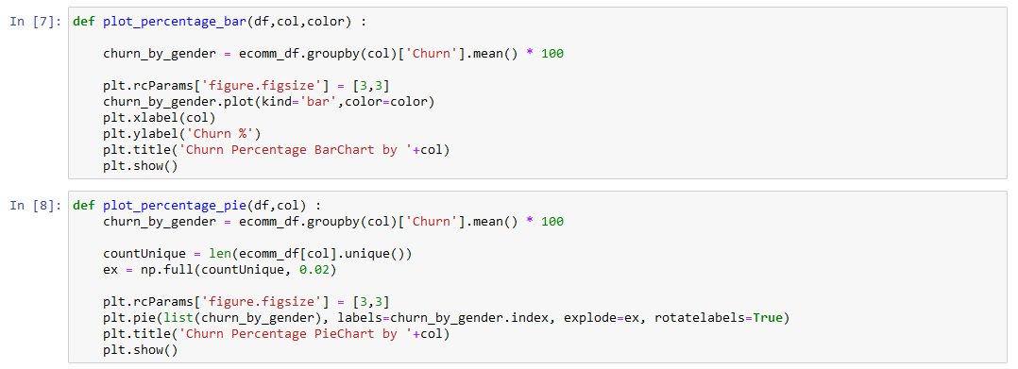
Visualization

Slide 6
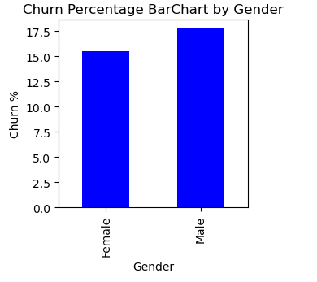
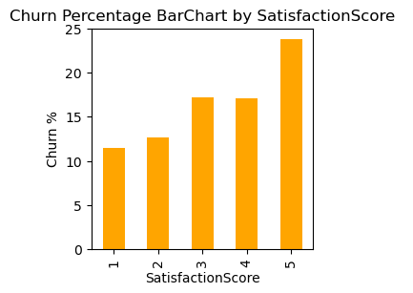
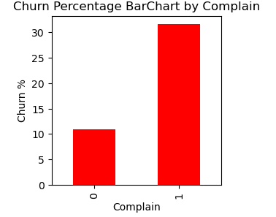
Visualization (Bar Chart)

Slide 7
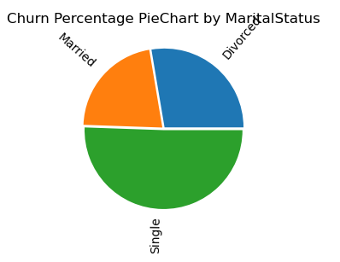
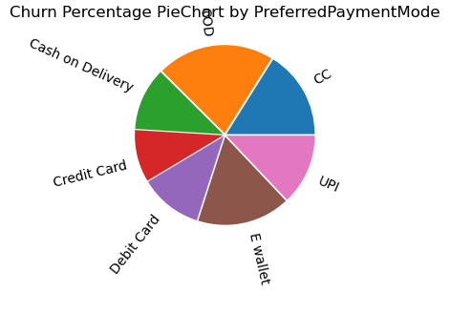
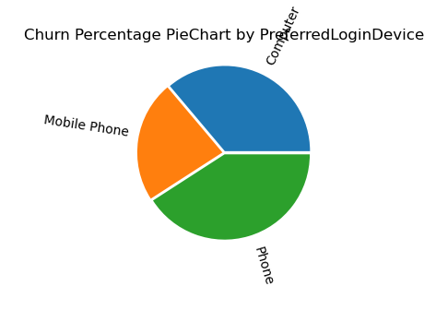
Visualization (Pie Chart)

Slide 8
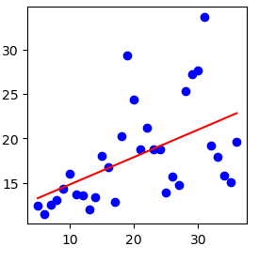
Visualization (Distance)
Distance from Warehouse to Home

Slide 9
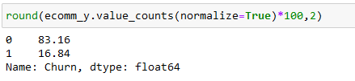
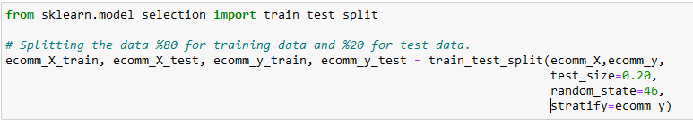
Splitting The Data

Slide 10
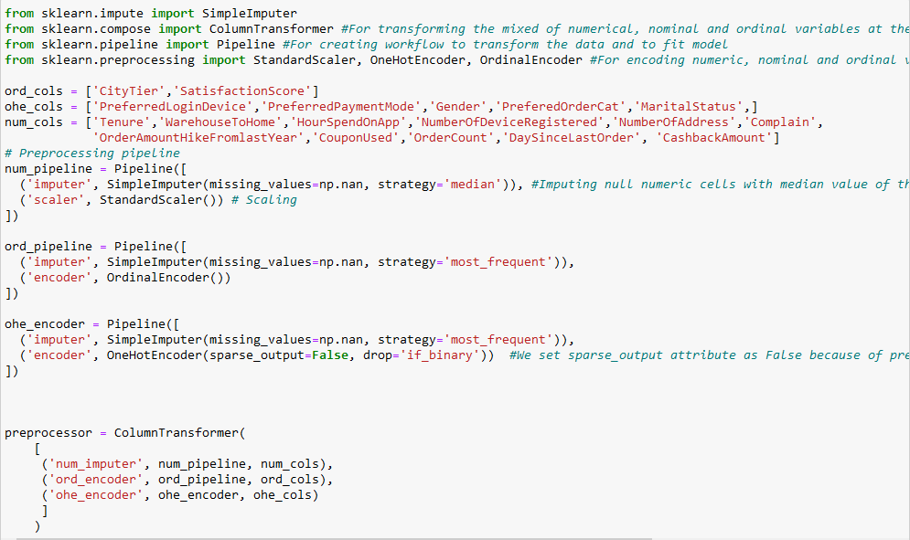
Pipeline Design for Preprocessing
Numerical features => SimpleImputer and StandardScaler
Ordinal features => SimpleImputer and OrdinalEncoder
Nominal features => SimpleImputer and OneHotEncoder

Slide 11
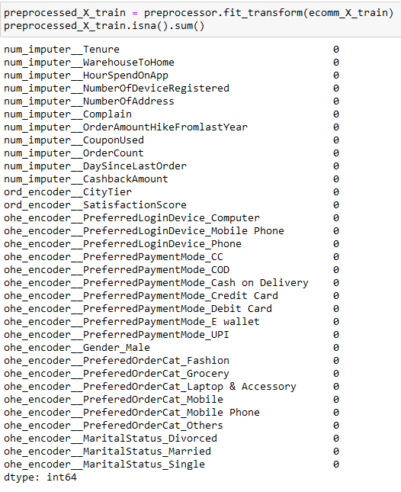
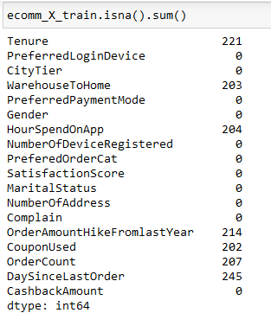
Preprocessing

Slide 12
Feature Selection
None feature selection method was applied.

Slide 13
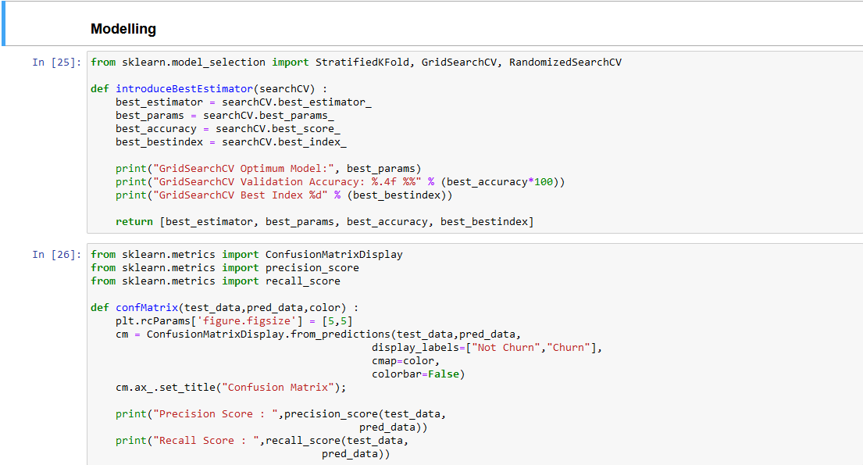
Modelling

Slide 14
Modelling
In this section, we use classifier models since our target is categorical (classifier problem).
In this study, the classification models to be tuned using GridSearchCV are as follows:
LogisticRegression : with L1, L2, and ElasticNet penalties,
KNN.
The classification models to be tuned using RandomizedSearchCV are as follows:
DecisionTreeClassifier,
RandomForestClassifier.

Slide 15
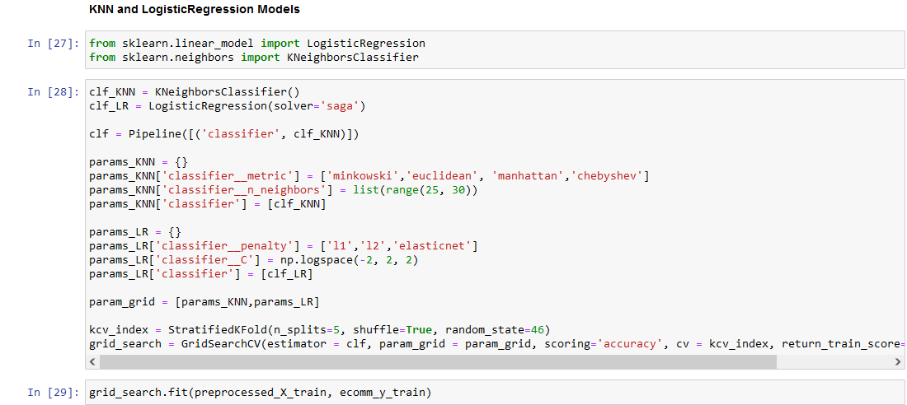
Tuning KNN and LogisticRegression

Slide 16
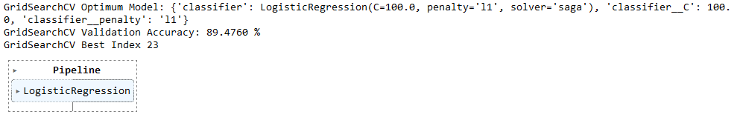
Result of KNN and LogisticRegression
Selected model is Logistic Regression with the parameters:
The best LogisticRegression model with the l1 penalty achieved an accuracy of 89%, while the best KNN model with minkowski distance metric achieved an accuracy of 86%.

Slide 17
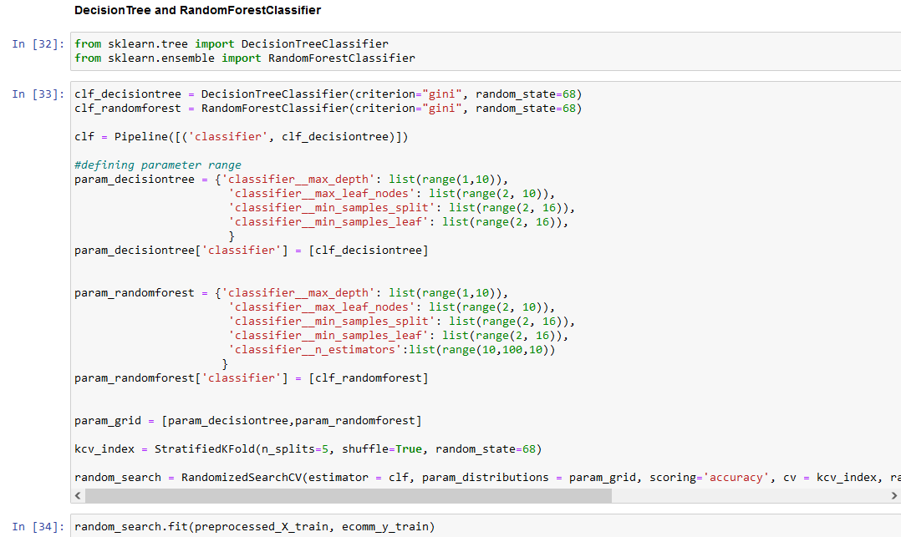
Tuning DecisionTree and RandomForest

Slide 18
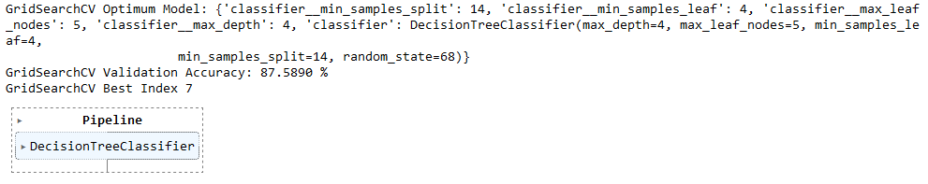
Result of DecisionTree and RandomForest
Selected model is Logistic Regression with the parameters:
The best DecisionTreeClassifier model with the max depth = 4 and max leaf nodes = 5 achieved an accuracy of 87.5%, while the best RandomForestClassifier model with the max depth = 7 and max leaf nodes = 9 achieved an accuracy of 84.8%.

Slide 19
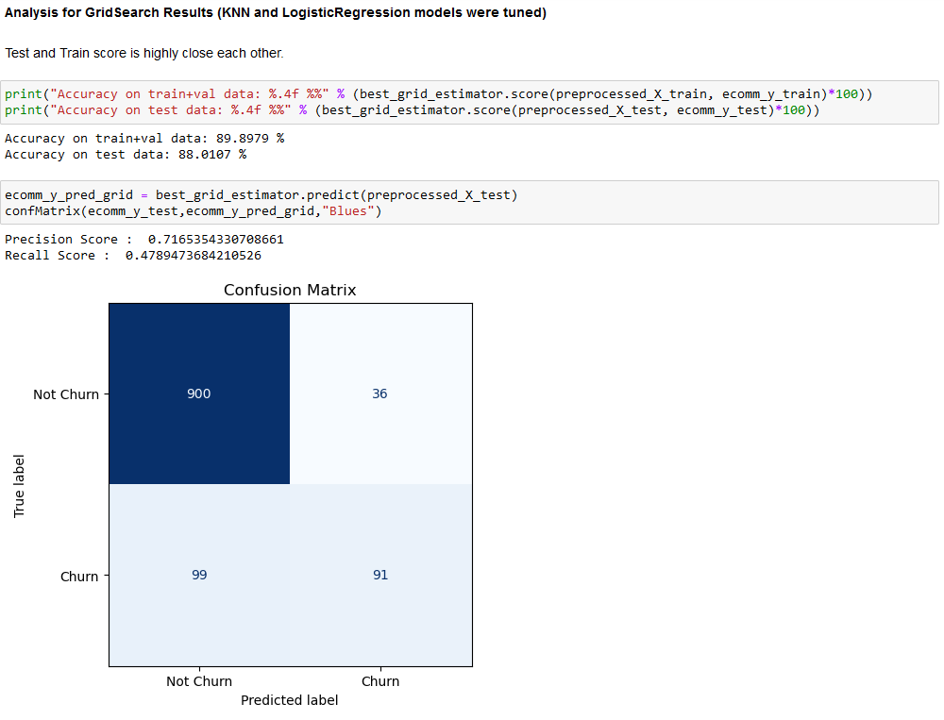
Evaluation Analysis for LogisticRegression

Slide 20
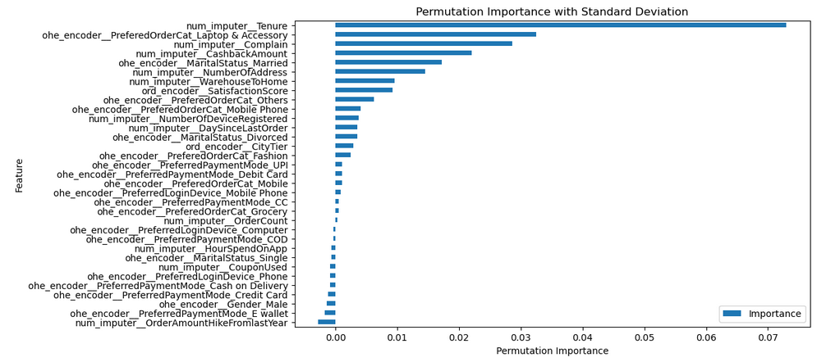
Feature Importances for LogisticRegression
Library is «permutation_importance»

Slide 21
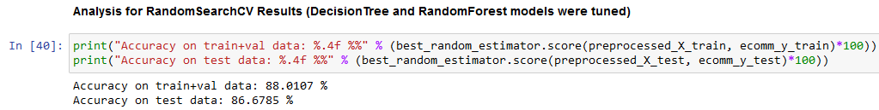

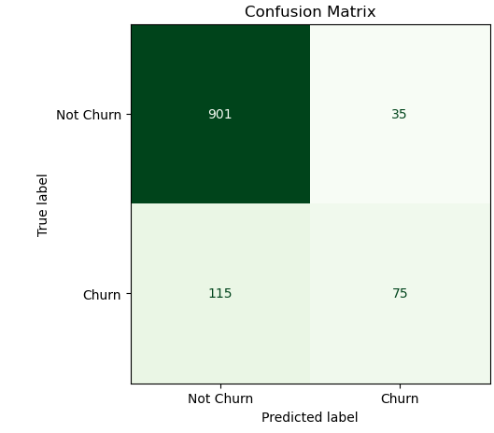
Evaluation Analysis for DecisionTree

Slide 22
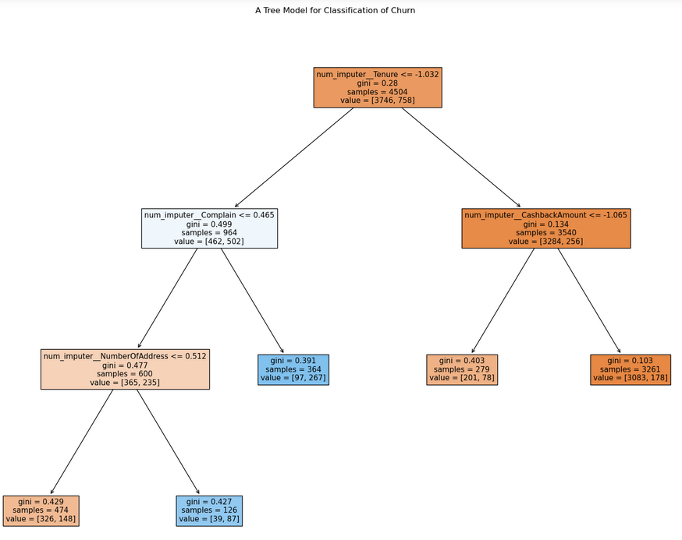
The Best Tree of DecisionTree
With «gini» criterion,

Slide 23
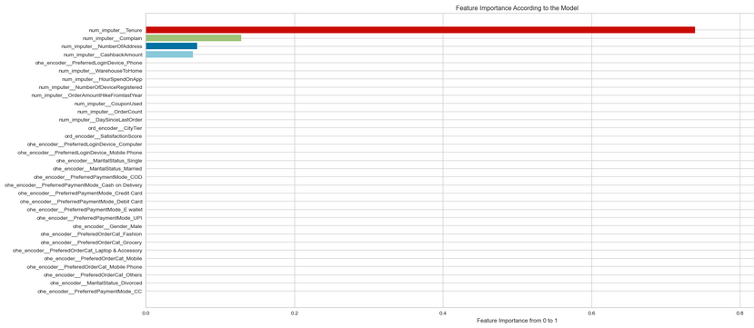
Feature Importances for DecisionTree

Slide 24
Result
As a result, LogisticRegression model is selected due to high and close score values.
For further result, due to imbalanced data maybe the undersampling process is required to raise score more.
We observed that there are high correlations between the some features and churn rates;
Customer tenure,
Customer complains,
Cash back amount,
Marital status.

Slide 25
Conclusion
Through this project, we examined the E-commerce churn data and visually presented the relationships between churn occurrence and certain features.
Subsequently, we split the imbalanced dataset into test and train sets while maintaining the rate. In the next stage, LogisticRegression, KNN, DecisionTree, and RandomForest models were applied
Furthermore the parameters used by each of these models were tuned.
The train and test scores of these tuned models were compared.
As a result, the best model was the LogisticRegression model with an l1 penalty parameter. This model achieved an accuracy of 89% on the train dataset and 88% on the test dataset."

Slide 26
Thanks

