Slide 1
StreamHybridSketch
Federated sketches for privacy-preserving streaming analytics
Adnan Soni
2023BCD0017
Bhaskara Akshay Sriram
2023BCD0015
Muhammed Minhaj P S
2023BCS0225
Hafiz Feroze
2023BCS0006
IOE413 Streaming Data Analytics · Team 22
Notes:
[0:00-0:15] Hi, we are Team 22. Our project, StreamHybridSketch, finds what is popular right now across many users' data, privately, on a live stream. We will cover the problem, our design, results, and then a live demo.

Slide 2
Live top-k answers, no raw data collected
Example: a city's 50 busiest areas today, without any phone sending its location history.
1
2
3
Never-ending stream
Privacy adds up
Popularity shifts
A new answer every window (day, 6 h), not one answer at the end.
Every release leaks a little. The total must be tracked and kept small.
A festival makes one area hot. Notice it fast instead of averaging it away.
Notes:
[0:15-0:35] Picture a city app showing today's busiest areas. Collecting everyone's location history is a privacy problem, so devices send only small summaries. Three things make it hard: the data never stops, every published answer leaks a little privacy, and popularity keeps changing.

Slide 3
Built on three published papers
1
2
3
Wu et al. · NeurIPS'23
Zhu et al. · AISTATS'20
Gascón et al. · ICML-W'23
Size a CountSketch from the data's tail; reuse cell positions but re-pick signs each round (HybridSketch); add noise for DP.
TrieHH: find popular words letter by letter from sampled user votes; the sampling itself gives privacy.
An invertible table (IBLT) lists the popular items directly, so no candidate list is needed.
Main baseline · reproduced
Reproduced on Sentiment140
Built in and compared
Notes:
[0:35-0:55] We build on three papers. Wu et al. is our baseline: how big a sketch must be, and HybridSketch, which re-picks signs each round so errors cancel. TrieHH finds popular words letter by letter. Gascon et al. list popular items directly with an invertible table. All three publish a fixed number of times; a stream publishes forever.

Slide 4
Raw events never leave the edge
raw data exists only inside this zone
Producer
replays real data in time order
Kafka events
one lane per edge
8 Flower edges
sketch + noise + mask
Flower server
sums uploads, masks cancel
ground truth, for grading only
Grafana
live dashboard
InfluxDB
stores scores, metrics
Evaluator
scores vs exact truth
Kafka releases
top-50 per window
Each round: edges sketch their users' items, add a share of the privacy noise and a cancelling mask. The server only ever sees the noisy total.
Notes:
[0:55-1:20] One round of our pipeline. Real check-ins and tweets are replayed into Kafka, one lane per edge. Each of eight Flower edges sketches its users' items, adds a share of the privacy noise and a mask. The masks cancel when the server adds the uploads, so it only sees the noisy total. Answers flow back through Kafka to an evaluator and Grafana.

Slide 5
Five switchable stream extensions
a
Tree release long totals need only a few noisy pieces
SHS-W = c + d
for "what is popular now" questions
b
Peeling remove heavy items so they stop polluting
c
Adaptive width smallest accurate sketch each round
SHS-C = a + b + d
for totals since the start, at strict privacy
d
Drift detector top-50 changes, so restart the window
e
IBLT layer list popular items, no candidate list
Notes:
[1:20-1:50] We added five switchable parts: a tree of summaries so long totals carry little noise; peeling, which removes heavy items that would otherwise pollute the tree; adaptive sketch width; a drift detector that restarts the window when the top-50 changes; and an IBLT that needs no candidate list. Testing showed two winners: SHS-W for current trends, SHS-C for long totals at strict privacy.

Slide 6
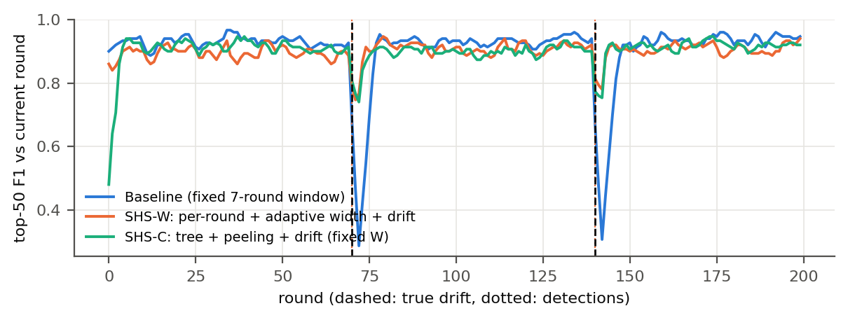
Drift: recovery in 1.5 rounds, not 5.5
1.5
rounds to recover after a sudden change (baseline 5.5)
0.85
Synthetic stream, ε = 1. Dashed lines: true drifts at rounds 70 and 140.
top-50 F1 in the 7 rounds after a change (baseline 0.56)
Notes:
[1:50-2:10] When the 200 most popular items are swapped out at rounds 70 and 140, the baseline collapses and needs five and a half rounds to recover. With the drift detector it takes one and a half, and accuracy after the change rises from 0.56 to 0.85.

Slide 7
Less upload, lower error at tight privacy
31–61%
less upload per edge with SHS-W at the same privacy (ε = 1)
2.0–2.6×
lower long-run error with tree + peeling at ε = 0.125
Notes:
[2:10-2:30] SHS-W also uploads 31 to 61 percent less at the same privacy level. At very strict privacy, tree release with peeling cuts long-run error two to two-and-a-half times on all three datasets.

Slide 8
What did not work, reported honestly
Tree loses at ε ≥ 0.5
and on recent-window questions: noise is no longer the main error
All parts at once is worse
than SHS-W or SHS-C on their own
IBLT costs 2–4× more upload
than a CountSketch that has a candidate list
Drift false alarms on tweets
topics shift naturally; costs 0.13 F1
Reproduced: two-phase widths 6–16× smaller, HybridSketch beats Shared by 3.2–3.5×, TrieHH precision 0.86–1.00. Partial: FreshSketch beat Hybrid.
Notes:
[2:30-2:50] We report what did not work: the tree only helps at strict privacy, enabling everything at once is worse, the IBLT costs more upload, and the drift detector raises false alarms on tweets. The paper reproductions matched, except FreshSketch beat HybridSketch.

Slide 9
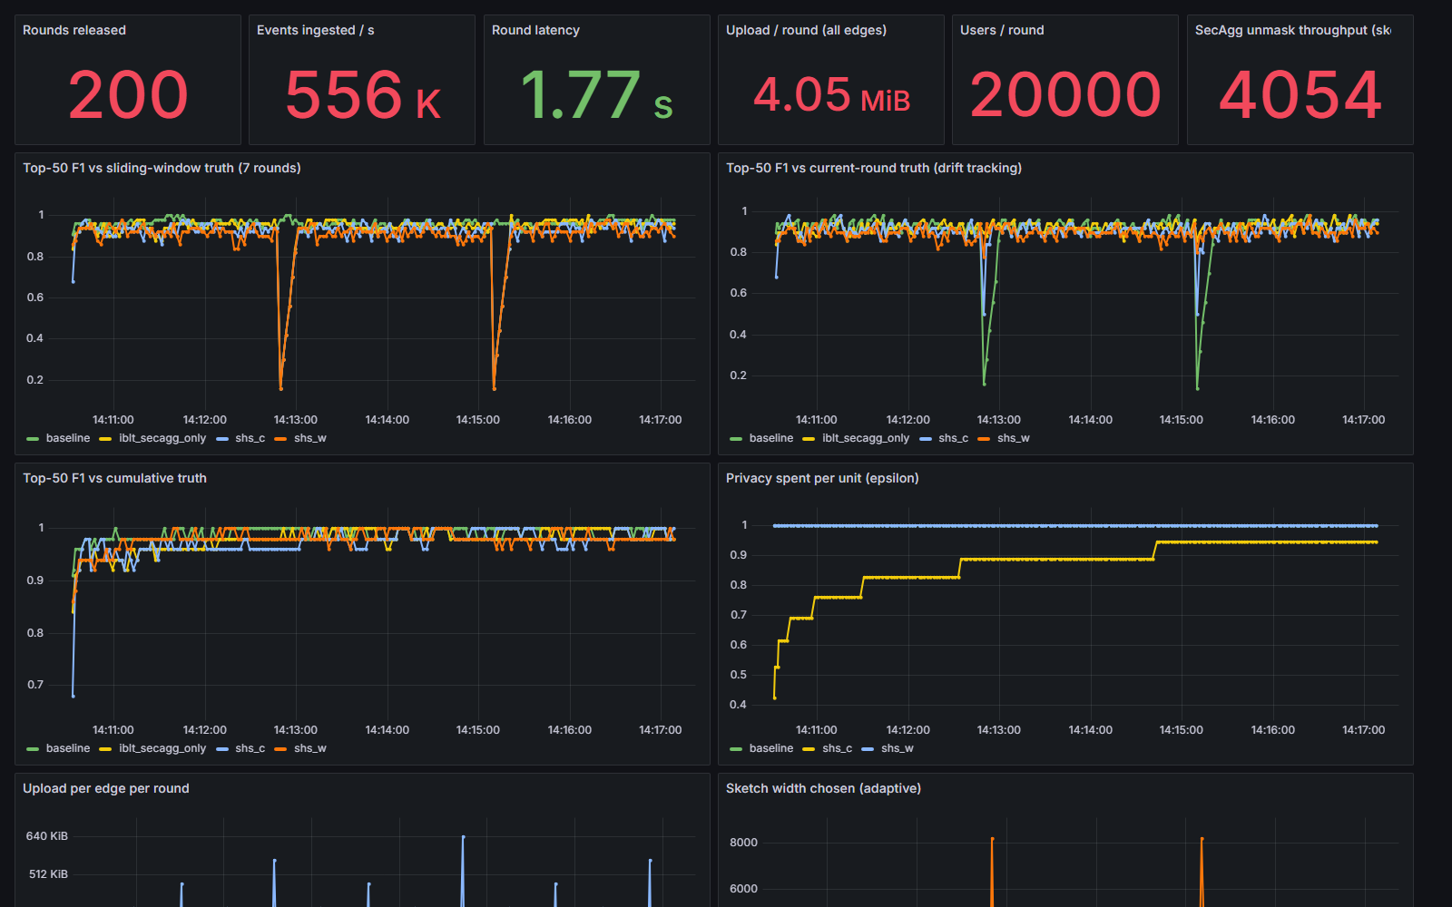
Live demo: the pipeline end to end
1
One command
setup.ps1 -Demo starts Kafka, 8 edges, the server and Grafana
2
Watch it stream
each round: upload, unmask, release, score
3
Drifts at 70 and 140
baseline drops; SHS-W and SHS-C recover in a round
Notes:
[2:50-3:00, then the demo recording, about 2 min, until ~5:00] Now the live demo. One command starts everything. Watch the panels fill round by round, and watch rounds 70 and 140: the baseline drops while ours recovers within a round.

Slide 10
Takeaways
Private, federated top-k on a live stream works end to end
Drift-aware windows recover 3.7× faster and upload up to 61% less
Tree release with peeling halves long-run error at strict privacy
No single setting wins everywhere: pick SHS-W or SHS-C by question
Thank you · Team 22
Notes:
[~5:00-5:20] To sum up: private federated top-k on a live stream works end to end. Drift-aware windows recover 3.7 times faster with up to 61 percent less upload, and tree release with peeling halves long-run error at strict privacy. Thank you.

