Slide 1
Project Overview
Special sort of ADC: ΣΔ
Ongoing Project at IME
Objectives: Measure, analyze, improve
Focus in P5: test bench, measurement and data processing

Slide 2
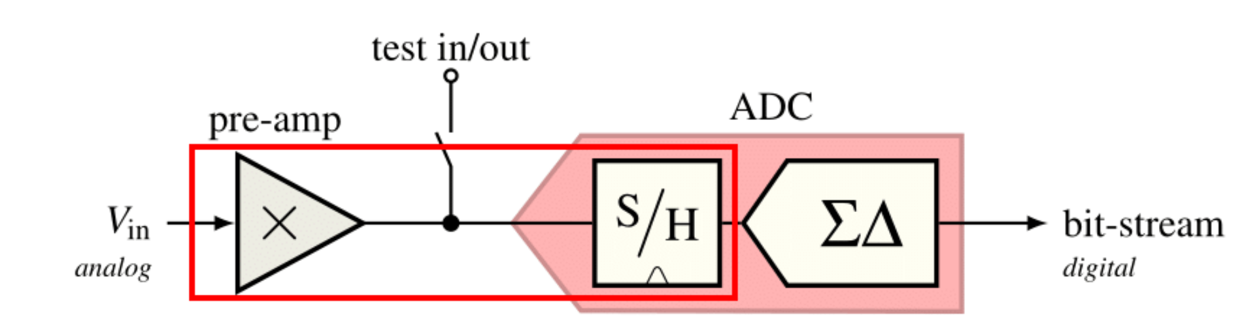
System Overview
Source: Burgherr

Slide 3
Oversampling ADC
Much higher f_{S} than 2 × f_{Nyquist}
Reduced demands on analog circuitry
Increased demands on digital circuitry
Yields additional bits of resolution
Even better resolution with noise shaping:
ΣΔ Modulators

Slide 4
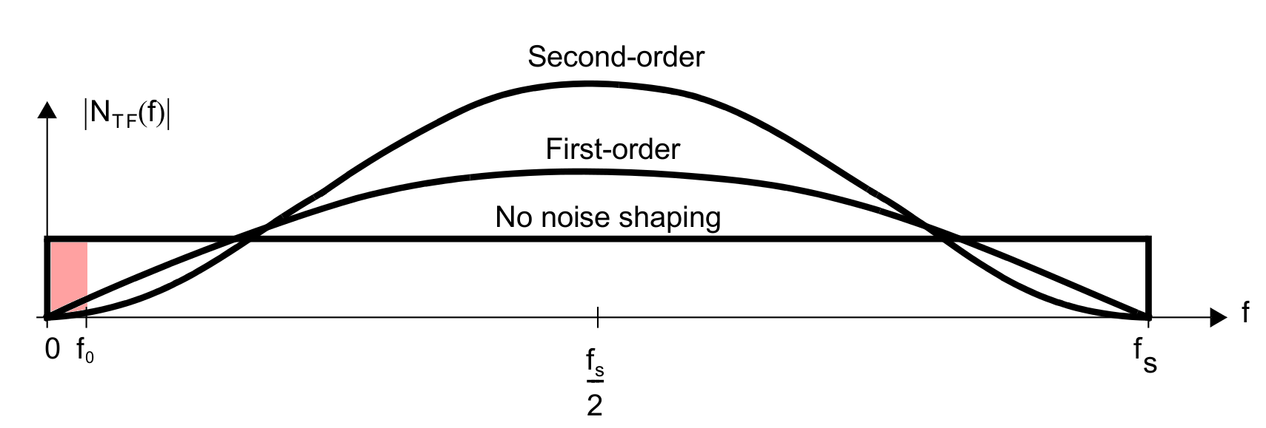
ΣΔ Modulators: Noise Shaping
STF != NTF
Source: Carusone et al.

Slide 5
Test Bench
Reliable results
Prevention of user errors
Efficiency
Documentation
Automation

Slide 6
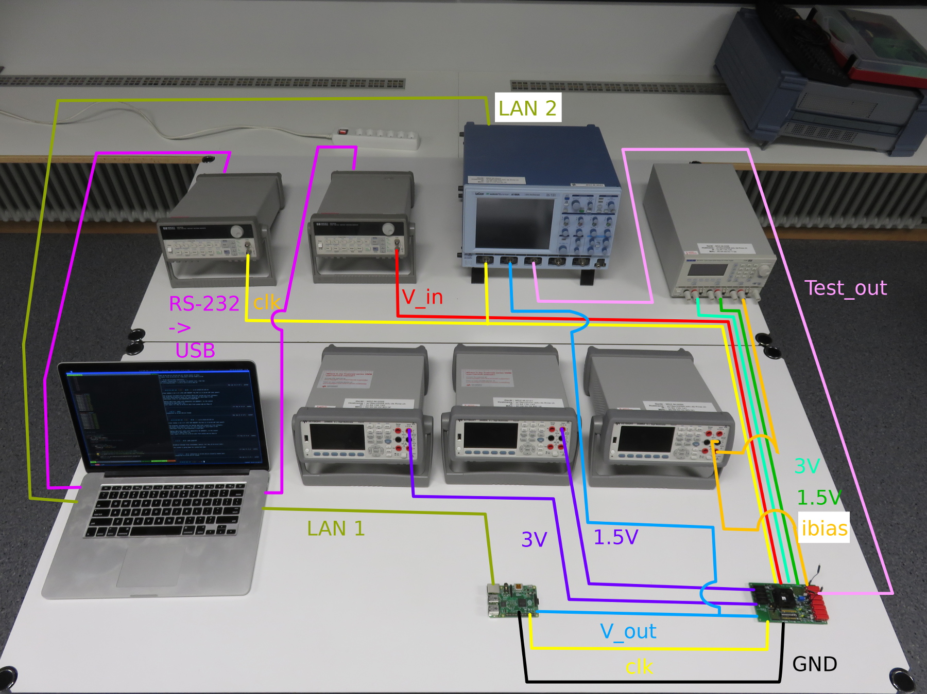
Test Bench

Slide 7
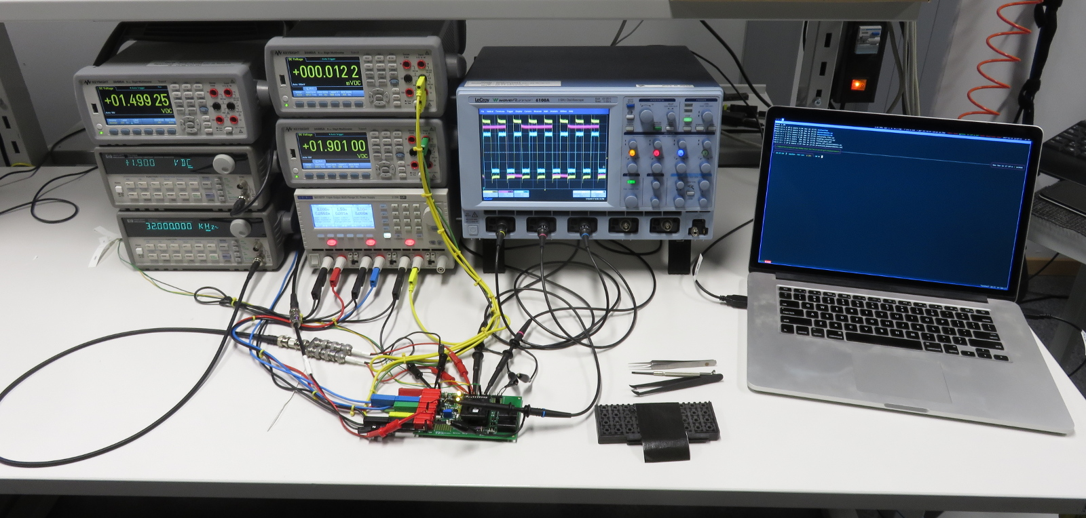
Test Bench

