Slide 1
Measurement and Improvement of a Sensor Measurement Chain
P5, HS2016, Raphael Frey & Alex Murray
2016-Jan-27

Slide 2
Project Overview
Special sort of ADC: ΣΔ
Ongoing Project at IME
Objectives: Measure, analyze, improve
Focus in P5: test bench, measurement and data processing

Slide 3
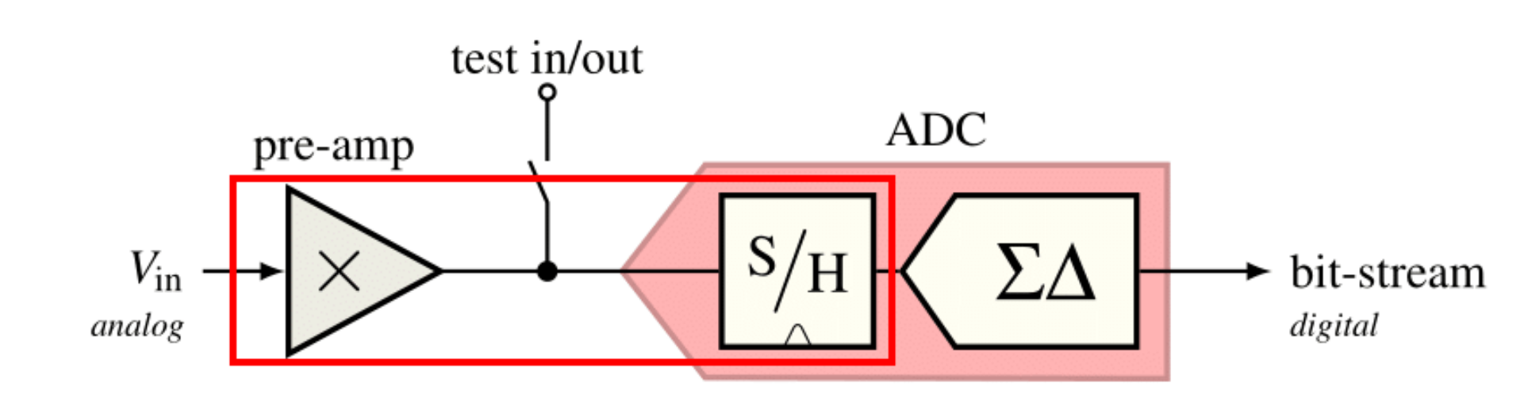
System Overview
Source: Burgherr

Slide 4
Oversampling ADC
Much higher f_{S} than 2 × f_{Nyquist}
Reduced demands on analog circuitry
Increased demands on digital circuitry
Yields additional bits of resolution
Even better resolution with noise shaping:
ΣΔ Modulators

Slide 5
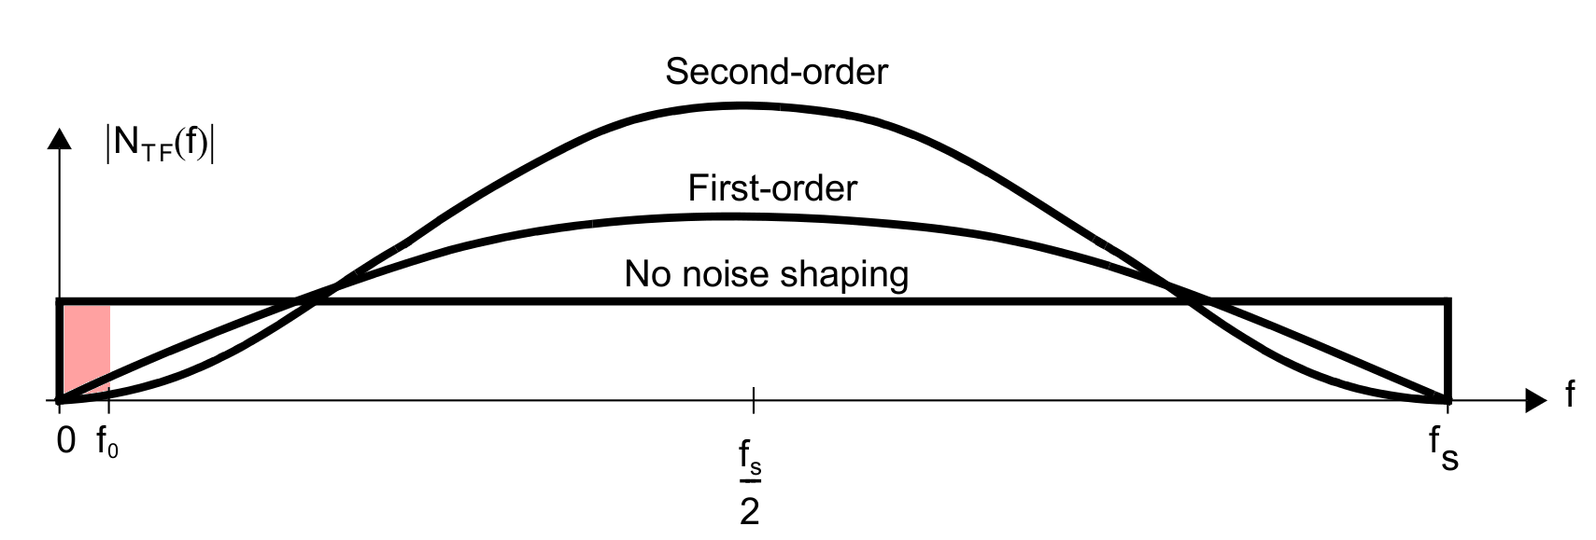
ΣΔ Modulators: Noise Shaping
STF != NTF
Source: Carusone et al.

Slide 6
Test Bench
Reliable results
Prevention of user errors
Efficiency
Documentation
Automation

Slide 7
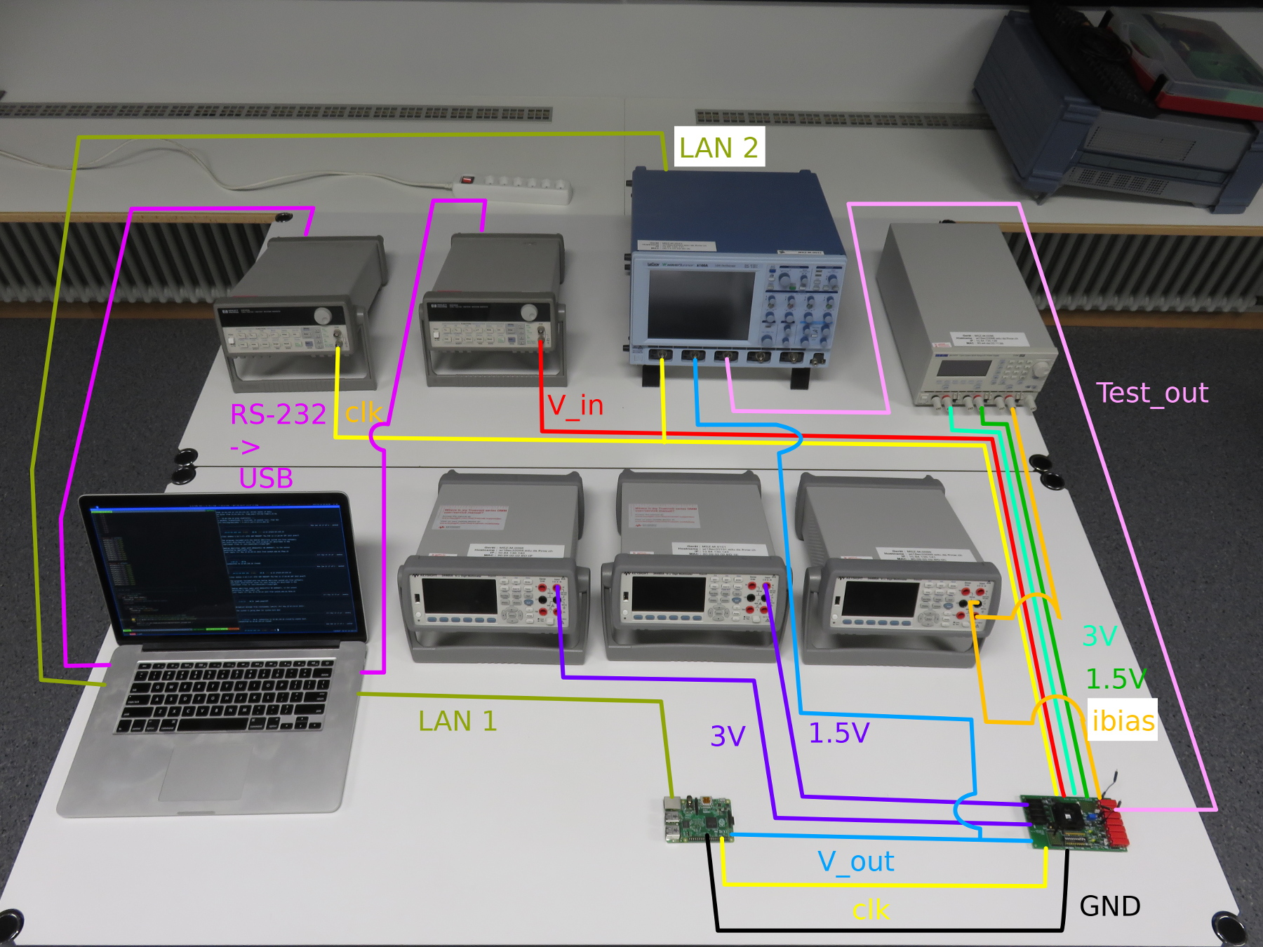
Test Bench

Slide 8
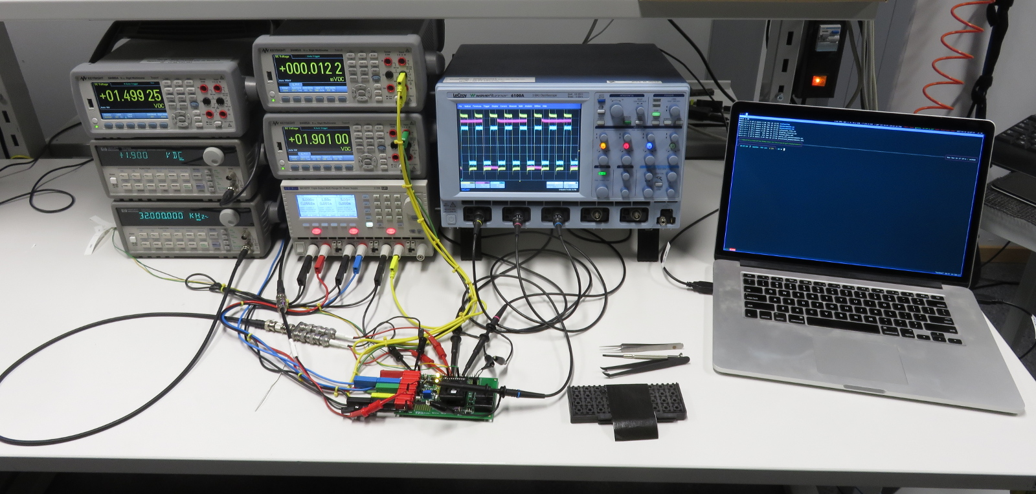
Test Bench

Slide 9
Measurements

Slide 10
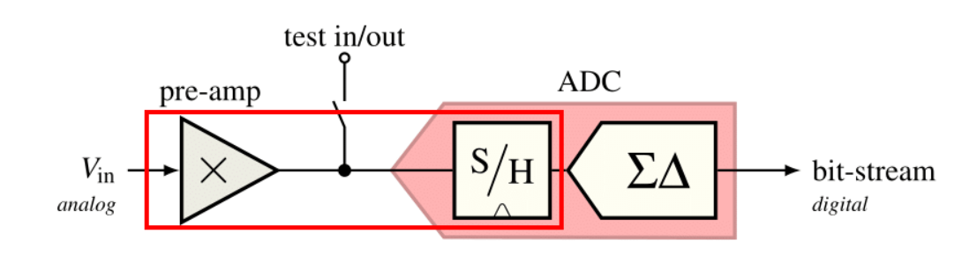
Overview

Slide 11
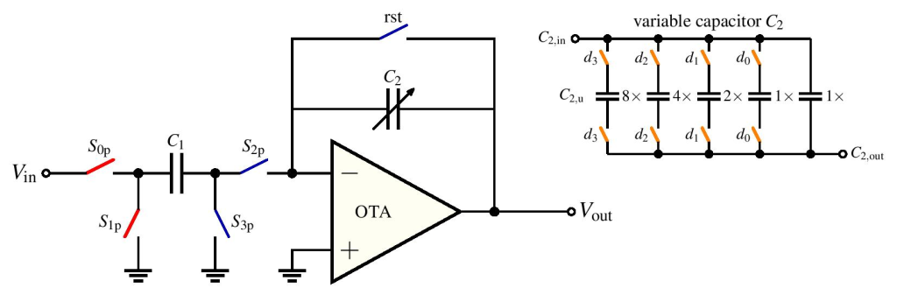
Pre-Amplifier
Gains 1, 2, 4, 8, 16
Negative Gain

Slide 12
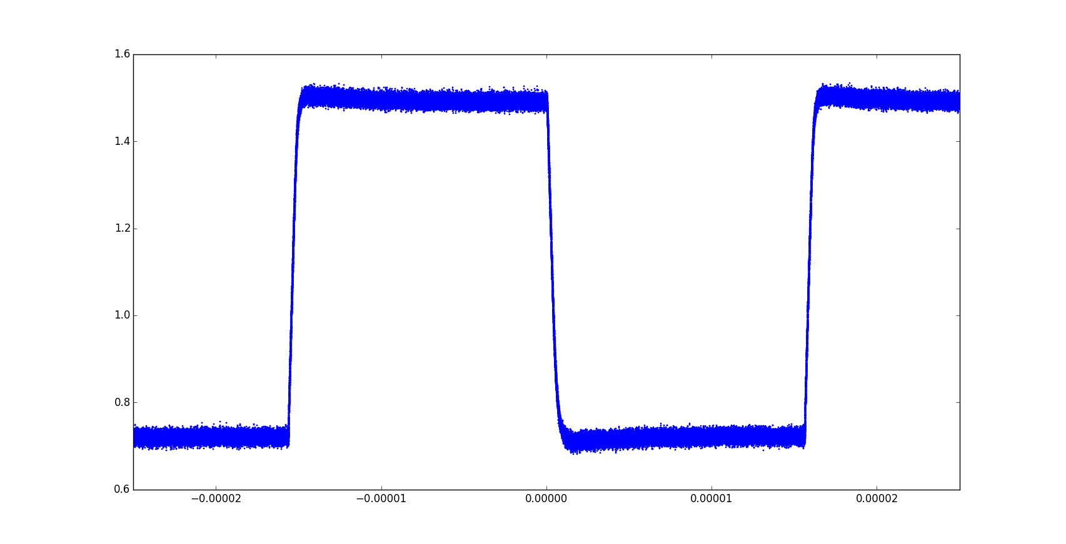
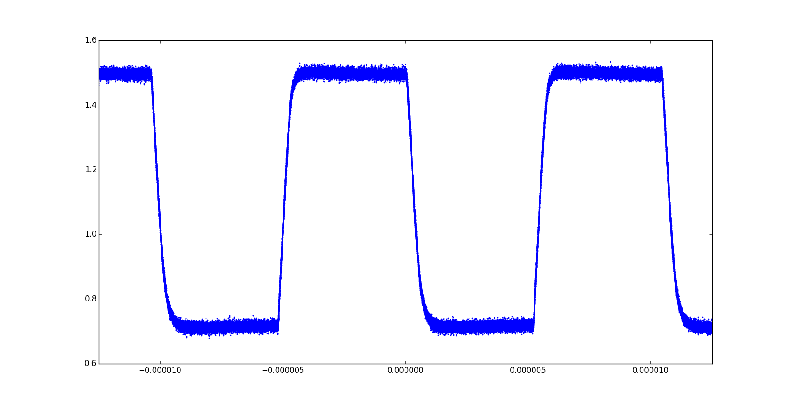
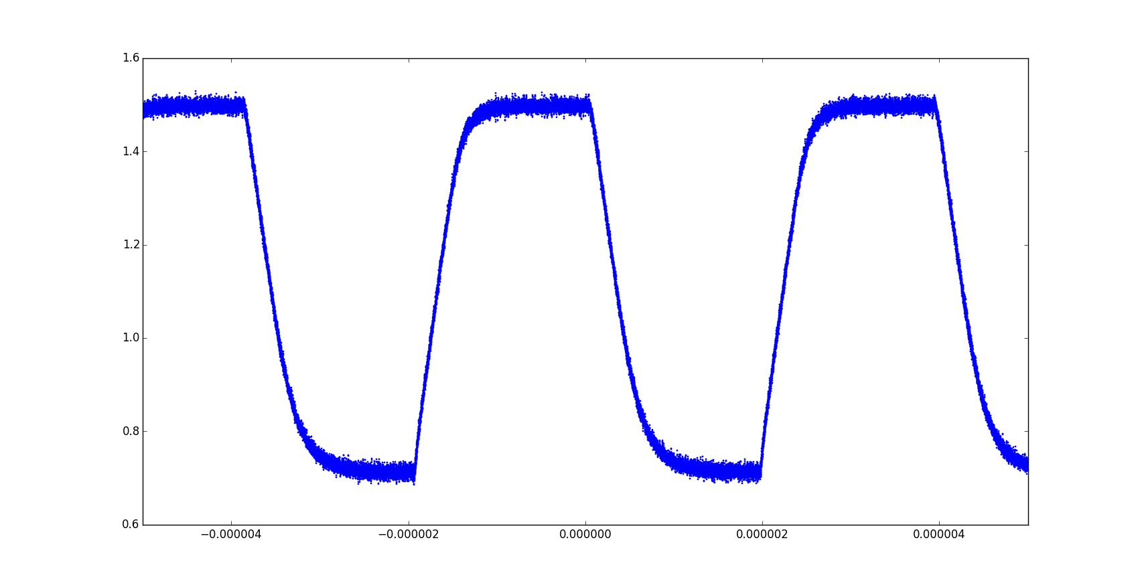
Pre-Amplifier Output vs Sampling Frequency
fs = 32 kHz
fs = 96 kHz
fs = 256 kHz

Slide 13
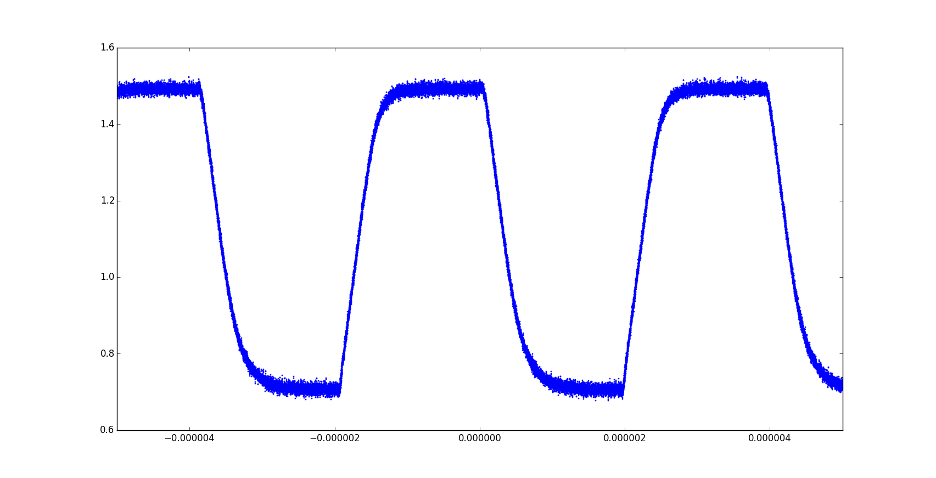
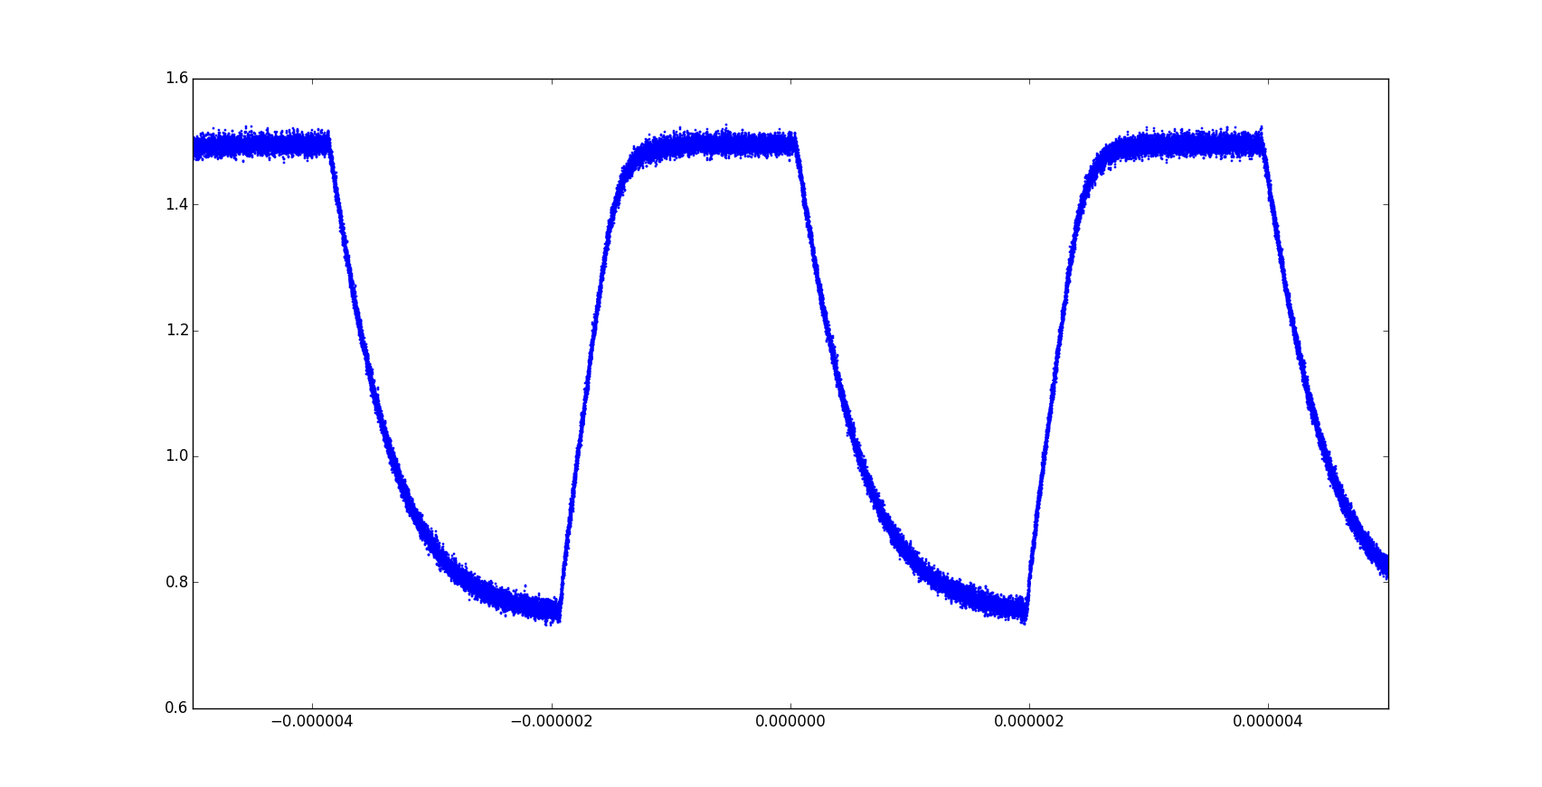
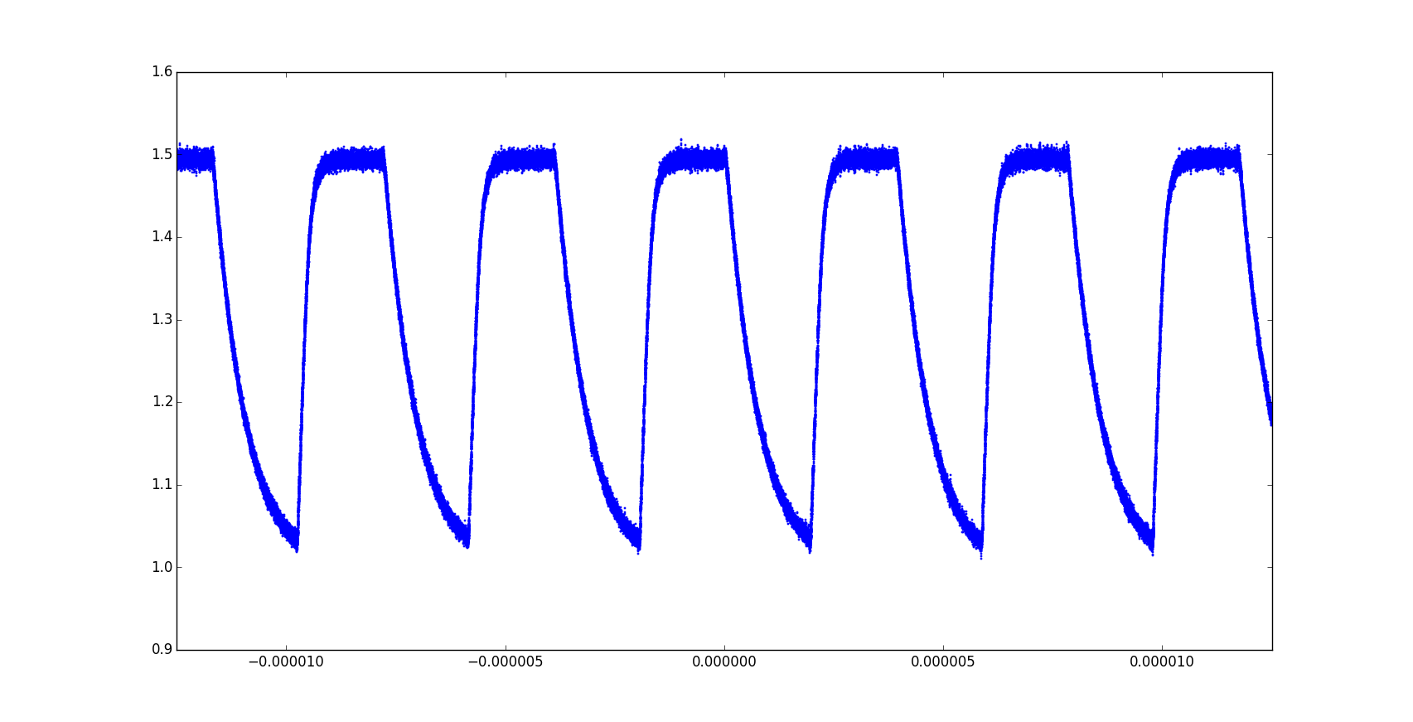
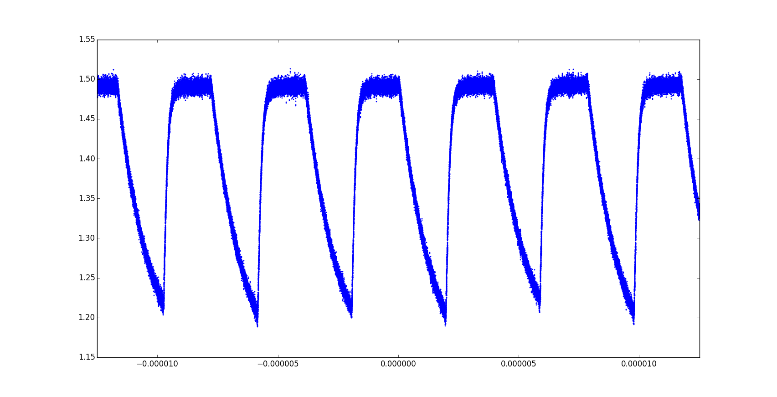
Pre-Amplifier Output vs Gain
Gain = 1
Gain = 8
Gain = 16
Gain = 4

Slide 14
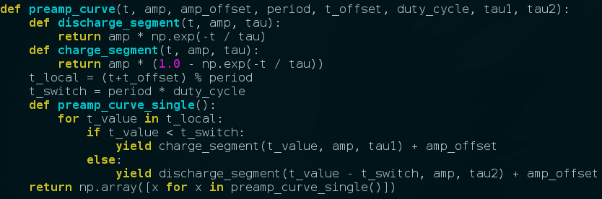
First Order RC Model
Least-Squares fit with scipy.curve_fit()

Slide 15
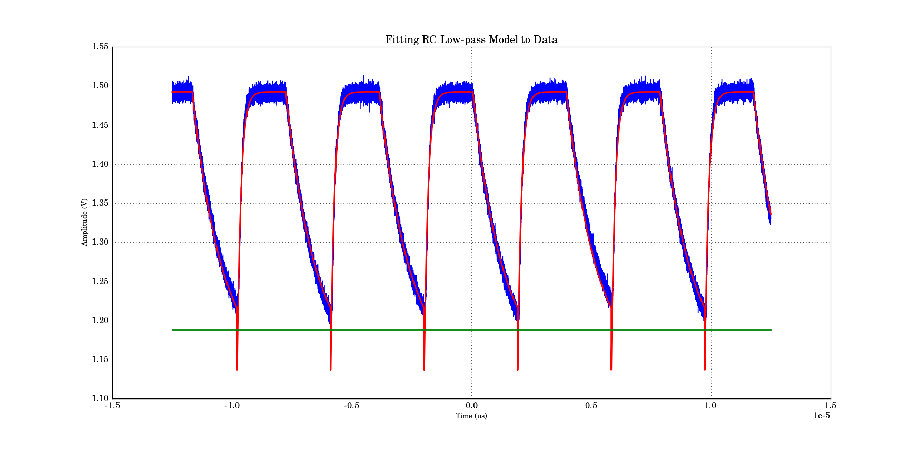
Fitting the Model

Slide 16
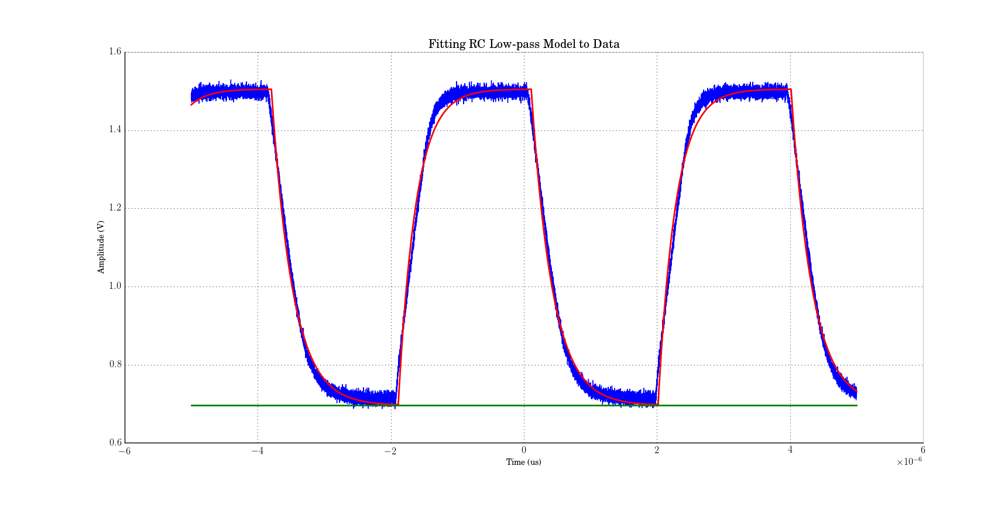
Fitting the Model
fs = 256 kHz

Slide 17
Fitting the Model
Tau 1&2
DC voltage with offset

Slide 18
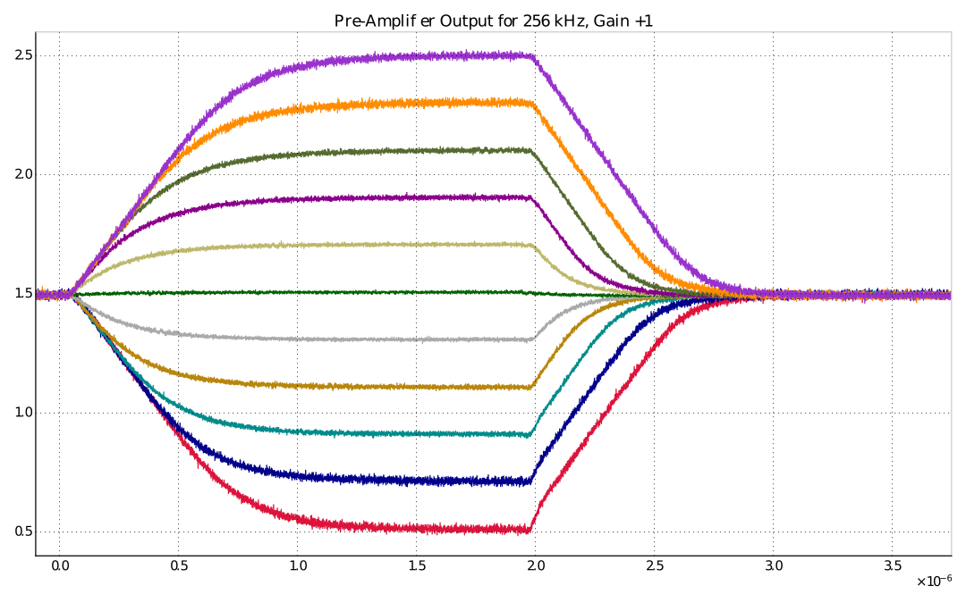
Pre-Amplifier Output vs Input
Gets worse

Slide 19
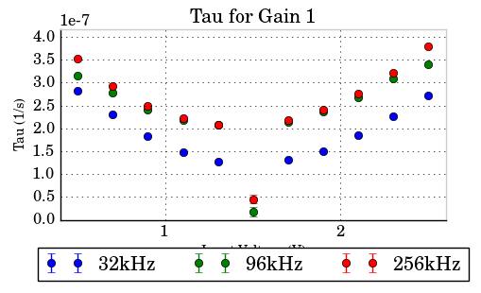
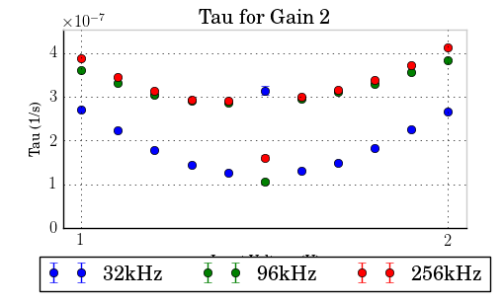
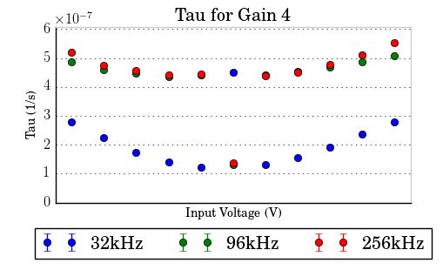
Tau vs Input Voltage

Slide 20
Tau vs Input Voltage
Tau for fs=32 kHz is independent of gain
Tau gets worse for higher fs
Tau increases the more it deviates from Vref
  gm decreases when Tau increases

Slide 21
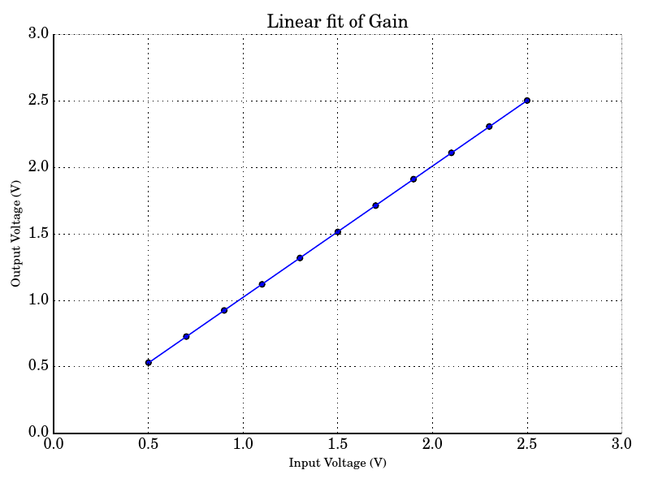
Measuring Effective Gain
Effective Gain
Offset

Slide 22
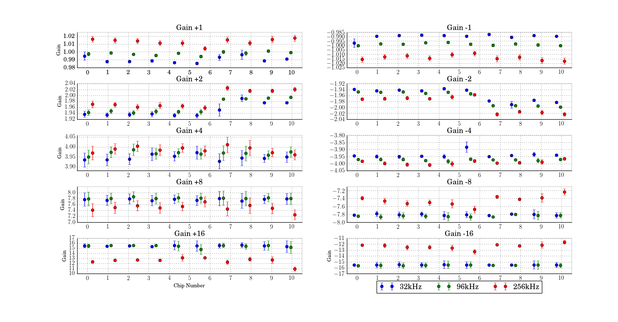
Effective Gain vs fs, Chip, and configured gain

Slide 23
Sigma-Delta Modulator

Slide 24
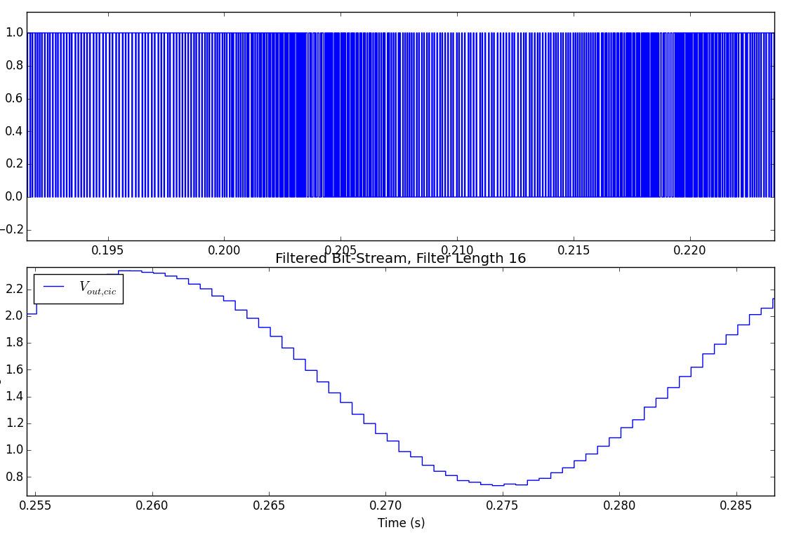
Reconstructed Sine Wave from Bitstream

Slide 25
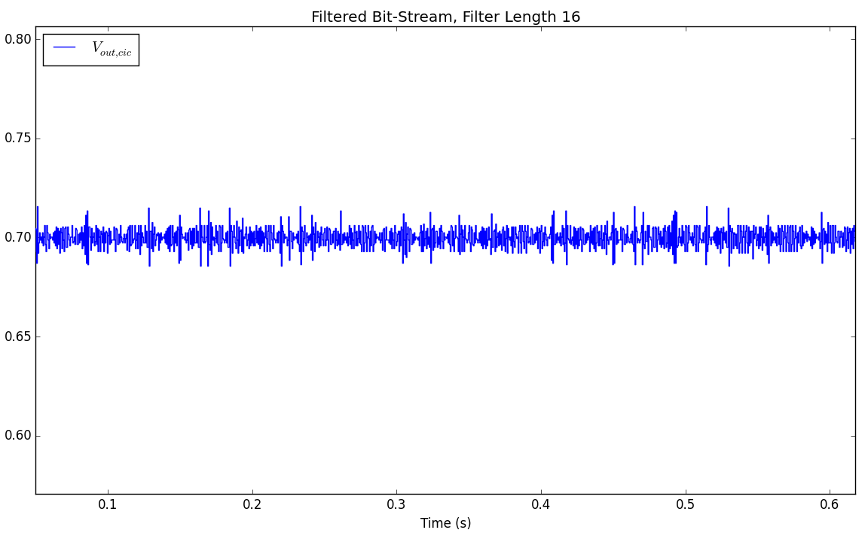
Reconstructed DC signal

Slide 26
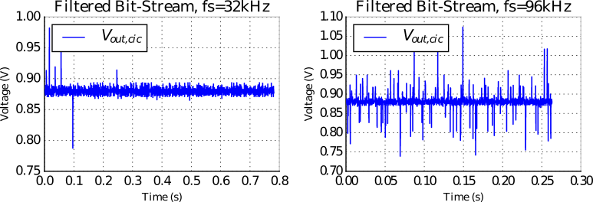
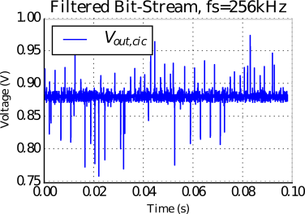
Strange Outliers

Slide 27
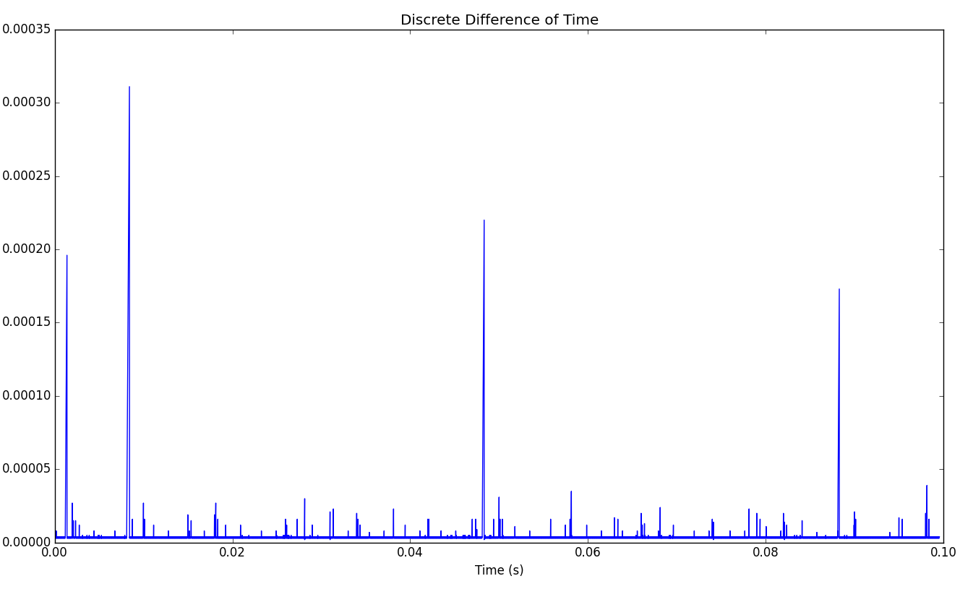
Looking at the Time Axis

Slide 28
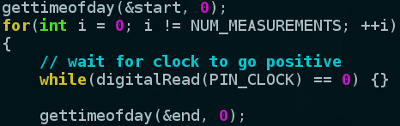
Linux and Time
gettimeofday() is only ~10us accurate
Use clock_gettime(CLOCK_MONOTONIC)
Change niceness to -20 (high process priority)

Slide 29
Measuring Effective Gain & Offset
Effective Gain
Offset

Slide 30
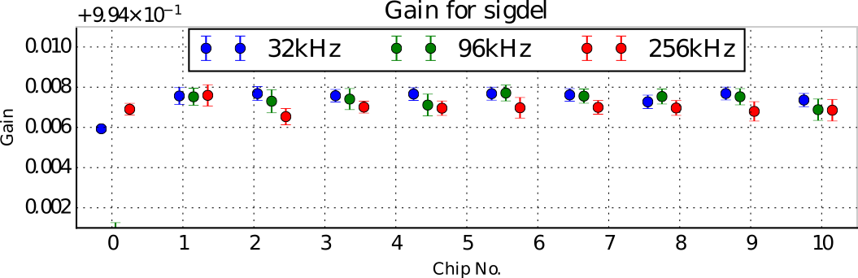
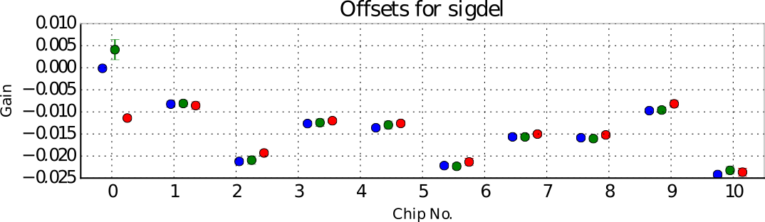
Effective Gain & Offset vs fs and chip

Slide 31
Whole System

Slide 32
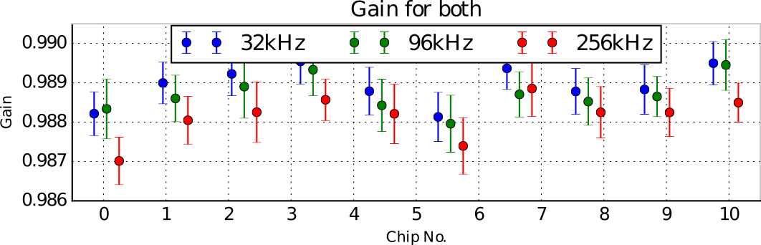
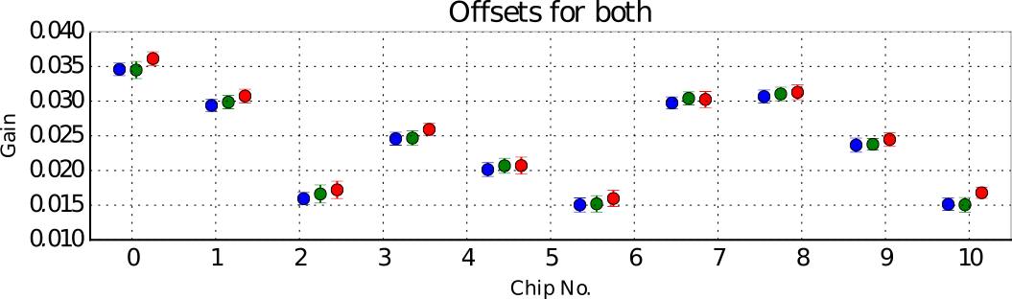
Whole System: Gain & Offset

Slide 33
Conclusions
Pre-Amplifier needs improvement
  Increase Ibias (more power consumption)
  Decrease capacitor values?
Investigate conversion artefacts

Slide 34
Questions

