Slide 1
Requirements →About the home page →About pages, links for each element on the homepage elements

Slide 2
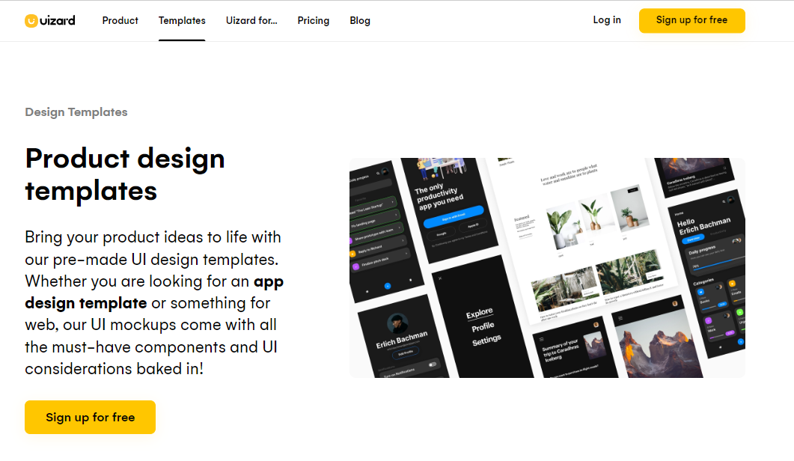

Slide 3
→The home page contains links and buttons(log in, sign up). Test the status of each link: >Is every link clickable? >Does every link has a linked page >Is the text of each link and button correct?

Slide 4
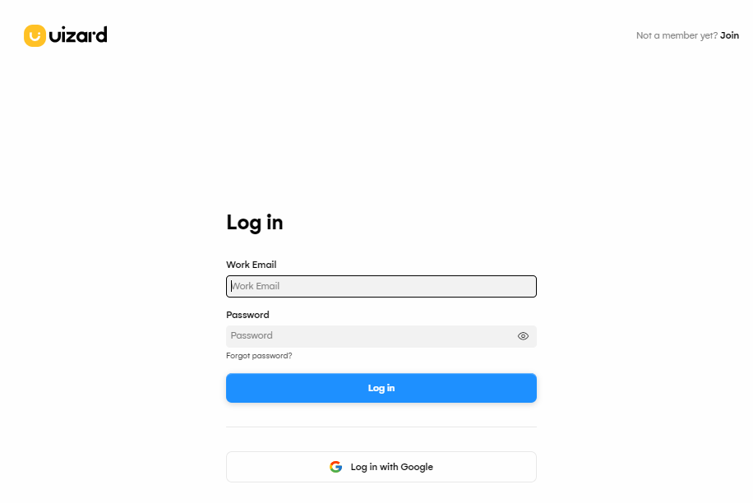

Slide 5
For the login page →Check the links and every element’s property →For the text fields on the login page: design appropriate test cases empty user name, password each empty both space each one space both incorrect(alphanumeric, non alphanumeric) correct username, incorrect password correct password, incorrect username

Slide 6
→The sign-up page requires unique user name, between 5-5 characters, all fields need to be filled. →Check the links for the text fields on the sign-up page, design appropriate test cases empty fields and try to click on create account All space Each one by one space Existing user name, all small, all capital 4 characters,5 characters,6 characters,7 characters, 8 characters, each with empty password, acceptable password, leave the email field empty,

Slide 7
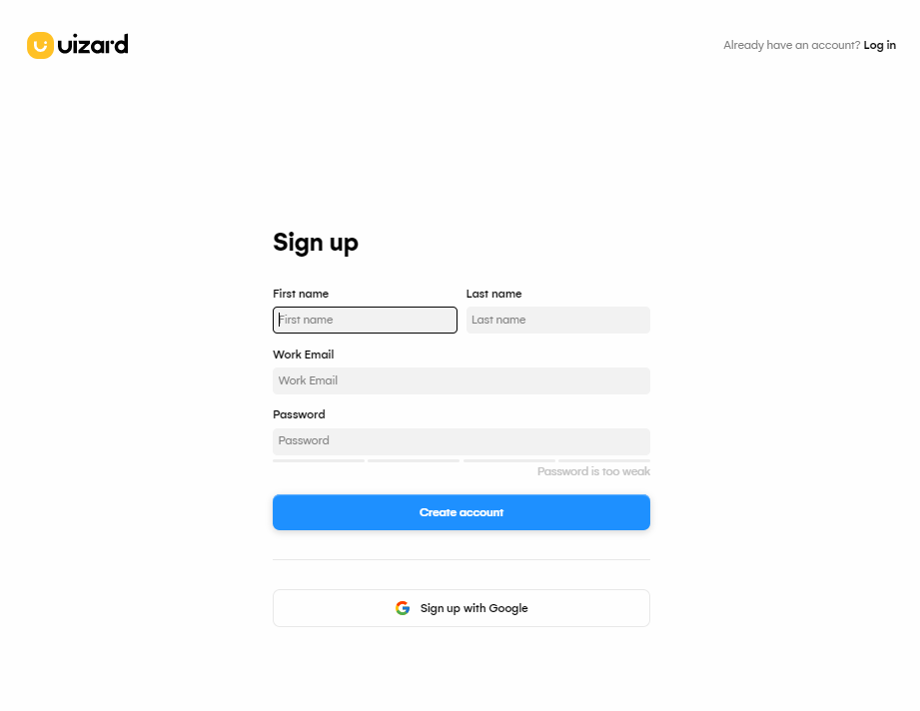

Slide 8
→Enter a nonalphanumeric character of the required length. →Enter nonalphanumeric email address →Once values are entered and submitted, check if the checkboxes are visible, enabled and selectable. →Accept button is working

Slide 9
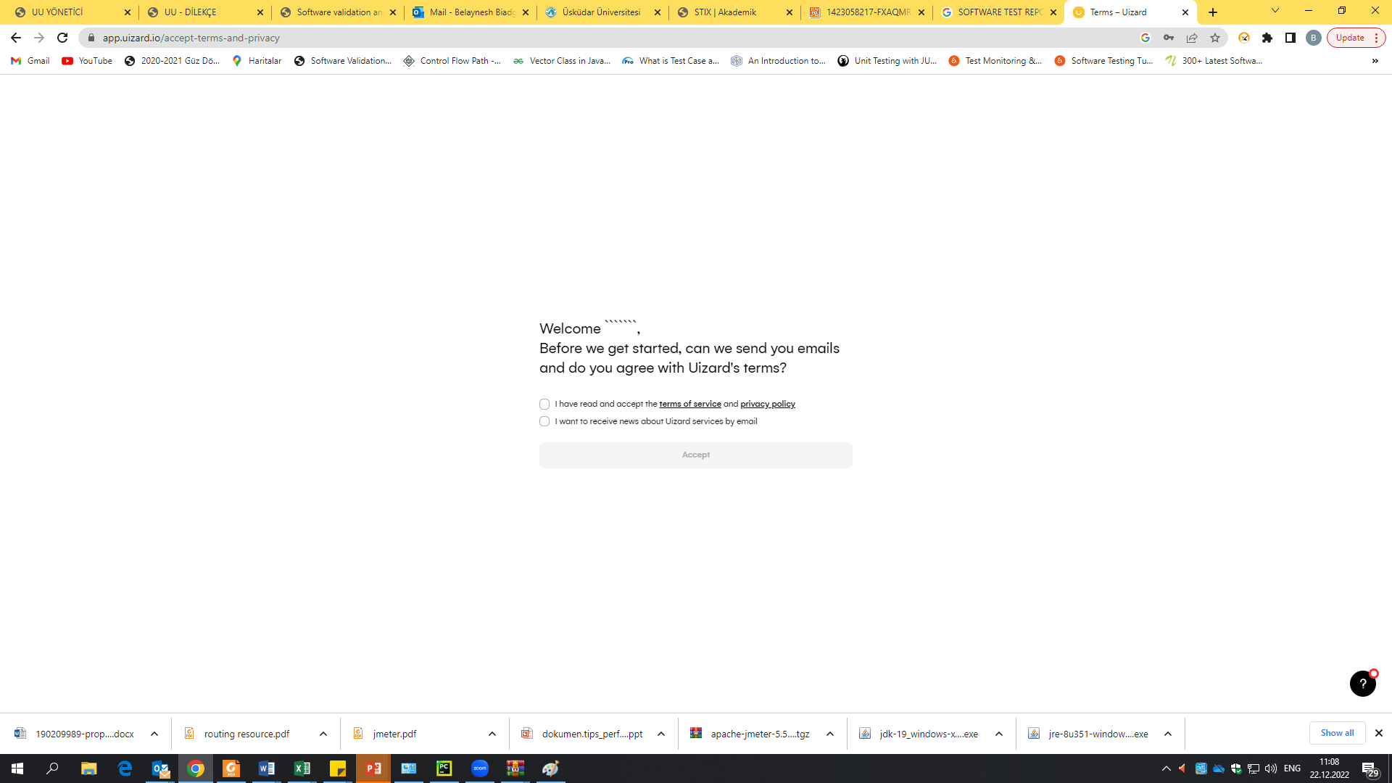
Enter a nonalphanumeric character of the required length

Slide 10
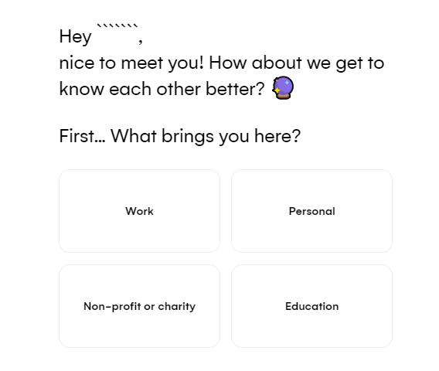

Slide 11
→Check if the displayed text contains the username →if all options are displayed, clickable

Slide 12
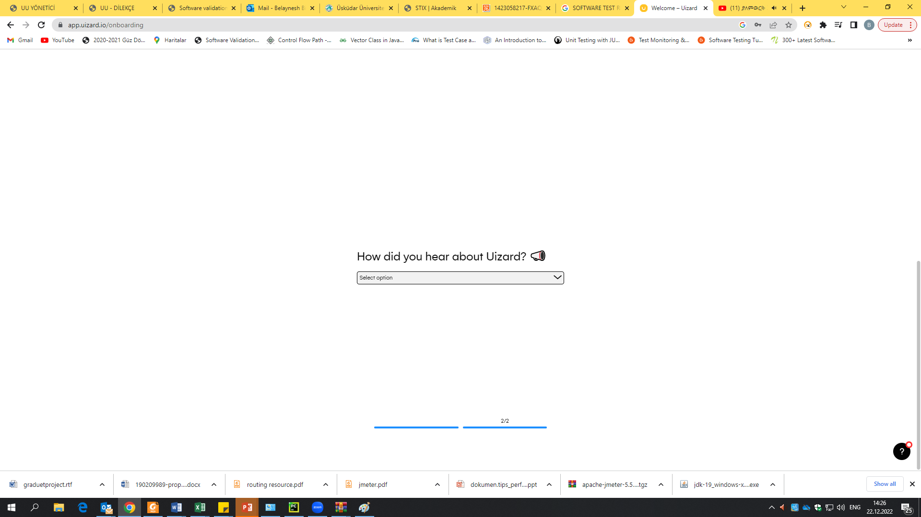

Slide 13
→Check the default text →Check if the dropdown list contains all the choices →Check if choices are selectable

