Slide 1
Type of test case
Functional test: Check if software features work as intended.
Usability test: Evaluate the user experience and ease of use of the software.
Security test: Identify and evaluate potential vulnerabilities in the software to ensure security.

Slide 2
Functional test
identify defects and ensure the system meets its functional requirements.

Slide 3
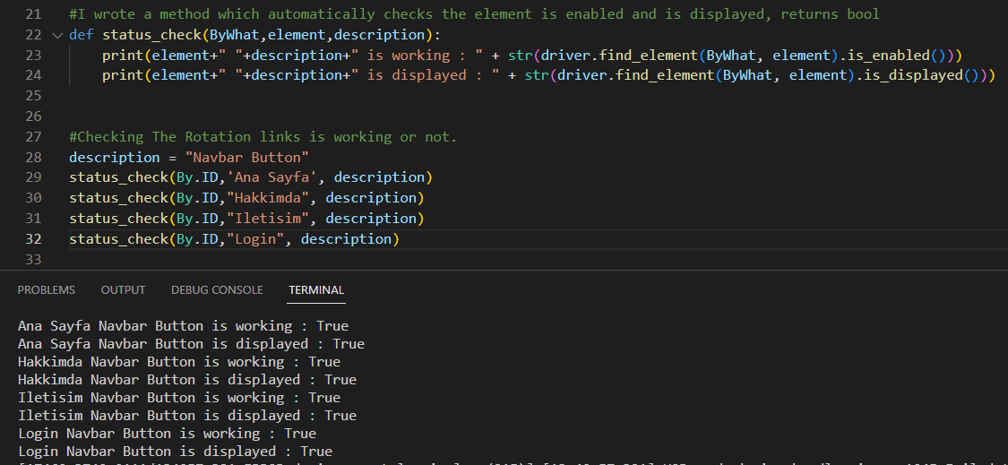
Bywhat represents what selenium uses to find element and element variable represents ByWhat's variables indicator. It then uses the is_enabled() method to check if the element is enabled, and the is_displayed() method to check if the element is displayed.
The method then prints the results of these checks, along with the description of the element and the element value passed.

Slide 4
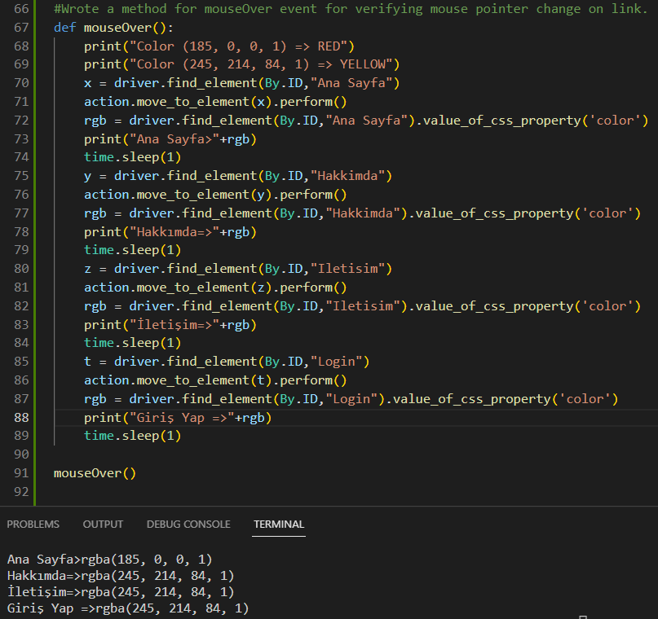
mouse over event on a web page and check the color of elements when the mouse pointer is over it. It then prints the color in RGB format.

Slide 5
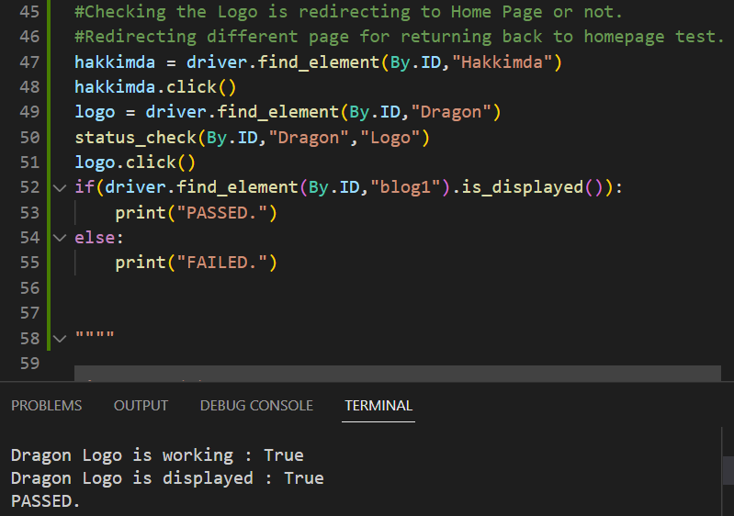
This test is validating the logo is redirecting to the homepage or not.

Slide 6
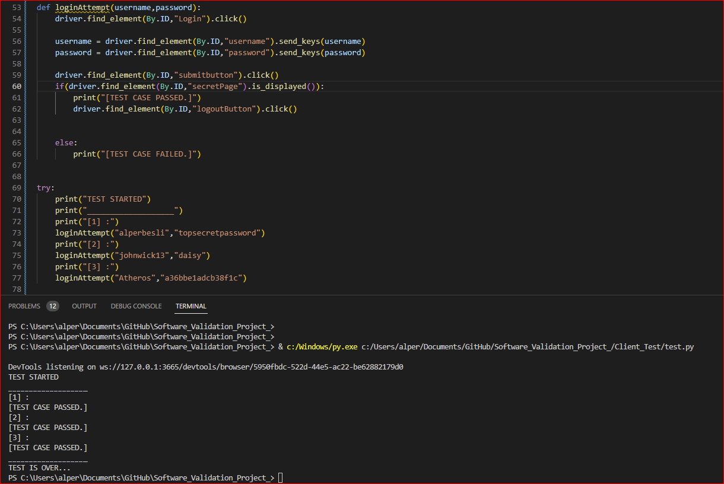
This code is a login test script.
It also have 3 test cases
It performs the following steps: clicks on login button, enters the given username and password, clicks on submit button, then checks if the element with the ID "secretPage" is displayed, If it is displayed it prints "TEST CASE PASSED." else it prints "TEST CASE FAILED."

Slide 7
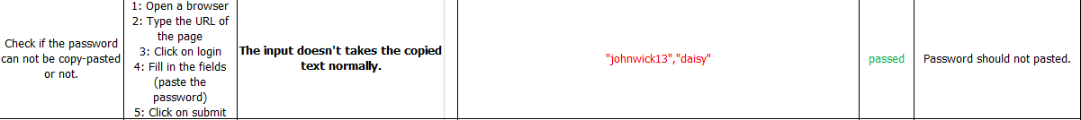
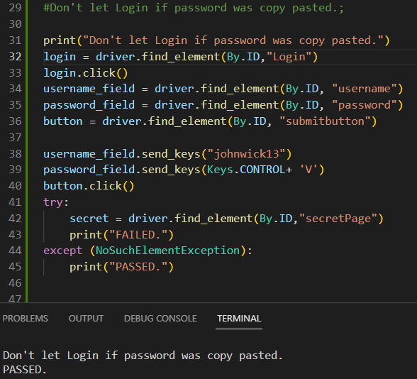
Prevent login if the password was copied and pasted

Slide 8
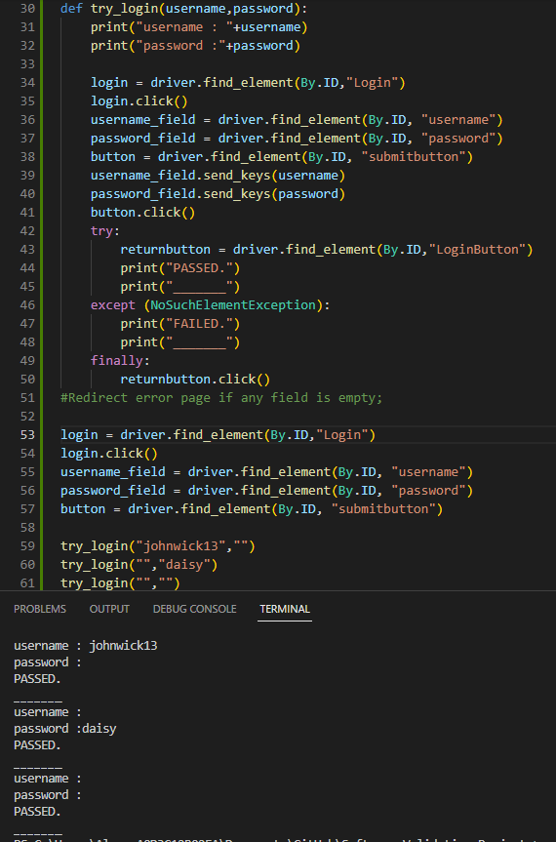
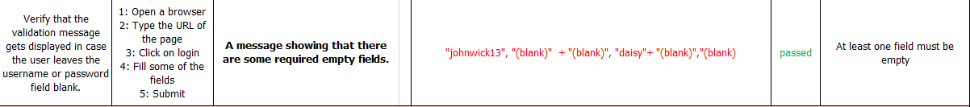
Display a message indicating that there are some mandatory fields that have not been filled in.

Slide 9
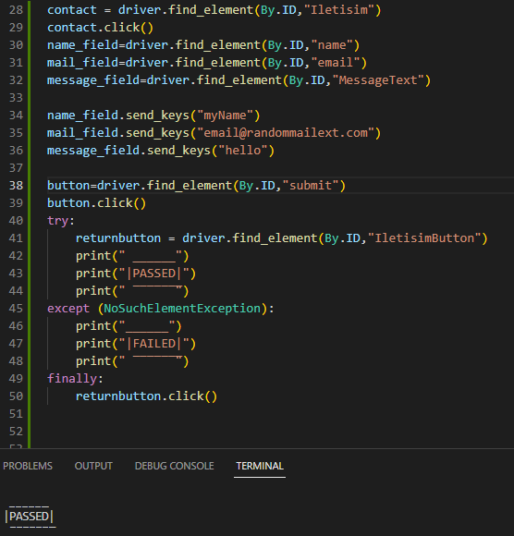
"NoSuchElementException" is an exception thrown by Selenium when an element cannot be located on the web page with the given search criteria. It indicates that the element is not present or not visible on the page and cannot be interacted with.

Slide 10
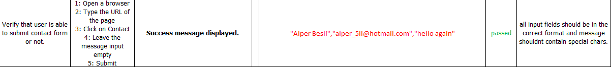
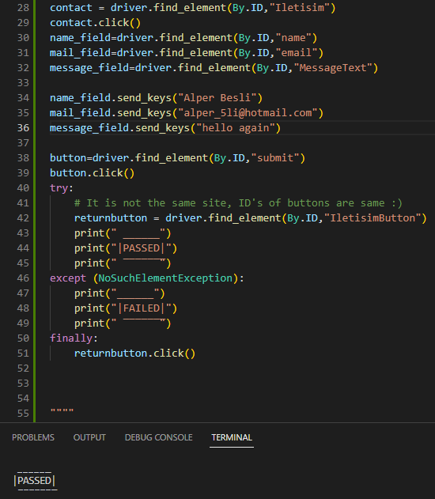

Slide 11
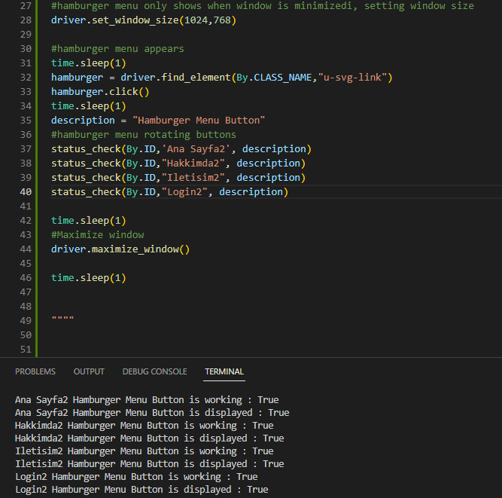
A hamburger menu is a navigation menu icon.
It is often used to hide the navigation menu on smaller screens and make it accessible only when the icon is clicked.

Slide 12
Usability test
Users chosen, features to be tested selected

Slide 13

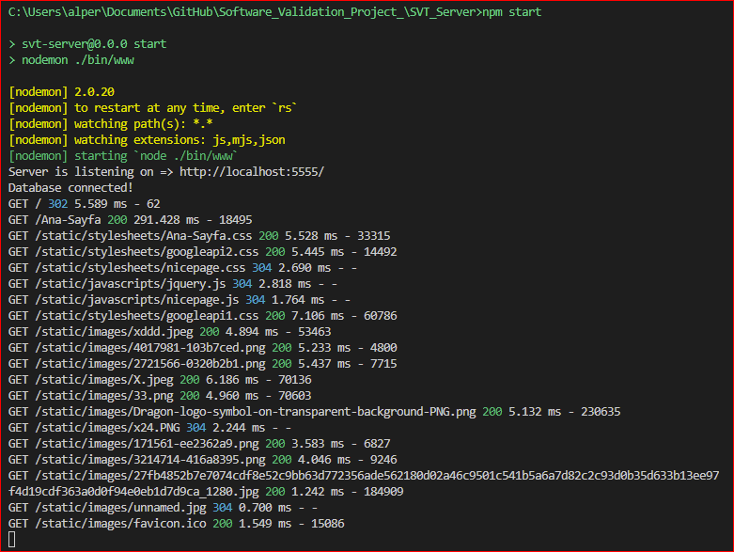
Nodemon is a utility that automatically restarts your Node.js application when changes are made to the code.

Slide 14
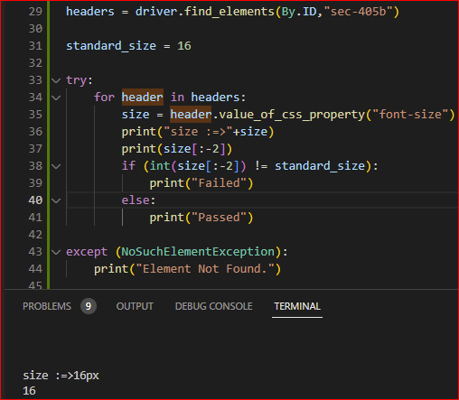

Slide 15
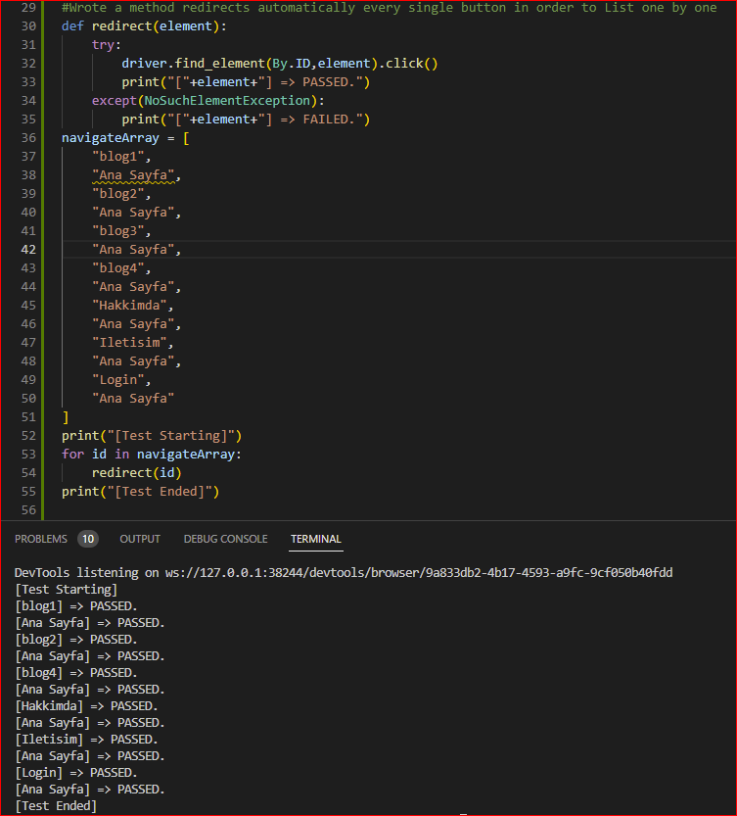

Navigate Array:
Navigating an array refers to the process of accessing and manipulating the elements of an array.

Slide 16

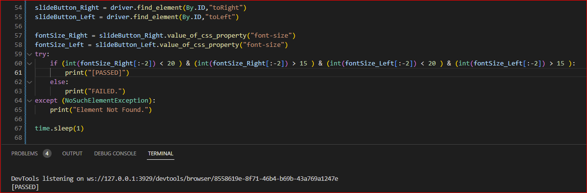

Slide 17
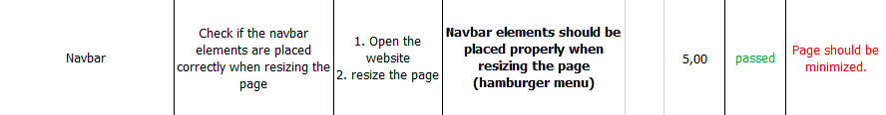
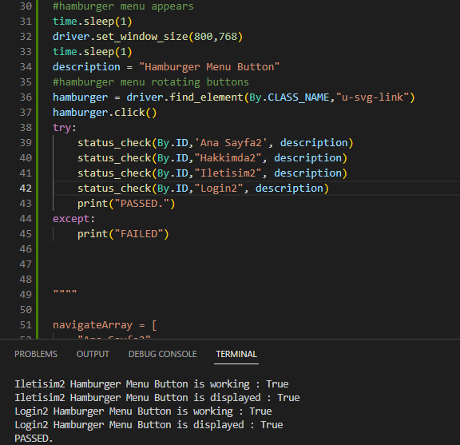

Slide 18
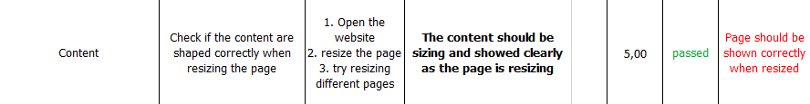
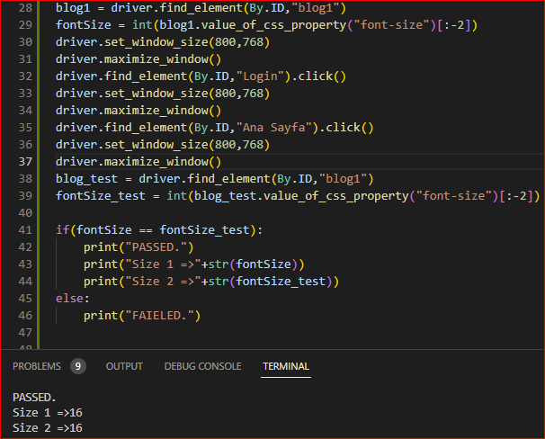
The .value_of_css_property() method is a value of the CSS property for a specific element on a web page.

Slide 19
Security test
identify vulnerabilities and potential risks and ensure the system meets security requirements

Slide 20
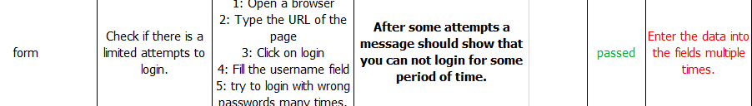
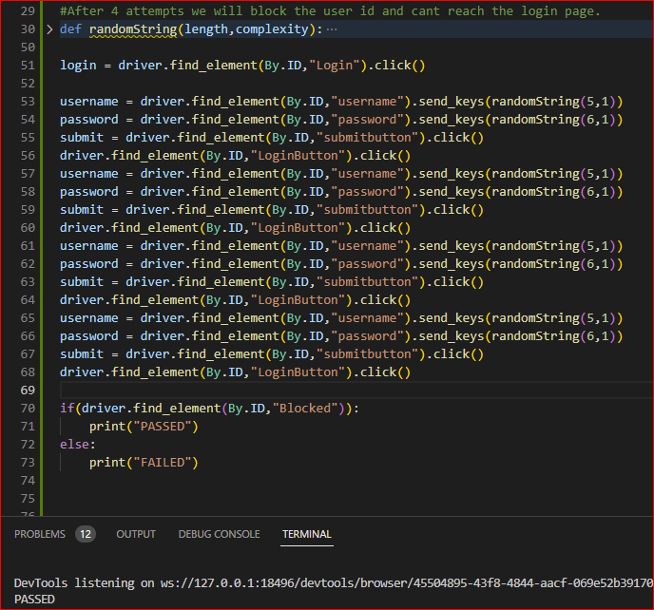

Slide 21
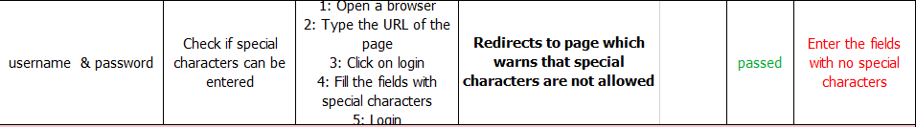
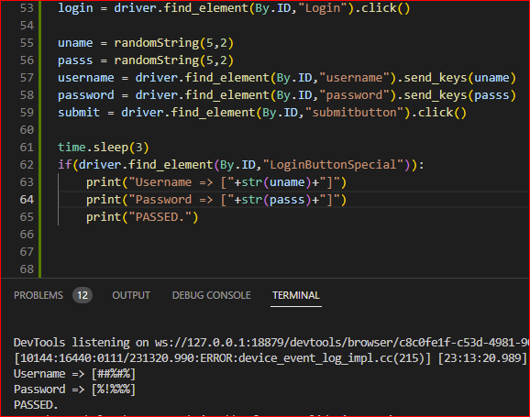

Slide 22
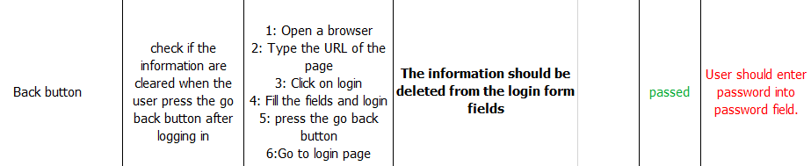
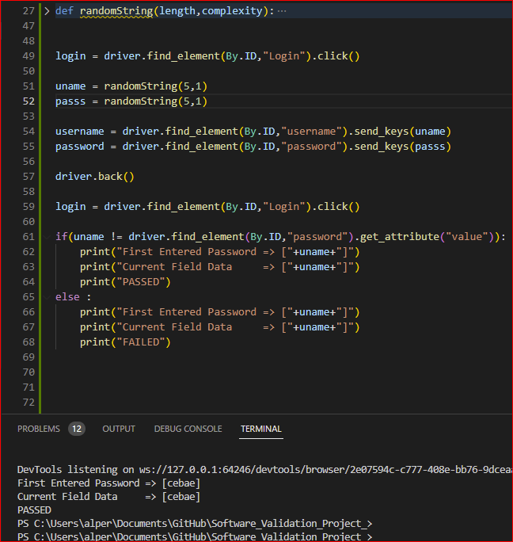

Slide 23
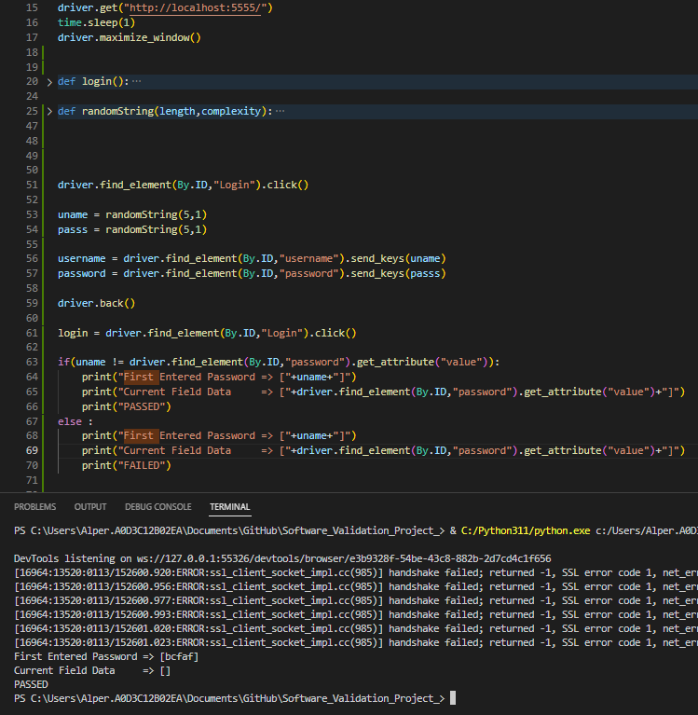
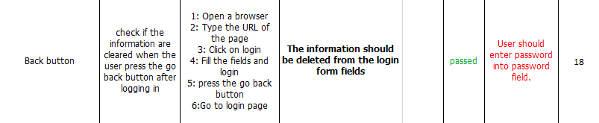
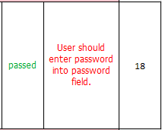

Slide 24
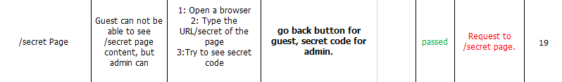
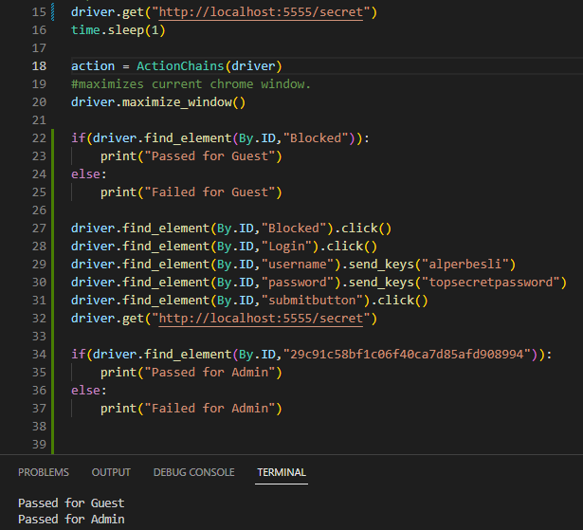

Slide 25
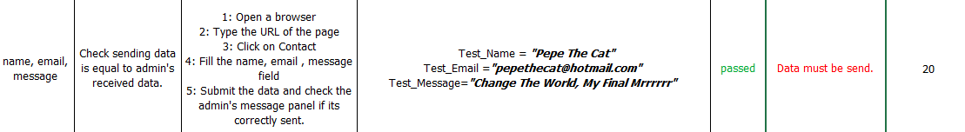
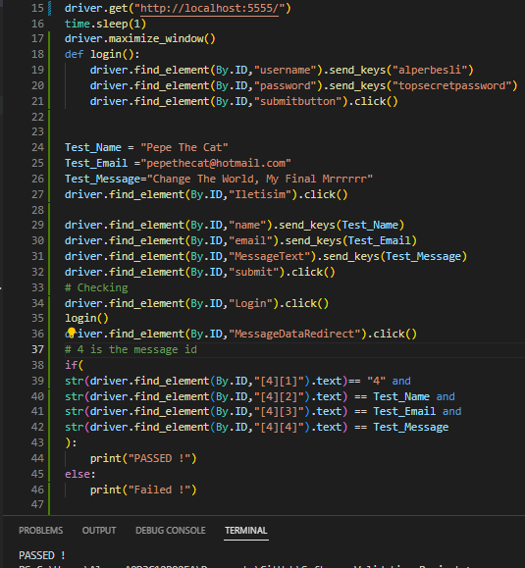
Data Flow Test
Follow the data if there is a error or change on the data which unexpected .

Slide 26
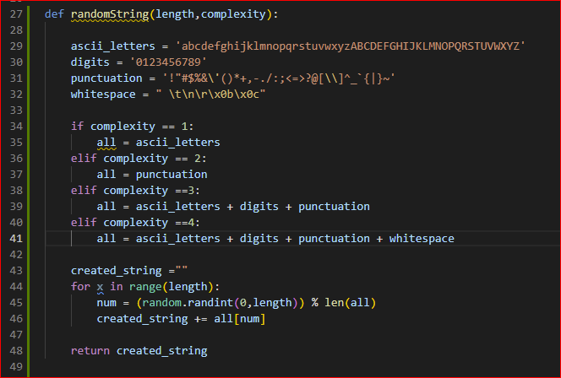
Random String Method

Slide 27
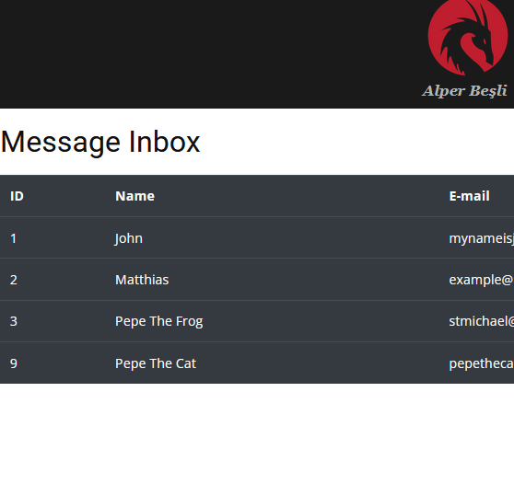
MySQL ver5.7.31 bug fixed with SQL CLI : « ALTER TABLE messages AUTO_INCREMENT=1;»

Slide 28
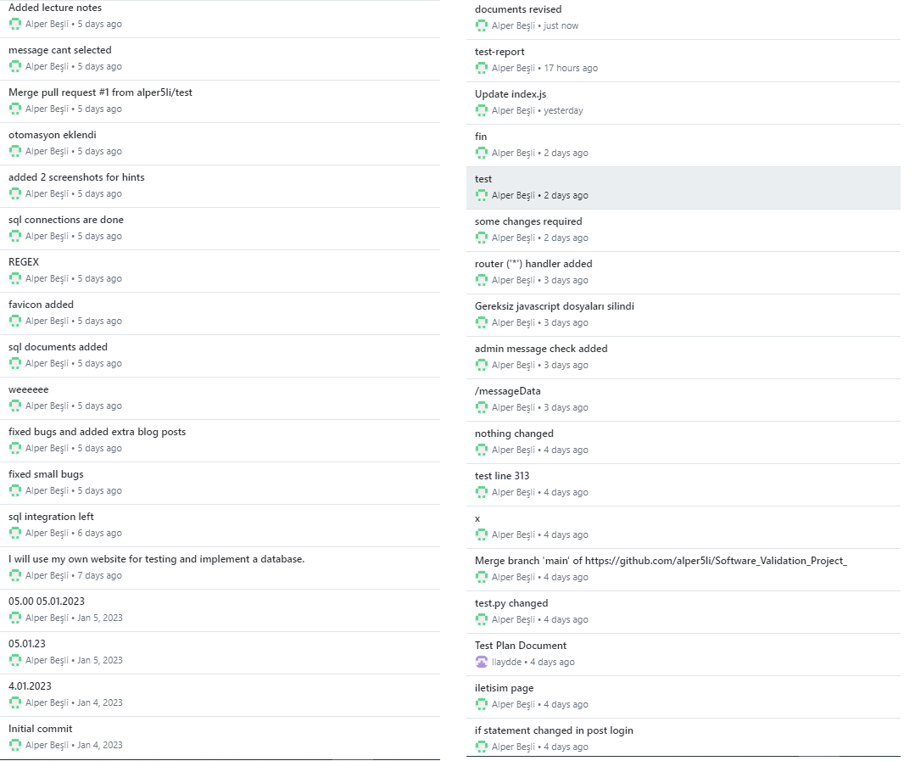
Our Github Branch history

