Slide 1
Assignment 01
Machine Learning WS23/24

Slide 2
Assignment 01 Solution
1. General Questions
2. Naive Bayes
3. Ranking Losses

Slide 3
General Questions

Slide 4
General Questions
To test your understanding of the first lecture, see if you can answer the following questions:
What are the stages of the ML cycle? Which ones are iterative stages?
All the stages are iterative, which means that you might come back to a previous stage in order to refine the process.
Pre-processing
Feature Selection
Machine Learning
Evaluation
Feature Extraction

Slide 5
General Questions
To test your understanding of the first lecture, see if you can answer the following questions:
What are the different types of learning?
Machine Learning
Supervised Learning
Unsupervised Learning

Slide 6
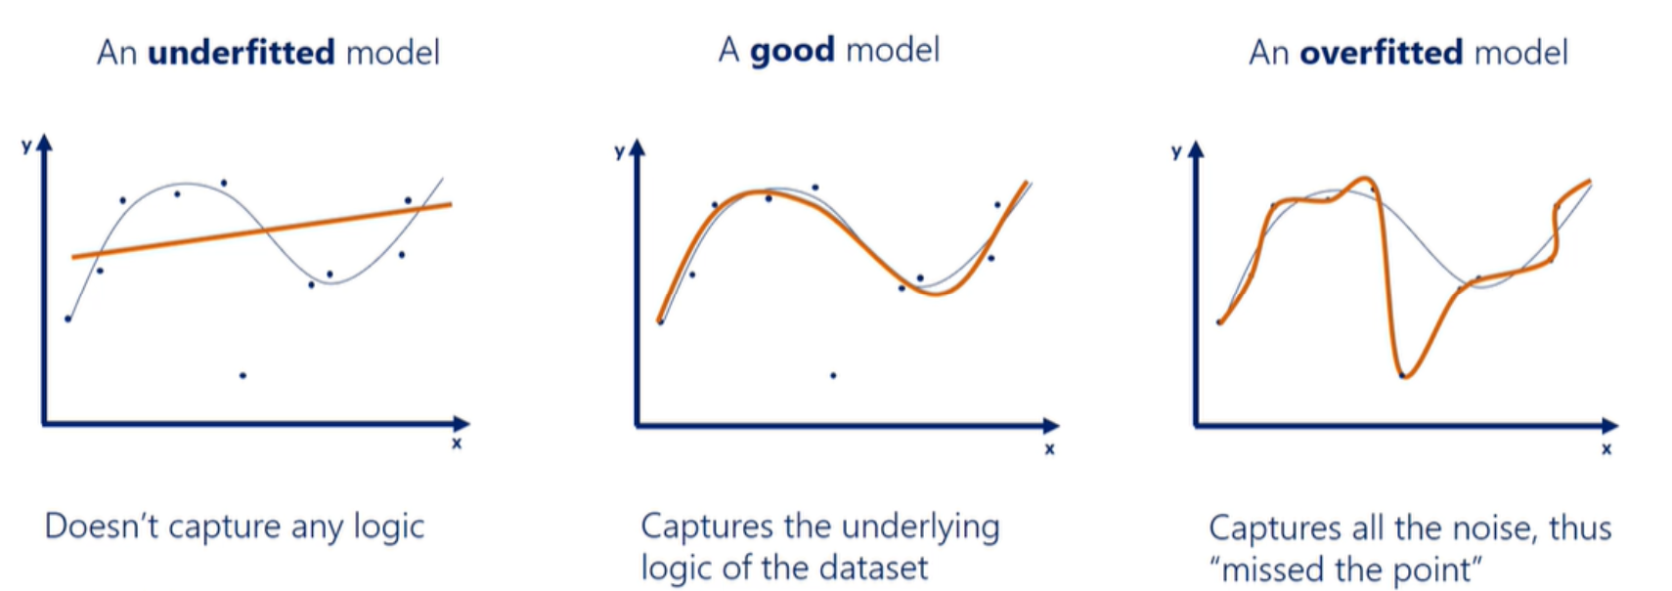
General Questions
To test your understanding of the first lecture, see if you can answer the following questions:
How would you describe the overfitting and underfitting phenomenon?

Slide 7
Naive Bayes

Slide 8
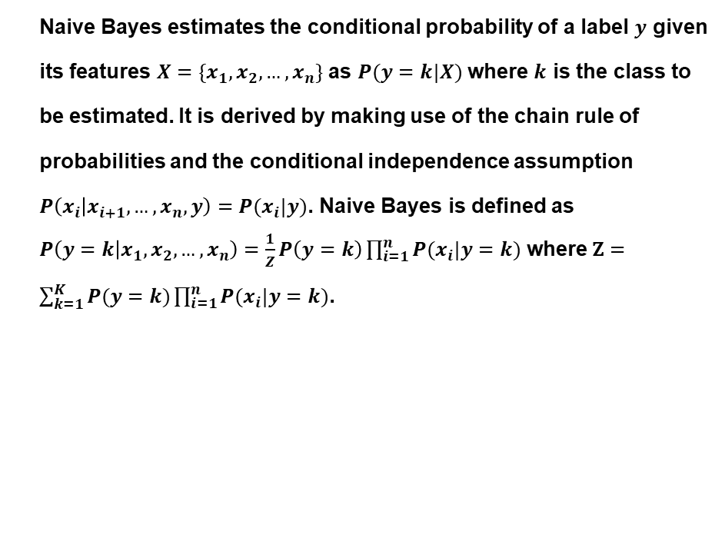
Naive Bayes
Naive Bayes estimates the conditional probability of a label $y$ given its features $X=\{x_{1}, x_{2},…,x_{n}\}$ as $P(y=k|X)$ where $k$ is the class to be estimated. It is derived by making use of the chain rule of probabilities and the conditional independence assumption $P\left(x_{i} | x_{i+1},…,x_{n},y\right)=P(x_{i}|y)$. Naive Bayes is defined as $P\left(y=k | x_{1},x_{2},…,x_{n}\right)=\frac{1}{Z}P\left(y=k\right)\prod_{i=1}^{n}{P(x_{i}|y=k)}$ where $Z=\sum_{k=1}^{K}{P(y=k)\prod_{i=1}^{n}{P(x_{i}|y=k)}}$.
Car | Color | Type | Origin | Stolen
1 | Red | Sports | Domestic | Yes
2 | Red | Sports | Domestic | No
3 | Blue | Sports | Domestic | Yes
4 | Blue | Sports | Domestic | No
5 | Blue | Sports | Imported | Yes
6 | Blue | Grand Tourer | Imported | No
7 | Blue | Grand Tourer | Imported | Yes
8 | Blue | Grand Tourer | Domestic | No
9 | Red | Grand Tourer | Imported | Yes
10 | Red | Sports | Imported | Yes

Slide 9
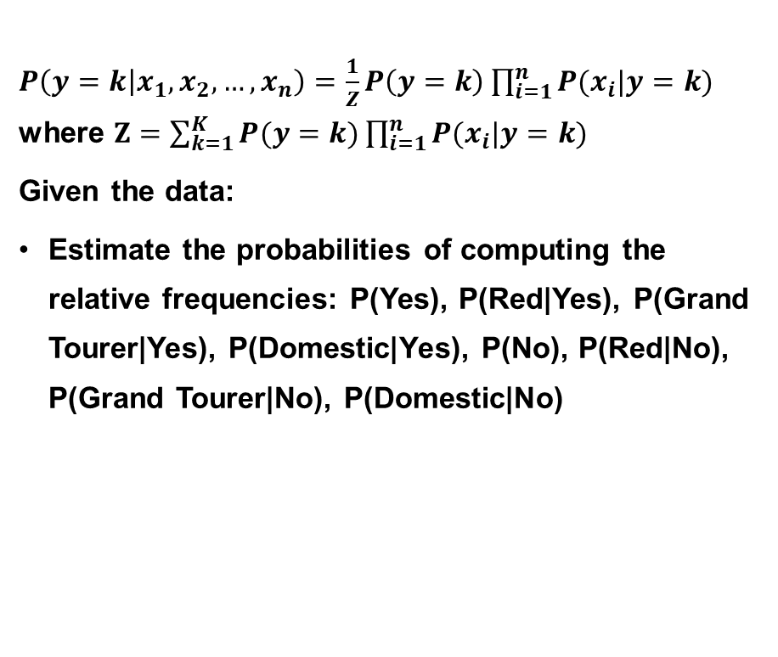
Naive Bayes
$P\left(y=k | x_{1},x_{2},…,x_{n}\right)=\frac{1}{Z}P\left(y=k\right)\prod_{i=1}^{n}{P(x_{i}|y=k)}$ where $Z=\sum_{k=1}^{K}{P(y=k)\prod_{i=1}^{n}{P(x_{i}|y=k)}}$
Given the data:
Estimate the probabilities of computing the relative frequencies: P(Yes), P(Red|Yes), P(Grand Tourer|Yes), P(Domestic|Yes), P(No), P(Red|No), P(Grand Tourer|No), P(Domestic|No)
Car | Color | Type | Origin | Stolen
1 | Red | Sports | Domestic | Yes
2 | Red | Sports | Domestic | No
3 | Blue | Sports | Domestic | Yes
4 | Blue | Sports | Domestic | No
5 | Blue | Sports | Imported | Yes
6 | Blue | Grand Tourer | Imported | No
7 | Blue | Grand Tourer | Imported | Yes
8 | Blue | Grand Tourer | Domestic | No
9 | Red | Grand Tourer | Imported | Yes
10 | Red | Sports | Imported | Yes

Slide 10
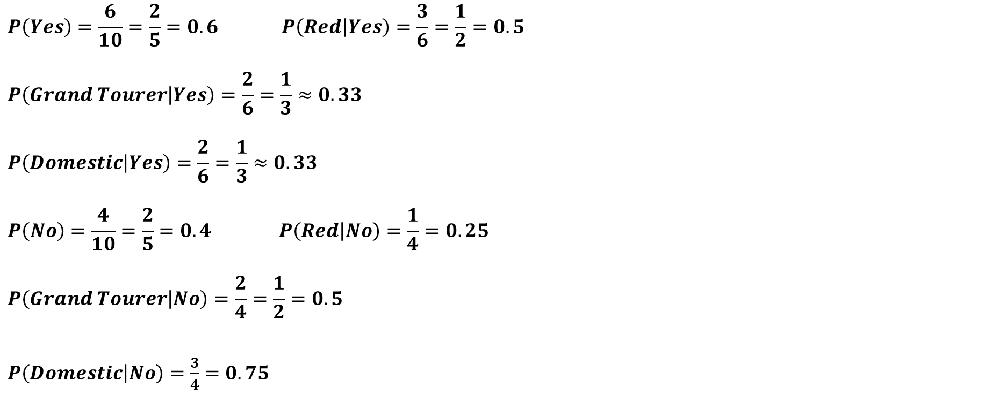
Naive Bayes
$$P\left(Yes\right)=\frac{6}{10}=\frac{2}{5}=0.6 P\left(Red | Yes\right)=\frac{3}{6}=\frac{1}{2}=0.5$$
$$P\left(Grand Tourer | Yes\right)=\frac{2}{6}=\frac{1}{3}≈0.33$$
$$P\left(Domestic | Yes\right)=\frac{2}{6}=\frac{1}{3}≈0.33$$
$$P\left(No\right)=\frac{4}{10}=\frac{2}{5}=0.4 P\left(Red | No\right)=\frac{1}{4}=0.25$$
$$P\left(Grand Tourer | No\right)=\frac{2}{4}=\frac{1}{2}=0.5$$
$P\left(Domestic | No\right)=\frac{3}{4}=0.75$
Car | Color | Type | Origin | Stolen
1 | Red | Sports | Domestic | Yes
2 | Red | Sports | Domestic | No
3 | Blue | Sports | Domestic | Yes
4 | Blue | Sports | Domestic | No
5 | Blue | Sports | Imported | Yes
6 | Blue | Grand Tourer | Imported | No
7 | Blue | Grand Tourer | Imported | Yes
8 | Blue | Grand Tourer | Domestic | No
9 | Red | Grand Tourer | Imported | Yes
10 | Red | Sports | Imported | Yes

Slide 11
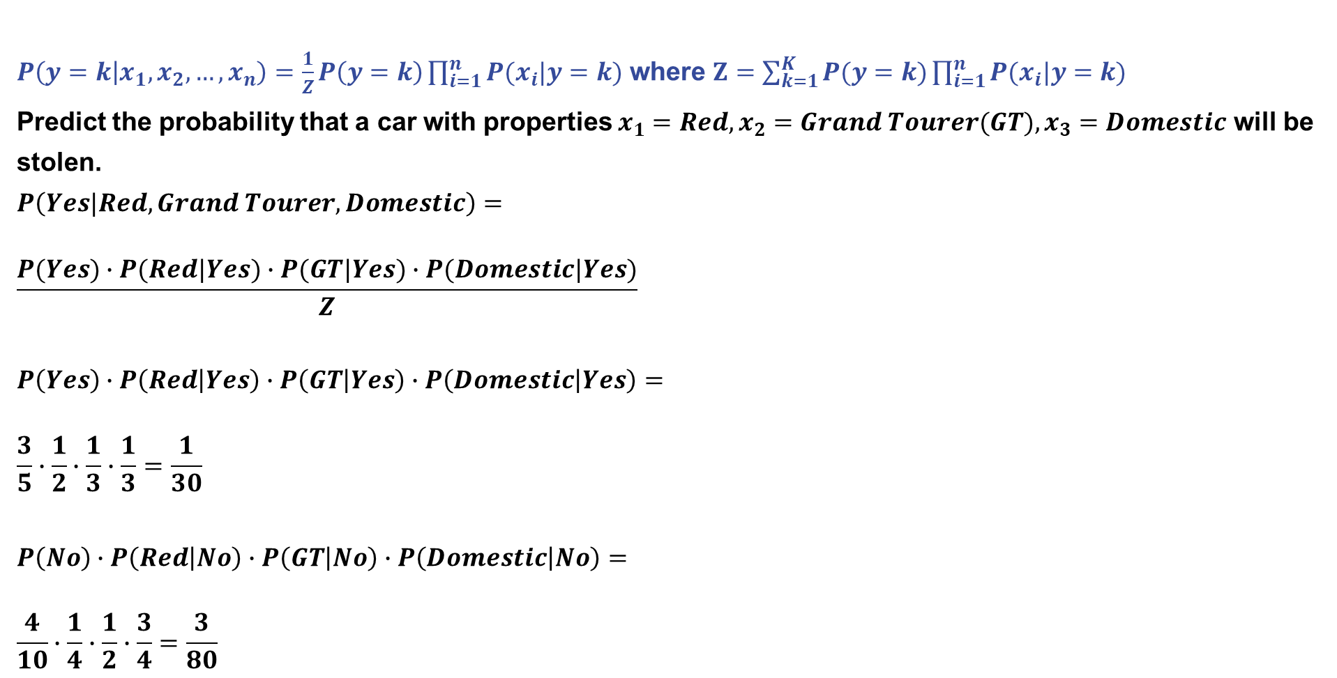
Naive Bayes
$P\left(y=k | x_{1},x_{2},…,x_{n}\right)=\frac{1}{Z}P\left(y=k\right)\prod_{i=1}^{n}{P(x_{i}|y=k)}$ where $Z=\sum_{k=1}^{K}{P(y=k)\prod_{i=1}^{n}{P(x_{i}|y=k)}}$
Predict the probability that a car with properties $x_{1}=Red,x_{2}=Grand Tourer(GT),x_{3}=Domestic$ will be stolen.
$$P\left(Yes|Red,Grand Tourer,Domestic\right)=$$
$$\frac{P(Yes)∙P(Red|Yes)∙P(GT|Yes)∙P(Domestic|Yes)}{Z}$$
$$P\left(Yes\right)∙P\left(Red | Yes\right)∙P\left(GT | Yes\right)∙P\left(Domestic | Yes\right)=$$
$$\frac{3}{5}∙\frac{1}{2}∙\frac{1}{3}∙\frac{1}{3}=\frac{1}{30}$$
$$P\left(No\right)∙P\left(Red | No\right)∙P\left(GT | No\right)∙P\left(Domestic | No\right)=$$
$$\frac{4}{10}∙\frac{1}{4}∙\frac{1}{2}∙\frac{3}{4}=\frac{3}{80}$$
Car | Color | Type | Origin | Stolen
1 | Red | Sports | Domestic | Yes
2 | Red | Sports | Domestic | No
3 | Blue | Sports | Domestic | Yes
4 | Blue | Sports | Domestic | No
5 | Blue | Sports | Imported | Yes
6 | Blue | Grand Tourer | Imported | No
7 | Blue | Grand Tourer | Imported | Yes
8 | Blue | Grand Tourer | Domestic | No
9 | Red | Grand Tourer | Imported | Yes
10 | Red | Sports | Imported | Yes

Slide 12
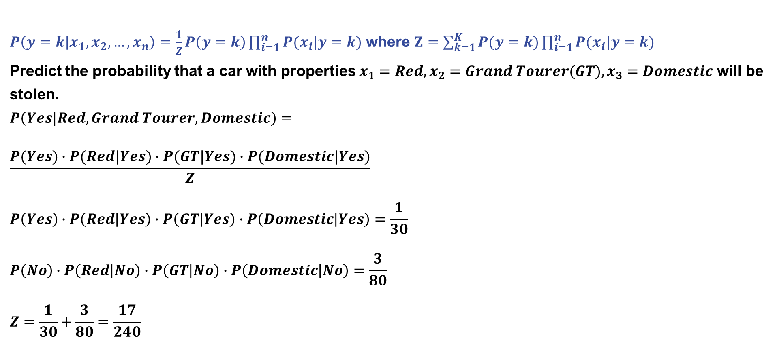
Naive Bayes
$P\left(y=k | x_{1},x_{2},…,x_{n}\right)=\frac{1}{Z}P\left(y=k\right)\prod_{i=1}^{n}{P(x_{i}|y=k)}$ where $Z=\sum_{k=1}^{K}{P(y=k)\prod_{i=1}^{n}{P(x_{i}|y=k)}}$
Predict the probability that a car with properties $x_{1}=Red,x_{2}=Grand Tourer(GT),x_{3}=Domestic$ will be stolen.
$$P\left(Yes|Red,Grand Tourer,Domestic\right)=$$
$$\frac{P(Yes)∙P(Red|Yes)∙P(GT|Yes)∙P(Domestic|Yes)}{Z}$$
$$P\left(Yes\right)∙P\left(Red | Yes\right)∙P\left(GT | Yes\right)∙P\left(Domestic | Yes\right)=\frac{1}{30}$$
$$P\left(No\right)∙P\left(Red | No\right)∙P\left(GT | No\right)∙P\left(Domestic | No\right)=\frac{3}{80}$$
$$Z=\frac{1}{30}+\frac{3}{80}=\frac{17}{240}$$
Car | Color | Type | Origin | Stolen
1 | Red | Sports | Domestic | Yes
2 | Red | Sports | Domestic | No
3 | Blue | Sports | Domestic | Yes
4 | Blue | Sports | Domestic | No
5 | Blue | Sports | Imported | Yes
6 | Blue | Grand Tourer | Imported | No
7 | Blue | Grand Tourer | Imported | Yes
8 | Blue | Grand Tourer | Domestic | No
9 | Red | Grand Tourer | Imported | Yes
10 | Red | Sports | Imported | Yes

Slide 13
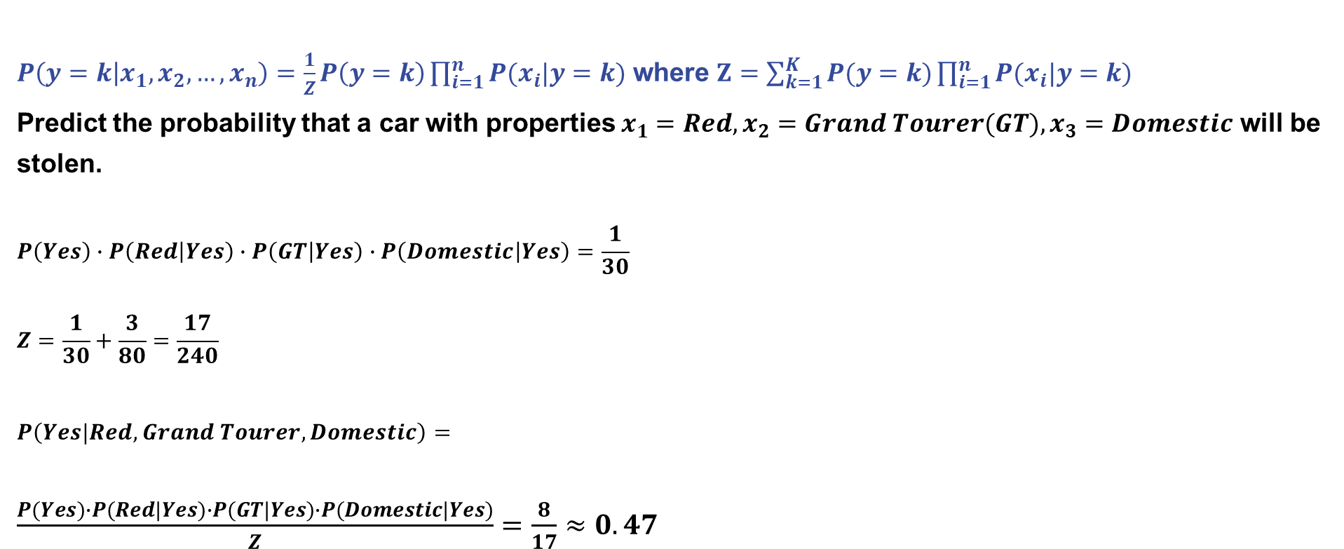
Naive Bayes
$P\left(y=k | x_{1},x_{2},…,x_{n}\right)=\frac{1}{Z}P\left(y=k\right)\prod_{i=1}^{n}{P(x_{i}|y=k)}$ where $Z=\sum_{k=1}^{K}{P(y=k)\prod_{i=1}^{n}{P(x_{i}|y=k)}}$
Predict the probability that a car with properties $x_{1}=Red,x_{2}=Grand Tourer(GT),x_{3}=Domestic$ will be stolen.
$$P\left(Yes\right)∙P\left(Red | Yes\right)∙P\left(GT | Yes\right)∙P\left(Domestic | Yes\right)=\frac{1}{30}$$
$$Z=\frac{1}{30}+\frac{3}{80}=\frac{17}{240}$$
$$P\left(Yes|Red,Grand Tourer,Domestic\right)=$$
$\frac{P(Yes)∙P(Red|Yes)∙P(GT|Yes)∙P(Domestic|Yes)}{Z}=\frac{8}{17}≈0.47$
Car | Color | Type | Origin | Stolen
1 | Red | Sports | Domestic | Yes
2 | Red | Sports | Domestic | No
3 | Blue | Sports | Domestic | Yes
4 | Blue | Sports | Domestic | No
5 | Blue | Sports | Imported | Yes
6 | Blue | Grand Tourer | Imported | No
7 | Blue | Grand Tourer | Imported | Yes
8 | Blue | Grand Tourer | Domestic | No
9 | Red | Grand Tourer | Imported | Yes
10 | Red | Sports | Imported | Yes

Slide 14
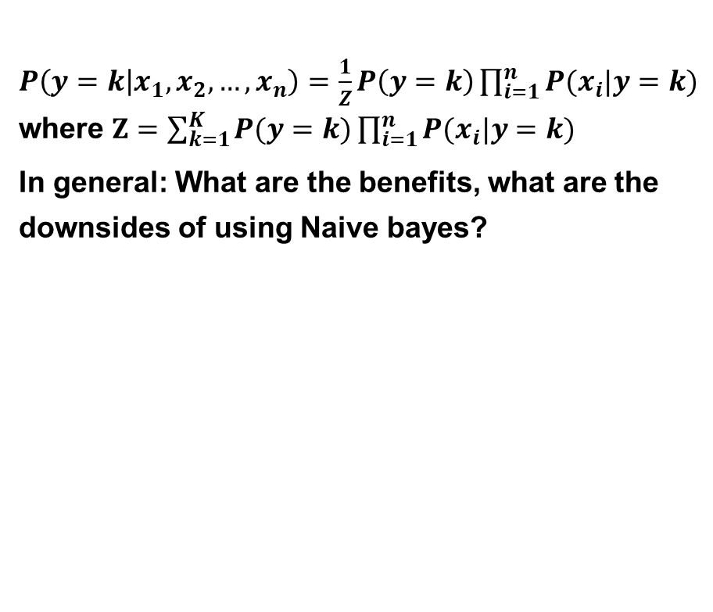
Naive Bayes
$P\left(y=k | x_{1},x_{2},…,x_{n}\right)=\frac{1}{Z}P\left(y=k\right)\prod_{i=1}^{n}{P(x_{i}|y=k)}$ where $Z=\sum_{k=1}^{K}{P(y=k)\prod_{i=1}^{n}{P(x_{i}|y=k)}}$
In general: What are the benefits, what are the downsides of using Naive bayes?
Advantages | Disadvantages
Simple to implement | Assumption of independent predictors
Fast | Zero frequency problem
Scalable | Limited expressiveness
 | Not suitable for continuous variables

Slide 15
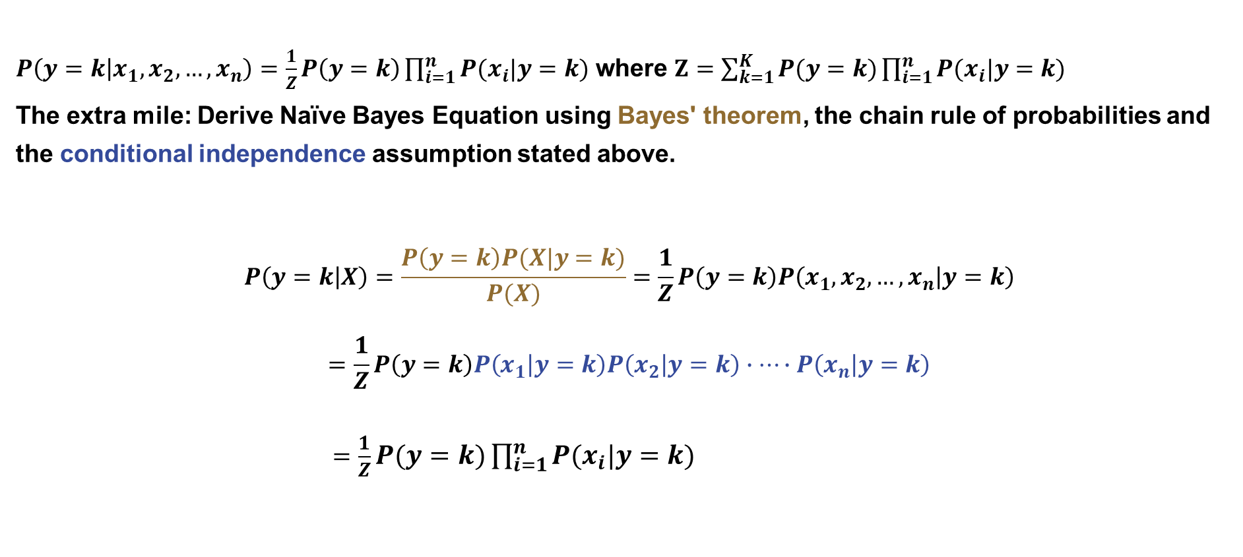
Naive Bayes
$P\left(y=k | x_{1},x_{2},…,x_{n}\right)=\frac{1}{Z}P\left(y=k\right)\prod_{i=1}^{n}{P(x_{i}|y=k)}$ where $Z=\sum_{k=1}^{K}{P(y=k)\prod_{i=1}^{n}{P(x_{i}|y=k)}}$
The extra mile: Derive Naïve Bayes Equation using Bayes' theorem, the chain rule of probabilities and the conditional independence assumption stated above.
$$P\left(y=k | X\right)=\frac{P\left(y=k\right)P(X|y=k)}{P(X)}=\frac{1}{Z}P\left(y=k\right)P\left(x_{1},x_{2},…,x_{n} | y=k\right)$$
$$=\frac{1}{Z}P\left(y=k\right)P\left(x_{1} | y=k\right)P\left(x_{2} | y=k\right)∙…∙P\left(x_{n} | y=k\right)$$
$=\frac{1}{Z}P(y=k)\prod_{i=1}^{n}{P(x_{i}|y=k)}$

Slide 16
Ranking Losses

Slide 17
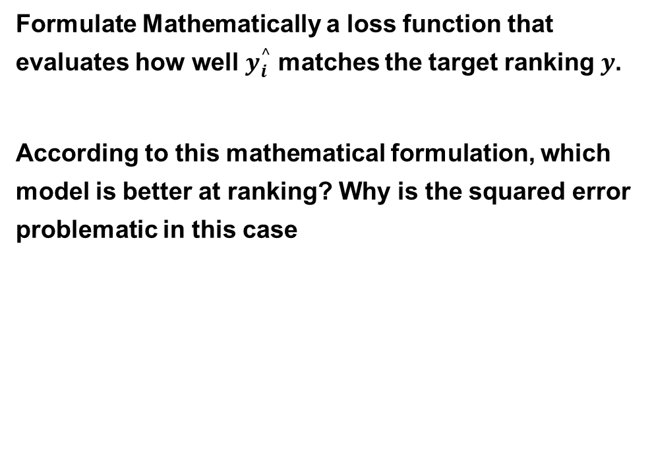
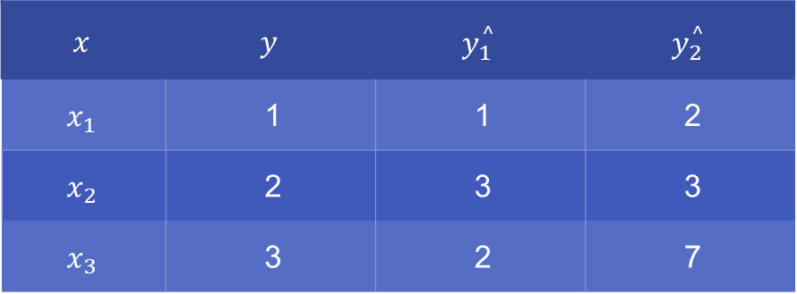
Ranking Losses
Formulate Mathematically a loss function that evaluates how well $y_{i}^{^}$ matches the target ranking $y$.
According to this mathematical formulation, which model is better at ranking? Why is the squared error problematic in this case
$$x$$ | $$y$$ | $$y_{1}^{^}$$ | $$y_{2}^{^}$$
$$x_{1}$$ | 1 | 1 | 2
$$x_{2}$$ | 2 | 3 | 3
$$x_{3}$$ | 3 | 2 | 7

Slide 18
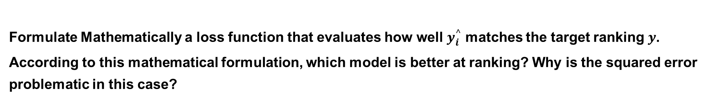
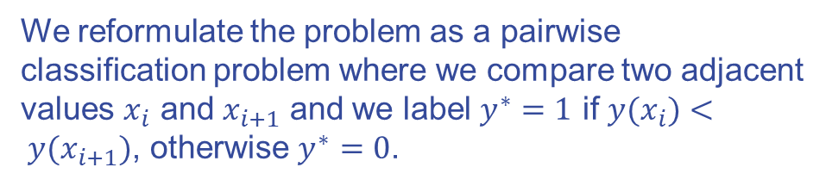
Ranking Losses
Formulate Mathematically a loss function that evaluates how well $y_{i}^{^}$ matches the target ranking $y$.
According to this mathematical formulation, which model is better at ranking? Why is the squared error problematic in this case?
$$x$$ | $$y$$ | $$y_{1}^{^}$$ | $$y_{2}^{^}$$
$$x_{1}$$ | 1 | 1 | 2
$$x_{2}$$ | 2 | 3 | 3
$$x_{3}$$ | 3 | 2 | 7
We reformulate the problem as a pairwise classification problem where we compare two adjacent values $x_{i}$ and $x_{i+1}$ and we label $y^{∗}=1$ if ${y(x}_{i})< y(x_{i+1})$, otherwise $y^{∗}=0$.

Slide 19
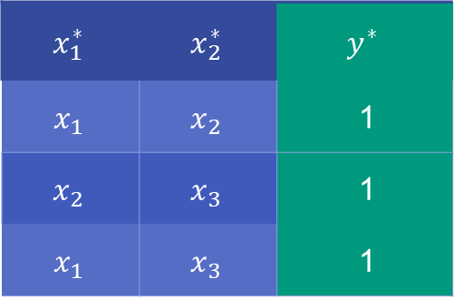
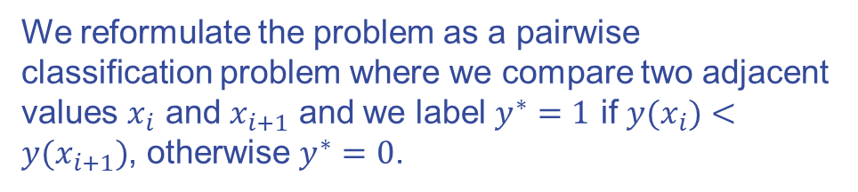
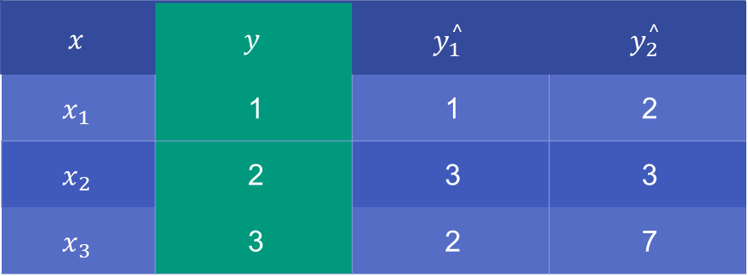
Ranking Losses
Formulate Mathematically a loss function that evaluates how well $y_{i}^{^}$ matches the target ranking $y$.
According to this mathematical formulation, which model is better at ranking? Why is the squared error problematic in this case?
We reformulate the problem as a pairwise classification problem where we compare two adjacent values $x_{i}$ and $x_{i+1}$ and we label $y^{∗}=1$ if ${y(x}_{i})<y(x_{i+1})$, otherwise $y^{∗}=0$.
$$x$$ | $$y$$ | $$y_{1}^{^}$$ | $$y_{2}^{^}$$
$$x_{1}$$ | 1 | 1 | 2
$$x_{2}$$ | 2 | 3 | 3
$$x_{3}$$ | 3 | 2 | 7
$$x_{1}^{∗}$$ | $$x_{2}^{∗}$$ | $$y^{∗}$$
$$x_{1}$$ | $$x_{2}$$ | 1
$$x_{2}$$ | $$x_{3}$$ | 1
$$x_{1}$$ | $$x_{3}$$ | 1

Slide 20
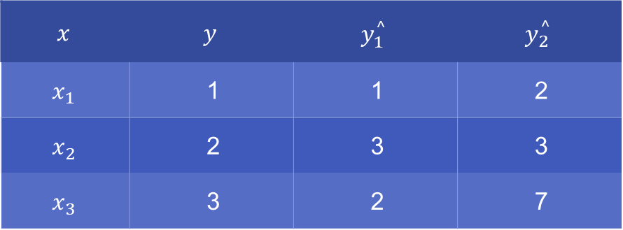
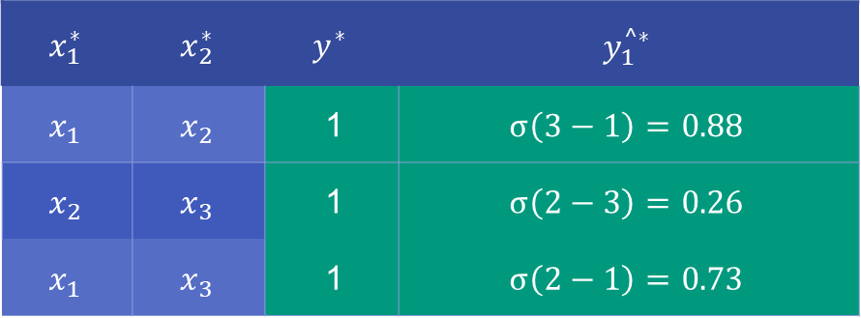

Ranking Losses
Formulate Mathematically a loss function that evaluates how well $y_{i}^{^}$ matches the target ranking $y$.
According to this mathematical formulation, which model is better at ranking? Why is the squared error problematic in this case?
We also calculate auxiliary predictions for the ML models $y_{k}^{^∗}=σ(y_{k}^{^}\left(x_{i+1}^{∗}\right)−y_{k}^{^}\left(x_{i}^{∗}\right))$
$$x$$ | $$y$$ | $$y_{1}^{^}$$ | $$y_{2}^{^}$$
$$x_{1}$$ | 1 | 1 | 2
$$x_{2}$$ | 2 | 3 | 3
$$x_{3}$$ | 3 | 2 | 7
$$x_{1}^{∗}$$ | $$x_{2}^{∗}$$ | $$y^{∗}$$ | $$y_{1}^{^∗}$$
$$x_{1}$$ | $$x_{2}$$ | 1 | $$σ\left(3−1\right)=0.88$$
$$x_{2}$$ | $$x_{3}$$ | 1 | $$σ\left(2−3\right)=0.26$$
$$x_{1}$$ | $$x_{3}$$ | 1 | $$σ\left(2−1\right)=0.73$$

Slide 21
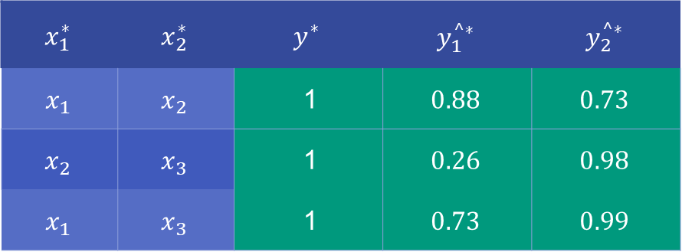
Ranking Losses
Formulate Mathematically a loss function that evaluates how well $y_{i}^{^}$ matches the target ranking $y$.
According to this mathematical formulation, which model is better at ranking? Why is the squared error problematic in this case?
We also calculate auxiliary predictions for the ML models $y_{k}^{^∗}=σ(y_{k}^{^}\left(x_{i+1}^{∗}\right)−y_{k}^{^}\left(x_{i}^{∗}\right))$
$$x$$ | $$y$$ | $$y_{1}^{^}$$ | $$y_{2}^{^}$$
$$x_{1}$$ | 1 | 1 | 2
$$x_{2}$$ | 2 | 3 | 3
$$x_{3}$$ | 3 | 2 | 7
$$x_{1}^{∗}$$ | $$x_{2}^{∗}$$ | $$y^{∗}$$ | $$y_{1}^{^∗}$$ | $$y_{2}^{^∗}$$
$$x_{1}$$ | $$x_{2}$$ | 1 | $$0.88$$ | $$0.73$$
$$x_{2}$$ | $$x_{3}$$ | 1 | $$0.26$$ | $$0.98$$
$$x_{1}$$ | $$x_{3}$$ | 1 | $$0.73$$ | $$0.99$$

Slide 22
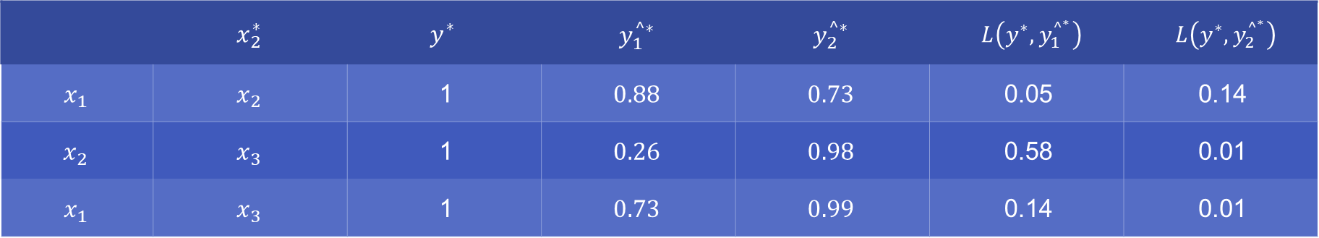
Ranking Losses
Formulate Mathematically a loss function that evaluates how well $y_{i}^{^}$ matches the target ranking $y$.
According to this mathematical formulation, which model is better at ranking? Why is the squared error problematic in this case?
With this new auxiliary binary classification problem formulation, we can use the logistic loss as a loss function: $L\left(y^{∗},y_{k}^{{^}^{∗}}\right)=−y^{∗}∙\log\left(y_{k}^{^∗}\right)−(1−y^{∗})∙\log{(1−y_{k}^{^∗})}$
 | $$x_{2}^{∗}$$ | $$y^{∗}$$ | $$y_{1}^{^∗}$$ | $$y_{2}^{^∗}$$ | $L\left(y^{∗},y_{1}^{{^}^{∗}}\right)$ | $L\left(y^{∗},y_{2}^{{^}^{∗}}\right)$
$$x_{1}$$ | $$x_{2}$$ | 1 | $$0.88$$ | $$0.73$$ | 0.05 | 0.14
$$x_{2}$$ | $$x_{3}$$ | 1 | $$0.26$$ | $$0.98$$ | 0.58 | 0.01
$$x_{1}$$ | $$x_{3}$$ | 1 | $$0.73$$ | $$0.99$$ | 0.14 | 0.01

Slide 23
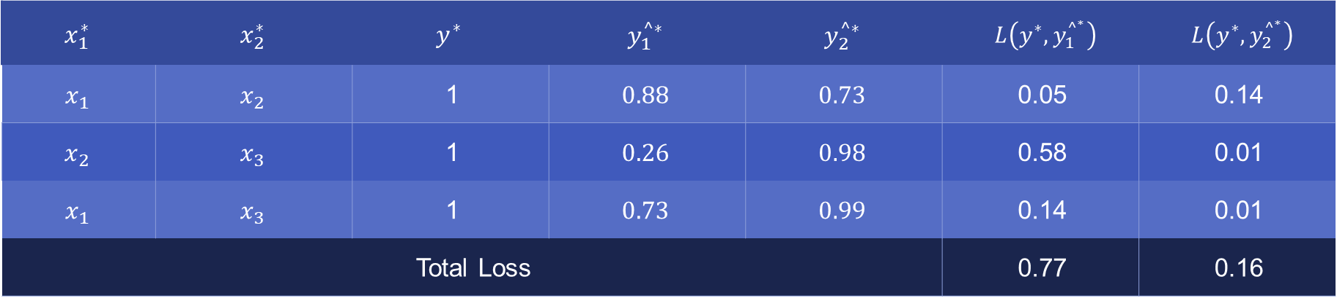
Ranking Losses
Formulate Mathematically a loss function that evaluates how well $y_{i}^{^}$ matches the target ranking $y$.
According to this mathematical formulation, which model is better at ranking? Why is the squared error problematic in this case?
With this new auxiliary binary classification problem formulation, we can use the logistic loss as a loss function: $L\left(y^{∗},y_{k}^{{^}^{∗}}\right)=−y^{∗}∙\log\left(y_{k}^{^∗}\right)−(1−y^{∗})∙\log{(1−y_{k}^{^∗})}$
$$x_{1}^{∗}$$ | $$x_{2}^{∗}$$ | $$y^{∗}$$ | $$y_{1}^{^∗}$$ | $$y_{2}^{^∗}$$ | $L\left(y^{∗},y_{1}^{{^}^{∗}}\right)$ | $L\left(y^{∗},y_{2}^{{^}^{∗}}\right)$
$$x_{1}$$ | $$x_{2}$$ | 1 | $$0.88$$ | $$0.73$$ | 0.05 | 0.14
$$x_{2}$$ | $$x_{3}$$ | 1 | $$0.26$$ | $$0.98$$ | 0.58 | 0.01
$$x_{1}$$ | $$x_{3}$$ | 1 | $$0.73$$ | $$0.99$$ | 0.14 | 0.01
Total Loss |  |  |  |  | 0.77 | 0.16

Slide 24
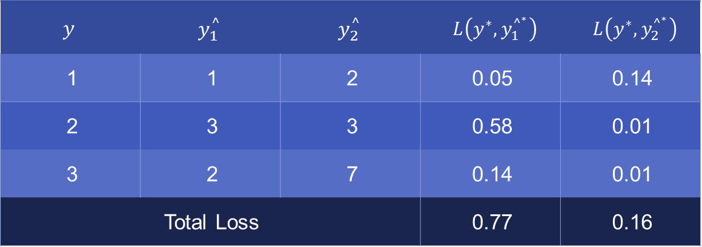
Ranking Losses
Formulate Mathematically a loss function that evaluates how well $y_{i}^{^}$ matches the target ranking $y$.
According to this mathematical formulation, which model is better at ranking? Why is the squared error problematic in this case?
With this new auxiliary binary classification problem formulation, we can use the logistic loss as a loss function: $L\left(y^{∗},y_{k}^{{^}^{∗}}\right)=−y^{∗}∙\log\left(y_{k}^{^∗}\right)−(1−y^{∗})∙\log{(1−y_{k}^{^∗})}$
$$y$$ | $$y_{1}^{^}$$ | $$y_{2}^{^}$$ | $L\left(y^{∗},y_{1}^{{^}^{∗}}\right)$ | $L\left(y^{∗},y_{2}^{{^}^{∗}}\right)$
1 | 1 | 2 | 0.05 | 0.14
2 | 3 | 3 | 0.58 | 0.01
3 | 2 | 7 | 0.14 | 0.01
Total Loss |  |  | 0.77 | 0.16

Slide 25
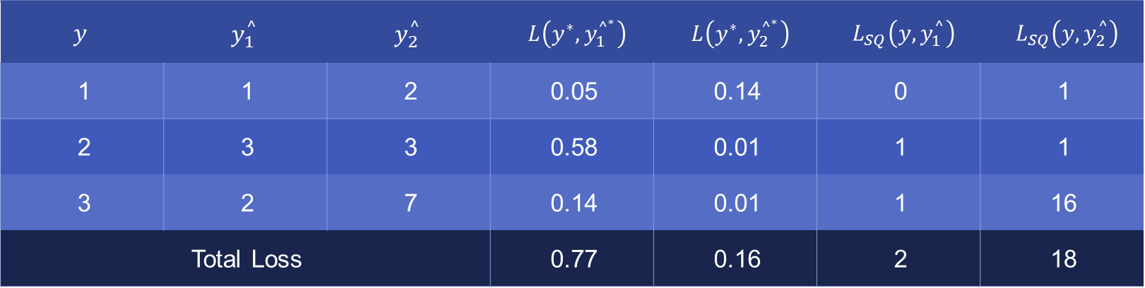
Ranking Losses
Formulate Mathematically a loss function that evaluates how well $y_{i}^{^}$ matches the target ranking $y$.
According to this mathematical formulation, which model is better at ranking? Why is the squared error problematic in this case?
Compare with the squared error loss: $L_{SQ}\left(y,y_{k}^{^}\right)={\left(y−y_{k}^{^}\right)}^{2}$
$$y$$ | $$y_{1}^{^}$$ | $$y_{2}^{^}$$ | $L\left(y^{∗},y_{1}^{{^}^{∗}}\right)$ | $L\left(y^{∗},y_{2}^{{^}^{∗}}\right)$ | $L_{SQ}\left(y,y_{1}^{^}\right)$ | $L_{SQ}\left(y,y_{2}^{^}\right)$
1 | 1 | 2 | 0.05 | 0.14 | 0 | 1
2 | 3 | 3 | 0.58 | 0.01 | 1 | 1
3 | 2 | 7 | 0.14 | 0.01 | 1 | 16
Total Loss |  |  | 0.77 | 0.16 | 2 | 18

