Slide 1
Assignment 02
Machine Learning WS23/24

Slide 2
Assignment 02 Solution
1. Linear Regression
2. Logistic Regression

Slide 3
Linear Regression

Slide 4
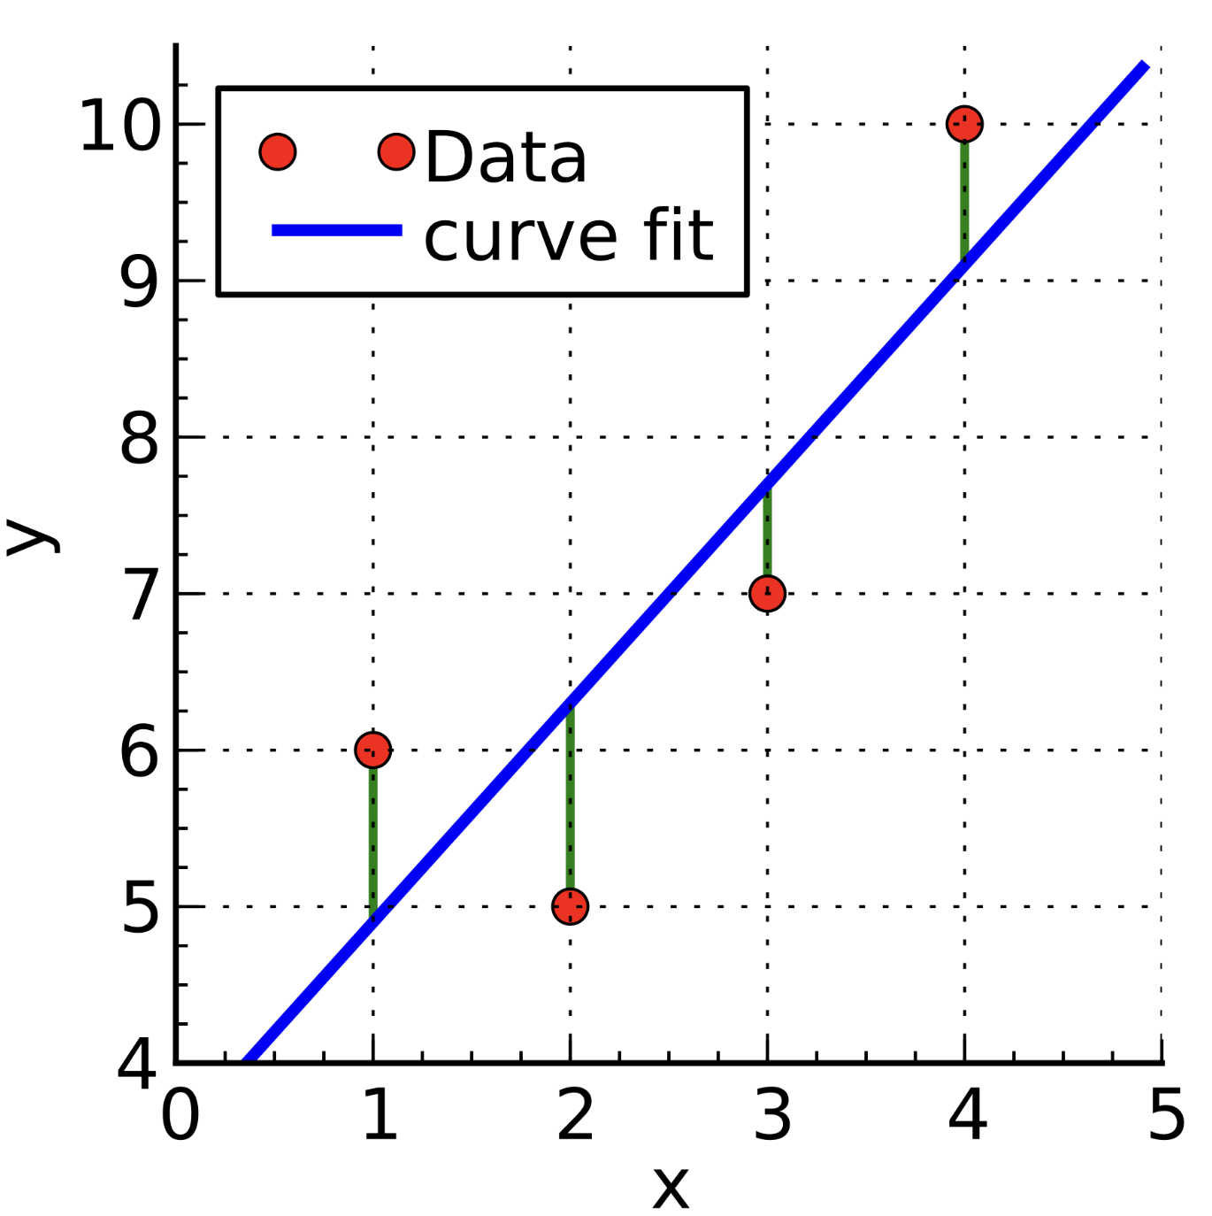
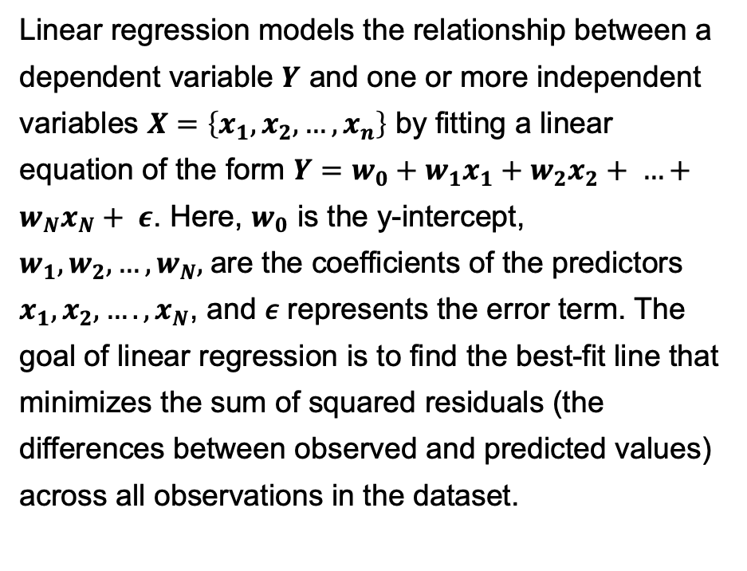
Linear Regression
Linear regression models the relationship between a dependent variable 𝒀 and one or more independent variables $X=\left\{x_{1}, x_{2}, …, x_{n}\right\}$ by fitting a linear equation of the form $Y=w_{0}+w_{1}x_{1}+w_{2}x_{2}+ …+w_{N}x_{N}+ ε$. Here, $w_{0}$ is the y-intercept, $w_{1},w_{2},…, w_{N},$are the coefficients of the predictors $x_{1},x_{2}, …., x_{N}$, and 𝜖 represents the error term. The goal of linear regression is to find the best-fit line that minimizes the sum of squared residuals (the differences between observed and predicted values) across all observations in the dataset.

Slide 5
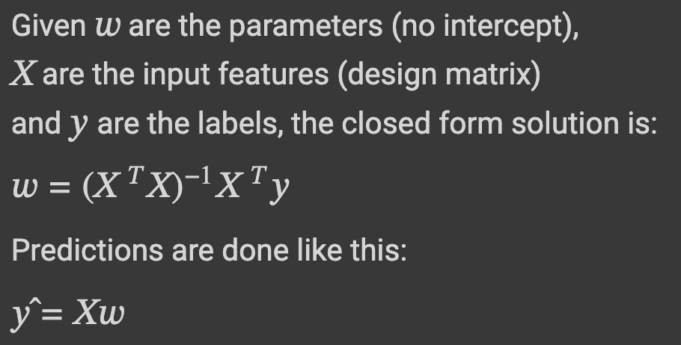
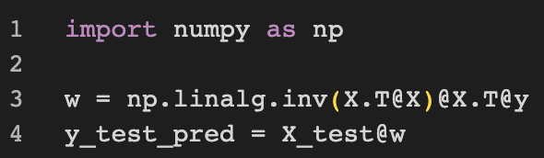
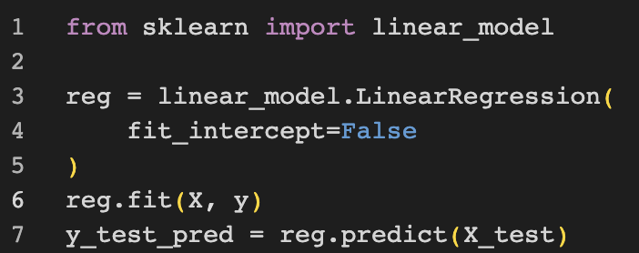
Linear Regression
Use Linear Regression to solve for the parameters.
Do not include the bias term. Use the closed-form solution.
Further calculate the changes for a person with Age = 40, BMI = 32.5.
Result: 7328.64906056

Slide 6
Logistic Regression

Slide 7
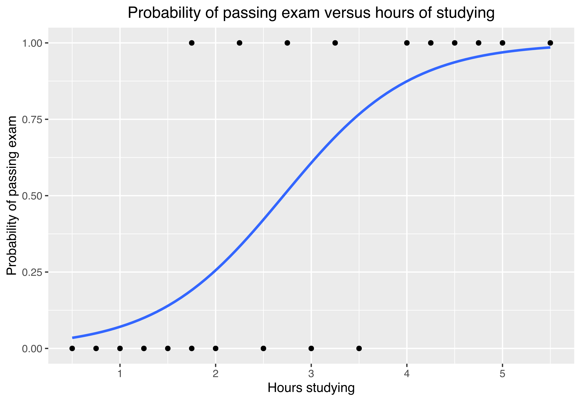
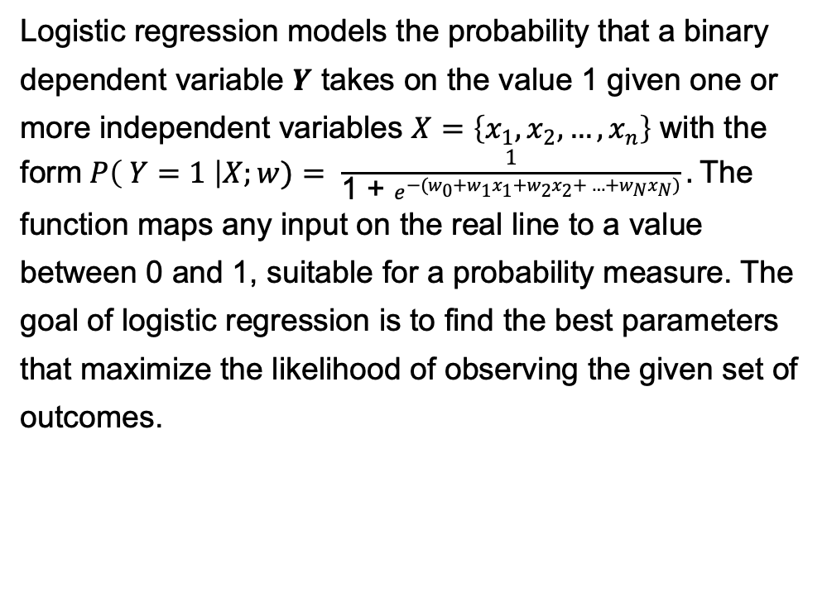
Logistic Regression
Logistic regression models the probability that a binary dependent variable 𝒀 takes on the value 1 given one or more independent variables $X=\left\{x_{1}, x_{2}, …, x_{n}\right\}$ with the form$P\left( Y=1 \right|X;w)= \frac{1}{\text{1 + }e^{−(w_{0}+w_{1}x_{1}+w_{2}x_{2}+ …+w_{N}x_{N})}}.$The function maps any input on the real line to a value between 0 and 1, suitable for a probability measure. The goal of logistic regression is to find the best parameters that maximize the likelihood of observing the given set of outcomes.

Slide 8
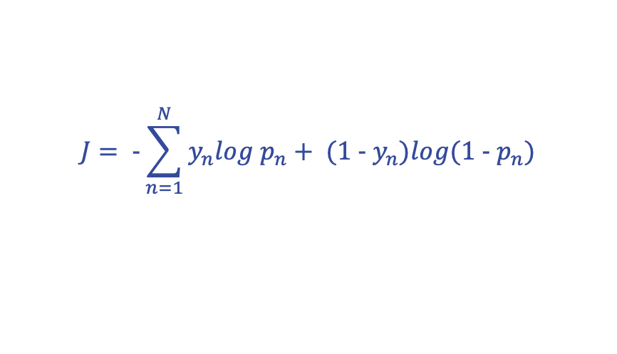
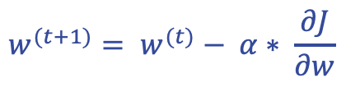

Logistic Regression
Starting from negative loglikelihood (binary cross entropy loss),
derive the update rule for w for gradient descent.
Ignore the bias term for the moment.
$$J= -\sum_{n=1}^{N}{y_{n}log p_{n}+ (1 - y_{n})log(1 - p_{n})}$$
where $p_{n}=h_{w}\left(x_{n}\right)=P\left( y=1 \right| X=x_{n};w)= σ\left(x_{n}\right)$
$σ\left(x_{n}\right)$ = $\frac{e^{x_{n}w}}{1 + e^{x_{n}w}}= \frac{1}{1+ e^{{−x}_{n}w}}$
Update rule:
$$w^{(t+1)}= w^{(t)}− α∗ \frac{∂J}{∂w}$$

Slide 9
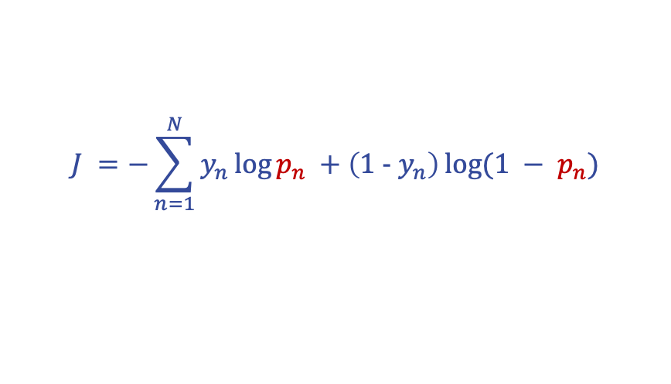
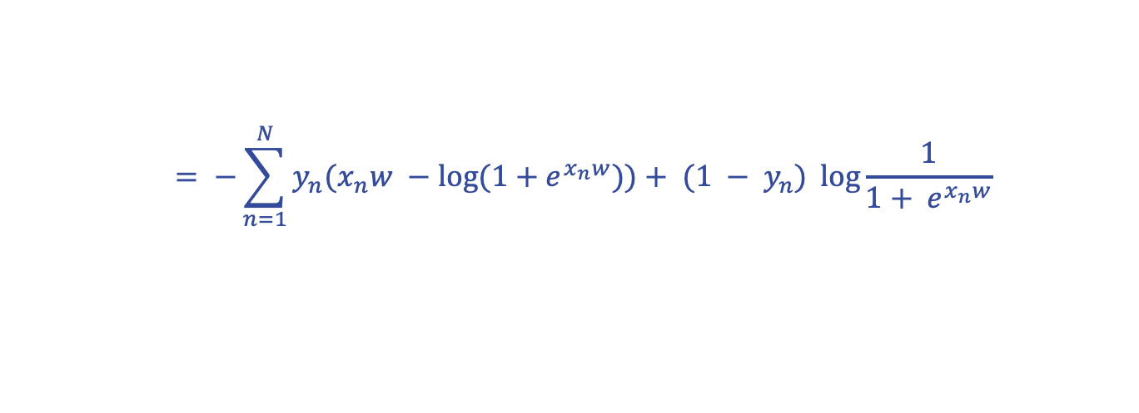
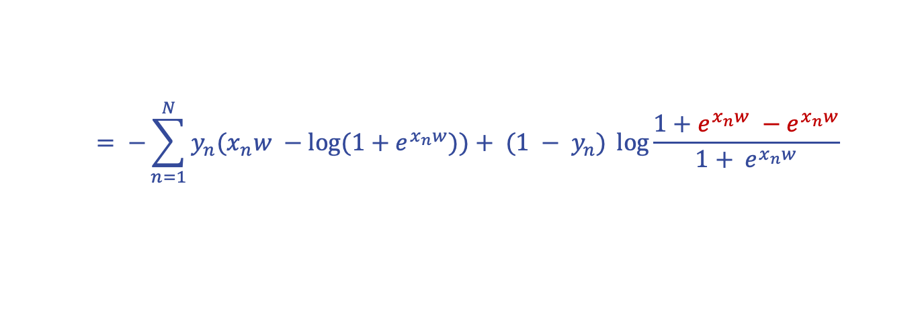
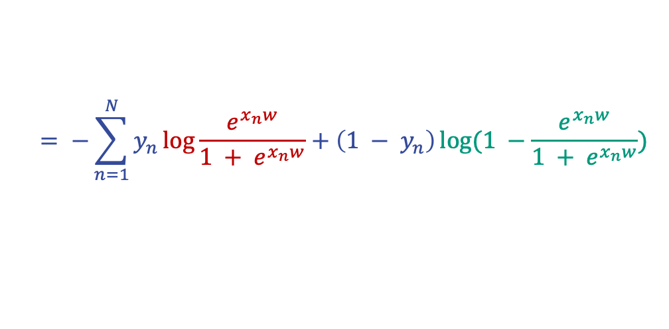
Logistic Regression
$$J =−\sum_{n=1}^{N}{y_{n}\log{p_{n}} +\left(1 - y_{n}\right)\log{(1 − p_{n})}}$$
$$= −\sum_{n=1}^{N}{y_{n}\log{\frac{e^{x_{n}w}}{1 + e^{x_{n}w}}}+\left(1 − y_{n}\right)\log{(1 −\frac{e^{x_{n}w}}{1 + e^{x_{n}w}})}}$$
$$= −\sum_{n=1}^{N}{y_{n}{(x}_{n}w −log⁡(1+e^{x_{n}w}))+ (1 − y_{n}) \log{\frac{1+e^{x_{n}w} −e^{x_{n}w}}{{1+ e}^{x_{n}w}}}}$$
$$= −\sum_{n=1}^{N}{y_{n}{(x}_{n}w −log⁡(1+e^{x_{n}w}))+ (1 − y_{n}) \log{\frac{1}{{1+ e}^{x_{n}w}}}}$$

Slide 10
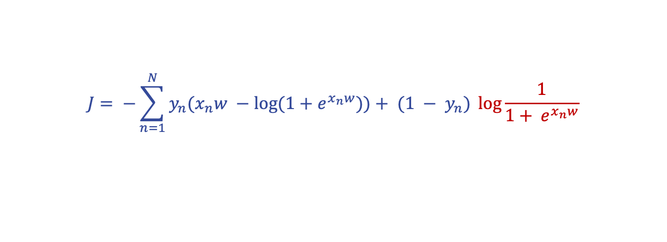
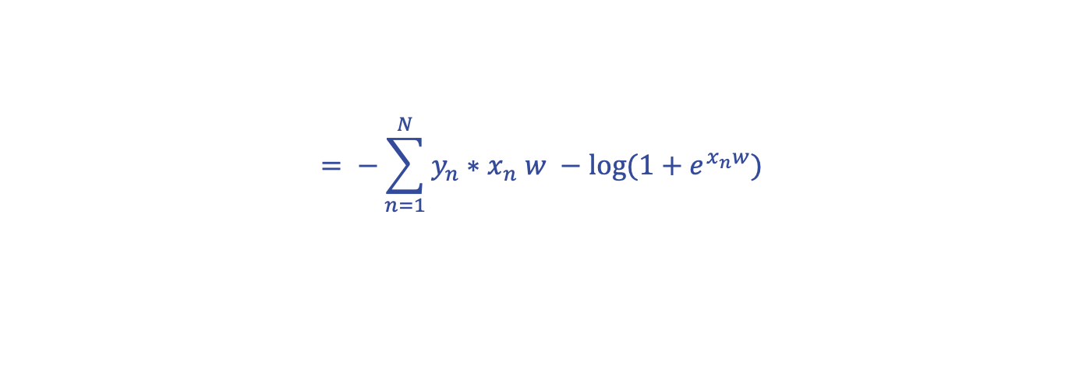
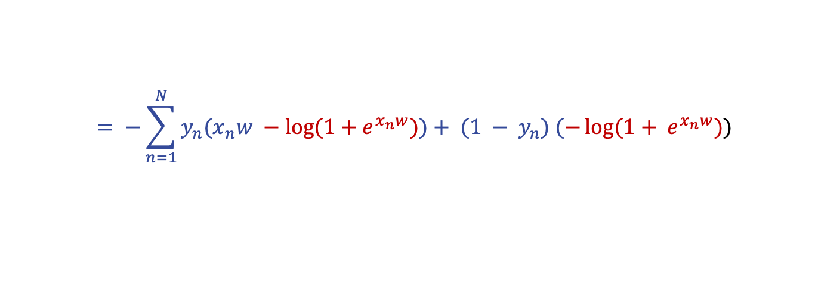
Logistic Regression
$$J= −\sum_{n=1}^{N}{y_{n}{(x}_{n}w −log⁡(1+e^{x_{n}w}))+ (1 − y_{n}) \log{\frac{1}{{1+ e}^{x_{n}w}}}}$$
$$= −\sum_{n=1}^{N}{y_{n}{(x}_{n}w −log⁡(1+e^{x_{n}w}))+ (1 − y_{n}) (−\log{{(1+ e}^{x_{n}w}))}}$$
$$= −\sum_{n=1}^{N}{y_{n}{∗x}_{n}w −log⁡(1+e^{x_{n}w})}$$

Slide 11
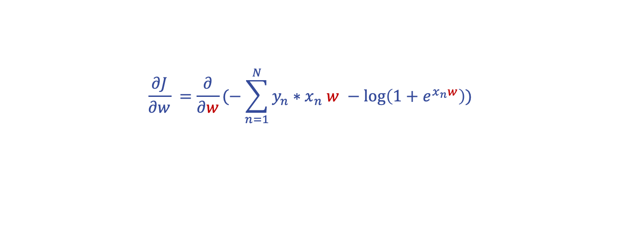
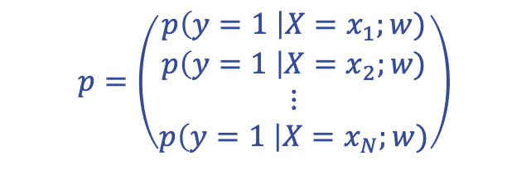
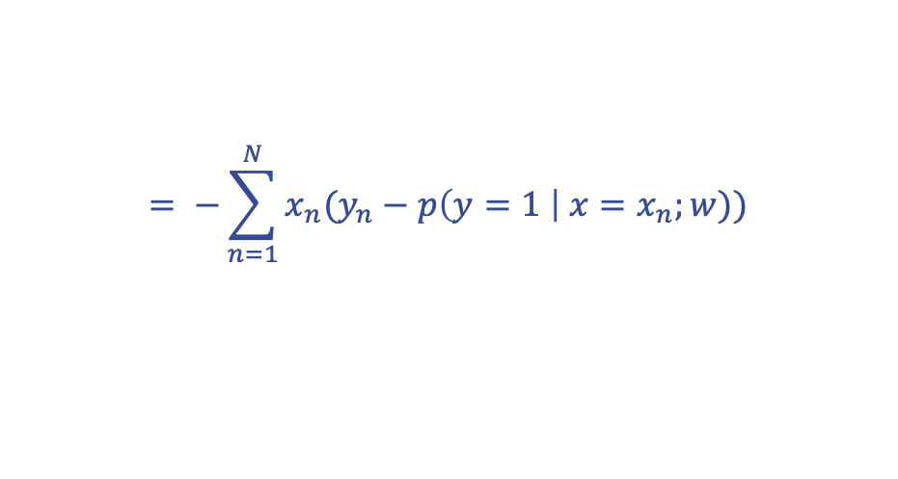
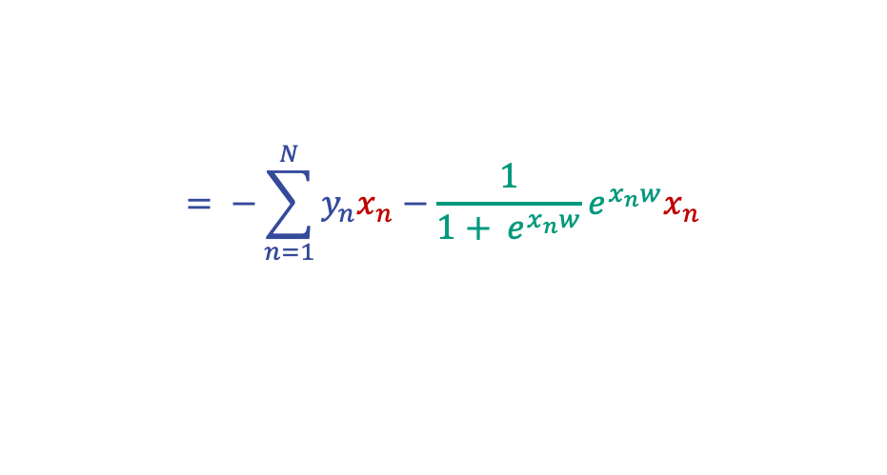
Logistic Regression
$$\frac{∂J}{∂w} =\frac{∂}{∂w}(−\sum_{n=1}^{N}{y_{n}{∗x}_{n}w −\log\left(1+e^{x_{n}w}\right)})$$
$$= −\sum_{n=1}^{N}{y_{n}x_{n}−\frac{1}{{1+ e}^{x_{n}w}}e^{x_{n}w}x_{n}}$$
$$= −\sum_{n=1}^{N}{x_{n}(y_{n}−p\left(y=1 \right| x=x_{n};w))}$$
$$p=\left(\begin{matrix}p\left(y=1 \right|X=x_{1};w) \\ p\left(y=1 \right|X=x_{2};w) \\ \begin{matrix}⋮ \\ p\left(y=1 \right|X=x_{N};w)\end{matrix}\end{matrix}\right)$$
$$= −X^{T}(y −p)$$
where

Slide 12


Logistic Regression
Update rule:
$$w^{(t+1)}= w^{(t)}+ α∗X^{T}(y −p)$$
$$p=\left(\begin{matrix}p\left(y=1 \right|X=x_{1};w) \\ p\left(y=1 \right|X=x_{2};w) \\ \begin{matrix}⋮ \\ p\left(y=1 \right|X=x_{N};w)\end{matrix}\end{matrix}\right)$$
where

Slide 13
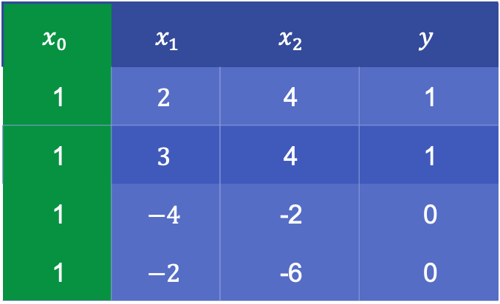
Logistic Regression
Perform one gradient descent update step using the initial parameters as $w^{(0)}={\left(\begin{matrix}0 & 0 & 0\end{matrix}\right)}^{T}$and learning rate $α=0.5$using the following data:
Note: Think about a good way to include the bias in the data instead of deriving its update rule on its own.
$$x_{0}$$ | $x_{1}$ | $x_{2}$ | $$y$$
1 | $$2$$ | 4 | 1
1 | $$3$$ | 4 | 1
1 | $$−4$$ | -2 | 0
1 | $$−2$$ | -6 | 0

Slide 14
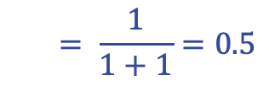
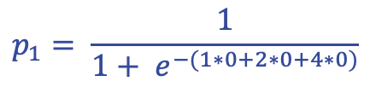
Logistic Regression
Perform one gradient descent update step using the initial parameters as $w^{(0)}={\left(\begin{matrix}0 & 0 & 0\end{matrix}\right)}^{T}$and learning rate $α=0.5$:
$$p_{1}= \frac{1}{1+ e^{−(1∗0+2∗0+4∗0)}}$$
$$= \frac{1}{1+1}=0.5$$
similarly for all $x_{n}$. The outcome is 50% probability, which makes sense as we have not learned anything yet.

Slide 15

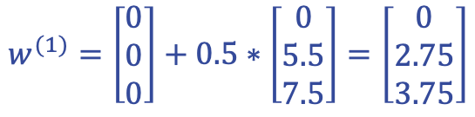
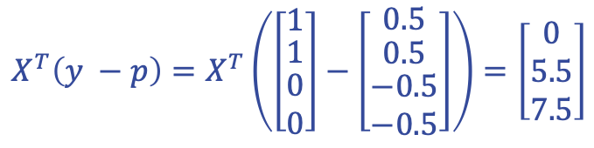
Logistic Regression
Perform one gradient descent update step using the initial parameters as $w^{(0)}={\left(\begin{matrix}0 & 0 & 0\end{matrix}\right)}^{T}$and learning rate $α=0.5$:
$$w^{(t+1)}= w^{(t)}+ α∗X^{T}(y −p)$$
$$X^{T}\left(y −p\right)=X^{T}\left(\left[\begin{matrix}1 \\ \begin{matrix}1 \\ \begin{matrix}0 \\ 0\end{matrix}\end{matrix}\end{matrix}\right]−\left[\begin{matrix}0.5 \\ \begin{matrix}0.5 \\ \begin{matrix}−0.5 \\ −0.5\end{matrix}\end{matrix}\end{matrix}\right]\right)=\left[\begin{matrix}0 \\ 5.5 \\ 7.5\end{matrix}\right]$$
$$w^{(1)}=\left[\begin{matrix}0 \\ 0 \\ 0\end{matrix}\right]+0.5∗\left[\begin{matrix}0 \\ 5.5 \\ 7.5\end{matrix}\right]=\left[\begin{matrix}0 \\ 2.75 \\ 3.75\end{matrix}\right]$$

Slide 16
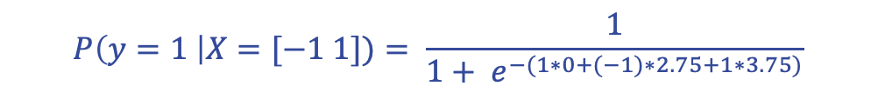
Logistic Regression
Predict $P\left(y=1 \right|X=[−1 1]):$
$$P\left(y=1 \right|X=[−1 1])= \frac{1}{1+ e^{−(1∗0+(−1)∗2.75+1∗3.75)}}$$
$$=0.731$$

