Slide 1
Account Planning
AI-Native Portfolio Management Platform

Slide 2
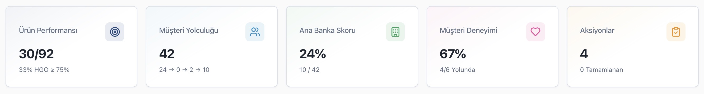
Portföy Yönetimi
Bu müşterilerin Hizmet Kalitesi ve Portföy Performansı için kullandığımız ana metriklerimiz
Performans yönetimi için kullandığımız çok farklı sayıda metriklerimiz var
Pusula / Özet II:
15 Pusula metriği
30 ana üründe Benchmark
Sektör/Resmi Segment bazında tresholdlar
Adet/Hacim
Stok/Flow gelişimi
ScaleUp Enterprise / Benchmark :
Yeni müşteriden Ana Banka olana kadar müşteri yolculuğu
Adım bazlı aksiyonlar
Gelişim takibi
PrimaryBank / Principality:
Garanti Yaklaşımı: dış veri ağırlıklı, rakip bazlı aksiyon
BBVA Yaklaşımı: iç veri bazlı, sektör/segment treshold yaklaşımı
Hibrit Hesaplama: ikili karşılaştırma
Müşteri Deneyimi (RCP, ICX):
Model Tahminleri: eğilim, churn, fiyat hassasiyeti
Excel Listeleri: İşkolu, Bölgeler tarafından paylaşılan
Pusula Listeleri: pusuladan paylaşılan müşteri listeleri

Slide 3
Portföy Yönetimi
Bu metrikleri takip etmek için kullandığımız araçlar
… ve bunları takip edebilmek için bir çok aracımız …
Pusula / Özet II:
Step
Qlik Dashboard
Excel
ScaleUp Enterprise / Benchmark:
Qlik Dashboard
Pusula
Step / 360
PrimaryBank / Principality:
Primary Bank Datamart
Qlik Dashboard
Propensity Model
Step / 360
Müşteri Deneyimi (RCP, ICX):
Pusula Listeleri
Mail / Excel
Qlik

Slide 4
Portföy Yönetimi
Yapamadıklarımız…
… ve bir o kadar da yapamadıklarımız var!
Önceliklendirme:
Hangi ürün
Hangi aksiyon
Kar/Hacim/Cüzdan Payı
Uzun vadeli ilişki
Churn prevention
Stratejik öncelikler, APKO
İç kontrol / uyum
Takip:
Qlik Dashboard’lar üzerinden tek yönlü paylaşım
Önerilen aksiyonların sonucu bilinmiyor
Geri Bildirim:
Bu öneri / aksiyon müşteri için gerçekten uygun mu?
Öneri müşteriye ulaştı mı?
Müşterinin cevabı ne oldu?
Çoktan seçmeli mi açık uçlu mu?
Aksiyon Planlama:
Bugün ne yapmalıyım: portföylerin hedefleri ile ilişkili aksiyon planı
En kolay / En değerli: hangi aksiyon benim için / banka için daha değerli?
Bu hafta/bu ay yeterince verimli miydi?: self-assessment
Bekleyen işlemlerim neler?

Slide 5


Tüzel Müşteri Dünyası
Günün sonunda…
İç Veri Kaynakları
ATS
MİY Öncelikleri
Analitik Modeller
Step
Qlik
Pusula
İşkolları
EVAM
Email
Excel
APKO
Intranet
Bölgeler
Kural Bazlı İçgörüler
Dış Veri Kaynakları
İşkolu Öncelikleri
Performans

Slide 6
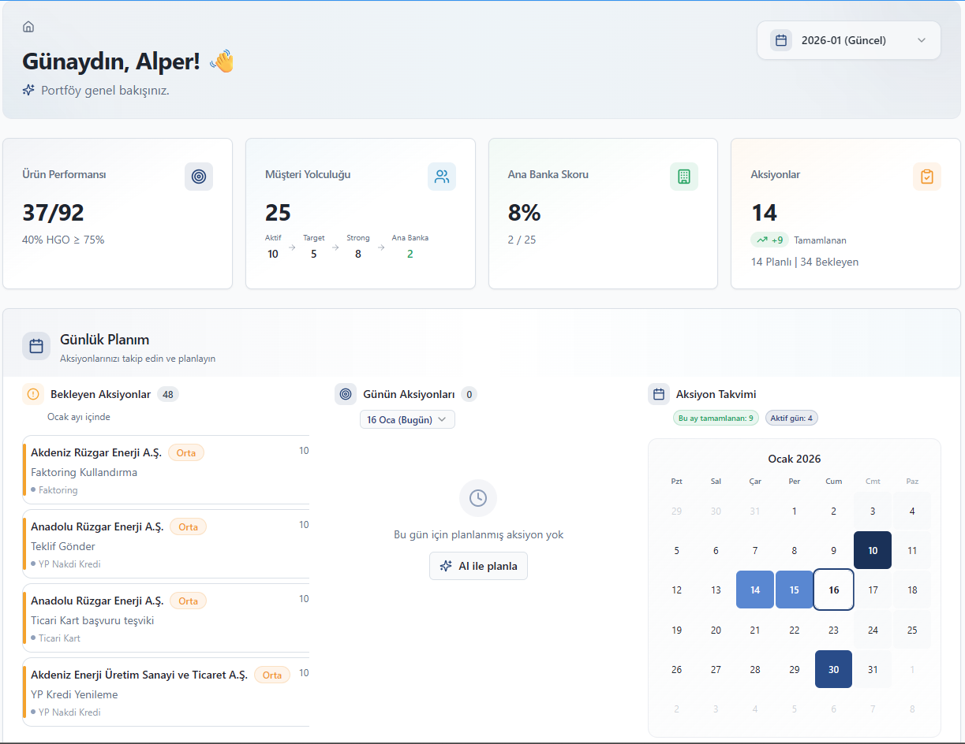
Portföy Yönetimi
Bu karmaşayı yönetmek için neye ihtiyacımız var…
Bütüncül
Portföye bütünsel
bakan
Entegre
Core Sistem, Strateji, Analitik, Saha, Aksiyon
Akıllı
«AI-Native» olarak tasarlanmış bir yönetim platformu

Slide 7


Account Planning
Account Planning:
Portföy yöneticilerinin sorumluluğundaki müşterilere ilişkin tüm veri kaynaklarını entegre ederek kurumsal hafızayı oluşturan;
alınması gereken aksiyonları veri odaklı olarak belirleyen, müşteri etkileşimini ve sahiplenmeyi artırmak amacıyla sebep-sonuç ilişkileri kuran;
aksiyonları portföy ve Banka önceliklerine göre optimize eden ve portföy yöneticisinin zaman planına uygun şekilde planlamayı sağlayan bir
Portföy Yönetim Platformu’dur.
nedir Account Planning ?
İşkolu Öncelikleri
RM Öncelikleri
Bütçe
ATS
Bölgeler
Pusula
APKO
EVAM
AP
Analitik Modeller
Kural Bazlı İçgörüler
Eğilim
KKB
Çoklu Veri Kaynağı
Kurumsal Hafıza
Stratejik önceliklendirme
Aksiyon Odaklı
Planlama ve Optimizasyon
Churn
Sektör
Fiyatlama
Tic. Sicil
Web
Performans

Slide 8











Account Planning
AI-Native Portfolio Management Platform
Transform portfolio management from reporting-driven to action-driven & enable sustainable sales in Enterprise segment
616K+
~1,900
50%+
One AI-powered
Customers (SME+BEI)
RMs
Portfolio reassignment
Operating platform
The Problems
The Solution
Business Value
RM Productivity
Fragmented tools and data
Data
Strategy
Analytics
Field Feedback
Higher RM productivity and efficiency
Increased RM interactions
Portfolio Overview
Total Customers
616K
New to Segment
111K
New to
RM
129K
Lost institutional memory
Unified customer & and portfolio
Bank strategy,
segments &
priorities
AI/ML insights, next best actions
RM insights, customer interactions
Increased wallet share and revenue
Customer Visits
Increased Principality
Unclear action priorities
% Customer
Visit / RM
SMEs
29%
176__
Commercial
73%
187__
AI Action Engine
Better customer relation % experience
More customer’s primary bank
∙Prioritize ∙Recommend ∙Personlize
∙Simulate ∙Learn
RCP
Weak feedback loop
Sector Distribution
Consistent execution and governance
Increase Customer Experience
Perakende
Ulaşım
Gayrimenkul
Tarım
Diğer
120K
60K
57K
53K
326K
Today’s Top Actions
Product focus &
Lack of planning & Activity cycle ownership
RM Daily Plan
1
Cross Sell
Scalable AI-enabled relationship management
Higher amount of quality contact
Right actions. Right customers. Right time.
2
Deepen
3
Retain
Establishing a long-term enterprise client relationship typically requires approximately six months of advance planning, unlike retail clients.
DEMO

Slide 9

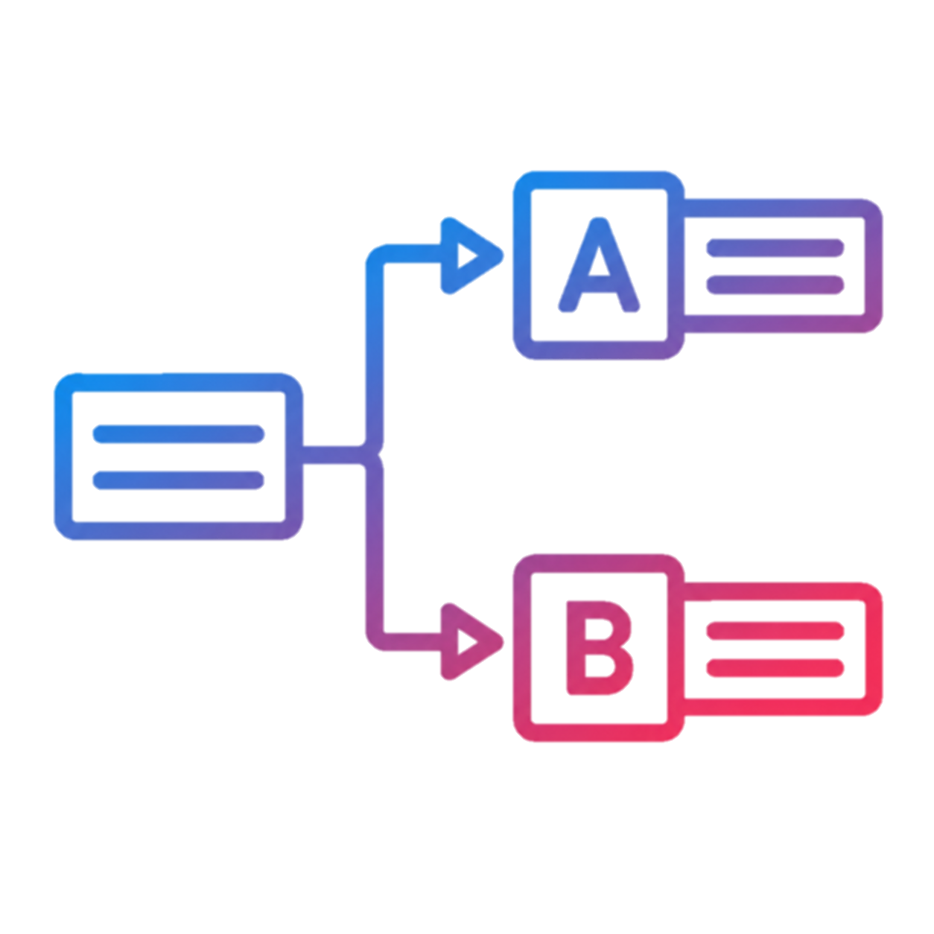








Step 1 : Action Management
The core component of a successfull performance management
Signal to Action, Action to Success
5
30+
200+
4
4
Layers
Analytic Models
Distinct Signals
Engines
Pools
CAPTURE
TRANSFORM
PRIORITIZE
ACTIVATE
MONITOR
Signal Sources
Signal Pool
Action Pool
Priority Signals
Lifecycle Pool
Reporting Pool
Realtime Monitoring Engine
Scoring Engine
A/B Test Split Engine
Models
Enrichment
Action Engine
RM KPIs
SQLs
Sub-Signals
Org. Priorities
Sub-Signals
Sub-Signals
Excel Upload
Customer Reqrmnts
RM Input
Profitblty
Action Status Update
Action
Library
Formula
Library
Realization
Library
RM Action Status Updates
Enrichment
Governance
Governance
Governance
Governance
Governance
Signal Owner
Quality Control
Audit / Change Mngmtn
Action Owner
Enrichment SQLs
Quality Control
Audit / Change Mngmtn
Strategic Priority Owner
Signal Weights
Organizational Diversity
Audit / Change Mngmtn
Model Owner
Homogeneity Quality
A/B Test Owner
Realization SQLs Owner
Audit / Change Mngmtn
Performance Owner
Reporting Owner
Action Status Quality Controls
Feedback and Finetunes

Slide 10
Step 1 : Action Management : Signal
Centralized pool of multi-source indicators governed by common standards
5
30+
200+
4
4
Layers
Analytic Models
Distinct Signals
Engines
Pools
CAPTURE
Signal Sources
Signal Pool
Models: 30+ analytic models
Datamarts: 9+ datamarts
Excel Files:
RM Inputs:
Signal Pool
Models
Pricing Models
External Data
KKB, Primary Bank
Pusula Lists
Visit/Call Notes
Centralized repository for validated signals, providing standardized storage and access for downstream consumption
SQLs
Recommender Models
Product Data
Ent. Datamart, Principality, Daily Activity
Temporal Priorities
Investment plans
Excel Upload
Churn Models
Service Data
Transactions, Contact, IDX
Subsidiary Potential Customers
Preferences
RM Input
Value Models
Segment Data
Segmentation, Official SME
Operational Activities
Reminders
Governance
Signal Owner
Quality Control
Audit / Change Mngmtn
Signal Owner
Responsible for
Defining the signal source system, calculation rules,
Monitoring the generation schedule, reporting runtime issues
Quality Assurance: ensuring that the signal produces the expected outputs in line with requirements
Continuous
Accountable
Qulity-Assured

Slide 11




Step 1 : Action Management : Action
From signals to standardized, governed and executable actions
5
30+
200+
4
4
Layers
Analytic Models
Distinct Signals
Engines
Pools
TRANSFORM
Action Pool
Action Pool
Enrichment
Action Engine
Centralized repository of validated and reusable actions, governed by common standards and ready for scheduled execution
Sub-Signals
Sub-Signals
Sub-Signals
SQL Queries prepared by Action Owners
Queries are checked and approved systematically
Qualified queries are stored into the Action Library
Queries are scheduled to run periodically
Action
Library
Governance
Action Owner
Enrichment SQLs
Quality Control
Audit / Change Mngmtn
Action Owner
Responsible for
Converting signals to business actions using enriched SQL queries
Define what to do, how to do, when to do
Rephrase the business rules into clear and conciese recipies
Continuous
Accountable
Qulity-Assured

Slide 12
Step 1 : Action Management : Priority
Dynamic prioritization scores combining multiple business dimensions through configurable weights.
5
30+
200+
4
4
Layers
Analytic Models
Distinct Signals
Engines
Pools
PRIORITIZE
Priority Signals
RM KPIs
Org. Priorities
Customer Requirements
Profitability
Score Weights
Dynamic Action Scores
Scoring Engine
Actions mapped to products
Products mapped to Pusula KPIs
Easch action score is calculated based on RMs KPI gaps
Product priorities defined by LOBs
Can be configured as needed
Action score are recalculated on priority change
Product propensity for each customer is calculated
Each action score incorporates the customer product propensity
Product unit profitability is calculated by customer scale and sector
Each action score is calculated by the customer product tendency
RM KPIs
%25
RM KPIs
Continuously recalculated action scores combining RM KPIs, organizational priorities, customer propensity and profitability through configurable weights.
x
Org. Priorities
Org. Priorities
%25
Customer Reqrmnts
%25
Customer Reqrmnts
Profitblty
%25
Profitblty
Formula
Library
0 - 100
0 - 100
0 - 100
0 - 100
Final Score
0 - 100
Governance
Strategic Priority Owner
Signal Weights
Organizational Diversity
Audit / Change Mngmtn
Performance Owner
Responsible for
Defining organizational priorities,
Communicating and adjusting scoring weights, including the underlying rationale
Monitoring the impact and outcomes of scoring adjustments
Continuous
Accountable
Qulity-Assured

Slide 13

Step 1 : Action Management : Realization
Controlled action activation through A/B testing and continuous feedback.
5
30+
200+
4
4
Layers
Analytic Models
Distinct Signals
Engines
Pools
ACTIVATE
Lifecycle Pool
A/B Test Clusters
A/B Splits
Action Exposure Decision
Realization Updates
Realization Pool
& Institutional Memory
A/B Test Split Engine
Cluster A
%10 - %90
Group A:
Holdout group used to measure the organic response without action exposure Group B: Treatment group exposed to the action for execution by the designated actor
Soft Response:
RM Action status updates Hard Response: SQL/service based outcome tracking to measure action realization.
Centralized repository of execution and outcome data, combining RM feedbacks, status updates and system-observed realizations for performance measurement and continuous learning.
Cluster B
%10 - %90
Cluster C
%10 - %90
Cluster X
%10 - %90
Realization
Library
RM Action Status Updates
Governance
A/B Test
Owner
Responsible for
Defining the A/B test clusters
Ensuring the homogeneity among test and control groups for accurate measure
Identifying the impact metrics for the selected action with Action Owner
A/B Test Owner
Action Owner
Homogeneity Quality
Realization SQLs
Audit / Change Mngmtn
Continuous
Accountable
Qulity-Assured
Action
Owner
Responsible for
Defining the A/B test clusters, split size (%10 A / %90 B)
Deciding how and how frequently the realizations will be measured
Identifying the impact metrics for the selected action with A/B Test Owner

Slide 14
Step 1 : Action Management : Monitoring
Continuous performance monitoring across organizational levels with actionable feedback loops
5
30+
200+
4
4
Layers
Analytic Models
Distinct Signals
Engines
Pools
MONITOR
Reporting Pool
Reporting Clusters
Scope
Reporting Pool
Realtime Monitoring Engine
RM Level
Action planning and completion, product/customer distribution, and alignment with priorities
Centralized repository of action performance and realization data, enabling consistent reporting, root-cause analysis and continuous improvement across organizational levels.
Branch Level
RM action performance, cross-branch benchmarking, and workload/potential analysis
Region Level
Branch performance analysis and cross-region benchmarking
Action Status Update
Product Level
Product-level action performance, feedback analysis, and action improvement opportunities
Enrichment
Governance
Performance
Owner
Responsible for
Monitoring action performance across organizational levels
Identifying performance gaps, trends and root causes
Driving improvement actions based on observed outcomes
Performance Owner
Reporting Owner
Action Status Quality Controls
Feedback and Finetunes
Continuous
Accountable
Qulity-Assured
Reporting
Owner
Responsible for
Ensuring consistent and timely performance reporting
Maintaining reporting quality and metric consistency

Slide 15





Next Steps
W.I.P.
The one single tool what a superbanker needs.
Frontend
Developments
Backend & API Distinct Signals
AI / Agents Integrations
PORTFOLIO ANALYSIS
CUSTOMER ANALYSIS
ACTION QUALITY
AUTO-PILOT
RM
CO-PILOT
Portfolio Summarizers
Customer Summarizers
Action Summarizers
API Integration
RM Assistant Agents
KAP Notifications
Enterprise Datamart Bot
Enterprise Datamart Bot
Sectoral Insights
Portfolio Action Analyst
Multistep Action Tracking
Agenda Planner
Meeting Prep
Voice Notes
Remote RM Assistant.
Complaint Prevention & Solver
Portfolio Advisors
RM Chatbots
Portfolio Advisors
Agentic Integration
Product Balance Adv.
Pusula Bot
Enterprise Datamart Bot
Chat with Documents & Products
Chat with Processes
Customer-Action Conformity
Action Presentation Advisor
Multistep Actions Agentic Pipeline
Specialized Advisors
Sector Spec. Adv.
Sustainability Adv.
Financial Adv.

Slide 16
Teşekkürler
Account Planning
AI-Native Portfolio Management Platform

