Slide 1
База данни на
Издателска къща

Slide 2
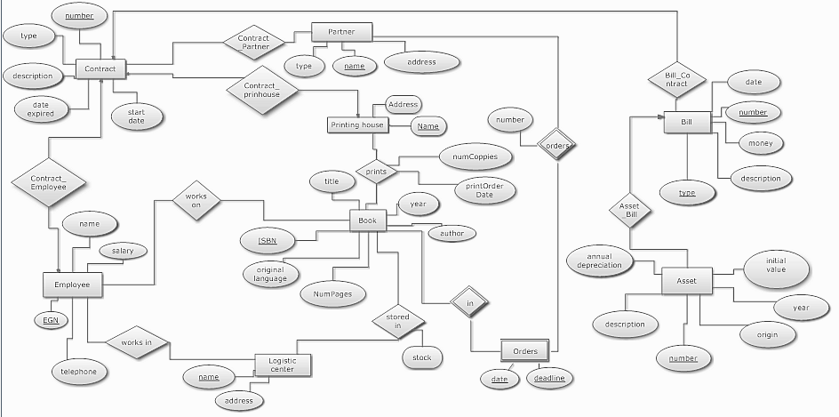
E/R модел на базата данни
E/R модел на базата данни

Slide 3
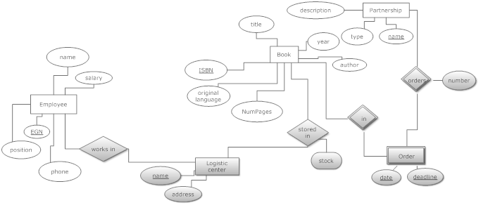
E/R модел на модула „Търговски отдел“

Slide 4
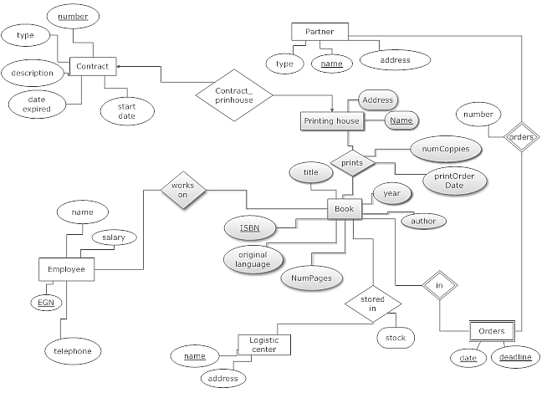

E/R модел на модула „Продукция“

Slide 5
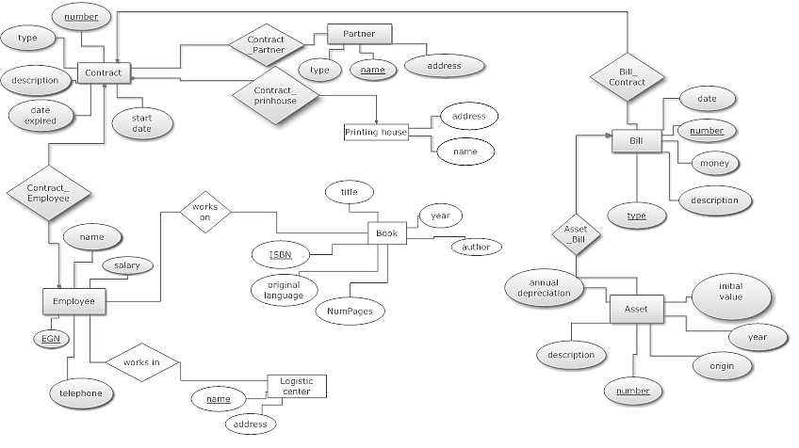
E/R модел на модула
„Счетоводно-правен отдел“

Slide 6
Преобразуване на E/R към релационен
Book(ISBN, Title, Author, NumPages,OriginalLanguage)
WorkingOn(BookISBN, EmpEGN)
PrintingHouse(Name, Contract_Number, Address)
Printed (PrHouseName, BISBN, PrintOrderDate, NumCoppies)

Slide 7
WorkinIn (Employee_EGN, LogisticCentre_name)
LogisticCentre (Name, Address)
StoredIn (LogisticCentre_name, Book_ISBN, stock)
Order (Book_ISBN, Order_date, Order_deadline, Order_number, Partner_name)

Slide 8
Contract(Number, Type, Description, start_date, end_date)
Partner (Name, Type, Address)
Bill (Number, Type, Date, Money, Description)
Employee (EGN, Name, Salary, Telephone, IBAN)
Partner_Contract(Contract_Number, Partner_Name)
Asset (Number, Year, Origin, InitialValue, AnnualDeprecation)
Bill_Contract(Contract _ Number, Bill_Type, Bill_ Number)
Contract_ Employee (Contract_Number, Employee_EGN)
Asset _ Bill(Bill_Type, Bill_Number, Asset_Number)
||
V

Slide 9
Contract(Number, Type, Description, Start_Date, End_Date)
Partner (Name, Type, Address)
Bill (Type, Number,Date, Money, Description, Contract_Number)
Employee (EGN, Name, Salary, Telephone, Contract_Number, IBAN)
Partner_Contract(Contract_Number, Partner_Name)
Asset (Number, Year, Origin, InitialValue, AnnualDepreciation)

Slide 10
Нормализация на базата данни
Book(ISBN, Title, Author, NumPages,OriginalLanguage)
ISBN->title, author, numpages, originalLanguage
WorkingOn(BookISBN, EmpEGN)
PrintingHouse(Name, Contract_Number, Address)
Name->Address
Printed (PrHouseName, BISBN, PrintOrderDate, NumCoppies)

Slide 11
WorkinIn (Employee_EGN, LogisticCentre_name)
LogisticCentre (Name, Address)
Name->address
StoredIn (LogisticCentre_name, Book_ISBN, stock)
LogisticCentre_name, Book_ISBN->stock
Order (Book_ISBN, Order_date, Order_deadline, Order_number, Partner_name)
Book_ISBN, Order_date, Partner_name->Order_deadline, Order_number
||
V
Order (Book_ISBN, Order_date, Partner_name, Order_deadline, Order_number)

