Slide 1
ETL
rıdvan nuri göçmen
extract transform load

Slide 2
> problem?
how to collect data from multiple sources, in multiple formats?
how to handle different data formats and clean data that you collect?
how to move it to one or more data stores?

Slide 3
> solution?
Design and use data collector layer
Design and use data transformer layer
Design and use data loader layer

Slide 4
EXTRACT
Design and use data collector layer
TRANSFORM
Design and use data transformer layer
LOAD
Design and use data loader layer
ETL as solution

Slide 5
> What is ETL?
Extract, transform, and load (ETL) is;
A type of data integration
A data pipeline used to collect data from various sources
Transform the data according to business rules
Load it into a destination data store

Slide 6
> What is ETL?
Extract, transform, and load (ETL) is;
An automated process which takes raw data from many different sources,
Extracts the information that your business needs,
Transforms it into a format that can serve business needs,
And loads it to a data warehouse.

Slide 7
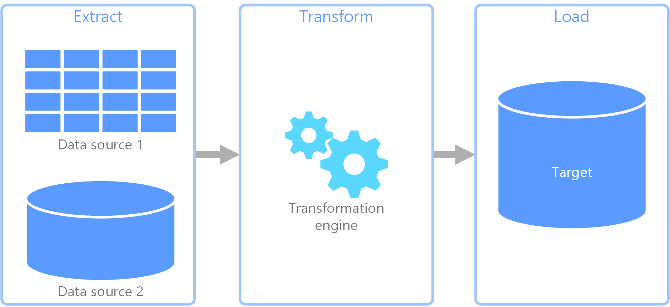
ETL diagram

Slide 8
> How ETL is used?
It's often used to build a data warehouse.
Typical use cases for ELT fall within the big data realm.
ETL is used to move and transform data from many different sources and load it into various targets, like Hadoop Mongo etc.
ETL is an important part of today’s business intelligence (BI). Put data in one place to programmatically analyze and discover business insights.

Slide 9
Building ETL Infrastructure
Extract from data sources
Data validation
Transform data
Load data to warehouse

Slide 10
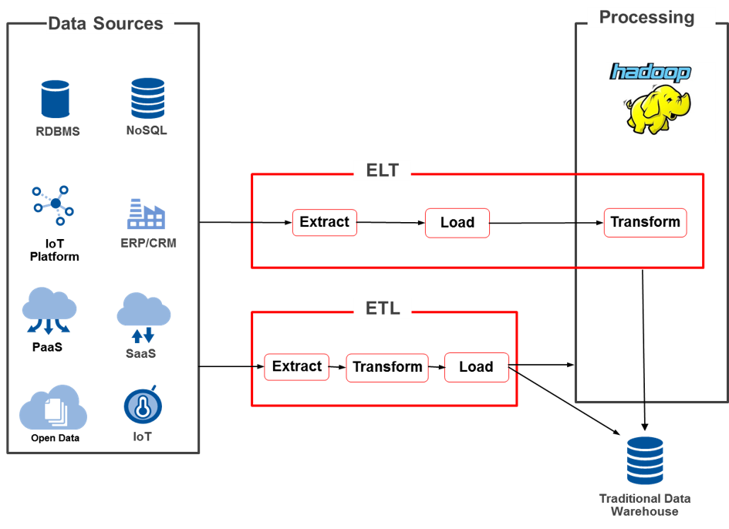
ETL infrastructure

Slide 11
> extract
Extract layer of ETL
Most ETL systems combine data from multiple sources.
Each with its own data organization and format - including relational databases, non-relational databases, XML, JSON, CSV files, etc.
Basically you can use scripts, batch processes or crawlers to extract data.
Successful extraction converts data into a single format for standardized processing.

Slide 12
> validation
Data validation for ETL
The validation engine confirms whether data pulled from sources has the expected values.
The validation engine rejects data if it fails the validation rules.
You analyze rejected records, on an ongoing basis, to identify what went wrong, correct the source data, or modify extraction to resolve the problem in the next batches.

Slide 13
> transform
Transform layer of ETL
After extracting data, ETL uses business rules to transform the data into new formats.
Removing extraneous or erroneous data.
Applying business rules.

Slide 14
> data mapping
Mapping data in transform layer
Data mapping is part of the transformation process.
Data mapping describes which source field maps to which destination field.

Slide 15
> load
Load layer of ETL
loads the transformed data to the target data sources.
Overwrite existing information every time the ETL pipeline loads a new batch .
ETL can add new data without overwriting, with a timestamp indicating it is new.

Slide 16
> services
Popular ETL Services
Building your own ETL pipeline ;)
Clover Etl
Apache Nifi
Azure Data Factory
Aws Glue

Slide 17
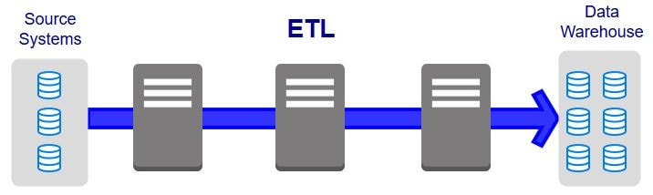
ETL diagram

Slide 18
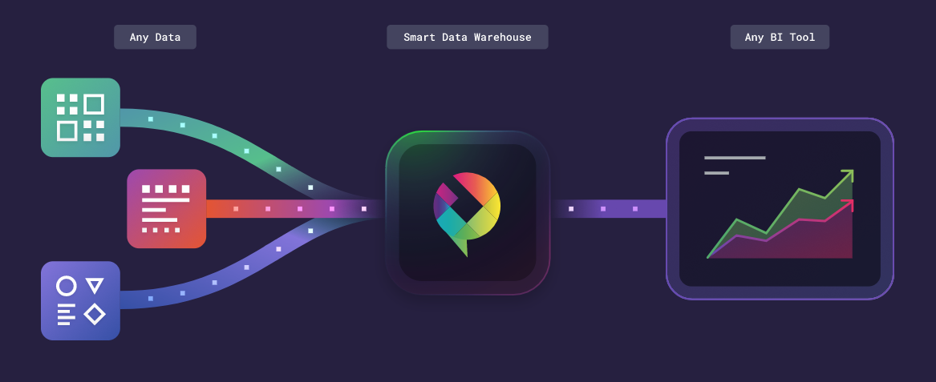
ETL diagram focused on bi

Slide 19


> whoami
Rıdvan Nuri Göçmen | Software Engineer
I turn ideas to working software products
+mynet.com
+zingat.com +gimora.com
and++
ridvannuri
rnglab
10 years+ hands on development

