Slide 1
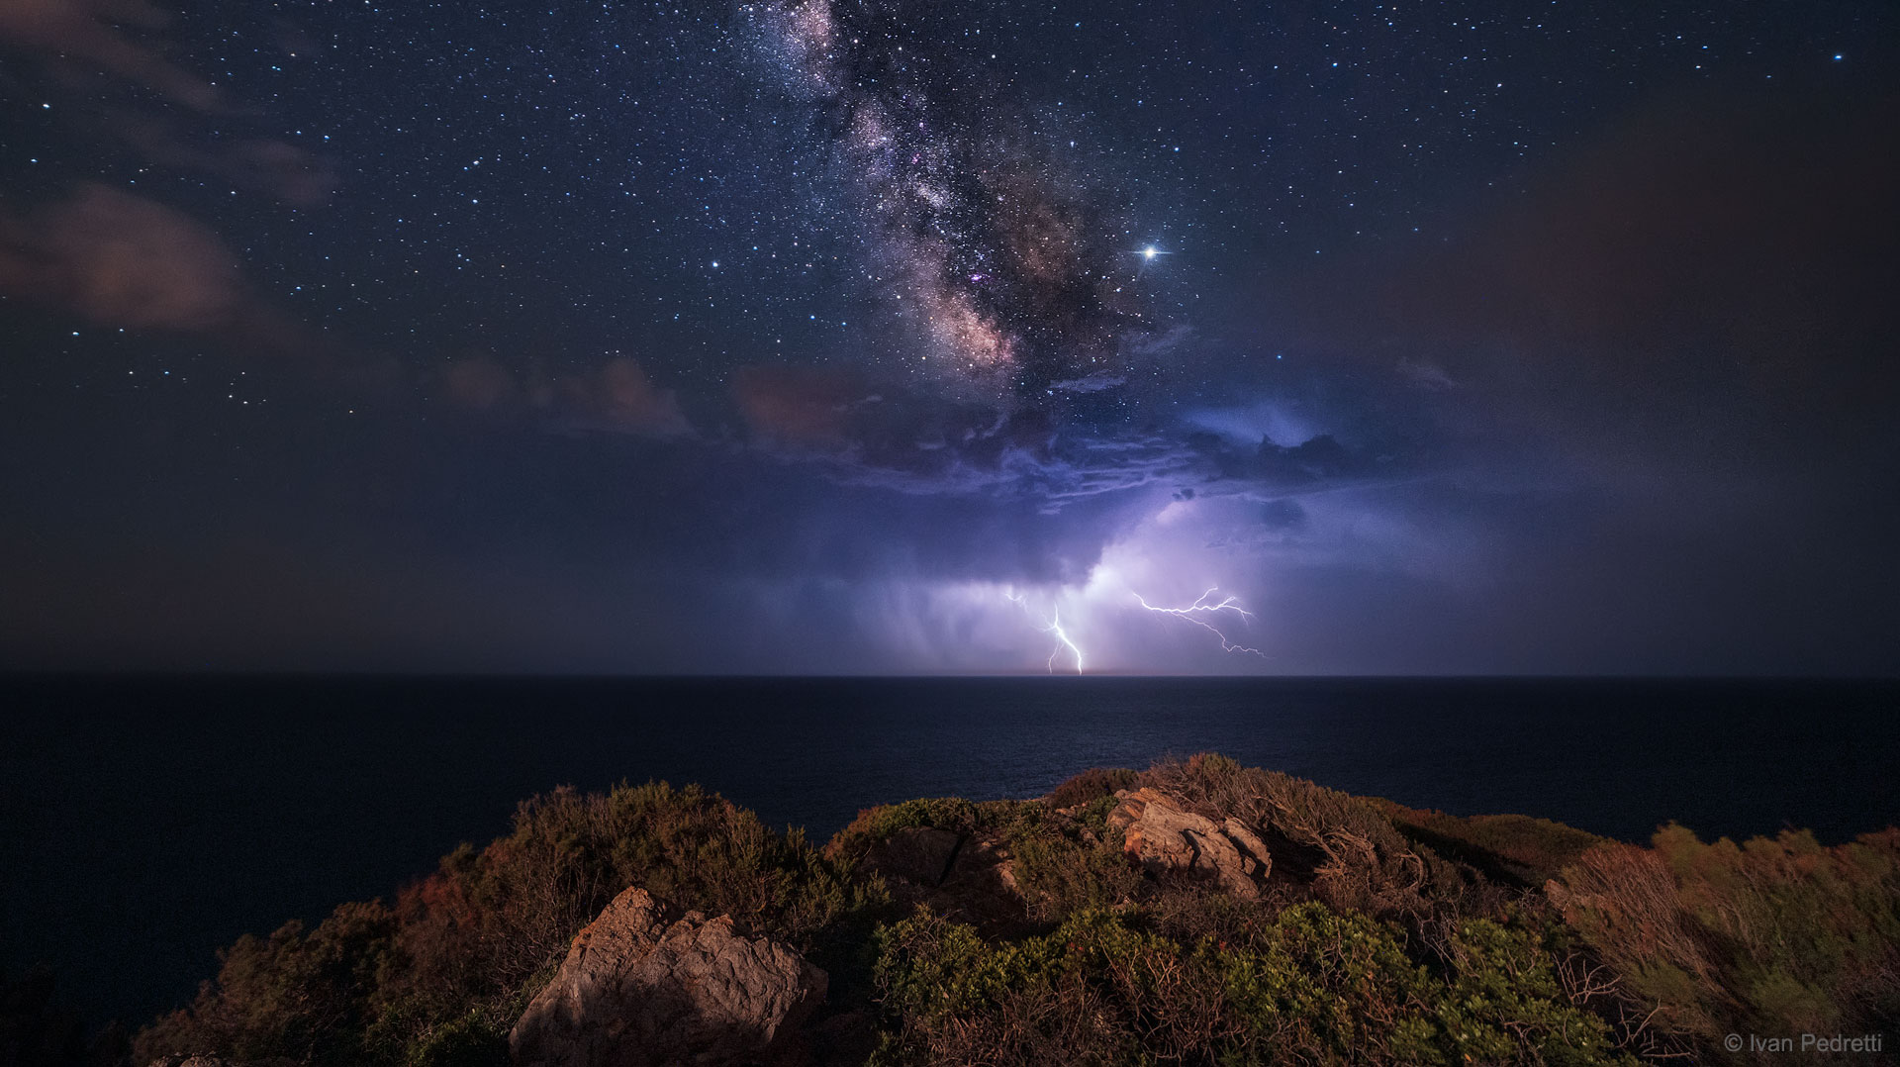
Classification of Sky Objects
Alper ÇAKIR

Slide 2

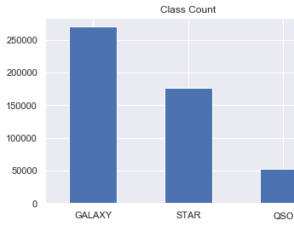

Introductıon
Solution: To classify sky objects, I extracted spectroscopic & photometric data from SDSS. I merged these tables via SDSS’s sql window.
Objectives: Classification of sky objects such as star, galaxy, and quasar via spectroscopic & photometric data.

Slide 3
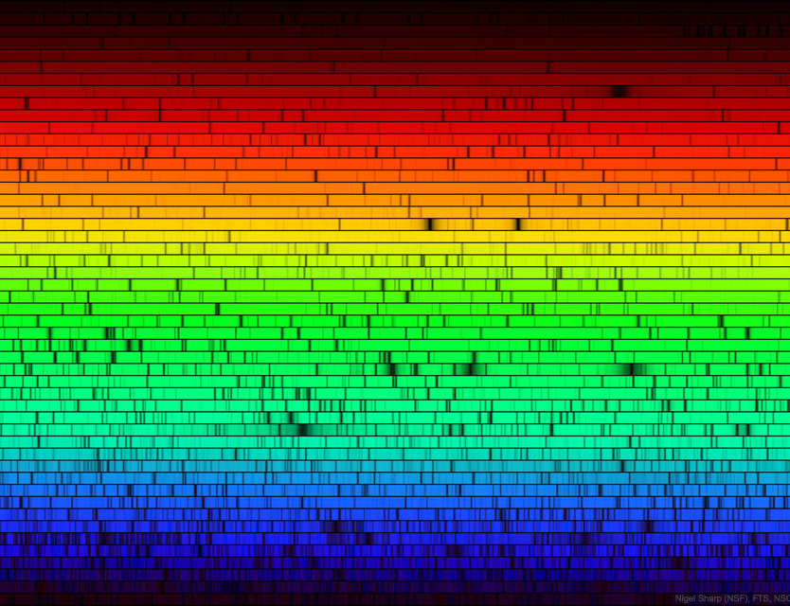
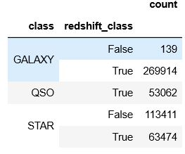
Data & Methadology
Spectroscopic Data : Various quantities measured from an object's spectrum, such as its spectral type or redshift.
Photometric Data : Various quantities measured from an object's image, such as its brightness, mag, flux or size.

Slide 4
Data & Methadology
Cleaning & EDA
Feature Engineering
ML Models
Evaluation of Models
Optimization & Holdout Test
Conclusion

Slide 5
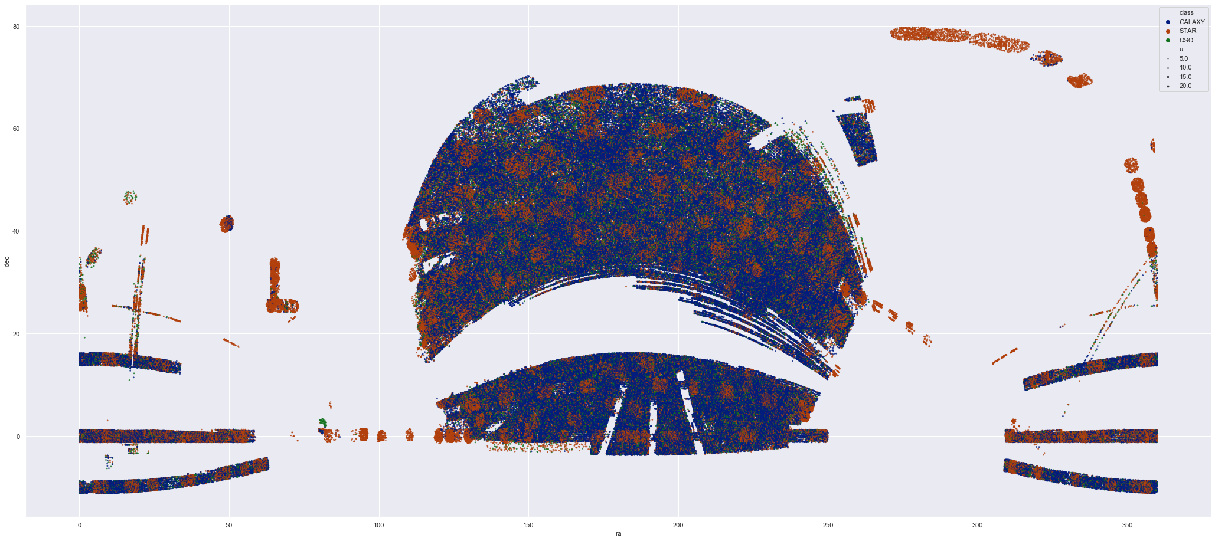

Slide 6
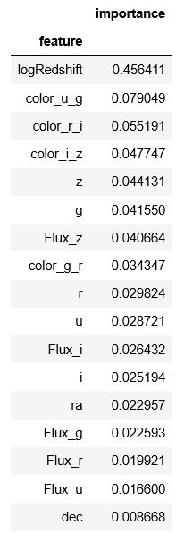
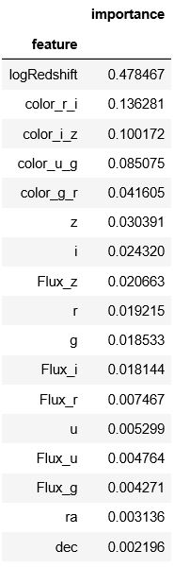
Classıfıcatıon models
1. Basic Models : KNN, Logistic Regression, Naive Bayes, Linear SVC, and Decision Tree.
2. Ensemble Methods:
2.1. Bagging : Random Forest, Extra Trees, and Bagging Classifier
2.2. Boosting : AdaBoost and GradientBoosting
2.3. Voting Classifier: Soft & Hard
Extra Trees Random Forest

Slide 7
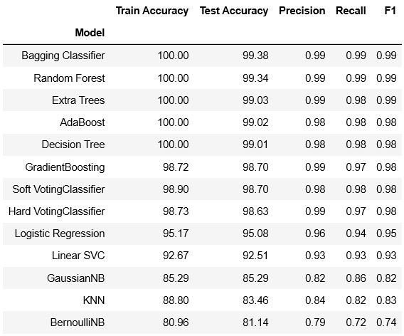
Performance & optımızatıon
As can be seen, ensemble models are really successful at this classification task.
The most successful model on the test data is bagging classifier, so I’m going to use it for Grid Search.

Slide 8
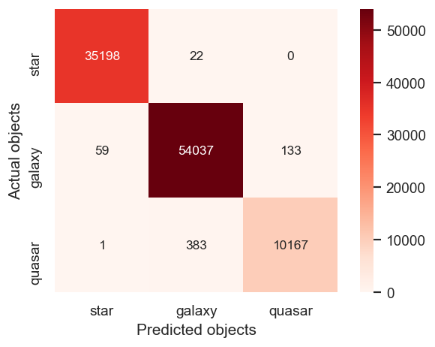
Performance & optımızatıon
First version of Bagging Classifier’s accuracy was % 99.38
And after grid search:
Accuracy of Bagged Decision Tree on holdout: % 99.44

Slide 9
Conclusıons
Best results that I got are from ensemble models. Naive Bayes and KNN models have relatively smaller accuracy values in this model.
As can be seen in the feature importance tables, redshift and color indexes are the most valuable features.
After the model evaluation, I decided that Bagging Classifier is the optimum algorithm for this data.

Slide 10
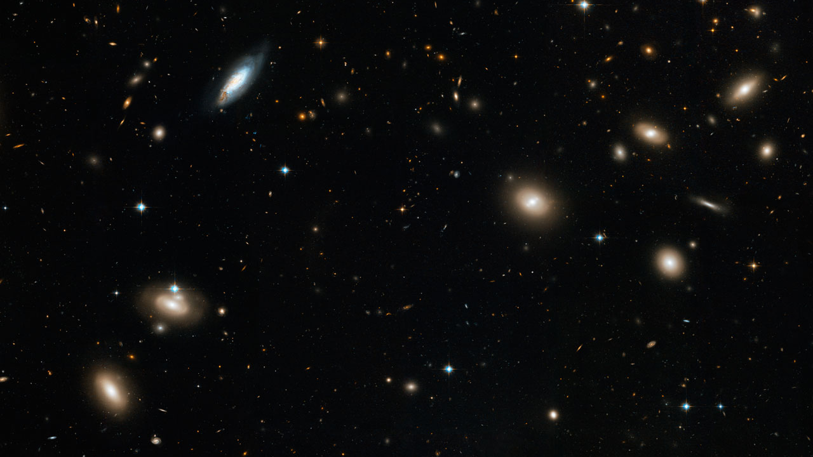

THANK YOU

