Slide 1



Arxiv: Classification & Recommendation
Alper Çakır

Slide 2

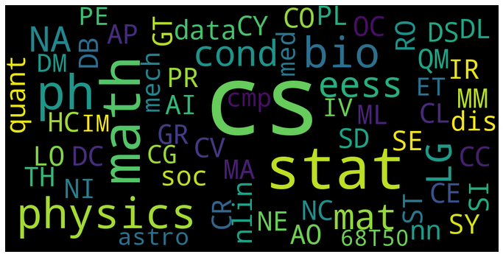

Introductıon
Objectives: Classification of article’s tags and building a recommendation system via the article’s summary, title, author, and genre features.
Solution: To do this, I extracted a dataset which contains articles between 1998-2018. As can be seen in the left photo, the dataset contains articles mostly in computer science area.

Slide 3
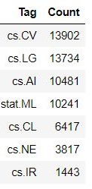
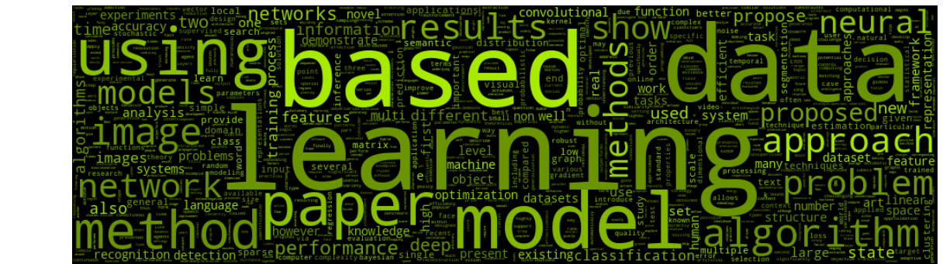
Data
The Dataset contains articles with 41000 rows and 6 columns(summary, tags, etc.) and these articles are mostly about computer science. When examined the subtags of CS, computer vision is the top number. The following subtags are Learning, Artificial Intelligence, and Machine Learning.

Slide 4
Methodology
Set up & Text Cleaning
Transforming columns as list type from dictionary.
Cleaning text: alphanumericals, capitals, numbers, etc…
Visualization
Word Clouds and graphs of the most common words and tags.
Text Mining Alg.
Lemmatization: verbs in past and future tenses are changed into present.
Count & TfIdf Vectorization processes.

Slide 5
Methodology
Classification
Basic models : Logistic Reg, Naive Bayes, etc…
Evaluation & Grid Search
Recommendation
Based on summary
Based on tags, author, and title

Slide 6
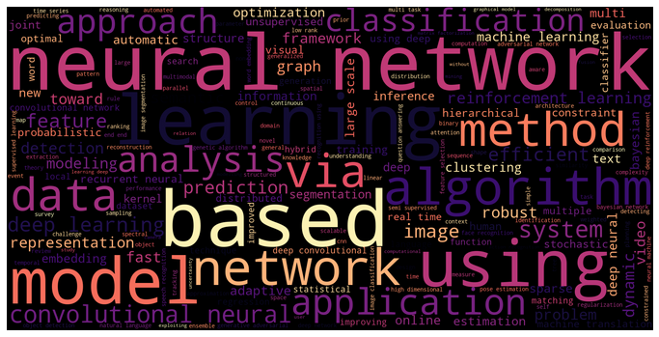
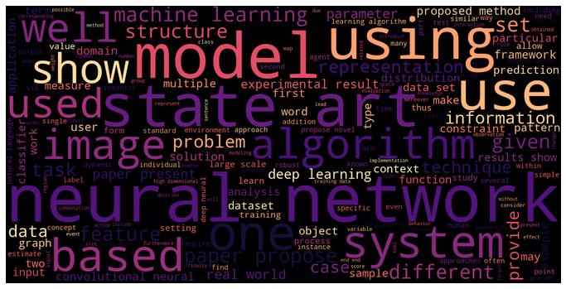
Word Clouds
Title based
Summary based

Slide 7
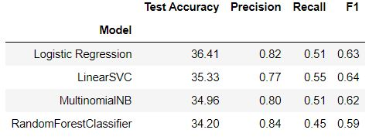
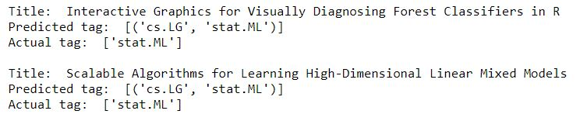

Classıfıcatıon
Defined models:
Logistic Regression with %63,1 F1-score
Multinomial NB with %61,9 F1-score
Linear SVC with %64,3 F1-score
Random Forest with %59 F1-score
I have chosen Logistic Regression for the Grid Search process because of the accuracy score, and as a result, I got an F1-score that has increased to %64,1.

Slide 8
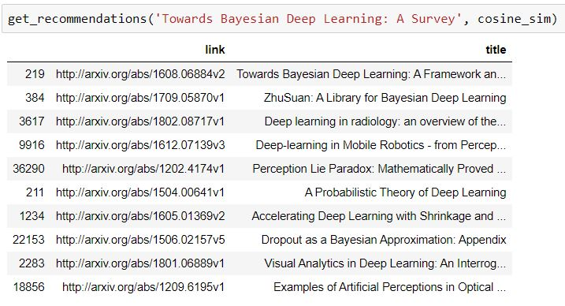
Recommendatıon system
Based on summary:

Slide 9
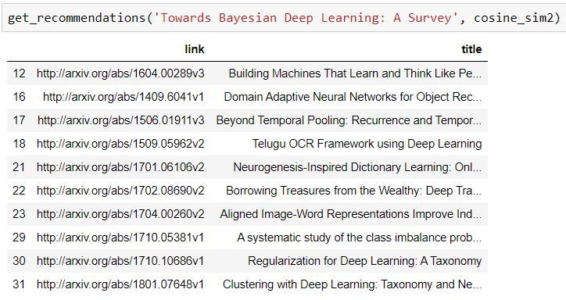
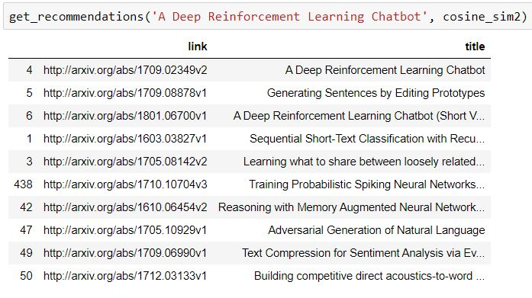
Recommendatıon system
Based on tags, title, and authors

Slide 10
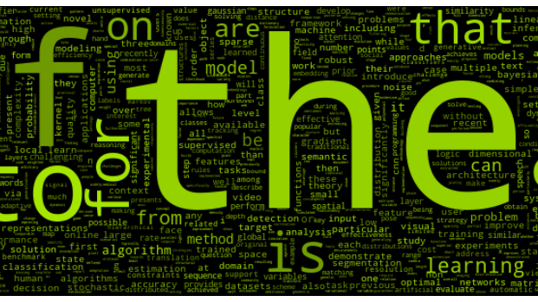
THANK YOU

