Slide 1

Youtube
Statistics
Alper çakır

Slide 2
INTRODUCTION
Objectives: Correlation between measurable variables such as likes and dislikes. In addition to that visualizing the distribution of attributes.
Solution: use Youtube video statistics data file which includes USA, Canada, Great Britain, France, and Germany from kaggle.

Slide 3
METHODOLOGY
Counting the category names
Distribution of attributes by categories
Correlatian matrix and draw the heatmap

Slide 4
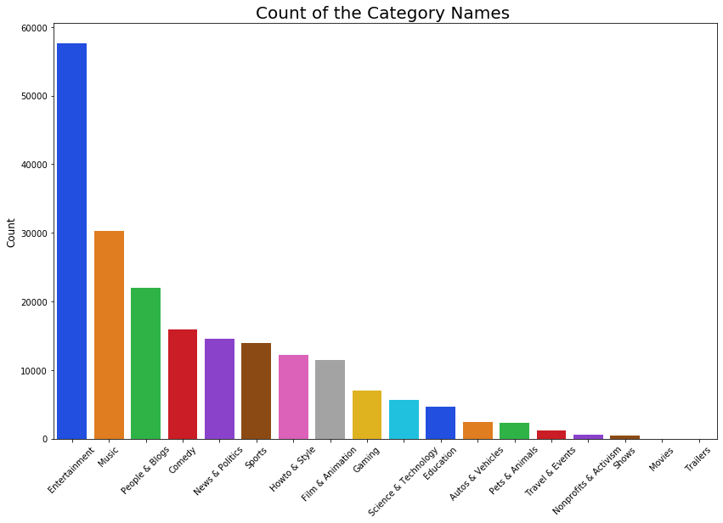

Slide 5
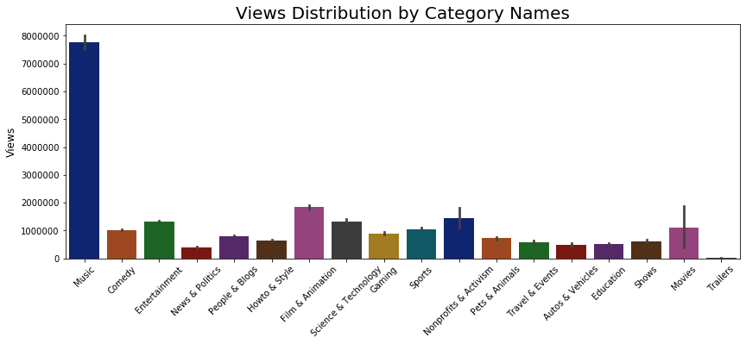

Slide 6
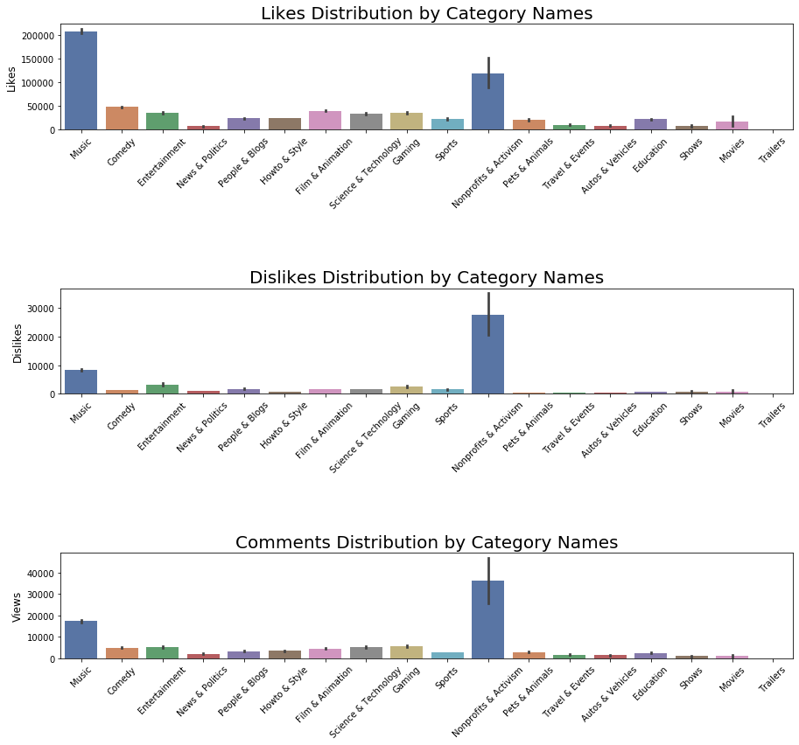

Slide 7
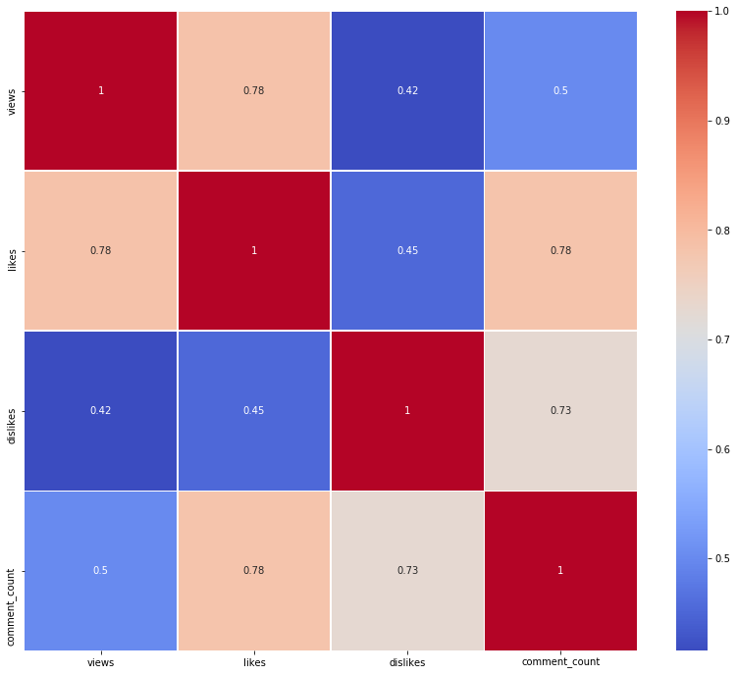
Correlation
Heatmap

Slide 8
Conclusion
Some Insights:
We have seen the most contents in entertainment, comedy, and music category so we can say people uses youtube to get some relax.
There are some categories that have less contents but still more views than some categories (such as comparement of entertainment and comedy categories).
There are categories that have less views but more comments, likes, or dislikes.
Views and Likes attributes are highly correlated, just like Dislikes and comments. People often tend to comment when they don’t like the content.

Slide 9
Future Work
What else would be done
Relationship between categories and trending duration.
There are how many days between trending date and publish date?
Does publish hour or day has any effect on views, likes, etc.?
Most viewed, liked, etc. videos, and tags. Visualization with wordclouds.
Are there same videos that trending in different countries?

Slide 10
THANK YOU

