Slide 1

Library Automation System Group 8

Slide 2
What Is Library Automation System ?
Libraries need a system with different user profiles.
Thanks to this system, data can be stored securely and data loss is minimized. New data can be entered easily and existing data can be easily updated. Authorized persons can easily access data from anywhere. Staff and users minimize time loss and workload. Makes it easy to track and access library materials such as books and magazines. By handling many tasks in the form of automation, it ensures that the margin of error is minimized. The system that provides these benefits and is recommended to respond to problems is the Library Management System.

Slide 3
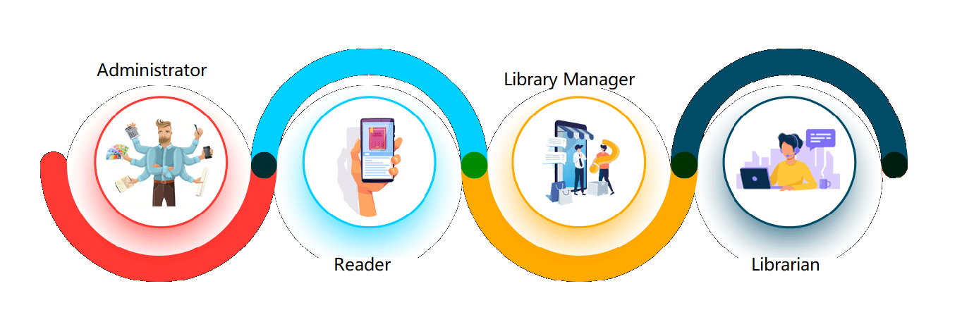
Users of the system

Slide 4
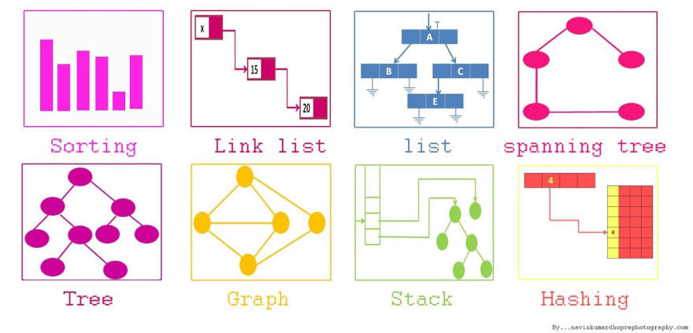
Using of Data Structures
List: To kept in list for author, To hold book
and magazine written by author, To kept in list
for publisher.
Stack: To hold the votes in the material class
Graph: To store library type objects.
Hash: To store Accounts
Skip List: To store Books and Magazines
AVLTree / Binary Search Tree: To store Publishers and Authors
Merge Sort Algorithm: to sort materials by rate.

