Slide 1


REDSTONE
CSE396-COMPUTER ENGINEERING PROJECT
Spring 2022

Slide 2
Who We are ?
Gebze Technical University Computer Engineering students;
Hüseyin Ömer Güray
Muhammed Bedir Uluçay
Mithat Enes Özdemir
Muhammed Alperen Karaçete
Ozan Şelte
Burak Ceylan
Zeynep Çiğdem Parlatan
Rian Ryzhov
Anıl Mert Ulaşan
Yusuf Boy
Selimhan Meral
Mustafa Gürler

Slide 3
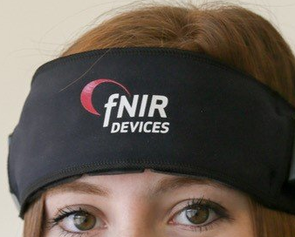
What we aim for and how we will do?
We aim to make a headband that detects which type of music the user is more inclined to listen to according to the current mode.
We will detect the current mode of the user using the f-Nirs technique.
We will use the f-Nirs technique by measuring the oxygen level of the cells in the brain by using infrared photodiodes and infrared lights that we will put into the hardware.

Slide 4
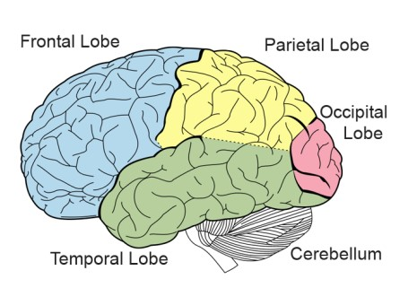
theoretıcal framework
The travel of vibration waves is converted into electrical signals transmitted through the air to the ear first and then to the brain with the help of auditory nerves. By interpreting these signals in the relevant regions of the brain, the perception and meaning of music is revealed. New signals, organized according to the characteristics of the perceived music, are sent to many brain regions.

Slide 5
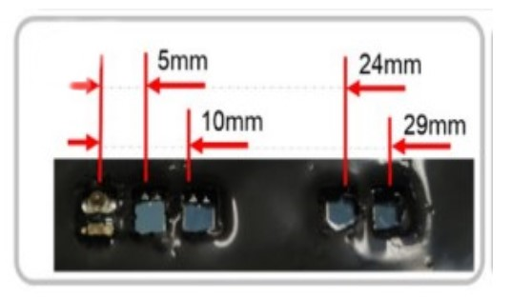
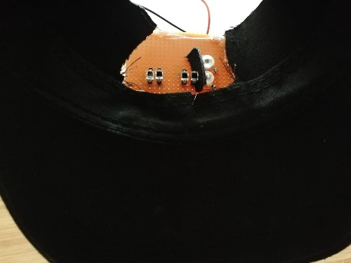
In our project, we focused on the frontal lobe region of the brain. Therefore, when designing our hardware, we placed the photodiodes in the forehead area.

Slide 6
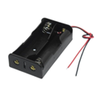
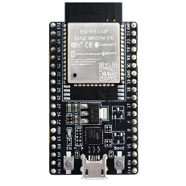
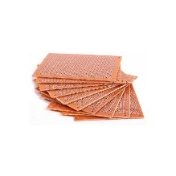
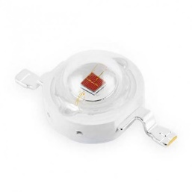
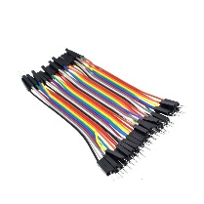
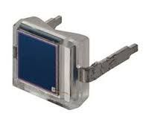
Hardware Detaıls
TOTAL COST: 298.64₺

Slide 7
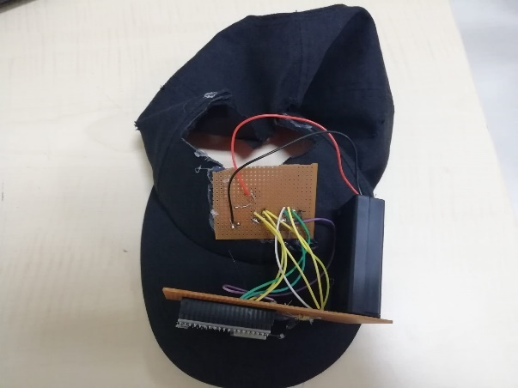
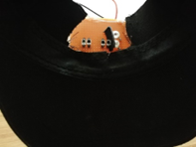
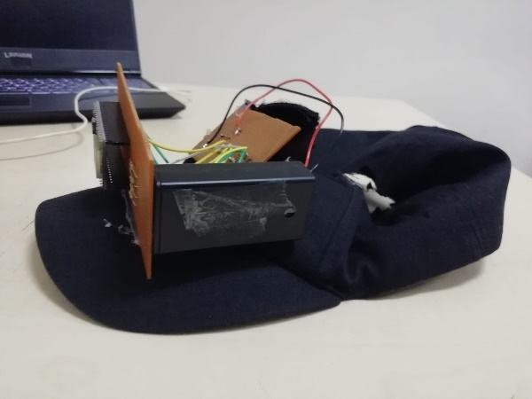
Hardware Detaıls

Slide 8
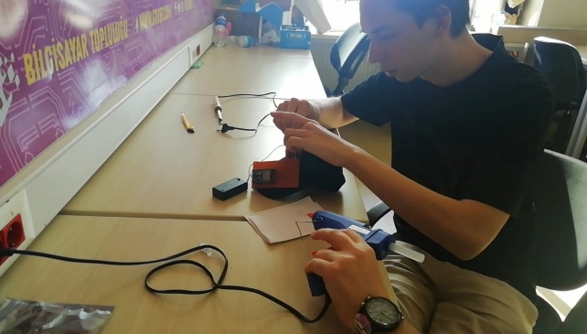
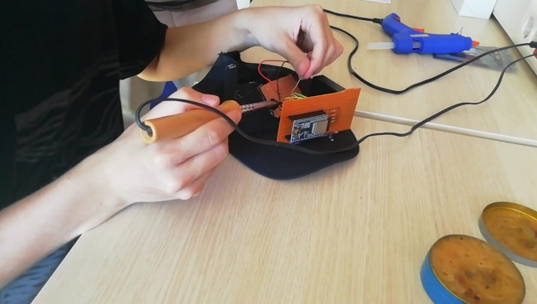
BUILDING

Slide 9
Workıng Prıncıple
Analogue data reading was performed with the help of ESP32-WROOM-32D Wi-Fi Bluetooth Development Module from the diodes on the hardware.
The read analog data is transferred to the phone with the help of the mobile application we developed using the BLE technology provided by the ESP32-WROOM-32D Wi-Fi Bluetooth Development module.
The data transferred from ESP32 to the phone takes place from the beginning to the end of the piece of music that the user listens while using our product.
After the data collection over the phone is completed, the collected dataset is transferred to the database we have set up on a remote server.

Slide 10
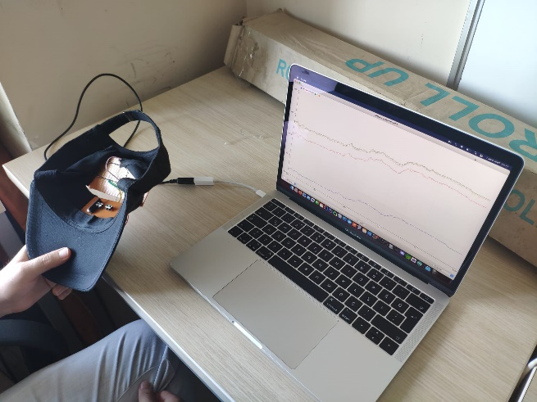
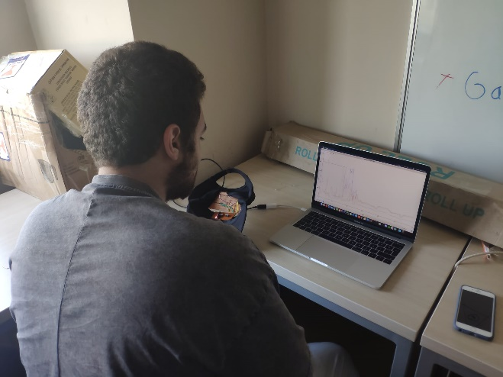
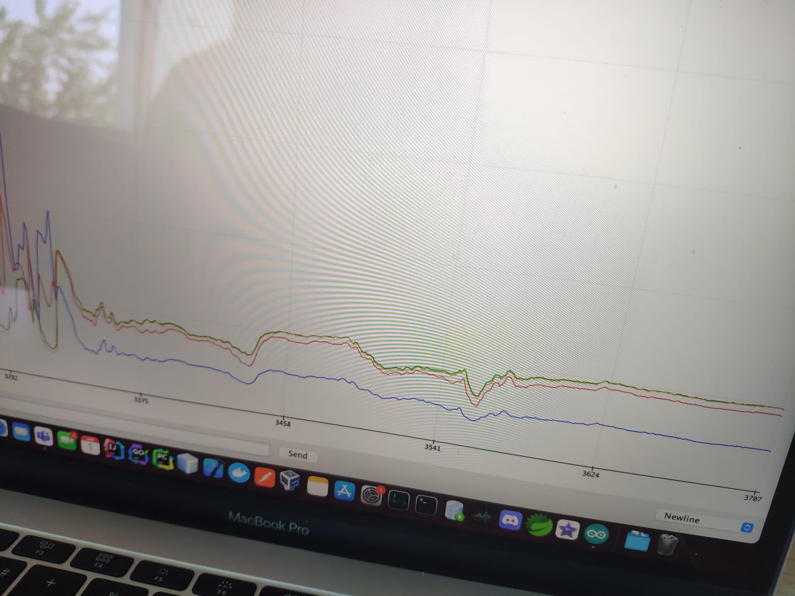
Validation and Characterization
The sensor data coming from the plotter as serial data from the ESP32-WROOM-32D module was checked according to behavior of the photodiode.

Slide 11
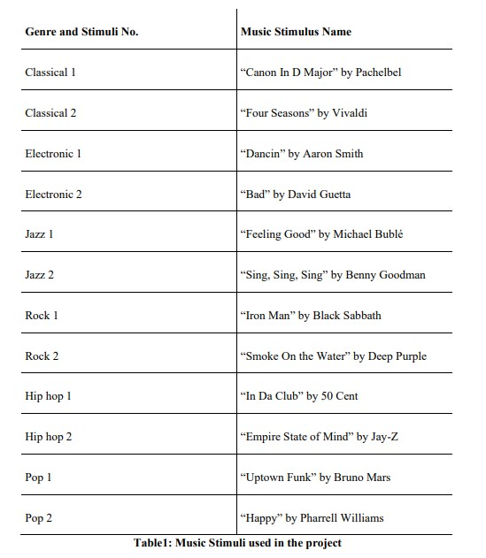
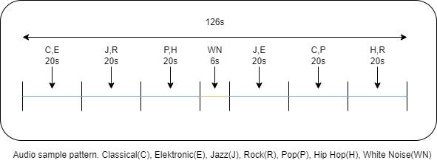
PREPARATıON OF TEST DATA
For the preparation of test data, 6 different genres and 2 songs of each genre were selected.

Slide 12
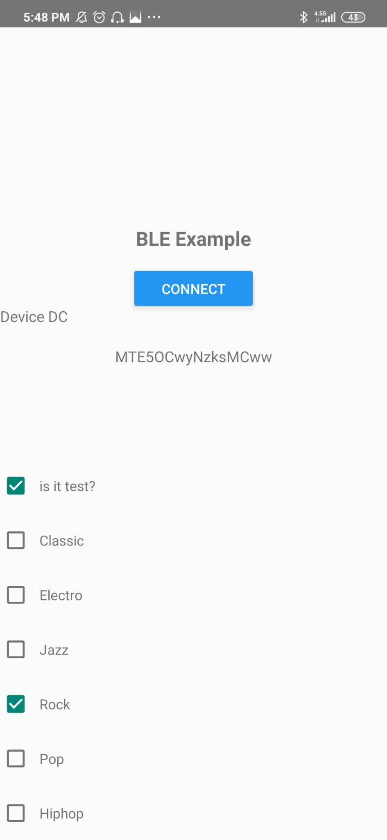
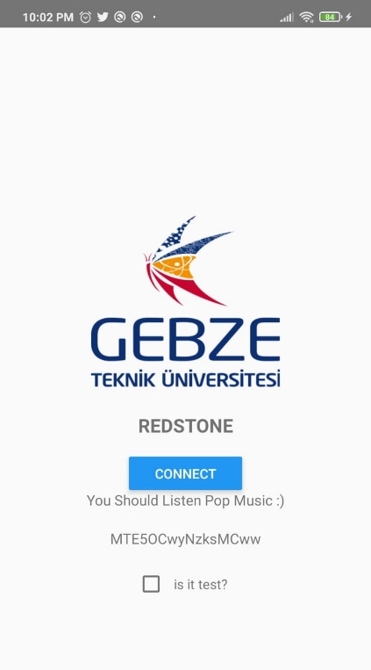
SYSTEM DESıGN
In the application we are using React-Native. To the connect with Bluetooth we used 'react-native-ble-plx' library. If our data is a test data, we are choosing ‘its test’ checkbox. If it’s not a test data, we are just sending base64 values and waiting response from our backend service to which song is proper for the person.

Slide 13
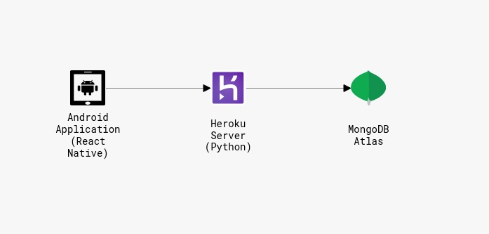
When the song stops playing, we are sending a post request to our backend service which we deployed on Heroku. We are using axios to post our data. Our backend is written in Python and our database is MongoDB on MongoDB Atlas platform.

Slide 14
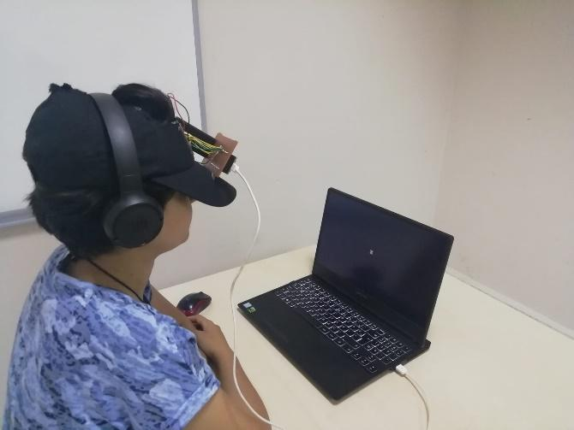
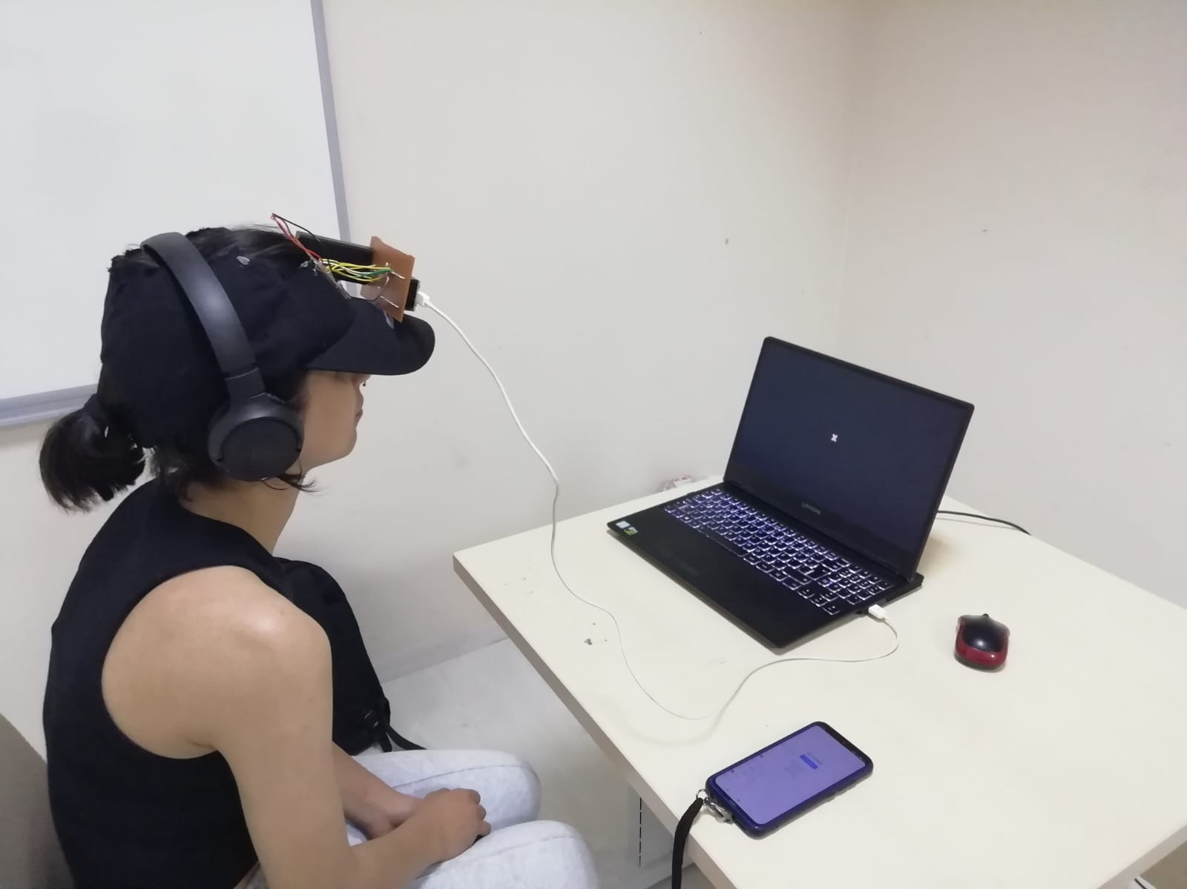
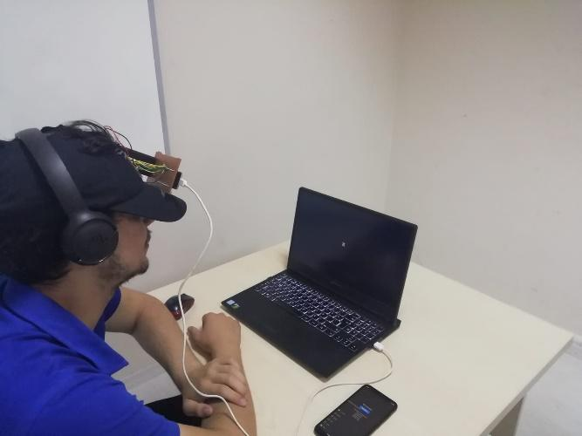
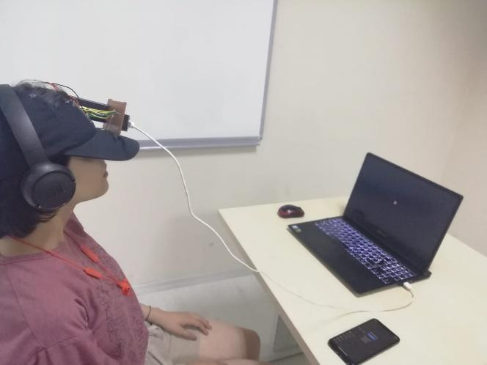
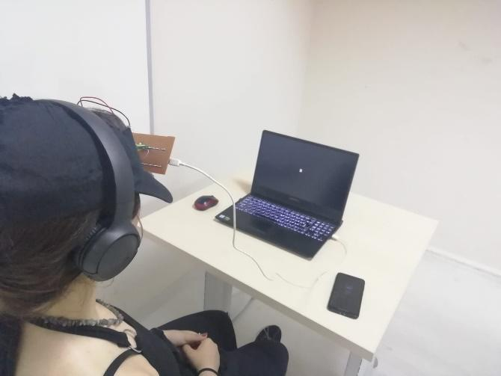
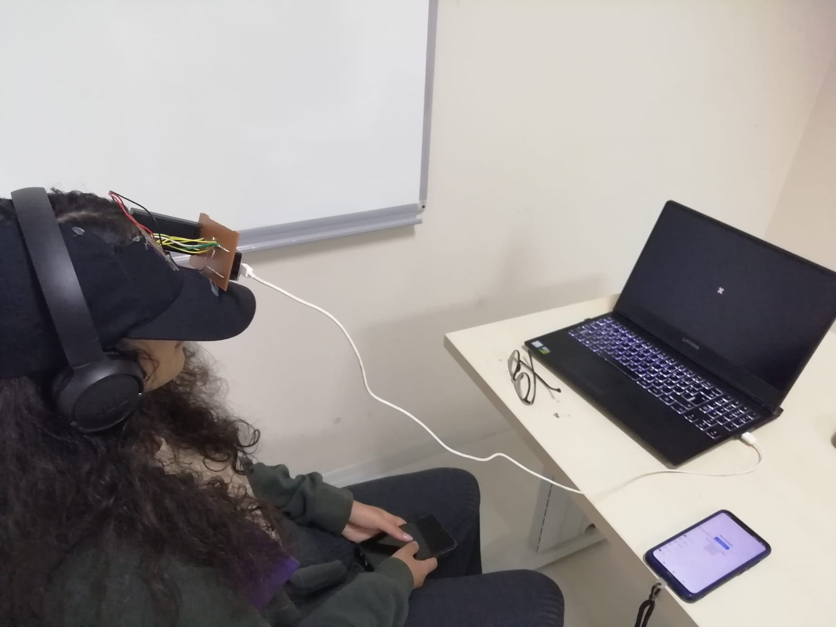
TEST PHASE
Before starting the test, the whole process was explained to the participants. The participants were asked to sit and look at a fixed cross throughout the test so that blood flow in the brain is not affected by the movement.

Slide 15
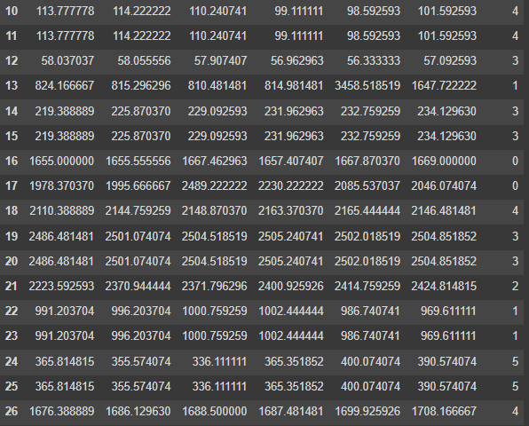
DATA PROCESSING
Data processing phase, we ended up with a model that trains itself to suggest a song kind in six different songs.
We receive 4 different columns of data from 4 different sensor which is attached to user frontal lobe. Since we have 6 different kinds of mix in our test song, we separated the values into 6 equal columns. Each part of data column obtained from dividing into 6 different ranges mean of the dataset. In the end of this part our dataset has 6 columns and the label. Label represents the song kind that chosen by user. Selecting the best data manipulation algorithm, we decided on RandomForest. Because we have 6 kinds of songs and to achieve a successful model, we need nonlinear algorithms. After we need classification because as we mentioned sensor data should present one type of genres.

Slide 16
DATA PROCESSING-Selectıng Classıfıcatıon Algorıthm
Since we must predict a song type, we must apply classification algorithm to the model. We applied KNN (K-Nearest Neighbors), SVC (Support Vector Machine), DT (Decision Tree), Random Forest and Naïve Bayes algorithms to train the model. Then we tested each algorithm by applying k-fold cross validation. We checked confusion matrices, precision/recall values, execution time and overall accuracies to decide on the best classification algorithm.

Slide 17
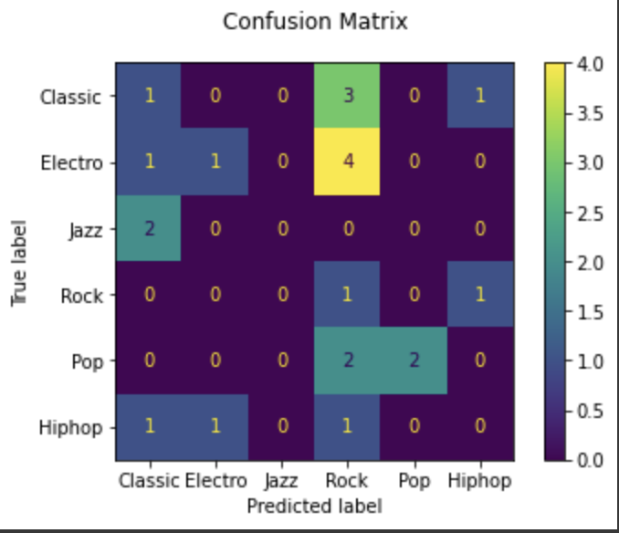
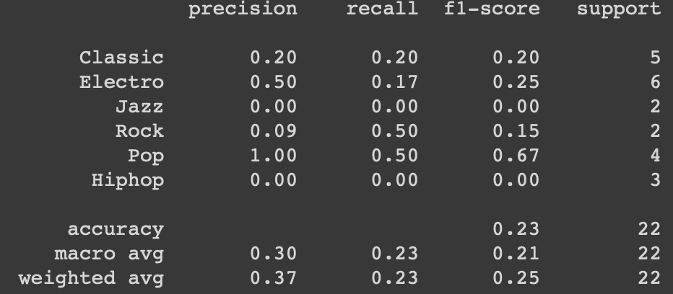
DT(DECISION TREE) ALGORITHM
Decision Tree Table
Decision Tree Graph

Slide 18
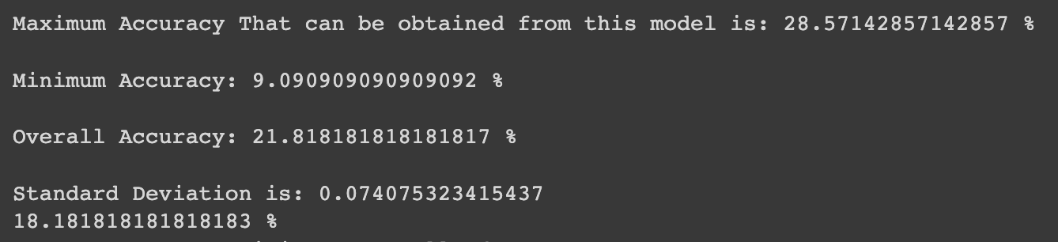
DT(DECISION TREE) OVERALL RESULTS

Slide 19
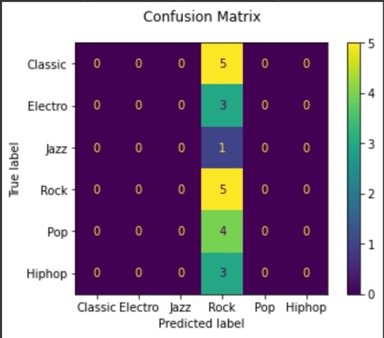
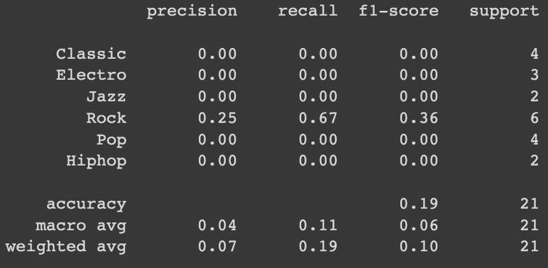
SVC(SUPPORT VECTOR MACHINE) ALGORITHM
Support Vector Machine Table
Support Vector Machine Graph

Slide 20
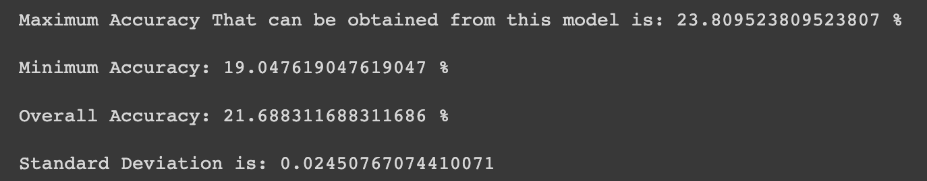
SVC(SUPPORT VECTOR MACHINE) OVERALL RESULTS

Slide 21
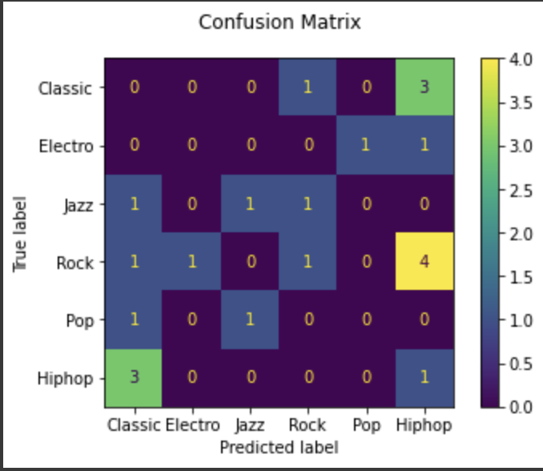
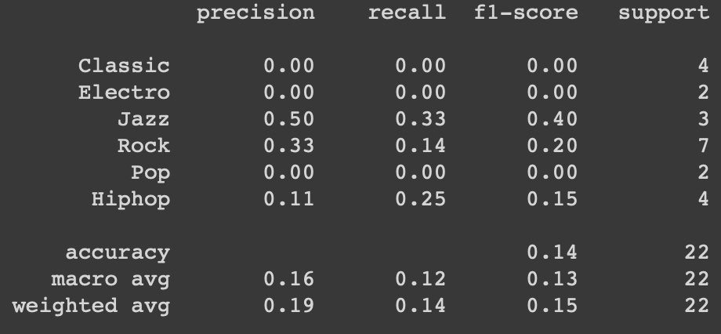
GUESSIANNB ALGORITHM
GuessianNBTable
GuessianNB Graph

Slide 22
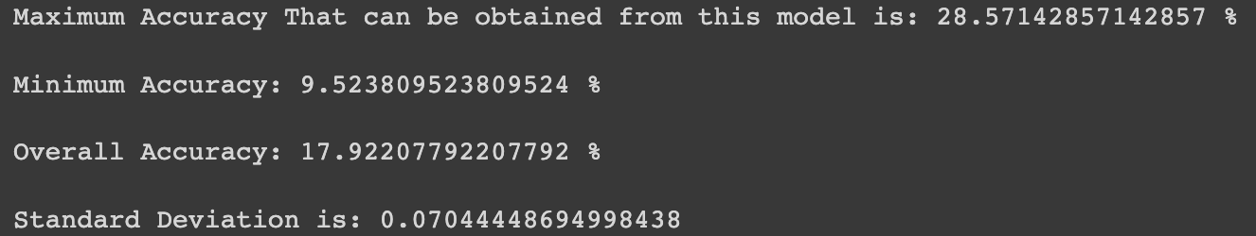
GUESSIANNB OVERALL RESULTS

Slide 23
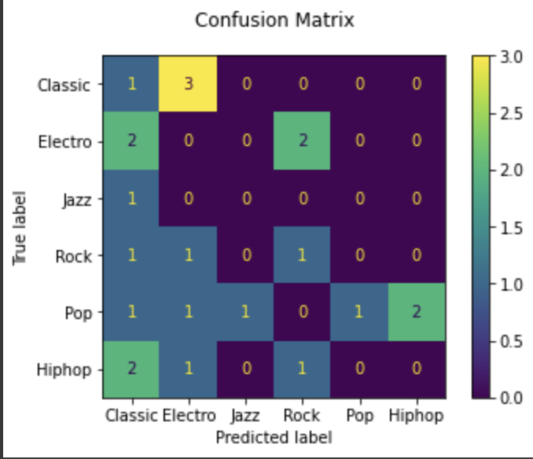
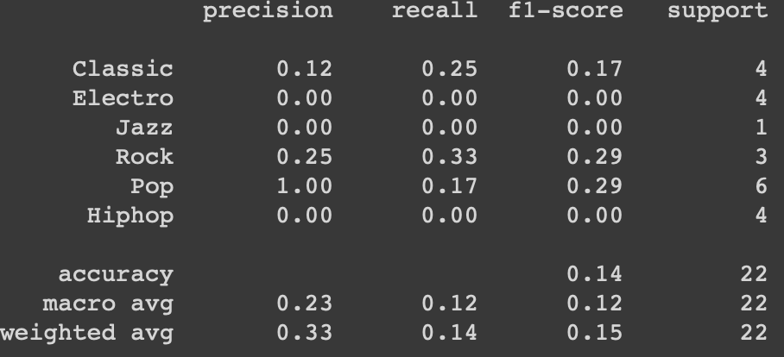
KNN ALGORITHM
KNN Table
KNN Graph

Slide 24
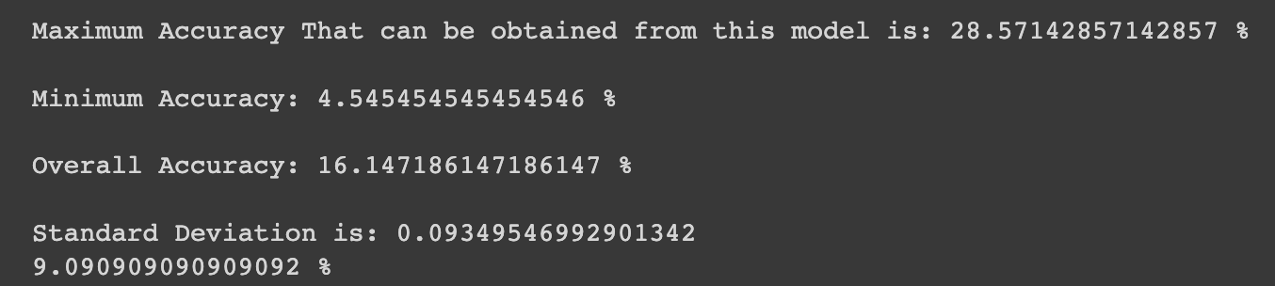
KNN OVERALL RESULTS

Slide 25
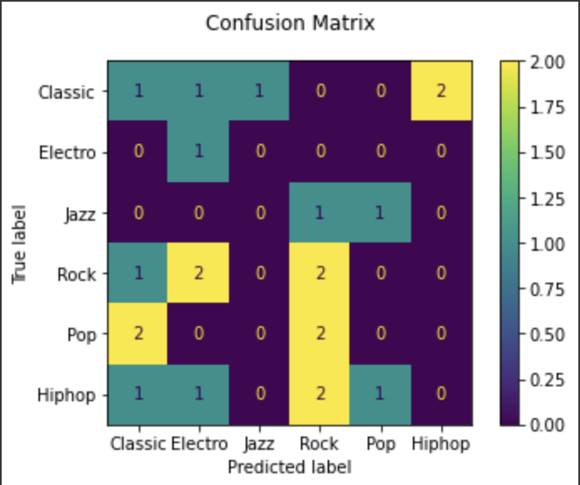
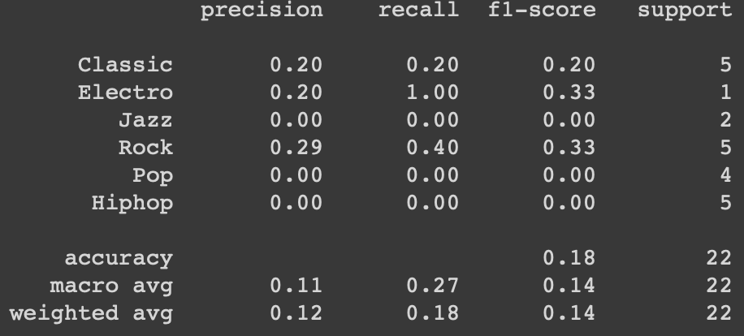
RANDOM FOREST ALGORITHM
Random Forest Table
Random Forest Graph

Slide 26
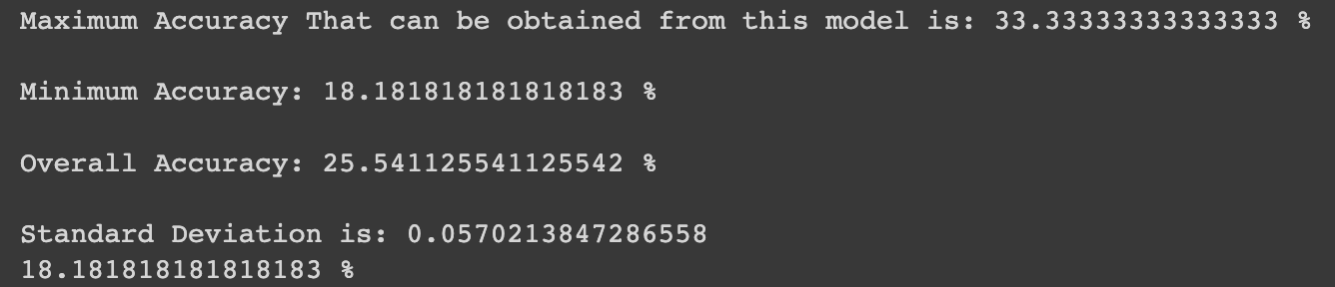
RANDOM FOREST OVERALL RESULTS

Slide 27
DEMO

Slide 28
OUR VIDEO AND WEB SITE
Website: https://redstonegtu.github.io/redstonegtu/
YouTube Video: https://www.youtube.com/watch?v=7K6aRm8lHxc

