Slide 1
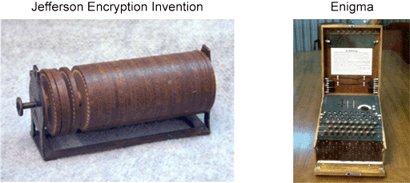
Cryptography
Cryptography is the practice and study of techniques to secure communications in the presence of third parties.
Cryptanalysis is the practice and study of determining and exploiting weakness in cryptographic techniques.
Cryptology is an umbrella term which covers both cryptography and cryptanalysis.
1

Slide 2

Rail Cipher
2

Slide 3
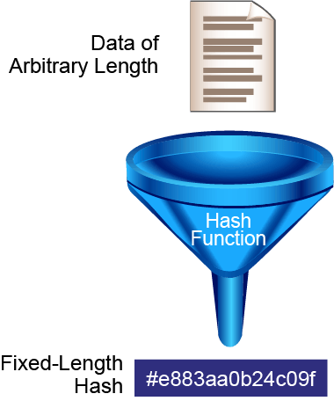
Hashing
Hashing is a mechanism that is used for data integrity assurance. Hashing is based on a one-way mathematical function: functions that are relatively easy to compute, but significantly difficult to reverse.
3

Slide 4
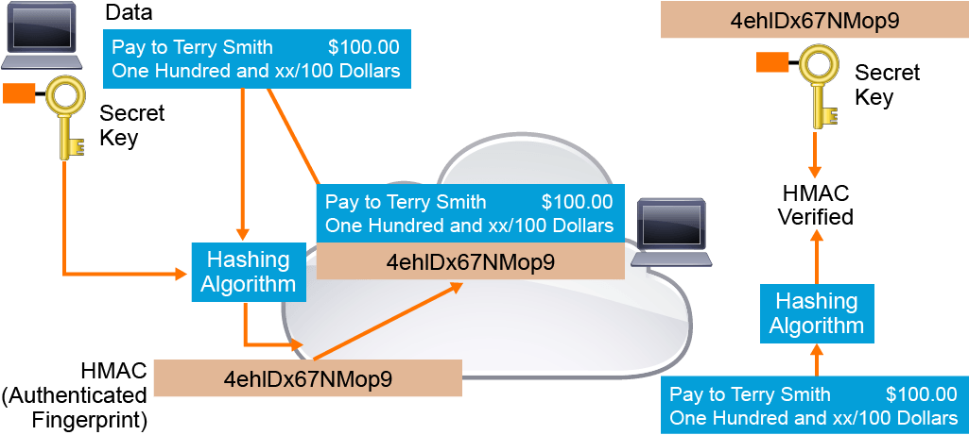
Kriptografik Kimlik Doğrulama
4

Slide 5
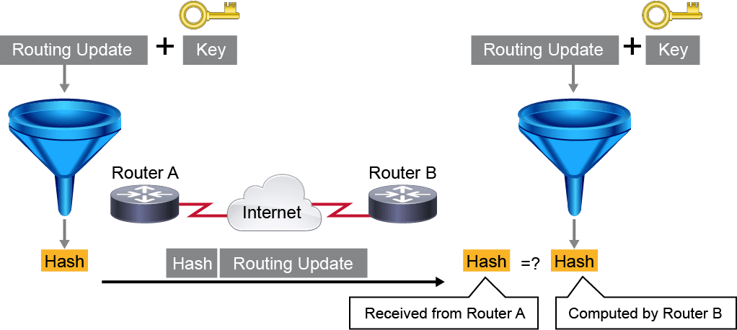
5

Slide 6
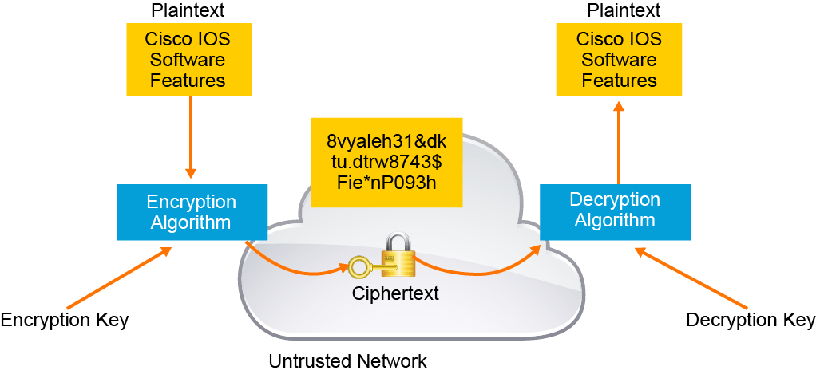
Encryption
Encryption is the process of disguising a message in such a way as to hide its original contents. With encryption, the plaintext readable message is converted to ciphertext, which is the unreadable, “disguised” message. Decryption reverses this process. Encryption is used to guarantee confidentiality so that only authorized entities can read the original message.
6

Slide 7
Cryptanalsis
Brute-force Attack
Ciphertext-only Attack
Known-plaintext Attack
Chosen-plaintext Attack
Chosen-ciphertext Attack
Birthday Attack
Meet-in-the-Middle Attack
7

Slide 8
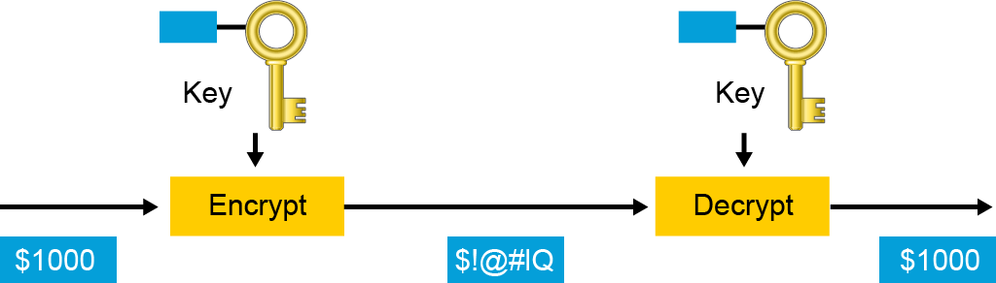
Symmetric Encryption
Symmetric encryption algorithms use the same key for encryption and decryption. Therefore, the sender and the receiver must share the same secret key before communicating securely. The security of a symmetric algorithm rests in the secrecy of the shared key
8

Slide 9
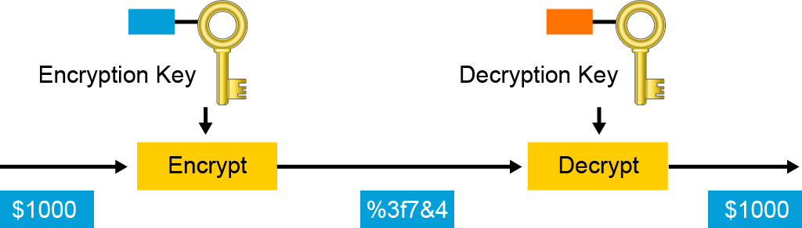
Asymmetric Encryption
Asymmetric algorithms utilize a pair of keys for encryption and decryption. The paired keys are intimately related and are generated together. Most commonly, an entity with a key pair will share one of the keys (the public key) and it will keep the other key in complete secrecy (the private key).
9

Slide 10
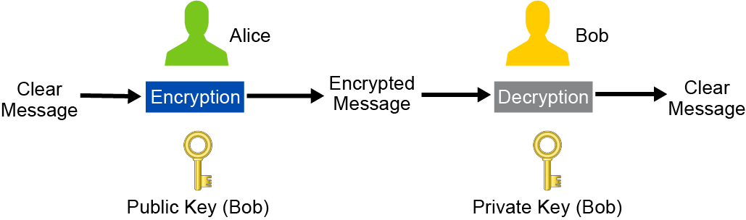
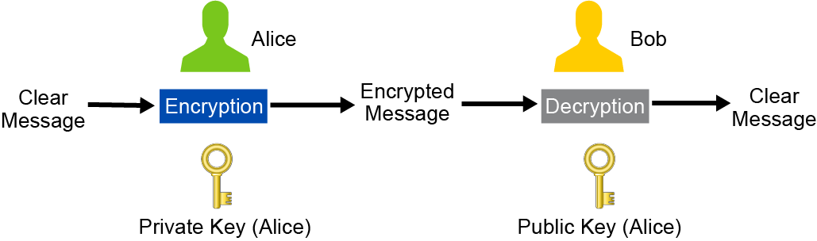
Şifreleme
Kimlik Doğrulama
10

Slide 11
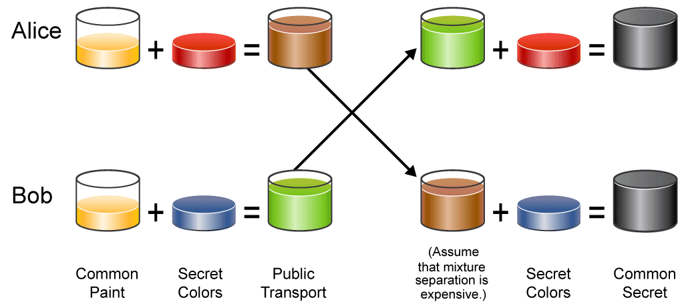
Diffie-Hellman Key Exchange
The DH key agreement method allows two parties to share information over an untrusted network and mutually compute an identical shared secret that cannot be computed by eavesdroppers who intercept the shared information.
11

Slide 12
The mathematical model in the DH key exchange process:
p = large prime number, can be known to Alice, Bob, and Eve.
g = based or generator, can be known to Alice, Bob, and Eve.
a = Alice's chosen private key, which is known only to Alice.
b = Bob's chosen private key, which is known only to Bob.
A = Alice's calculated public key using g, p, and a, can be known to Alice, Bob, and Eve. A = g^a mod p.
B = Bob's calculated public key using g, p, and b, can be known to Alice, Bob, and Eve. B = g^b mod p.
s = The shared secret key, which is calculated by using the other party's public key, each party's own chosen secret key, and the prime number p, is known to both Alice and Bob, but not to Eve.
s = B^a mod p (calculated by Alice).
s = A^b mod p (calculated by Bob).
s can also be calculated using the formula s = g^ab mod p which requires knowledge of both parties chosen private key.
After each party calculates the shared secret key s independently, each party will end up with the exact same value s. All three formulas for s will produce the same result. s = g^ab mod p = B^a mod p = A^b mod p.
12

Slide 13
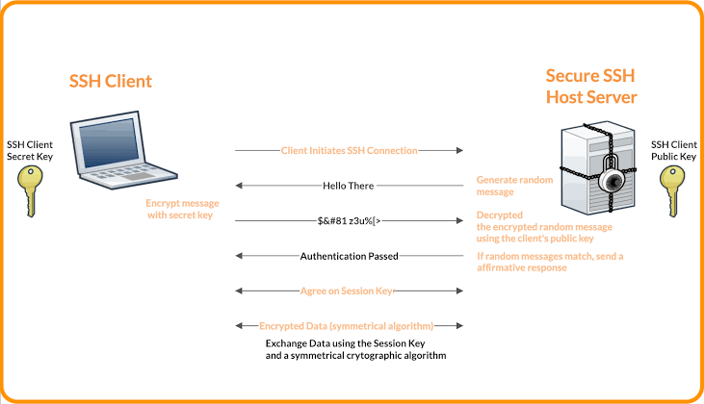
SSH
13

Slide 14
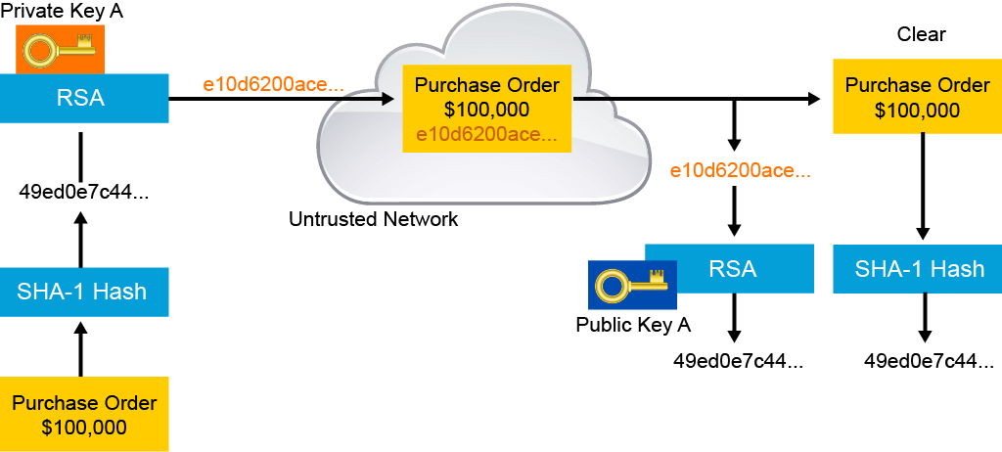
Digital Signatures
The idea of encrypting a file with your private key is a step toward digital signatures. Anyone who decrypts the file with your public key knows that you were the one who encrypted it. But, since asymmetric encryption is computationally expensive, it is not optimal. Digital signatures leave the original data unencrypted. It does not require expensive decryption to simply read the signed documents.
14

Slide 15
Digital signatures provide three bsic security services
Authenticity of digitally signed data
Integrity of digitally signed data
Nonrepudiation of the transaction
To achieve these goals, digital signatures have the following properties:
The signature is authentic: The signature convinces the recipient of the document that the signer signed the document.
The signature is not forgeable: The signature is proof that the signer, and no one else, signed the document.
The signature is not reusable: The signature is a part of the document and cannot be moved to a different document.
The signature is unalterable: After a document is signed, it cannot be altered.
The signature cannot be repudiated: Signers cannot claim later that they did not sign it.
15

Slide 16
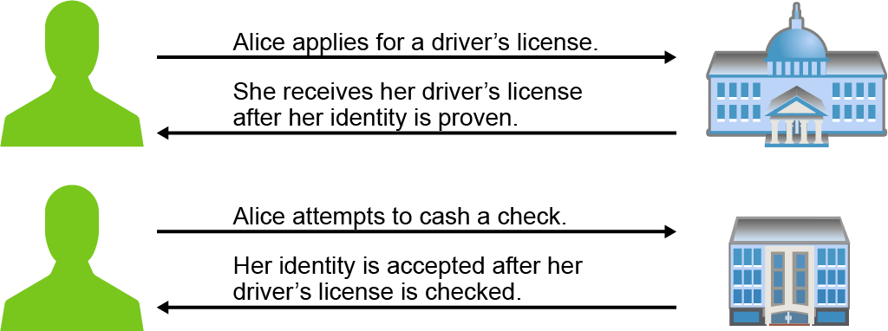
Public Key Infrastructure
Entities enroll with a PKI and receive identity certificates that are signed by a certificate authority. Among the identity information included in the certificate is the entity's public key. The certificate authority’s digital signature on the identity certificate validates that the included public key is the real public key belonging to the associated entity.
16

Slide 17
Currently, digital identity certificates use the X.509 version 3 structure:
Version
Serial number
Algorithm ID
Issuer
Validity
Not before
Not after
Subject
Subject public key info
Public key algorithm
Subject public key
Issuer unique identifier (optional)
Subject unique identifier (optional)
Extensions (optional)
Certificate signature algorithm
Certificate signature
17

Slide 18
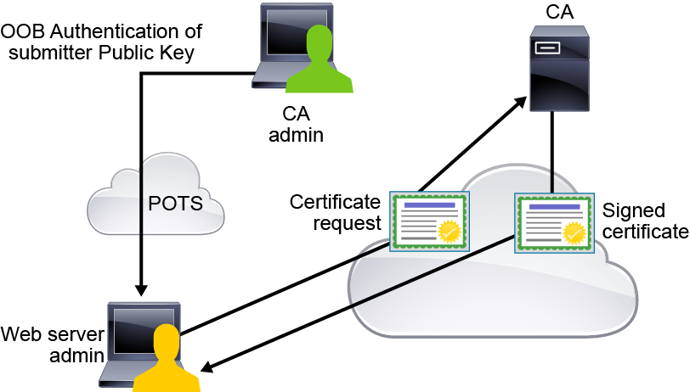
Certificate Enrollment
18

Slide 19
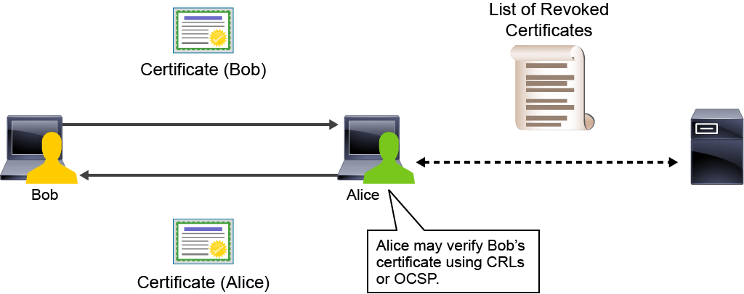
Certificate Revocation
19

Slide 20
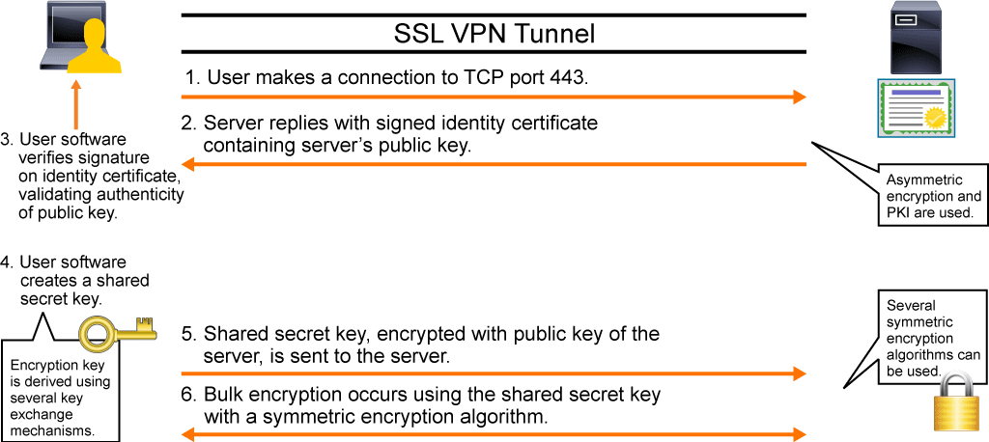
SSL/TLS
Browser Sertifika
20

Slide 21
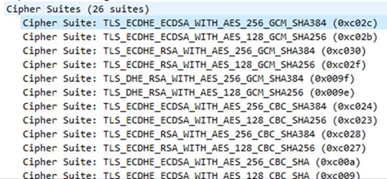
Cipher Suite
21

Slide 22
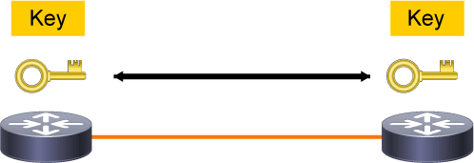
Key Management
Key management deals with the secure generation, verification, exchange, storage, and destruction of keys. It is extremely important to have secure methods of key management.
22

