Slide 1
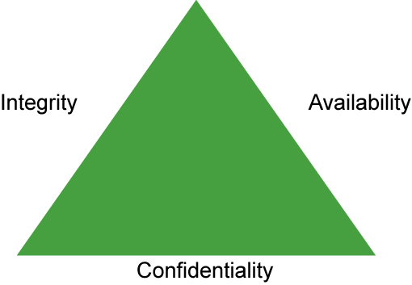
Information Security CIA
1

Slide 2
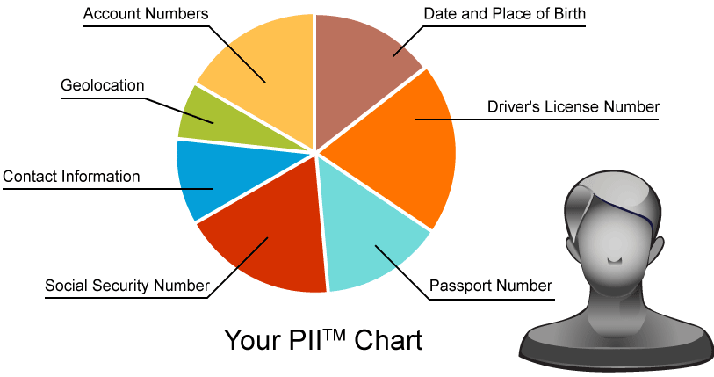
Personally Identifiable Information
2

Slide 3
Risk
Risk is a function of the likelihood of a given threat source’s exercising a particular potential vulnerability, and the resulting impact of that adverse event on the organization.
Business Risk
Data Risk
Data Loss
Systems Risk
Insider Threat
Application Risk
Risk Management:
Risk Acceptance
Risk Avoidance
Risk Limitation
Risk Transfer
3

Slide 4
Vulnerability Assessment
A vulnerability is a defect in software or hardware, at least in the context of information security, and it is paired with an exploit as the means to exercise that vulnerability to some end
Vulnerability Assessment Process Steps:
Device Discovery
Service Enumaration
Scanning
Validation
4

Slide 5
CVSS
CVSS is a free and open industry standard for assessing the severity of computer system security vulnerabilities. Its development has been overseen by the CVSS SIG with input from representatives of a broad range of industry sectors, from banking and finance to technology and academia. CVSS attempts to assign severity scores to vulnerabilities, allowing responders to prioritize responses and resources according to threat.
Metrics:
Attak Vector
Attack Complexity
Privileges Required
User Interaction
Scope
Confidentiality Impact
Integrity Impact
Availability Impact
For more information on CVSS v3.0, refer to the CVSS v3.0 User Guide at https://www.first.org/cvss/cvss-v30-user_guide_v1.4.pdf
5

Slide 6
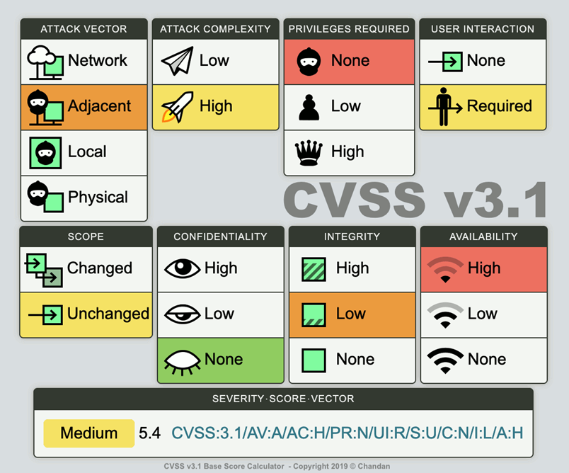
6

Slide 7
Access Control Models
Access control includes control over access to the network resources, information system resources, and information. It is crucial for an organization to implement the proper access controls to protect the organization's resources and information.
Role-Based
Discretinaory
Mandatory
7

Slide 8
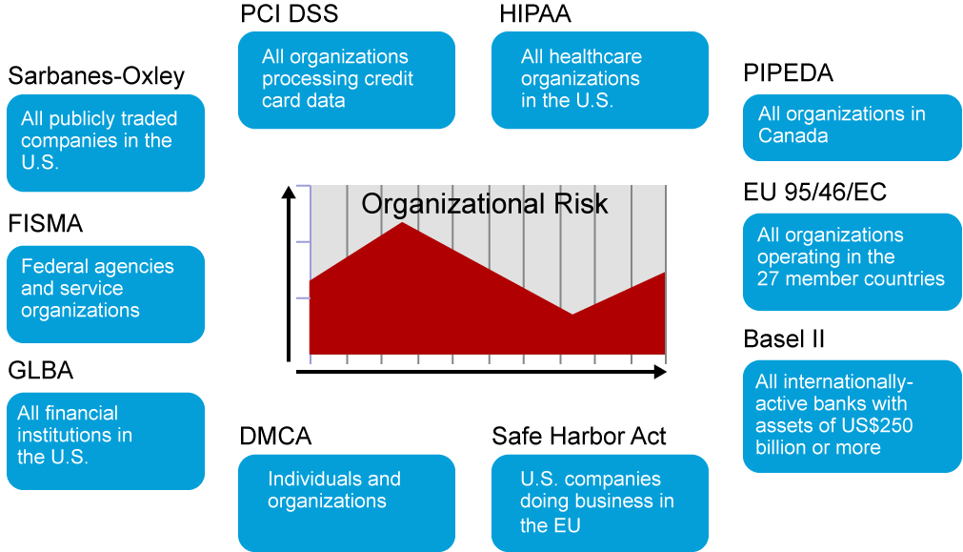
Regulatory Compliance
8

Slide 9
Information Security Management
Information security management is the identification of an organization's assets, followed by the development, documentation, and implementation of policies and procedures for protecting these assets. Security management is often challenging to accomplish in the changing landscape of mobile workers and virtual data centers; cloud computing-based services add more complexity.
Deming Cycle:
Plan
Do
Check
Act
9

Slide 10
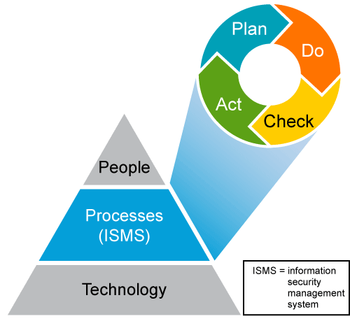
10

Slide 11
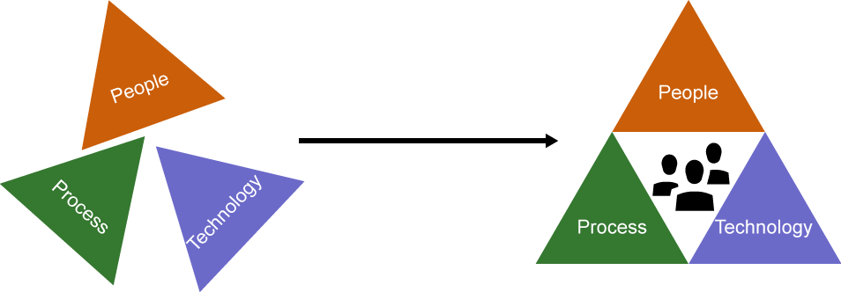
Security Operations Center
A SOC is related to the people, processes, and technologies involved in providing situational awareness through the detection, containment, and remediation of information security threats. Using a measured, consistent, and creative approach to security incident response and security monitoring delivers the most effective and efficient results for the organization.
11

