Slide 1
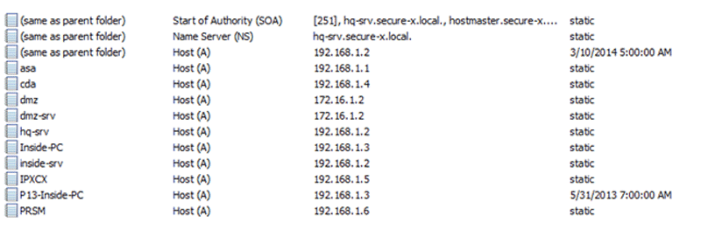
DNS Operasyonları
DNS provides mappings between the host names and IP addresses, or other mappings. For example, DNS can map host names, such as host.alperensoydan.com, to IP address, such as 195.27.45.89. DNS service enables access to the network resources by their names instead of having to remember their IP addresses.
1

Slide 2
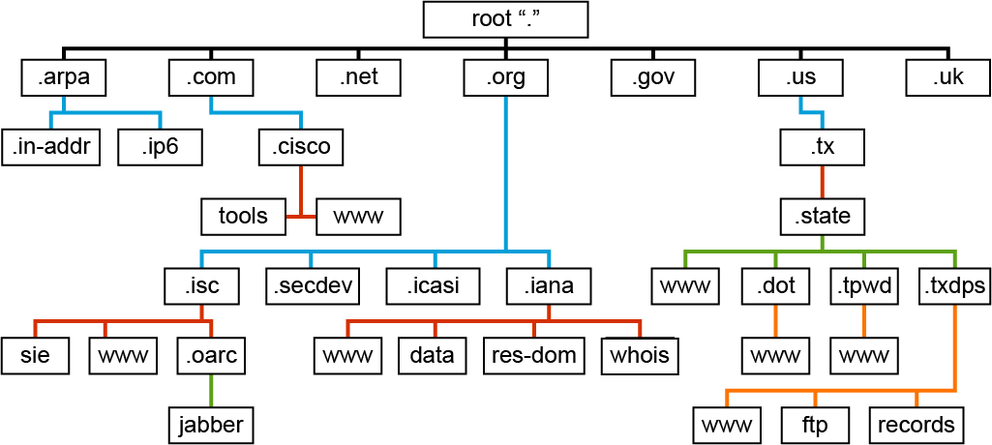
DNS Hierarchy
2

Slide 3
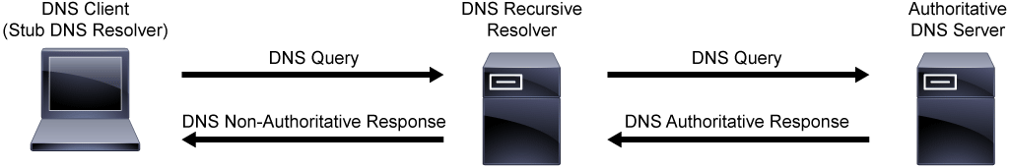
DNS Terminology
Resource Record
DNS Recursive Resolver
Open DNS Recursive Resolver
Authorative DNS Server
Zone
3

Slide 4
DNS RR Types
A kaydı
AAAA kaydı
MX kaydı
PTR kaydı
NS kaydı
TXT kaydı
Nslookup örnek
4

Slide 5
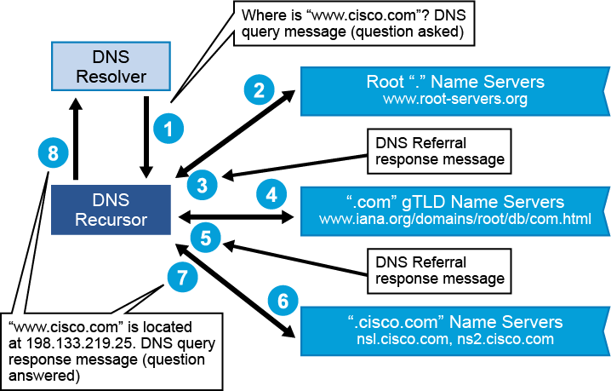
Recursive DNS Sorgusu
5

Slide 6
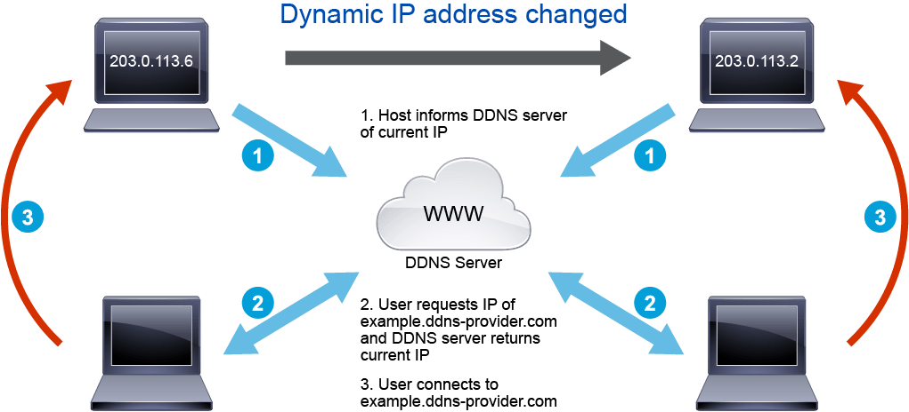
Dinamik DNS
DDNS allows the automated discovery and registration of the client system's public IP addresses. The DDNS client program on the end user device in the private network connects to the DDNS provider's with a unique log in name, then the DDNS provider uses the name to link the discovered public IP address with a hostname in the domain name system.
6

Slide 7
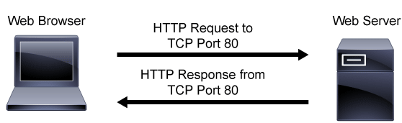
HTTP Operasyonları
HTTP is a client/server protocol where the web browser is the client and the web server is the server. HTTP is a stateless application layer protocol.
7

Slide 8
URL Kavramı ve HTTP Request Methodları
http://www.example.alperensoydan.com:80/video?docid=9667378358355
Protocol: HTTP
Host: example.alperensoydan.com
Port:80
Path: /video
Parameters: ?docid=…
Request Methodları
GET
HEAD
POST
PUT
DELETE
8

Slide 9
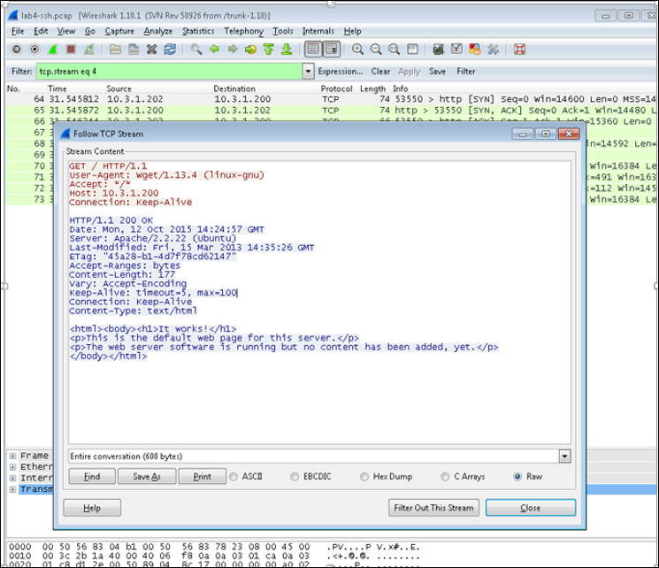
9

Slide 10
HTTP Durum Kodları
100 = Continue: The server has received the request headers and the client should proceed to send the request body
200 = OK: The processing of the request that was sent by the client was successful.
301 = Moved Permanently: The resource has permanently moved to a different URI.
404 = Not Found: The server cannot find the requested URI.
500 = Internal Server Error: This generic web server error message is given when an unexpected condition is encountered and no more specific message is suitable.
10

Slide 11
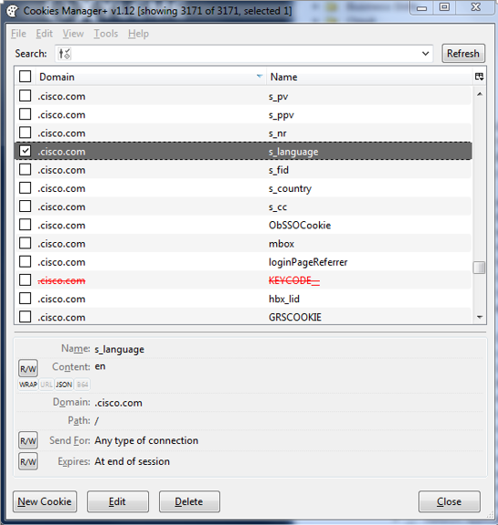
HTTP Cookie
An HTTP cookie is a small piece of data that is sent from the web server and stored in the user's web browser while the user is browsing. Cookies are used by the web server to remember stateful information.
11

Slide 12
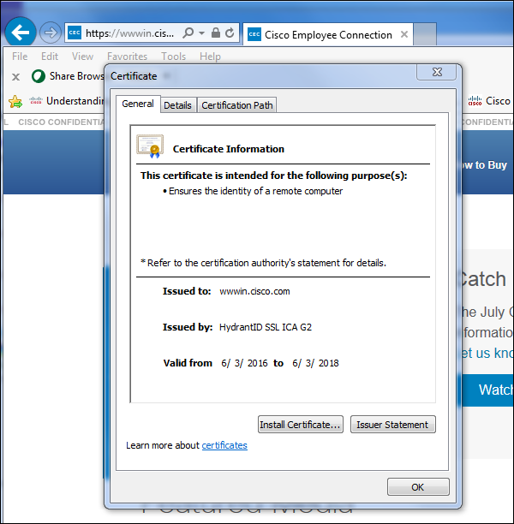
HTTPS Operasyonları
As a protocol, HTTP is unencrypted, and therefore does not protect user data from interception or alteration. All data that is sent over HTTP is in plain text and can be read by anyone that manages to break into the connection between the browser and the web server.
12

Slide 13
Web Scripting
Web page content can be static and dynamic. Static content is generally created using a markup language such as HTML and XML.
<!DOCTYPE html>
<html>
<head>
<title>Page Title</title>
</head>
<body>
<h1>My First Heading</h1>
<p>My first paragraph.</p>
</body>
</html>
13

Slide 14
Server-Side and Client-Side Scripting
Server-side scripting is used in web applications development which involves using scripts on a web server to produce a response
Client-side scripting uses a language that is designed for the script to be executed by the client's web browser.
<script type="text/javascript">
document.write(‘Merhaba Dünya!')
</script>
14

Slide 15
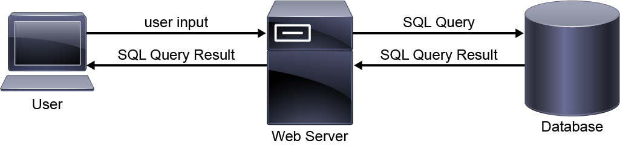
SQL Operasyonları
SQL is used to query, operate, and administer relational database management systems such as Microsoft SQL server, Oracle, or MySQL.
15

Slide 16
SMTP Operasyonları
MTA
DNS MX Kaydı
Groupware Server
SMTP Client
SMTP Server
Mail User Agent
POP
IMAP
MAPI
16

Slide 17
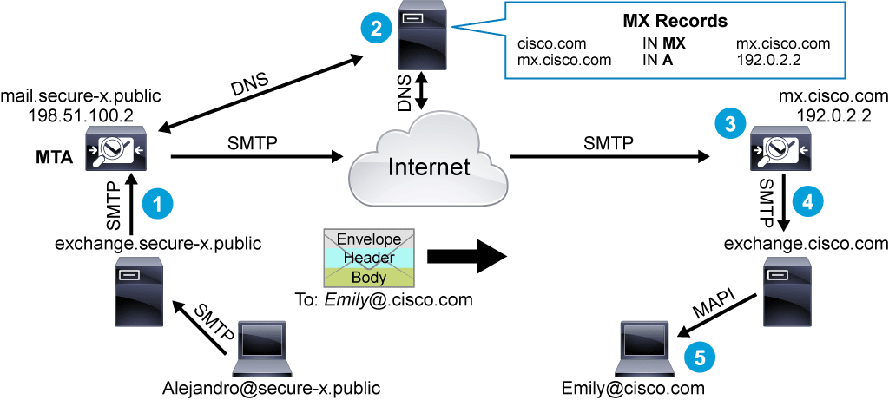
17

Slide 18
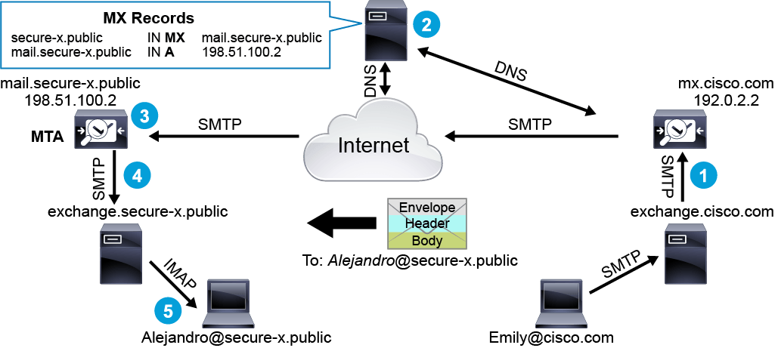
18

Slide 19
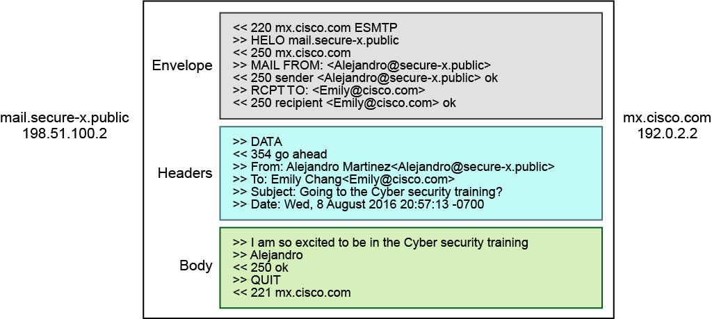
19

Slide 20
SMTP Komutları
HELO or EHLO
MAIL FROM
RCPT TO
DATA
QUIT
20

