Slide 1


Artificial Intelligence
This presentation will introduce my Artificial Intelligence project, highlighting its objectives, methodologies, and potential impact.

Slide 2
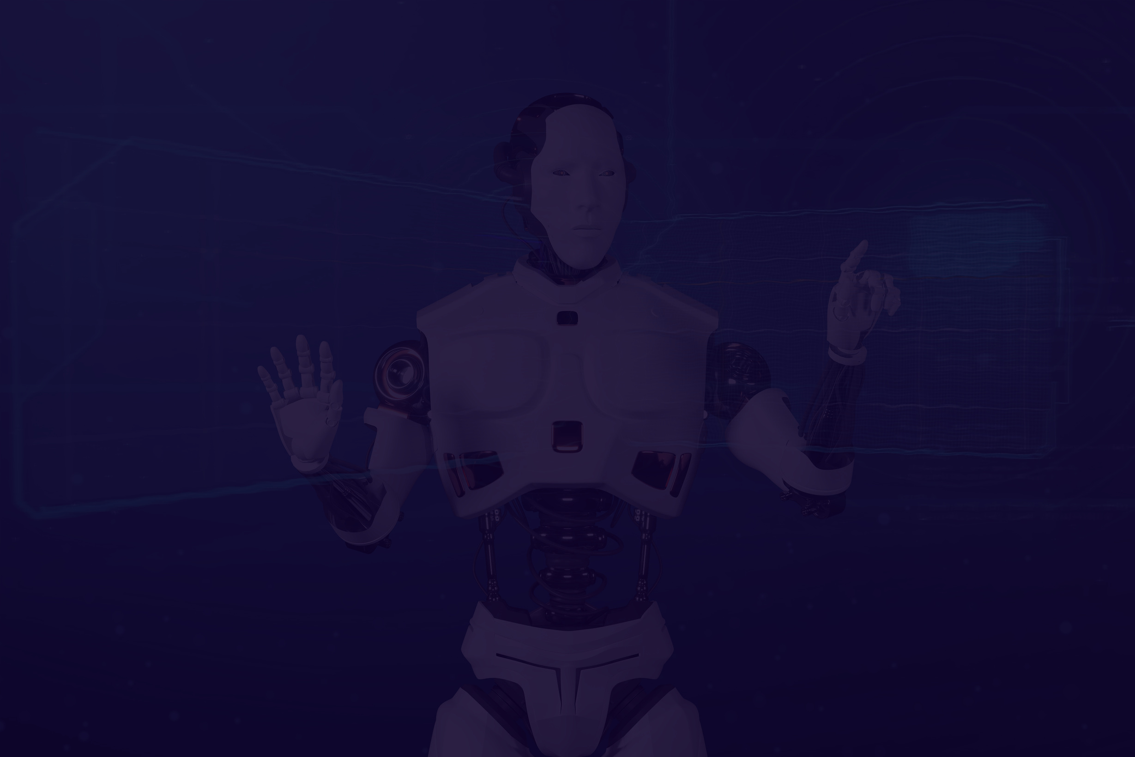
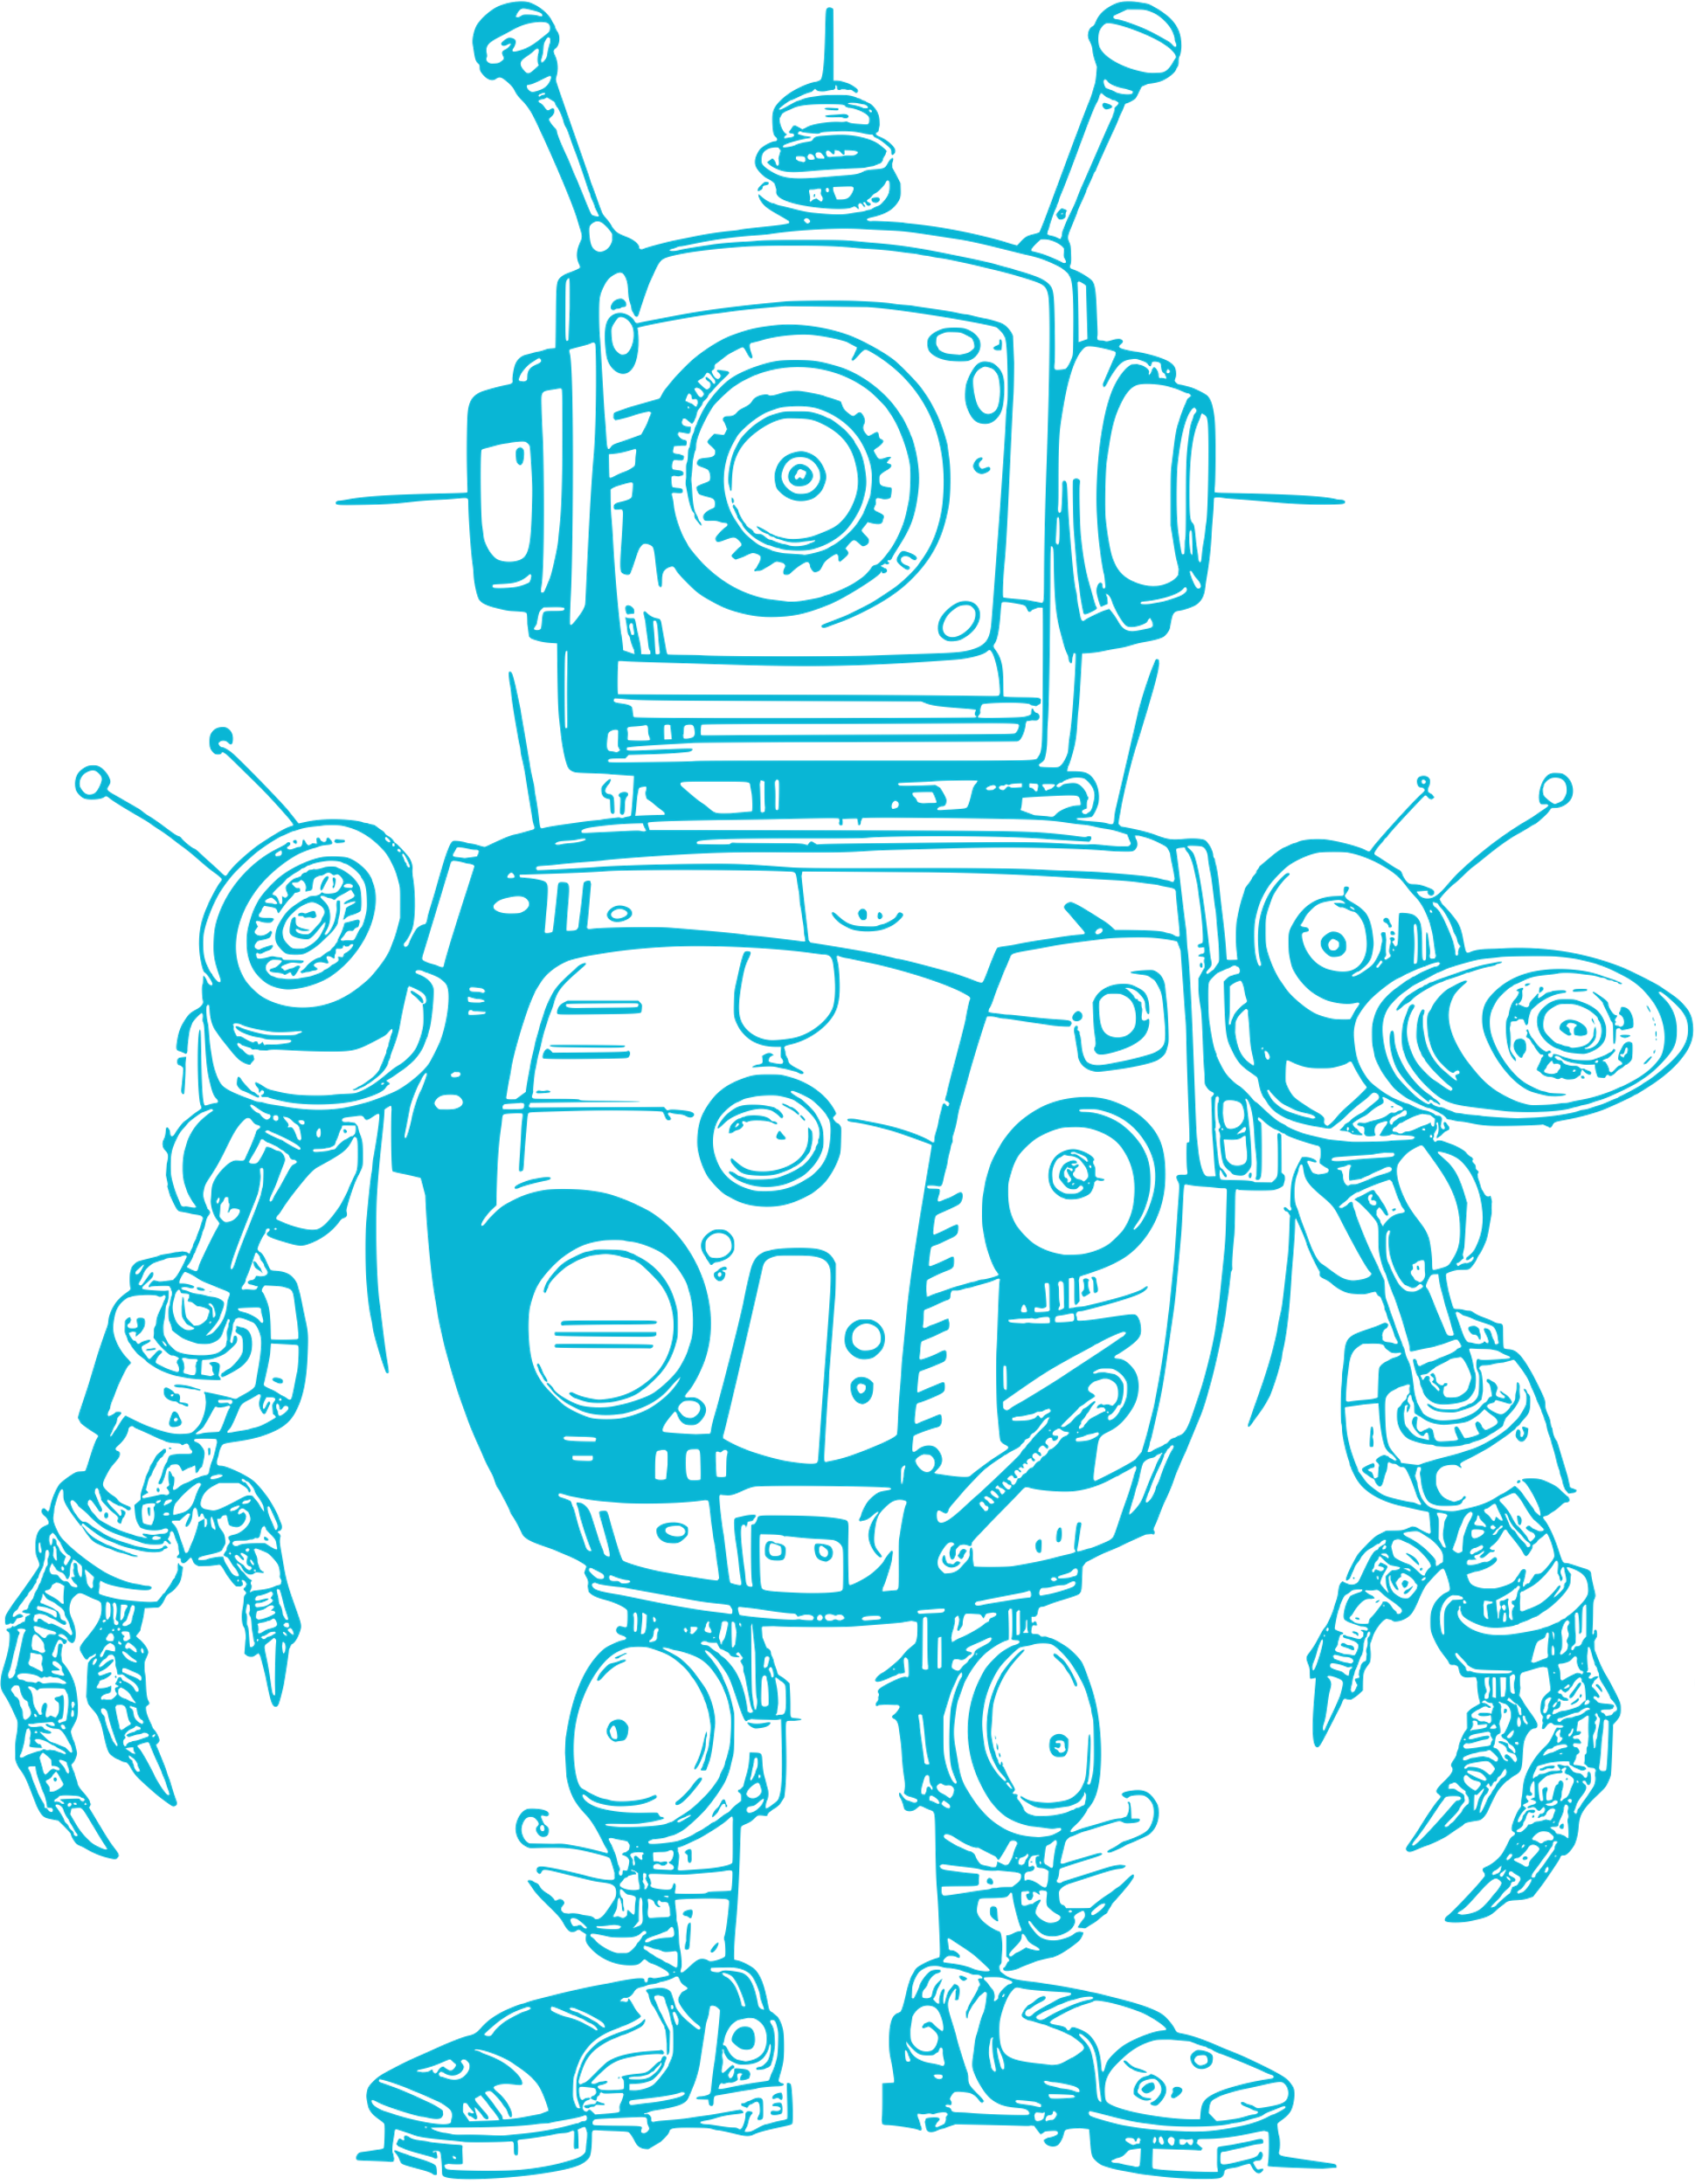
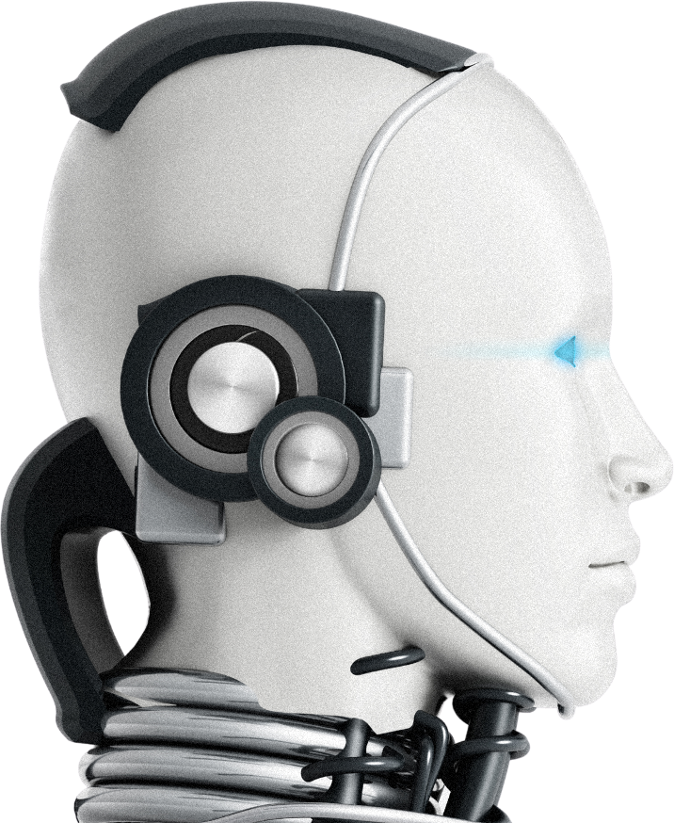
02
Project Overview
Virtual Therapist is an AI-powered web application designed to provide a confidential and supportive environment for individuals to discuss their thoughts and feelings. Created with the intention of offering flexibility and accessibility, app allows users to engage in therapy-like conversations without the need to talk to a human therapist.

Slide 3
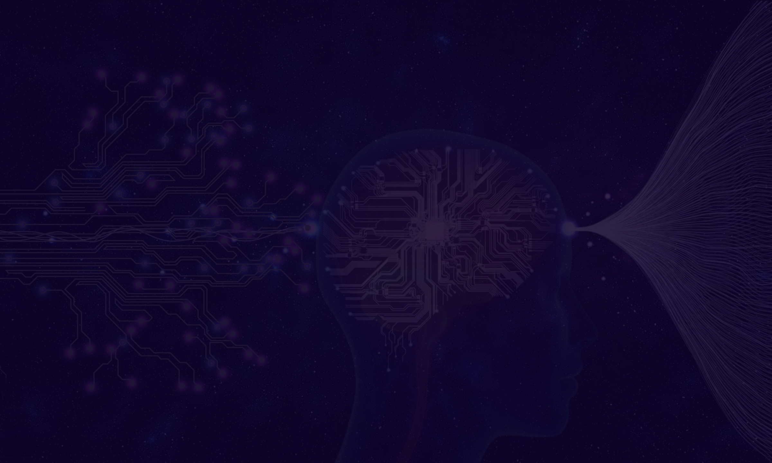

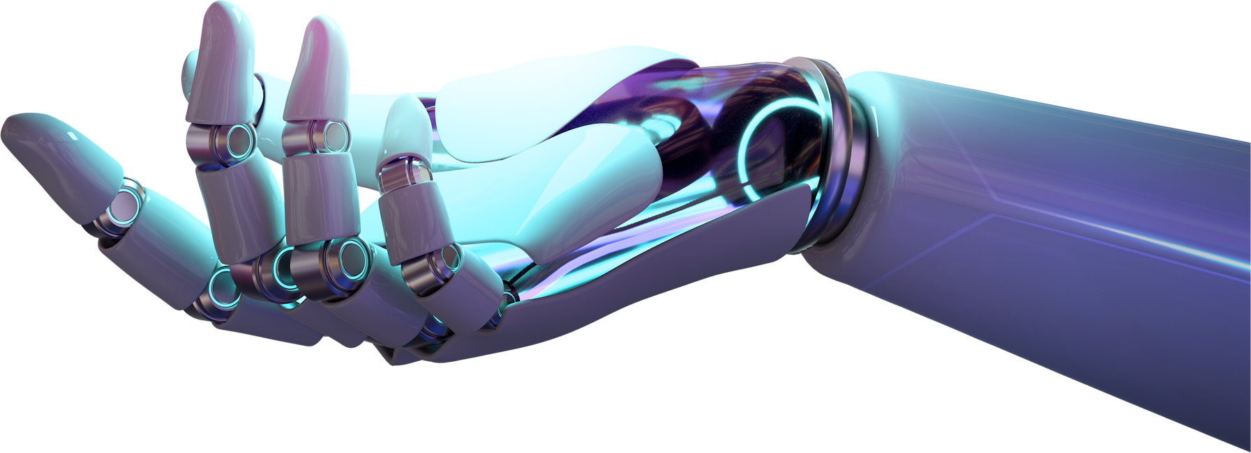
Problem Statement
A significant portion of the global population lacks adequate access to mental health care due to high costs, stigma, geographical limitations, and a shortage of qualified professionals. Our project aims to overcome these barriers by developing an AI-driven therapy platform that provides accessible, affordable, and effective mental health support for all individuals.
03

Slide 4




04
Methodology
Data Collection
Preprocessing
Model Selection
Gather relevant data from diverse sources.
Clean, normalize, and engineer data.
Choose and train ML/DL algorithms for peak performance.

Slide 5





Thank You!
YASAR ALPEREN VANLIOGLU
504140633
https://www.linkedin.com/in/vanlioglu/
alperenv76@gmail.com

