Slide 1
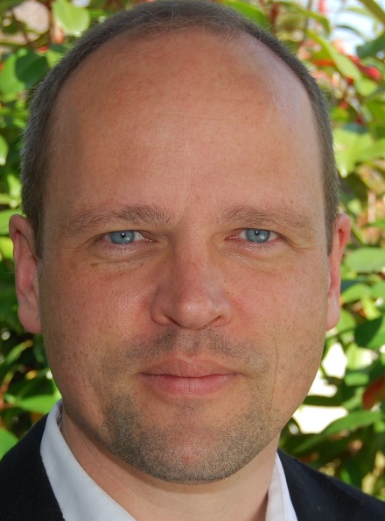

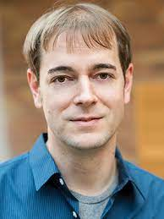
From Approximate to Exact Integer Programming
Daniel Dadush
Friedrich Eisenbrand EPFL
Thomas Rothvoss University of Washington

Slide 2
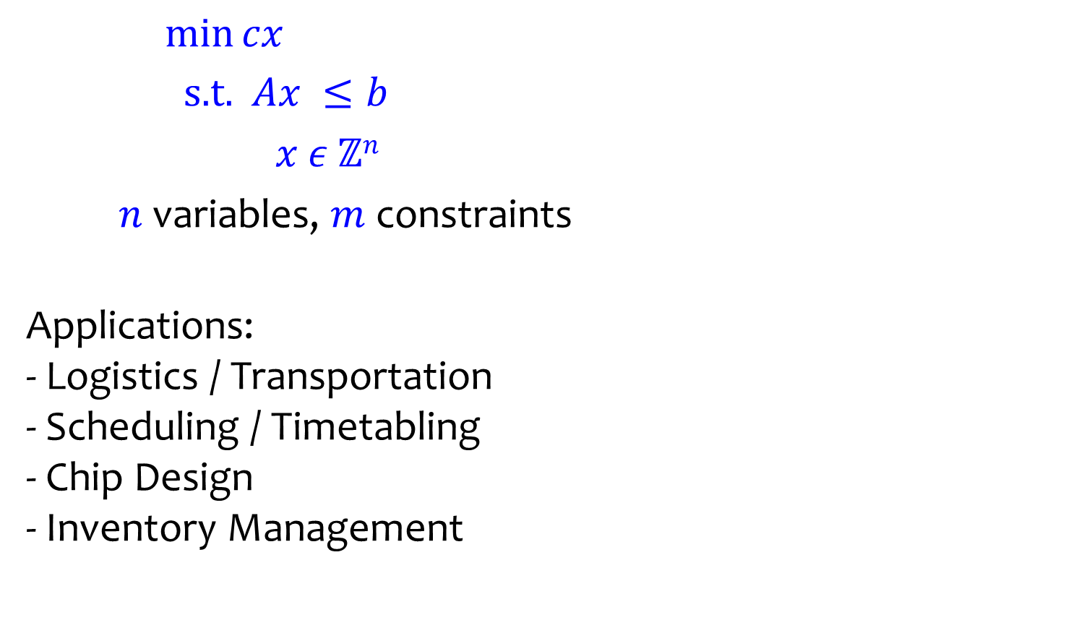


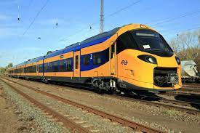
Integer Programming (IP)
variables, constraints
Applications: - Logistics / Transportation - Scheduling / Timetabling - Chip Design - Inventory Management
$c$
$K$

Slide 3
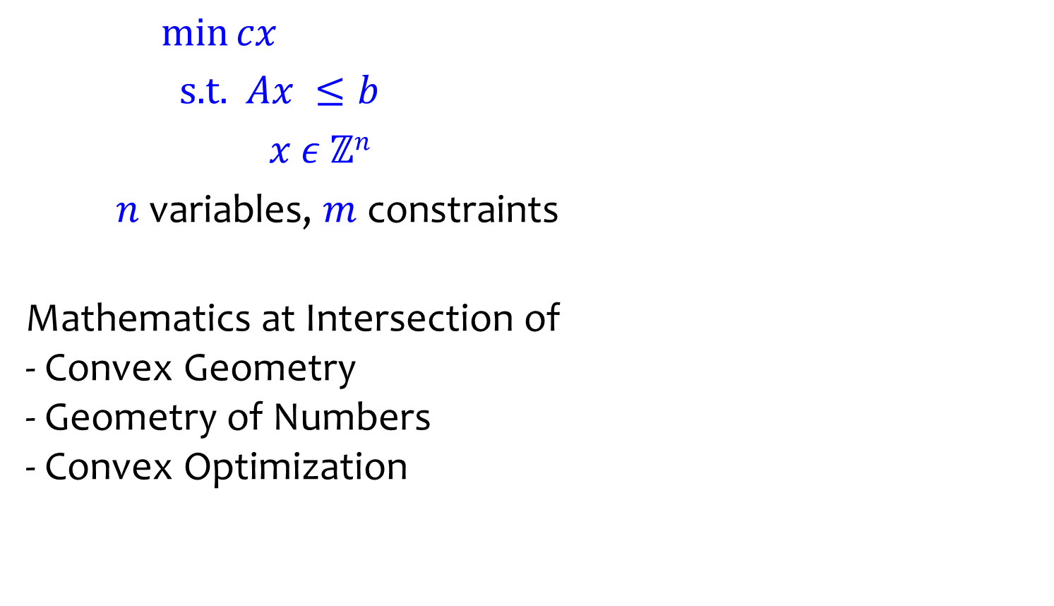

Integer Programming (IP)
variables, constraints
Mathematics at Intersection of - Convex Geometry - Geometry of Numbers - Convex Optimization
$c$
$K$

Slide 4
Outline
Anatomy of IP Algorithms
Approximate IP and Exact IP
Fast IP Algorithms via Approximate IP

Slide 5
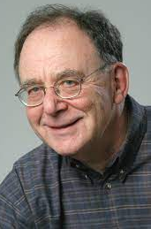
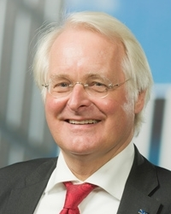
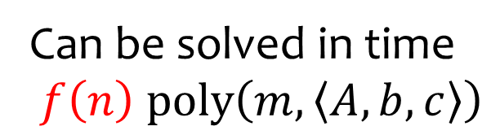
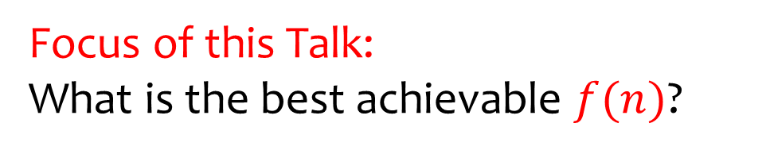
What is the Complexity of IP?
Can be solved in time
NP-Complete
Encoding length
Karp 1972
Lenstra 1983
Focus of this Talk: What is the best achievable ?

Slide 6
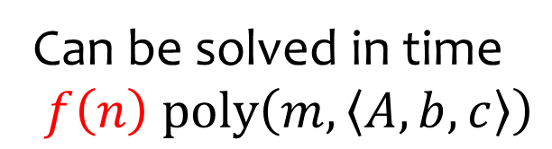

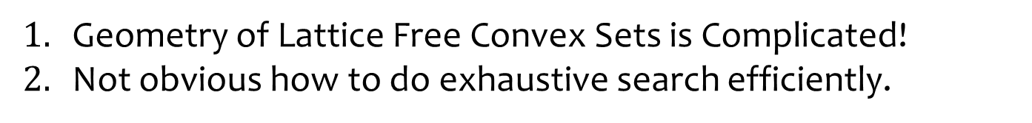
Why is this difficult?
Can be solved in time
Lenstra 1983
$ℤ^{2}$
Geometry of Lattice Free Convex Sets is Complicated!
Not obvious how to do exhaustive search efficiently.

Slide 7



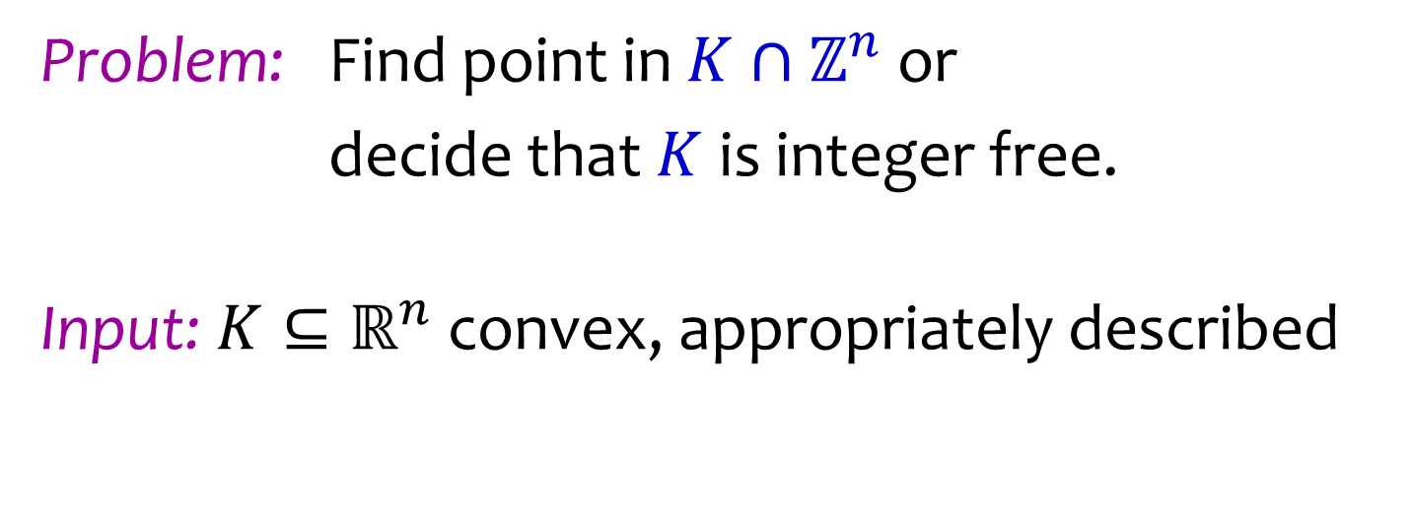
Anatomy of an IP Algorithm
$y$
$K$
$ℤ^{n}$
Problem: Find point in or
decide that is integer free.
Input: convex, appropriately described

Slide 8

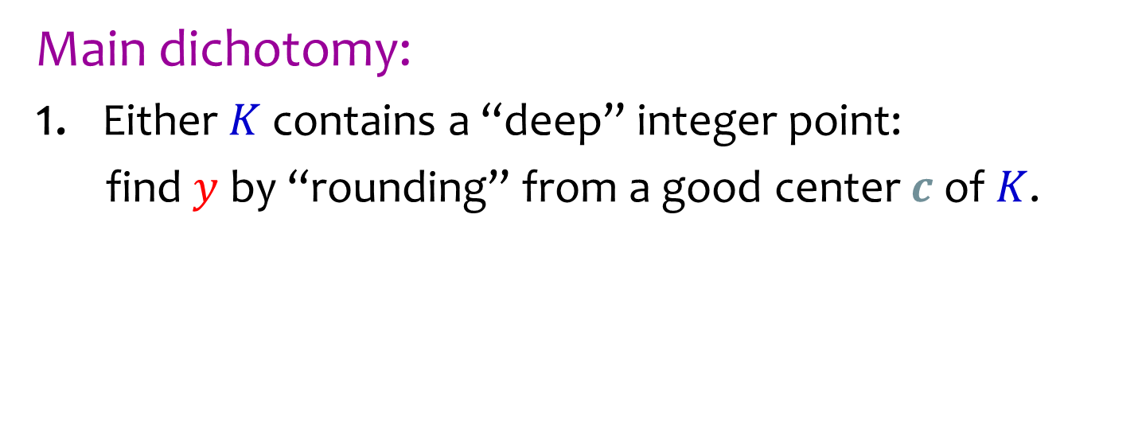
Anatomy of an IP Algorithm
$y$
$K$
$c$
$ℤ^{n}$
Main dichotomy:
Either contains a “deep” integer point:
find by “rounding” from a good center of .

Slide 9



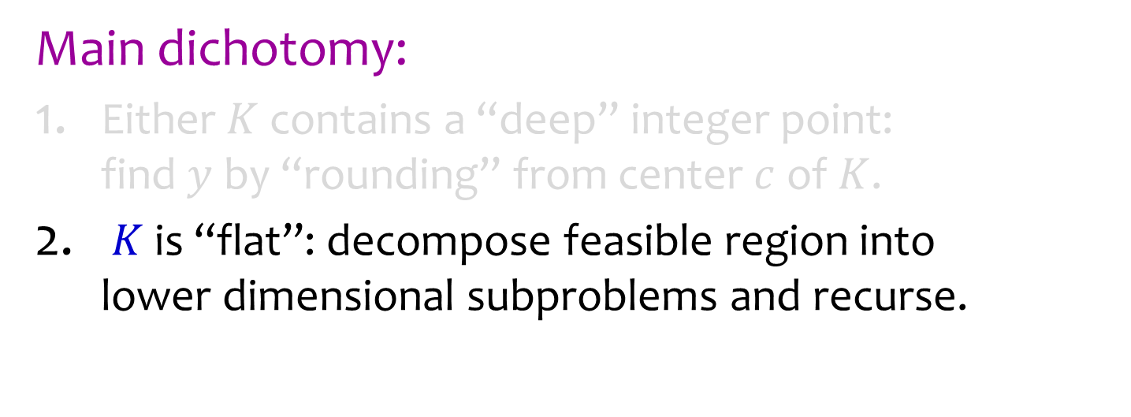
Anatomy of an IP Algorithm
$x_{2}\text{=}2$
subproblems
$K$
$x_{2}\text{=}1$
$ℤ^{n}$
Main dichotomy:
Either contains a “deep” integer point: find by “rounding” from center of .
is “flat”: decompose feasible region into lower dimensional subproblems and recurse.

Slide 10
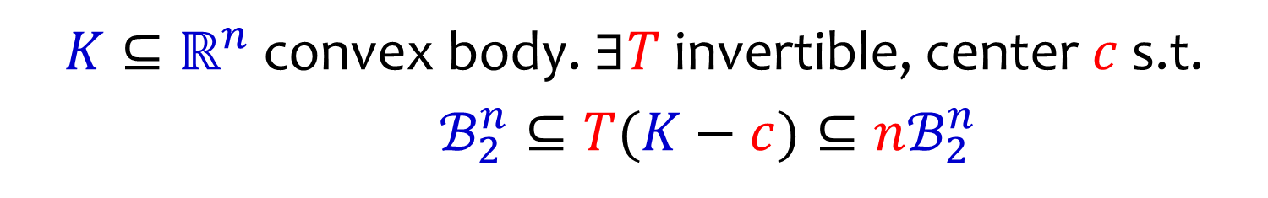


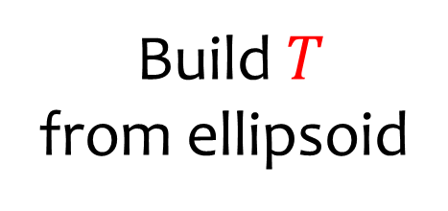

Ellipsoidal Apx: John’s Theorem
convex body. invertible, center s.t.
$K$
$c$
Build
from ellipsoid
$ℤ^{n}$

Slide 11






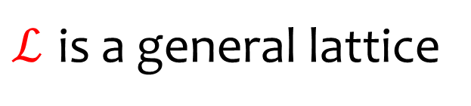
Ellipsoidal Apx: John’s Theorem
convex body. invertible, center s.t.
Apply Transformation
$T\left(K−c\right)$
$1$
$n$
$0$
$ℬ_{2}^{n}$
$ℒ=Tℤ^{n}$
is a general lattice

Slide 12
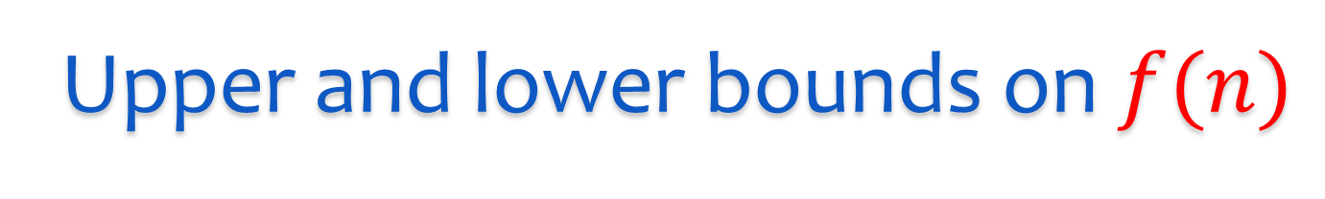

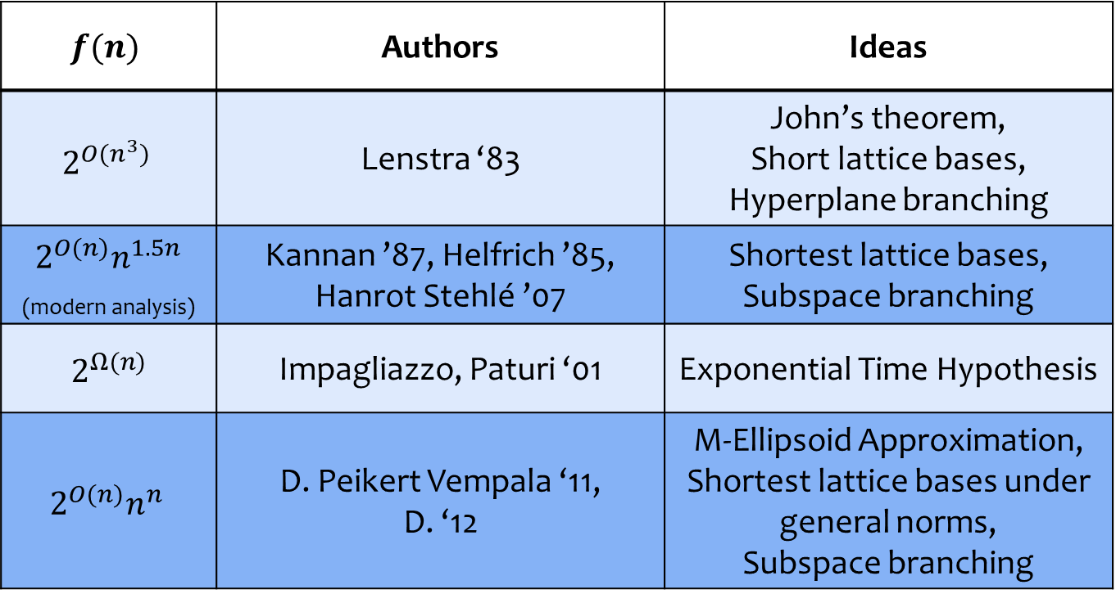
Upper and lower bounds on
 | Authors | Ideas
 | Lenstra ‘83 | John’s theorem, Short lattice bases, Hyperplane branching
_{(modern analysis)} | Kannan ’87, Helfrich ’85, Hanrot Stehlé ’07 | Shortest lattice bases, Subspace branching
 | Impagliazzo, Paturi ‘01 | Exponential Time Hypothesis
 | D. Peikert Vempala ‘11, D. ‘12 | M-Ellipsoid Approximation, Shortest lattice bases under general norms, Subspace branching
 | Authors | Ideas
 | Lenstra ‘83 | John’s theorem, Short lattice bases, Hyperplane branching
 | Kannan ’87, Helfrich ’85, Hanrot Stehlé ’07 | Shortest lattice bases, Subspace branching
 | Impagliazzo, Paturi ‘01 | Exponential Time Hypothesis
 | D. Peikert Vempala ‘11, D. ‘12 | M-Ellipsoid Approximation, Shortest lattice bases under general norms, Subspace branching
Open Question: ?

Slide 13

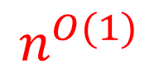
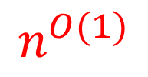

Current IP Algorithms
$n^{O\left(1\right)}$
Recursion Tree
$n^{O\left(1\right)}$
…………...
$n^{O\left(1\right)}$
…………...
$n^{O\left(1\right)}$
…………...
controlled by # of nodes .

Slide 14





?
$O\left(1\right)$
Recursion Tree
$O\left(1\right)$
…………...
$O\left(1\right)$
…………...
$O\left(1\right)$
…………...
controlled by # of nodes .

Slide 15
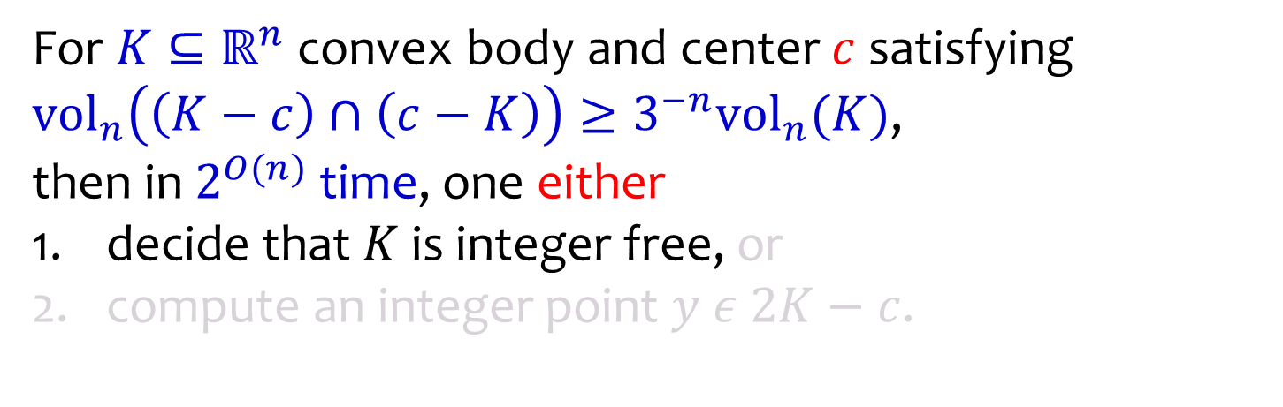



Approximate IP [D. 14, D. Kun 16]
For convex body and center satisfying , then in time, one either
decide that is integer free, or
compute an integer point .
$ℤ^{n}$
$c$
$K$

Slide 16
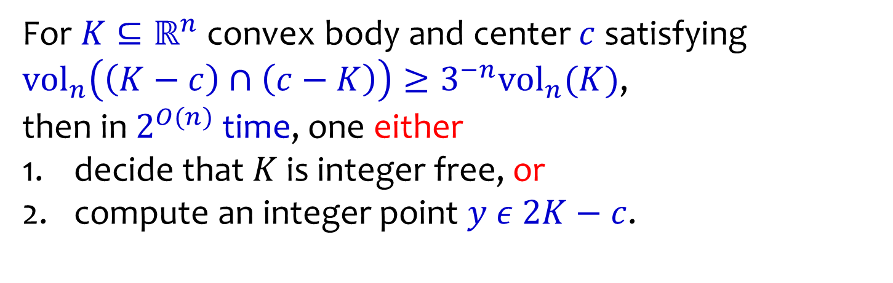


Approximate IP [D. 14, D. Kun 16]
For convex body and center satisfying , then in time, one either
decide that is integer free, or
compute an integer point .
$2K−c$
$ℤ^{n}$
$c$
$y$
$K$

Slide 17
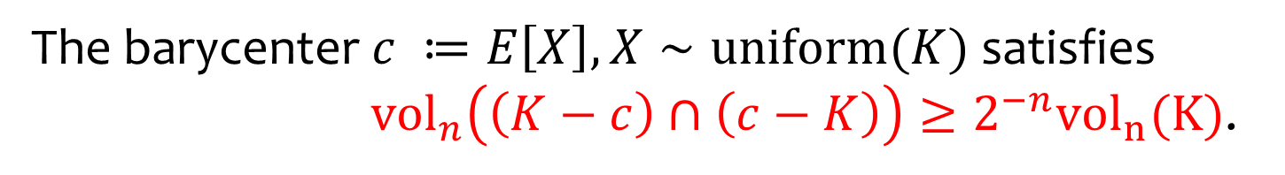

Milman Pajor ‘00
The barycenter satisfies
.
$c$
$K$

Slide 18
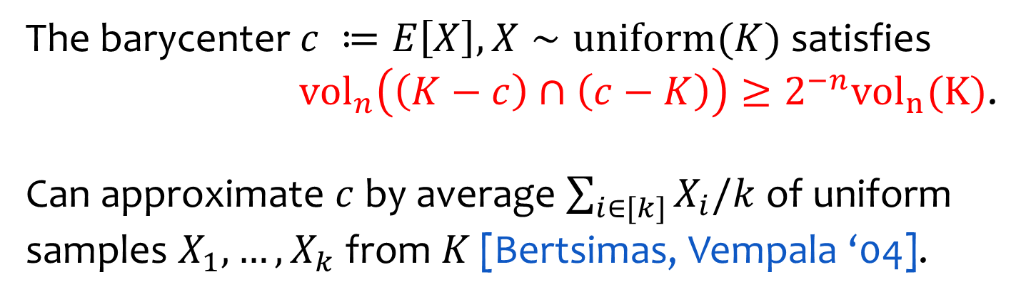




Milman Pajor ‘00
The barycenter satisfies
.
Can approximate by average of uniform samples from [Bertsimas, Vempala ‘04].
$X_{2}$
$X_{3}$
$c$
$X_{1}$
$X_{4}$
$K$

Slide 19




Approximate to Exact IP?
Approx IP is a ``near miss’’, but still loses a lot of info.
Is there a way to reduce exact IP to approximate IP?
$\left(\text{1+}\text{ϵ}\right)K$
$K$
$x$
$y$

Slide 20
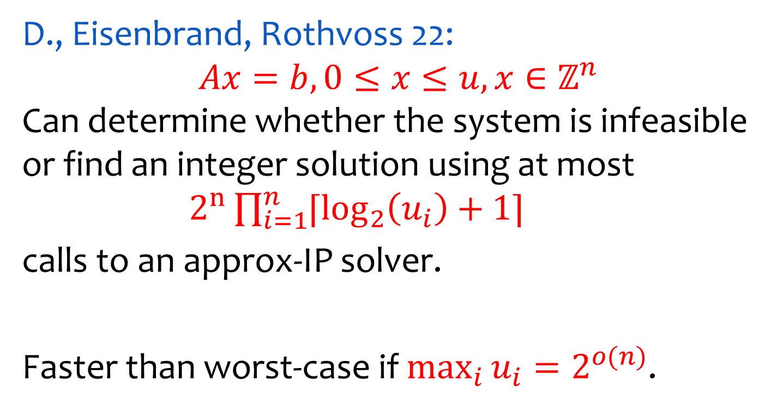
Standard form IPs with Bounded Vars
D., Eisenbrand, Rothvoss 22: Can determine whether the system is infeasible or find an integer solution using at most
calls to an approx-IP solver.
Faster than worst-case if .

Slide 21
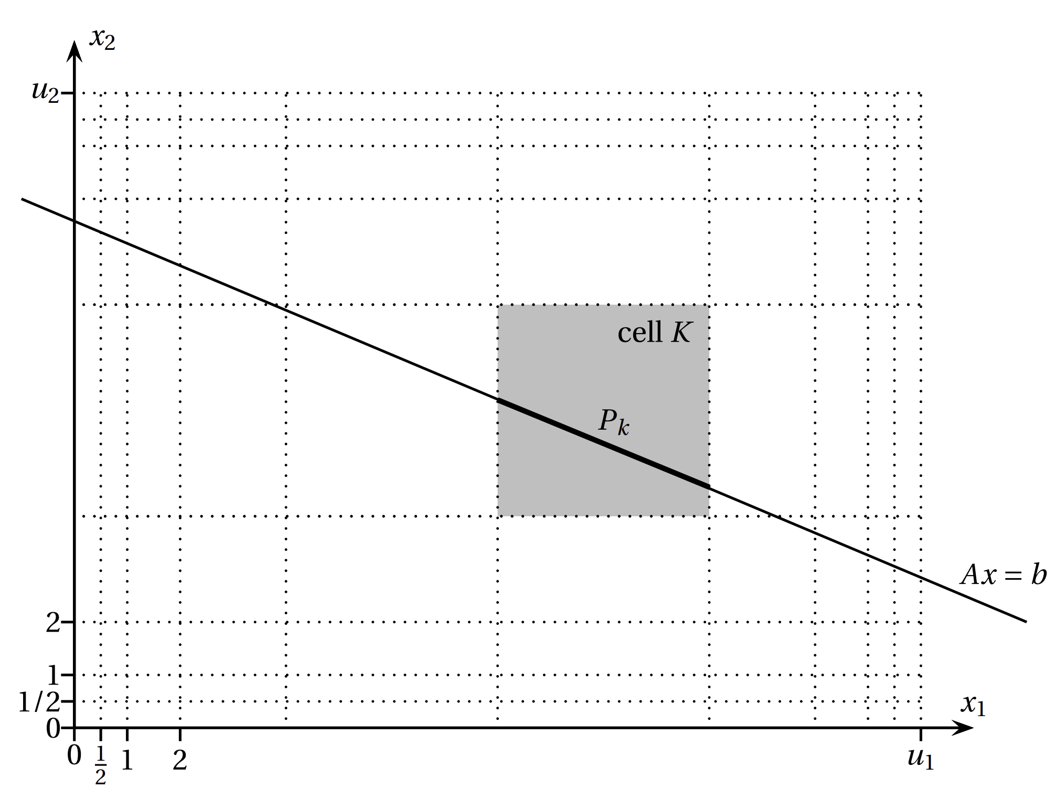
Partition Domain into Reflection Sets
Cook, Hartmann, Kannan, Mcdiarmid ‘92

Slide 22
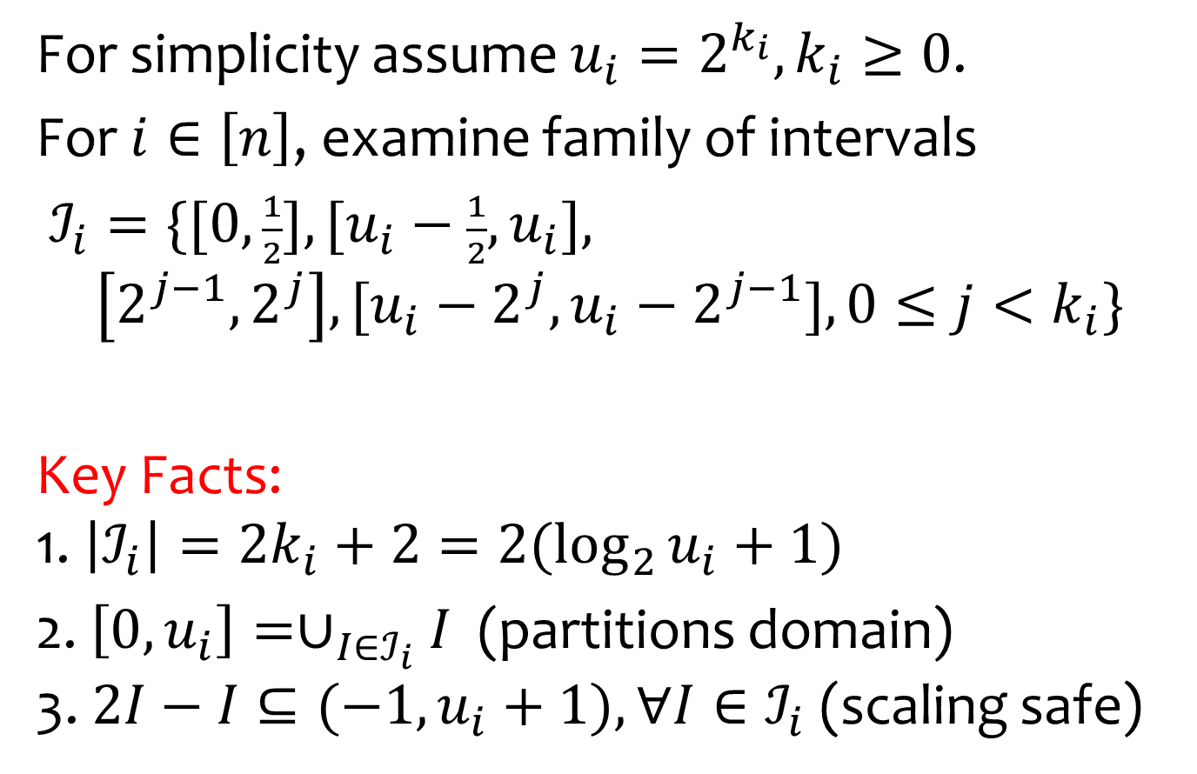
Partition Domain into Reflection Sets
For simplicity assume .
For , examine family of intervals
Key Facts: 1.
2. (partitions domain) 3. (scaling safe)

Slide 23
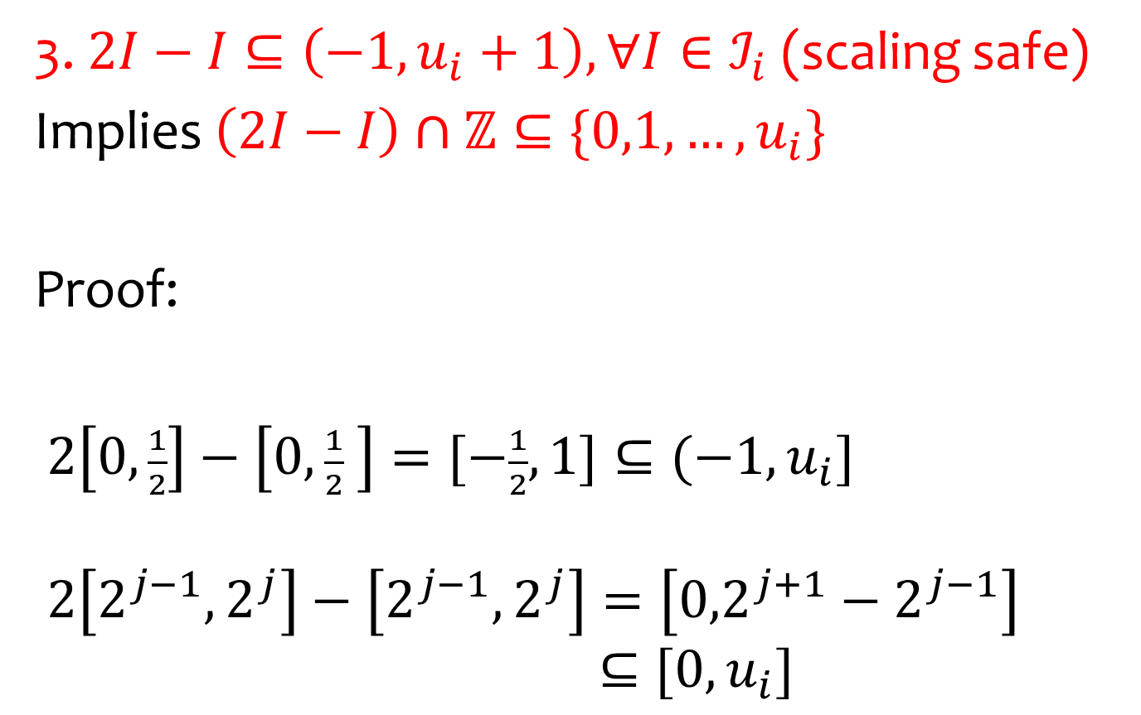
Key Reflection Set Property
3. (scaling safe)
Implies
Proof:

Slide 24
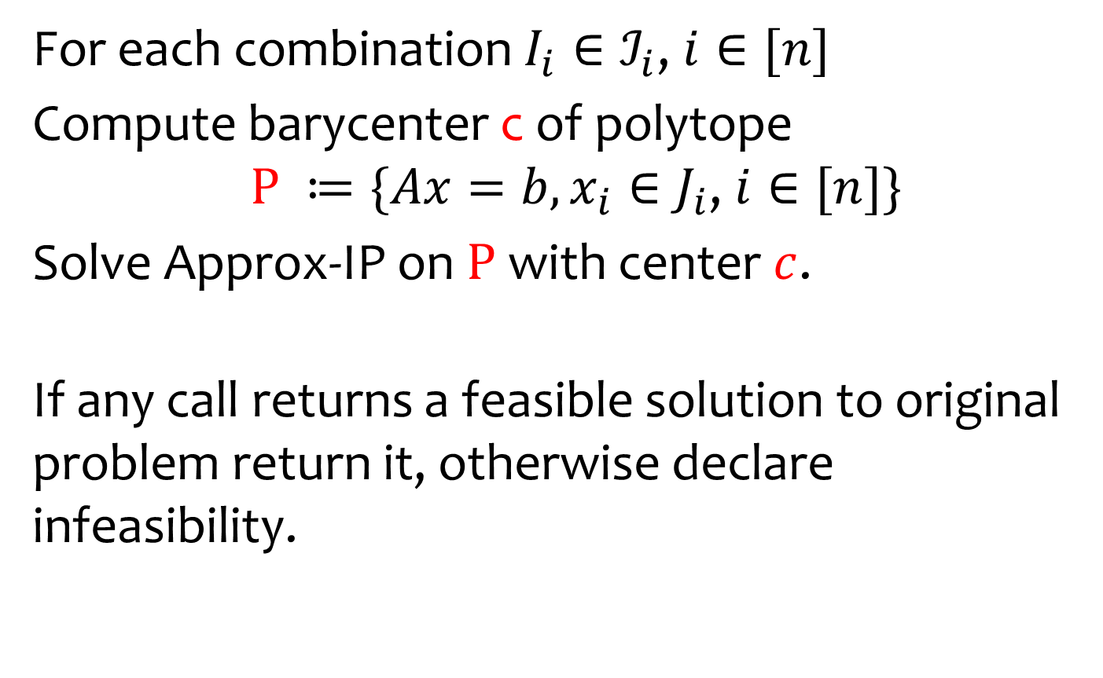
Algorithm
For each combination ,
Compute barycenter c of polytope ,
Solve Approx-IP on with center .
If any call returns a feasible solution to original problem return it, otherwise declare infeasibility.

Slide 25
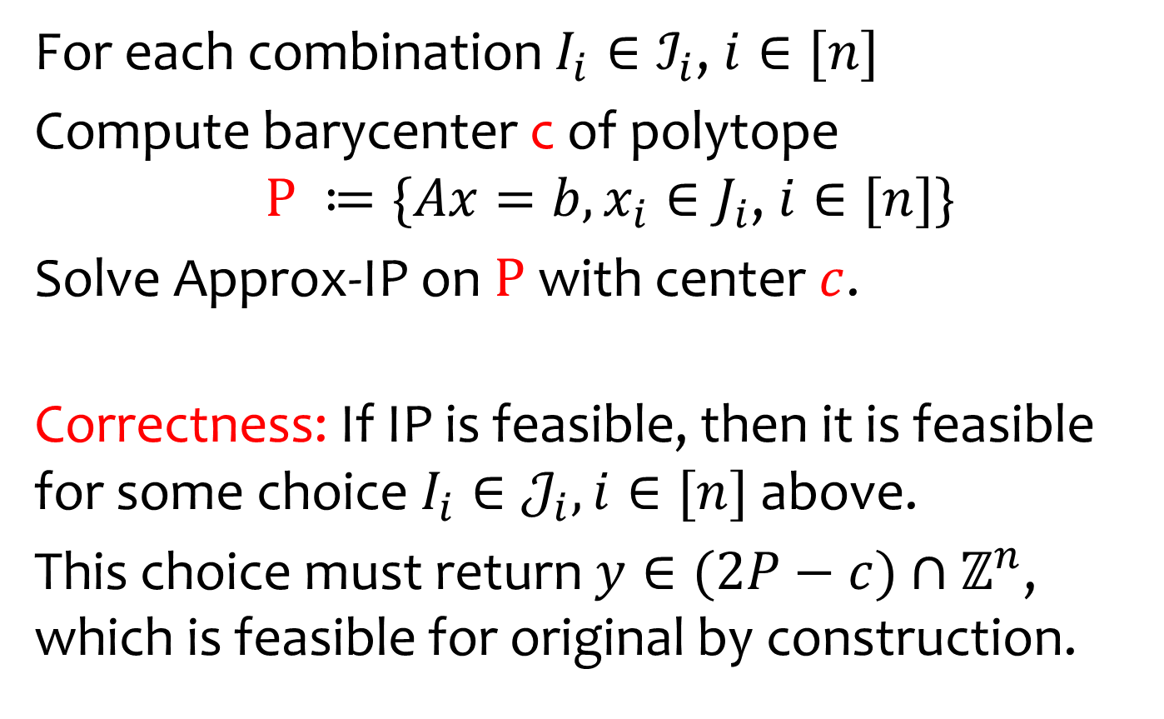
Algorithm
For each combination ,
Compute barycenter c of polytope ,
Solve Approx-IP on with center .
Correctness: If IP is feasible, then it is feasible for some choice above.
This choice must return , which is feasible for original by construction.

Slide 26
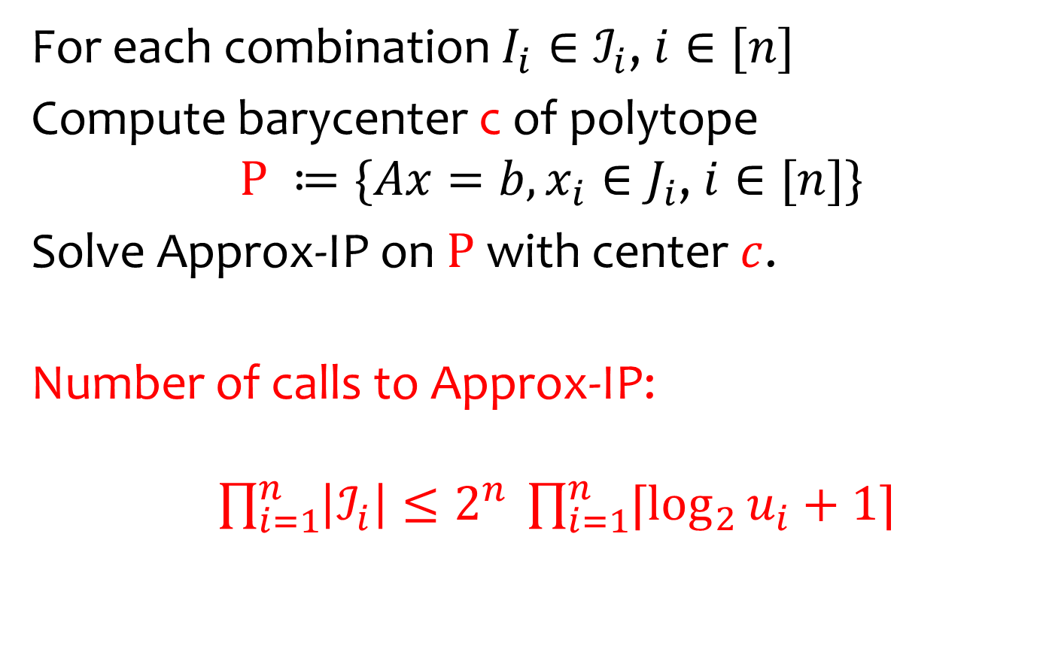
Algorithm
For each combination ,
Compute barycenter c of polytope ,
Solve Approx-IP on with center .
Number of calls to Approx-IP:

Slide 27
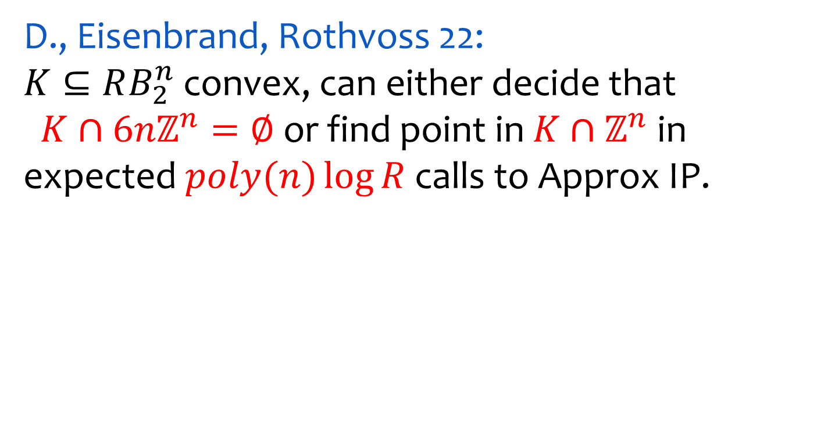



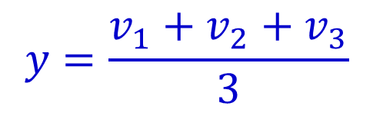



Sublattice IP
D., Eisenbrand, Rothvoss 22: convex, can either decide that or find point in in expected calls to Approx IP.
$v_{1}$
$v_{2}$
$y$
$y=\frac{v_{1}+v_{2}+v_{3}}{3}$
$K$
$v_{3}$
$3ℤ^{n}$

Slide 28

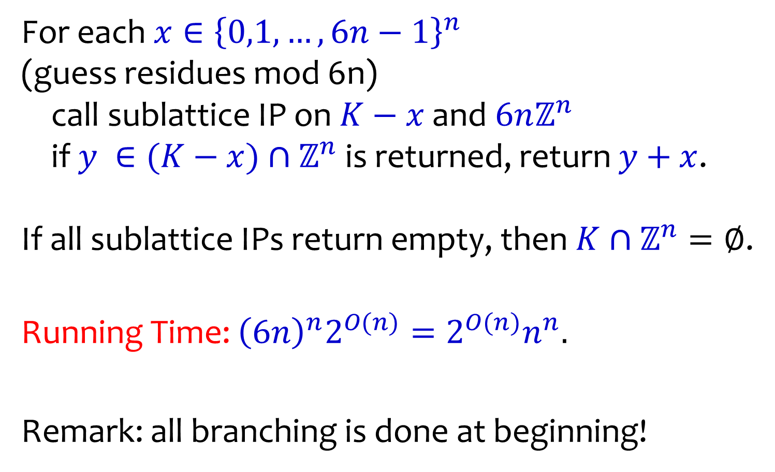
IP reduces to sublattice IPs
For each (guess residues mod 6n) call sublattice IP on and if is returned, return . If all sublattice IPs return empty, then .
Running Time:
Remark: all branching is done at beginning!

Slide 29
Sublattice IP
D., Eisenbrand, Rothvoss 22: convex, can either decide that or find point in in expected calls to Approx IP.
$v_{1}$
$v_{2}$
$y$
$y=\frac{v_{1}+v_{2}+v_{3}}{3}$
$K$
$v_{3}$
$3ℤ^{n}$

Slide 30
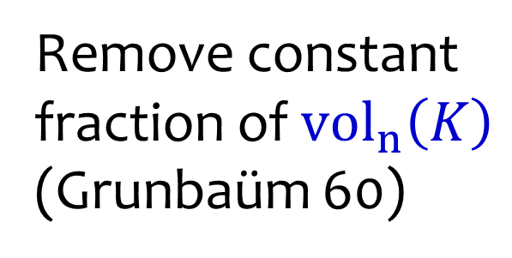

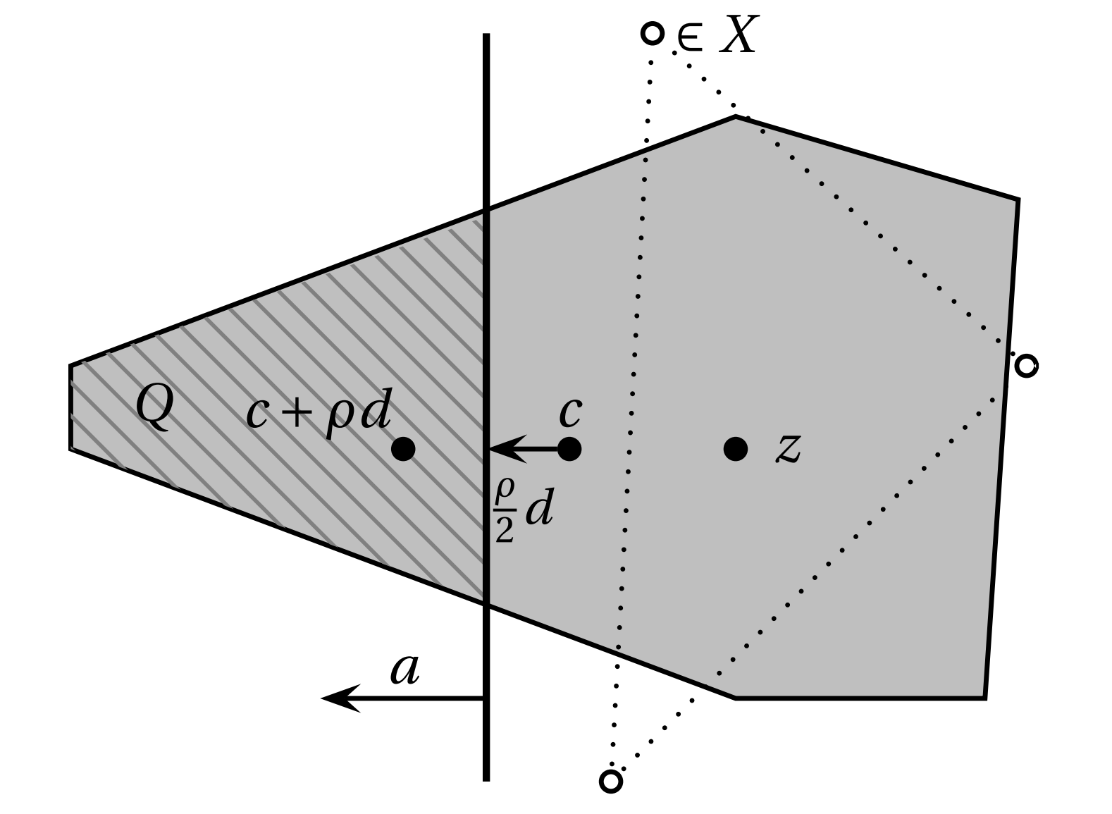
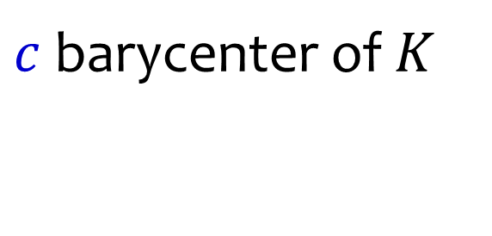
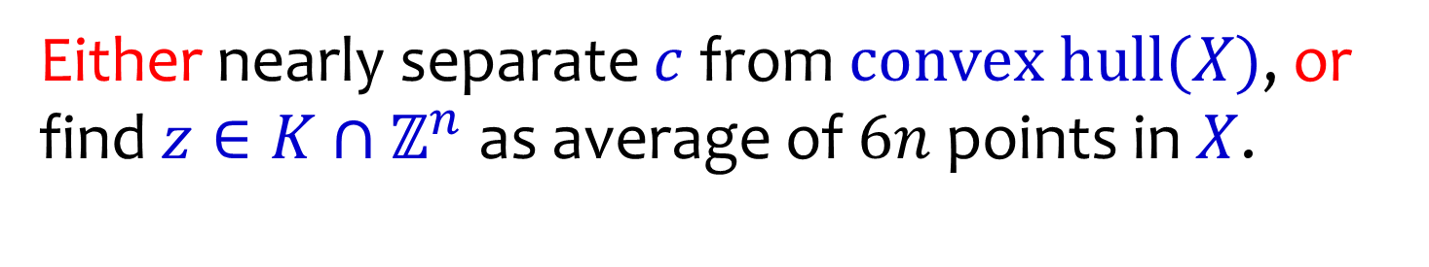
Main Subroutine: Cut or Average
Remove constant fraction of (Grunbaüm 60)
$⊆6nℤ^{n}∩\left(3K−c\right)$
barycenter of
Either nearly separate from , or find as average of points in .

Slide 31

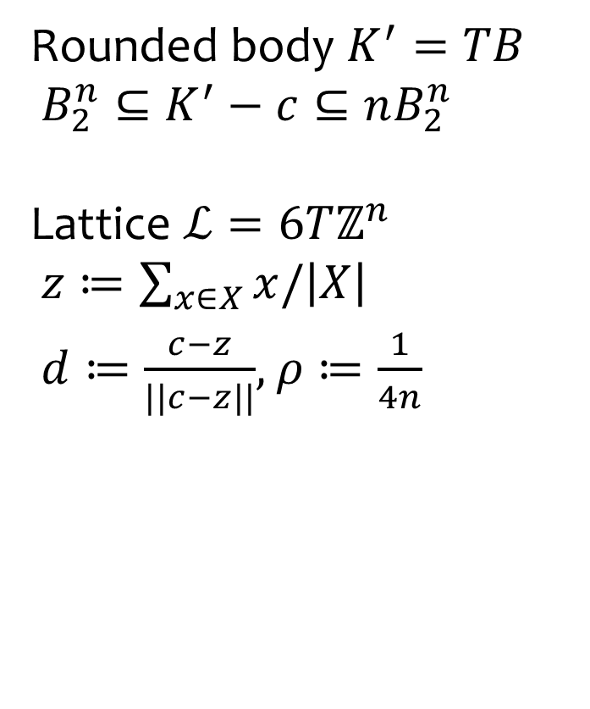


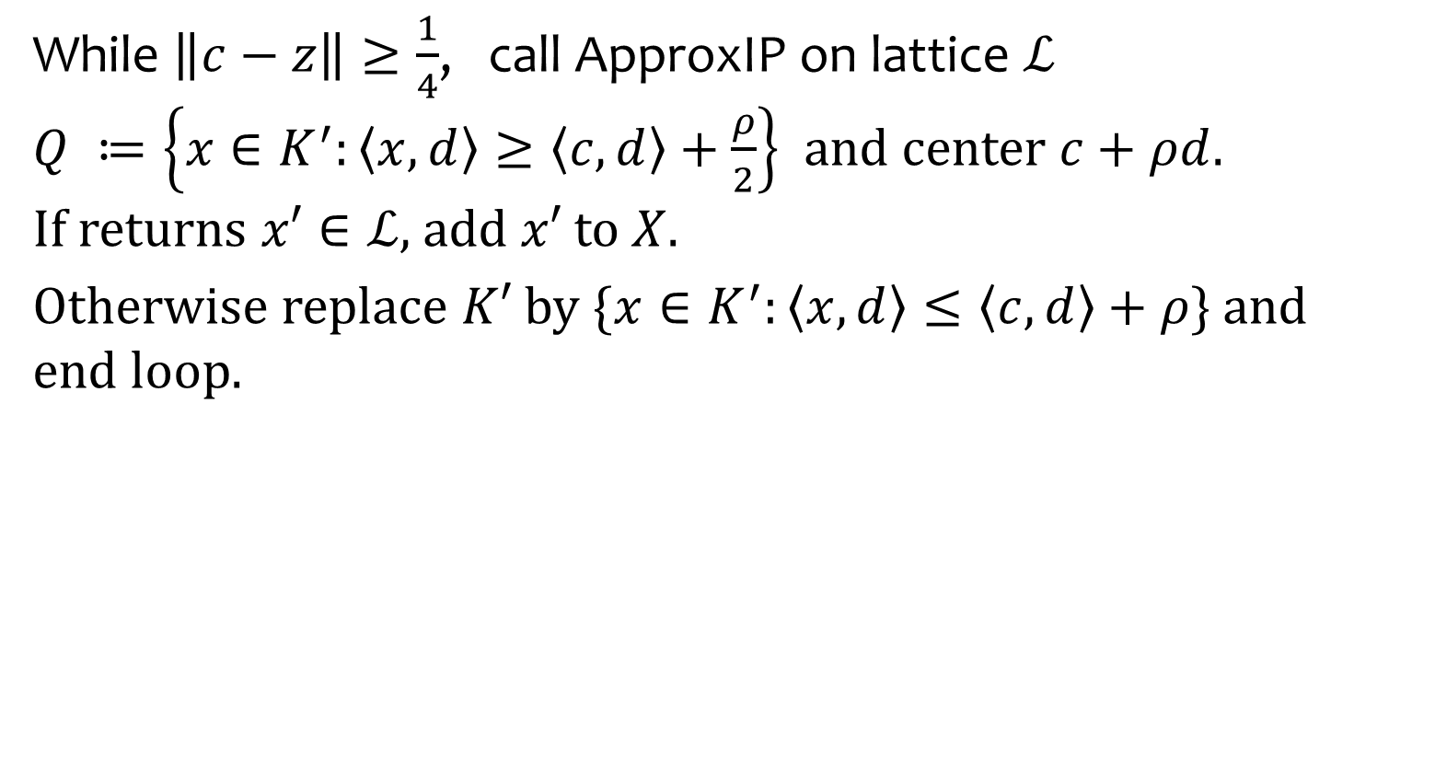
Main Subroutine: Cut or Average
$⊆ℒ∩\left(3K′−c\right)$
Rounded body Lattice
,
barycenter of
While , call ApproxIP on lattice and center . If returns add to .
Otherwise replace by } and end loop.

Slide 32
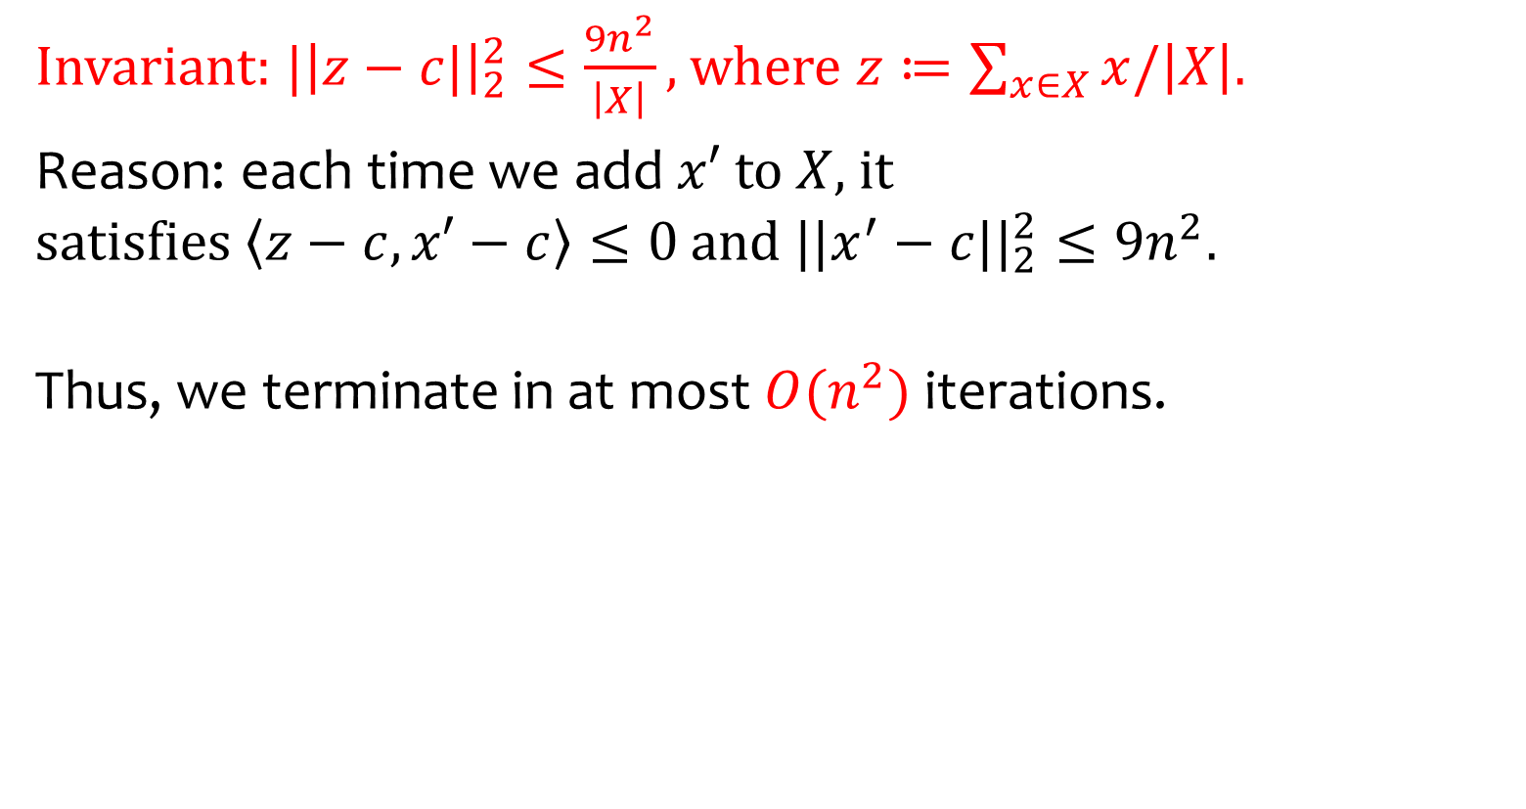
Idea of Analysis
Invariant: where .
Reason: each time we add to , it satisfies and .
Thus, we terminate in at most iterations.

Slide 33
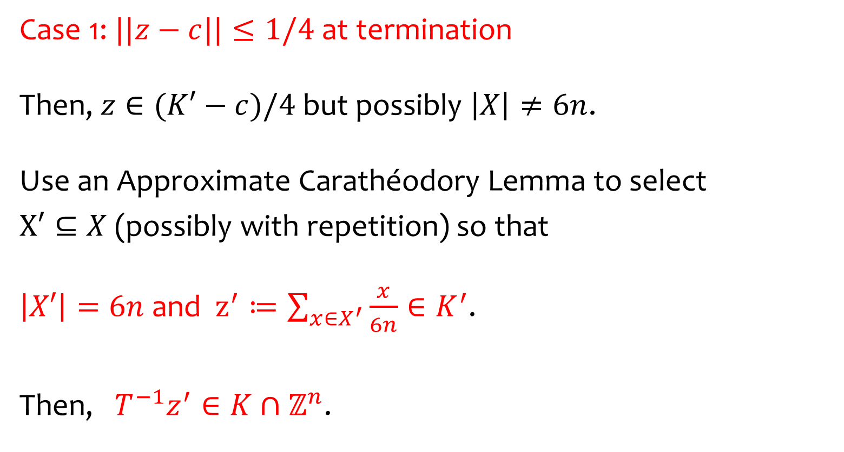
Idea of Analysis
Case 1: at termination Then, but possibly . Use an Approximate Carathéodory Lemma to select
(possibly with repetition) so that and .
Then, .

Slide 34
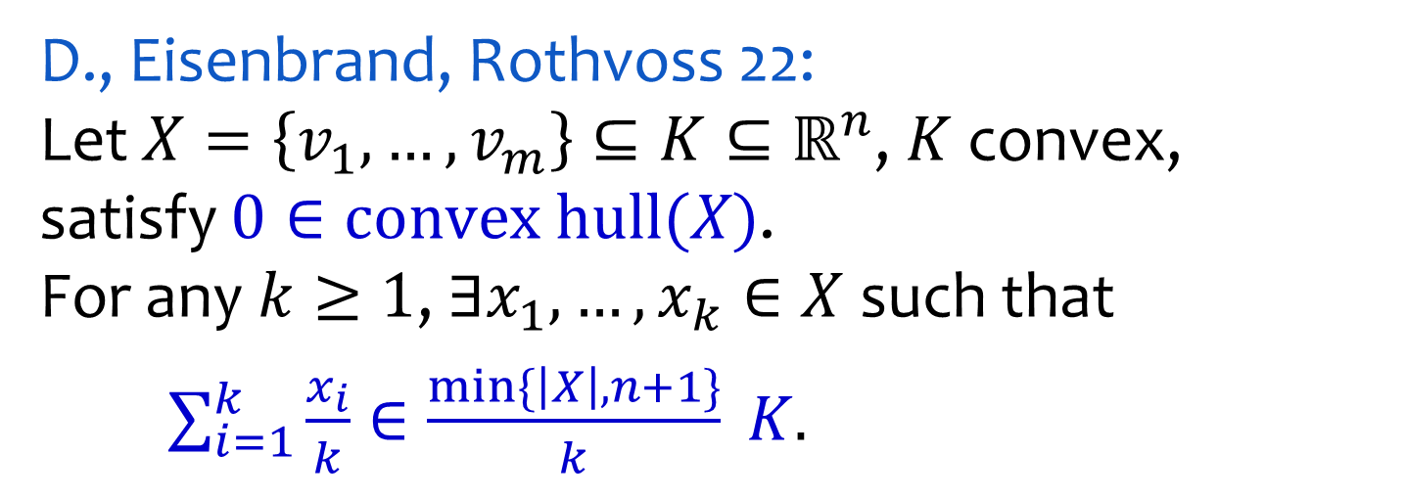


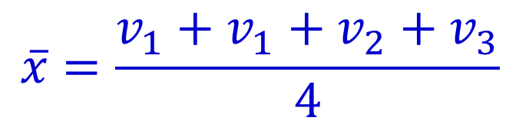





Approximate Carathéodory
D., Eisenbrand, Rothvoss 22: Let , convex, satisfy . For any , such that
$v_{3}$
$v_{4}$
$\overset{´}{x}=\frac{v_{1}+v_{1}+v_{2}+v_{3}}{4}$
$\overset{´}{x}$
$0$
$v_{2}$
$K$
$v_{1}$

Slide 35
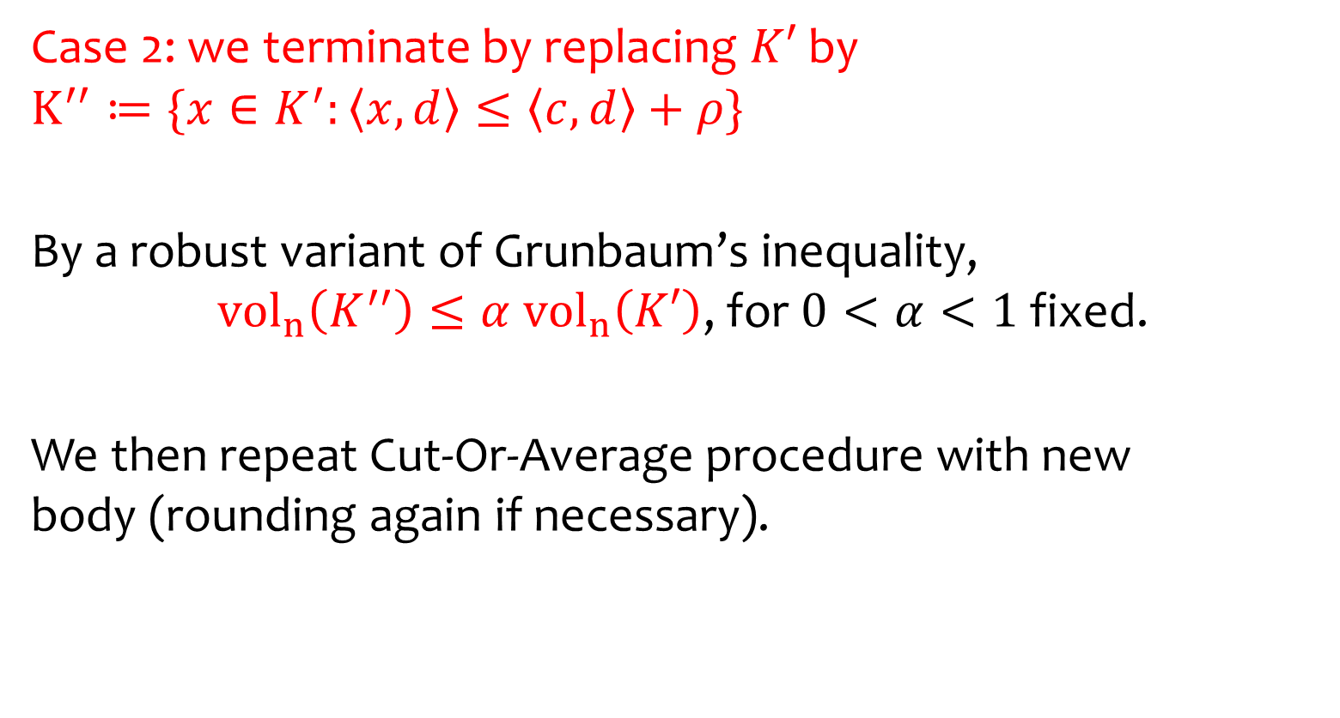
Idea of Analysis
Case 2: we terminate by replacing by }
By a robust variant of Grunbaum’s inequality, , for fixed.
We then repeat Cut-Or-Average procedure with new body (rounding again if necessary).

Slide 36

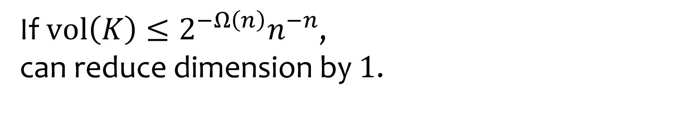
Small Volume Implies Flatness
$K$
$x_{2}\text{=}1$
$ℤ^{n}$
If , can reduce dimension by .

Slide 37






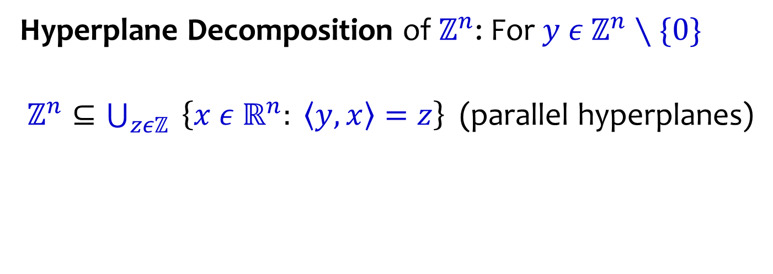
Hyperplane Decompositions
$y$
$\left(1,0\right)$
$ℤ^{2}$
$x_{1}\text{=}1$
$…$
$x_{1}\text{=}8$
Hyperplane Decomposition of : For
(parallel hyperplanes)

Slide 38











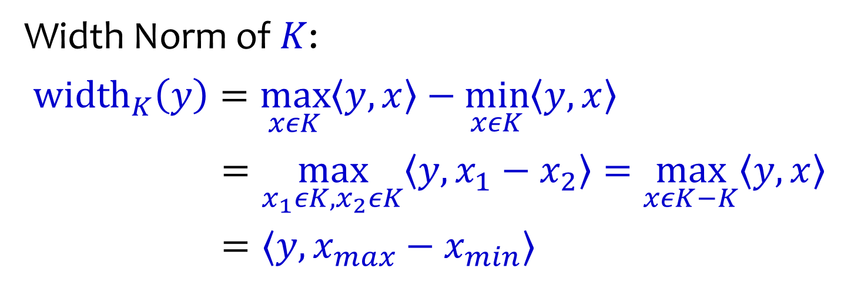
Hyperplane Decompositions
$x_{max}$
$y$
$K$
$7.2$
${\text{width}}_{K}\left(y\right)=6.3$
$\left(1,0\right)$
$x_{min}$
$ℤ^{2}$
$1.9$
$x_{1}\text{=}1$
$2$
$3$
$4$
$6$
$7$
$x_{1}\text{=}8$
Width Norm of :

Slide 39





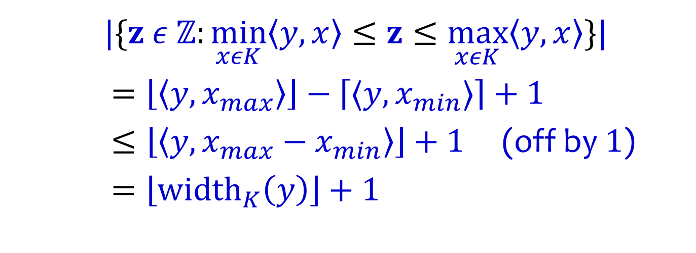
Hyperplane Decompositions
$x_{max}$
$y$
$K$
$7.2$
${\text{width}}_{K}\left(y\right)=6.3$
$\left(1,0\right)$
$x_{min}$
$ℤ^{2}$
$1.9$
$x_{1}\text{=}1$
$2$
$3$
$4$
$6$
$7$
$x_{1}\text{=}8$
}|
(off by )

Slide 40



Lattice Width
$y$
${\text{width}}_{K}\left(y\right)=1.2$
$K$
$ℤ^{2}$
width
Nearly tight relaxation for minimizing number of dimensional sub-problems.

Slide 41

Lattice Width
$y$
${\text{width}}_{K}\left(y\right)=1.2$
$K$
$ℤ^{2}$
width
Computable in time (similar to Approx-IP).

Slide 42

Volume Bound on Lattice Width
$y$
${\text{width}}_{K}\left(y\right)=1.2$
$K$
$ℤ^{2}$
width

Slide 43

Volume Bound on Lattice Width
width
Equivalently, letting ,
,
want .

Slide 44

Volume Bound on Lattice Width
Minkowski’s Convex Body Theorem: Since convex symmetric,
if .
Reverse Santal Inequality (Bourgain-Milman ‘87): .

Slide 45
Summary
Clean reductions from IP to sublattice IP and sublattice IP to 2-approx IP. Conceptually simpler IP algorithm.
Faster Standard Form IP solver when variable bounds are polynomial.
Open Problems
Speedups beyond small variable bound IPs?
2. Reduction from -sublattice IP to approx IP?

