Slide 1
DSA210 TERM PROJECT · SPRING 2026
Incident Genome
Predicting cloud outage duration from the signals visible in the first hour.
Alper Kılıç · Sabancı University · Introduction to Data Science
Instructors: Öznur Taştan, Özgür Asar · May 2026
Notes:
Hi, I am Alper Kilic, and this is my DSA210 term project: Incident Genome.

Slide 2
01 / THE PROBLEM
Can early signals tell us how long an outage lasts?
— Cloud outages cost large companies thousands of dollars per minute of downtime.
— Most outage analysis happens after the fact, in post-mortems — not in the first hour.
— Research question: using only what we can see in the first hour — service, start-hour, day-of-week, first-hour update count — can we predict whether an outage will be SHORT (< 60 min) or LONG (≥ 60 min)?
— 704 incidents scraped from 14 public cloud status pages: GitHub, Cloudflare, OpenAI, Discord, and more.
Notes:
Cloud outages cost companies thousands of dollars per minute. My research question is simple: can we predict whether an outage will be short or long, using only what we can see in the first hour?

Slide 3
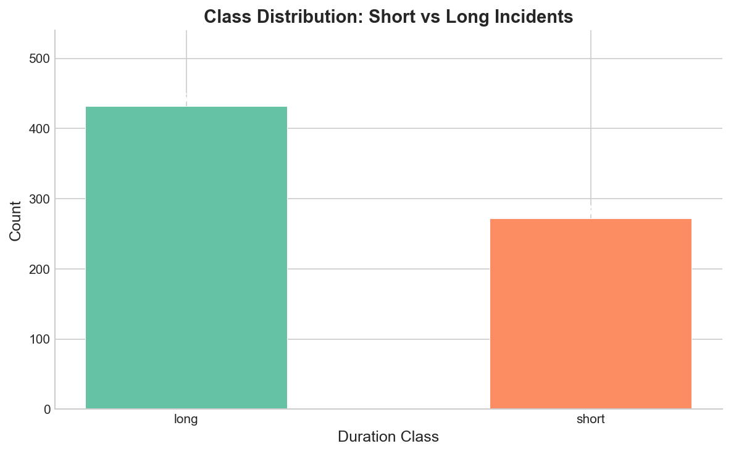
02 / THE DATA
869 raw incidents, cleaned down to 704
— Scraped from Statuspage.io JSON APIs — no API key needed, fully reproducible.
— 869 raw → 704 cleaned incidents, spanning 2019 to 2026.
— Binary target: short (< 60 min) vs long (≥ 60 min).
— Class split: 38.6% short / 61.4% long — a mild 1.59:1 imbalance.
Notes:
I collected data from 14 public cloud status pages, including GitHub, Cloudflare, Discord, and OpenAI. These services use Statuspage.io, which exposes incident history as structured JSON. No API key is needed, so the project is fully reproducible. After cleaning, I had 704 incidents. The target variable is binary: short means under 60 minutes, long means 60 minutes or more. The split is about 39 percent short and 61 percent long.

Slide 4
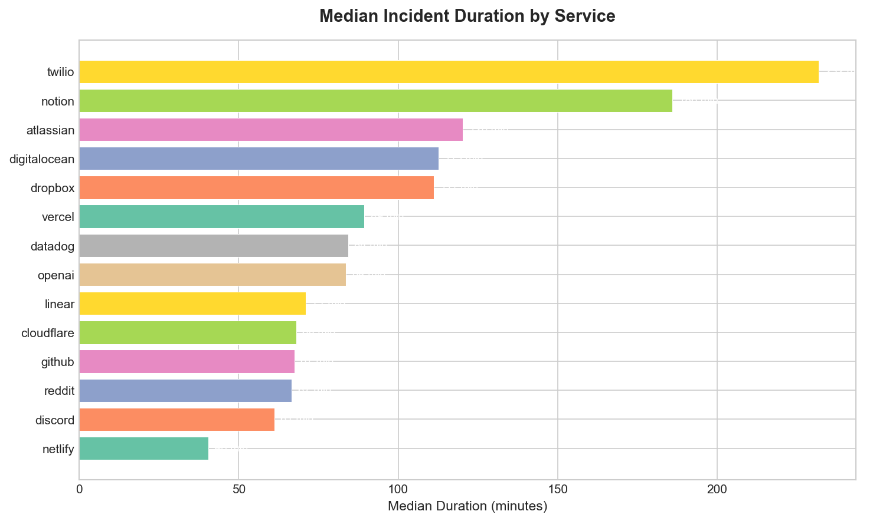
03 / EXPLORATORY ANALYSIS
What the data shows
— Median duration is 82.5 minutes — but with a heavy right skew (skewness ~8).
— Incidents peak on Tuesdays, around 15:00 UTC.
— Median resolution time varies more than 5× across services.
— Netlify resolves fastest; Twilio is the slowest.
Notes:
In exploratory analysis, I found that median duration is 82.5 minutes with heavy right skew. Incidents peak on Tuesdays around 3 PM UTC. Resolution speed varies a lot across services -- Netlify resolves about five times faster than Twilio.

Slide 5
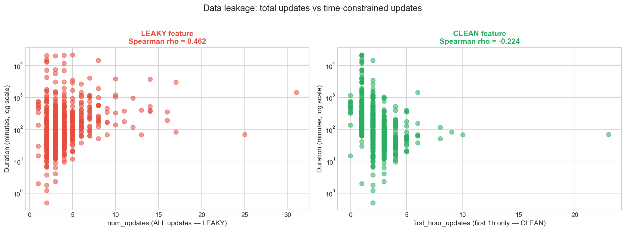
04 / THE KEY FINDING
A data leak — caught by a sign flip
— num_updates correlated with duration at ρ = +0.46 — it looked like a great feature.
— But it counts updates posted AFTER resolution — longer incidents accumulate more.
— Replaced it with first_hour_updates (first 3600s only): ρ flipped to −0.224.
— The sign flip is the proof: the original correlation was a leakage artifact.
Notes:
The most important finding was a data leakage problem. The original feature, total number of updates, had a positive correlation of 0.46 with duration. But that is because longer incidents naturally get more updates after they end. When I replaced it with first-hour updates only, the correlation flipped to negative 0.224. This sign flip proved the original correlation was an artifact. Catching this leakage was critical for building an honest model.

Slide 6
05 / THE MODEL
Five honest features, two models, one rule
— The rule: every feature must be observable within the first hour.
— Five features: service, created_hour, created_weekday, first_hour_updates, is_business_hours. Three leaky candidates explicitly excluded.
— Random Forest as the primary model, Logistic Regression as the linear baseline.
— 80/20 stratified split, class_weight='balanced' for the imbalance, 5-fold cross-validation, GridSearchCV tuning.
Notes:
For the ML model, I used a Random Forest classifier with five features: service name, hour, weekday, first-hour update count, and a business-hours flag. I handled class imbalance with balanced class weights and used stratified splits.

Slide 7
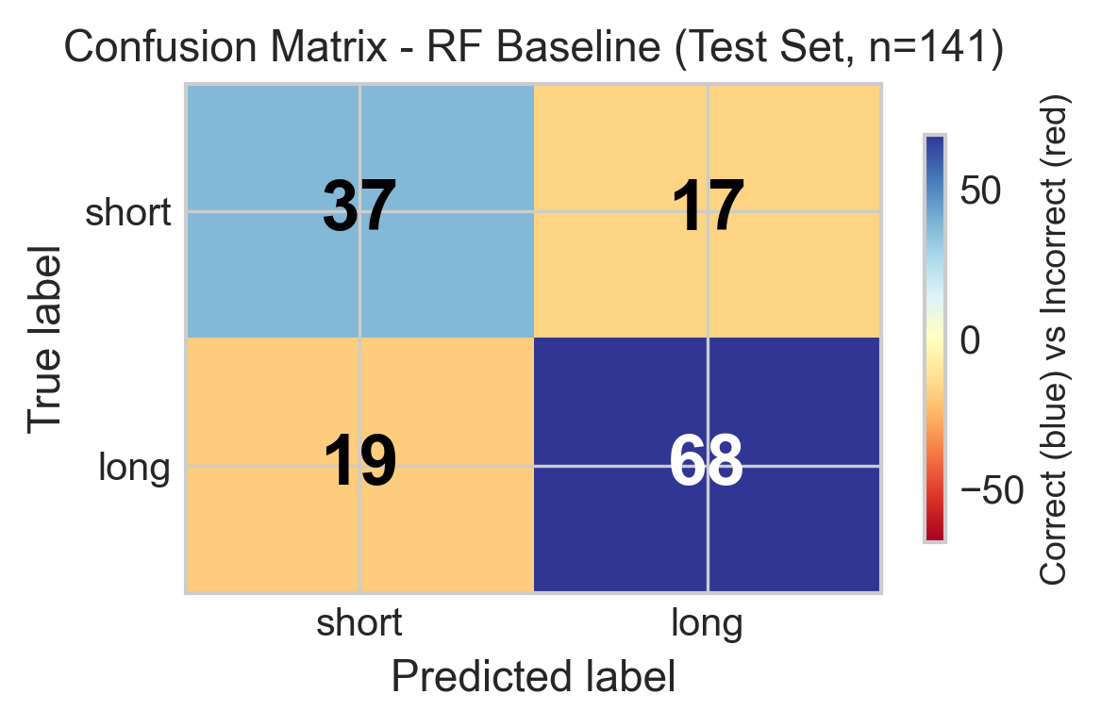
06 / RESULTS
Genuine signal, beyond chance
— Random Forest: 74.5% accuracy, F1-macro 0.732.
— Majority-class baseline: 61.7% accuracy, F1-macro 0.382.
— Improvement is statistically significant — binomial test, p = 6.67 × 10⁻⁴.
— Errors are balanced across both classes, not collapsed onto the majority.
Notes:
The Random Forest achieved 74.5 percent accuracy and an F1-macro score of 0.7317. The majority-class baseline only gets 61.7 percent accuracy and 0.3816 F1-macro. A binomial test confirms this improvement is statistically significant, with a p-value of 6.67 times 10 to the negative 4.

Slide 8
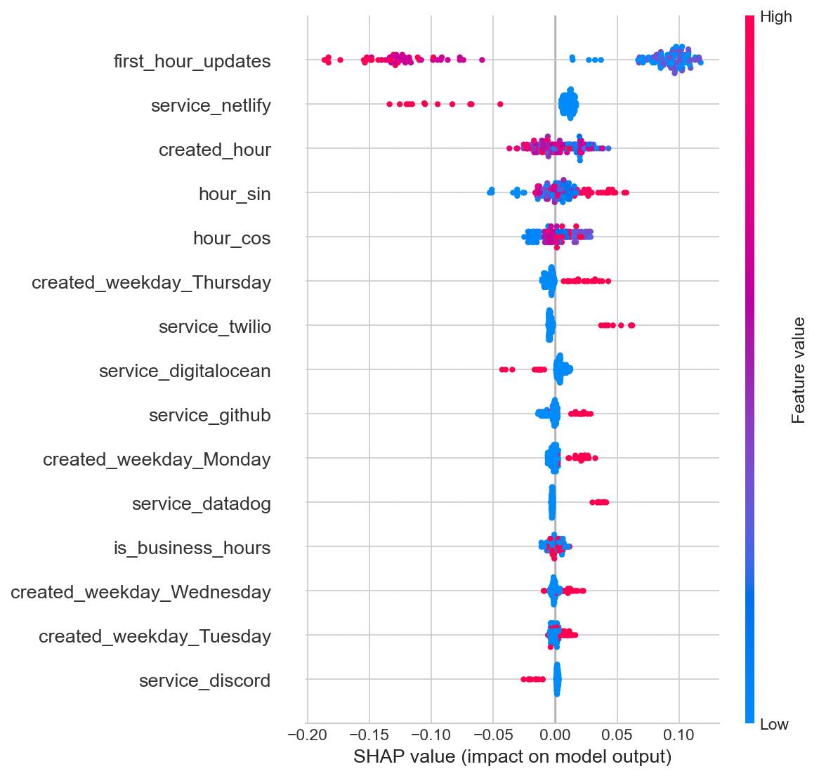
07 / INTERPRETABILITY
What the model actually learned
— SHAP analysis: first_hour_updates dominates every other feature by 5–6×.
— Service identity is the second strongest signal; time-of-day is third.
— Early communication intensity is the single best predictor of outage duration.
— The feature rescued from the data leak turned out to be the most important one.
Notes:
SHAP analysis shows that first-hour updates dominates all other features by a factor of five to six. Early communication intensity is the strongest predictor of outage duration.

Slide 9
08 / CONCLUSION
Answered — with an honest caveat
— Yes — early signals do predict outage duration above chance.
— But the effect size is small (Cohen's h = 0.284) — this is a research result, not a production-ready triage system.
— Limitations: small dataset, self-reported data, no text features, observational only.
— Future work: NLP on update text, temporal-aware validation, expand to 30+ services.
Thank you.
Notes:
To conclude: yes, early signals do predict outage duration above chance. But the effect size is small -- Cohen's h is 0.284 -- so this is not production-ready yet. Future work includes NLP on update text and expanding to more services. Thank you.

