Slide 1
ETL – Mini Project
Pat Wolfe
Alpesh Patel

Slide 2
Background for ETL
The intent of this team project was to become familiar with the concept of Extraction, Transformation, and Load
Our team decided to take a look at data on Olympic data vs. Gross Domestic Product (GDP)
The ambitious goal was to perform ETL on two sets of data provided at (Kaggle.com) and perform an analysis of countries, medals, GDP, etc

Slide 3
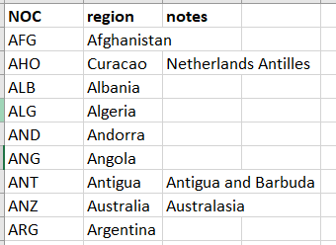
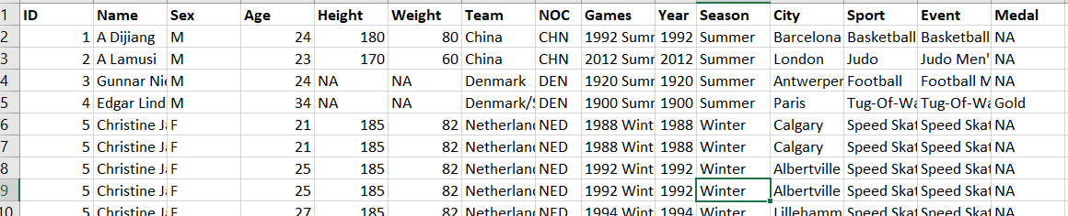
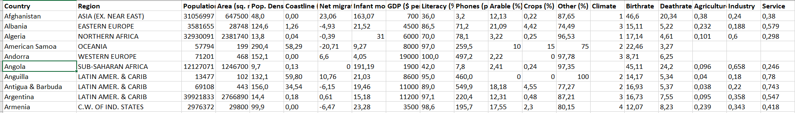
Sources of Data – Extraction
Olympic Key
3 CSV files that contained:
Historical Olympics that included events, medals, countries
Current GDP data of countries of the world
National Olympic Commit Regions (key for Olympic data)
Olympic Data
GDP Data

Slide 4
Transformation
The initial thought was that with the use of the Olympic Key’s country information we would be able to easily merge data with GDP……. (it wasn’t that simple)
We first used Python Pandas (and other libraries) to import the CSVs and created data frames out of each.
Once we had them pulled into our environment we focused on the data that we had intent to use (SEX, NOC, Medals, and Sport)
Then merge the two data frame together for Olympics Data and a list of regions defined by NOC and renamed the column Region to Country for use with GDP Data
Next, for the GDP data, we extracted columns relevant to our work (Country, Population, and GDP) and applied some styling to the data frame
…… This is where it gets fun (see next page)

Slide 5
Transformation
We tried to merge the Olympics DF with GDP DF on country and quickly learned that it wasn’t going to work and get the results we expected
There were ~275K rows in Olympics data
There were ~230 rows in Olympics data
What we expected:
A quick merge to see how each country’s GDP was compared to the medals and events that have happened in the Olympics
The df’s returned a lot of null rows or was not even rendering any data as there were too many rows that had countries listed
So we recognized that due to the # of rows that don’t correlate well with each other we decided to Group the Olympic data by Country and Medals and then perform a count on the medals won
Although we lost the ability to see what events and sex of athletes we were able to perform an “outer join” on the data on “country”

Slide 6
Transformation
Now we had all the rows of the countries with types of count of medals and rows of the GDP that provided population and GDP
pandas.DataFrame.aggregate – was used initially to try to aggregate data by the first or max value
Once we felt comfortable with our final data frame that provided Total Medal count against GDP and population by country we exported a file to CSV.
Attempted to loaded it directly to:
MongoDB on Azure – receiving too many errors from within Jupyter and when running the file
AWS – Connections wasn’t established
SQL - Too time consuming as we already had it structured
SalesForce – attempted but couldn’t find elements required to connect

Slide 7
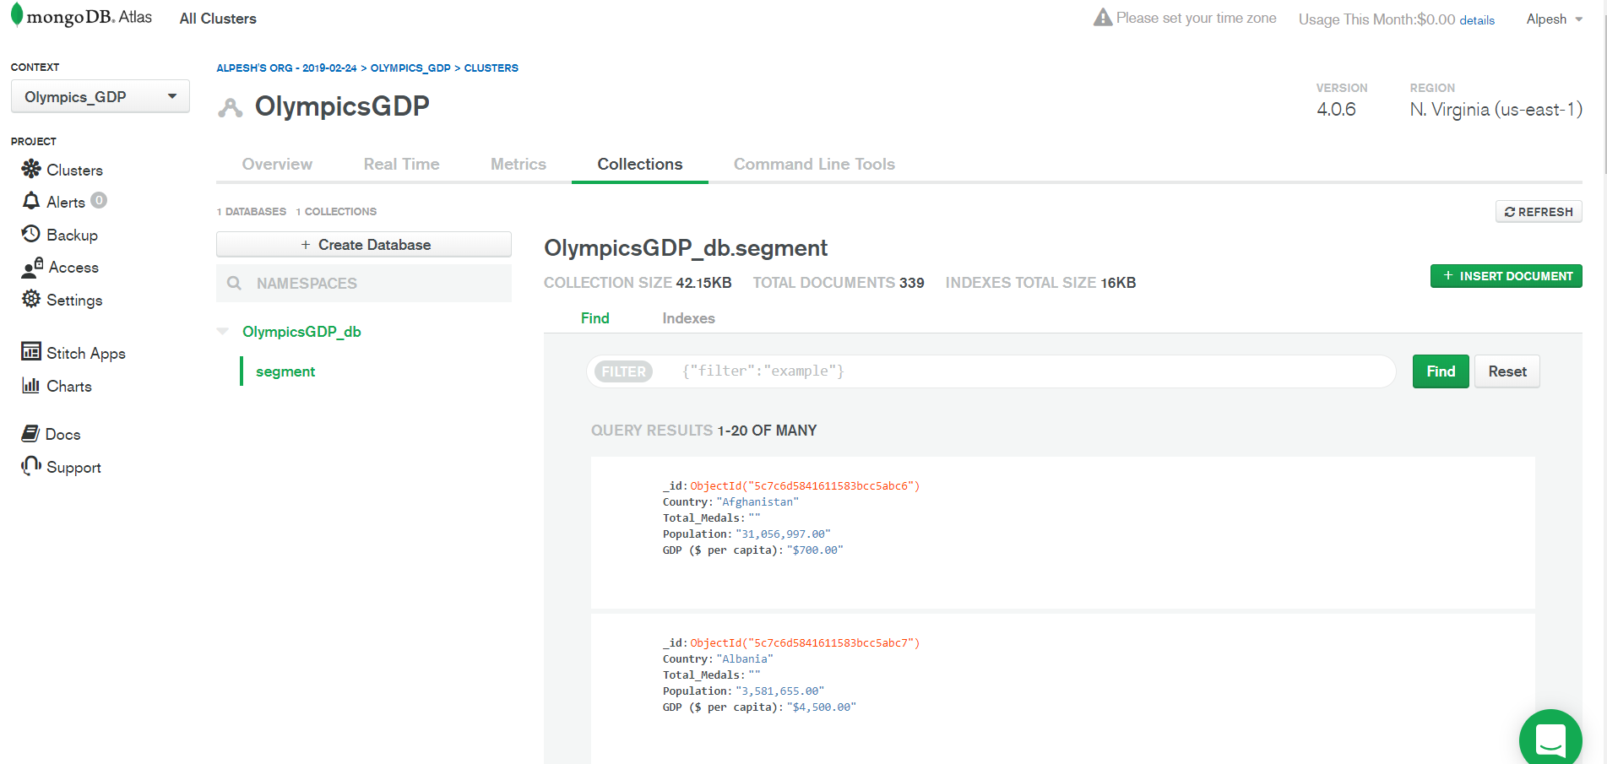
Load
Created a python file (see repo) to read our OlympicsGDP data into Azure MongoDB
https://cloud.mongodb.com
All connections are welcome to write to this database
Username/Password to read/write is embedded in code if you want to try

Slide 8
Final Thoughts
Initial effort attempted was to pull congressional senators campaign contributions and see how industry performed and take a look at the networth of senators
Some API connections worked
Received 500 errors (server side still to this day (ProPublica)
The transformation portion does require a lot of rescoping and redetermining what data to use from the sources you have. This could be come time consuming if you had various sources with no commonality or data sets were of different sizes.
Def should spend more time on the true ETL functions.
Extraction could have taken just as much time if APIs, WebScraping, and CSV were used.
Transformation thought about using TALEND OpenStudio - could’ve made it much easier to map and clean
Loading – Not sure why jupyter wasn’t able to help load to azure.

