Slide 1
SIMPLE LIBRARY DATABASE
Simple library database project designed by Alp Furkan ÜRKMEZ (matr. Num. 10031115) with using:
SQL, implemented on MySQL 8.0
Java, implemented on Eclipse Java Neon , Java SE 1.8
To establish a connection between MySQL and Eclipse, mysql java connector 5.1.47

Slide 2
POPULATION
NAME
ID
BORN IN
SITE
(0, n)
CITY
(0, n)
SURNAME
SSN
NAME
GENDER
(1, 1)
REGİSTERED
(1,1)
TEL
PERSON
(0, n)
AGE
(0, n)
STATUS
NAME
ID
#STUDENT
(1, 1)
DEPARTMENT
PROCESS
COPY
UNIVERSITY
(1, n)
ID
#BOOK
STUDENT ID
(1, n)
DATE
ID
WRITER
STUDENT
PROCESS ID
isSUCCEED
YEAR
(1, 1)
(0, 1)
(1, n)
DAY
MONTH
TYPE OF PROCESS
YEAR OF STUDY
DURATION OF STAY
OF
COPY IN
LIBRARY IN
REGULAR
EXCHANGE
(1, n)
(1, n)
(1, n)
(1, 1)
NAME
ISBN
ID
#BOOK
CAPACITY
WRİTTEN BY
(1, 1)
BOOK
LIBRARY

Slide 3
EXTERNAL CONSTRAINTS
STUDENT can borrow any book if it registered the UNIVERSITY in which book located in its LIBRARY.
If any REGULAR student starts an exchange program in any UNİVERSİTY, no longer it is REGULAR student.
If a STUDENT is an EXCHANGE student, duration of stay cannot be longer than 10 months.

Slide 4
ENTITIES
ENTITY | IDENTIFIERS | VOLUME | DESCRIPTION
PERSON | SSN | 100.000 | KEEPS PERSON INFO.
STUDENT | {STUDENT ID, UNIVERSITY} | 20.000 | KEEPS STUDENT INFO.
WRITER | ID | 100 | KEEPS WRITER INFO.
REGULAR | {STUDENT ID, UNIVERSITY} | 15.000 | KEEPS REGULAR STUDENT INFO.
EXCHANGE | {STUDENT ID, UNIVERSITY} | 5.000 | KEEPS EXCHANGE STUDENT INFO.
CITY | ID | 81 | KEEPS CITY INFO.
COPY | {ID, BOOK} | 900.000 | KEEPS COPY INFO.
BOOK | ISBN | 900 | KEEPS BOOK INFO.
UNIVERSITY | ID | 10 | KEEPS UNIVERSITYINFO.
LIBRARY | ID | 30 | KEEPS LIBRARY INFO

Slide 5
RELATIONSHIPS
RELATIONSHIPS | COMPONENTS | VOLUME | DESCRIPTION
BORN IN | PERSON – CITY | 100.000 | PERSON BORN IN CITY
REGISTERED | STUDENT - UNIVERSITY | 20.000 | STUDENT REGISTERED UNIVERSITY
SITE | UNIVERSITY - CITY | 10 | UNIVERSITY SITE CITY
PROCESS | STUDENT – COPY | 200.000 | STUDENT MAKE PROCESS ON COPY
OF | COPY - BOOK | 900.000 | COPY OF BOOK
COPY IN | COPY – LIBRARY | 900.000 | COPY IN LIBRARY
LIBRARY IN | LIBRARY – UNIVERSITY | 30 | LIBRARY IN UNIVERSITY
WRITTEN BY | BOOK - WRITER | 900 | BOOK WRITTEN BY WRITER

Slide 6
ATTRIBUTES 1/3
ATTRIBUTE | DOMAIN | DESCRIPTION
SSN | INT | PRIMARY KEY OF A TABLE, PERSON’S ID NUMBER
NAME | VARCHAR(20) | PERSON’S NAME
SURNAME | VARCHAR(20) | PERSON’S SURNAME
GENDER | ENUM TYPE (‘M’, ‘F’) | M: MALE F: FEMALE
TEL | VARCHAR(20) | CELL PHONE NUMBER
AGE | INT | PERSON’S AGE
ISBN | INT | PRIMARY KEY, INTERNATIONAL SERIAL BANDROL NUMBER
NAME | VARCHAR(20) | NAME OF A BOOK
ID | INT | PRIMARY KEY, CITY ID
NAME | VARCHAR(20) | NAME OF A CITY
POPULATION | INT | POPULATION OF A CITY
ID | INT | PRIMARY KEY, WRITER ID
NUMBER OF BOOKS | INT | NUMBER OF BOOKS WRITTEN BY WRITER

Slide 7
ATTRIBUTES 2/3
ATTRIBUTE | DATA TYPE | DESCRIPTION
ID | INT | PRIMARY KEY WITH THE BOOK, COPY ID
STATUS | CHAR(1) | ACTUALLY ENUM BUT JDBC. (‘+’, ‘-’) AVAILABLE OR BORROWED
DURATION OF STAY | INT | D.O.S. OF EXCHANGE
ID | INT | LIBRARY ID
NUMBER OF BOOKS | INT | N.O.B IN LIBRARY
CAPACITY | INT | NUMBER OF SEATS IN LIBRARY
YEAR OF STUDY | INT | LEVEL OF REGULAR STUDENT
STUDENT ID | INT | PRIMARY KEY WITH UNIVERSITY
DEPARTMENT | VARCHAR(20) | DEPT. OF STUDENT
ID | INT | UNIVERSITY ID
NAME | VARCHAR(20) | UNIVERSITY NAME
NUMBER OF STUDENTS | INT | NUM. OF REGISTERED STUDENTS

Slide 8
ATTRIBUTES 3/3
ATTRIBUTE | DATA TYPE | DESCRIPTION
PROCESS ID | INT | PRIMARY KEY
ISSUCCEED | CHAR(1) | ACTUALLY ENUM (‘+’, ‘-’) BUT JDBC SUCCEED OR FAILED
TYPE OF PROCESS | ENUM (‘B’, ‘R’) | B: BORROW R: RETURN
DATE | COMPOSITE VARIABLE | DATE OF PROCESS

Slide 9
SSN
NAME
SURNAME
POPULATION
NAME
ID
TEL
GENDER
AGE
BORN IN
SITE
(1, 1)
(0, n)
CITY
(0, n)
PERSON
(1, 1)
NUMBER
(0, n)
REGİSTERED
HAS
(0, 1)
(0, 1)
(0, n)
(1,1)
STATUS
NAME
ID
#STUDENT
ISA W - P
ISA S - P
COPY
UNIVERSITY
(1, 1)
(1, n)
DEPARTMENT
PROCESS
ID
ID
#BOOK
STUDENT ID
(1, n)
(0, 1)
(1, 1)
(1, n)
(1, 1)
(1, 1)
WRITER
STUDENT
PROCESS_ID
TYPE OF PROCESS
Date
isSUCCEED
OF
COPY IN
LIBRARY IN
(0, 1)
(0, 1)
(1, n)
ISA R - S
ISA E - S
(1, n)
(1, n)
(1, 1)
YEAR OF STUDY
DURATION OF STAY
ID
#BOOK
CAPACITY
WRİTTEN BY
(1, 1)
(1, 1)
NAME
ISBN
LIBRARY
REGULAR
EXCHANGE
BOOK
(1, 1)

Slide 10
EXTERNAL CONSTRAINTS
Each instance of STUDENT participates to ISA-R-S or ISA-E-S, but not to both.
Each PERSON can participate either WRİTER or STUDENT or both or none of them.
STUDENT can borrow any book if it registered the UNIVERSITY in which book located in its LIBRARY.
If any REGULAR student starts an exchange program in any UNİVERSİTY, no longer it is REGULAR student.
If a STUDENT is an EXCHANGE student, duration of stay cannot be longer than 10 months.

Slide 11
ADDITIONAL ENTITIES, RELATIONSHIPS & ATTRIBUTES AFTER RESTRUCTURING 1 / 2
CONCEPT | CONSTRUCT | VOLUME | DESCRIPTION
TEL | ENTITY | 300.000 | PERSON’S TELEPHONE NUMBERS
CONCEPT | CONSTRUCT | VOLUME | DESCRIPTION
ISA W-P | RELATIONSHIP | 100 | WRITER IS A PERSON
ISA S-P | RELATIONSHIP | 20.000 | STUDENT IS A PERSON
ISA R-S | RELATIONSHIP | 15.000 | REGULAR IS A STUDENT
ISA E-S | RELATIONSHIP | 5.000 | EXCHANGE IS A STUDENT
HAS | RELATIONSHIP | 400.000 | PERSON’S NUMBER
COLUMN | DATA TYPE | DESCRIPTION
NUMBER | VARCHAR(20) | PRIMARY KEY, TELEPHONE NUMBERS

Slide 12
ADDITIONAL ENTITIES, RELATIONSHIPS & ATTRIBUTES AFTER RESTRUCTURING 2 / 2
COLUMN | DATA TYPE | DESCRIPTION
PROCESS ID | INT | PRIMARY KEY
ISSUCCEED | CHAR(1) | ACTUALLY ENUM (‘+’, ‘-’) SUCCEED OR FAILED
TYPE OF PROCESS | ENUM (‘B’, ‘R’) | B: BORROW R: RETURN
DATE | DATE | DATE OF PROCESS

Slide 13
DIRECT TRANSLATION 1/6
University (ID, name, numberOfStudents)
foreign key: University[ID] ⊆ Site[University]
inclusion: University[ID] ⊆ LibraryIn[University]
Library (ID, capacity, numberOfBooks)
foreign key: Library[ID] ⊆ LibraryIn[Library]
inclusion: Library[ID] ⊆ CopyIn[Library]
Book (ISBN, name)
foreign key: Book[ISBN] ⊆ WrittenBy[Book]
inclusion: Book[ISBN] ⊆ of[Book]
City (ID, name, population)
Tel (number)
foreign key: Tel[number] ⊆ Has[Tel]

Slide 14
DIRECT TRANSLATION 2/6
Copy (ID, Book, status)
foreign key: Copy[Book] ⊆ Book[ISBN]
inclusion: Copy[Book] ⊆ Process[ISBN]
Person (SSN, name, surname, gender, age)
foreign key: Person[SSN] ⊆ BornIn[Person]
Student (SSN, department, studentID)
foreign key: Student[SSN] ⊆ Person[SSN]
join constraints: studentID, University (in the join between a student and registered, equating the attributes student[SSN] and registered[Student] the pair of attributes studentID and University form a key.
inclusion: Student[SSN] ⊆ Process[SSN]
foreign key: PERSON[SSN] ⊆ ISA S-P[SSN]
Writer (SSN, ID, numberOfBooks)
foreign key: Writer[SSN] ⊆ Person[SSN]
key: ID
inclusion: Writer[ID] ⊆ WrittenBy[Writer]
foreign key: PERSON[SSN] ⊆ ISA W-P[SSN]

Slide 15
DIRECT TRANSLATION 3/6
Regular (SSN, studentID, University, yearOfStudy)
foreign key: Regular[SSN] ⊆ Student[SSN]
foreign key: Regular[studentID, University] ⊆ Student[studentID, University]
Exchange (SSN, studentID, University, durationOfStay)
foreign key: Exchange[SSN]⊆Student[SSN]
foreign key: Exchange[studentID, University] ⊆ Student[studentID, University]

Slide 16
DIRECT TRANSLATION 4/6
Has (Tel, SSN)
foreign key: Has[Tel] ⊆ Tel[number]
foreign key: Has[SSN]⊆Person[SSN]
BornIn (SSN, City)
foreign key: BornIn[SSN]⊆Person[SSN]
foreign key: BornIn[City]⊆City[ID]
Site (Unıversity, City)
foreign key: Site[University]⊆University[ID]
foreign key: Site[City]⊆City[ID]
LibraryIn (Library, University)
foreign key: LibraryIn[LibraryIn]⊆Library[ID]
foreign key: LibraryIn[University]⊆University[ID]

Slide 17
DIRECT TRANSLATION 5/6
WrittenBy (ISBN, Writer)
foreign key: WrittenBy[ISBN]⊆Book[ISBN]
foreign key: WrittenBy[Writer]⊆ Writer[ID]
Process (processID, typeOfProcess, isSucceed, date, SSN, studentID, University, copyID, Book)
foreign key: Process[SSN]⊆Person[SSN]
foreign key: Process[studentID] ⊆ Student[studentID]
foreign key: Process[University] ⊆ University[ID]
foreign key: Process[CopyID] ⊆ Copy[ID]
foreign key: Process[Book] ⊆ Book[ISBN]
Registered(Student, University)
foreign key: Registered[Student] ⊆ Student[SSN]
foreign key: Registered[University] ⊆ University[ID]

Slide 18
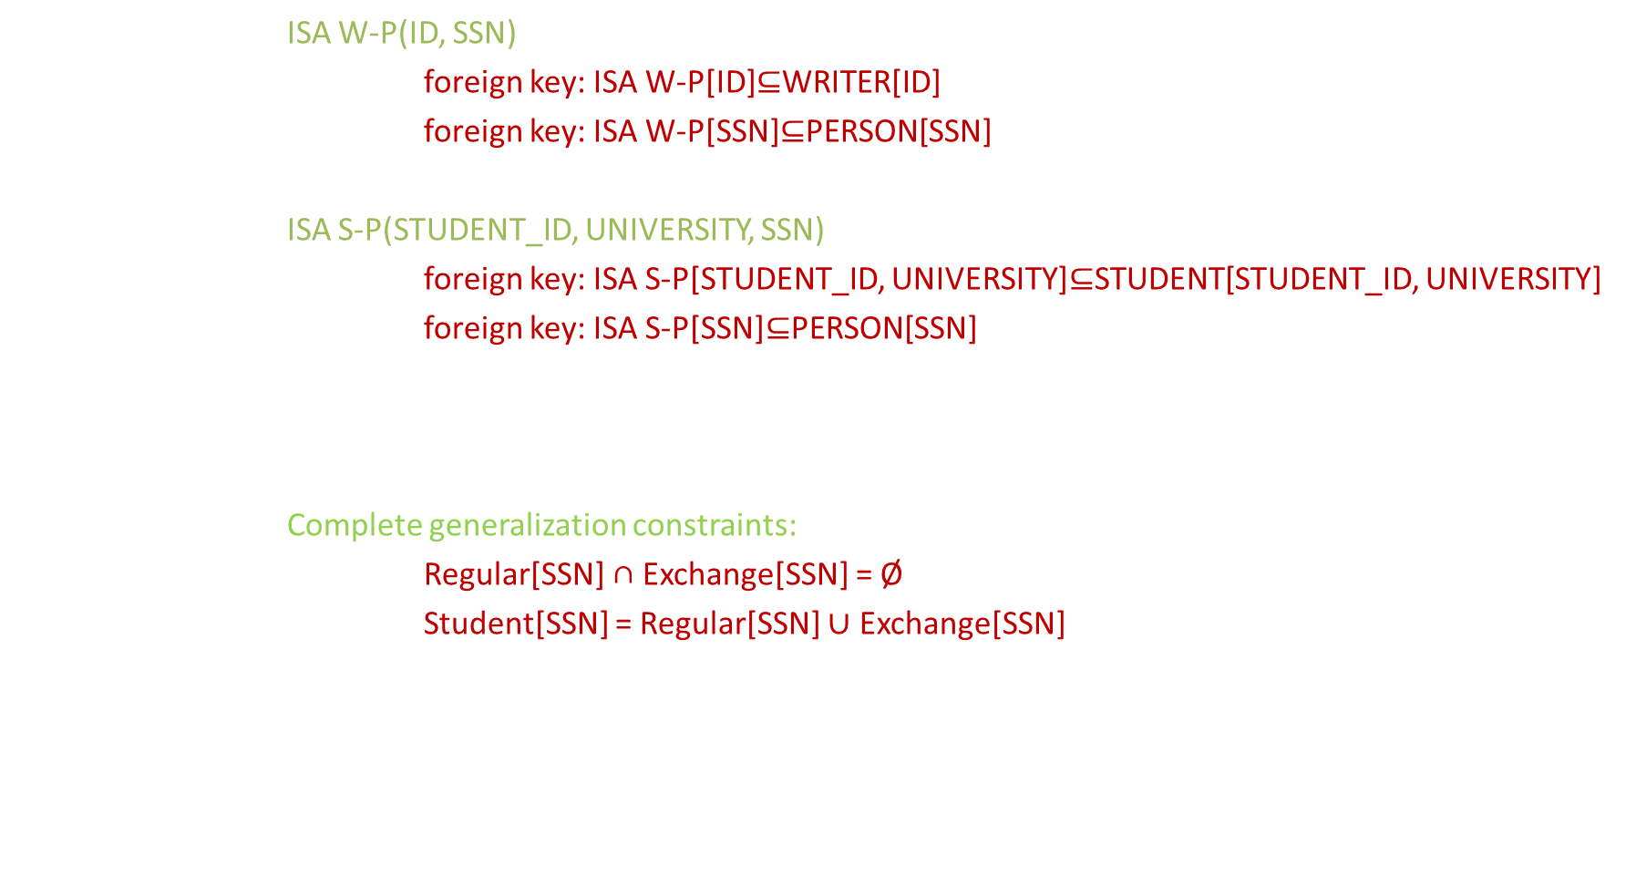
DIRECT TRANSLATION 6/6
ISA W-P(ID, SSN)
foreign key: ISA W-P[ID]⊆WRITER[ID]
foreign key: ISA W-P[SSN]⊆PERSON[SSN]
ISA S-P(STUDENT_ID, UNIVERSITY, SSN)
foreign key: ISA S-P[STUDENT_ID, UNIVERSITY]⊆STUDENT[STUDENT_ID, UNIVERSITY]
foreign key: ISA S-P[SSN]⊆PERSON[SSN]
Complete generalization constraints:
Regular[SSN] ∩ Exchange[SSN] = Ø
Student[SSN] = Regular[SSN] $∪$ Exchange[SSN]

Slide 19
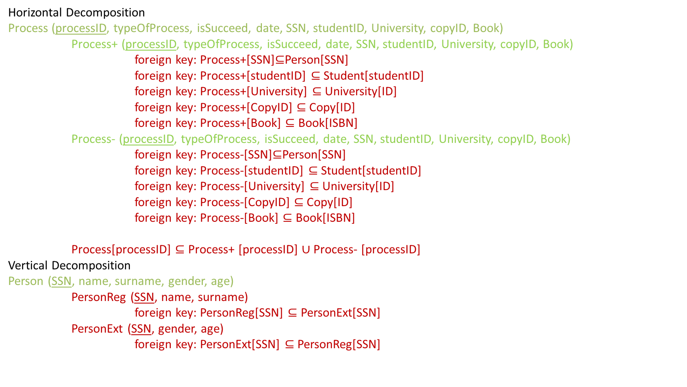
RESTRUCTURING OF RELATIONAL SCHEMA
Horizontal Decomposition
Process (processID, typeOfProcess, isSucceed, date, SSN, studentID, University, copyID, Book)
Process+ (processID, typeOfProcess, isSucceed, date, SSN, studentID, University, copyID, Book)
foreign key: Process+[SSN]⊆Person[SSN]
foreign key: Process+[studentID] ⊆ Student[studentID]
foreign key: Process+[University] ⊆ University[ID]
foreign key: Process+[CopyID] ⊆ Copy[ID]
foreign key: Process+[Book] ⊆ Book[ISBN]
Process- (processID, typeOfProcess, isSucceed, date, SSN, studentID, University, copyID, Book)
foreign key: Process-[SSN]⊆Person[SSN]
foreign key: Process-[studentID] ⊆ Student[studentID]
foreign key: Process-[University] ⊆ University[ID]
foreign key: Process-[CopyID] ⊆ Copy[ID]
foreign key: Process-[Book] ⊆ Book[ISBN]
Process[processID] ⊆ Process+ [processID] $∪$ Process- [processID]
Vertical Decomposition
Person (SSN, name, surname, gender, age)
PersonReg (SSN, name, surname)
foreign key: PersonReg[SSN] ⊆ PersonExt[SSN]
PersonExt (SSN, gender, age)
foreign key: PersonExt[SSN] ⊆ PersonReg[SSN]

Slide 20
OPERATIONS
Show all copies inserted database with informations.
List processes .
List all students with their informations.
List universities with the average age of students.
Show people and their numbers who has more than one telephone number.

Slide 21
TABLE OF OPERATIONS
OPERATION | TYPE | FREQUENCY
1 | Interactive | 5 / day
2 | Interactive | 3 / day
3 | Batch | 1 / 5 months
4 | Batch | 1 / year
5 | Interactive | 1 / month

Slide 22
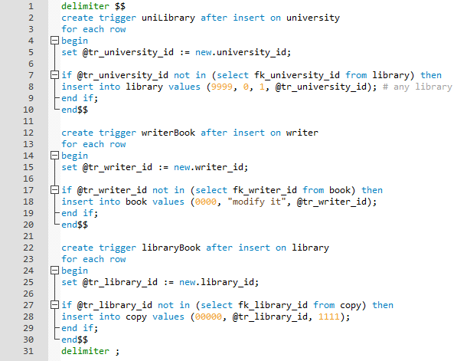
NOTES 1 / 2

Slide 23
NOTES 2 / 2
I also wanted to add those triggers in the previous slide because of the inclusions (1, n), but if I do this changes, instances are going to be complicated. So that, I left it without any triggers but the cardinality between University – LibraryIn, copyIn – Library and Writer – writtenBy is (1, n).

